Slide 1
#include <stdio.h>
int main() {
printf("Hello World\n");
return 0;
}
A compiler does a lot of things while compiling your program

Slide 2
#include <stdio.h>
int main() {
printf("Hello World\n");
return 0;
}
A compiler does a lot of things while compiling your program
One of them is to check if the parentheses are balanced

Slide 3
() {()}
Balanced Parentheses
Each opening symbol has a corresponding closing symbol
Parentheses are properly nested

Slide 4


{}()
(){)}}
((}{))

Slide 5
Balanced Parentheses
Given a string containing (, ),{ and }, write an algorithm to check if it is balanced
(
)
{
(
)
{
}
}
Find the first closing element
Where is the starting element?
Immediately to the left

Slide 6
Balanced Parentheses
Given a string containing (, ),{ and }, write an algorithm to check if it is balanced
(
)
{
(
)
{
}
}
Find the first closing element
Where is the starting element?
Immediately to the left
Delete both the elements
Repeat

Slide 7
Balanced Parentheses
Given a string containing (, ),{ and }, write an algorithm to check if it is balanced
(
)
{
(
)
{
}
}
Find the first closing element
Where is the starting element?
Immediately to the left
Delete both the elements
Repeat

Slide 8
Balanced Parentheses
Given a string containing (, ),{ and }, write an algorithm to check if it is balanced
(
)
{
(
)
{
}
}
Find the first closing element
Where is the starting element?
Immediately to the left
Delete both the elements
Repeat

Slide 9
Balanced Parentheses
Given a string containing (, ),{ and }, write an algorithm to check if it is balanced
(
)
{
(
)
{
}
}
Find the first closing element
Where is the starting element?
Immediately to the left
Delete both the elements
Repeat

Slide 10
Balanced Parentheses
Given a string containing (, ),{ and }, write an algorithm to check if it is balanced
(
)
{
(
)
{
}
}
Find the first closing element
Where is the starting element?
Immediately to the left
Delete both the elements
Repeat

Slide 11
Balanced Parentheses
Given a string containing (, ),{ and }, write an algorithm to check if it is balanced
(
)
{
(
)
{
}
}
Find the first closing element
Where is the starting element?
Immediately to the left
Delete both the elements
Repeat

Slide 12
Balanced Parentheses
Given a string containing (, ),{ and }, write an algorithm to check if it is balanced
(
)
{
(
)
{
}
}
Find the first closing element
Where is the starting element?
Immediately to the left
Delete both the elements
Repeat

Slide 13
Balanced Parentheses
Given a string containing (, ),{ and }, write an algorithm to check if it is balanced
(
)
{
(
)
{
}
}
Find the first closing element
Where is the starting element?
Immediately to the left
Delete both the elements
Repeat

Slide 14
Balanced Parentheses
Given a string containing (, ),{ and }, write an algorithm to check if it is balanced
(
)
{
(
)
{
}
}
Find the first closing element
Where is the starting element?
Immediately to the left
Delete both the elements
Repeat

Slide 15
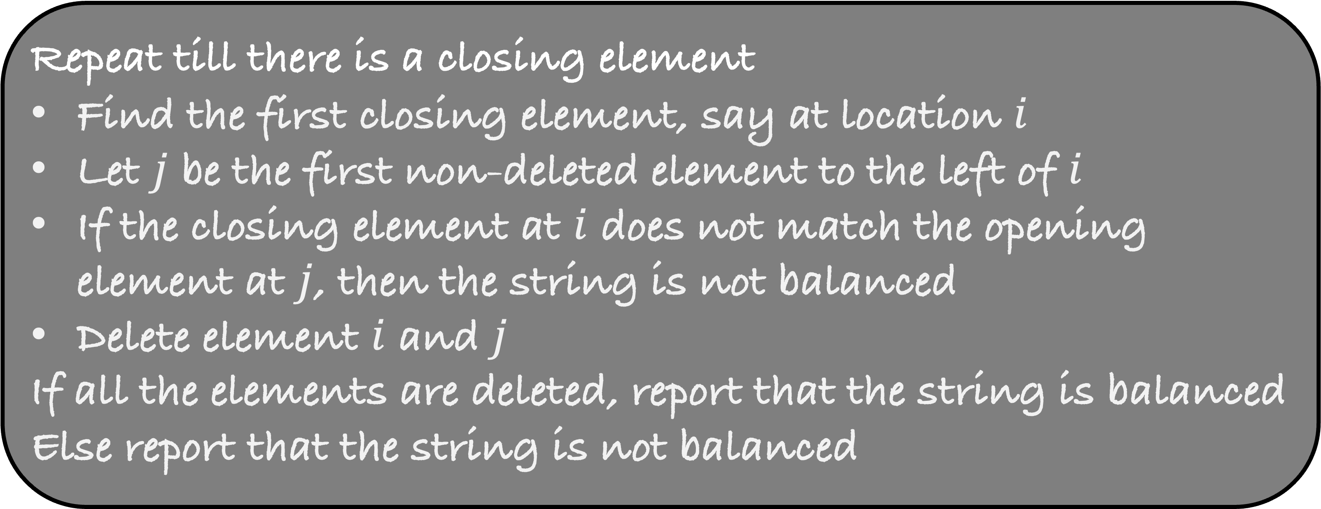
Repeat till there is a closing element
Find the first closing element, say at location $i$
Let $j$ be the first non-deleted element to the left of $i$
If the closing element at $i$ does not match the opening element at $j$, then the string is not balanced
Delete element $i$ and $j$
If all the elements are deleted, report that the string is balanced
Else report that the string is not balanced

Slide 16


(
{
{
(
)
{
}
}
$$j$$
$$i$$

Slide 17


(
{
{
(
)
{
}
}
$$j$$
$$i$$

Slide 18

(
{
{
(
)
{
}
}
$$j$$
$$i$$

Slide 19

(
{
{
(
)
{
}
}
$$j$$
$$i$$
There are no closing elements remaining
But some elements are still not deleted
So, the string is not balanced

Slide 20
(
{
{
(
)
)
}
}
$$j$$
$$i$$

Slide 21
(
{
{
(
)
)
}
}
$$j$$
$$i$$

Slide 22

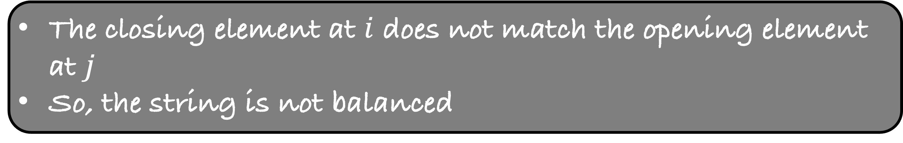
(
{
{
(
)
)
}
}
$$j$$
$$i$$
The closing element at $i$ does not match the opening element at $j$
So, the string is not balanced

Slide 23
Repeat till there is a closing element
Find the first closing element, say at location $i$
Let $j$ be the first non-deleted element to the left of $i$
If the closing element at $i$ does not match the opening element at $j$, then the string is not balanced
Delete element $i$ and $j$
If all the elements are deleted, report that the string is balanced
Else report that the string is not balanced
What is the running time of this algorithm?

Slide 24
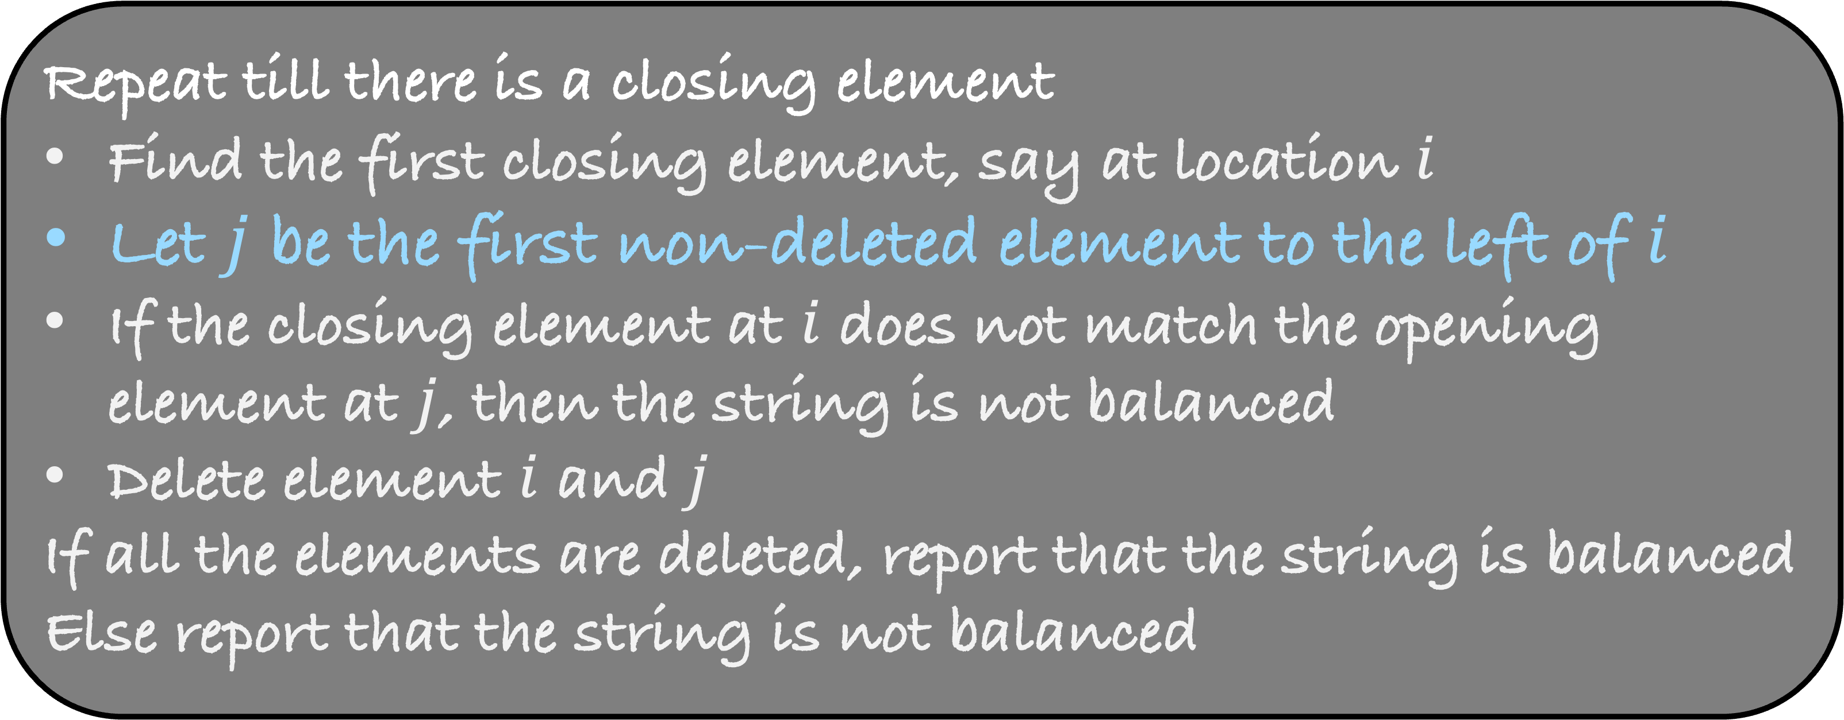
Repeat till there is a closing element
Find the first closing element, say at location $i$
Let $j$ be the first non-deleted element to the left of $i$
If the closing element at $i$ does not match the opening element at $j$, then the string is not balanced
Delete element $i$ and $j$
If all the elements are deleted, report that the string is balanced
Else report that the string is not balanced
What is the running time of this algorithm?

Slide 25



(
(
(
(
(
(
(
)
(
)
(
)
)
)
)
)
)
)
$$\frac{n}{4}$$
$$\frac{n}{2}$$
$$\frac{n}{4}$$

Slide 26
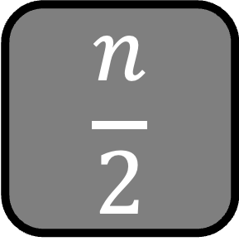
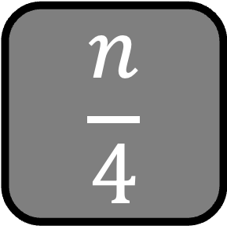



(
(
(
(
(
(
(
)
(
)
(
)
)
)
)
)
)
)
$$j$$
$$i$$
$$\frac{n}{4}$$
$$\frac{n}{2}$$
$$\frac{n}{4}$$

Slide 27



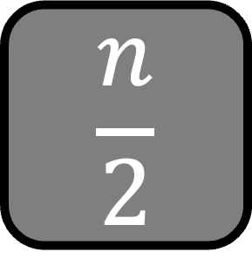
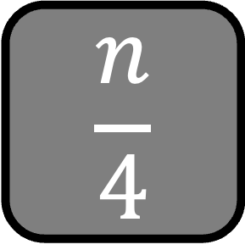

(
(
(
(
(
(
(
)
(
)
(
)
)
)
)
)
)
)
$$j$$
$$i$$
$$\frac{n}{4}$$
$$\frac{n}{2}$$
$$\frac{n}{4}$$
For each closing element, we have to travel $≥\frac{n}{2}$ deleted elements
Total running time of the algorithm is $≈\frac{n}{4} ×\frac{n}{2}$
$=O\left(n^{2}\right)$

Slide 28
Repeat till there is a closing element
Find the first closing element, say at location $i$
Let $j$ be the first non-deleted element to the left of $i$
If the closing element at $i$ does not match the opening element at $j$, then the string is not balanced
Delete element $i$ and $j$
If all the elements are deleted, report that the string is balanced
Else report that the string is not balanced
Implementing the blue step takes a lot of time
Can we improve our algorithm?
We don’t want to go over the deleted elements again and again?

Slide 29
(
)
{
(
)
{
}
}
The stack can contain only opening elements in the string
Stack

Slide 30
)
{
(
)
{
}
}
(
Stack

Slide 31
)
{
(
)
{
}
}
Where is the corresponding opening element?
In the stack
(
Stack

Slide 32
(
)
{
(
)
{
}
}
Where is the corresponding opening element?
In the stack
There is a match
Remove both the elements
Stack

Slide 33
(
)
{
(
)
{
}
}
Where is the corresponding opening element?
In the stack
There is a match
Remove both the elements
Stack

Slide 34
(
)
{
}
}
{
Stack

Slide 35
)
{
}
}
(
{
Stack

Slide 36
)
{
}
}
Where is the corresponding opening element?
On the top of the stack
(
{
Stack

Slide 37
(
)
{
}
}
Where is the corresponding opening element?
On the top of the stack
{
Remove the top of the stack
There is a match
Delete both the elements
Stack

Slide 38
(
)
{
}
}
{
Stack

Slide 39
}
}
{
{
Stack

Slide 40
}
}
{
{
Stack

Slide 41
{
}
}
{
Stack

Slide 42
{
}
}
{
Stack

Slide 43
{
}
Stack

Slide 44
{
}
All the elements are deleted and there is nothing in the stack
So, the string is balanced
Stack

Slide 45
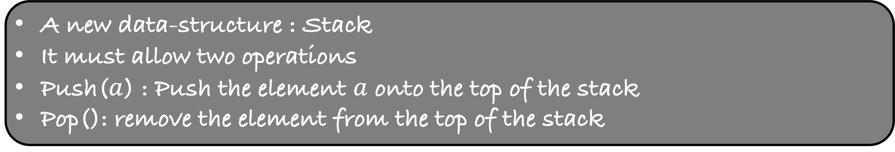
For every closing element, the opening element must be at the top of the stack
So, the opening element, if it exists, can be found in O(1) time
A new data-structure : Stack
It must allow two operations
Push($a$) : Push the element $a$ onto the top of the stack
Pop(): remove the element from the top of the stack
Let us try to implement the stack using an array

Slide 46
Stack using Arrays

Slide 47
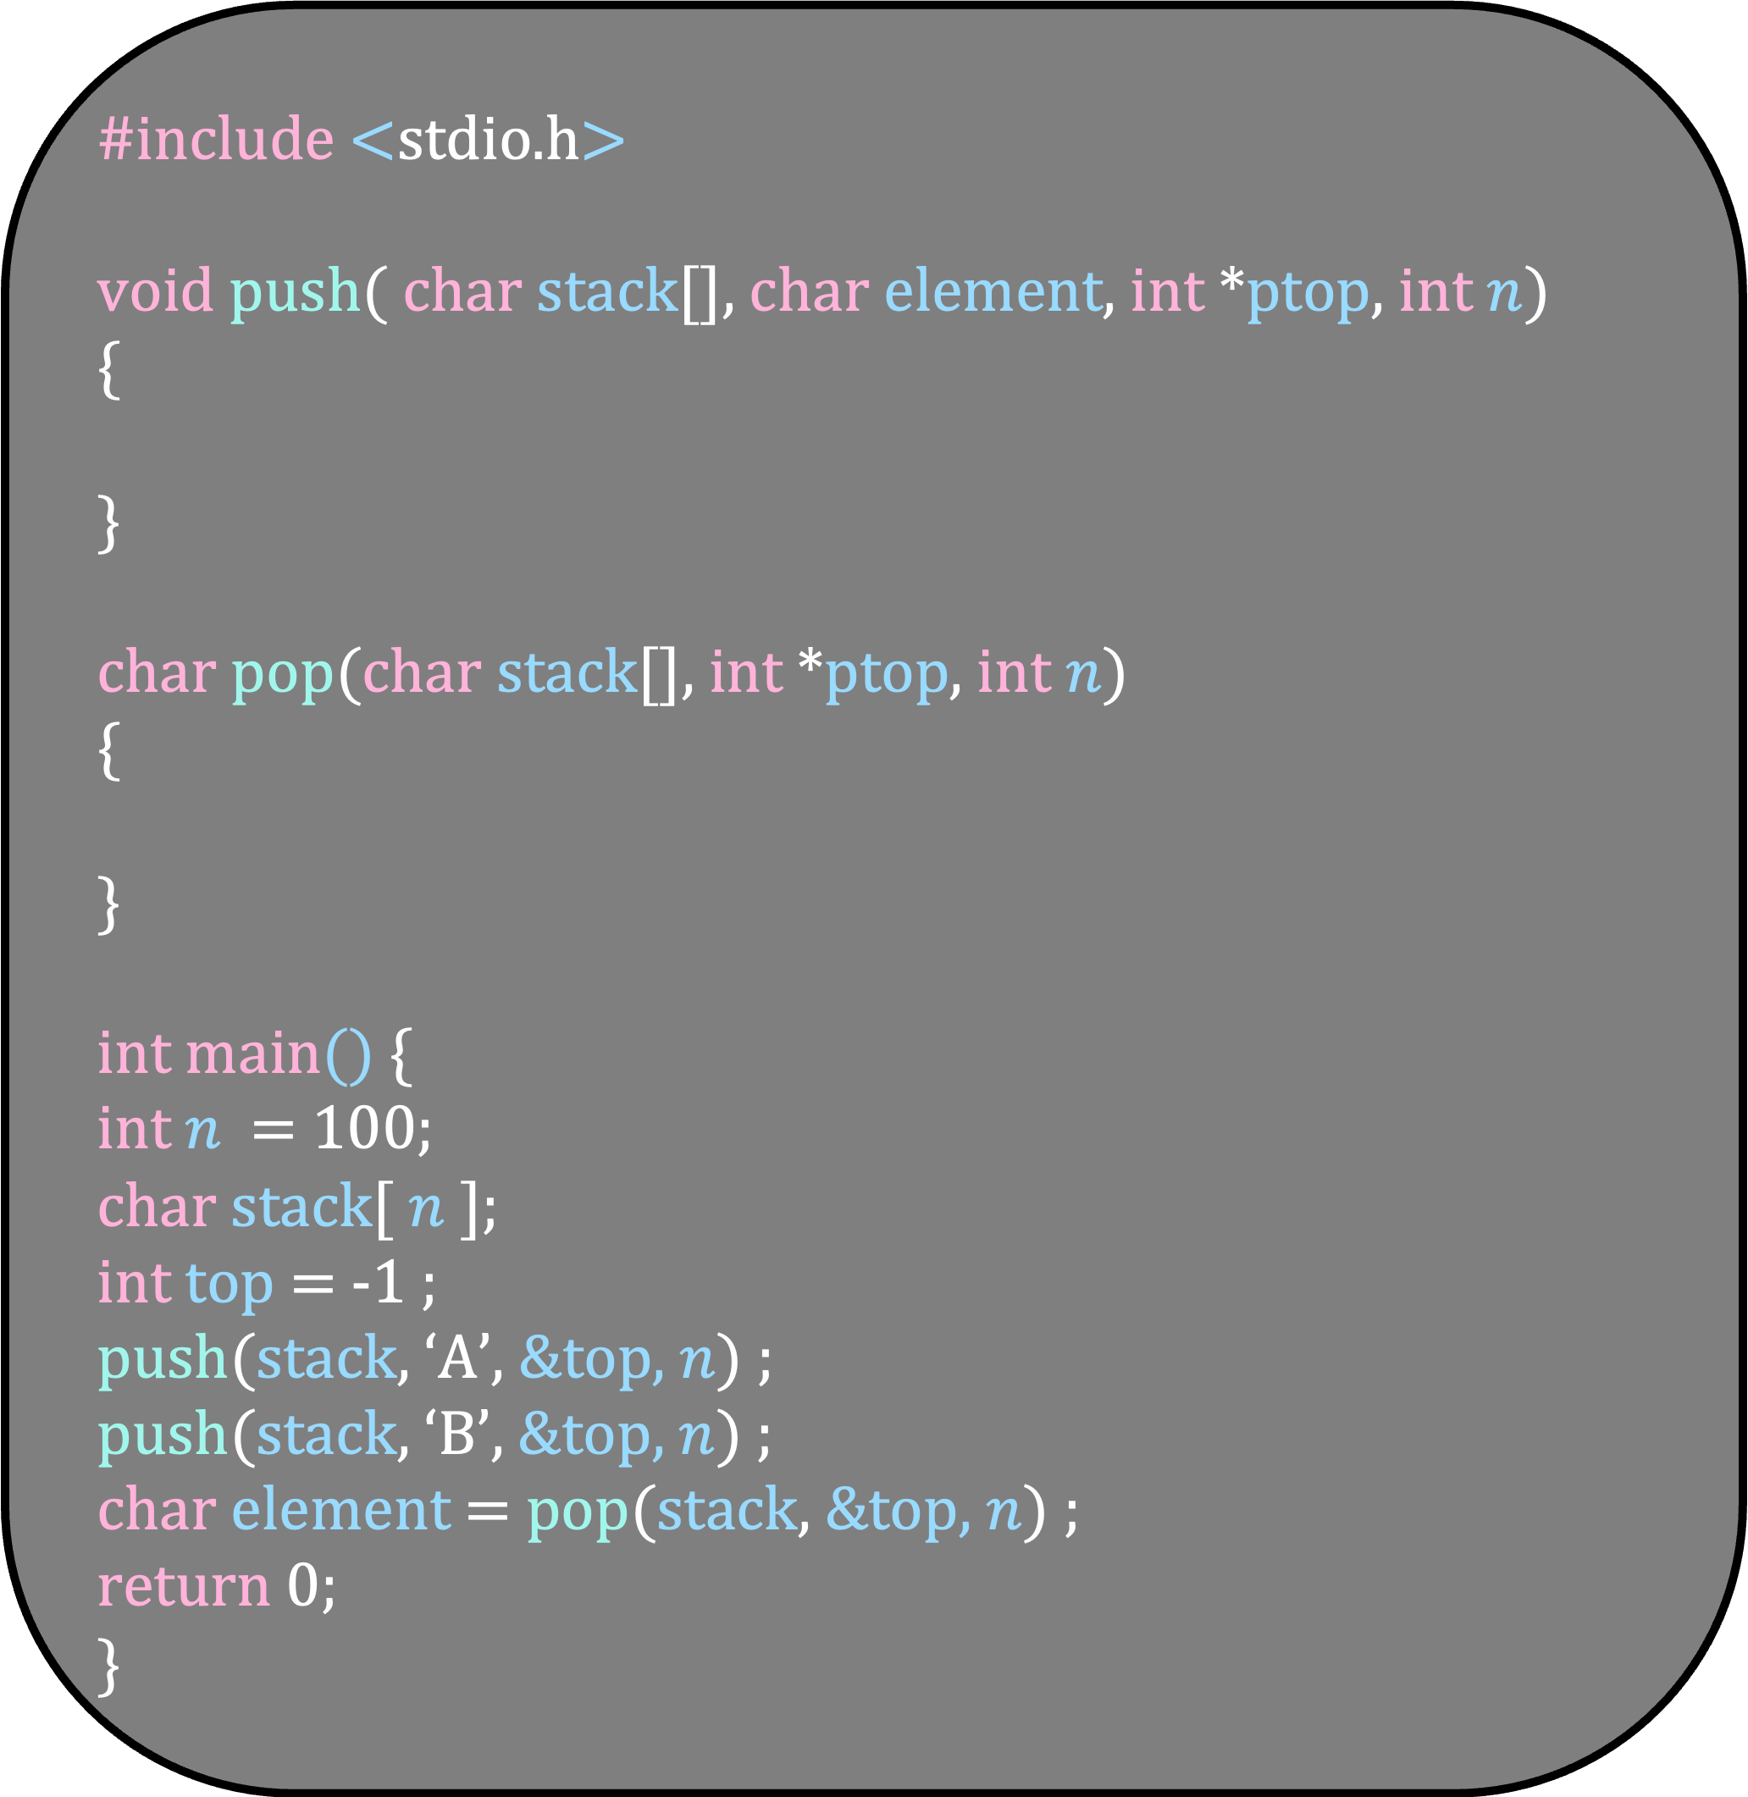
#include <stdio.h>
void push( char stack[], char element, int *ptop, int $n$)
{
}
char pop(char stack[], int *ptop, int $n$)
{
}
int main() {
int $n$ = 100;
char stack[ $n$ ];
int top = -1 ;
push(stack, ‘A’, &top, $n$) ;
push(stack, ‘B’, &top, $n$) ;
char element = pop(stack, &top, $n$) ;
return 0;
}

Slide 48
#include <stdio.h>
void push( char stack[], char element, int *ptop, int $n$)
{
}
char pop(char stack[], int *ptop, int $n$)
{
}
int main() {
int $n$ = 100;
char stack[ $n$ ];
int top = -1 ;
push(stack, ‘A’, &top, $n$) ;
push(stack, ‘B’, &top, $n$) ;
char element = pop(stack, &top, $n$) ;
return 0;
}
top = -1

Slide 49
#include <stdio.h>
void push( char stack[], char element, int *ptop, int $n$)
{
}
char pop(char stack[], int *ptop, int $n$)
{
}
int main() {
int $n$ = 100;
char stack[ $n$ ];
int top = -1 ;
push(stack, ‘A’, &top, $n$) ;
push(stack, ‘B’, &top, $n$) ;
char element = pop(stack, &top, $n$) ;
return 0;
}
A
top = 0

Slide 50
#include <stdio.h>
void push( char stack[], char element, int *ptop, int $n$)
{
}
char pop(char stack[], int *ptop, int $n$)
{
}
int main() {
int $n$ = 100;
char stack[ $n$ ];
int top = -1 ;
push(stack, ‘A’, &top, $n$) ;
push(stack, ‘B’, &top, $n$) ;
char element = pop(stack, &top, $n$) ;
return 0;
}
A
B
top = 1

Slide 51
#include <stdio.h>
void push( char stack[], char element, int *ptop, int $n$)
{
}
char pop(char stack[], int *ptop, int $n$)
{
}
int main() {
int $n$ = 100;
char stack[ $n$ ];
int top = -1 ;
push(stack, ‘A’, &top, $n$) ;
push(stack, ‘B’, &top, $n$) ;
char element = pop(stack, &top, $n$) ;
return 0;
}
A
B
top = 0

Slide 52
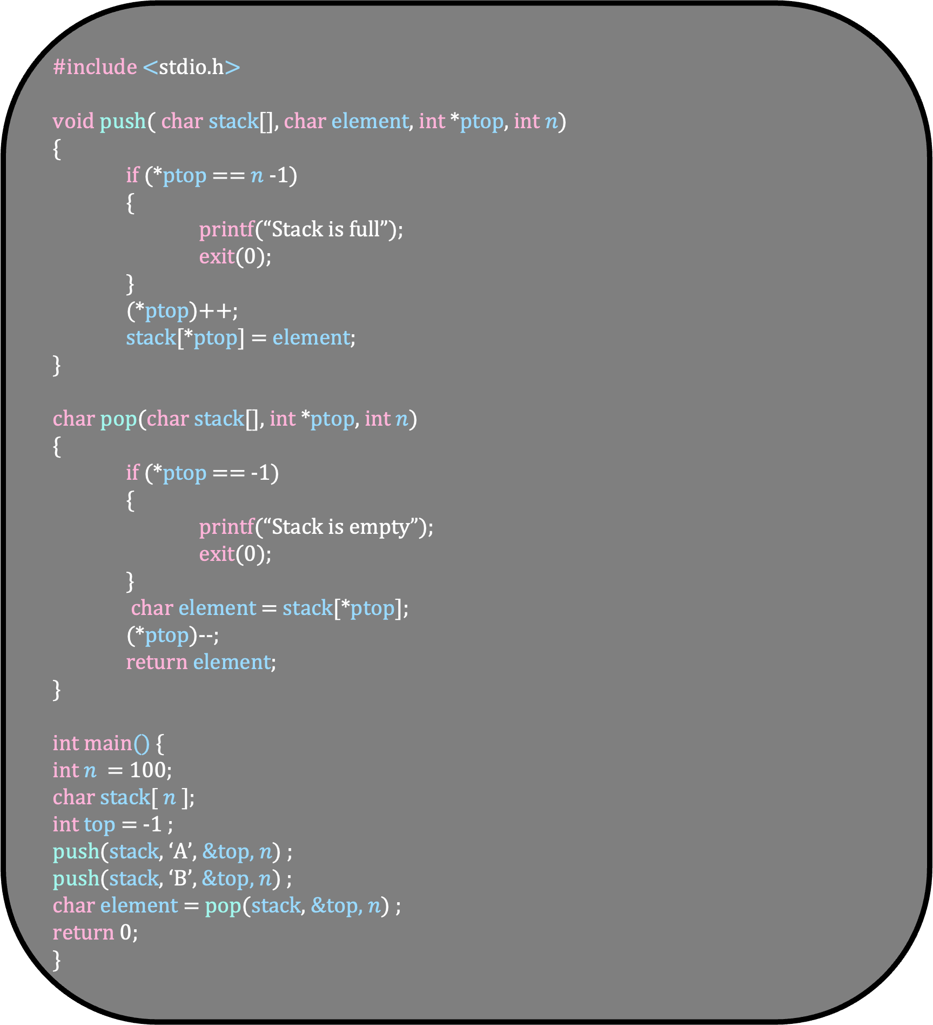
#include <stdio.h>
void push( char stack[], char element, int *ptop, int $n$)
{
if (*ptop == $n$-1)
{
printf(“Stack is full”);
exit(0);
}
(*ptop)++;
stack[*ptop] = element;
}
char pop(char stack[], int *ptop, int $n$)
{
if (*ptop == -1)
{
printf(“Stack is empty”);
exit(0);
}
char element = stack[*ptop];
(*ptop)--;
return element;
}
int main() {
int $n$ = 100;
char stack[ $n$ ];
int top = -1 ;
push(stack, ‘A’, &top, $n$) ;
push(stack, ‘B’, &top, $n$) ;
char element = pop(stack, &top, $n$) ;
return 0;
}

Slide 53
#include <stdio.h>
void push( char stack[], char element, int *ptop, int $n$)
{
if (*ptop == $n$-1)
{
printf(“Stack is full”);
exit(0);
}
(*ptop)++;
stack[*ptop] = element;
}
char pop(char stack[], int *ptop, int $n$)
{
if (*ptop == -1)
{
printf(“Stack is empty”);
exit(0);
}
char element = stack[*ptop];
(*ptop)--;
return element;
}
int main() {
int $n$ = 100;
char stack[ $n$ ];
int top = -1 ;
push(stack, ‘A’, &top, $n$) ;
push(stack, ‘B’, &top, $n$) ;
char element = pop(stack, &top, $n$) ;
return 0;
}
top = -1

Slide 54
#include <stdio.h>
void push( char stack[], char element, int *ptop, int $n$)
{
if (*ptop == $n$-1)
{
printf(“Stack is full”);
exit(0);
}
(*ptop)++;
stack[*ptop] = element;
}
char pop(char stack[], int *ptop, int $n$)
{
if (*ptop == -1)
{
printf(“Stack is empty”);
exit(0);
}
char element = stack[*ptop];
(*ptop)--;
return element;
}
int main() {
int $n$ = 100;
char stack[ $n$ ];
int top = -1 ;
push(stack, ‘A’, &top, $n$) ;
push(stack, ‘B’, &top, $n$) ;
char element = pop(stack, &top, $n$) ;
return 0;
}
top = -1

Slide 55
#include <stdio.h>
void push( char stack[], char element, int *ptop, int $n$)
{
if (*ptop == $n$-1)
{
printf(“Stack is full”);
exit(0);
}
(*ptop)++;
stack[*ptop] = element;
}
char pop(char stack[], int *ptop, int $n$)
{
if (*ptop == -1)
{
printf(“Stack is empty”);
exit(0);
}
char element = stack[*ptop];
(*ptop)--;
return element;
}
int main() {
int $n$ = 100;
char stack[ $n$ ];
int top = -1 ;
push(stack, ‘A’, &top, $n$) ;
push(stack, ‘B’, &top, $n$) ;
char element = pop(stack, &top, $n$) ;
return 0;
}
top = -1

Slide 56

#include <stdio.h>
void push( char stack[], char element, int *ptop, int $n$)
{
if (*ptop == $n$-1)
{
printf(“Stack is full”);
exit(0);
}
(*ptop)++;
stack[*ptop] = element;
}
char pop(char stack[], int *ptop, int $n$)
{
if (*ptop == -1)
{
printf(“Stack is empty”);
exit(0);
}
char element = stack[*ptop];
(*ptop)--;
return element;
}
int main() {
int $n$ = 100;
char stack[ $n$ ];
int top = -1 ;
push(stack, ‘A’, &top, $n$) ;
push(stack, ‘B’, &top, $n$) ;
char element = pop(stack, &top, $n$) ;
return 0;
}B
top = 0

Slide 57
#include <stdio.h>
void push( char stack[], char element, int *ptop, int $n$)
{
if (*ptop == $n$-1)
{
printf(“Stack is full”);
exit(0);
}
(*ptop)++;
stack[*ptop] = element;
}
char pop(char stack[], int *ptop, int $n$)
{
if (*ptop == -1)
{
printf(“Stack is empty”);
exit(0);
}
char element = stack[*ptop];
(*ptop)--;
return element;
}
int main() {
int $n$ = 100;
char stack[ $n$ ];
int top = -1 ;
push(stack, ‘A’, &top, $n$) ;
push(stack, ‘B’, &top, $n$) ;
char element = pop(stack, &top, $n$) ;
return 0;
}
A
top = 0

Slide 58
#include <stdio.h>
void push( char stack[], char element, int *ptop, int $n$)
{
if (*ptop == $n$-1)
{
printf(“Stack is full”);
exit(0);
}
(*ptop)++;
stack[*ptop] = element;
}
char pop(char stack[], int *ptop, int $n$)
{
if (*ptop == -1)
{
printf(“Stack is empty”);
exit(0);
}
char element = stack[*ptop];
(*ptop)--;
return element;
}
int main() {
int $n$ = 100;
char stack[ $n$ ];
int top = -1 ;
push(stack, ‘A’, &top, $n$) ;
push(stack, ‘B’, &top, $n$) ;
char element = pop(stack, &top, $n$) ;
return 0;
}
A
B
top = 1

Slide 59
#include <stdio.h>
void push( char stack[], char element, int *ptop, int $n$)
{
if (*ptop == $n$-1)
{
printf(“Stack is full”);
exit(0);
}
(*ptop)++;
stack[*ptop] = element;
}
char pop(char stack[], int *ptop, int $n$)
{
if (*ptop == -1)
{
printf(“Stack is empty”);
exit(0);
}
char element = stack[*ptop];
(*ptop)--;
return element;
}
int main() {
int $n$ = 100;
char stack[ $n$ ];
int top = -1 ;
push(stack, ‘A’, &top, $n$) ;
push(stack, ‘B’, &top, $n$) ;
char element = pop(stack, &top, $n$) ;
return 0;
}
A
B
top = 1

Slide 60
#include <stdio.h>
void push( char stack[], char element, int *ptop, int $n$)
{
if (*ptop == $n$-1)
{
printf(“Stack is full”);
exit(0);
}
(*ptop)++;
stack[*ptop] = element;
}
char pop(char stack[], int *ptop, int $n$)
{
if (*ptop == -1)
{
printf(“Stack is empty”);
exit(0);
}
char element = stack[*ptop];
(*ptop)--;
return element;
}
int main() {
int $n$ = 100;
char stack[ $n$ ];
int top = -1 ;
push(stack, ‘A’, &top, $n$) ;
push(stack, ‘B’, &top, $n$) ;
char element = pop(stack, &top, $n$) ;
return 0;
}
A
B
top = 1

Slide 61
#include <stdio.h>
void push( char stack[], char element, int *ptop, int $n$)
{
if (*ptop == $n$-1)
{
printf(“Stack is full”);
exit(0);
}
(*ptop)++;
stack[*ptop] = element;
}
char pop(char stack[], int *ptop, int $n$)
{
if (*ptop == -1)
{
printf(“Stack is empty”);
exit(0);
}
char element = stack[*ptop];
(*ptop)--;
return element;
}
int main() {
int $n$ = 100;
char stack[ $n$ ];
int top = -1 ;
push(stack, ‘A’, &top, $n$) ;
push(stack, ‘B’, &top, $n$) ;
char element = pop(stack, &top, $n$) ;
return 0;
}
A
B
top = 1

Slide 62
#include <stdio.h>
void push( char stack[], char element, int *ptop, int $n$)
{
if (*ptop == $n$-1)
{
printf(“Stack is full”);
exit(0);
}
(*ptop)++;
stack[*ptop] = element;
}
char pop(char stack[], int *ptop, int $n$)
{
if (*ptop == -1)
{
printf(“Stack is empty”);
exit(0);
}
char element = stack[*ptop];
(*ptop)--;
return element;
}
int main() {
int $n$ = 100;
char stack[ $n$ ];
int top = -1 ;
push(stack, ‘A’, &top, $n$) ;
push(stack, ‘B’, &top, $n$) ;
char element = pop(stack, &top, $n$) ;
return 0;
}
A
B
top = 0

Slide 63
#include <stdio.h>
void push( char stack[], char element, int *ptop, int $n$)
{
if (*ptop == $n$-1)
{
printf(“Stack is full”);
exit(0);
}
(*ptop)++;
stack[*ptop] = element;
}
char pop(char stack[], int *ptop, int $n$)
{
if (*ptop == -1)
{
printf(“Stack is empty”);
exit(0);
}
char element = stack[*ptop];
(*ptop)--;
return element;
}
int main() {
int $n$ = 100;
char stack[ $n$ ];
int top = -1 ;
push(stack, ‘A’, &top, $n$) ;
push(stack, ‘B’, &top, $n$) ;
char element = pop(stack, &top, $n$) ;
return 0;
}
A
B
top = 0

Slide 64
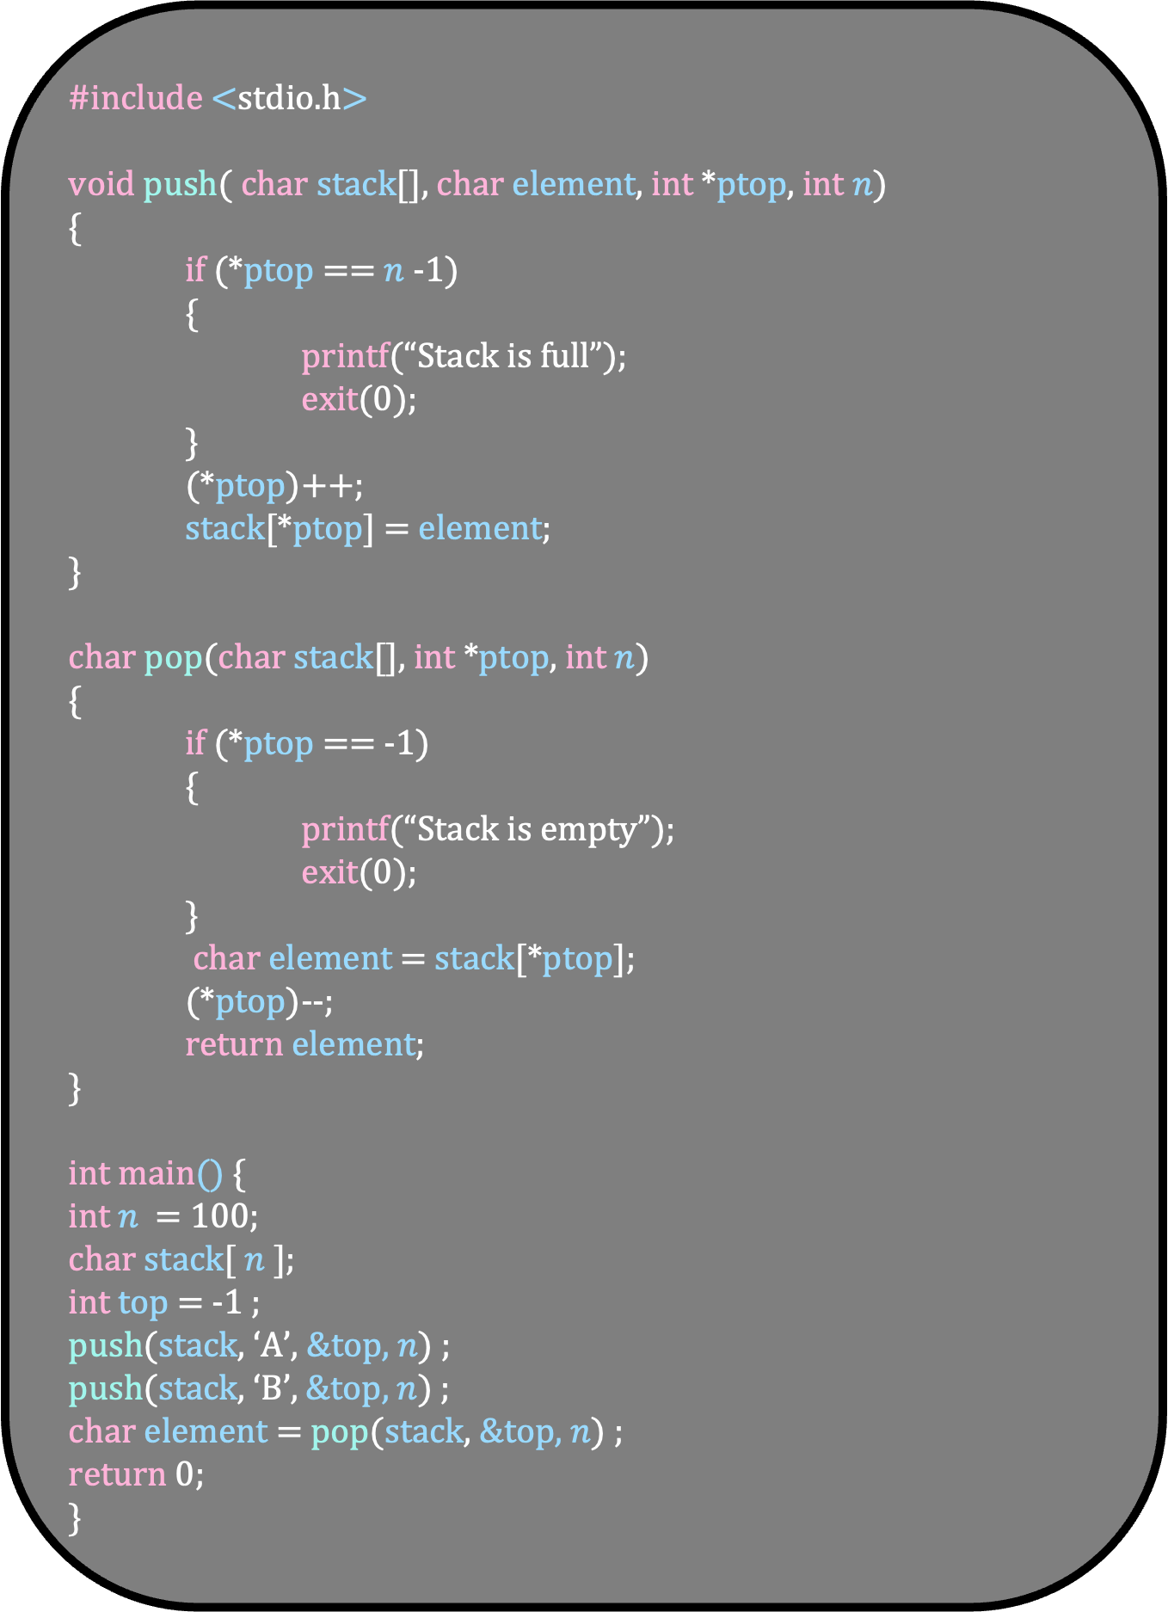
#include <stdio.h>
void push( char stack[], char element, int *ptop, int $n$)
{
if (*ptop == $n$-1)
{
printf(“Stack is full”);
exit(0);
}
(*ptop)++;
stack[*ptop] = element;
}
char pop(char stack[], int *ptop, int $n$)
{
if (*ptop == -1)
{
printf(“Stack is empty”);
exit(0);
}
char element = stack[*ptop];
(*ptop)--;
return element;
}
int main() {
int $n$ = 100;
char stack[ $n$ ];
int top = -1 ;
push(stack, ‘A’, &top, $n$) ;
push(stack, ‘B’, &top, $n$) ;
char element = pop(stack, &top, $n$) ;
return 0;
}
Running Time of Push and Pop
O(1)

Slide 65
#include <stdio.h>
void push( char stack[], char element, int *ptop, int $n$)
{
if (*ptop == $n$-1)
{
printf(“Stack is full”);
exit(0);
}
(*ptop)++;
stack[*ptop] = element;
}
char pop(char stack[], int *ptop, int $n$)
{
if (*ptop == -1)
{
printf(“Stack is empty”);
exit(0);
}
char element = stack[*ptop];
(*ptop)--;
return element;
}
int main() {
int $n$ = 100;
char stack[ $n$ ];
int top = -1 ;
push(stack, ‘A’, &top, $n$) ;
push(stack, ‘B’, &top, $n$) ;
char element = pop(stack, &top, $n$) ;
return 0;
}
Given a string containing (,),{,}, determine whether it is balanced

Slide 66
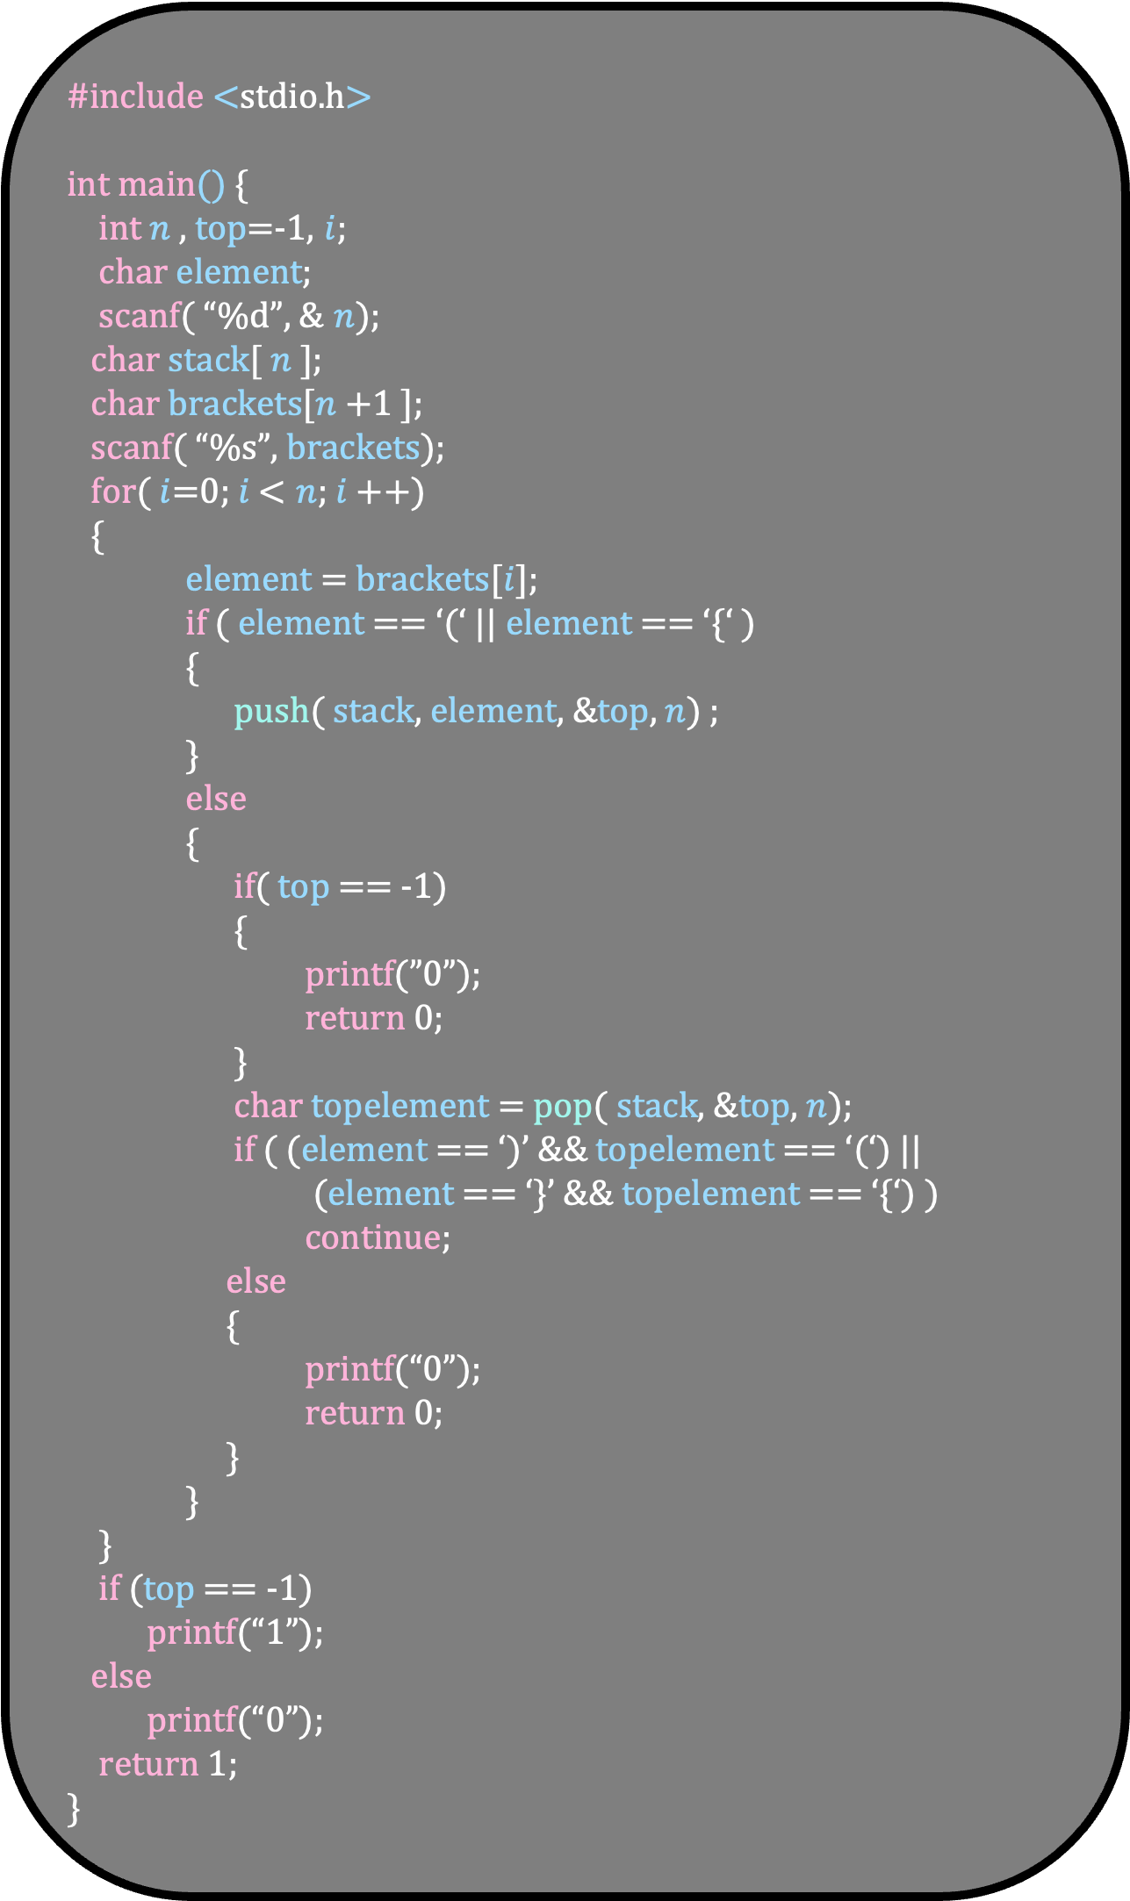
#include <stdio.h>
int main() {
int $n$ , top=-1, $i$;
char element;
scanf( “%d”, & $n$);
char stack[ $n$ ];
char brackets[$n$+1 ];
scanf( “%s”, brackets);
for( $i$=0; $i$ < $n$; $i$++)
{
element = brackets[$i$];
if ( element == ‘(‘ || element == ‘{‘ )
{
push( stack, element, &top, $n$) ;
}
else
{
if( top == -1)
{
printf(”0”);
return 0;
}
char topelement = pop( stack, &top, $n$);
if ( (element == ‘)’ && topelement == ‘(‘) ||
(element == ‘}’ && topelement == ‘{‘) )
continue;
else
{
printf(“0”);
return 0;
}
}
}
if (top == -1)
printf(“1”);
else
printf(“0”);
return 1;
}
(
)
{
(
)
{
}
}
top = -1

Slide 67
#include <stdio.h>
int main() {
int $n$ , top=-1, $i$;
char element;
scanf( “%d”, & $n$);
char stack[ $n$ ];
char brackets[$n$+1 ];
scanf( “%s”, brackets);
for( $i$=0; $i$ < $n$; $i$++)
{
element = brackets[$i$];
if ( element == ‘(‘ || element == ‘{‘ )
{
push( stack, element, &top, $n$) ;
}
else
{
if( top == -1)
{
printf(”0”);
return 0;
}
char topelement = pop( stack, &top, $n$);
if ( (element == ‘)’ && topelement == ‘(‘) ||
(element == ‘}’ && topelement == ‘{‘) )
continue;
else
{
printf(“0”);
return 0;
}
}
}
if (top == -1)
printf(“1”);
else
printf(“0”);
return 1;
}
(
)
{
(
)
{
}
}
top = -1

Slide 68
#include <stdio.h>
int main() {
int $n$ , top=-1, $i$;
char element;
scanf( “%d”, & $n$);
char stack[ $n$ ];
char brackets[$n$+1 ];
scanf( “%s”, brackets);
for( $i$=0; $i$ < $n$; $i$++)
{
element = brackets[$i$];
if ( element == ‘(‘ || element == ‘{‘ )
{
push( stack, element, &top, $n$) ;
}
else
{
if( top == -1)
{
printf(”0”);
return 0;
}
char topelement = pop( stack, &top, $n$);
if ( (element == ‘)’ && topelement == ‘(‘) ||
(element == ‘}’ && topelement == ‘{‘) )
continue;
else
{
printf(“0”);
return 0;
}
}
}
if (top == -1)
printf(“1”);
else
printf(“0”);
return 1;
}
(
)
{
(
)
{
}
}
top = -1

Slide 69
#include <stdio.h>
int main() {
int $n$ , top=-1, $i$;
char element;
scanf( “%d”, & $n$);
char stack[ $n$ ];
char brackets[$n$+1 ];
scanf( “%s”, brackets);
for( $i$=0; $i$ < $n$; $i$++)
{
element = brackets[$i$];
if ( element == ‘(‘ || element == ‘{‘ )
{
push( stack, element, &top, $n$) ;
}
else
{
if( top == -1)
{
printf(”0”);
return 0;
}
char topelement = pop( stack, &top, $n$);
if ( (element == ‘)’ && topelement == ‘(‘) ||
(element == ‘}’ && topelement == ‘{‘) )
continue;
else
{
printf(“0”);
return 0;
}
}
}
if (top == -1)
printf(“1”);
else
printf(“0”);
return 1;
}
)
{
(
)
{
}
}
(
top = 0

Slide 70

#include <stdio.h>
int main() {
int $n$ , top=-1, $i$;
char element;
scanf( “%d”, & $n$);
char stack[ $n$ ];
char brackets[$n$+1 ];
scanf( “%s”, brackets);
for( $i$=0; $i$ < $n$; $i$++)
{
element = brackets[$i$];
if ( element == ‘(‘ || element == ‘{‘ )
{
push( stack, element, &top, $n$) ;
}
else
{
if( top == -1)
{
printf(”0”);
return 0;
}
char topelement = pop( stack, &top, $n$);
if ( (element == ‘)’ && topelement == ‘(‘) ||
(element == ‘}’ && topelement == ‘{‘) )
continue;
else
{
printf(“0”);
return 0;
}
}
}
if (top == -1)
printf(“1”);
else
printf(“0”);
return 1;
}B
)
{
(
)
{
}
}
(
top = 0

Slide 71
#include <stdio.h>
int main() {
int $n$ , top=-1, $i$;
char element;
scanf( “%d”, & $n$);
char stack[ $n$ ];
char brackets[$n$+1 ];
scanf( “%s”, brackets);
for( $i$=0; $i$ < $n$; $i$++)
{
element = brackets[$i$];
if ( element == ‘(‘ || element == ‘{‘ )
{
push( stack, element, &top, $n$) ;
}
else
{
if( top == -1)
{
printf(”0”);
return 0;
}
char topelement = pop( stack, &top, $n$);
if ( (element == ‘)’ && topelement == ‘(‘) ||
(element == ‘}’ && topelement == ‘{‘) )
continue;
else
{
printf(“0”);
return 0;
}
}
}
if (top == -1)
printf(“1”);
else
printf(“0”);
return 1;
}
)
{
(
)
{
}
}
(
top = 0

Slide 72
#include <stdio.h>
int main() {
int $n$ , top=-1, $i$;
char element;
scanf( “%d”, & $n$);
char stack[ $n$ ];
char brackets[$n$+1 ];
scanf( “%s”, brackets);
for( $i$=0; $i$ < $n$; $i$++)
{
element = brackets[$i$];
if ( element == ‘(‘ || element == ‘{‘ )
{
push( stack, element, &top, $n$) ;
}
else
{
if( top == -1)
{
printf(”0”);
return 0;
}
char topelement = pop( stack, &top, $n$);
if ( (element == ‘)’ && topelement == ‘(‘) ||
(element == ‘}’ && topelement == ‘{‘) )
continue;
else
{
printf(“0”);
return 0;
}
}
}
if (top == -1)
printf(“1”);
else
printf(“0”);
return 1;
}
)
{
(
)
{
}
}
(
top = 0

Slide 73
#include <stdio.h>
int main() {
int $n$ , top=-1, $i$;
char element;
scanf( “%d”, & $n$);
char stack[ $n$ ];
char brackets[$n$+1 ];
scanf( “%s”, brackets);
for( $i$=0; $i$ < $n$; $i$++)
{
element = brackets[$i$];
if ( element == ‘(‘ || element == ‘{‘ )
{
push( stack, element, &top, $n$) ;
}
else
{
if( top == -1)
{
printf(”0”);
return 0;
}
char topelement = pop( stack, &top, $n$);
if ( (element == ‘)’ && topelement == ‘(‘) ||
(element == ‘}’ && topelement == ‘{‘) )
continue;
else
{
printf(“0”);
return 0;
}
}
}
if (top == -1)
printf(“1”);
else
printf(“0”);
return 1;
}
)
{
(
)
{
}
}
(
top = 0

Slide 74
#include <stdio.h>
int main() {
int $n$ , top=-1, $i$;
char element;
scanf( “%d”, & $n$);
char stack[ $n$ ];
char brackets[$n$+1 ];
scanf( “%s”, brackets);
for( $i$=0; $i$ < $n$; $i$++)
{
element = brackets[$i$];
if ( element == ‘(‘ || element == ‘{‘ )
{
push( stack, element, &top, $n$) ;
}
else
{
if( top == -1)
{
printf(”0”);
return 0;
}
char topelement = pop( stack, &top, $n$);
if ( (element == ‘)’ && topelement == ‘(‘) ||
(element == ‘}’ && topelement == ‘{‘) )
continue;
else
{
printf(“0”);
return 0;
}
}
}
if (top == -1)
printf(“1”);
else
printf(“0”);
return 1;
}
)
{
(
)
{
}
}
(
top = 0

Slide 75
#include <stdio.h>
int main() {
int $n$ , top=-1, $i$;
char element;
scanf( “%d”, & $n$);
char stack[ $n$ ];
char brackets[$n$+1 ];
scanf( “%s”, brackets);
for( $i$=0; $i$ < $n$; $i$++)
{
element = brackets[$i$];
if ( element == ‘(‘ || element == ‘{‘ )
{
push( stack, element, &top, $n$) ;
}
else
{
if( top == -1)
{
printf(”0”);
return 0;
}
char topelement = pop( stack, &top, $n$);
if ( (element == ‘)’ && topelement == ‘(‘) ||
(element == ‘}’ && topelement == ‘{‘) )
continue;
else
{
printf(“0”);
return 0;
}
}
}
if (top == -1)
printf(“1”);
else
printf(“0”);
return 1;
}
)
{
(
)
{
}
}
(
top = 0

Slide 76
#include <stdio.h>
int main() {
int $n$ , top=-1, $i$;
char element;
scanf( “%d”, & $n$);
char stack[ $n$ ];
char brackets[$n$+1 ];
scanf( “%s”, brackets);
for( $i$=0; $i$ < $n$; $i$++)
{
element = brackets[$i$];
if ( element == ‘(‘ || element == ‘{‘ )
{
push( stack, element, &top, $n$) ;
}
else
{
if( top == -1)
{
printf(”0”);
return 0;
}
char topelement = pop( stack, &top, $n$);
if ( (element == ‘)’ && topelement == ‘(‘) ||
(element == ‘}’ && topelement == ‘{‘) )
continue;
else
{
printf(“0”);
return 0;
}
}
}
if (top == -1)
printf(“1”);
else
printf(“0”);
return 1;
}
)
{
(
)
{
}
}
(
top = -1

Slide 77
#include <stdio.h>
int main() {
int $n$ , top=-1, $i$;
char element;
scanf( “%d”, & $n$);
char stack[ $n$ ];
char brackets[$n$+1 ];
scanf( “%s”, brackets);
for( $i$=0; $i$ < $n$; $i$++)
{
element = brackets[$i$];
if ( element == ‘(‘ || element == ‘{‘ )
{
push( stack, element, &top, $n$) ;
}
else
{
if( top == -1)
{
printf(”0”);
return 0;
}
char topelement = pop( stack, &top, $n$);
if ( (element == ‘)’ && topelement == ‘(‘) ||
(element == ‘}’ && topelement == ‘{‘) )
continue;
else
{
printf(“0”);
return 0;
}
}
}
if (top == -1)
printf(“1”);
else
printf(“0”);
return 1;
}
)
{
(
)
{
}
}
(
top = -1

Slide 78
(
)
#include <stdio.h>
int main() {
int $n$ , top=-1, $i$;
char element;
scanf( “%d”, & $n$);
char stack[ $n$ ];
char brackets[$n$+1 ];
scanf( “%s”, brackets);
for( $i$=0; $i$ < $n$; $i$++)
{
element = brackets[$i$];
if ( element == ‘(‘ || element == ‘{‘ )
{
push( stack, element, &top, $n$) ;
}
else
{
if( top == -1)
{
printf(”0”);
return 0;
}
char topelement = pop( stack, &top, $n$);
if ( (element == ‘)’ && topelement == ‘(‘) ||
(element == ‘}’ && topelement == ‘{‘) )
continue;
else
{
printf(“0”);
return 0;
}
}
}
if (top == -1)
printf(“1”);
else
printf(“0”);
return 1;
}
{
(
)
{
}
}
top = -1
Visualize the algorithm

Slide 79
(
)
#include <stdio.h>
int main() {
int $n$ , top=-1, $i$;
char element;
scanf( “%d”, & $n$);
char stack[ $n$ ];
char brackets[$n$+1 ];
scanf( “%s”, brackets);
for( $i$=0; $i$ < $n$; $i$++)
{
element = brackets[$i$];
if ( element == ‘(‘ || element == ‘{‘ )
{
push( stack, element, &top, $n$) ;
}
else
{
if( top == -1)
{
printf(”0”);
return 0;
}
char topelement = pop( stack, &top, $n$);
if ( (element == ‘)’ && topelement == ‘(‘) ||
(element == ‘}’ && topelement == ‘{‘) )
continue;
else
{
printf(“0”);
return 0;
}
}
}
if (top == -1)
printf(“1”);
else
printf(“0”);
return 1;
}
Running Time
O(n)

Slide 80
Stack using Pointers

Slide 81
When the maximum stack size is not known in advance, we can use dynamic memory allocation
Here, we implement the stack using a linked list

Slide 82
#include <stdio.h>
struct node {
char c;
struct node *next;
};
struct node *top = NULL;
void push(char element)
{
}
char pop()
{
}
int main() {
push(‘A’) ;
push(‘B) ;
char element = pop() ;
return 0;
}
top:NULL

Slide 83
#include <stdio.h>
struct node {
char c;
struct node *next;
};
struct node *top = NULL;
void push(char element)
{
}
char pop()
{
}
int main() {
push(‘A’) ;
push(‘B) ;
char element = pop() ;
return 0;
}
A
top:100
NULL

Slide 84
#include <stdio.h>
struct node {
char c;
struct node *next;
};
struct node *top = NULL;
void push(char element)
{
}
char pop()
{
}
int main() {
push(‘A’) ;
push(‘B) ;
char element = pop() ;
return 0;
}
top:200
B
100
A
NULL

Slide 85
#include <stdio.h>
struct node {
char c;
struct node *next;
};
struct node *top = NULL;
void push(char element)
{
}
char pop()
{
}
int main() {
push(‘A’) ;
push(‘B) ;
char element = pop() ;
return 0;
}
top:100
A
NULL

Slide 86
#include <stdio.h>
struct node {
char c;
struct node *next;
};
struct node *top = NULL;
void push(char element)
{
struct node *p = malloc(sizeof(struct node));
if( p == NULL)
exit(1);
p->c = element;
p->next = top;
top = p;
}
char pop()
{ if (top == NULL)
exit(1);
struct node *p = top ;
char element = p->c;
top = top->next;
free(p);
return element;
}
int main() {
push(‘A’) ;
push(‘B) ;
char element = pop() ;
return 0;
}
top:NULL

Slide 87
#include <stdio.h>
struct node {
char c;
struct node *next;
};
struct node *top = NULL;
void push(char element)
{
struct node *p = malloc(sizeof(struct node));
if( p == NULL)
exit(1);
p->c = element;
p->next = top;
top = p;
}
char pop()
{ if (top == NULL)
exit(1);
struct node *p = top ;
char element = p->c;
top = top->next;
free(p);
return element;
}
int main() {
push(‘A’) ;
push(‘B) ;
char element = pop() ;
return 0;
}
top:NULL

Slide 88
#include <stdio.h>
struct node {
char c;
struct node *next;
};
struct node *top = NULL;
void push(char element)
{
struct node *p = malloc(sizeof(struct node));
if( p == NULL)
exit(1);
p->c = element;
p->next = top;
top = p;
}
char pop()
{ if (top == NULL)
exit(1);
struct node *p = top ;
char element = p->c;
top = top->next;
free(p);
return element;
}
int main() {
push(‘A’) ;
push(‘B) ;
char element = pop() ;
return 0;
}
p:100
top:NULL

Slide 89
#include <stdio.h>
struct node {
char c;
struct node *next;
};
struct node *top = NULL;
void push(char element)
{
struct node *p = malloc(sizeof(struct node));
if( p == NULL)
exit(1);
p->c = element;
p->next = top;
top = p;
}
char pop()
{ if (top == NULL)
exit(1);
struct node *p = top ;
char element = p->c;
top = top->next;
free(p);
return element;
}
int main() {
push(‘A’) ;
push(‘B) ;
char element = pop() ;
return 0;
}
p:100
top:NULL

Slide 90
#include <stdio.h>
struct node {
char c;
struct node *next;
};
struct node *top = NULL;
void push(char element)
{
struct node *p = malloc(sizeof(struct node));
if( p == NULL)
exit(1);
p->c = element;
p->next = top;
top = p;
}
char pop()
{ if (top == NULL)
exit(1);
struct node *p = top ;
char element = p->c;
top = top->next;
free(p);
return element;
}
int main() {
push(‘A’) ;
push(‘B) ;
char element = pop() ;
return 0;
}
A
p:100
top:NULL

Slide 91
#include <stdio.h>
struct node {
char c;
struct node *next;
};
struct node *top = NULL;
void push(char element)
{
struct node *p = malloc(sizeof(struct node));
if( p == NULL)
exit(1);
p->c = element;
p->next = top;
top = p;
}
char pop()
{ if (top == NULL)
exit(1);
struct node *p = top ;
char element = p->c;
top = top->next;
free(p);
return element;
}
int main() {
push(‘A’) ;
push(‘B) ;
char element = pop() ;
return 0;
}
A
p:100
NULL
top:NULL

Slide 92
#include <stdio.h>
struct node {
char c;
struct node *next;
};
struct node *top = NULL;
void push(char element)
{
struct node *p = malloc(sizeof(struct node));
if( p == NULL)
exit(1);
p->c = element;
p->next = top;
top = p;
}
char pop()
{ if (top == NULL)
exit(1);
struct node *p = top ;
char element = p->c;
top = top->next;
free(p);
return element;
}
int main() {
push(‘A’) ;
push(‘B) ;
char element = pop() ;
return 0;
}
A
top:100
p:100
NULL

Slide 93
#include <stdio.h>
struct node {
char c;
struct node *next;
};
struct node *top = NULL;
void push(char element)
{
struct node *p = malloc(sizeof(struct node));
if( p == NULL)
exit(1);
p->c = element;
p->next = top;
top = p;
}
char pop()
{ if (top == NULL)
exit(1);
struct node *p = top ;
char element = p->c;
top = top->next;
free(p);
return element;
}
int main() {
push(‘A’) ;
push(‘B) ;
char element = pop() ;
return 0;
}
A
top:100
NULL

Slide 94
#include <stdio.h>
struct node {
char c;
struct node *next;
};
struct node *top = NULL;
void push(char element)
{
struct node *p = malloc(sizeof(struct node));
if( p == NULL)
exit(1);
p->c = element;
p->next = top;
top = p;
}
char pop()
{ if (top == NULL)
exit(1);
struct node *p = top ;
char element = p->c;
top = top->next;
free(p);
return element;
}
int main() {
push(‘A’) ;
push(‘B) ;
char element = pop() ;
return 0;
}
A
top:100
NULL

Slide 95
#include <stdio.h>
struct node {
char c;
struct node *next;
};
struct node *top = NULL;
void push(char element)
{
struct node *p = malloc(sizeof(struct node));
if( p == NULL)
exit(1);
p->c = element;
p->next = top;
top = p;
}
char pop()
{ if (top == NULL)
exit(1);
struct node *p = top ;
char element = p->c;
top = top->next;
free(p);
return element;
}
int main() {
push(‘A’) ;
push(‘B) ;
char element = pop() ;
return 0;
}
p:200
A
top:100
NULL

Slide 96
#include <stdio.h>
struct node {
char c;
struct node *next;
};
struct node *top = NULL;
void push(char element)
{
struct node *p = malloc(sizeof(struct node));
if( p == NULL)
exit(1);
p->c = element;
p->next = top;
top = p;
}
char pop()
{ if (top == NULL)
exit(1);
struct node *p = top ;
char element = p->c;
top = top->next;
free(p);
return element;
}
int main() {
push(‘A’) ;
push(‘B) ;
char element = pop() ;
return 0;
}
p:200
A
top:100
NULL

Slide 97
#include <stdio.h>
struct node {
char c;
struct node *next;
};
struct node *top = NULL;
void push(char element)
{
struct node *p = malloc(sizeof(struct node));
if( p == NULL)
exit(1);
p->c = element;
p->next = top;
top = p;
}
char pop()
{ if (top == NULL)
exit(1);
struct node *p = top ;
char element = p->c;
top = top->next;
free(p);
return element;
}
int main() {
push(‘A’) ;
push(‘B) ;
char element = pop() ;
return 0;
}
B
p:200
A
top:100
NULL

Slide 98
#include <stdio.h>
struct node {
char c;
struct node *next;
};
struct node *top = NULL;
void push(char element)
{
struct node *p = malloc(sizeof(struct node));
if( p == NULL)
exit(1);
p->c = element;
p->next = top;
top = p;
}
char pop()
{ if (top == NULL)
exit(1);
struct node *p = top ;
char element = p->c;
top = top->next;
free(p);
return element;
}
int main() {
push(‘A’) ;
push(‘B) ;
char element = pop() ;
return 0;
}
B
p:200
100
A
top:100
NULL

Slide 99
#include <stdio.h>
struct node {
char c;
struct node *next;
};
struct node *top = NULL;
void push(char element)
{
struct node *p = malloc(sizeof(struct node));
if( p == NULL)
exit(1);
p->c = element;
p->next = top;
top = p;
}
char pop()
{ if (top == NULL)
exit(1);
struct node *p = top ;
char element = p->c;
top = top->next;
free(p);
return element;
}
int main() {
push(‘A’) ;
push(‘B) ;
char element = pop() ;
return 0;
}
B
top:200
p:200
100
A
NULL

Slide 100
#include <stdio.h>
struct node {
char c;
struct node *next;
};
struct node *top = NULL;
void push(char element)
{
struct node *p = malloc(sizeof(struct node));
if( p == NULL)
exit(1);
p->c = element;
p->next = top;
top = p;
}
char pop()
{ if (top == NULL)
exit(1);
struct node *p = top ;
char element = p->c;
top = top->next;
free(p);
return element;
}
int main() {
push(‘A’) ;
push(‘B) ;
char element = pop() ;
return 0;
}
B
top:200
100
A
NULL

Slide 101
#include <stdio.h>
struct node {
char c;
struct node *next;
};
struct node *top = NULL;
void push(char element)
{
struct node *p = malloc(sizeof(struct node));
if( p == NULL)
exit(1);
p->c = element;
p->next = top;
top = p;
}
char pop()
{ if (top == NULL)
exit(1);
struct node *p = top ;
char element = p->c;
top = top->next;
free(p);
return element;
}
int main() {
push(‘A’) ;
push(‘B) ;
char element = pop() ;
return 0;
}
B
top:200
100
A
NULL

Slide 102
#include <stdio.h>
struct node {
char c;
struct node *next;
};
struct node *top = NULL;
void push(char element)
{
struct node *p = malloc(sizeof(struct node));
if( p == NULL)
exit(1);
p->c = element;
p->next = top;
top = p;
}
char pop()
{ if (top == NULL)
exit(1);
struct node *p = top ;
char element = p->c;
top = top->next;
free(p);
return element;
}
int main() {
push(‘A’) ;
push(‘B) ;
char element = pop() ;
return 0;
}
B
top:200
100
A
NULL

Slide 103
#include <stdio.h>
struct node {
char c;
struct node *next;
};
struct node *top = NULL;
void push(char element)
{
struct node *p = malloc(sizeof(struct node));
if( p == NULL)
exit(1);
p->c = element;
p->next = top;
top = p;
}
char pop()
{ if (top == NULL)
exit(1);
struct node *p = top ;
char element = p->c;
top = top->next;
free(p);
return element;
}
int main() {
push(‘A’) ;
push(‘B) ;
char element = pop() ;
return 0;
}
B
p:200
top:200
100
A
NULL

Slide 104
#include <stdio.h>
struct node {
char c;
struct node *next;
};
struct node *top = NULL;
void push(char element)
{
struct node *p = malloc(sizeof(struct node));
if( p == NULL)
exit(1);
p->c = element;
p->next = top;
top = p;
}
char pop()
{ if (top == NULL)
exit(1);
struct node *p = top ;
char element = p->c;
top = top->next;
free(p);
return element;
}
int main() {
push(‘A’) ;
push(‘B) ;
char element = pop() ;
return 0;
}
B
p:200
top:200
100
A
NULL

Slide 105
#include <stdio.h>
struct node {
char c;
struct node *next;
};
struct node *top = NULL;
void push(char element)
{
struct node *p = malloc(sizeof(struct node));
if( p == NULL)
exit(1);
p->c = element;
p->next = top;
top = p;
}
char pop()
{ if (top == NULL)
exit(1);
struct node *p = top ;
char element = p->c;
top = top->next;
free(p);
return element;
}
int main() {
push(‘A’) ;
push(‘B) ;
char element = pop() ;
return 0;
}
p:200
B
100
top:100
A
NULL

Slide 106
#include <stdio.h>
struct node {
char c;
struct node *next;
};
struct node *top = NULL;
void push(char element)
{
struct node *p = malloc(sizeof(struct node));
if( p == NULL)
exit(1);
p->c = element;
p->next = top;
top = p;
}
char pop()
{ if (top == NULL)
exit(1);
struct node *p = top ;
char element = p->c;
top = top->next;
free(p);
return element;
}
int main() {
push(‘A’) ;
push(‘B) ;
char element = pop() ;
return 0;
}
p:200
top:100
A
NULL

Slide 107
#include <stdio.h>
struct node {
char c;
struct node *next;
};
struct node *top = NULL;
void push(char element)
{
struct node *p = malloc(sizeof(struct node));
if( p == NULL)
exit(1);
p->c = element;
p->next = top;
top = p;
}
char pop()
{ if (top == NULL)
exit(1);
struct node *p = top ;
char element = p->c;
top = top->next;
free(p);
return element;
}
int main() {
push(‘A’) ;
push(‘B) ;
char element = pop() ;
return 0;
}
top:100
A
NULL

