Slide 1
First non-repeating number in a stream
Numbers arrive one by one
All the numbers are between 0 and n-1
After a new number arrives, find the first number in the stream that has appeared exactly once. The stream ends with the number -1
If there is no such number return -1
5
1
5
1
Answer
5
5
1
-1

Slide 2
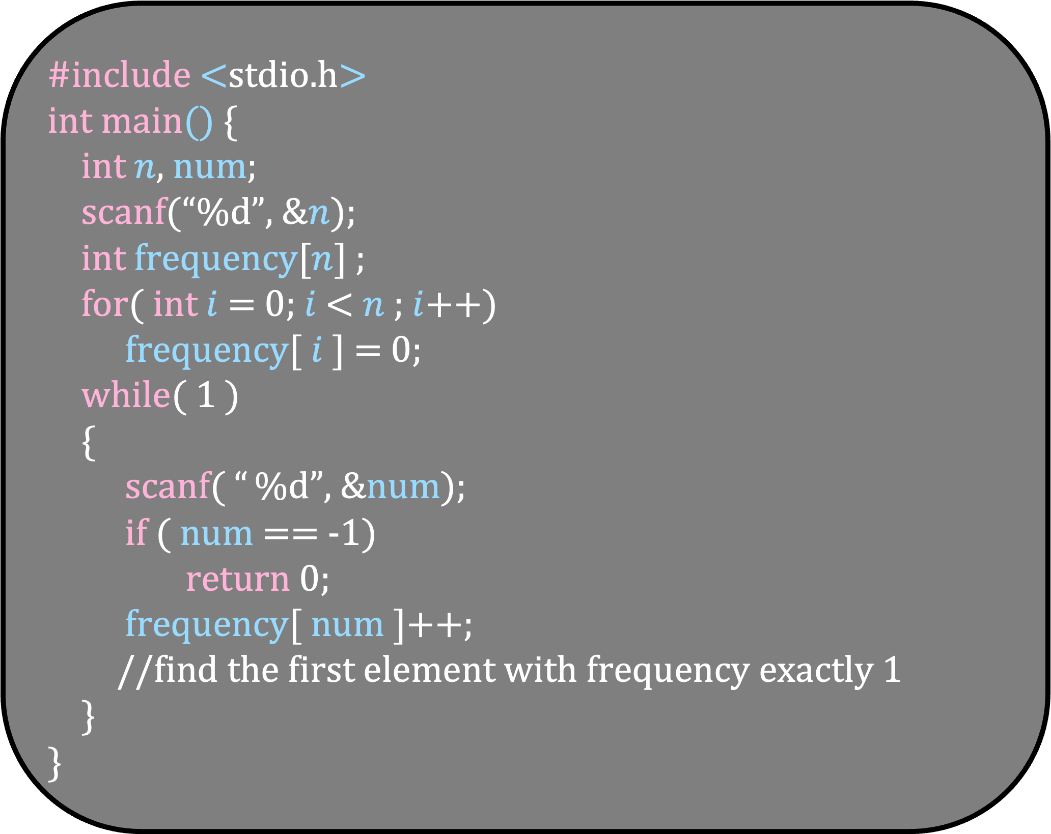
#include <stdio.h>
int main() {
int $n$, num;
scanf(“%d”, &$n$);
int frequency[$n$] ;
for( int $i$ = 0; $i$ < $n$ ; $i$++)
frequency[ $i$ ] = 0;
while( 1 )
{
scanf( “ %d”, &num);
if ( num == -1)
return 0;
frequency[ num ]++;
//find the first element with frequency exactly 1
}
}

Slide 3
Next Element
2
Frequency
0
1
2
3
4
5
6
7

Slide 4
Next Element
2
2
1
Frequency
0
1
2
3
4
5
6
7

Slide 5
Next Element
3
2
1
Frequency
0
1
2
3
4
5
6
7

Slide 6
Next Element
3
2
3
first
First contains our answer
1
1
Frequency
0
1
2
3
4
5
6
7

Slide 7
Next Element
3
2
3
first
last
The next element is to be added after the last element
1
1
Frequency
0
1
2
3
4
5
6
7

Slide 8
Next Element
5
2
3
first
last
1
1
Frequency
0
1
2
3
4
5
6
7

Slide 9
Next Element
5
2
3
5
first
last
1
1
1
Frequency
0
1
2
3
4
5
6
7

Slide 10
Next Element
5
2
3
5
first
last
1
1
1
Frequency
0
1
2
3
4
5
6
7

Slide 11
Next Element
3
2
3
5
Do not add 3 again
Increment its frequency
first
last
1
1
1
Frequency
0
1
2
3
4
5
6
7

Slide 12
Next Element
3
2
3
5
first
last
1
2
1
Frequency
0
1
2
3
4
5
6
7

Slide 13
Next Element
2
2
3
5
first
last
1
2
1
Frequency
0
1
2
3
4
5
6
7

Slide 14
Next Element
2
2
3
5
first
last
2
2
1
Frequency
0
1
2
3
4
5
6
7

Slide 15
Next Element
2
3
5
first
last
2
2
1
Frequency
0
1
2
3
4
5
6
7

Slide 16
Next Element
2
5
last
first
2
2
1
Frequency
0
1
2
3
4
5
6
7

Slide 17
#include <stdio.h>
#include <stdlib.h>
struct node {
int num;
struct node *next;
};
struct node *first = NULL;
struct node *last = NULL;
void enqueue(int element)
{
//adds element to the end of the queue
//using last
}
int dequeue()
{
//removes the element at the start of
//the queue using first
}
int main() {
enqueue(1) ;
enqueue(2) ;
int element = dequeue() ;
return 0;
}
first:NULL
last:NULL

Slide 18
#include <stdio.h>
#include <stdlib.h>
struct node {
int num;
struct node *next;
};
struct node *first = NULL;
struct node *last = NULL;
void enqueue(int element)
{
//adds element to the end of the queue
//using last
}
int dequeue()
{
//removes the element at the start of
//the queue using first
}
int main() {
enqueue(1) ;
enqueue(2) ;
int element = dequeue() ;
return 0;
}
1
NULL
first:100
last:100

Slide 19
#include <stdio.h>
#include <stdlib.h>
struct node {
int num;
struct node *next;
};
struct node *first = NULL;
struct node *last = NULL;
void enqueue(int element)
{
//adds element to the end of the queue
//using last
}
int dequeue()
{
//removes the element at the start of
//the queue using first
}
int main() {
enqueue(1) ;
enqueue(2) ;
int element = dequeue() ;
return 0;
}
1
2
200
NULL
first:100
last:200

Slide 20
#include <stdio.h>
#include <stdlib.h>
struct node {
int num;
struct node *next;
};
struct node *first = NULL;
struct node *last = NULL;
void enqueue(int element)
{
//adds element to the end of the queue
//using last
}
int dequeue()
{
//removes the element at the start of
//the queue using first
}
int main() {
enqueue(1) ;
enqueue(2) ;
int element = dequeue() ;
return 0;
}
2
NULL
last:200
first:200

Slide 21
void enqueue(int element)
{
struct node *p = malloc(sizeof(struct node));
if( p == NULL)
exit(1);
p->num = element;
p->next = NULL;
if( last == NULL)
{ first = p;
last = p ;
}
else
{ last->next = p;
last = p ;
}
}
#include <stdio.h>
#include <stdlib.h>
struct node {
int num;
struct node *next;
};
struct node *first = NULL;
struct node *last = NULL;
int main() {
enqueue(1) ;
enqueue(2) ;
int element = dequeue() ;
return 0;
}
int dequeue()
{
if( first == NULL)
exit(1);
struct node *p = first;
int element = p->num;
if (first == last)
{
first = NULL;
last = NULL;
}
else
first = first->next;
free(p);
return element;
}

Slide 22
void enqueue(int element)
{
struct node *p = malloc(sizeof(struct node));
if( p == NULL)
exit(1);
p->num = element;
p->next = NULL;
if( last == NULL)
{ first = p;
last = p ;
}
else
{ last->next = p;
last = p ;
}
}
#include <stdio.h>
#include <stdlib.h>
struct node {
int num;
struct node *next;
};
struct node *first = NULL;
struct node *last = NULL;
int main() {
enqueue(1) ;
enqueue(2) ;
int element = dequeue() ;
element = dequeue() ;
return 0;
}
int dequeue()
{
if( first == NULL)
exit(1);
struct node *p = first;
int element = p->num;
if (first == last)
{
first = NULL;
last = NULL;
}
else
first = first->next;
free(p);
return element;
}
first:NULL
last:NULL

Slide 23
#include <stdio.h>
#include <stdlib.h>
struct node {
int num;
struct node *next;
};
struct node *first = NULL;
struct node *last = NULL;
int main() {
enqueue(1) ;
enqueue(2) ;
int element = dequeue() ;
element = dequeue() ;
return 0;
}
void enqueue(int element)
{
struct node *p = malloc(sizeof(struct node));
if( p == NULL)
exit(1);
p->num = element;
p->next = NULL;
if( last == NULL)
{ first = p;
last = p ;
}
else
{ last->next = p;
last = p ;
}
}
int dequeue()
{
if( first == NULL)
exit(1);
struct node *p = first;
int element = p->num;
if (first == last)
{
first = NULL;
last = NULL;
}
else
first = first->next;
free(p);
return element;
}
first:NULL
last:NULL

Slide 24
#include <stdio.h>
#include <stdlib.h>
struct node {
int num;
struct node *next;
};
struct node *first = NULL;
struct node *last = NULL;
int main() {
enqueue(1) ;
enqueue(2) ;
int element = dequeue() ;
element = dequeue() ;
return 0;
}
void enqueue(int element)
{
struct node *p = malloc(sizeof(struct node));
if( p == NULL)
exit(1);
p->num = element;
p->next = NULL;
if( last == NULL)
{ first = p;
last = p ;
}
else
{ last->next = p;
last = p ;
}
}
p:100
int dequeue()
{
if( first == NULL)
exit(1);
struct node *p = first;
int element = p->num;
if (first == last)
{
first = NULL;
last = NULL;
}
else
first = first->next;
free(p);
return element;
}
first:NULL
last:NULL

Slide 25
#include <stdio.h>
#include <stdlib.h>
struct node {
int num;
struct node *next;
};
struct node *first = NULL;
struct node *last = NULL;
int main() {
enqueue(1) ;
enqueue(2) ;
int element = dequeue() ;
element = dequeue() ;
return 0;
}
void enqueue(int element)
{
struct node *p = malloc(sizeof(struct node));
if( p == NULL)
exit(1);
p->num = element;
p->next = NULL;
if( last == NULL)
{ first = p;
last = p ;
}
else
{ last->next = p;
last = p ;
}
}
p:100
int dequeue()
{
if( first == NULL)
exit(1);
struct node *p = first;
int element = p->num;
if (first == last)
{
first = NULL;
last = NULL;
}
else
first = first->next;
free(p);
return element;
}
first:NULL
last:NULL

Slide 26
#include <stdio.h>
#include <stdlib.h>
struct node {
int num;
struct node *next;
};
struct node *first = NULL;
struct node *last = NULL;
int main() {
enqueue(1) ;
enqueue(2) ;
int element = dequeue() ;
element = dequeue() ;
return 0;
}
void enqueue(int element)
{
struct node *p = malloc(sizeof(struct node));
if( p == NULL)
exit(1);
p->num = element;
p->next = NULL;
if( last == NULL)
{ first = p;
last = p ;
}
else
{ last->next = p;
last = p ;
}
}
p:100
1
int dequeue()
{
if( first == NULL)
exit(1);
struct node *p = first;
int element = p->num;
if (first == last)
{
first = NULL;
last = NULL;
}
else
first = first->next;
free(p);
return element;
}
first:NULL
last:NULL

Slide 27
#include <stdio.h>
#include <stdlib.h>
struct node {
int num;
struct node *next;
};
struct node *first = NULL;
struct node *last = NULL;
int main() {
enqueue(1) ;
enqueue(2) ;
int element = dequeue() ;
element = dequeue() ;
return 0;
}
void enqueue(int element)
{
struct node *p = malloc(sizeof(struct node));
if( p == NULL)
exit(1);
p->num = element;
p->next = NULL;
if( last == NULL)
{ first = p;
last = p ;
}
else
{ last->next = p;
last = p ;
}
}
p:100
1
int dequeue()
{
if( first == NULL)
exit(1);
struct node *p = first;
int element = p->num;
if (first == last)
{
first = NULL;
last = NULL;
}
else
first = first->next;
free(p);
return element;
}
NULL
first:NULL
last:NULL

Slide 28
#include <stdio.h>
#include <stdlib.h>
struct node {
int num;
struct node *next;
};
struct node *first = NULL;
struct node *last = NULL;
int main() {
enqueue(1) ;
enqueue(2) ;
int element = dequeue() ;
element = dequeue() ;
return 0;
}
void enqueue(int element)
{
struct node *p = malloc(sizeof(struct node));
if( p == NULL)
exit(1);
p->num = element;
p->next = NULL;
if( last == NULL)
{ first = p;
last = p ;
}
else
{ last->next = p;
last = p ;
}
}
p:100
1
int dequeue()
{
if( first == NULL)
exit(1);
struct node *p = first;
int element = p->num;
if (first == last)
{
first = NULL;
last = NULL;
}
else
first = first->next;
free(p);
return element;
}
NULL
first:100
last:100

Slide 29
void enqueue(int element)
{
struct node *p = malloc(sizeof(struct node));
if( p == NULL)
exit(1);
p->num = element;
p->next = NULL;
if( last == NULL)
{ first = p;
last = p ;
}
else
{ last->next = p;
last = p ;
}
}
#include <stdio.h>
#include <stdlib.h>
struct node {
int num;
struct node *next;
};
struct node *first = NULL;
struct node *last = NULL;
int main() {
enqueue(1) ;
enqueue(2) ;
int element = dequeue() ;
element = dequeue() ;
return 0;
}
1
int dequeue()
{
if( first == NULL)
exit(1);
struct node *p = first;
int element = p->num;
if (first == last)
{
first = NULL;
last = NULL;
}
else
first = first->next;
free(p);
return element;
}
NULL
first:100
last:100

Slide 30
#include <stdio.h>
#include <stdlib.h>
struct node {
int num;
struct node *next;
};
struct node *first = NULL;
struct node *last = NULL;
int main() {
enqueue(1) ;
enqueue(2) ;
int element = dequeue() ;
element = dequeue() ;
return 0;
}
void enqueue(int element)
{
struct node *p = malloc(sizeof(struct node));
if( p == NULL)
exit(1);
p->num = element;
p->next = NULL;
if( last == NULL)
{ first = p;
last = p ;
}
else
{ last->next = p;
last = p ;
}
}
1
NULL
int dequeue()
{
if( first == NULL)
exit(1);
struct node *p = first;
int element = p->num;
if (first == last)
{
first = NULL;
last = NULL;
}
else
first = first->next;
free(p);
return element;
}
first:100
last:100

Slide 31
#include <stdio.h>
#include <stdlib.h>
struct node {
int num;
struct node *next;
};
struct node *first = NULL;
struct node *last = NULL;
int main() {
enqueue(1) ;
enqueue(2) ;
int element = dequeue() ;
element = dequeue() ;
return 0;
}
p:200
void enqueue(int element)
{
struct node *p = malloc(sizeof(struct node));
if( p == NULL)
exit(1);
p->num = element;
p->next = NULL;
if( last == NULL)
{ first = p;
last = p ;
}
else
{ last->next = p;
last = p ;
}
}
1
NULL
int dequeue()
{
if( first == NULL)
exit(1);
struct node *p = first;
int element = p->num;
if (first == last)
{
first = NULL;
last = NULL;
}
else
first = first->next;
free(p);
return element;
}
first:100
last:100

Slide 32
#include <stdio.h>
#include <stdlib.h>
struct node {
int num;
struct node *next;
};
struct node *first = NULL;
struct node *last = NULL;
int main() {
enqueue(1) ;
enqueue(2) ;
int element = dequeue() ;
element = dequeue() ;
return 0;
}
p:200
void enqueue(int element)
{
struct node *p = malloc(sizeof(struct node));
if( p == NULL)
exit(1);
p->num = element;
p->next = NULL;
if( last == NULL)
{ first = p;
last = p ;
}
else
{ last->next = p;
last = p ;
}
}
1
NULL
int dequeue()
{
if( first == NULL)
exit(1);
struct node *p = first;
int element = p->num;
if (first == last)
{
first = NULL;
last = NULL;
}
else
first = first->next;
free(p);
return element;
}
first:100
last:100

Slide 33
#include <stdio.h>
#include <stdlib.h>
struct node {
int num;
struct node *next;
};
struct node *first = NULL;
struct node *last = NULL;
int main() {
enqueue(1) ;
enqueue(2) ;
int element = dequeue() ;
element = dequeue() ;
return 0;
}
p:200
void enqueue(int element)
{
struct node *p = malloc(sizeof(struct node));
if( p == NULL)
exit(1);
p->num = element;
p->next = NULL;
if( last == NULL)
{ first = p;
last = p ;
}
else
{ last->next = p;
last = p ;
}
}
1
2
NULL
NULL
int dequeue()
{
if( first == NULL)
exit(1);
struct node *p = first;
int element = p->num;
if (first == last)
{
first = NULL;
last = NULL;
}
else
first = first->next;
free(p);
return element;
}
first:100
last:100

Slide 34
#include <stdio.h>
#include <stdlib.h>
struct node {
int num;
struct node *next;
};
struct node *first = NULL;
struct node *last = NULL;
int main() {
enqueue(1) ;
enqueue(2) ;
int element = dequeue() ;
element = dequeue() ;
return 0;
}
p:200
void enqueue(int element)
{
struct node *p = malloc(sizeof(struct node));
if( p == NULL)
exit(1);
p->num = element;
p->next = NULL;
if( last == NULL)
{ first = p;
last = p ;
}
else
{ last->next = p;
last = p ;
}
}
1
2
NULL
NULL
int dequeue()
{
if( first == NULL)
exit(1);
struct node *p = first;
int element = p->num;
if (first == last)
{
first = NULL;
last = NULL;
}
else
first = first->next;
free(p);
return element;
}
first:100
last:100

Slide 35
#include <stdio.h>
#include <stdlib.h>
struct node {
int num;
struct node *next;
};
struct node *first = NULL;
struct node *last = NULL;
int main() {
enqueue(1) ;
enqueue(2) ;
int element = dequeue() ;
element = dequeue() ;
return 0;
}
p:200
void enqueue(int element)
{
struct node *p = malloc(sizeof(struct node));
if( p == NULL)
exit(1);
p->num = element;
p->next = NULL;
if( last == NULL)
{ first = p;
last = p ;
}
else
{ last->next = p;
last = p ;
}
}
1
2
200
NULL
int dequeue()
{
if( first == NULL)
exit(1);
struct node *p = first;
int element = p->num;
if (first == last)
{
first = NULL;
last = NULL;
}
else
first = first->next;
free(p);
return element;
}
first:100
last:100

Slide 36
#include <stdio.h>
#include <stdlib.h>
struct node {
int num;
struct node *next;
};
struct node *first = NULL;
struct node *last = NULL;
int main() {
enqueue(1) ;
enqueue(2) ;
int element = dequeue() ;
element = dequeue() ;
return 0;
}
p:200
void enqueue(int element)
{
struct node *p = malloc(sizeof(struct node));
if( p == NULL)
exit(1);
p->num = element;
p->next = NULL;
if( last == NULL)
{ first = p;
last = p ;
}
else
{ last->next = p;
last = p ;
}
}
1
2
200
NULL
int dequeue()
{
if( first == NULL)
exit(1);
struct node *p = first;
int element = p->num;
if (first == last)
{
first = NULL;
last = NULL;
}
else
first = first->next;
free(p);
return element;
}
first:100
last:200

Slide 37
#include <stdio.h>
#include <stdlib.h>
struct node {
int num;
struct node *next;
};
struct node *first = NULL;
struct node *last = NULL;
int main() {
enqueue(1) ;
enqueue(2) ;
int element = dequeue() ;
element = dequeue() ;
return 0;
}
1
2
200
NULL
int dequeue()
{
if( first == NULL)
exit(1);
struct node *p = first;
int element = p->num;
if (first == last)
{
first = NULL;
last = NULL;
}
else
first = first->next;
free(p);
return element;
}
first:100
last:200
void enqueue(int element)
{
struct node *p = malloc(sizeof(struct node));
if( p == NULL)
exit(1);
p->num = element;
p->next = NULL;
if( last == NULL)
{ first = p;
last = p ;
}
else
{ last->next = p;
last = p ;
}
}

Slide 38
#include <stdio.h>
#include <stdlib.h>
struct node {
int num;
struct node *next;
};
struct node *first = NULL;
struct node *last = NULL;
int main() {
enqueue(1) ;
enqueue(2) ;
int element = dequeue() ;
element = dequeue() ;
return 0;
}
int dequeue()
{
if( first == NULL)
exit(1);
struct node *p = first;
int element = p->num;
if (first == last)
{
first = NULL;
last = NULL;
}
else
first = first->next;
free(p);
return element;
}
1
2
200
NULL
first:100
last:200
void enqueue(int element)
{
struct node *p = malloc(sizeof(struct node));
if( p == NULL)
exit(1);
p->num = element;
p->next = NULL;
if( last == NULL)
{ first = p;
last = p ;
}
else
{ last->next = p;
last = p ;
}
}

Slide 39
#include <stdio.h>
#include <stdlib.h>
struct node {
int num;
struct node *next;
};
struct node *first = NULL;
struct node *last = NULL;
int main() {
enqueue(1) ;
enqueue(2) ;
int element = dequeue() ;
element = dequeue() ;
return 0;
}
int dequeue()
{
if( first == NULL)
exit(1);
struct node *p = first;
int element = p->num;
if (first == last)
{
first = NULL;
last = NULL;
}
else
first = first->next;
free(p);
return element;
}
1
2
200
NULL
first:100
last:200
p:100
void enqueue(int element)
{
struct node *p = malloc(sizeof(struct node));
if( p == NULL)
exit(1);
p->num = element;
p->next = NULL;
if( last == NULL)
{ first = p;
last = p ;
}
else
{ last->next = p;
last = p ;
}
}

Slide 40
#include <stdio.h>
#include <stdlib.h>
struct node {
int num;
struct node *next;
};
struct node *first = NULL;
struct node *last = NULL;
int main() {
enqueue(1) ;
enqueue(2) ;
int element = dequeue() ;
element = dequeue() ;
return 0;
}
int dequeue()
{
if( first == NULL)
exit(1);
struct node *p = first;
int element = p->num;
if (first == last)
{
first = NULL;
last = NULL;
}
else
first = first->next;
free(p);
return element;
}
1
2
200
NULL
first:100
last:200
p:100
void enqueue(int element)
{
struct node *p = malloc(sizeof(struct node));
if( p == NULL)
exit(1);
p->num = element;
p->next = NULL;
if( last == NULL)
{ first = p;
last = p ;
}
else
{ last->next = p;
last = p ;
}
}

Slide 41
#include <stdio.h>
#include <stdlib.h>
struct node {
int num;
struct node *next;
};
struct node *first = NULL;
struct node *last = NULL;
int main() {
enqueue(1) ;
enqueue(2) ;
int element = dequeue() ;
element = dequeue() ;
return 0;
}
int dequeue()
{
if( first == NULL)
exit(1);
struct node *p = first;
int element = p->num;
if (first == last)
{
first = NULL;
last = NULL;
}
else
first = first->next;
free(p);
return element;
}
1
2
200
NULL
first:100
last:200
p:100
void enqueue(int element)
{
struct node *p = malloc(sizeof(struct node));
if( p == NULL)
exit(1);
p->num = element;
p->next = NULL;
if( last == NULL)
{ first = p;
last = p ;
}
else
{ last->next = p;
last = p ;
}
}

Slide 42
#include <stdio.h>
#include <stdlib.h>
struct node {
int num;
struct node *next;
};
struct node *first = NULL;
struct node *last = NULL;
int main() {
enqueue(1) ;
enqueue(2) ;
int element = dequeue() ;
element = dequeue() ;
return 0;
}
int dequeue()
{
if( first == NULL)
exit(1);
struct node *p = first;
int element = p->num;
if (first == last)
{
first = NULL;
last = NULL;
}
else
first = first->next;
free(p);
return element;
}
1
2
200
NULL
first:100
last:200
p:100
void enqueue(int element)
{
struct node *p = malloc(sizeof(struct node));
if( p == NULL)
exit(1);
p->num = element;
p->next = NULL;
if( last == NULL)
{ first = p;
last = p ;
}
else
{ last->next = p;
last = p ;
}
}

Slide 43
#include <stdio.h>
#include <stdlib.h>
struct node {
int num;
struct node *next;
};
struct node *first = NULL;
struct node *last = NULL;
int main() {
enqueue(1) ;
enqueue(2) ;
int element = dequeue() ;
element = dequeue() ;
return 0;
}
int dequeue()
{
if( first == NULL)
exit(1);
struct node *p = first;
int element = p->num;
if (first == last)
{
first = NULL;
last = NULL;
}
else
first = first->next;
free(p);
return element;
}
1
2
200
NULL
p:100
last:200
first:200
void enqueue(int element)
{
struct node *p = malloc(sizeof(struct node));
if( p == NULL)
exit(1);
p->num = element;
p->next = NULL;
if( last == NULL)
{ first = p;
last = p ;
}
else
{ last->next = p;
last = p ;
}
}

Slide 44
#include <stdio.h>
#include <stdlib.h>
struct node {
int num;
struct node *next;
};
struct node *first = NULL;
struct node *last = NULL;
int main() {
enqueue(1) ;
enqueue(2) ;
int element = dequeue() ;
element = dequeue() ;
return 0;
}
int dequeue()
{
if( first == NULL)
exit(1);
struct node *p = first;
int element = p->num;
if (first == last)
{
first = NULL;
last = NULL;
}
else
first = first->next;
free(p);
return element;
}
2
NULL
p:100
last:200
first:200
void enqueue(int element)
{
struct node *p = malloc(sizeof(struct node));
if( p == NULL)
exit(1);
p->num = element;
p->next = NULL;
if( last == NULL)
{ first = p;
last = p ;
}
else
{ last->next = p;
last = p ;
}
}

Slide 45
#include <stdio.h>
#include <stdlib.h>
struct node {
int num;
struct node *next;
};
struct node *first = NULL;
struct node *last = NULL;
int main() {
enqueue(1) ;
enqueue(2) ;
int element = dequeue() ;
element = dequeue() ;
return 0;
}
2
NULL
int dequeue()
{
if( first == NULL)
exit(1);
struct node *p = first;
int element = p->num;
if (first == last)
{
first = NULL;
last = NULL;
}
else
first = first->next;
free(p);
return element;
}
last:200
first:200
void enqueue(int element)
{
struct node *p = malloc(sizeof(struct node));
if( p == NULL)
exit(1);
p->num = element;
p->next = NULL;
if( last == NULL)
{ first = p;
last = p ;
}
else
{ last->next = p;
last = p ;
}
}

Slide 46
#include <stdio.h>
#include <stdlib.h>
struct node {
int num;
struct node *next;
};
struct node *first = NULL;
struct node *last = NULL;
int main() {
enqueue(1) ;
enqueue(2) ;
int element = dequeue() ;
element = dequeue() ;
return 0;
}
int dequeue()
{
if( first == NULL)
exit(1);
struct node *p = first;
int element = p->num;
if (first == last)
{
first = NULL;
last = NULL;
}
else
first = first->next;
free(p);
return element;
}
2
NULL
last:200
first:200
void enqueue(int element)
{
struct node *p = malloc(sizeof(struct node));
if( p == NULL)
exit(1);
p->num = element;
p->next = NULL;
if( last == NULL)
{ first = p;
last = p ;
}
else
{ last->next = p;
last = p ;
}
}

Slide 47
#include <stdio.h>
#include <stdlib.h>
struct node {
int num;
struct node *next;
};
struct node *first = NULL;
struct node *last = NULL;
int main() {
enqueue(1) ;
enqueue(2) ;
int element = dequeue() ;
element = dequeue() ;
return 0;
}
int dequeue()
{
if( first == NULL)
exit(1);
struct node *p = first;
int element = p->num;
if (first == last)
{
first = NULL;
last = NULL;
}
else
first = first->next;
free(p);
return element;
}
2
NULL
last:200
first:200
void enqueue(int element)
{
struct node *p = malloc(sizeof(struct node));
if( p == NULL)
exit(1);
p->num = element;
p->next = NULL;
if( last == NULL)
{ first = p;
last = p ;
}
else
{ last->next = p;
last = p ;
}
}

Slide 48
#include <stdio.h>
#include <stdlib.h>
struct node {
int num;
struct node *next;
};
struct node *first = NULL;
struct node *last = NULL;
int main() {
enqueue(1) ;
enqueue(2) ;
int element = dequeue() ;
element = dequeue() ;
return 0;
}
int dequeue()
{
if( first == NULL)
exit(1);
struct node *p = first;
int element = p->num;
if (first == last)
{
first = NULL;
last = NULL;
}
else
first = first->next;
free(p);
return element;
}
2
NULL
last:200
first:200
p:200
void enqueue(int element)
{
struct node *p = malloc(sizeof(struct node));
if( p == NULL)
exit(1);
p->num = element;
p->next = NULL;
if( last == NULL)
{ first = p;
last = p ;
}
else
{ last->next = p;
last = p ;
}
}

Slide 49
#include <stdio.h>
#include <stdlib.h>
struct node {
int num;
struct node *next;
};
struct node *first = NULL;
struct node *last = NULL;
int main() {
enqueue(1) ;
enqueue(2) ;
int element = dequeue() ;
element = dequeue() ;
return 0;
}
int dequeue()
{
if( first == NULL)
exit(1);
struct node *p = first;
int element = p->num;
if (first == last)
{
first = NULL;
last = NULL;
}
else
first = first->next;
free(p);
return element;
}
2
NULL
last:200
first:200
p:200
void enqueue(int element)
{
struct node *p = malloc(sizeof(struct node));
if( p == NULL)
exit(1);
p->num = element;
p->next = NULL;
if( last == NULL)
{ first = p;
last = p ;
}
else
{ last->next = p;
last = p ;
}
}

Slide 50
#include <stdio.h>
#include <stdlib.h>
struct node {
int num;
struct node *next;
};
struct node *first = NULL;
struct node *last = NULL;
int main() {
enqueue(1) ;
enqueue(2) ;
int element = dequeue() ;
element = dequeue() ;
return 0;
}
int dequeue()
{
if( first == NULL)
exit(1);
struct node *p = first;
int element = p->num;
if (first == last)
{
first = NULL;
last = NULL;
}
else
first = first->next;
free(p);
return element;
}
2
NULL
p:200
last:NULL
first:NULL
void enqueue(int element)
{
struct node *p = malloc(sizeof(struct node));
if( p == NULL)
exit(1);
p->num = element;
p->next = NULL;
if( last == NULL)
{ first = p;
last = p ;
}
else
{ last->next = p;
last = p ;
}
}

Slide 51
#include <stdio.h>
#include <stdlib.h>
struct node {
int num;
struct node *next;
};
struct node *first = NULL;
struct node *last = NULL;
int main() {
enqueue(1) ;
enqueue(2) ;
int element = dequeue() ;
element = dequeue() ;
return 0;
}
int dequeue()
{
if( first == NULL)
exit(1);
struct node *p = first;
int element = p->num;
if (first == last)
{
first = NULL;
last = NULL;
}
else
first = first->next;
free(p);
return element;
}
2
NULL
p:200
last:NULL
first:NULL
void enqueue(int element)
{
struct node *p = malloc(sizeof(struct node));
if( p == NULL)
exit(1);
p->num = element;
p->next = NULL;
if( last == NULL)
{ first = p;
last = p ;
}
else
{ last->next = p;
last = p ;
}
}

Slide 52
#include <stdio.h>
#include <stdlib.h>
struct node {
int num;
struct node *next;
};
struct node *first = NULL;
struct node *last = NULL;
int main() {
enqueue(1) ;
enqueue(2) ;
int element = dequeue() ;
element = dequeue() ;
return 0;
}
int dequeue()
{
if( first == NULL)
exit(1);
struct node *p = first;
int element = p->num;
if (first == last)
{
first = NULL;
last = NULL;
}
else
first = first->next;
free(p);
return element;
}
p:200
last:NULL
first:NULL
void enqueue(int element)
{
struct node *p = malloc(sizeof(struct node));
if( p == NULL)
exit(1);
p->num = element;
p->next = NULL;
if( last == NULL)
{ first = p;
last = p ;
}
else
{ last->next = p;
last = p ;
}
}

Slide 53
#include <stdio.h>
#include <stdlib.h>
struct node {
int num;
struct node *next;
};
struct node *first = NULL;
struct node *last = NULL;
int main() {
enqueue(1) ;
enqueue(2) ;
int element = dequeue() ;
element = dequeue() ;
return 0;
}
int dequeue()
{
if( first == NULL)
exit(1);
struct node *p = first;
int element = p->num;
if (first == last)
{
first = NULL;
last = NULL;
}
else
first = first->next;
free(p);
return element;
}
last:NULL
first:NULL
void enqueue(int element)
{
struct node *p = malloc(sizeof(struct node));
if( p == NULL)
exit(1);
p->num = element;
p->next = NULL;
if( last == NULL)
{ first = p;
last = p ;
}
else
{ last->next = p;
last = p ;
}
}

Slide 54
#include <stdio.h>
int main() {
int $n$, num;
scanf(“%d”, &$n$);
int frequency[$n$] ;
for( int $i$ = 0; $i$ < $n$ ; $i$++)
frequency[ $i$ ] = 0;
while( 1 )
{
scanf( “ %d”, &num);
if ( num == -1)
return 0;
frequency[ num ]++;
//find the first element with frequency exactly 1
}
}

Slide 55
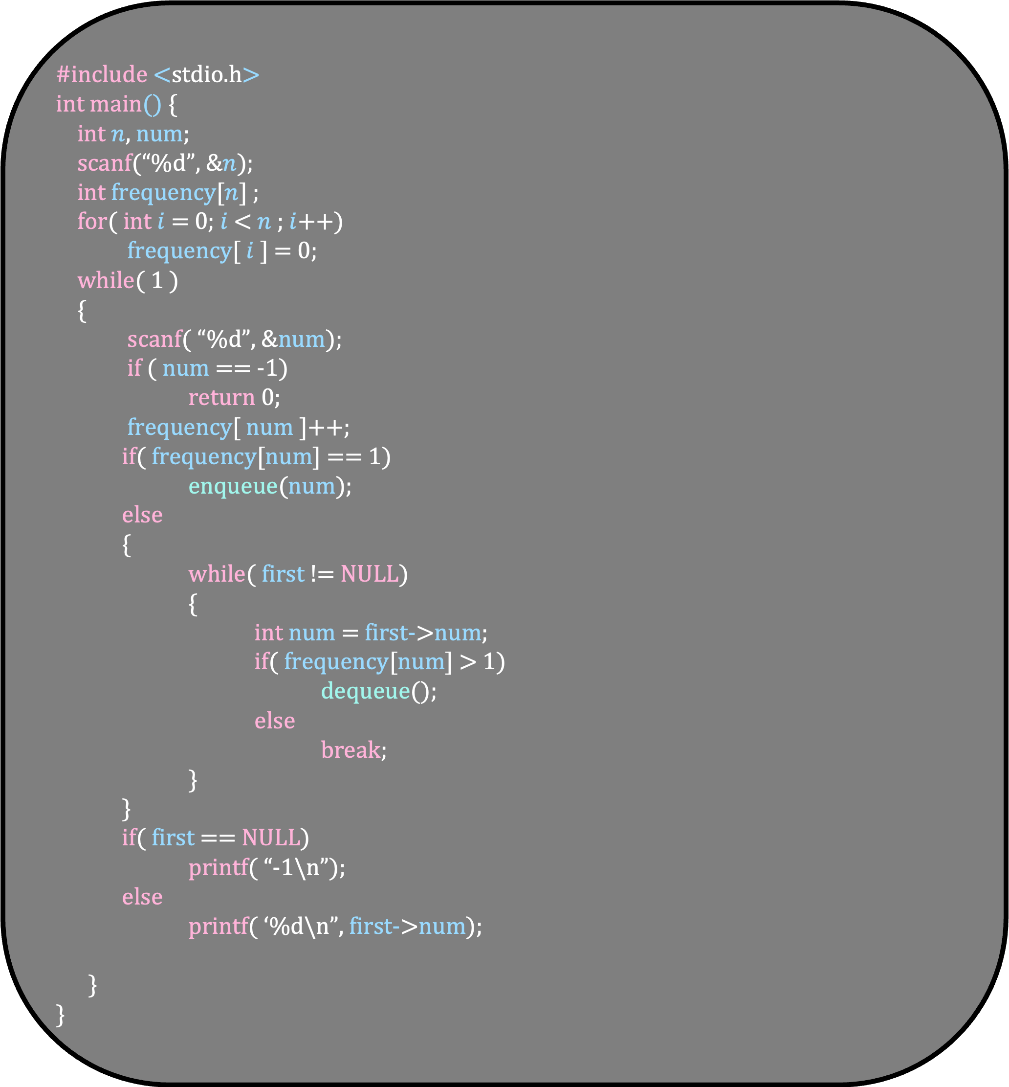
#include <stdio.h>
int main() {
int $n$, num;
scanf(“%d”, &$n$);
int frequency[$n$] ;
for( int $i$ = 0; $i$ < $n$ ; $i$++)
frequency[ $i$ ] = 0;
while( 1 )
{
scanf( “%d”, &num);
if ( num == -1)
return 0;
frequency[ num ]++;
if( frequency[num] == 1)
enqueue(num);
else
{
while( first != NULL)
{
int num = first->num;
if( frequency[num] > 1)
dequeue();
else
break;
}
}
if( first == NULL)
printf( “-1\n”);
else
printf( ‘%d\n”, first->num);
}
}

