Slide 1
Graph Traversals: BFS

Slide 2
You are given an undirected and unweighted graph G as an input and a source s (the source with index 0)
Find the length of the shortest path from the source to all the vertices in the graph
4
2
3
0
5
1

Slide 3
You are given an undirected and unweighted graph G as an input and a source s (the source with index 0)
Find the length of the shortest path from the source to all the vertices in the graph
4
4
2
3
3
1
0
5
0
2
1
1

Slide 4
Algorithm in plain English
s is the only vertex at distance 0 from s
for i=1 to n-1
Using all the vertices at distance (i-1) from s,
find all the vertices at distance i

Slide 5
4
2
3
0
5
0
1

Slide 6
4
2
3
0
5
0
1

Slide 7
4
2
3
1
0
5
0
1
1

Slide 8
Vertex 5 will be at distance 2
But don’t change the distance of vertex 0
4
2
3
1
Observation
We are discovering new vertices in this process
We need to update the distance of only newly discovered vertices
Vertices that are already discovered should not be touched
0
5
0
2
1
1

Slide 9
4
Not all vertices at distance 1 from vertex 0 have been processed
Process the vertex 2 now
2
3
1
0
5
0
2
1
1

Slide 10
4
Not all vertices at distance 1 from vertex 0 have been processed
Process the vertex 2 now
2
3
1
0
5
No update happens while processing the vertex 2
Completely visualize the algorithm and try to write code for it
0
2
1
1

Slide 11
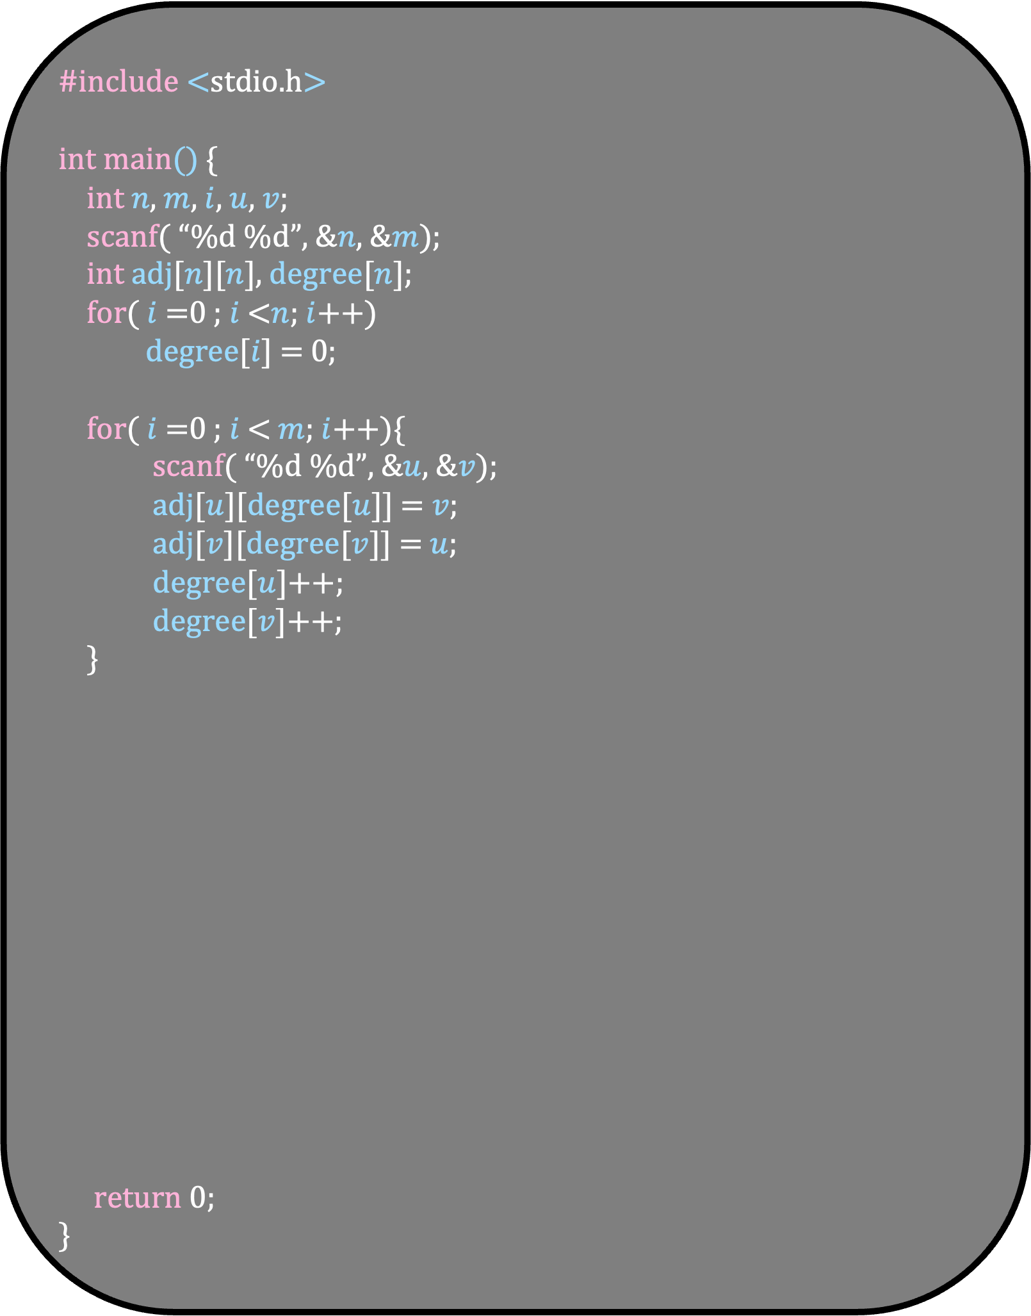
#include <stdio.h>
int main() {
int $n$, $m$, $i$, $u$, $v$;
scanf( “%d %d”, &$n$, &$m$);
int adj[$n$][$n$], degree[$n$];
for( $i$ =0 ; $i$ <$n$; $i$++)
degree[$i$] = 0;
for( $i$ =0 ; $i$ < $m$; $i$++){
scanf( “%d %d”, &$u$, &$v$);
adj[$u$][degree[$u$]] = $v$;
adj[$v$][degree[$v$]] = $u$;
degree[$u$]++;
degree[$v$]++;
}
return 0;
}

Slide 12
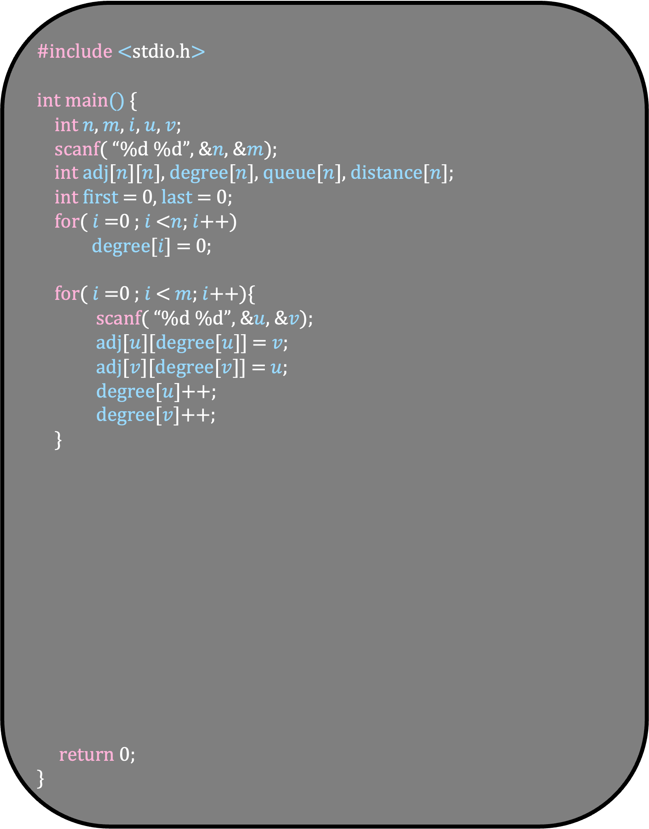
#include <stdio.h>
int main() {
int $n$, $m$, $i$, $u$, $v$;
scanf( “%d %d”, &$n$, &$m$);
int adj[$n$][$n$], degree[$n$], queue[$n$], distance[$n$];
int first = 0, last = 0;
for( $i$ =0 ; $i$ <$n$; $i$++)
degree[$i$] = 0;
for( $i$ =0 ; $i$ < $m$; $i$++){
scanf( “%d %d”, &$u$, &$v$);
adj[$u$][degree[$u$]] = $v$;
adj[$v$][degree[$v$]] = $u$;
degree[$u$]++;
degree[$v$]++;
}
return 0;
}
Why Queues?
All the vertices will be processed in order
First the vertices at distance 0, then distance 1 and then distance 2
We just add these vertices in the queue so that the order is maintained

Slide 13
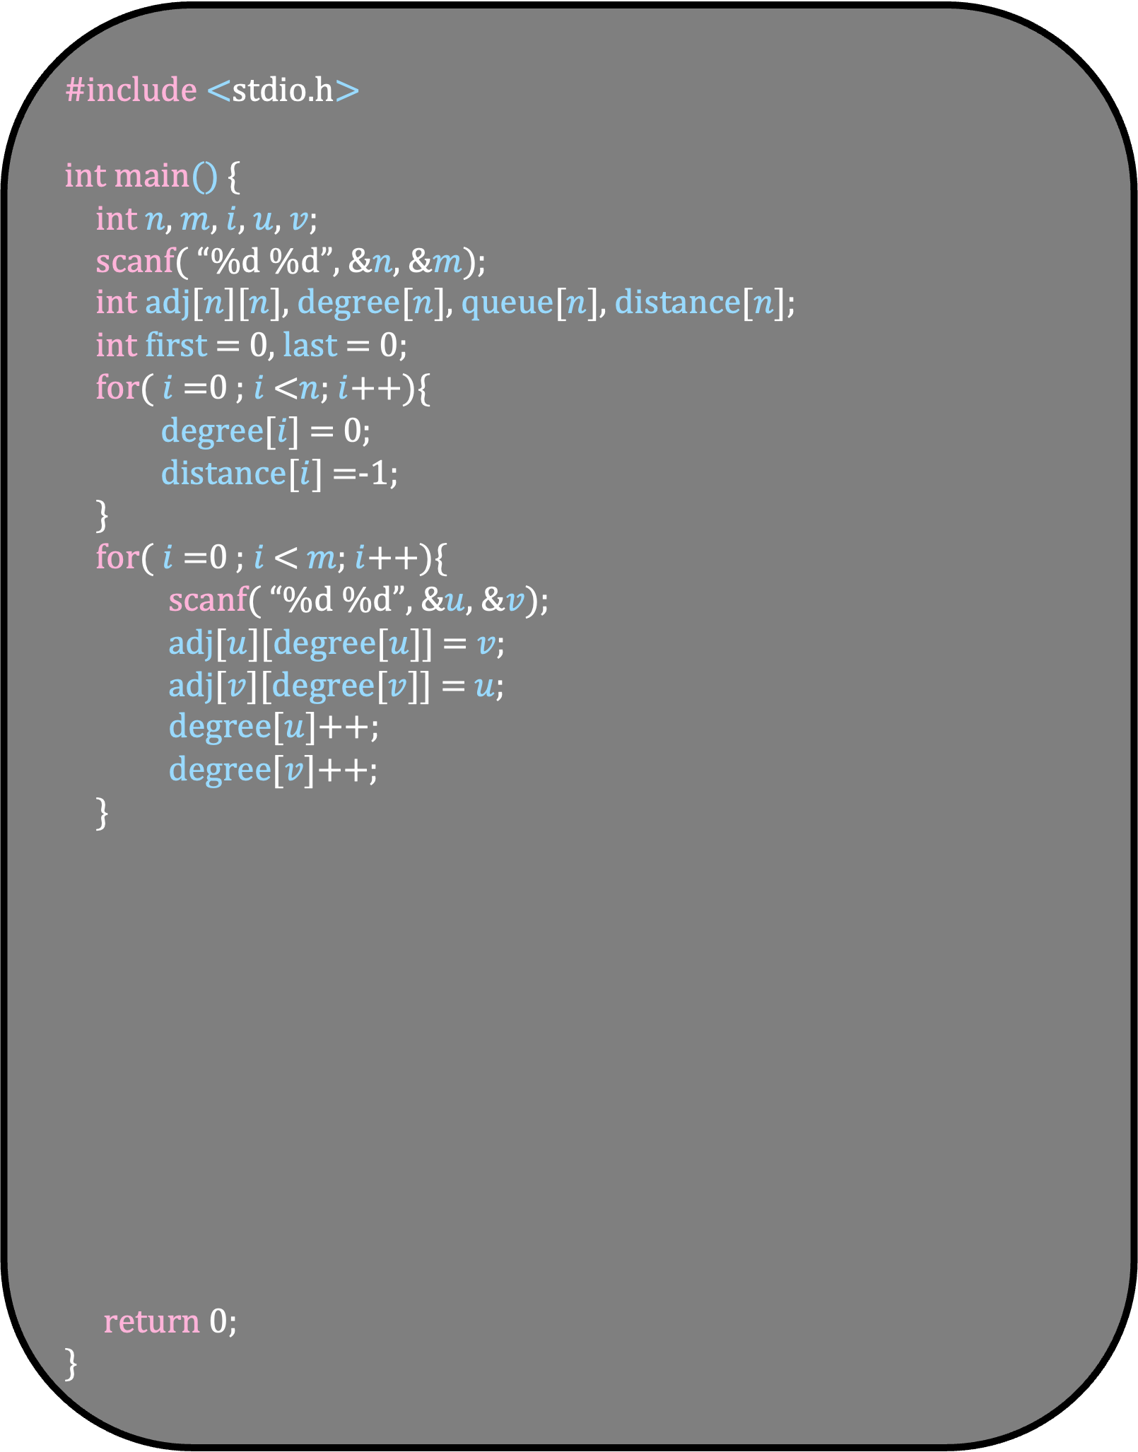
#include <stdio.h>
int main() {
int $n$, $m$, $i$, $u$, $v$;
scanf( “%d %d”, &$n$, &$m$);
int adj[$n$][$n$], degree[$n$], queue[$n$], distance[$n$];
int first = 0, last = 0;
for( $i$ =0 ; $i$ <$n$; $i$++){
degree[$i$] = 0;
distance[$i$] =-1;
}
for( $i$ =0 ; $i$ < $m$; $i$++){
scanf( “%d %d”, &$u$, &$v$);
adj[$u$][degree[$u$]] = $v$;
adj[$v$][degree[$v$]] = $u$;
degree[$u$]++;
degree[$v$]++;
}
return 0;
}

Slide 14
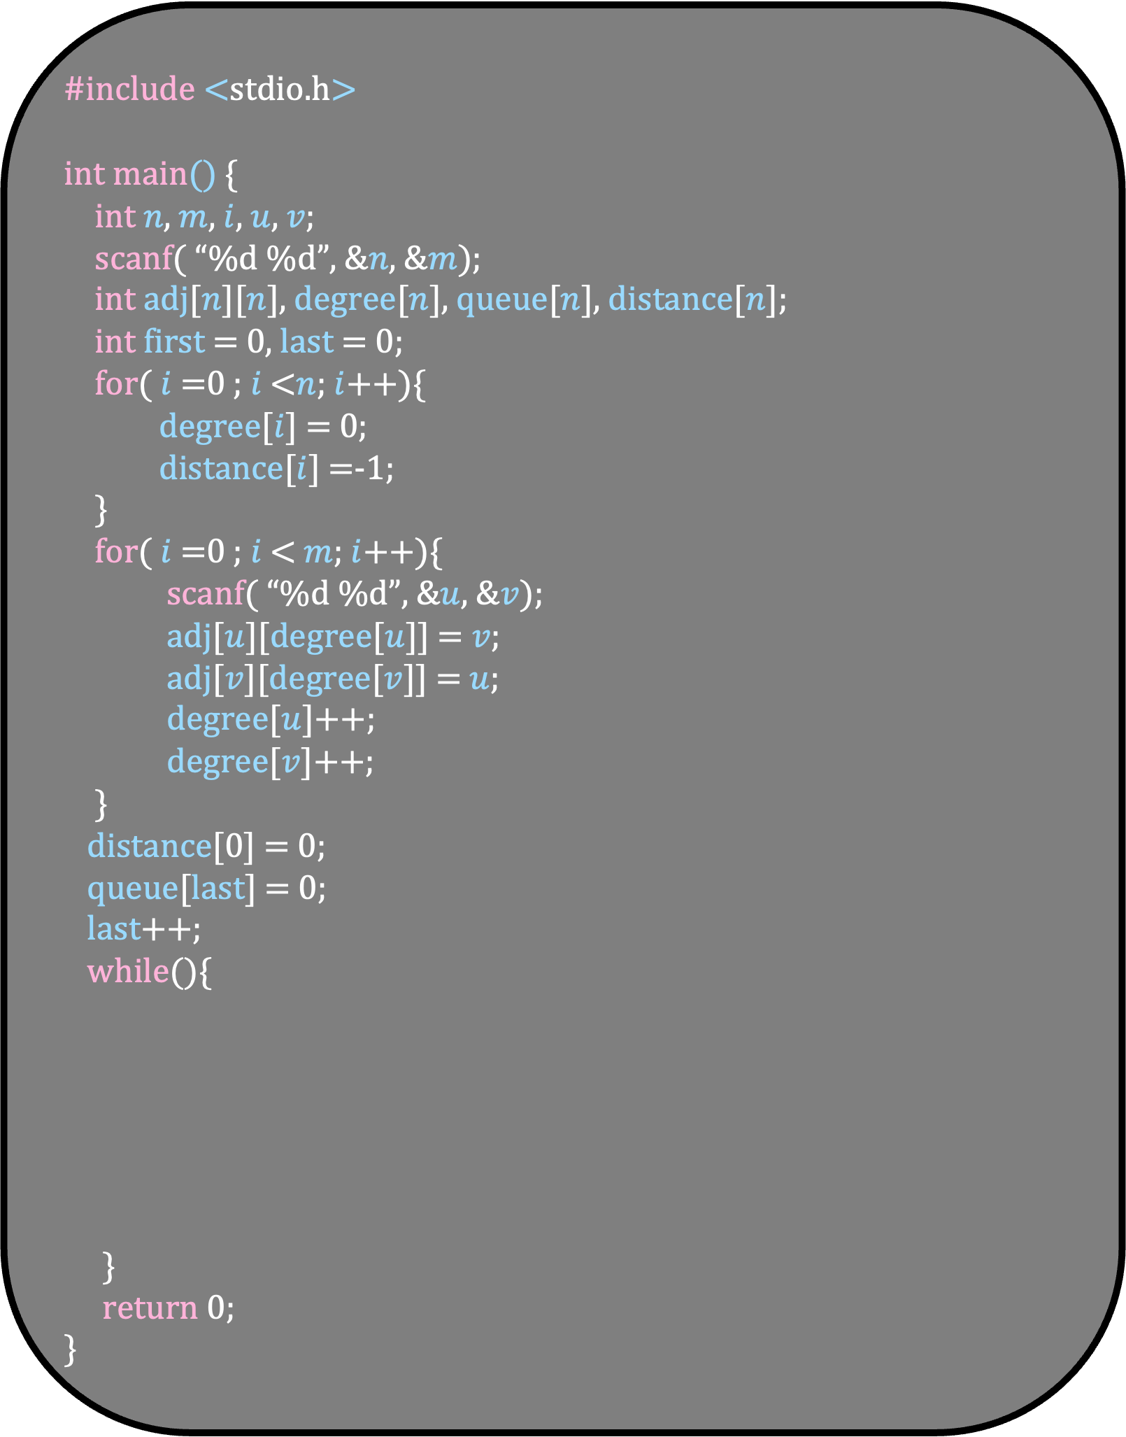
#include <stdio.h>
int main() {
int $n$, $m$, $i$, $u$, $v$;
scanf( “%d %d”, &$n$, &$m$);
int adj[$n$][$n$], degree[$n$], queue[$n$], distance[$n$];
int first = 0, last = 0;
for( $i$ =0 ; $i$ <$n$; $i$++){
degree[$i$] = 0;
distance[$i$] =-1;
}
for( $i$ =0 ; $i$ < $m$; $i$++){
scanf( “%d %d”, &$u$, &$v$);
adj[$u$][degree[$u$]] = $v$;
adj[$v$][degree[$v$]] = $u$;
degree[$u$]++;
degree[$v$]++;
}
distance[0] = 0;
queue[last] = 0;
last++;
while(){
}
return 0;
}
Rule
As soon as we set the distance of a vertex, we put it in the queue
We will process the queue in order
We will process all the vertices in the queue till it is empty

Slide 15
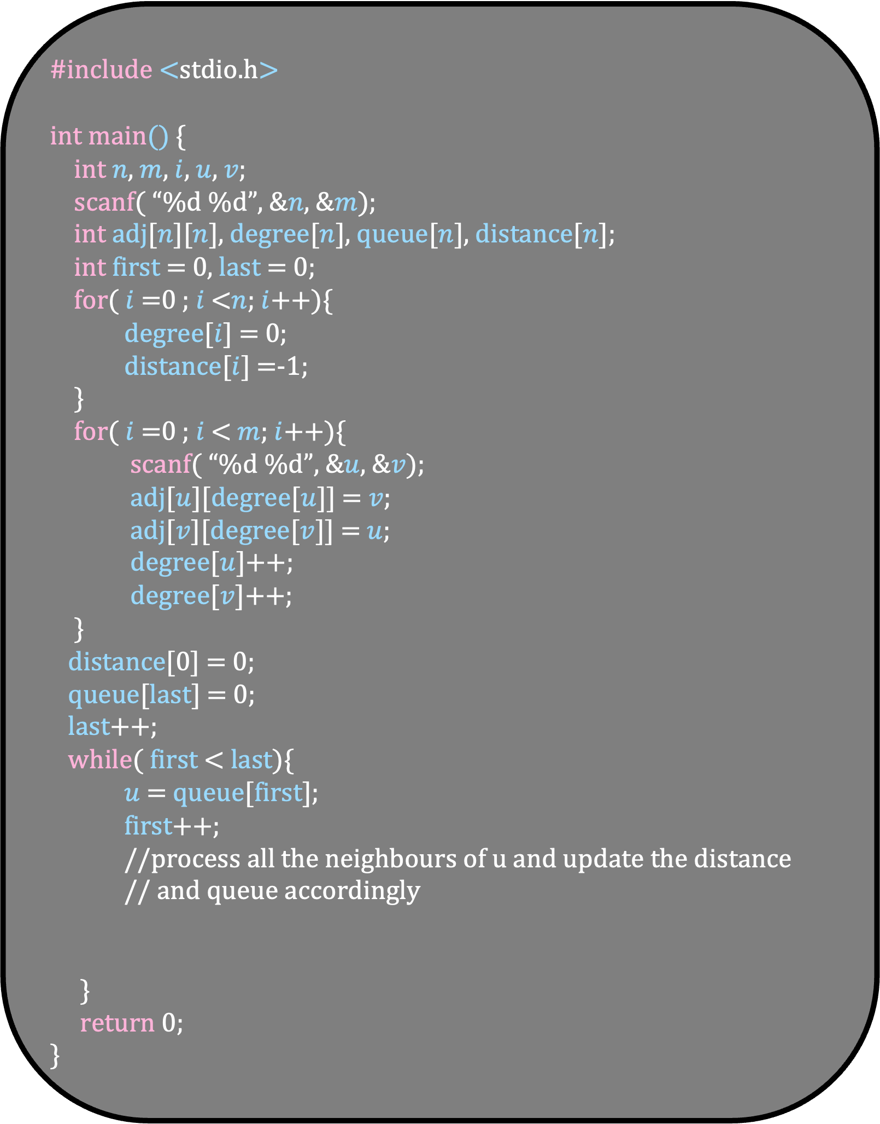
#include <stdio.h>
int main() {
int $n$, $m$, $i$, $u$, $v$;
scanf( “%d %d”, &$n$, &$m$);
int adj[$n$][$n$], degree[$n$], queue[$n$], distance[$n$];
int first = 0, last = 0;
for( $i$ =0 ; $i$ <$n$; $i$++){
degree[$i$] = 0;
distance[$i$] =-1;
}
for( $i$ =0 ; $i$ < $m$; $i$++){
scanf( “%d %d”, &$u$, &$v$);
adj[$u$][degree[$u$]] = $v$;
adj[$v$][degree[$v$]] = $u$;
degree[$u$]++;
degree[$v$]++;
}
distance[0] = 0;
queue[last] = 0;
last++;
while( first < last){
$u$ = queue[first];
first++;
//process all the neighbours of u and update the distance
// and queue accordingly
}
return 0;
}
Rule
As soon as we set the distance of a vertex, we put it in the queue
We will process the queue in order
We will process all the vertices in the queue till it is empty

Slide 16
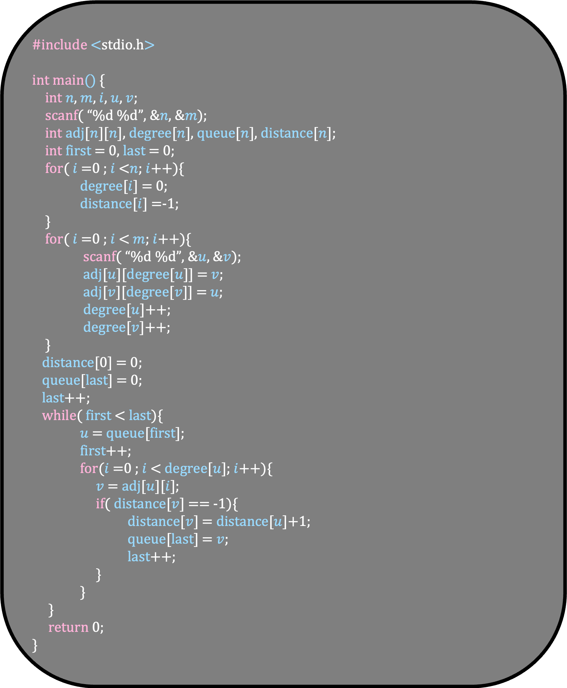
#include <stdio.h>
int main() {
int $n$, $m$, $i$, $u$, $v$;
scanf( “%d %d”, &$n$, &$m$);
int adj[$n$][$n$], degree[$n$], queue[$n$], distance[$n$];
int first = 0, last = 0;
for( $i$ =0 ; $i$ <$n$; $i$++){
degree[$i$] = 0;
distance[$i$] =-1;
}
for( $i$ =0 ; $i$ < $m$; $i$++){
scanf( “%d %d”, &$u$, &$v$);
adj[$u$][degree[$u$]] = $v$;
adj[$v$][degree[$v$]] = $u$;
degree[$u$]++;
degree[$v$]++;
}
distance[0] = 0;
queue[last] = 0;
last++;
while( first < last){
$u$ = queue[first];
first++;
for($i$ =0 ; $i$ < degree[$u$]; $i$++){
$v$ = adj[$u$][$i$];
if( distance[$v$] == -1){
distance[$v$] = distance[$u$]+1;
queue[last] = $v$;
last++;
}
}
}
return 0;
}
Observations
How many times we add a vertex in a queue?

Slide 17
#include <stdio.h>
int main() {
int $n$, $m$, $i$, $u$, $v$;
scanf( “%d %d”, &$n$, &$m$);
int adj[$n$][$n$], degree[$n$], queue[$n$], distance[$n$];
int first = 0, last = 0;
for( $i$ =0 ; $i$ <$n$; $i$++){
degree[$i$] = 0;
distance[$i$] =-1;
}
for( $i$ =0 ; $i$ < $m$; $i$++){
scanf( “%d %d”, &$u$, &$v$);
adj[$u$][degree[$u$]] = $v$;
adj[$v$][degree[$v$]] = $u$;
degree[$u$]++;
degree[$v$]++;
}
distance[0] = 0;
queue[last] = 0;
last++;
while( first < last){
$u$ = queue[first];
first++;
for($i$ =0 ; $i$ < degree[$u$]; $i$++){
$v$ = adj[$u$][$i$];
if( distance[$v$] == -1){
distance[$v$] = distance[$u$]+1;
queue[last] = $v$;
last++;
}
}
}
return 0;
}
Observations
How many times we add a vertex in a queue?
Once
That’s why we need a queue of size n only

Slide 18
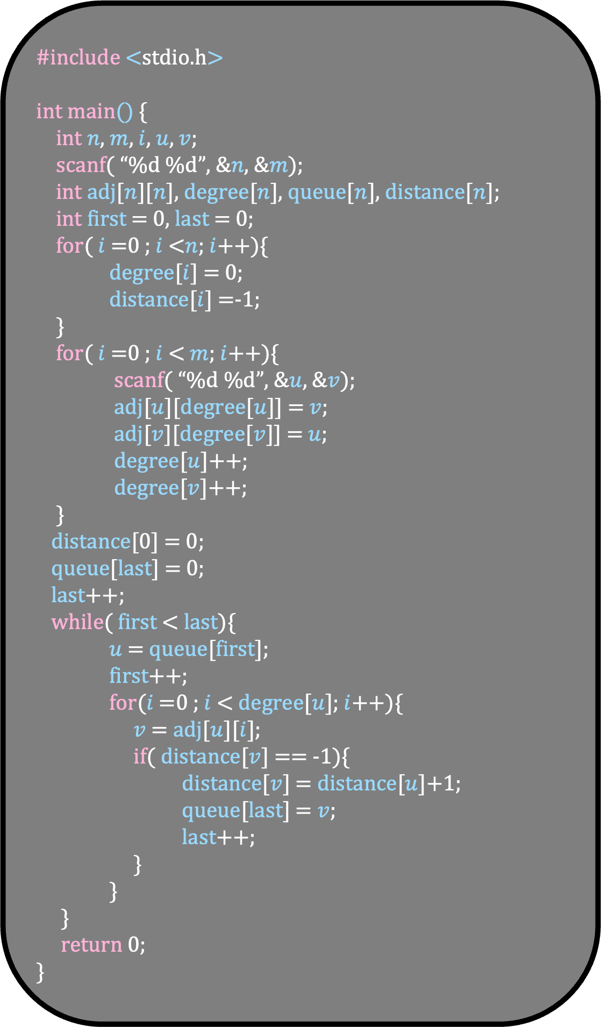
4
#include <stdio.h>
int main() {
int $n$, $m$, $i$, $u$, $v$;
scanf( “%d %d”, &$n$, &$m$);
int adj[$n$][$n$], degree[$n$], queue[$n$], distance[$n$];
int first = 0, last = 0;
for( $i$ =0 ; $i$ <$n$; $i$++){
degree[$i$] = 0;
distance[$i$] =-1;
}
for( $i$ =0 ; $i$ < $m$; $i$++){
scanf( “%d %d”, &$u$, &$v$);
adj[$u$][degree[$u$]] = $v$;
adj[$v$][degree[$v$]] = $u$;
degree[$u$]++;
degree[$v$]++;
}
distance[0] = 0;
queue[last] = 0;
last++;
while( first < last){
$u$ = queue[first];
first++;
for($i$ =0 ; $i$ < degree[$u$]; $i$++){
$v$ = adj[$u$][$i$];
if( distance[$v$] == -1){
distance[$v$] = distance[$u$]+1;
queue[last] = $v$;
last++;
}
}
}
return 0;
}
-1
2
-1
3
-1
0
5
0
-1
1
-1
first=0
Queue
last=0

Slide 19
4
#include <stdio.h>
int main() {
int $n$, $m$, $i$, $u$, $v$;
scanf( “%d %d”, &$n$, &$m$);
int adj[$n$][$n$], degree[$n$], queue[$n$], distance[$n$];
int first = 0, last = 0;
for( $i$ =0 ; $i$ <$n$; $i$++){
degree[$i$] = 0;
distance[$i$] =-1;
}
for( $i$ =0 ; $i$ < $m$; $i$++){
scanf( “%d %d”, &$u$, &$v$);
adj[$u$][degree[$u$]] = $v$;
adj[$v$][degree[$v$]] = $u$;
degree[$u$]++;
degree[$v$]++;
}
distance[0] = 0;
queue[last] = 0;
last++;
while( first < last){
$u$ = queue[first];
first++;
for($i$ =0 ; $i$ < degree[$u$]; $i$++){
$v$ = adj[$u$][$i$];
if( distance[$v$] == -1){
distance[$v$] = distance[$u$]+1;
queue[last] = $v$;
last++;
}
}
}
return 0;
}
-1
2
-1
3
-1
0
5
0
-1
1
-1
first=0
0
Queue
last=0

Slide 20
4
#include <stdio.h>
int main() {
int $n$, $m$, $i$, $u$, $v$;
scanf( “%d %d”, &$n$, &$m$);
int adj[$n$][$n$], degree[$n$], queue[$n$], distance[$n$];
int first = 0, last = 0;
for( $i$ =0 ; $i$ <$n$; $i$++){
degree[$i$] = 0;
distance[$i$] =-1;
}
for( $i$ =0 ; $i$ < $m$; $i$++){
scanf( “%d %d”, &$u$, &$v$);
adj[$u$][degree[$u$]] = $v$;
adj[$v$][degree[$v$]] = $u$;
degree[$u$]++;
degree[$v$]++;
}
distance[0] = 0;
queue[last] = 0;
last++;
while( first < last){
$u$ = queue[first];
first++;
for($i$ =0 ; $i$ < degree[$u$]; $i$++){
$v$ = adj[$u$][$i$];
if( distance[$v$] == -1){
distance[$v$] = distance[$u$]+1;
queue[last] = $v$;
last++;
}
}
}
return 0;
}
-1
2
-1
3
-1
0
5
0
-1
1
-1
first=0
0
Queue
last=1

Slide 21
4
#include <stdio.h>
int main() {
int $n$, $m$, $i$, $u$, $v$;
scanf( “%d %d”, &$n$, &$m$);
int adj[$n$][$n$], degree[$n$], queue[$n$], distance[$n$];
int first = 0, last = 0;
for( $i$ =0 ; $i$ <$n$; $i$++){
degree[$i$] = 0;
distance[$i$] =-1;
}
for( $i$ =0 ; $i$ < $m$; $i$++){
scanf( “%d %d”, &$u$, &$v$);
adj[$u$][degree[$u$]] = $v$;
adj[$v$][degree[$v$]] = $u$;
degree[$u$]++;
degree[$v$]++;
}
distance[0] = 0;
queue[last] = 0;
last++;
while( first < last){
$u$ = queue[first];
first++;
for($i$ =0 ; $i$ < degree[$u$]; $i$++){
$v$ = adj[$u$][$i$];
if( distance[$v$] == -1){
distance[$v$] = distance[$u$]+1;
queue[last] = $v$;
last++;
}
}
}
return 0;
}
-1
2
-1
3
-1
0
5
0
-1
1
-1
first=0
0
Queue
last=1

Slide 22

4
#include <stdio.h>
int main() {
int $n$, $m$, $i$, $u$, $v$;
scanf( “%d %d”, &$n$, &$m$);
int adj[$n$][$n$], degree[$n$], queue[$n$], distance[$n$];
int first = 0, last = 0;
for( $i$ =0 ; $i$ <$n$; $i$++){
degree[$i$] = 0;
distance[$i$] =-1;
}
for( $i$ =0 ; $i$ < $m$; $i$++){
scanf( “%d %d”, &$u$, &$v$);
adj[$u$][degree[$u$]] = $v$;
adj[$v$][degree[$v$]] = $u$;
degree[$u$]++;
degree[$v$]++;
}
distance[0] = 0;
queue[last] = 0;
last++;
while( first < last){
$u$ = queue[first];
first++;
for($i$ =0 ; $i$ < degree[$u$]; $i$++){
$v$ = adj[$u$][$i$];
if( distance[$v$] == -1){
distance[$v$] = distance[$u$]+1;
queue[last] = $v$;
last++;
}
}
}
return 0;
}
-1
2
-1
3
-1
0
5
0
-1
$u$
1
-1
first=0
0
Queue
last=1

Slide 23
4
#include <stdio.h>
int main() {
int $n$, $m$, $i$, $u$, $v$;
scanf( “%d %d”, &$n$, &$m$);
int adj[$n$][$n$], degree[$n$], queue[$n$], distance[$n$];
int first = 0, last = 0;
for( $i$ =0 ; $i$ <$n$; $i$++){
degree[$i$] = 0;
distance[$i$] =-1;
}
for( $i$ =0 ; $i$ < $m$; $i$++){
scanf( “%d %d”, &$u$, &$v$);
adj[$u$][degree[$u$]] = $v$;
adj[$v$][degree[$v$]] = $u$;
degree[$u$]++;
degree[$v$]++;
}
distance[0] = 0;
queue[last] = 0;
last++;
while( first < last){
$u$ = queue[first];
first++;
for($i$ =0 ; $i$ < degree[$u$]; $i$++){
$v$ = adj[$u$][$i$];
if( distance[$v$] == -1){
distance[$v$] = distance[$u$]+1;
queue[last] = $v$;
last++;
}
}
}
return 0;
}
-1
2
-1
3
-1
0
5
0
-1
$u$
1
-1
first=1
0
Queue
last=1

Slide 24
4
#include <stdio.h>
int main() {
int $n$, $m$, $i$, $u$, $v$;
scanf( “%d %d”, &$n$, &$m$);
int adj[$n$][$n$], degree[$n$], queue[$n$], distance[$n$];
int first = 0, last = 0;
for( $i$ =0 ; $i$ <$n$; $i$++){
degree[$i$] = 0;
distance[$i$] =-1;
}
for( $i$ =0 ; $i$ < $m$; $i$++){
scanf( “%d %d”, &$u$, &$v$);
adj[$u$][degree[$u$]] = $v$;
adj[$v$][degree[$v$]] = $u$;
degree[$u$]++;
degree[$v$]++;
}
distance[0] = 0;
queue[last] = 0;
last++;
while( first < last){
$u$ = queue[first];
first++;
for($i$ =0 ; $i$ < degree[$u$]; $i$++){
$v$ = adj[$u$][$i$];
if( distance[$v$] == -1){
distance[$v$] = distance[$u$]+1;
queue[last] = $v$;
last++;
}
}
}
return 0;
}
-1
2
-1
3
-1
0
5
0
-1
$u$
1
-1
first=1
0
Queue
last=1

Slide 25
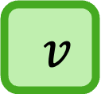
4
#include <stdio.h>
int main() {
int $n$, $m$, $i$, $u$, $v$;
scanf( “%d %d”, &$n$, &$m$);
int adj[$n$][$n$], degree[$n$], queue[$n$], distance[$n$];
int first = 0, last = 0;
for( $i$ =0 ; $i$ <$n$; $i$++){
degree[$i$] = 0;
distance[$i$] =-1;
}
for( $i$ =0 ; $i$ < $m$; $i$++){
scanf( “%d %d”, &$u$, &$v$);
adj[$u$][degree[$u$]] = $v$;
adj[$v$][degree[$v$]] = $u$;
degree[$u$]++;
degree[$v$]++;
}
distance[0] = 0;
queue[last] = 0;
last++;
while( first < last){
$u$ = queue[first];
first++;
for($i$ =0 ; $i$ < degree[$u$]; $i$++){
$v$ = adj[$u$][$i$];
if( distance[$v$] == -1){
distance[$v$] = distance[$u$]+1;
queue[last] = $v$;
last++;
}
}
}
return 0;
}
-1
2
-1
3
-1
$v$
0
5
0
-1
$u$
1
-1
first=1
0
Queue
last=1

Slide 26
4
#include <stdio.h>
int main() {
int $n$, $m$, $i$, $u$, $v$;
scanf( “%d %d”, &$n$, &$m$);
int adj[$n$][$n$], degree[$n$], queue[$n$], distance[$n$];
int first = 0, last = 0;
for( $i$ =0 ; $i$ <$n$; $i$++){
degree[$i$] = 0;
distance[$i$] =-1;
}
for( $i$ =0 ; $i$ < $m$; $i$++){
scanf( “%d %d”, &$u$, &$v$);
adj[$u$][degree[$u$]] = $v$;
adj[$v$][degree[$v$]] = $u$;
degree[$u$]++;
degree[$v$]++;
}
distance[0] = 0;
queue[last] = 0;
last++;
while( first < last){
$u$ = queue[first];
first++;
for($i$ =0 ; $i$ < degree[$u$]; $i$++){
$v$ = adj[$u$][$i$];
if( distance[$v$] == -1){
distance[$v$] = distance[$u$]+1;
queue[last] = $v$;
last++;
}
}
}
return 0;
}
-1
2
-1
3
-1
$v$
0
5
0
-1
$u$
1
-1
first=1
0
Queue
last=1

Slide 27
4
#include <stdio.h>
int main() {
int $n$, $m$, $i$, $u$, $v$;
scanf( “%d %d”, &$n$, &$m$);
int adj[$n$][$n$], degree[$n$], queue[$n$], distance[$n$];
int first = 0, last = 0;
for( $i$ =0 ; $i$ <$n$; $i$++){
degree[$i$] = 0;
distance[$i$] =-1;
}
for( $i$ =0 ; $i$ < $m$; $i$++){
scanf( “%d %d”, &$u$, &$v$);
adj[$u$][degree[$u$]] = $v$;
adj[$v$][degree[$v$]] = $u$;
degree[$u$]++;
degree[$v$]++;
}
distance[0] = 0;
queue[last] = 0;
last++;
while( first < last){
$u$ = queue[first];
first++;
for($i$ =0 ; $i$ < degree[$u$]; $i$++){
$v$ = adj[$u$][$i$];
if( distance[$v$] == -1){
distance[$v$] = distance[$u$]+1;
queue[last] = $v$;
last++;
}
}
}
return 0;
}
-1
2
-1
3
1
$v$
0
5
0
-1
$u$
1
-1
first=1
0
Queue
last=1

Slide 28
4
#include <stdio.h>
int main() {
int $n$, $m$, $i$, $u$, $v$;
scanf( “%d %d”, &$n$, &$m$);
int adj[$n$][$n$], degree[$n$], queue[$n$], distance[$n$];
int first = 0, last = 0;
for( $i$ =0 ; $i$ <$n$; $i$++){
degree[$i$] = 0;
distance[$i$] =-1;
}
for( $i$ =0 ; $i$ < $m$; $i$++){
scanf( “%d %d”, &$u$, &$v$);
adj[$u$][degree[$u$]] = $v$;
adj[$v$][degree[$v$]] = $u$;
degree[$u$]++;
degree[$v$]++;
}
distance[0] = 0;
queue[last] = 0;
last++;
while( first < last){
$u$ = queue[first];
first++;
for($i$ =0 ; $i$ < degree[$u$]; $i$++){
$v$ = adj[$u$][$i$];
if( distance[$v$] == -1){
distance[$v$] = distance[$u$]+1;
queue[last] = $v$;
last++;
}
}
}
return 0;
}
-1
2
-1
3
1
$v$
0
5
0
-1
$u$
1
-1
first=1
0
2
Queue
last=1

Slide 29
4
#include <stdio.h>
int main() {
int $n$, $m$, $i$, $u$, $v$;
scanf( “%d %d”, &$n$, &$m$);
int adj[$n$][$n$], degree[$n$], queue[$n$], distance[$n$];
int first = 0, last = 0;
for( $i$ =0 ; $i$ <$n$; $i$++){
degree[$i$] = 0;
distance[$i$] =-1;
}
for( $i$ =0 ; $i$ < $m$; $i$++){
scanf( “%d %d”, &$u$, &$v$);
adj[$u$][degree[$u$]] = $v$;
adj[$v$][degree[$v$]] = $u$;
degree[$u$]++;
degree[$v$]++;
}
distance[0] = 0;
queue[last] = 0;
last++;
while( first < last){
$u$ = queue[first];
first++;
for($i$ =0 ; $i$ < degree[$u$]; $i$++){
$v$ = adj[$u$][$i$];
if( distance[$v$] == -1){
distance[$v$] = distance[$u$]+1;
queue[last] = $v$;
last++;
}
}
}
return 0;
}
-1
2
-1
3
1
$v$
0
5
0
-1
$u$
1
-1
first=1
0
2
Queue
last=2

Slide 30
4
#include <stdio.h>
int main() {
int $n$, $m$, $i$, $u$, $v$;
scanf( “%d %d”, &$n$, &$m$);
int adj[$n$][$n$], degree[$n$], queue[$n$], distance[$n$];
int first = 0, last = 0;
for( $i$ =0 ; $i$ <$n$; $i$++){
degree[$i$] = 0;
distance[$i$] =-1;
}
for( $i$ =0 ; $i$ < $m$; $i$++){
scanf( “%d %d”, &$u$, &$v$);
adj[$u$][degree[$u$]] = $v$;
adj[$v$][degree[$v$]] = $u$;
degree[$u$]++;
degree[$v$]++;
}
distance[0] = 0;
queue[last] = 0;
last++;
while( first < last){
$u$ = queue[first];
first++;
for($i$ =0 ; $i$ < degree[$u$]; $i$++){
$v$ = adj[$u$][$i$];
if( distance[$v$] == -1){
distance[$v$] = distance[$u$]+1;
queue[last] = $v$;
last++;
}
}
}
return 0;
}
-1
2
-1
3
1
$v$
0
5
0
-1
$u$
1
-1
first=1
0
2
Queue
last=2

Slide 31

4
#include <stdio.h>
int main() {
int $n$, $m$, $i$, $u$, $v$;
scanf( “%d %d”, &$n$, &$m$);
int adj[$n$][$n$], degree[$n$], queue[$n$], distance[$n$];
int first = 0, last = 0;
for( $i$ =0 ; $i$ <$n$; $i$++){
degree[$i$] = 0;
distance[$i$] =-1;
}
for( $i$ =0 ; $i$ < $m$; $i$++){
scanf( “%d %d”, &$u$, &$v$);
adj[$u$][degree[$u$]] = $v$;
adj[$v$][degree[$v$]] = $u$;
degree[$u$]++;
degree[$v$]++;
}
distance[0] = 0;
queue[last] = 0;
last++;
while( first < last){
$u$ = queue[first];
first++;
for($i$ =0 ; $i$ < degree[$u$]; $i$++){
$v$ = adj[$u$][$i$];
if( distance[$v$] == -1){
distance[$v$] = distance[$u$]+1;
queue[last] = $v$;
last++;
}
}
}
return 0;
}
-1
2
-1
3
1
0
5
0
-1
$u$
1
-1
$v$
first=1
0
2
Queue
last=2

Slide 32
4
#include <stdio.h>
int main() {
int $n$, $m$, $i$, $u$, $v$;
scanf( “%d %d”, &$n$, &$m$);
int adj[$n$][$n$], degree[$n$], queue[$n$], distance[$n$];
int first = 0, last = 0;
for( $i$ =0 ; $i$ <$n$; $i$++){
degree[$i$] = 0;
distance[$i$] =-1;
}
for( $i$ =0 ; $i$ < $m$; $i$++){
scanf( “%d %d”, &$u$, &$v$);
adj[$u$][degree[$u$]] = $v$;
adj[$v$][degree[$v$]] = $u$;
degree[$u$]++;
degree[$v$]++;
}
distance[0] = 0;
queue[last] = 0;
last++;
while( first < last){
$u$ = queue[first];
first++;
for($i$ =0 ; $i$ < degree[$u$]; $i$++){
$v$ = adj[$u$][$i$];
if( distance[$v$] == -1){
distance[$v$] = distance[$u$]+1;
queue[last] = $v$;
last++;
}
}
}
return 0;
}
-1
2
-1
3
1
0
5
0
-1
$u$
1
-1
$v$
first=1
0
2
Queue
last=2

Slide 33
4
#include <stdio.h>
int main() {
int $n$, $m$, $i$, $u$, $v$;
scanf( “%d %d”, &$n$, &$m$);
int adj[$n$][$n$], degree[$n$], queue[$n$], distance[$n$];
int first = 0, last = 0;
for( $i$ =0 ; $i$ <$n$; $i$++){
degree[$i$] = 0;
distance[$i$] =-1;
}
for( $i$ =0 ; $i$ < $m$; $i$++){
scanf( “%d %d”, &$u$, &$v$);
adj[$u$][degree[$u$]] = $v$;
adj[$v$][degree[$v$]] = $u$;
degree[$u$]++;
degree[$v$]++;
}
distance[0] = 0;
queue[last] = 0;
last++;
while( first < last){
$u$ = queue[first];
first++;
for($i$ =0 ; $i$ < degree[$u$]; $i$++){
$v$ = adj[$u$][$i$];
if( distance[$v$] == -1){
distance[$v$] = distance[$u$]+1;
queue[last] = $v$;
last++;
}
}
}
return 0;
}
-1
2
-1
3
1
0
5
0
-1
$u$
1
1
$v$
first=1
0
2
Queue
last=2

Slide 34
4
#include <stdio.h>
int main() {
int $n$, $m$, $i$, $u$, $v$;
scanf( “%d %d”, &$n$, &$m$);
int adj[$n$][$n$], degree[$n$], queue[$n$], distance[$n$];
int first = 0, last = 0;
for( $i$ =0 ; $i$ <$n$; $i$++){
degree[$i$] = 0;
distance[$i$] =-1;
}
for( $i$ =0 ; $i$ < $m$; $i$++){
scanf( “%d %d”, &$u$, &$v$);
adj[$u$][degree[$u$]] = $v$;
adj[$v$][degree[$v$]] = $u$;
degree[$u$]++;
degree[$v$]++;
}
distance[0] = 0;
queue[last] = 0;
last++;
while( first < last){
$u$ = queue[first];
first++;
for($i$ =0 ; $i$ < degree[$u$]; $i$++){
$v$ = adj[$u$][$i$];
if( distance[$v$] == -1){
distance[$v$] = distance[$u$]+1;
queue[last] = $v$;
last++;
}
}
}
return 0;
}
-1
2
-1
3
1
0
5
0
-1
$u$
1
1
$v$
first=1
0
2
Queue
last=2

Slide 35
4
#include <stdio.h>
int main() {
int $n$, $m$, $i$, $u$, $v$;
scanf( “%d %d”, &$n$, &$m$);
int adj[$n$][$n$], degree[$n$], queue[$n$], distance[$n$];
int first = 0, last = 0;
for( $i$ =0 ; $i$ <$n$; $i$++){
degree[$i$] = 0;
distance[$i$] =-1;
}
for( $i$ =0 ; $i$ < $m$; $i$++){
scanf( “%d %d”, &$u$, &$v$);
adj[$u$][degree[$u$]] = $v$;
adj[$v$][degree[$v$]] = $u$;
degree[$u$]++;
degree[$v$]++;
}
distance[0] = 0;
queue[last] = 0;
last++;
while( first < last){
$u$ = queue[first];
first++;
for($i$ =0 ; $i$ < degree[$u$]; $i$++){
$v$ = adj[$u$][$i$];
if( distance[$v$] == -1){
distance[$v$] = distance[$u$]+1;
queue[last] = $v$;
last++;
}
}
}
return 0;
}
-1
2
-1
3
1
0
5
0
-1
$u$
1
1
$v$
first=1
0
2
1
Queue
last=2

Slide 36
4
#include <stdio.h>
int main() {
int $n$, $m$, $i$, $u$, $v$;
scanf( “%d %d”, &$n$, &$m$);
int adj[$n$][$n$], degree[$n$], queue[$n$], distance[$n$];
int first = 0, last = 0;
for( $i$ =0 ; $i$ <$n$; $i$++){
degree[$i$] = 0;
distance[$i$] =-1;
}
for( $i$ =0 ; $i$ < $m$; $i$++){
scanf( “%d %d”, &$u$, &$v$);
adj[$u$][degree[$u$]] = $v$;
adj[$v$][degree[$v$]] = $u$;
degree[$u$]++;
degree[$v$]++;
}
distance[0] = 0;
queue[last] = 0;
last++;
while( first < last){
$u$ = queue[first];
first++;
for($i$ =0 ; $i$ < degree[$u$]; $i$++){
$v$ = adj[$u$][$i$];
if( distance[$v$] == -1){
distance[$v$] = distance[$u$]+1;
queue[last] = $v$;
last++;
}
}
}
return 0;
}
-1
2
-1
3
1
0
5
0
-1
$u$
1
1
$v$
first=1
0
2
1
Queue
last=3

Slide 37
4
#include <stdio.h>
int main() {
int $n$, $m$, $i$, $u$, $v$;
scanf( “%d %d”, &$n$, &$m$);
int adj[$n$][$n$], degree[$n$], queue[$n$], distance[$n$];
int first = 0, last = 0;
for( $i$ =0 ; $i$ <$n$; $i$++){
degree[$i$] = 0;
distance[$i$] =-1;
}
for( $i$ =0 ; $i$ < $m$; $i$++){
scanf( “%d %d”, &$u$, &$v$);
adj[$u$][degree[$u$]] = $v$;
adj[$v$][degree[$v$]] = $u$;
degree[$u$]++;
degree[$v$]++;
}
distance[0] = 0;
queue[last] = 0;
last++;
while( first < last){
$u$ = queue[first];
first++;
for($i$ =0 ; $i$ < degree[$u$]; $i$++){
$v$ = adj[$u$][$i$];
if( distance[$v$] == -1){
distance[$v$] = distance[$u$]+1;
queue[last] = $v$;
last++;
}
}
}
return 0;
}
-1
2
-1
3
1
0
5
0
-1
$u$
1
1
$v$
first=1
0
2
1
Queue
last=3

Slide 38

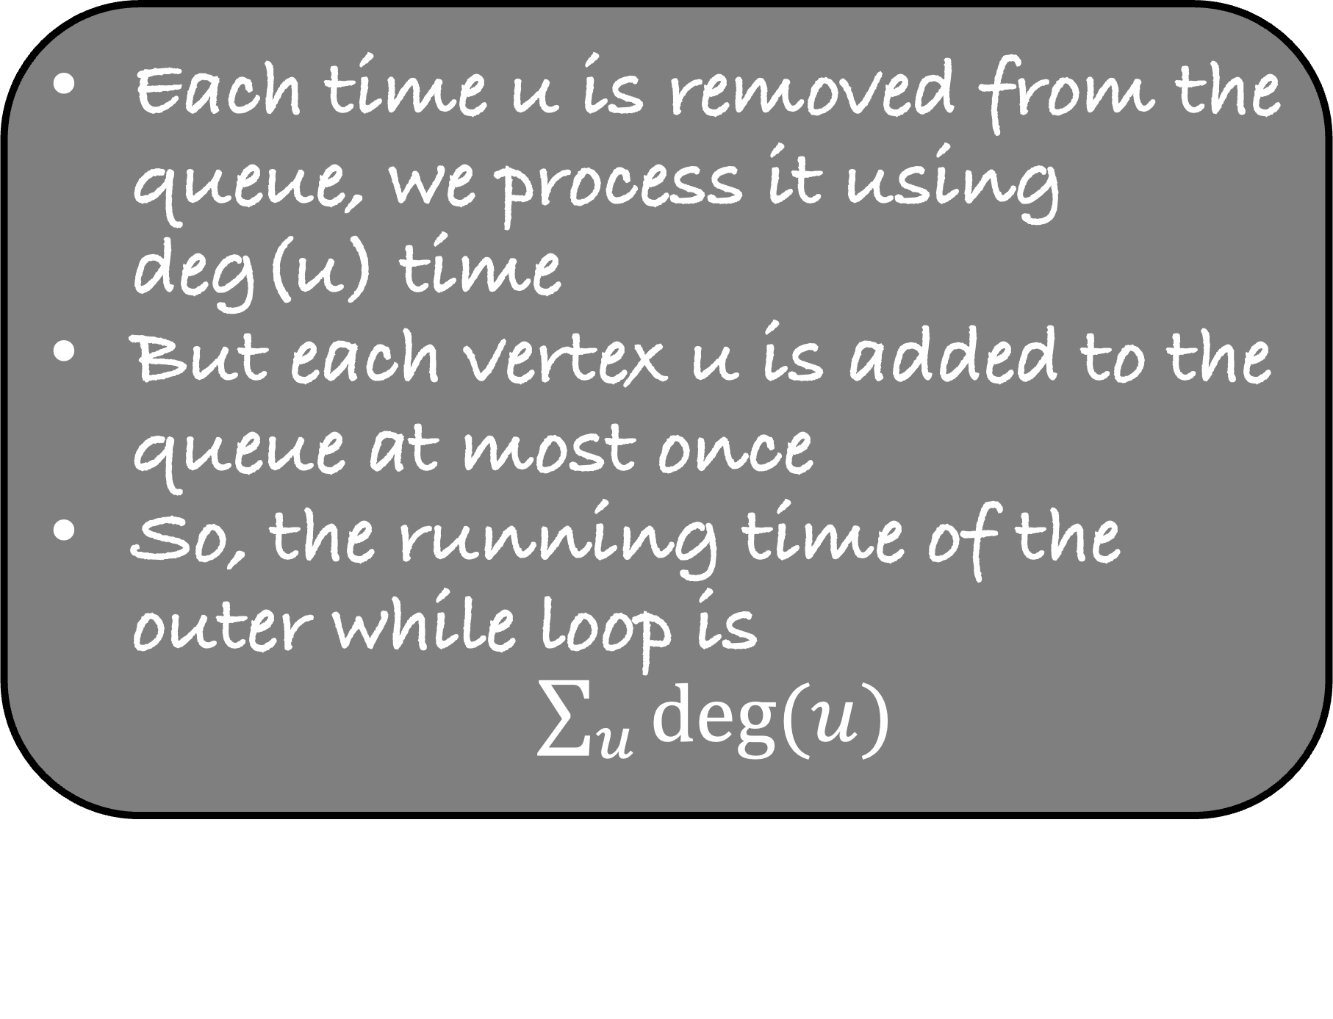

#include <stdio.h>
int main() {
int $n$, $m$, $i$, $u$, $v$;
scanf( “%d %d”, &$n$, &$m$);
int adj[$n$][$n$], degree[$n$], queue[$n$], distance[$n$];
int first = 0, last = 0;
for( $i$ =0 ; $i$ <$n$; $i$++){
degree[$i$] = 0;
distance[$i$] =-1;
}
for( $i$ =0 ; $i$ < $m$; $i$++){
scanf( “%d %d”, &$u$, &$v$);
adj[$u$][degree[$u$]] = $v$;
adj[$v$][degree[$v$]] = $u$;
degree[$u$]++;
degree[$v$]++;
}
distance[0] = 0;
queue[last] = 0;
last++;
while( first < last){
$u$ = queue[first];
first++;
for($i$ =0 ; $i$ < degree[$u$]; $i$++){
$v$ = adj[$u$][$i$];
if( distance[$v$] == -1){
distance[$v$] = distance[$u$]+1;
queue[last] = $v$;
last++;
}
}
}
return 0;
}
What is the running time of this algorithm?
$$cn$$
$$cm$$
Each time u is removed from the queue, we process it using deg(u) time
But each vertex u is added to the queue at most once
So, the running time of the outer while loop is
$\sum_{u}{deg⁡(u)}$
deg(u)

Slide 39
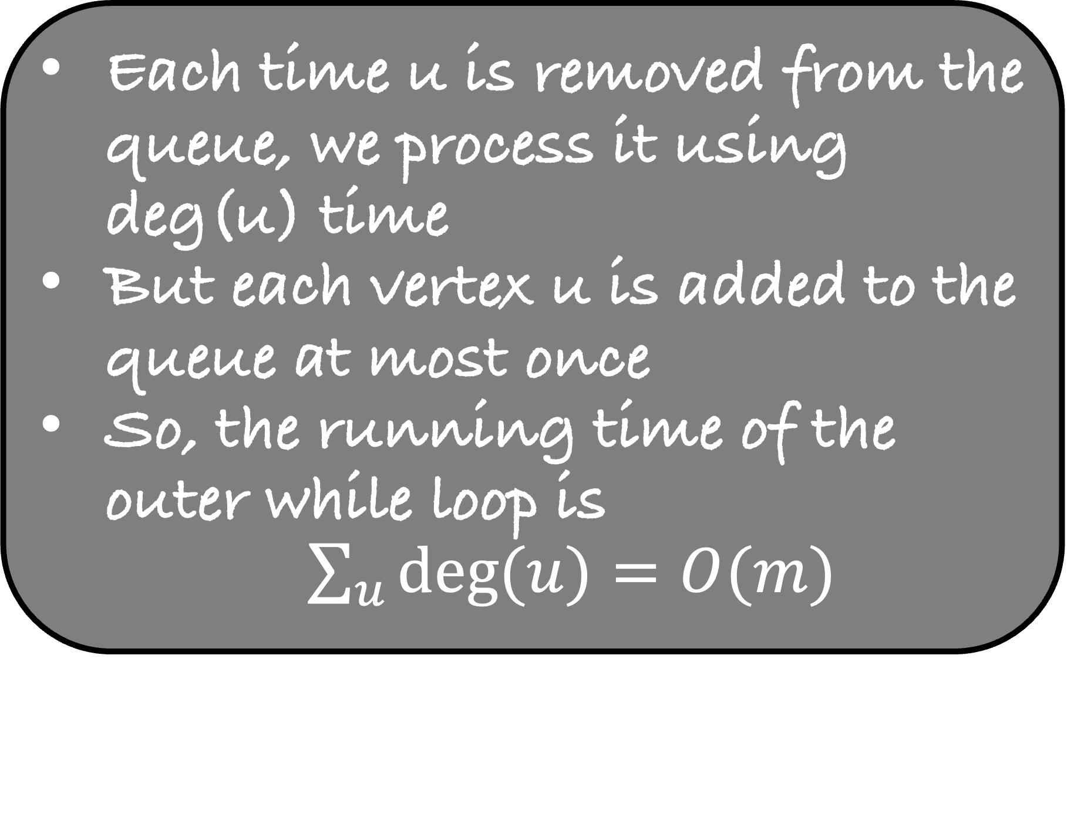
#include <stdio.h>
int main() {
int $n$, $m$, $i$, $u$, $v$;
scanf( “%d %d”, &$n$, &$m$);
int adj[$n$][$n$], degree[$n$], queue[$n$], distance[$n$];
int first = 0, last = 0;
for( $i$ =0 ; $i$ <$n$; $i$++){
degree[$i$] = 0;
distance[$i$] =-1;
}
for( $i$ =0 ; $i$ < $m$; $i$++){
scanf( “%d %d”, &$u$, &$v$);
adj[$u$][degree[$u$]] = $v$;
adj[$v$][degree[$v$]] = $u$;
degree[$u$]++;
degree[$v$]++;
}
distance[0] = 0;
queue[last] = 0;
last++;
while( first < last){
$u$ = queue[first];
first++;
for($i$ =0 ; $i$ < degree[$u$]; $i$++){
$v$ = adj[$u$][$i$];
if( distance[$v$] == -1){
distance[$v$] = distance[$u$]+1;
queue[last] = $v$;
last++;
}
}
}
return 0;
}
What is the running time of this algorithm?
$$cn$$
$$cm$$
Each time u is removed from the queue, we process it using deg(u) time
But each vertex u is added to the queue at most once
So, the running time of the outer while loop is
$\sum_{u}{deg⁡(u)}=O(m)$
deg(u)

Slide 40


#include <stdio.h>
int main() {
int $n$, $m$, $i$, $u$, $v$;
scanf( “%d %d”, &$n$, &$m$);
int adj[$n$][$n$], degree[$n$], queue[$n$], distance[$n$];
int first = 0, last = 0;
for( $i$ =0 ; $i$ <$n$; $i$++){
degree[$i$] = 0;
distance[$i$] =-1;
}
for( $i$ =0 ; $i$ < $m$; $i$++){
scanf( “%d %d”, &$u$, &$v$);
adj[$u$][degree[$u$]] = $v$;
adj[$v$][degree[$v$]] = $u$;
degree[$u$]++;
degree[$v$]++;
}
distance[0] = 0;
queue[last] = 0;
last++;
while( first < last){
$u$ = queue[first];
first++;
for($i$ =0 ; $i$ < degree[$u$]; $i$++){
$v$ = adj[$u$][$i$];
if( distance[$v$] == -1){
distance[$v$] = distance[$u$]+1;
queue[last] = $v$;
last++;
}
}
}
return 0;
}
What is the running time of this algorithm?
$$cn$$
$$O(m+n)$$
$$cm$$
$$cm$$

Slide 41
#include <stdio.h>
int main() {
int $n$, $m$, $i$, $u$, $v$;
scanf( “%d %d”, &$n$, &$m$);
int adj[$n$][$n$], degree[$n$], queue[$n$], distance[$n$];
int first = 0, last = 0;
for( $i$ =0 ; $i$ <$n$; $i$++){
degree[$i$] = 0;
distance[$i$] =-1;
}
for( $i$ =0 ; $i$ < $m$; $i$++){
scanf( “%d %d”, &$u$, &$v$);
adj[$u$][degree[$u$]] = $v$;
adj[$v$][degree[$v$]] = $u$;
degree[$u$]++;
degree[$v$]++;
}
distance[0] = 0;
queue[last] = 0;
last++;
while( first < last){
$u$ = queue[first];
first++;
for($i$ =0 ; $i$ < degree[$u$]; $i$++){
$v$ = adj[$u$][$i$];
if( distance[$v$] == -1){
distance[$v$] = distance[$u$]+1;
queue[last] = $v$;
last++;
}
}
}
return 0;
}
The algorithm is called the Breadth First Search Algorithm or the BFS algorithm
BFS because at each vertex we try to discover all its neighbours

Slide 42
#include <stdio.h>
int main() {
int $n$, $m$, $i$, $u$, $v$;
scanf( “%d %d”, &$n$, &$m$);
int adj[$n$][$n$], degree[$n$], queue[$n$], distance[$n$];
int first = 0, last = 0;
for( $i$ =0 ; $i$ <$n$; $i$++){
degree[$i$] = 0;
distance[$i$] =-1;
}
for( $i$ =0 ; $i$ < $m$; $i$++){
scanf( “%d %d”, &$u$, &$v$);
adj[$u$][degree[$u$]] = $v$;
adj[$v$][degree[$v$]] = $u$;
degree[$u$]++;
degree[$v$]++;
}
distance[0] = 0;
queue[last] = 0;
last++;
while( first < last){
$u$ = queue[first];
first++;
for($i$ =0 ; $i$ < degree[$u$]; $i$++){
$v$ = adj[$u$][$i$];
if( distance[$v$] == -1){
distance[$v$] = distance[$u$]+1;
queue[last] = $v$;
last++;
}
}
}
return 0;
}
We can make a tree from this code that will preserve the distance from the source 0

Slide 43
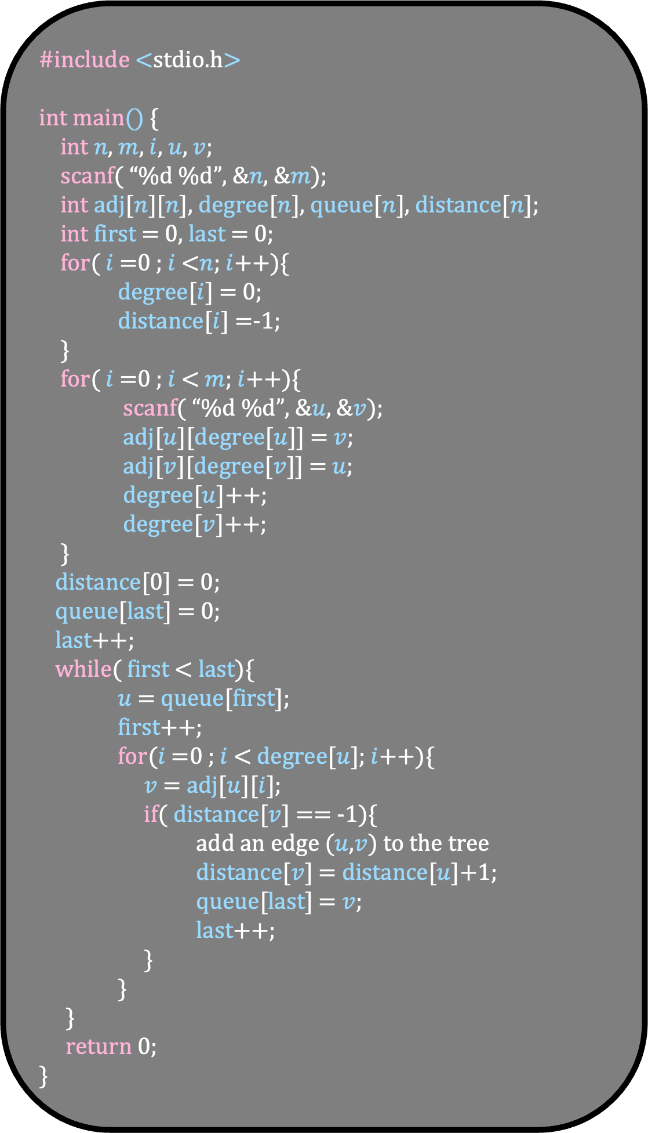
#include <stdio.h>
int main() {
int $n$, $m$, $i$, $u$, $v$;
scanf( “%d %d”, &$n$, &$m$);
int adj[$n$][$n$], degree[$n$], queue[$n$], distance[$n$];
int first = 0, last = 0;
for( $i$ =0 ; $i$ <$n$; $i$++){
degree[$i$] = 0;
distance[$i$] =-1;
}
for( $i$ =0 ; $i$ < $m$; $i$++){
scanf( “%d %d”, &$u$, &$v$);
adj[$u$][degree[$u$]] = $v$;
adj[$v$][degree[$v$]] = $u$;
degree[$u$]++;
degree[$v$]++;
}
distance[0] = 0;
queue[last] = 0;
last++;
while( first < last){
$u$ = queue[first];
first++;
for($i$ =0 ; $i$ < degree[$u$]; $i$++){
$v$ = adj[$u$][$i$];
if( distance[$v$] == -1){
add an edge ($u$,$v$) to the tree
distance[$v$] = distance[$u$]+1;
queue[last] = $v$;
last++;
}
}
}
return 0;
}
We can make a tree from this code that will preserve the distance from the source 0
4
4
2
3
3
1
0
5
0
2
1
1

Slide 44
#include <stdio.h>
int main() {
int $n$, $m$, $i$, $u$, $v$;
scanf( “%d %d”, &$n$, &$m$);
int adj[$n$][$n$], degree[$n$], queue[$n$], distance[$n$];
int first = 0, last = 0;
for( $i$ =0 ; $i$ <$n$; $i$++){
degree[$i$] = 0;
distance[$i$] =-1;
}
for( $i$ =0 ; $i$ < $m$; $i$++){
scanf( “%d %d”, &$u$, &$v$);
adj[$u$][degree[$u$]] = $v$;
adj[$v$][degree[$v$]] = $u$;
degree[$u$]++;
degree[$v$]++;
}
distance[0] = 0;
queue[last] = 0;
last++;
while( first < last){
$u$ = queue[first];
first++;
for($i$ =0 ; $i$ < degree[$u$]; $i$++){
$v$ = adj[$u$][$i$];
if( distance[$v$] == -1){
add an edge ($u$,$v$) to the tree
distance[$v$] = distance[$u$]+1;
queue[last] = $v$;
last++;
}
}
}
return 0;
}
We can make a tree from this code that will preserve the distance from the source 0
4
4
2
3
3
1
0
5
0
2
1
1

Slide 45
#include <stdio.h>
int main() {
int $n$, $m$, $i$, $u$, $v$;
scanf( “%d %d”, &$n$, &$m$);
int adj[$n$][$n$], degree[$n$], queue[$n$], distance[$n$];
int first = 0, last = 0;
for( $i$ =0 ; $i$ <$n$; $i$++){
degree[$i$] = 0;
distance[$i$] =-1;
}
for( $i$ =0 ; $i$ < $m$; $i$++){
scanf( “%d %d”, &$u$, &$v$);
adj[$u$][degree[$u$]] = $v$;
adj[$v$][degree[$v$]] = $u$;
degree[$u$]++;
degree[$v$]++;
}
distance[0] = 0;
queue[last] = 0;
last++;
while( first < last){
$u$ = queue[first];
first++;
for($i$ =0 ; $i$ < degree[$u$]; $i$++){
$v$ = adj[$u$][$i$];
if( distance[$v$] == -1){
add an edge ($u$,$v$) to the tree
distance[$v$] = distance[$u$]+1;
queue[last] = $v$;
last++;
}
}
}
return 0;
}
We can make a tree from this code that will preserve the distance from the source 0
4
4
2
3
3
1
0
5
0
2
1
1

Slide 46
#include <stdio.h>
int main() {
int $n$, $m$, $i$, $u$, $v$;
scanf( “%d %d”, &$n$, &$m$);
int adj[$n$][$n$], degree[$n$], queue[$n$], distance[$n$];
int first = 0, last = 0;
for( $i$ =0 ; $i$ <$n$; $i$++){
degree[$i$] = 0;
distance[$i$] =-1;
}
for( $i$ =0 ; $i$ < $m$; $i$++){
scanf( “%d %d”, &$u$, &$v$);
adj[$u$][degree[$u$]] = $v$;
adj[$v$][degree[$v$]] = $u$;
degree[$u$]++;
degree[$v$]++;
}
distance[0] = 0;
queue[last] = 0;
last++;
while( first < last){
$u$ = queue[first];
first++;
for($i$ =0 ; $i$ < degree[$u$]; $i$++){
$v$ = adj[$u$][$i$];
if( distance[$v$] == -1){
add an edge ($u$,$v$) to the tree
distance[$v$] = distance[$u$]+1;
queue[last] = $v$;
last++;
}
}
}
return 0;
}
We can make a tree from this code that will preserve the distance from the source 0
4
4
2
3
3
1
0
5
0
2
1
1

Slide 47
#include <stdio.h>
int main() {
int $n$, $m$, $i$, $u$, $v$;
scanf( “%d %d”, &$n$, &$m$);
int adj[$n$][$n$], degree[$n$], queue[$n$], distance[$n$];
int first = 0, last = 0;
for( $i$ =0 ; $i$ <$n$; $i$++){
degree[$i$] = 0;
distance[$i$] =-1;
}
for( $i$ =0 ; $i$ < $m$; $i$++){
scanf( “%d %d”, &$u$, &$v$);
adj[$u$][degree[$u$]] = $v$;
adj[$v$][degree[$v$]] = $u$;
degree[$u$]++;
degree[$v$]++;
}
distance[0] = 0;
queue[last] = 0;
last++;
while( first < last){
$u$ = queue[first];
first++;
for($i$ =0 ; $i$ < degree[$u$]; $i$++){
$v$ = adj[$u$][$i$];
if( distance[$v$] == -1){
add an edge ($u$,$v$) to the tree
distance[$v$] = distance[$u$]+1;
queue[last] = $v$;
last++;
}
}
}
return 0;
}
We can make a tree from this code that will preserve the distance from the source 0
4
4
2
3
3
1
0
5
0
2
1
1

Slide 48
#include <stdio.h>
int main() {
int $n$, $m$, $i$, $u$, $v$;
scanf( “%d %d”, &$n$, &$m$);
int adj[$n$][$n$], degree[$n$], queue[$n$], distance[$n$];
int first = 0, last = 0;
for( $i$ =0 ; $i$ <$n$; $i$++){
degree[$i$] = 0;
distance[$i$] =-1;
}
for( $i$ =0 ; $i$ < $m$; $i$++){
scanf( “%d %d”, &$u$, &$v$);
adj[$u$][degree[$u$]] = $v$;
adj[$v$][degree[$v$]] = $u$;
degree[$u$]++;
degree[$v$]++;
}
distance[0] = 0;
queue[last] = 0;
last++;
while( first < last){
$u$ = queue[first];
first++;
for($i$ =0 ; $i$ < degree[$u$]; $i$++){
$v$ = adj[$u$][$i$];
if( distance[$v$] == -1){
add an edge ($u$,$v$) to the tree
distance[$v$] = distance[$u$]+1;
queue[last] = $v$;
last++;
}
}
}
return 0;
}
We can make a tree from this code that will preserve the distance from the source 0
0
0
2
1
1
1
5
2
BFS Tree
3
3
4
4

Slide 49
BFS Tree
Look at the non-tree edge (shown in yellow) in the BFS tree
0
0
2
1
1
1
5
2
3
3
4
4

Slide 50
BFS Tree
Look at the non-tree edge (shown in yellow) in the BFS tree
Can the non-tree edge look like this?
0
0
No, as then vertex 4 should be at a distance 2 from 0
Or, it should be at level 2 in the BFS tree
2
1
1
1
5
2
This means that the non-tree edges can be of two types only
3
3
4
4

Slide 51
BFS Tree
Look at the non-tree edge (shown in yellow) in the BFS tree
Can the non-tree edge look like this?
0
0
No, as then vertex 4 should be at a distance 2 from 0
Or, it should be at level 2 in the BFS tree
2
1
1
1
5
2
This means that the non-tree edges can be of two types only
3
3
4
4

Slide 52
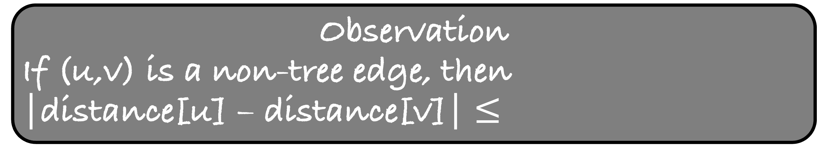
BFS Tree
Look at the non-tree edge (shown in yellow) in the BFS tree
Can the non-tree edge look like this?
0
0
No, as then vertex 4 should be at a distance 2 from 0
Or, it should be at level 2 in the BFS tree
2
1
1
1
5
2
This means that the non-tree edges can be of two types only
3
3
Observation
If (u,v) is a non-tree edge, then
|distance[u] – distance[v]| $≤$
4
4

Slide 53
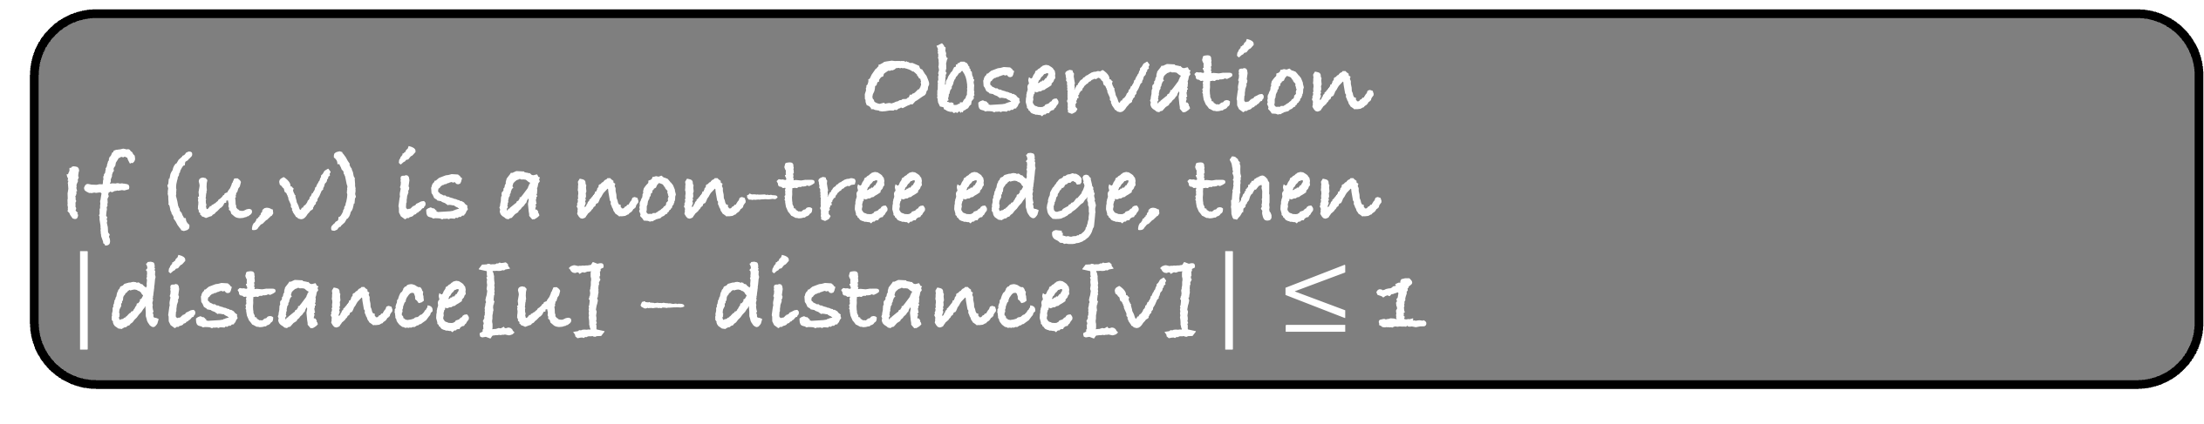
BFS Tree
Look at the non-tree edge (shown in yellow) in the BFS tree
Can the non-tree edge look like this?
0
0
No, as then vertex 4 should be at a distance 2 from 0
Or, it should be at level 2 in the BFS tree
2
1
1
1
5
2
This means that the non-tree edges can be of two types only
3
3
Observation
If (u,v) is a non-tree edge, then
|distance[u] – distance[v]| $≤$ 1
4
4

Slide 54

BFS Tree
Observation
If (u,v) is a non-tree edge, then
|distance[u] – distance[v]| $≤$ 1
0
0
2
1
This observation is true for the tree edge with a strict equality
But it is even true for a non-tree edge
It is one of the most important properties of the BFS tree which will help us in solving many problems
Let us look at one of them
1
1
5
2
3
3
4
4

Slide 55
A graph is bipartite if its vertex set can be partitioned into two disjoint sets A and B such that every edge has one endpoint in A and the other in B.
2
4
0
3
1
5

Slide 56
A graph is bipartite if its vertex set can be partitioned into two disjoint sets A and B such that every edge has one endpoint in A and the other in B.
Given a connected graph, check whether it is bipartite
2
4
0
3
1
5

Slide 57
2
4
0
3
1
5
Imagine that you do a BFS from 0 in a bipartite graph
How will the BFS tree look like?

Slide 58
2
4
0
0
3
1
5
The 0-th level of BFS tree will contain red vertex 0
What will the first level contain?

Slide 59
2
4
0
3
4
0
3
1
5
The first level will contain only green vertices
What will the second level contain?

Slide 60
2
4
0
3
4
0
3
1
1
5
The second level will contain only red vertices
I hope you see the pattern
All even levels will contain red vertices and all odd levels will contain green vertices

Slide 61
2
4
0
3
4
0
3
1
1
5
5
But these edges are fine as they are allowed in a bipartite graph
Let us look at other types of non-tree edges
Can there be a non-tree edge like this?
Yes

Slide 62
2
4
0
3
4
0
3
1
1
5
5
Can there be a non-tree edge like this?
No, because the graph is bipartite

Slide 63
2
4
0
3
4
0
3
1
1
5
5
Can there be a non-tree edge like this?
No, because of the property of BFS tree

Slide 64
2
4
0
3
4
0
3
1
1
5
5
Observation
If there is a non-tree edge such that both its endpoints are at the same level in the BFS tree, then the graph is

Slide 65
2
4
0
3
4
0
3
1
1
5
5
Observation
If there is a non-tree edge such that both its endpoints are at the same level in the BFS tree, then the graph is not bipartite
If no such edge exists, then the graph is bipartite
Try to write the code for this problem which checks this property

Slide 66
#include <stdio.h>
int main() {
int $n$, $m$, $i$, $u$, $v$;
scanf( “%d %d”, &$n$, &$m$);
int adj[$n$][$n$], degree[$n$], queue[$n$], distance[$n$];
int first = 0, last = 0;
for( $i$ =0 ; $i$ <$n$; $i$++){
degree[$i$] = 0;
distance[$i$] =-1;
}
for( $i$ =0 ; $i$ < $m$; $i$++){
scanf( “%d %d”, &$u$, &$v$);
adj[$u$][degree[$u$]] = $v$;
adj[$v$][degree[$v$]] = $u$;
degree[$u$]++;
degree[$v$]++;
}
distance[0] = 0;
queue[last] = 0;
last++;
while( first < last){
$u$ = queue[first];
first++;
for($i$ =0 ; $i$ < degree[$u$]; $i$++){
$v$ = adj[$u$][$i$];
if( distance[$v$] == -1){
distance[$v$] = distance[$u$]+1;
queue[last] = $v$;
last++;
}
}
}
return 0;
}

Slide 67
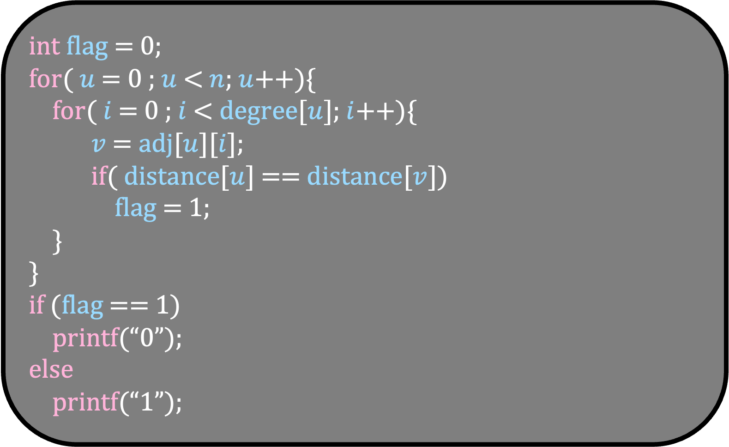
#include <stdio.h>
int main() {
int $n$, $m$, $i$, $u$, $v$;
scanf( “%d %d”, &$n$, &$m$);
int adj[$n$][$n$], degree[$n$], queue[$n$], distance[$n$];
int first = 0, last = 0;
for( $i$ =0 ; $i$ <$n$; $i$++){
degree[$i$] = 0;
distance[$i$] =-1;
}
for( $i$ =0 ; $i$ < $m$; $i$++){
scanf( “%d %d”, &$u$, &$v$);
adj[$u$][degree[$u$]] = $v$;
adj[$v$][degree[$v$]] = $u$;
degree[$u$]++;
degree[$v$]++;
}
distance[0] = 0;
queue[last] = 0;
last++;
while( first < last){
$u$ = queue[first];
first++;
for($i$ =0 ; $i$ < degree[$u$]; $i$++){
$v$ = adj[$u$][$i$];
if( distance[$v$] == -1){
distance[$v$] = distance[$u$]+1;
queue[last] = $v$;
last++;
}
}
}
return 0;
}
int flag = 0;
for( $u$ = 0 ; $u$ < $n$; $u$++){
for( $i$ = 0 ; $i$ < degree[$u$]; $i$++){
$v$ = adj[$u$][$i$];
if( distance[$u$] == distance[$v$])
flag = 1;
}
}
if (flag == 1)
printf(“0”);
else
printf(“1”);

Slide 68
Till now, we have implicitly assumed that the graph is connected
What if the graph is not connected?

Slide 69
Given a graph G, find the number of connected components in it
4
2
3
Ans = 1
0
5
1

Slide 70
Given a graph G, find the number of connected components in it
4
2
3
Ans = 2
0
5
1

Slide 71
Given a graph G, find the number of connected components in it
If you do BFS from any node in this graph, the BFS tree will not contain all the vertices of the graph
Repeatedly do BFS from an undiscovered node
Count the number of BFS trees
4
2
3
0
5
1

Slide 72
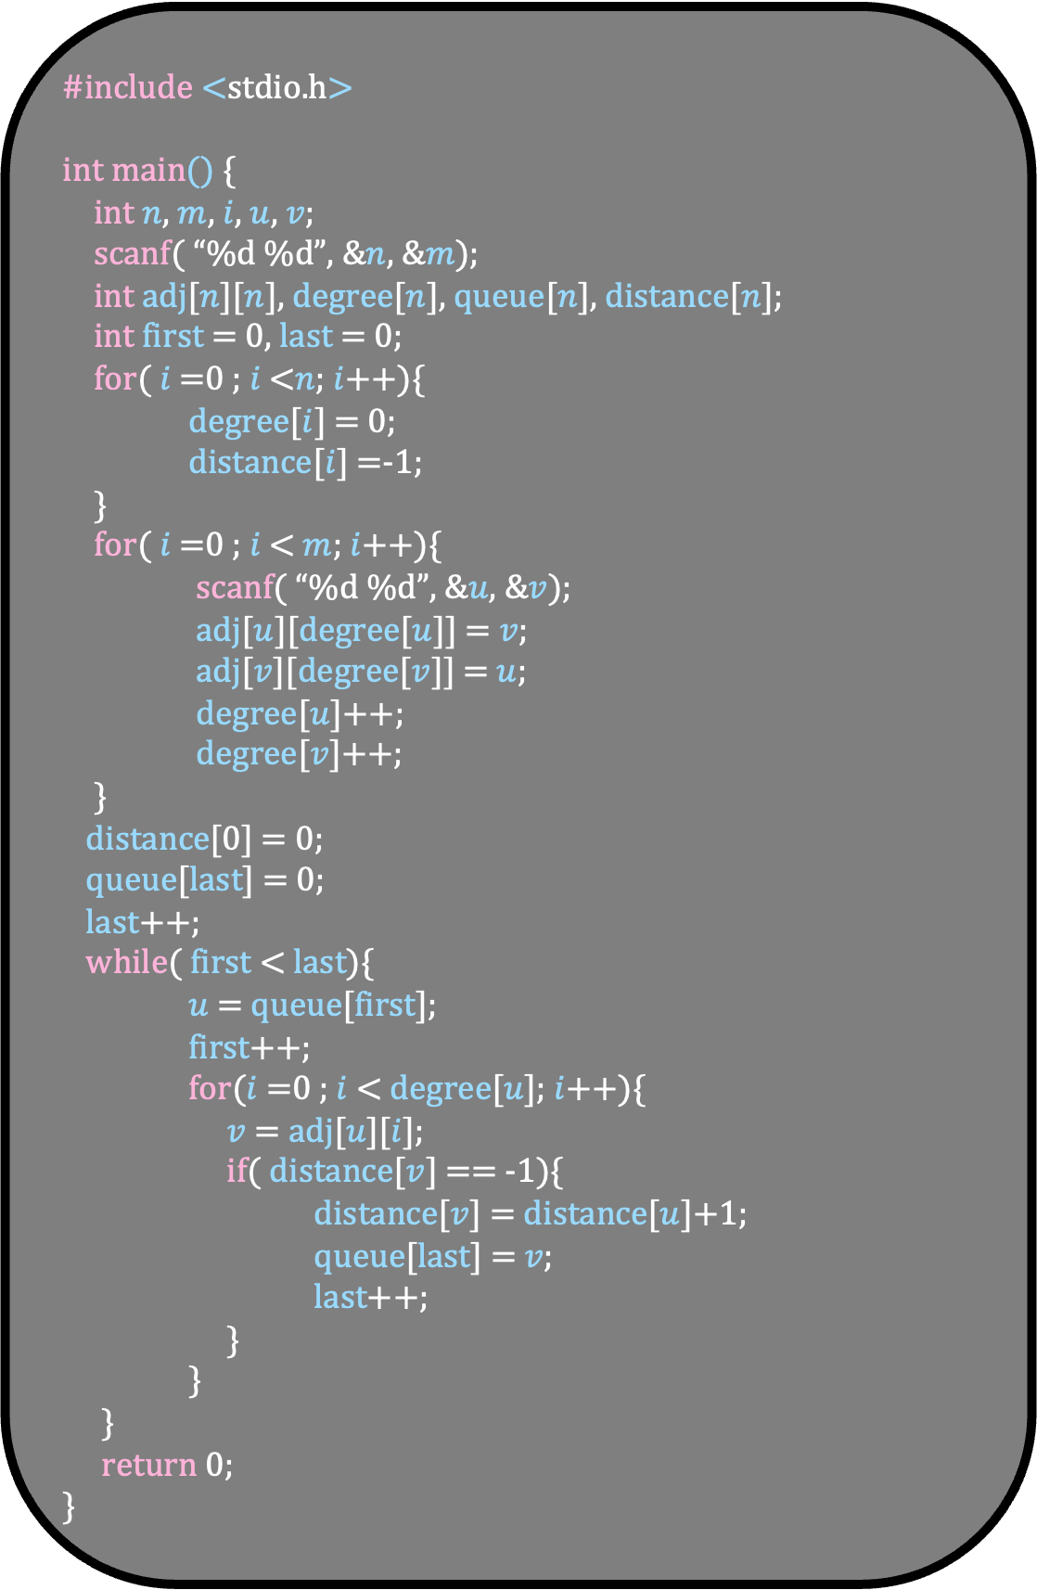
#include <stdio.h>
int main() {
int $n$, $m$, $i$, $u$, $v$;
scanf( “%d %d”, &$n$, &$m$);
int adj[$n$][$n$], degree[$n$], queue[$n$], distance[$n$];
int first = 0, last = 0;
for( $i$ =0 ; $i$ <$n$; $i$++){
degree[$i$] = 0;
distance[$i$] =-1;
}
for( $i$ =0 ; $i$ < $m$; $i$++){
scanf( “%d %d”, &$u$, &$v$);
adj[$u$][degree[$u$]] = $v$;
adj[$v$][degree[$v$]] = $u$;
degree[$u$]++;
degree[$v$]++;
}
distance[0] = 0;
queue[last] = 0;
last++;
while( first < last){
$u$ = queue[first];
first++;
for($i$ =0 ; $i$ < degree[$u$]; $i$++){
$v$ = adj[$u$][$i$];
if( distance[$v$] == -1){
distance[$v$] = distance[$u$]+1;
queue[last] = $v$;
last++;
}
}
}
return 0;
}

Slide 73
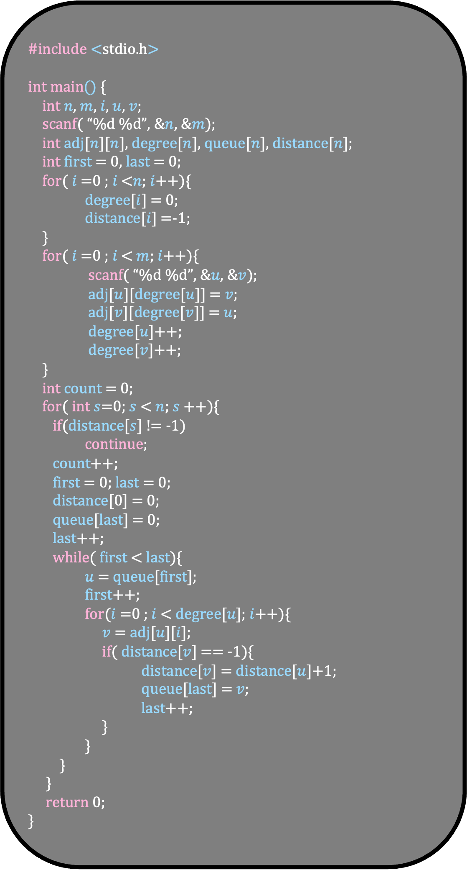
#include <stdio.h>
int main() {
int $n$, $m$, $i$, $u$, $v$;
scanf( “%d %d”, &$n$, &$m$);
int adj[$n$][$n$], degree[$n$], queue[$n$], distance[$n$];
int first = 0, last = 0;
for( $i$ =0 ; $i$ <$n$; $i$++){
degree[$i$] = 0;
distance[$i$] =-1;
}
for( $i$ =0 ; $i$ < $m$; $i$++){
scanf( “%d %d”, &$u$, &$v$);
adj[$u$][degree[$u$]] = $v$;
adj[$v$][degree[$v$]] = $u$;
degree[$u$]++;
degree[$v$]++;
}
int count = 0;
for( int $s$=0; $s$ < $n$; $s$++){
if(distance[$s$] != -1)
continue;
count++;
first = 0; last = 0;
distance[0] = 0;
queue[last] = 0;
last++;
while( first < last){
$u$ = queue[first];
first++;
for($i$ =0 ; $i$ < degree[$u$]; $i$++){
$v$ = adj[$u$][$i$];
if( distance[$v$] == -1){
distance[$v$] = distance[$u$]+1;
queue[last] = $v$;
last++;
}
}
}
}
return 0;
}

Slide 74

#include <stdio.h>
int main() {
int $n$, $m$, $i$, $u$, $v$;
scanf( “%d %d”, &$n$, &$m$);
int adj[$n$][$n$], degree[$n$], queue[$n$], distance[$n$];
int first = 0, last = 0;
for( $i$ =0 ; $i$ <$n$; $i$++){
degree[$i$] = 0;
distance[$i$] =-1;
}
for( $i$ =0 ; $i$ < $m$; $i$++){
scanf( “%d %d”, &$u$, &$v$);
adj[$u$][degree[$u$]] = $v$;
adj[$v$][degree[$v$]] = $u$;
degree[$u$]++;
degree[$v$]++;
}
int count = 0;
for( int $s$=0; $s$ < $n$; $s$++){
if(distance[$s$] != -1)
continue;
count++;
first = 0; last = 0;
distance[$s$] = 0;
queue[last] = $s$;
last++;
while( first < last){
$u$ = queue[first];
first++;
for($i$ =0 ; $i$ < degree[$u$]; $i$++){
$v$ = adj[$u$][$i$];
if( distance[$v$] == -1){
distance[$v$] = distance[$u$]+1;
queue[last] = $v$;
last++;
}
}
}
}
return 0;
}

Slide 75


You are given an empty n $×$ n chess board with a starting position and destination of a knight. Find the minimum number of moves to reach the destination

Slide 76
You are given an empty n $×$ n chess board with a starting position and destination of a knight. Find the minimum number of moves to reach the destination

Slide 77
You are given an empty n $×$ n chess board with a starting position and destination of a knight. Find the minimum number of moves to reach the destination

Slide 78
You are given an empty n $×$ n chess board with a starting position and destination of a knight. Find the minimum number of moves to reach the destination

Slide 79
You are given an empty n $×$ n chess board with a starting position and destination of a knight. Find the minimum number of moves to reach the destination

Slide 80
You are given an empty n $×$ n chess board with a starting position and destination of a knight. Find the minimum number of moves to reach the destination

Slide 81
You are given an empty n $×$ n chess board with a starting position and destination of a knight. Find the minimum number of moves to reach the destination
Even here we are finding the shortest path
But the graph is implicit

Slide 82
What are the vertices in the graph?
For each cell (i,j), make a node (i,j)
What are the edges?

Slide 83
What are the vertices in the graph?
For each cell (i,j), make a node (i,j)
What are the edges?
What are the neighbors of cell (i,j) in the graph?
(i,j)

Slide 84
What are the vertices in the graph?
For each cell (i,j), make a node (i,j)
What are the edges?
What are the neighbors of cell (i,j) in the graph?
(i,j)

Slide 85
What are the vertices in the graph?
For each cell (i,j), make a node (i,j)
What are the edges?
(i,j)
What are the neighbors of cell (i,j) in the graph?

Slide 86
What are the vertices in the graph?
For each cell (i,j), make a node (i,j)
What are the edges?
(i,j)
What are the neighbors of cell (i,j) in the graph?

Slide 87
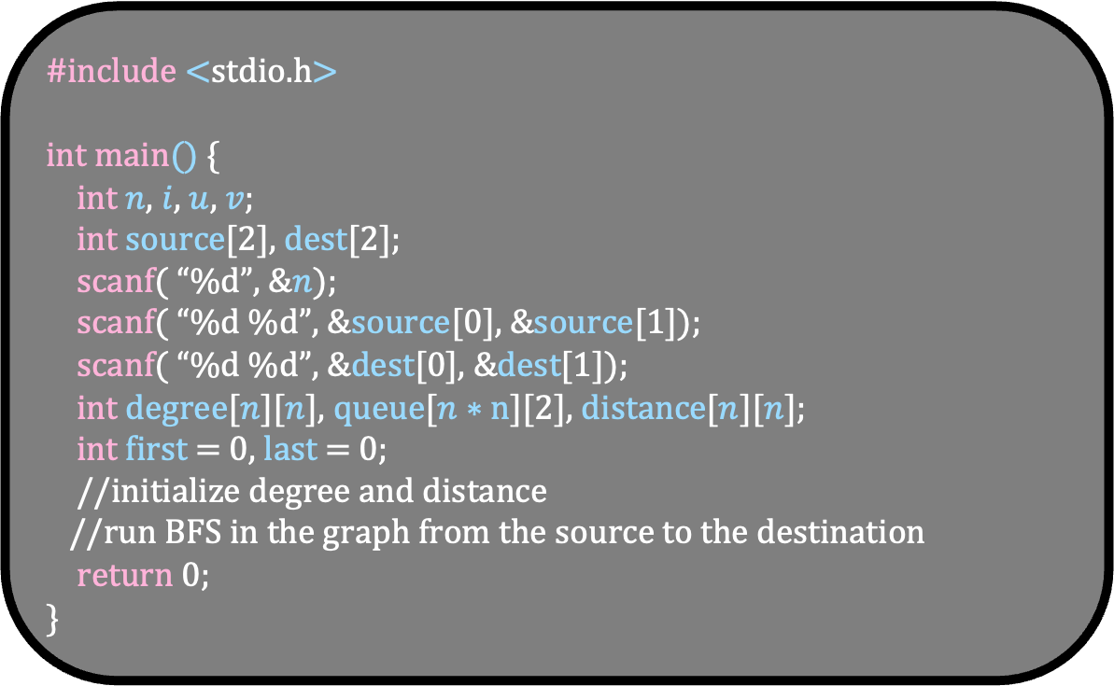
#include <stdio.h>
int main() {
int $n$, $i$, $u$, $v$;
int source[2], dest[2];
scanf( “%d”, &$n$);
scanf( “%d %d”, &source[0], &source[1]);
scanf( “%d %d”, &dest[0], &dest[1]);
int degree[$n$][$n$], queue[$n∗n$][2], distance[$n$][$n$];
int first = 0, last = 0;
//initialize degree and distance
//run BFS in the graph from the source to the destination
return 0;
}

Slide 88
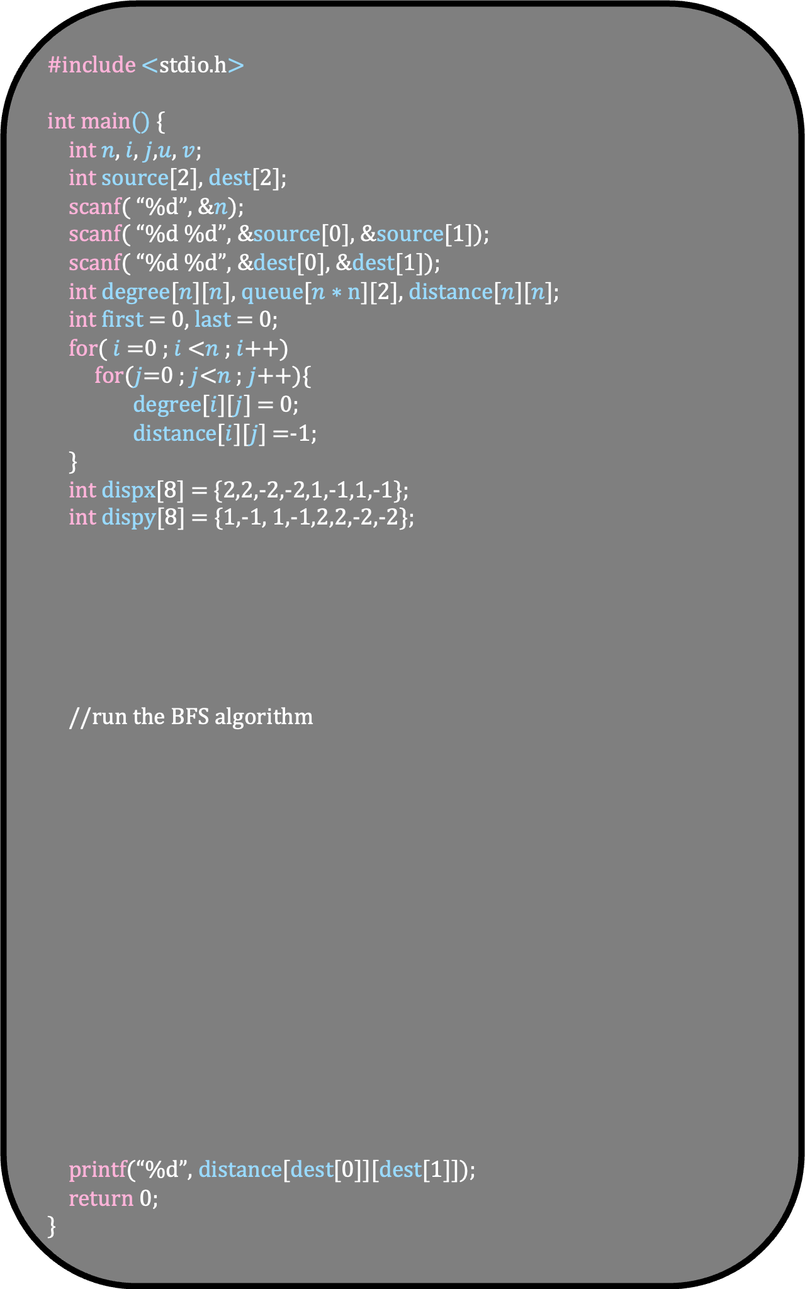
#include <stdio.h>
int main() {
int $n$, $i$, $j$,$u$, $v$;
int source[2], dest[2];
scanf( “%d”, &$n$);
scanf( “%d %d”, &source[0], &source[1]);
scanf( “%d %d”, &dest[0], &dest[1]);
int degree[$n$][$n$], queue[$n∗n$][2], distance[$n$][$n$];
int first = 0, last = 0;
for( $i$ =0 ; $i$ <$n$ ; $i$++)
for($j$=0 ; $j$<$n$ ; $j$++){
degree[$i$][$j$] = 0;
distance[$i$][$j$] =-1;
}
int dispx[8] = {2,2,-2,-2,1,-1,1,-1};
int dispy[8] = {1,-1, 1,-1,2,2,-2,-2};
//run the BFS algorithm
printf(“%d”, distance[dest[0]][dest[1]]);
return 0;
}

Slide 89
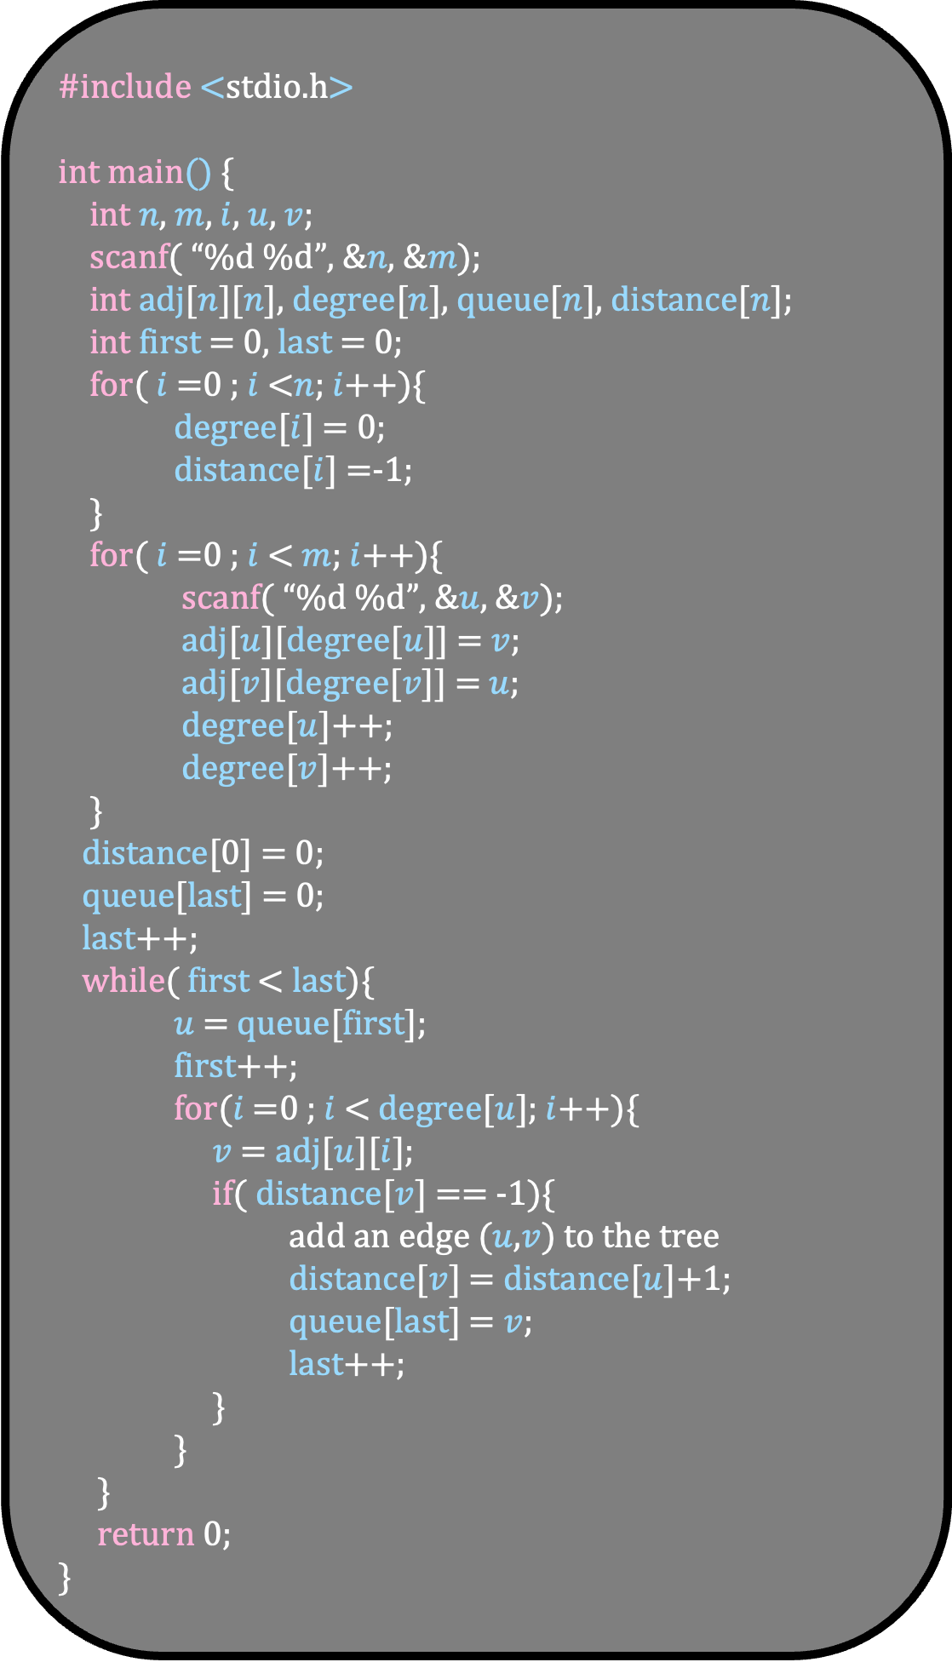
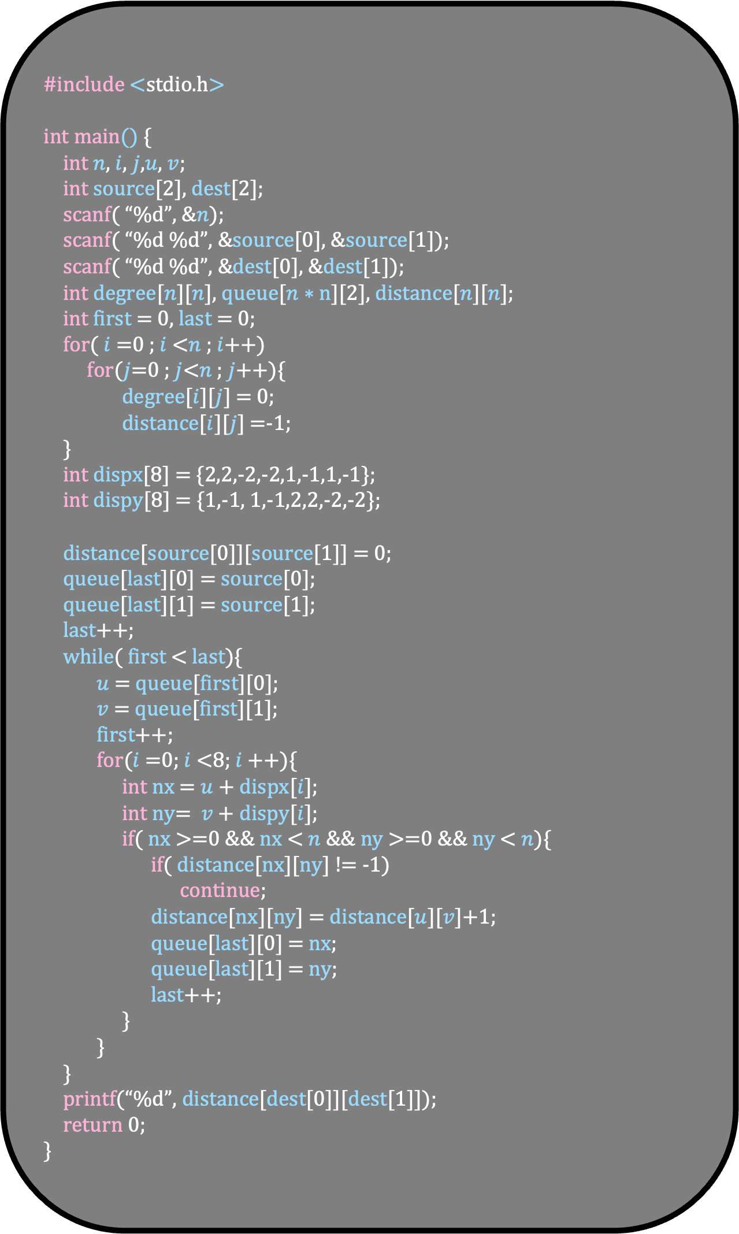
#include <stdio.h>
int main() {
int $n$, $i$, $j$,$u$, $v$;
int source[2], dest[2];
scanf( “%d”, &$n$);
scanf( “%d %d”, &source[0], &source[1]);
scanf( “%d %d”, &dest[0], &dest[1]);
int degree[$n$][$n$], queue[$n∗n$][2], distance[$n$][$n$];
int first = 0, last = 0;
for( $i$ =0 ; $i$ <$n$ ; $i$++)
for($j$=0 ; $j$<$n$ ; $j$++){
degree[$i$][$j$] = 0;
distance[$i$][$j$] =-1;
}
int dispx[8] = {2,2,-2,-2,1,-1,1,-1};
int dispy[8] = {1,-1, 1,-1,2,2,-2,-2};
distance[source[0]][source[1]] = 0;
queue[last][0] = source[0];
queue[last][1] = source[1];
last++;
while( first < last){
$u$= queue[first][0];
$v$ = queue[first][1];
first++;
for($i$=0; $i$<8; $i$++){
int nx = $u$ + dispx[$i$];
int ny= $v$ + dispy[$i$];
if( nx >=0 && nx < $n$ && ny >=0 && ny < $n$){
if( distance[nx][ny] != -1)
continue;
distance[nx][ny] = distance[$u$][$v$]+1;
queue[last][0] = nx;
queue[last][1] = ny;
last++;
}
}
}
printf(“%d”, distance[dest[0]][dest[1]]);
return 0;
}
#include <stdio.h>
int main() {
int $n$, $m$, $i$, $u$, $v$;
scanf( “%d %d”, &$n$, &$m$);
int adj[$n$][$n$], degree[$n$], queue[$n$], distance[$n$];
int first = 0, last = 0;
for( $i$ =0 ; $i$ <$n$; $i$++){
degree[$i$] = 0;
distance[$i$] =-1;
}
for( $i$ =0 ; $i$ < $m$; $i$++){
scanf( “%d %d”, &$u$, &$v$);
adj[$u$][degree[$u$]] = $v$;
adj[$v$][degree[$v$]] = $u$;
degree[$u$]++;
degree[$v$]++;
}
distance[0] = 0;
queue[last] = 0;
last++;
while( first < last){
$u$ = queue[first];
first++;
for($i$ =0 ; $i$ < degree[$u$]; $i$++){
$v$ = adj[$u$][$i$];
if( distance[$v$] == -1){
add an edge ($u$,$v$) to the tree
distance[$v$] = distance[$u$]+1;
queue[last] = $v$;
last++;
}
}
}
return 0;
}

Slide 90
A directed graph is strongly connected, if there is a directed path between any pair of vertices in the graph. Given a directed graph G, check if it is strongly connected
4
2
3
No
0
5
1

Slide 91
A directed graph is strongly connected, if there is a directed path between any pair of vertices in the graph. Given a directed graph G, check if it is strongly connected
4
2
3
Yes
0
5
1
How to solve this problem?

Slide 92
A directed graph is strongly connected, if there is a directed path between any pair of vertices in the graph. Given a directed graph G, check if it is strongly connected
Algorithm in plain English
For each vertex s in G
Do a BFS from s
if BFS tree of s does not contain all the vertices of the graph
Answer is No
Answer is Yes
What is the running time of the algorithm?
O(n(m+n))

Slide 93
A directed graph is strongly connected, if there is a directed path between any pair of vertices in the graph. Given a directed graph G, check if it is strongly connected
Algorithm in plain English
For each vertex s in G
Do a BFS from s
if BFS tree of s does not contain all the vertices of the graph
Answer is No
Answer is Yes
What is the running time of the algorithm?
O(n(m+n)) = O(mn+$n^{2}$)

Slide 94
A directed graph is strongly connected, if there is a directed path between any pair of vertices in the graph. Given a directed graph G, check if it is strongly connected
Algorithm in plain English
For each vertex s in G
Do a BFS from s
if BFS tree of s does not contain all the vertices of the graph
Answer is No
Answer is Yes
We are doing BFS n times
Can you solve this problem using two BFS traversals?

Slide 95
A directed graph is strongly connected, if there is a directed path between any pair of vertices in the graph. Given a directed graph G, check if it is strongly connected
Algorithm in plain English
Pick a vertex s
Do a BFS from s in the graph
Do a BFS from s in the reverse graph
If both BFS trees contain all the vertices
Answer is Yes
Else
Answer is No

Slide 96
Algorithm in plain English
Pick a vertex s
Do a BFS from s in the graph
Do a BFS from s in the reverse graph
If both BFS trees contain all the vertices
Answer is Yes
Else
Answer is No
If the answer is No, then either s cannot reach a vertex or a vertex cannot reach s
So clearly, the graph is not strongly connected

Slide 97
Algorithm in plain English
Pick a vertex s
Do a BFS from s in the graph
Do a BFS from s in the reverse graph
If both BFS trees contain all the vertices
Answer is Yes
Else
Answer is No
If the answer is Yes
Pick a pair (u,v)
Can you show that there is a path from u to v in G?
u
v

Slide 98
Algorithm in plain English
Pick a vertex s
Do a BFS from s in the graph
Do a BFS from s in the reverse graph
If both BFS trees contain all the vertices
Answer is Yes
Else
Answer is No
If the answer is Yes
Pick a pair (u,v)
Can you show that there is a path from u to v in G?
u
s
v
In the reverse graph there is a path from s to u

Slide 99
Algorithm in plain English
Pick a vertex s
Do a BFS from s in the graph
Do a BFS from s in the reverse graph
If both BFS trees contain all the vertices
Answer is Yes
Else
Answer is No
If the answer is Yes
Pick a pair (u,v)
Can you show that there is a path from u to v in G?
u
s
v
In the reverse graph there is a path from s to u
In the original graph there is a path from s to v

Slide 100
Algorithm in plain English
Pick a vertex s
Do a BFS from s in the graph
Do a BFS from s in the reverse graph
If both BFS trees contain all the vertices
Answer is Yes
Else
Answer is No
Try to code this algorithm

Slide 101
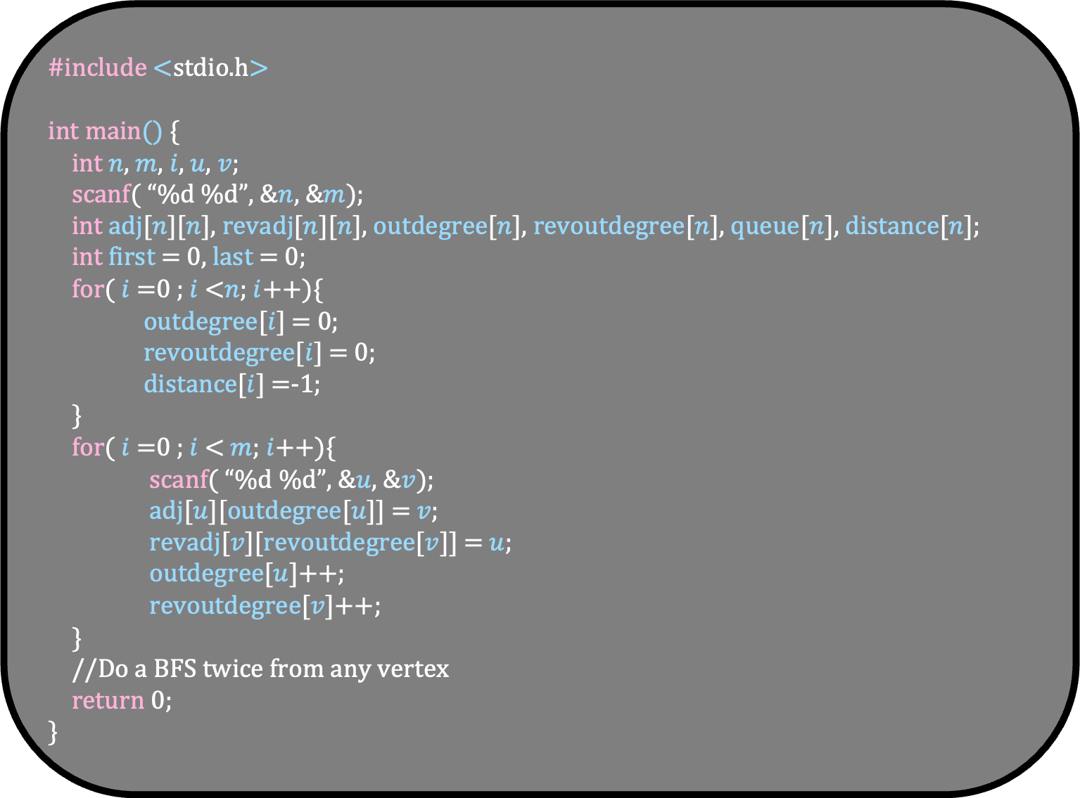
#include <stdio.h>
int main() {
int $n$, $m$, $i$, $u$, $v$;
scanf( “%d %d”, &$n$, &$m$);
int adj[$n$][$n$], revadj[$n$][$n$], outdegree[$n$], revoutdegree[$n$], queue[$n$], distance[$n$];
int first = 0, last = 0;
for( $i$ =0 ; $i$ <$n$; $i$++){
outdegree[$i$] = 0;
revoutdegree[$i$] = 0;
distance[$i$] =-1;
}
for( $i$ =0 ; $i$ < $m$; $i$++){
scanf( “%d %d”, &$u$, &$v$);
adj[$u$][outdegree[$u$]] = $v$;
revadj[$v$][revoutdegree[$v$]] = $u$;
outdegree[$u$]++;
revoutdegree[$v$]++;
}
//Do a BFS twice from any vertex
return 0;
}

Slide 102
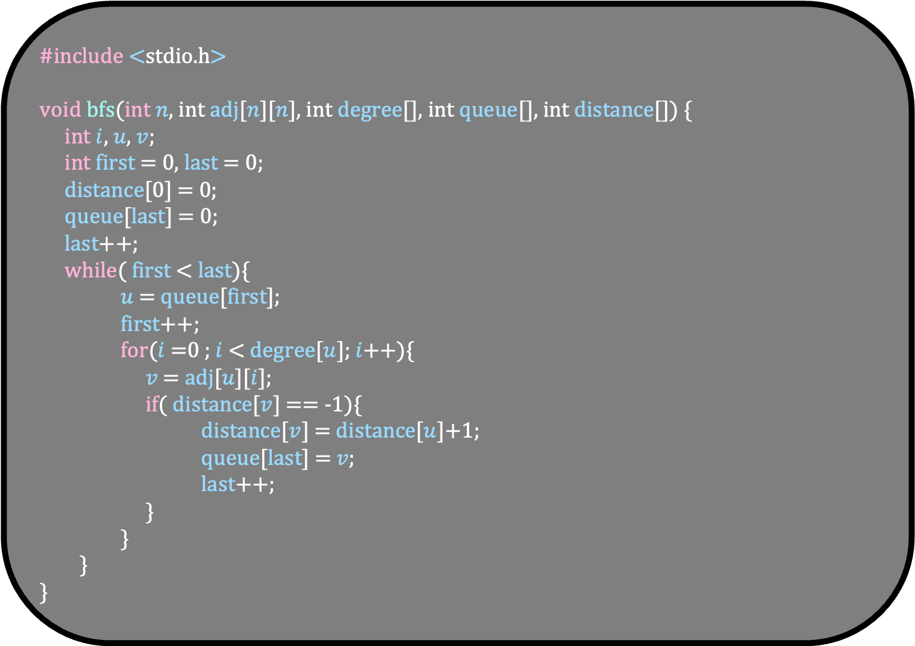
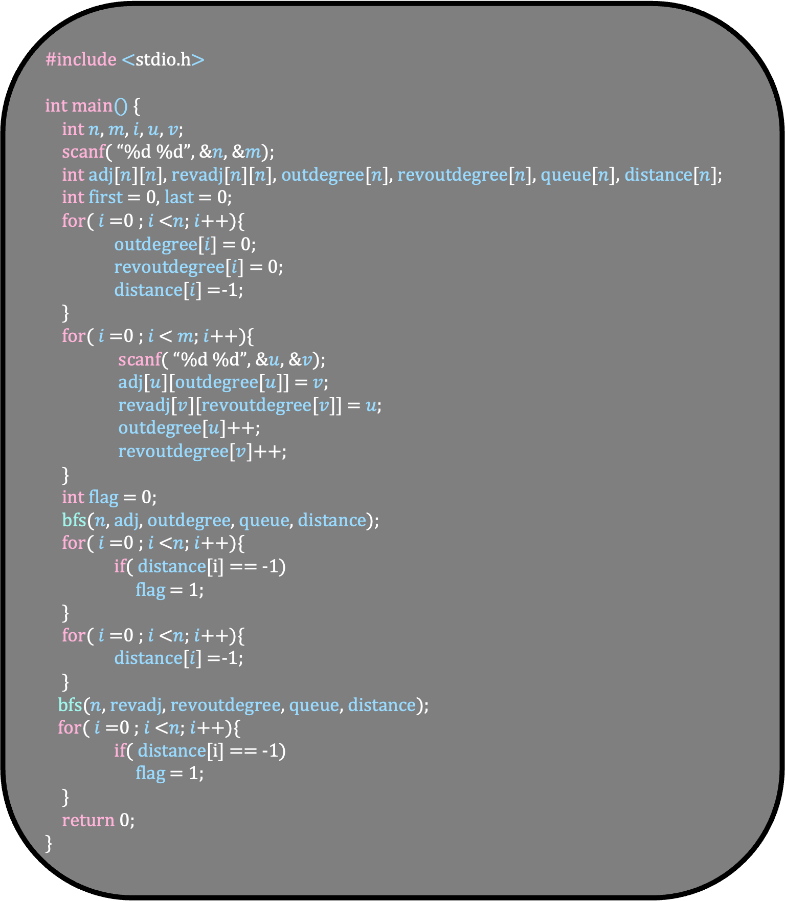
#include <stdio.h>
int main() {
int $n$, $m$, $i$, $u$, $v$;
scanf( “%d %d”, &$n$, &$m$);
int adj[$n$][$n$], revadj[$n$][$n$], outdegree[$n$], revoutdegree[$n$], queue[$n$], distance[$n$];
int first = 0, last = 0;
for( $i$ =0 ; $i$ <$n$; $i$++){
outdegree[$i$] = 0;
revoutdegree[$i$] = 0;
distance[$i$] =-1;
}
for( $i$ =0 ; $i$ < $m$; $i$++){
scanf( “%d %d”, &$u$, &$v$);
adj[$u$][outdegree[$u$]] = $v$;
revadj[$v$][revoutdegree[$v$]] = $u$;
outdegree[$u$]++;
revoutdegree[$v$]++;
}
int flag = 0;
bfs($n$, adj, outdegree, queue, distance);
for( $i$ =0 ; $i$ <$n$; $i$++){
if( distance[i] == -1)
flag = 1;
}
for( $i$ =0 ; $i$ <$n$; $i$++){
distance[$i$] =-1;
}
bfs($n$, revadj, revoutdegree, queue, distance);
for( $i$ =0 ; $i$ <$n$; $i$++){
if( distance[i] == -1)
flag = 1;
}
return 0;
}
#include <stdio.h>
void bfs(int $n$, int adj[$n$][$n$], int degree[], int queue[], int distance[]) {
int $i$, $u$, $v$;
int first = 0, last = 0;
distance[0] = 0;
queue[last] = 0;
last++;
while( first < last){
$u$ = queue[first];
first++;
for($i$ =0 ; $i$ < degree[$u$]; $i$++){
$v$ = adj[$u$][$i$];
if( distance[$v$] == -1){
distance[$v$] = distance[$u$]+1;
queue[last] = $v$;
last++;
}
}
}
}

