Slide 1
Graph Traversals: DFS

Slide 2
BFS is breadth first search

Slide 3
1

Slide 4
1
2
2

Slide 5
1
2
3
2
3

Slide 6
1
2
3
4
2
3
4
4

Slide 7
1
2
3
4
5
2
3
4
5
4
5

Slide 8
There is another way to traverse the graph
Imagine how a mouse will traverse the graph

Slide 9


Slide 10
V
V
V
V

Slide 11
V
V
V
V
V

Slide 12
V
V
V
V
V
V

Slide 13
V
V
V
V
V
V

Slide 14
V
V
V
V
V
V
V
V

Slide 15
V
V
V
V
V
V
V
V
V
V

Slide 16
V
V
V
V
V
V
V
V
V
V
V

Slide 17
V
V
V
V
V
V
V
V
V
V
V
V

Slide 18
V
V
V
V
V
V
V
V
V
V
V
V
V

Slide 19
V
V
V
V
V
V
V
V
V
V
V
V
V

Slide 20
V
V
V
V
V
V
V
V
V
V
V
V
V

Slide 21
V
V
V
V
V
V
V
V
V
V
V
V
V

Slide 22
V
V
V
V
V
V
V
V
V
V
V
V
V

Slide 23
V
V
V
V
V
V
V
V
V
V
V
V
V
V
V
V
This is the Depth First Search Algorithm or DFS algorithm
We search as far as we can along a path, hence the name Depth First Search

Slide 24
V
V
V
V
V
V
V
V
V
V
V
V
V
V
V
V
DFS does not guarantee a shortest path
However, we can check if the destination is reachable from the source

Slide 25
DFS Algorithm in Plain English
DFS(u)
Mark u as visited
For each unvisited neighbor v of u:
  DFS(v)

Slide 26
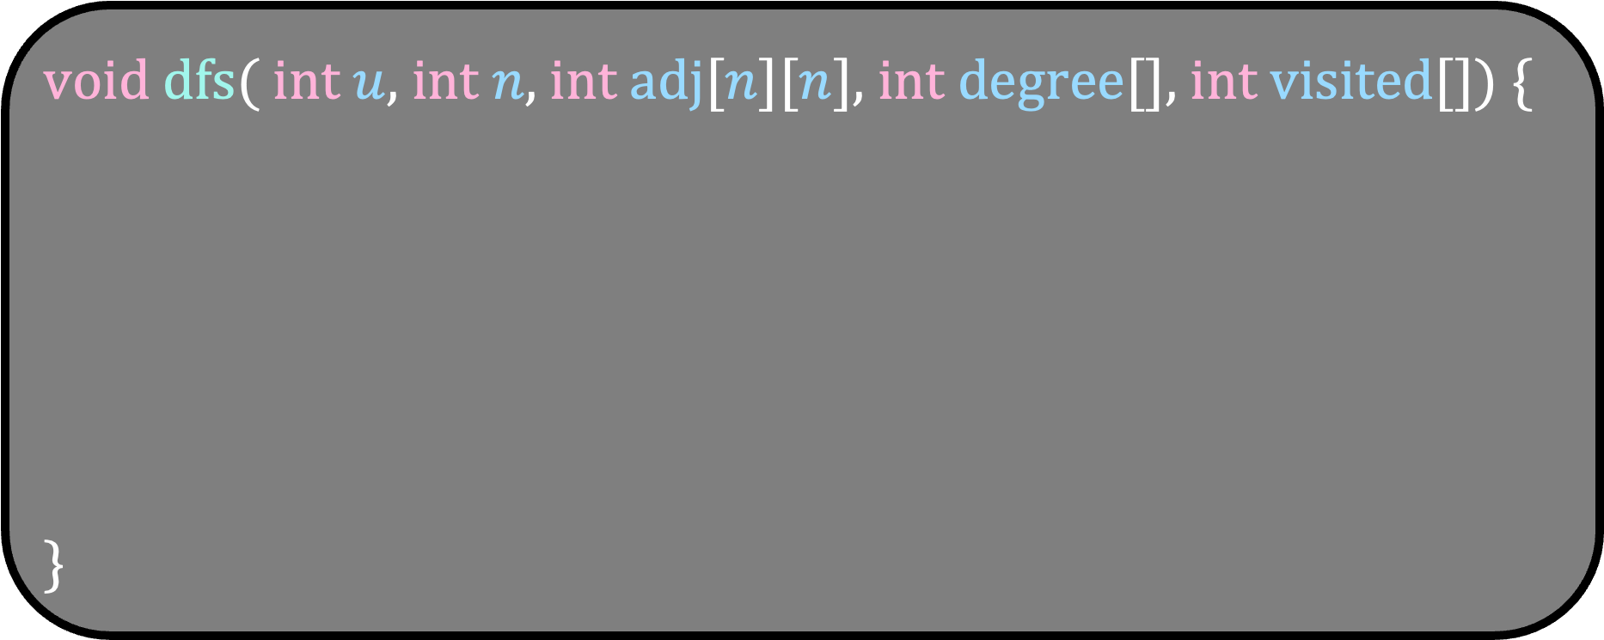
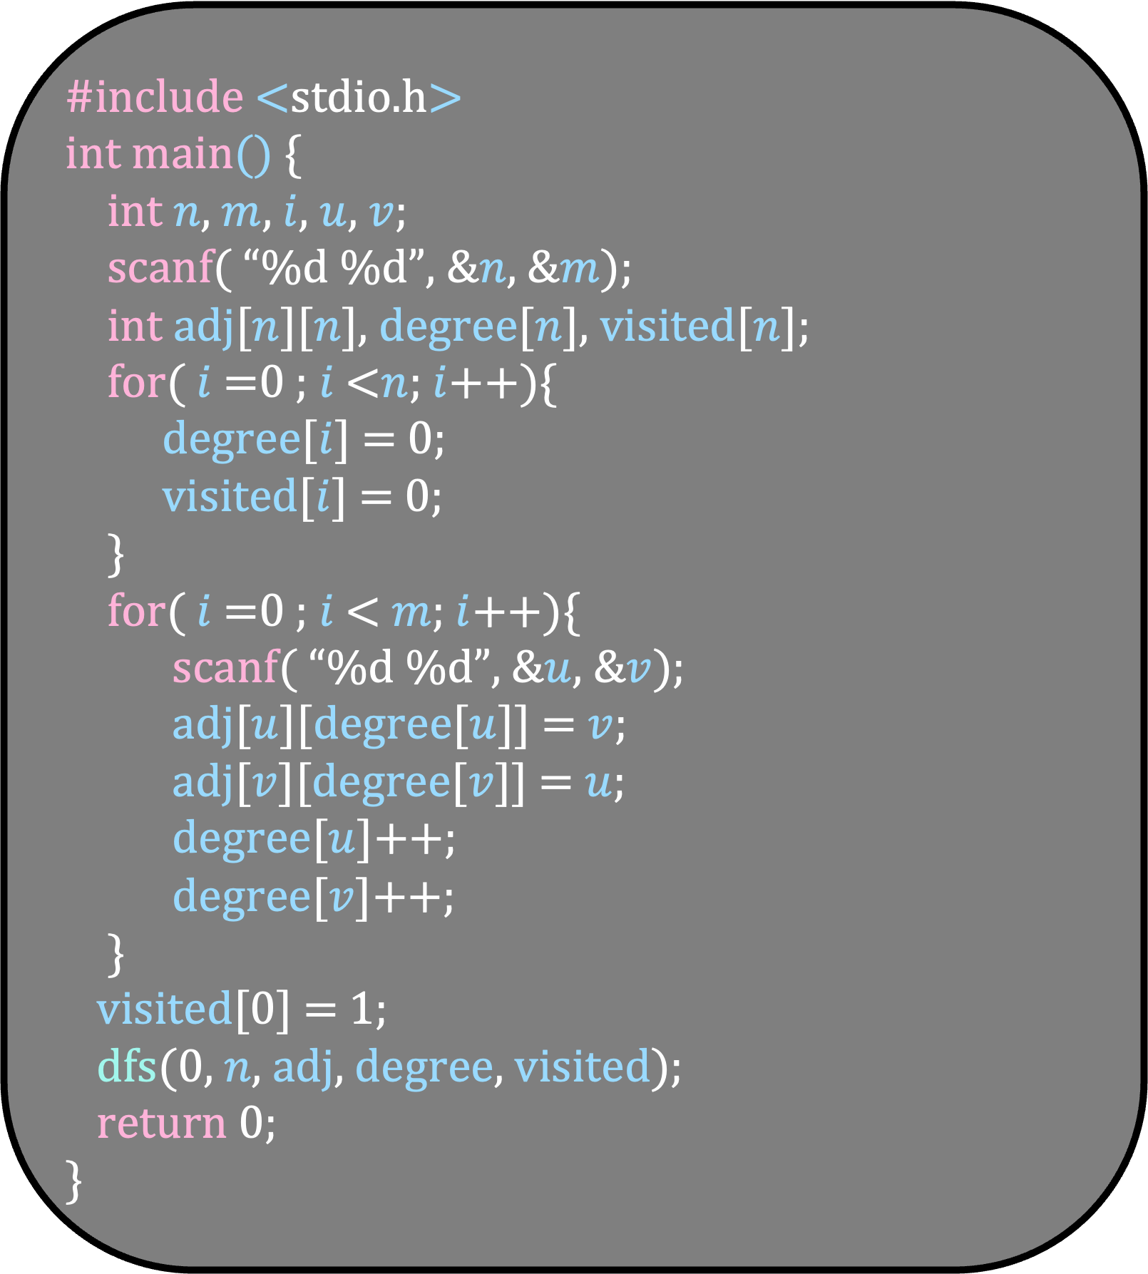
#include <stdio.h>
int main() {
int $n$, $m$, $i$, $u$, $v$;
scanf( “%d %d”, &$n$, &$m$);
int adj[$n$][$n$], degree[$n$], visited[$n$];
for( $i$ =0 ; $i$ <$n$; $i$++){
degree[$i$] = 0;
visited[$i$] = 0;
}
for( $i$ =0 ; $i$ < $m$; $i$++){
scanf( “%d %d”, &$u$, &$v$);
adj[$u$][degree[$u$]] = $v$;
adj[$v$][degree[$v$]] = $u$;
degree[$u$]++;
degree[$v$]++;
}
visited[0] = 1;
dfs(0, $n$, adj, degree, visited);
return 0;
}
void dfs( int $u$, int $n$, int adj[$n$][$n$], int degree[], int visited[]) {
}

Slide 27
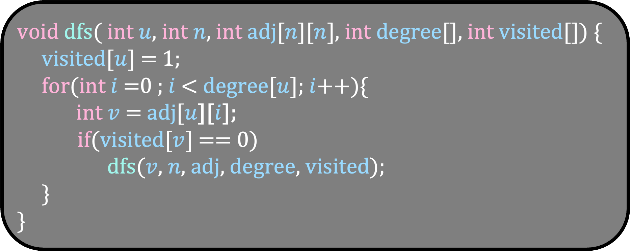
#include <stdio.h>
int main() {
int $n$, $m$, $i$, $u$, $v$;
scanf( “%d %d”, &$n$, &$m$);
int adj[$n$][$n$], degree[$n$], visited[$n$];
for( $i$ =0 ; $i$ <$n$; $i$++){
degree[$i$] = 0;
visited[$i$] = 0;
}
for( $i$ =0 ; $i$ < $m$; $i$++){
scanf( “%d %d”, &$u$, &$v$);
adj[$u$][degree[$u$]] = $v$;
adj[$v$][degree[$v$]] = $u$;
degree[$u$]++;
degree[$v$]++;
}
visited[0] = 1;
dfs(0, $n$, adj, degree, visited);
return 0;
}
void dfs( int $u$, int $n$, int adj[$n$][$n$], int degree[], int visited[]) {
visited[$u$] = 1;
for(int $i$ =0 ; $i$ < degree[$u$]; $i$++){
int $v$ = adj[$u$][$i$];
if(visited[$v$] == 0)
dfs($v$, $n$, adj, degree, visited);
}
}

Slide 28
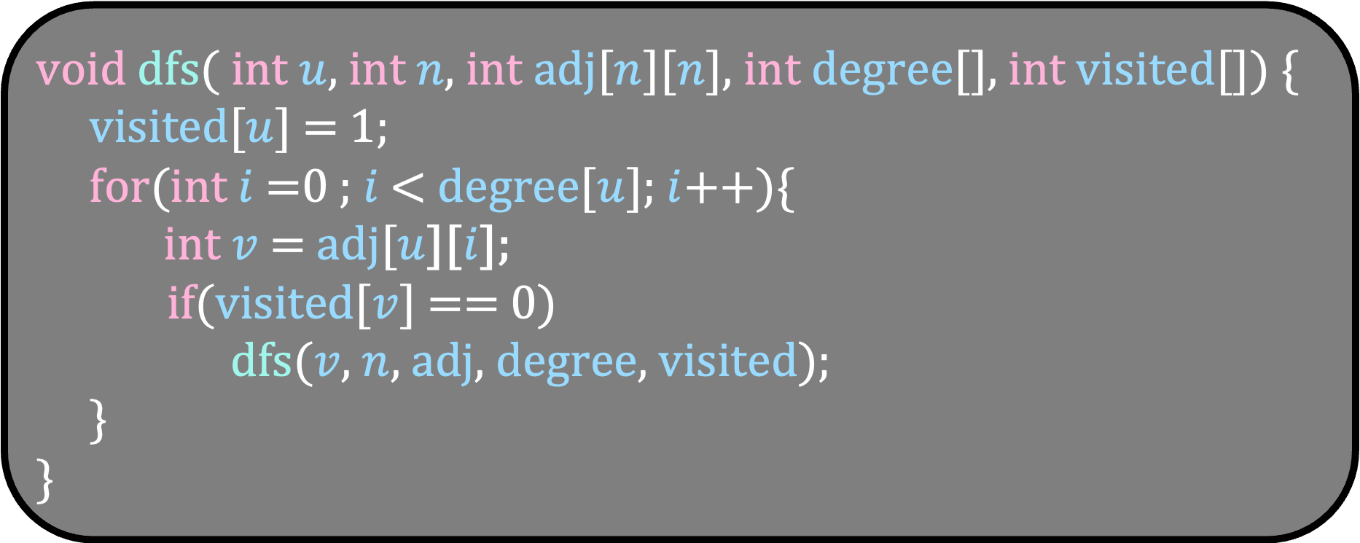
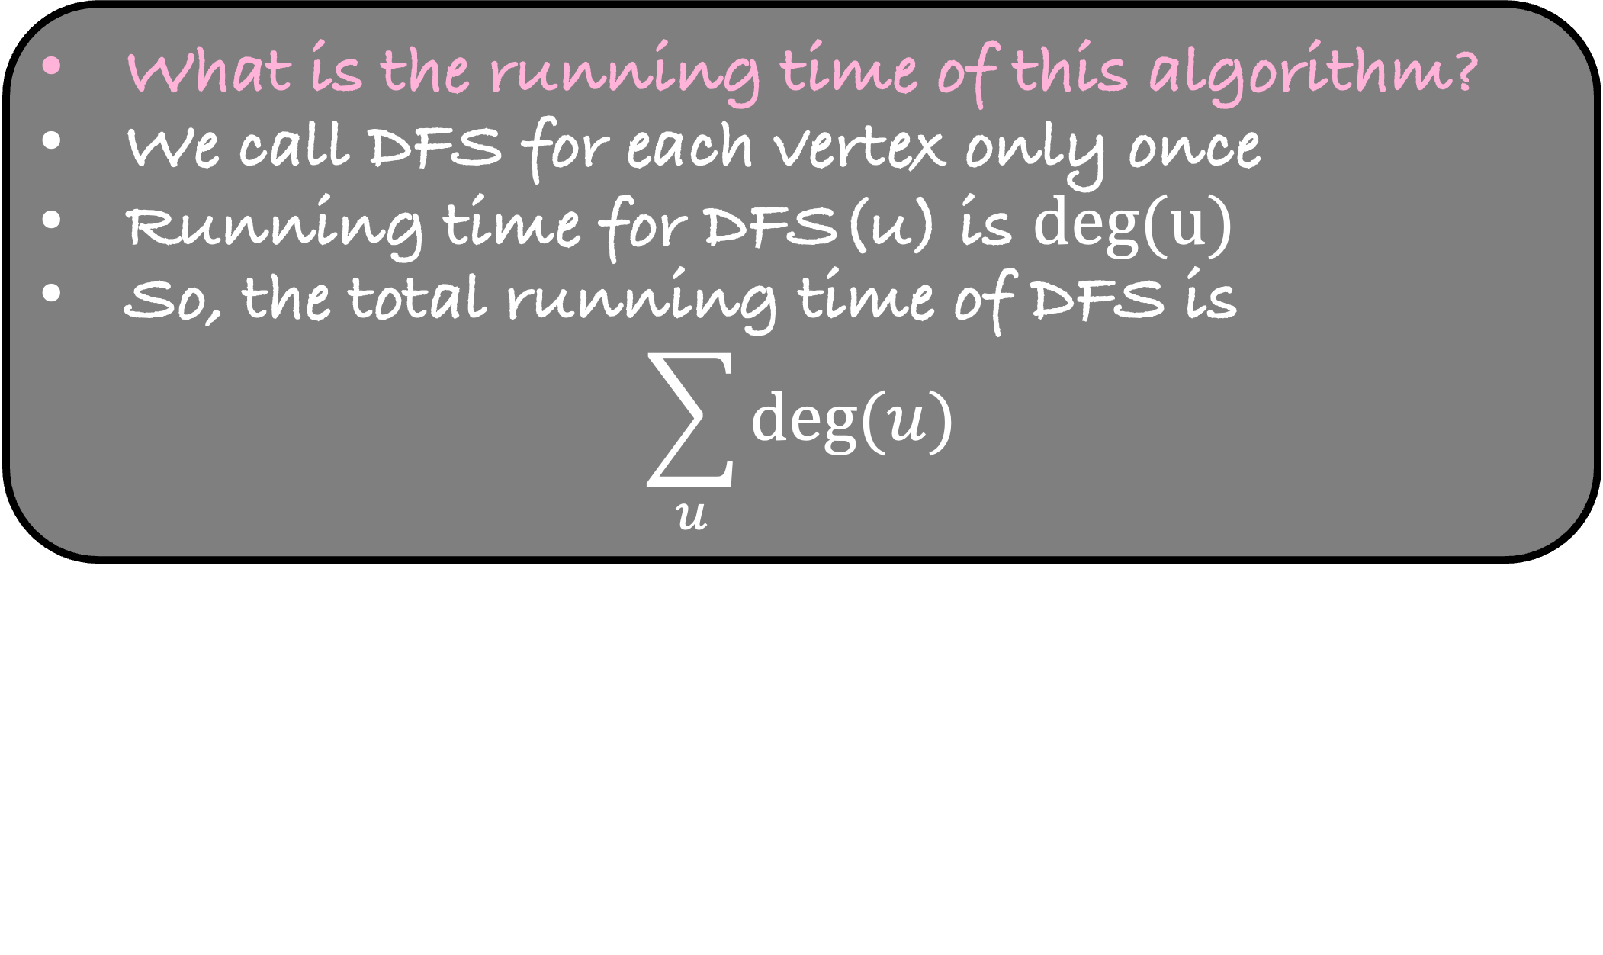
#include <stdio.h>
int main() {
int $n$, $m$, $i$, $u$, $v$;
scanf( “%d %d”, &$n$, &$m$);
int adj[$n$][$n$], degree[$n$], visited[$n$];
for( $i$ =0 ; $i$ <$n$; $i$++){
degree[$i$] = 0;
visited[$i$] = 0;
}
for( $i$ =0 ; $i$ < $m$; $i$++){
scanf( “%d %d”, &$u$, &$v$);
adj[$u$][degree[$u$]] = $v$;
adj[$v$][degree[$v$]] = $u$;
degree[$u$]++;
degree[$v$]++;
}
visited[0] = 1;
dfs(0, $n$, adj, degree, visited);
return 0;
}
void dfs( int $u$, int $n$, int adj[$n$][$n$], int degree[], int visited[]) {
visited[$u$] = 1;
for(int $i$ =0 ; $i$ < degree[$u$]; $i$++){
int $v$ = adj[$u$][$i$];
if(visited[$v$] == 0)
dfs($v$, $n$, adj, degree, visited);
}
}
What is the running time of this algorithm?
We call DFS for each vertex only once
Running time for DFS(u) is $deg(u)$
So, the total running time of DFS is
$$\sum_{u}{deg⁡(u)}$$

Slide 29
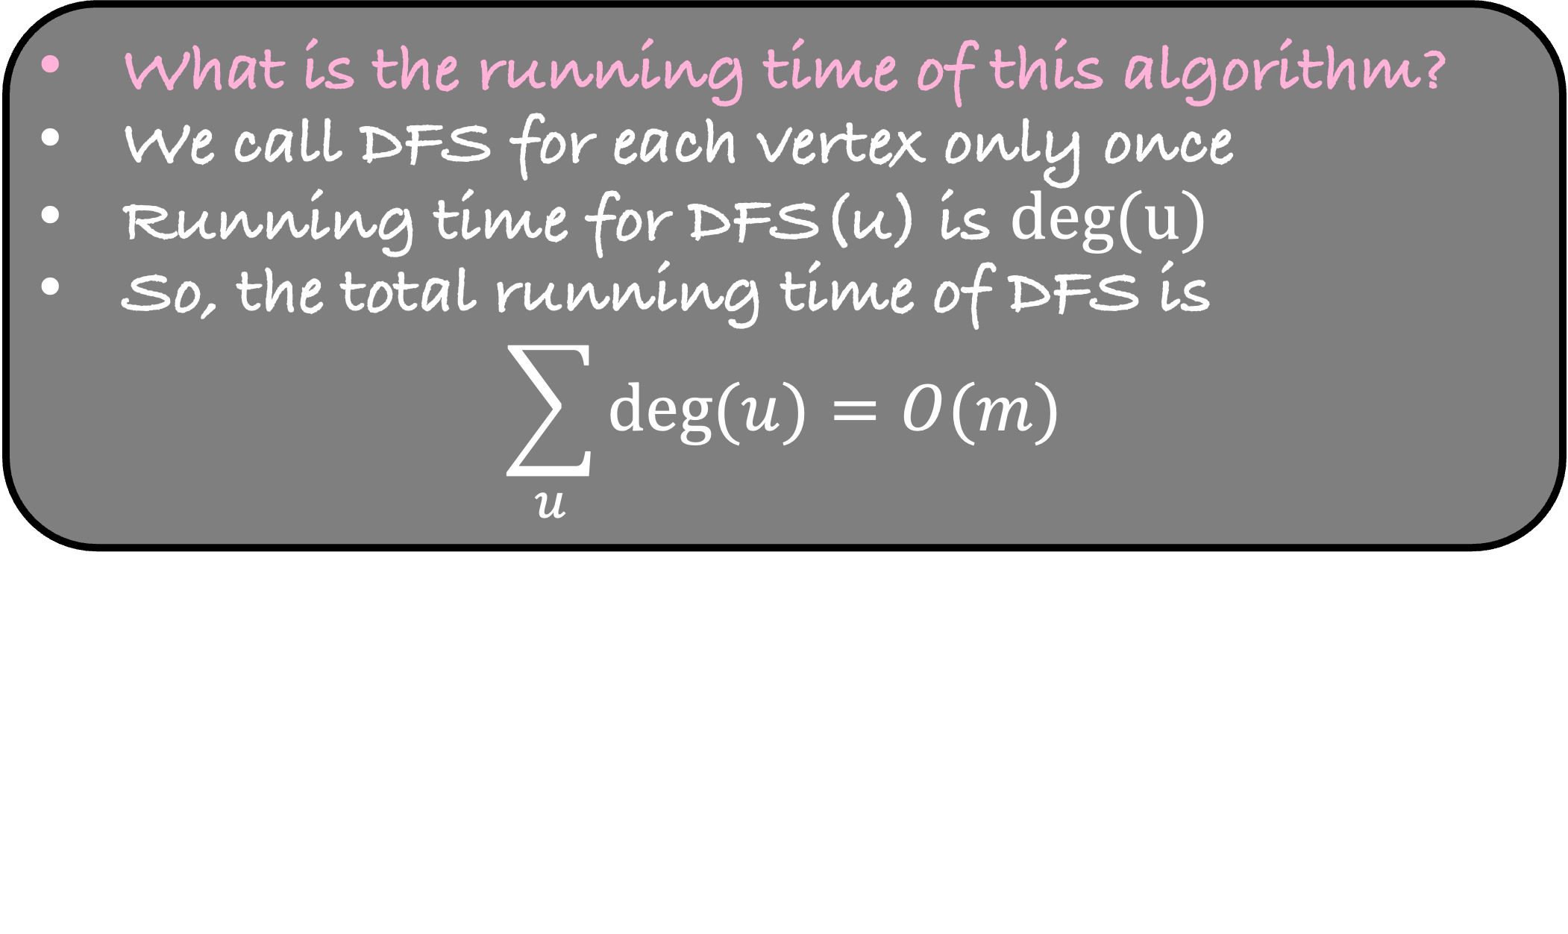
#include <stdio.h>
int main() {
int $n$, $m$, $i$, $u$, $v$;
scanf( “%d %d”, &$n$, &$m$);
int adj[$n$][$n$], degree[$n$], visited[$n$];
for( $i$ =0 ; $i$ <$n$; $i$++){
degree[$i$] = 0;
visited[$i$] = 0;
}
for( $i$ =0 ; $i$ < $m$; $i$++){
scanf( “%d %d”, &$u$, &$v$);
adj[$u$][degree[$u$]] = $v$;
adj[$v$][degree[$v$]] = $u$;
degree[$u$]++;
degree[$v$]++;
}
visited[0] = 1;
dfs(0, $n$, adj, degree, visited);
return 0;
}
void dfs( int $u$, int $n$, int adj[$n$][$n$], int degree[], int visited[]) {
visited[$u$] = 1;
for(int $i$ =0 ; $i$ < degree[$u$]; $i$++){
int $v$ = adj[$u$][$i$];
if(visited[$v$] == 0)
dfs($v$, $n$, adj, degree, visited);
}
}
What is the running time of this algorithm?
We call DFS for each vertex only once
Running time for DFS(u) is $deg(u)$
So, the total running time of DFS is
$$\sum_{u}{deg⁡(u)}=O(m)$$
O(m+n)

Slide 30
4
0
2
0
3
0
0
5
0
0
1
0

Slide 31
4
0
2
0
3
0
0
5
1
0
1
0

Slide 32
4
0
2
0
3
0
0
5
1
0
1
1

Slide 33
4
0
2
0
3
0
0
5
1
1
1
1

Slide 34
4
0
2
1
3
0
0
5
1
1
1
1

Slide 35
4
1
2
1
3
0
0
5
1
1
1
1

Slide 36
4
1
2
1
3
0
0
5
1
1
1
1

Slide 37
4
1
2
1
3
0
0
5
1
1
1
1

Slide 38
4
1
2
1
3
0
0
5
1
1
1
1

Slide 39
4
1
2
1
3
1
0
5
1
1
1
1

Slide 40
4
1
2
1
3
1
0
5
1
1
1
1

Slide 41
4
1
2
1
3
1
0
5
1
1
1
1

Slide 42
4
1
2
1
3
1
0
5
1
1
1
1

Slide 43
You are given an undirected and unweighted graph G as an input and a source s (the source with index 0)
Using DFS, check if s is connected to all the vertices of the graph

Slide 44
4
1
2
1
3
1
0
5
1
1
1
1
Like BFS, we can make a tree from the DFS algorithm
The edges in red are part of the DFS tree

Slide 45
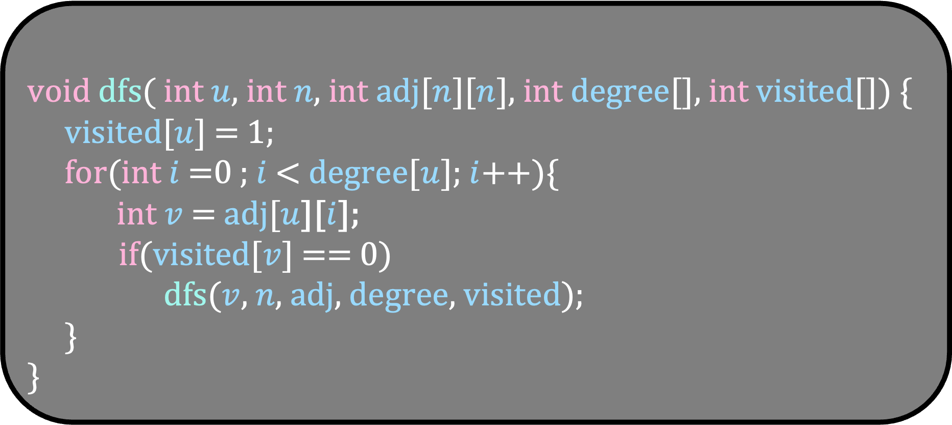
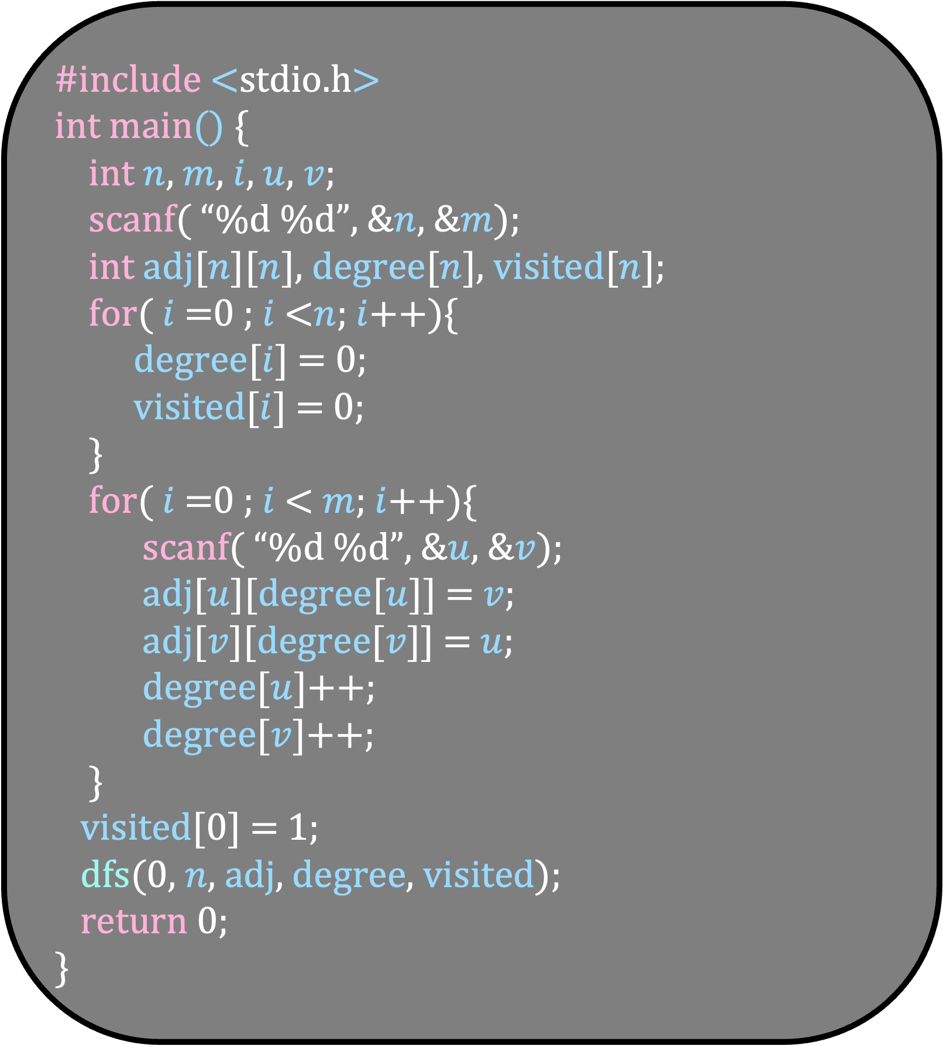
#include <stdio.h>
int main() {
int $n$, $m$, $i$, $u$, $v$;
scanf( “%d %d”, &$n$, &$m$);
int adj[$n$][$n$], degree[$n$], visited[$n$];
for( $i$ =0 ; $i$ <$n$; $i$++){
degree[$i$] = 0;
visited[$i$] = 0;
}
for( $i$ =0 ; $i$ < $m$; $i$++){
scanf( “%d %d”, &$u$, &$v$);
adj[$u$][degree[$u$]] = $v$;
adj[$v$][degree[$v$]] = $u$;
degree[$u$]++;
degree[$v$]++;
}
visited[0] = 1;
dfs(0, $n$, adj, degree, visited);
return 0;
}
void dfs( int $u$, int $n$, int adj[$n$][$n$], int degree[], int visited[]) {
visited[$u$] = 1;
for(int $i$ =0 ; $i$ < degree[$u$]; $i$++){
int $v$ = adj[$u$][$i$];
if(visited[$v$] == 0)
dfs($v$, $n$, adj, degree, visited);
}
}

Slide 46
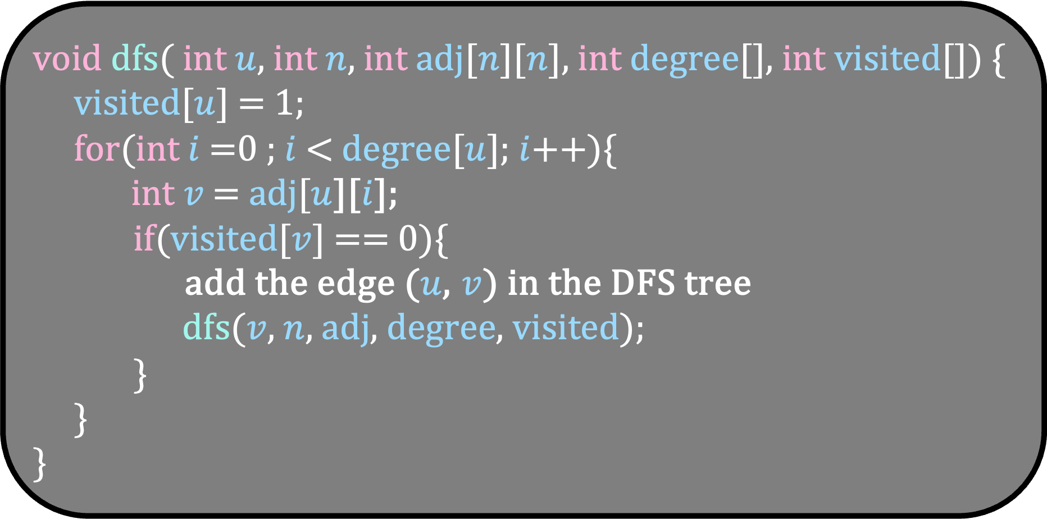

#include <stdio.h>
int main() {
int $n$, $m$, $i$, $u$, $v$;
scanf( “%d %d”, &$n$, &$m$);
int adj[$n$][$n$], degree[$n$], visited[$n$];
for( $i$ =0 ; $i$ <$n$; $i$++){
degree[$i$] = 0;
visited[$i$] = 0;
}
for( $i$ =0 ; $i$ < $m$; $i$++){
scanf( “%d %d”, &$u$, &$v$);
adj[$u$][degree[$u$]] = $v$;
adj[$v$][degree[$v$]] = $u$;
degree[$u$]++;
degree[$v$]++;
}
visited[0] = 1;
dfs(0, $n$, adj, degree, visited);
return 0;
}
void dfs( int $u$, int $n$, int adj[$n$][$n$], int degree[], int visited[]) {
visited[$u$] = 1;
for(int $i$ =0 ; $i$ < degree[$u$]; $i$++){
int $v$ = adj[$u$][$i$];
if(visited[$v$] == 0){
add the edge ($u$, $v$) in the DFS tree
dfs($v$, $n$, adj, degree, visited);
}
}
}
What if the graph is not connected?
Perform the DFS from unvisited vertices in order

Slide 47
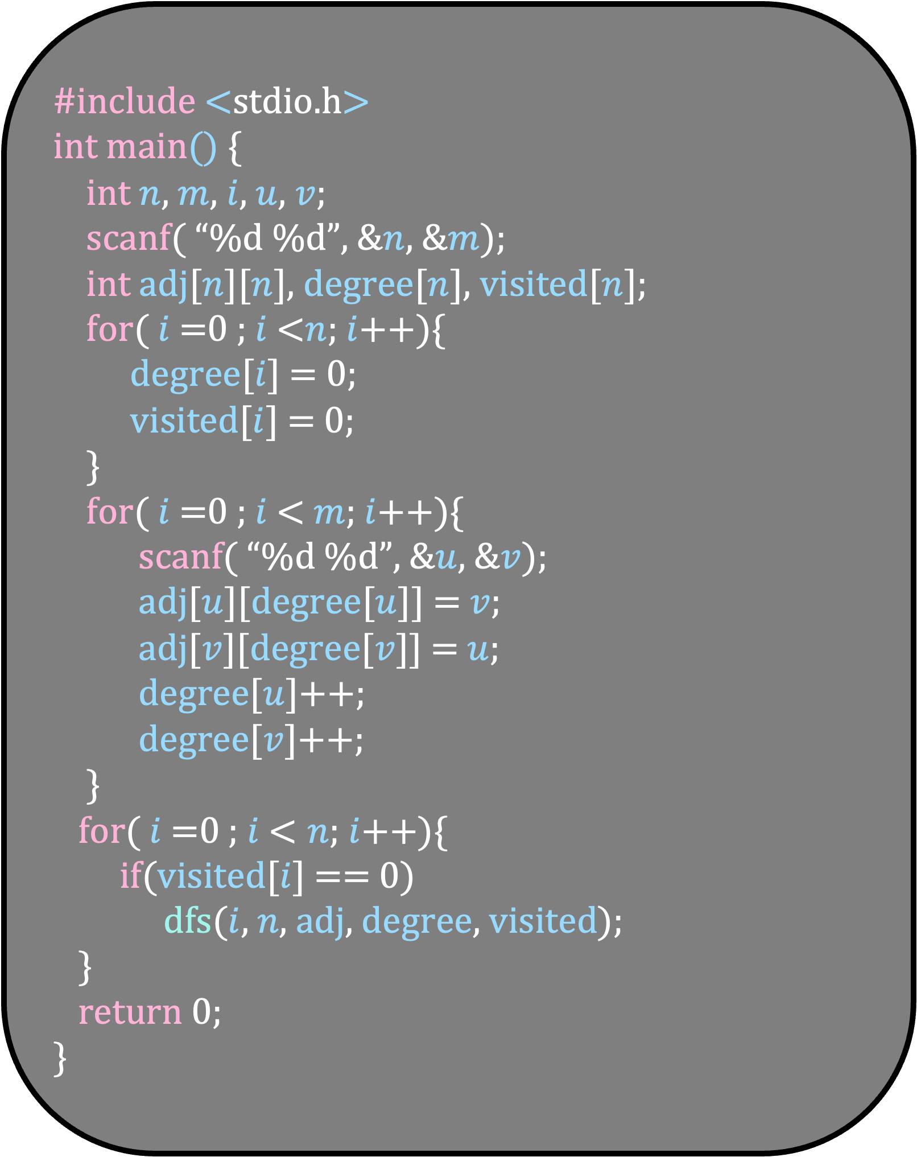
void dfs( int $u$, int $n$, int adj[$n$][$n$], int degree[], int visited[]) {
visited[$u$] = 1;
for(int $i$ =0 ; $i$ < degree[$u$]; $i$++){
int $v$ = adj[$u$][$i$];
if(visited[$v$] == 0){
add the edge ($u$, $v$) in the DFS tree
dfs($v$, $n$, adj, degree, visited);
}
}
}
#include <stdio.h>
int main() {
int $n$, $m$, $i$, $u$, $v$;
scanf( “%d %d”, &$n$, &$m$);
int adj[$n$][$n$], degree[$n$], visited[$n$];
for( $i$ =0 ; $i$ <$n$; $i$++){
degree[$i$] = 0;
visited[$i$] = 0;
}
for( $i$ =0 ; $i$ < $m$; $i$++){
scanf( “%d %d”, &$u$, &$v$);
adj[$u$][degree[$u$]] = $v$;
adj[$v$][degree[$v$]] = $u$;
degree[$u$]++;
degree[$v$]++;
}
for( $i$ =0 ; $i$ < $n$; $i$++){
if(visited[$i$] == 0)
dfs($i$, $n$, adj, degree, visited);
}
return 0;
}
What if the graph is not connected?
Perform the DFS from unvisited vertices in order

Slide 48
4
0
3
2
3
1
2
4
0
5
5
1
Arrange DFS trees and sibling subtrees left-to-right in discovery order.
Let us look at the kind of non-tree edges that may exist in the graph
Can an edge like this exist in the graph?
Yes

Slide 49
4
0
3
2
3
1
2
4
0
5
5
1
Arrange DFS trees and sibling subtrees left-to-right in discovery order.
Let us look at the kind of non-tree edges that may exist in the graph
Can an edge like this exist in the graph?
Yes
This edge is called a Forward edge

Slide 50
4
0
3
2
3
1
2
4
0
5
5
1
Arrange DFS trees and sibling subtrees left-to-right in discovery order.
Let us look at the kind of non-tree edges that may exist in the graph
Can an edge like this exist in the graph?
Yes

Slide 51
4
0
3
2
3
1
2
4
0
5
5
1
Arrange DFS trees and sibling subtrees left-to-right in discovery order.
Let us look at the kind of non-tree edges that may exist in the graph
Can an edge like this exist in the graph?
Yes
This edge is called a Backward edge

Slide 52
4
0
3
2
3
1
2
4
0
5
5
1
Arrange DFS trees and sibling subtrees left-to-right in discovery order.
Let us look at the kind of non-tree edges that may exist in the graph
Can an edge like this exist in the graph?
No

Slide 53
4
0
3
2
3
1
2
4
0
5
5
1
Arrange DFS trees and sibling subtrees left-to-right in discovery order.
Let us look at the kind of non-tree edges that may exist in the graph
Can an edge like this exist in the graph?
No
A cross edge going from left to right cannot exist

Slide 54
4
0
3
2
3
1
2
4
0
5
5
1
Arrange DFS trees and sibling subtrees left-to-right in discovery order.
Let us look at the kind of non-tree edges that may exist in the graph
Can an edge like this exist in the graph?
No
A cross edge going from left to right cannot exist

Slide 55
4
0
3
2
3
1
2
4
0
5
5
1
Arrange DFS trees and sibling subtrees left-to-right in discovery order.
Let us look at the kind of non-tree edges that may exist in the graph
Can an edge like this exist in the graph?
Yes

Slide 56
4
0
3
2
3
1
2
4
0
5
5
1
Arrange DFS trees and sibling subtrees left-to-right in discovery order.
Let us look at the kind of non-tree edges that may exist in the graph
Can an edge like this exist in the graph?
Yes
A cross edge from right to left can exist in the graph

Slide 57
Properties of a DFS tree in a directed graph
Any non tree edge is of one of the following types:
Forward edge
Backward edge
A cross edge from right to left
A left to right cross edge cannot exist in the graph
Let us now look what happens in an undirected graph

Slide 58
4
0
3
2
3
1
2
4
0
5
5
1
Forward and backward edge are same of the undirected graph
We will call such an edge a backward edge
Can there be a back edge in the graph?
Yes

Slide 59
4
0
3
2
3
1
2
4
0
5
5
1
Can there be a cross edge in the graph?
No

Slide 60
4
0
3
2
3
1
2
4
0
5
5
1
Can there be a cross edge in the graph?
No

Slide 61
Properties of a DFS tree in an undirected graph
Any non tree edge can only be a back edge
Cross edges cannot exist in the graph
Most of the problems will try to exploit the properties of DFS
Let us look at one of them

Slide 62
You are given a directed graph G. Check if it contains a cycle
How would you solve this problem using DFS?

Slide 63
0
3
1
2
4
6
9
10
5
7
8
If a back edge exists in the graph, then

Slide 64
0
3
1
2
4
6
9
10
5
7
8
If a back edge exists in the graph, then there is a cycle in the graph
If there is no back edge, then can we say that there is no cycle?

Slide 65
0
3
1
2
4
6
9
10
5
7
8
If there is no back edge, then the cycle must look like this
But there is no left to right cross edge in the graph
So, there is no cycle in the graph if there is no backedge
Try to code this algorithm

Slide 66
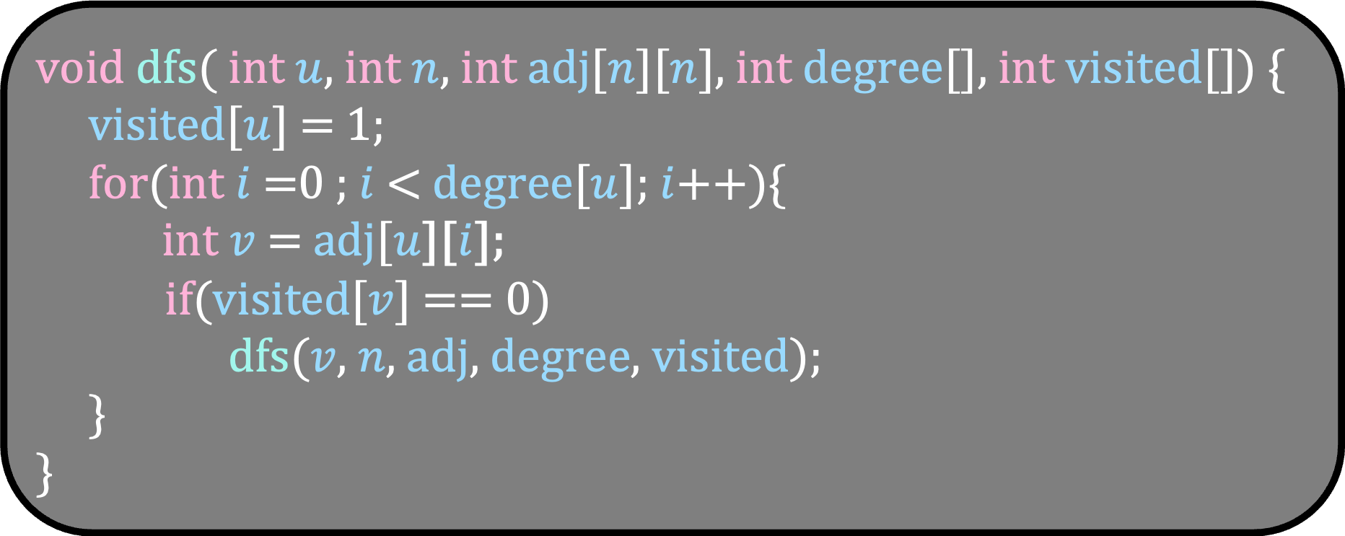
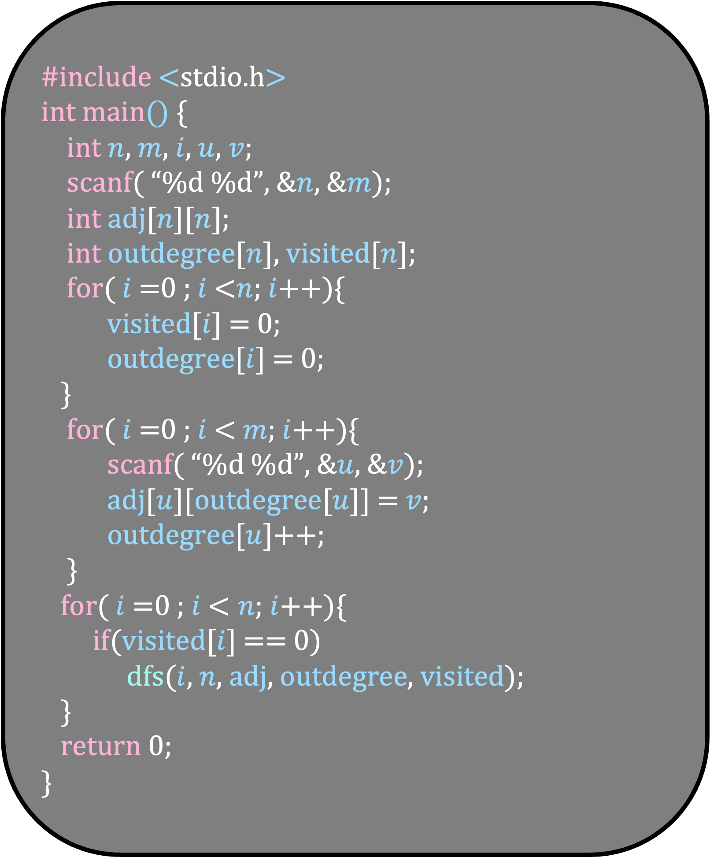
#include <stdio.h>
int main() {
int $n$, $m$, $i$, $u$, $v$;
scanf( “%d %d”, &$n$, &$m$);
int adj[$n$][$n$];
int outdegree[$n$], visited[$n$];
for( $i$ =0 ; $i$ <$n$; $i$++){
visited[$i$] = 0;
outdegree[$i$] = 0;
}
for( $i$ =0 ; $i$ < $m$; $i$++){
scanf( “%d %d”, &$u$, &$v$);
adj[$u$][outdegree[$u$]] = $v$;
outdegree[$u$]++;
}
for( $i$ =0 ; $i$ < $n$; $i$++){
if(visited[$i$] == 0)
dfs($i$, $n$, adj, outdegree, visited);
}
return 0;
}
void dfs( int $u$, int $n$, int adj[$n$][$n$], int degree[], int visited[]) {
visited[$u$] = 1;
for(int $i$ =0 ; $i$ < degree[$u$]; $i$++){
int $v$ = adj[$u$][$i$];
if(visited[$v$] == 0)
dfs($v$, $n$, adj, degree, visited);
}
}
We have not even built a tree
How do we change this algorithm?
There is no need to build a tree

Slide 67
#include <stdio.h>
int main() {
int $n$, $m$, $i$, $u$, $v$;
scanf( “%d %d”, &$n$, &$m$);
int adj[$n$][$n$];
int outdegree[$n$], visited[$n$];
for( $i$ =0 ; $i$ <$n$; $i$++){
visited[$i$] = 0;
outdegree[$i$] = 0;
}
for( $i$ =0 ; $i$ < $m$; $i$++){
scanf( “%d %d”, &$u$, &$v$);
adj[$u$][outdegree[$u$]] = $v$;
outdegree[$u$]++;
}
for( $i$ =0 ; $i$ < $n$; $i$++){
if(visited[$i$] == 0)
dfs($i$, $n$, adj, outdegree, visited);
}
return 0;
}
void dfs( int $u$, int $n$, int adj[$n$][$n$], int degree[], int visited[]) {
visited[$u$] = 1;
for(int $i$ =0 ; $i$ < degree[$u$]; $i$++){
int $v$ = adj[$u$][$i$];
if(visited[$v$] == 0)
dfs($v$, $n$, adj, degree, visited);
}
}
We will have 3 states for a vertex
DFS not started – visited = 0
DFS currently running – visited = 2
DFS completed -- – visited = 1

Slide 68
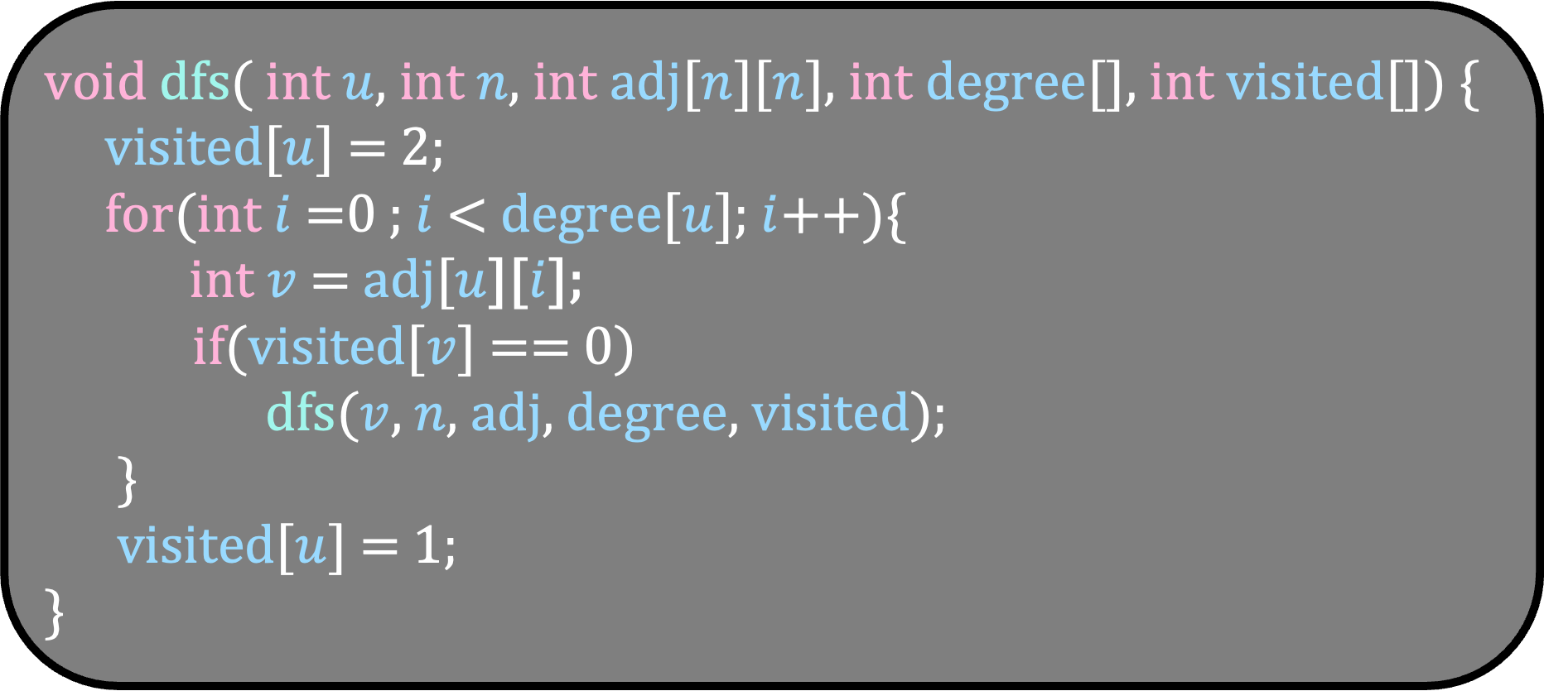
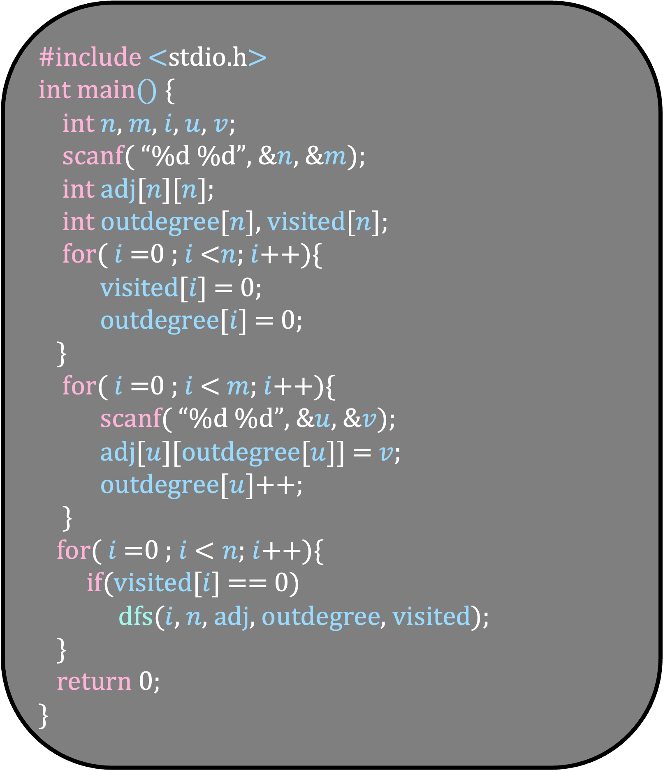
#include <stdio.h>
int main() {
int $n$, $m$, $i$, $u$, $v$;
scanf( “%d %d”, &$n$, &$m$);
int adj[$n$][$n$];
int outdegree[$n$], visited[$n$];
for( $i$ =0 ; $i$ <$n$; $i$++){
visited[$i$] = 0;
outdegree[$i$] = 0;
}
for( $i$ =0 ; $i$ < $m$; $i$++){
scanf( “%d %d”, &$u$, &$v$);
adj[$u$][outdegree[$u$]] = $v$;
outdegree[$u$]++;
}
for( $i$ =0 ; $i$ < $n$; $i$++){
if(visited[$i$] == 0)
dfs($i$, $n$, adj, outdegree, visited);
}
return 0;
}
void dfs( int $u$, int $n$, int adj[$n$][$n$], int degree[], int visited[]) {
visited[$u$] = 2;
for(int $i$ =0 ; $i$ < degree[$u$]; $i$++){
int $v$ = adj[$u$][$i$];
if(visited[$v$] == 0)
dfs($v$, $n$, adj, degree, visited);
}
visited[$u$] = 1;
}
We will have 3 states for a vertex
DFS not started – visited = 0
DFS currently running – visited = 2
DFS completed -- – visited = 1

Slide 69
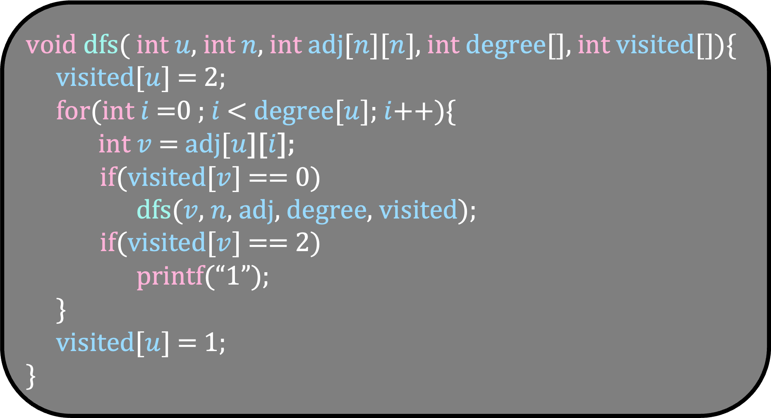
#include <stdio.h>
int main() {
int $n$, $m$, $i$, $u$, $v$;
scanf( “%d %d”, &$n$, &$m$);
int adj[$n$][$n$];
int outdegree[$n$], visited[$n$];
for( $i$ =0 ; $i$ <$n$; $i$++){
visited[$i$] = 0;
outdegree[$i$] = 0;
}
for( $i$ =0 ; $i$ < $m$; $i$++){
scanf( “%d %d”, &$u$, &$v$);
adj[$u$][outdegree[$u$]] = $v$;
outdegree[$u$]++;
}
for( $i$ =0 ; $i$ < $n$; $i$++){
if(visited[$i$] == 0)
dfs($i$, $n$, adj, outdegree, visited);
}
return 0;
}
void dfs( int $u$, int $n$, int adj[$n$][$n$], int degree[], int visited[]){
visited[$u$] = 2;
for(int $i$ =0 ; $i$ < degree[$u$]; $i$++){
int $v$ = adj[$u$][$i$];
if(visited[$v$] == 0)
dfs($v$, $n$, adj, degree, visited);
if(visited[$v$] == 2)
printf(“1”);
}
visited[$u$] = 1;
}
But we want to print 1 only once
So, what to do?

Slide 70
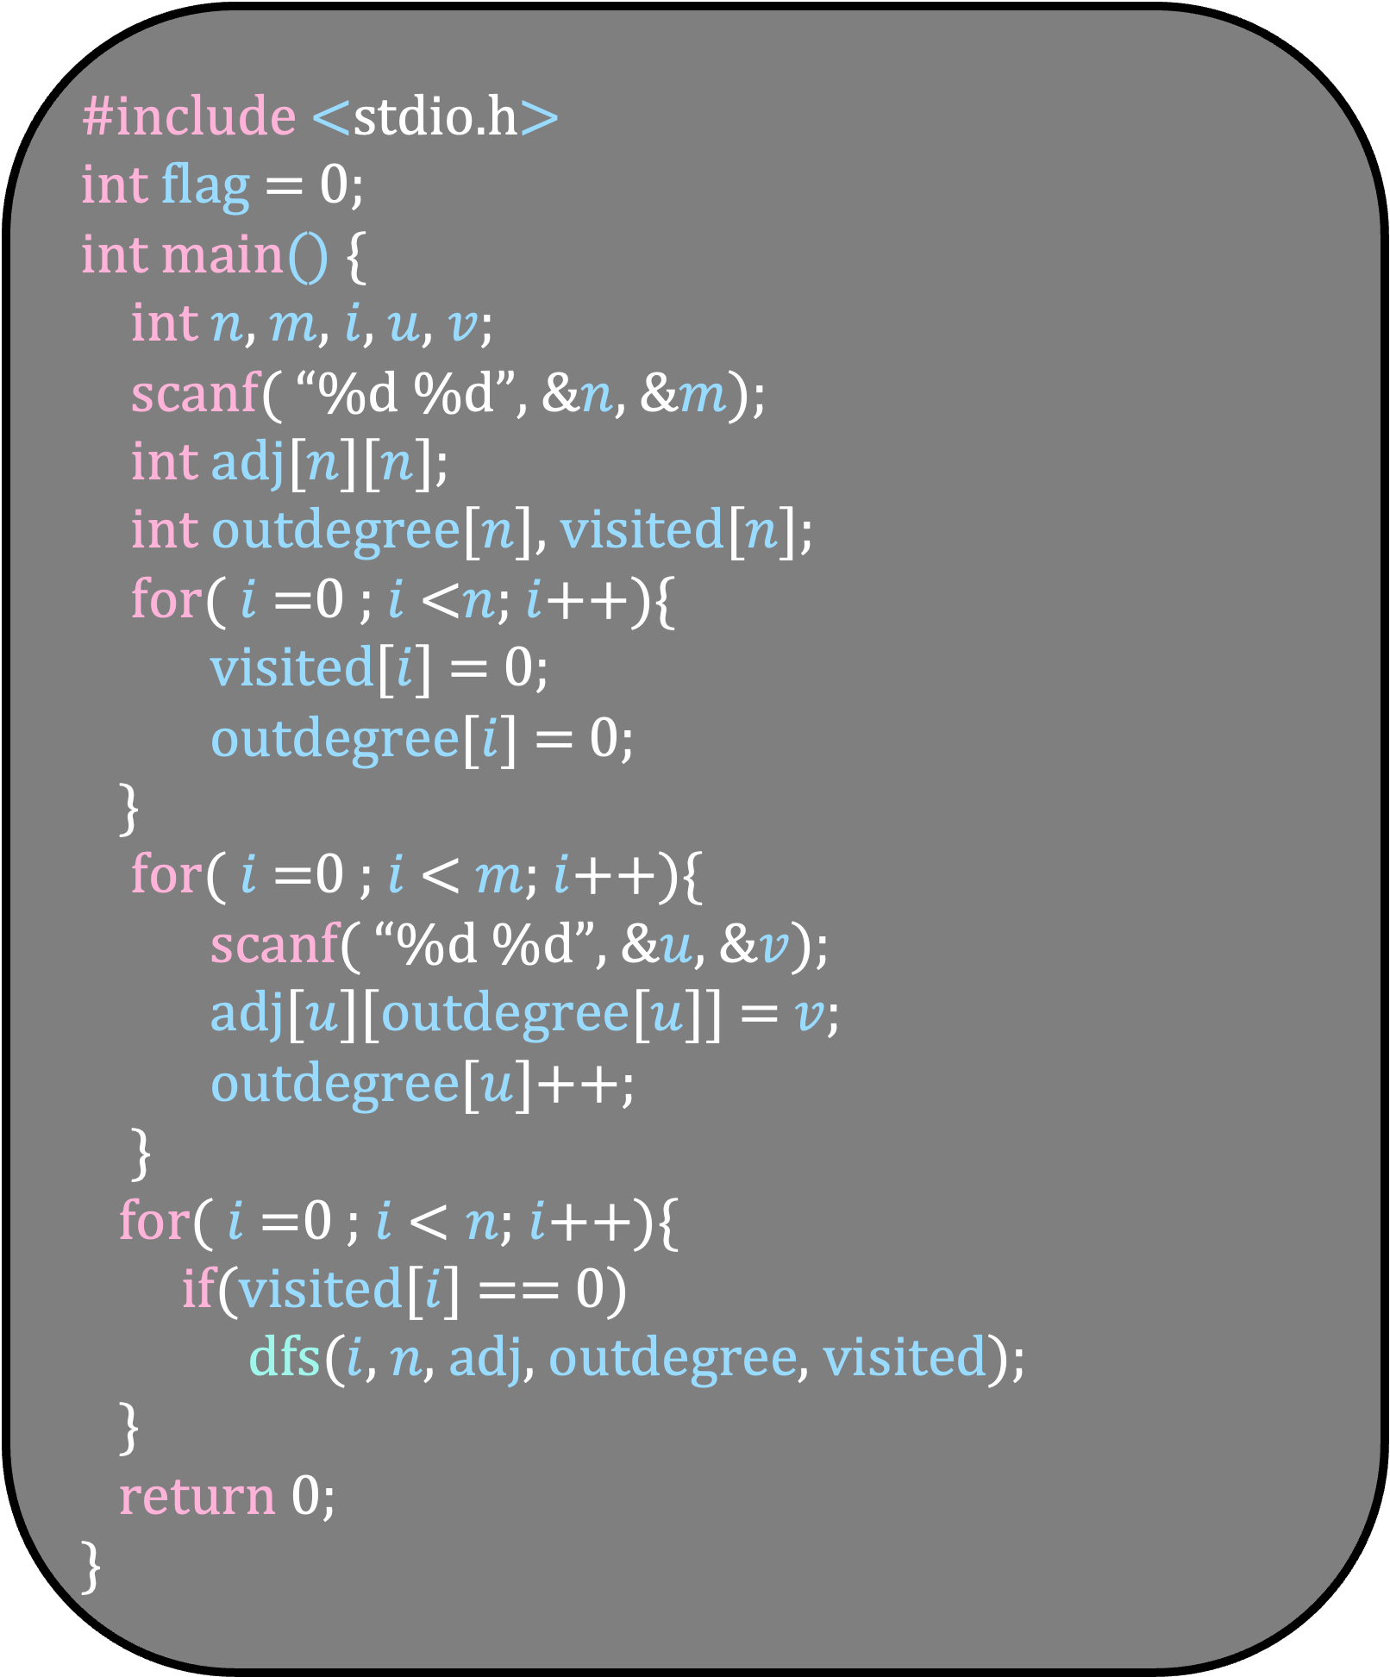
#include <stdio.h>
int flag = 0;
int main() {
int $n$, $m$, $i$, $u$, $v$;
scanf( “%d %d”, &$n$, &$m$);
int adj[$n$][$n$];
int outdegree[$n$], visited[$n$];
for( $i$ =0 ; $i$ <$n$; $i$++){
visited[$i$] = 0;
outdegree[$i$] = 0;
}
for( $i$ =0 ; $i$ < $m$; $i$++){
scanf( “%d %d”, &$u$, &$v$);
adj[$u$][outdegree[$u$]] = $v$;
outdegree[$u$]++;
}
for( $i$ =0 ; $i$ < $n$; $i$++){
if(visited[$i$] == 0)
dfs($i$, $n$, adj, outdegree, visited);
}
return 0;
}
void dfs( int $u$, int $n$, int adj[$n$][$n$], int degree[], int visited[]){
visited[$u$] = 2;
for(int $i$ =0 ; $i$ < degree[$u$]; $i$++){
int $v$ = adj[$u$][$i$];
if(visited[$v$] == 0)
dfs($v$, $n$, adj, degree, visited);
if(visited[$v$] == 2)
printf(“1”);
}
visited[$u$] = 1;
}
But we want to print 1 only once
So, what to do?

Slide 71
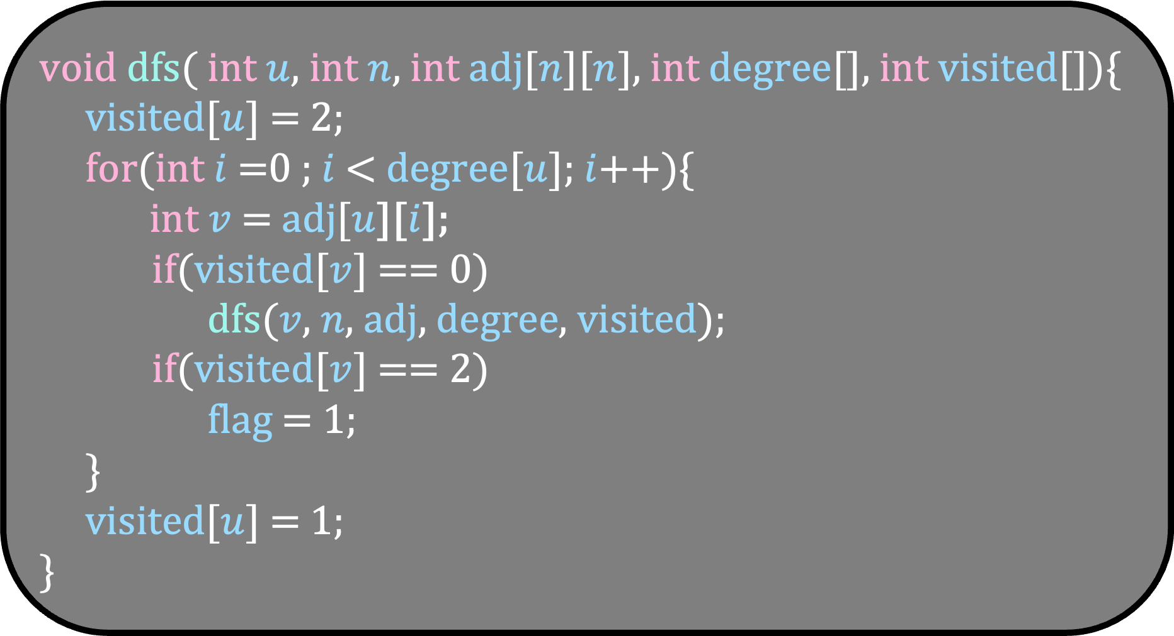
#include <stdio.h>
int flag = 0;
int main() {
int $n$, $m$, $i$, $u$, $v$;
scanf( “%d %d”, &$n$, &$m$);
int adj[$n$][$n$];
int outdegree[$n$], visited[$n$];
for( $i$ =0 ; $i$ <$n$; $i$++){
visited[$i$] = 0;
outdegree[$i$] = 0;
}
for( $i$ =0 ; $i$ < $m$; $i$++){
scanf( “%d %d”, &$u$, &$v$);
adj[$u$][outdegree[$u$]] = $v$;
outdegree[$u$]++;
}
for( $i$ =0 ; $i$ < $n$; $i$++){
if(visited[$i$] == 0)
dfs($i$, $n$, adj, outdegree, visited);
}
return 0;
}
void dfs( int $u$, int $n$, int adj[$n$][$n$], int degree[], int visited[]){
visited[$u$] = 2;
for(int $i$ =0 ; $i$ < degree[$u$]; $i$++){
int $v$ = adj[$u$][$i$];
if(visited[$v$] == 0)
dfs($v$, $n$, adj, degree, visited);
if(visited[$v$] == 2)
flag = 1;
}
visited[$u$] = 1;
}
But we want to print 1 only once
So, what to do?

Slide 72
Topological Sorting
Given a directed acyclic graph, arrange the vertices from left to right so that for any edge (u,v), u comes before v in the ordering.
4
2
3
0
5
0
2
3
4
5
1
1

Slide 73
Topological Sorting
Given a directed acyclic graph, arrange the vertices from left to right so that for any edge (u,v), u comes before v in the ordering.
There is a simple algorithm for this problem
Can you think about it?
Algorithm in plain English
While the graph is not empty
Take any vertex, say v, with indegree 0
Append v to the ordering
Remove v with all its outgoing edges from the graph

Slide 74
4
2
3
0
5
1

Slide 75
4
2
3
5
1
0

Slide 76
4
3
5
1
0
2

Slide 77
4
5
1
0
2
3

Slide 78
4
1
0
2
3
5

Slide 79
4
0
2
3
5
1

Slide 80
4
2
3
0
5
1
0
2
3
5
1
4

Slide 81
Algorithm in plain English
While the graph is not empty
Take any vertex, say v, with indegree 0
Append v to the ordering
Remove v with all its outgoing edges from the graph
What is the running time of this algorithm?
O(m+n)

Slide 82
Topological Sorting
Given a directed acyclic graph, arrange the vertices from left to right so that for any edge (u,v), u comes before v in the ordering.
We will use DFS to solve this problem

Slide 83
4
0
3
2
3
1
2
4
0
5
5
1
Can you use the DFS tree to come up with an ordering?
Note that there are only two types of non-tree edges
Forward edge
Cross edge from right to left

Slide 84
4
0
3
2
3
1
2
4
0
5
5
1
Can you use the DFS tree to come up with an ordering?
Which vertex should be the first vertex in the ordering?
3

Slide 85
4
0
3
2
3
1
2
4
0
5
5
1
3
4
Which vertex should be the second vertex in the ordering?
4
Do you see the pattern?
Reverse the tree order and sibling order

Slide 86
4
0
3
2
3
1
2
4
0
5
5
1
3
4
0
2
5
1
Which vertex should be the second vertex in the ordering?
4
Do you see the pattern?
Reverse the tree order and sibling order in a pre order traversal

Slide 87
0
3
1
2
4
5
3
4
0
2
5
1
Which vertex should be the second vertex in the ordering?
4
Do you see the pattern?
Reverse the tree order and sibling order in a pre order traversal
But how to implement it?

Slide 88
4
0
3
2
3
1
2
4
0
5
5
1
Mark the vertices in the order their DFS ends
Which is the vertex whose DFS ends first?
Vertex 1

Slide 89
4
0
3
2
3
1
2
4
1
0
5
5
2
1
Mark the vertices in the order their DFS ends
Which is the vertex whose DFS ends first?
Vertex 1
Which is the vertex whose DFS ends second?
Vertex 5

Slide 90
4
0
3
4
6
2
3
1
2
4
1
3
5
0
5
5
2
1
Do you see how we can order the vertices now?
Reverse order of our numbering
Can you now write a code for this problem using our DFS algorithm?

Slide 91

#include <stdio.h>
int main() {
int $n$, $m$, $i$, $u$, $v$;
scanf( “%d %d”, &$n$, &$m$);
int adj[$n$][$n$];
int outdegree[$n$], visited[$n$];
for( $i$ =0 ; $i$ <$n$; $i$++){
visited[$i$] = 0;
outdegree[$i$] = 0;
}
for( $i$ =0 ; $i$ < $m$; $i$++){
scanf( “%d %d”, &$u$, &$v$);
adj[$u$][outdegree[$u$]] = $v$;
outdegree[$u$]++;
}
for( $i$ =0 ; $i$ < $n$; $i$++){
if(visited[$i$] == 0)
dfs($i$, $n$, adj, outdegree, visited);
}
return 0;
}
void dfs( int $u$, int $n$, int adj[$n$][$n$], int degree[], int visited[]) {
visited[$u$] = 1;
for(int $i$ =0 ; $i$ < degree[$u$]; $i$++){
int $v$ = adj[$u$][$i$];
if(visited[$v$] == 0)
dfs($v$, $n$, adj, degree, visited);
}
}

Slide 92
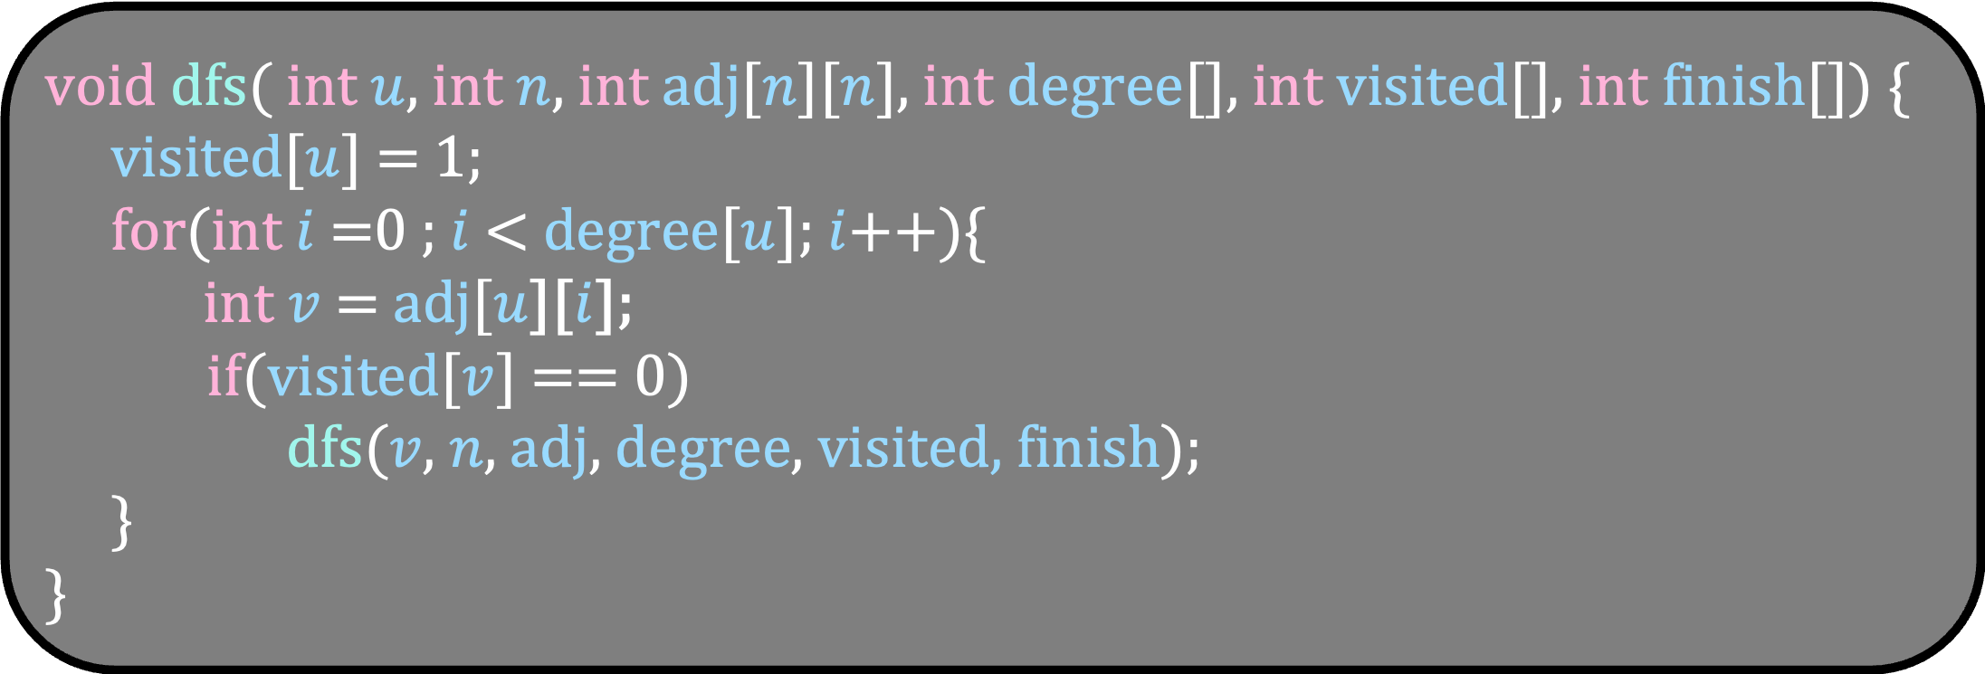
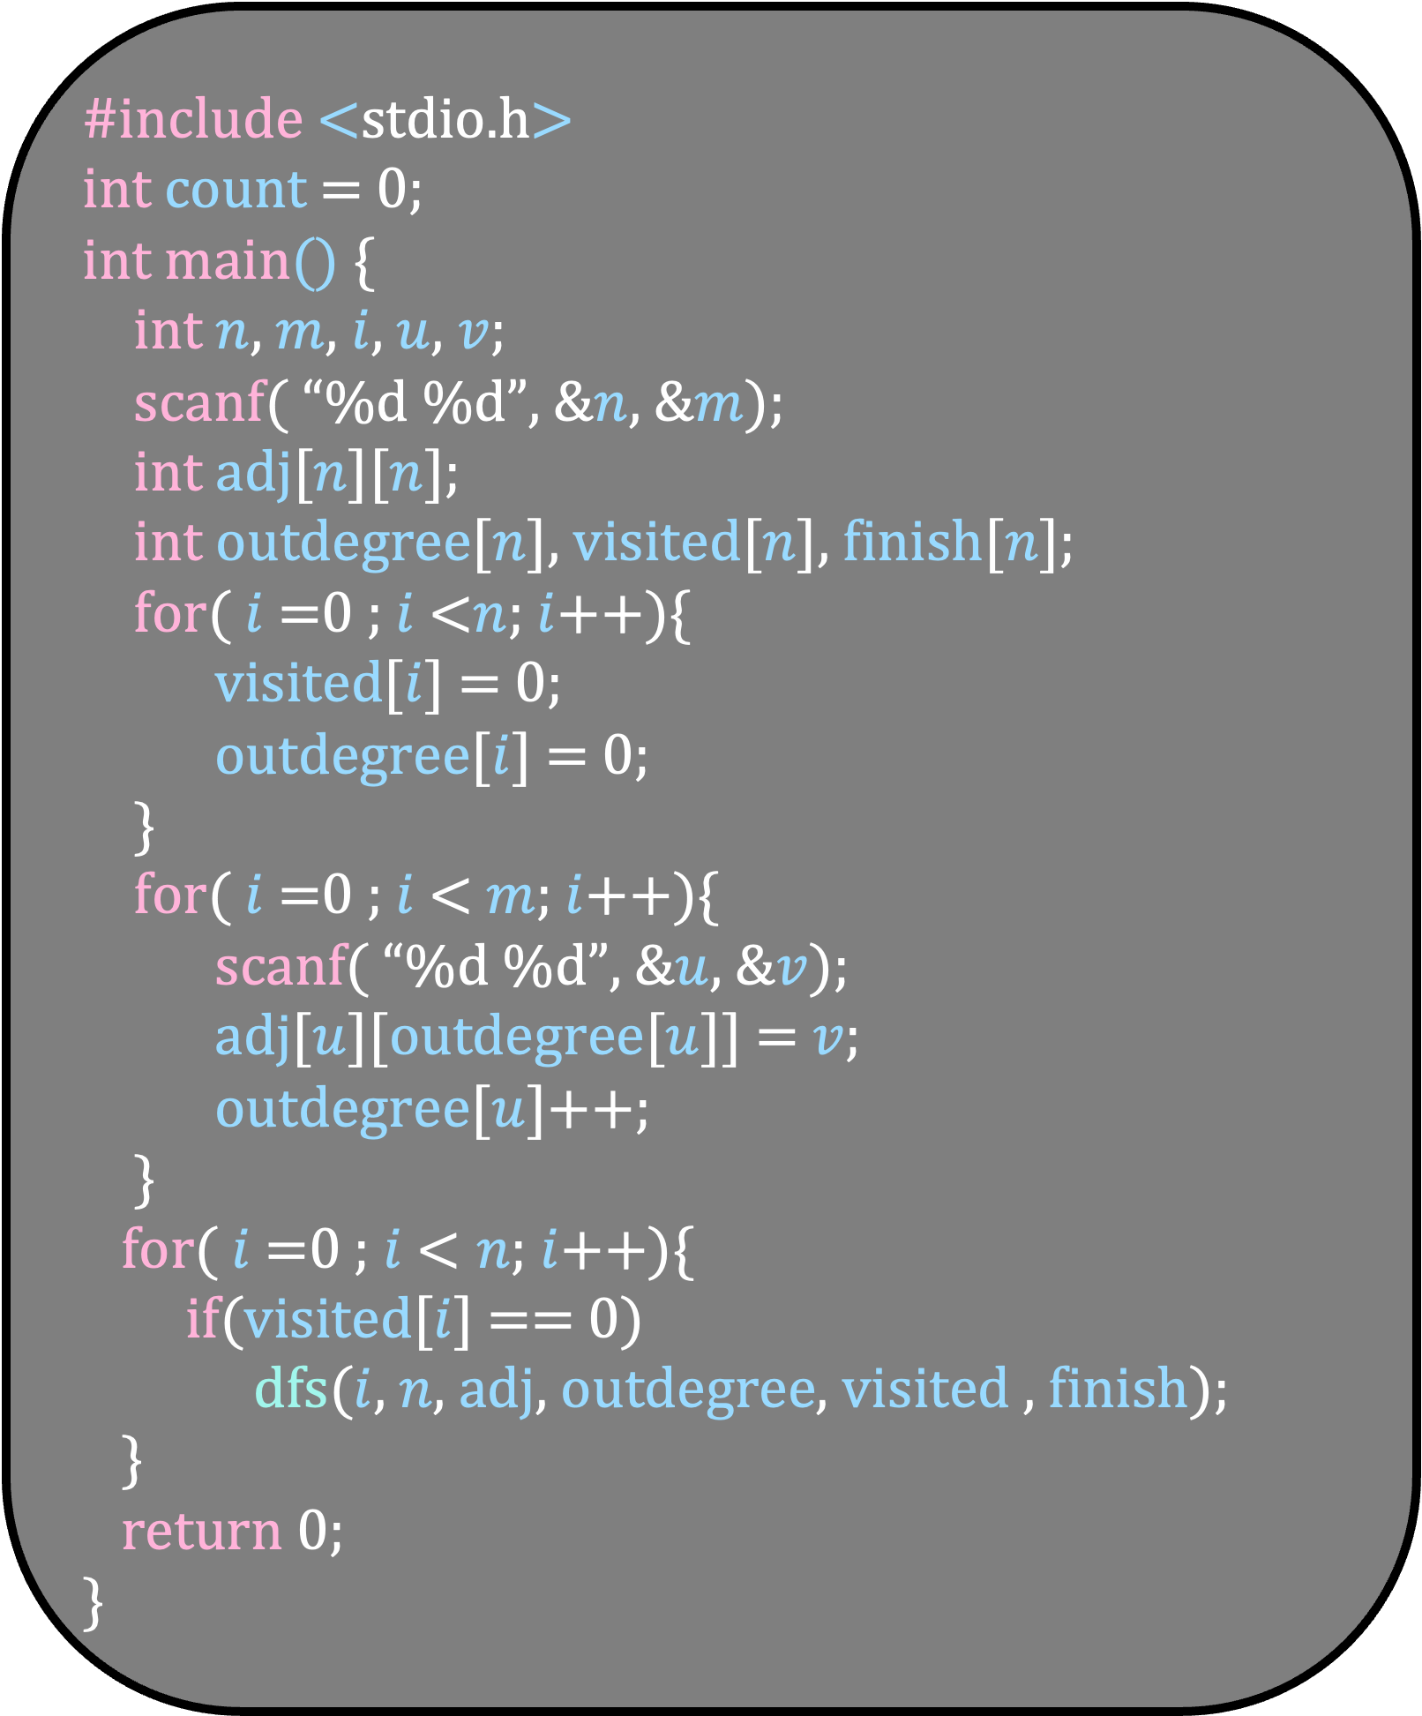
#include <stdio.h>
int count = 0;
int main() {
int $n$, $m$, $i$, $u$, $v$;
scanf( “%d %d”, &$n$, &$m$);
int adj[$n$][$n$];
int outdegree[$n$], visited[$n$], finish[$n$];
for( $i$ =0 ; $i$ <$n$; $i$++){
visited[$i$] = 0;
outdegree[$i$] = 0;
}
for( $i$ =0 ; $i$ < $m$; $i$++){
scanf( “%d %d”, &$u$, &$v$);
adj[$u$][outdegree[$u$]] = $v$;
outdegree[$u$]++;
}
for( $i$ =0 ; $i$ < $n$; $i$++){
if(visited[$i$] == 0)
dfs($i$, $n$, adj, outdegree, visited , finish);
}
return 0;
}
void dfs( int $u$, int $n$, int adj[$n$][$n$], int degree[], int visited[], int finish[]) {
visited[$u$] = 1;
for(int $i$ =0 ; $i$ < degree[$u$]; $i$++){
int $v$ = adj[$u$][$i$];
if(visited[$v$] == 0)
dfs($v$, $n$, adj, degree, visited, finish);
}
}

Slide 93
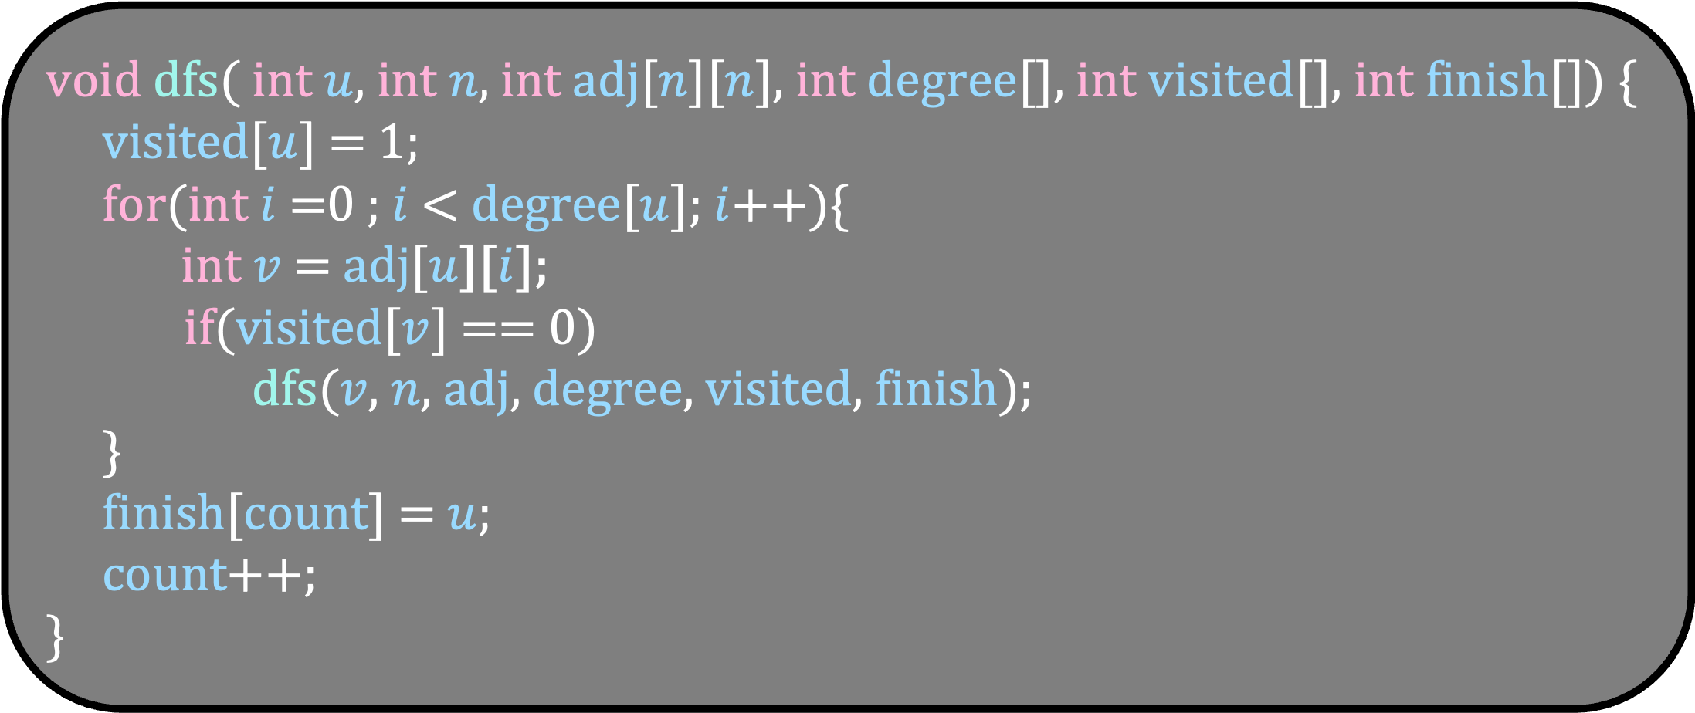
#include <stdio.h>
int count = 0;
int main() {
int $n$, $m$, $i$, $u$, $v$;
scanf( “%d %d”, &$n$, &$m$);
int adj[$n$][$n$];
int outdegree[$n$], visited[$n$], finish[$n$];
for( $i$ =0 ; $i$ <$n$; $i$++){
visited[$i$] = 0;
outdegree[$i$] = 0;
}
for( $i$ =0 ; $i$ < $m$; $i$++){
scanf( “%d %d”, &$u$, &$v$);
adj[$u$][outdegree[$u$]] = $v$;
outdegree[$u$]++;
}
for( $i$ =0 ; $i$ < $n$; $i$++){
if(visited[$i$] == 0)
dfs($i$, $n$, adj, outdegree, visited , finish);
}
return 0;
}
void dfs( int $u$, int $n$, int adj[$n$][$n$], int degree[], int visited[], int finish[]) {
visited[$u$] = 1;
for(int $i$ =0 ; $i$ < degree[$u$]; $i$++){
int $v$ = adj[$u$][$i$];
if(visited[$v$] == 0)
dfs($v$, $n$, adj, degree, visited, finish);
}
finish[count] = $u$;
count++;
}

