Slide 1
Lower Bounds on Comparison based sorting

Slide 2
MergeSort --- O(n log n)
HeapSort --- O(n log n)
Quicksort --- O(n log n) average running time
But can we sort number in better thab O(n log n) time?
No, for comparison based sorting algorithms
Yes, otherwise

Slide 3
We will show that any comparison based sorting algorithm must take
$Ω$(n log n) time
How do we even start proving such a statement?
How do we argue about every algorithm?

Slide 4
Insertion Sort

Slide 5
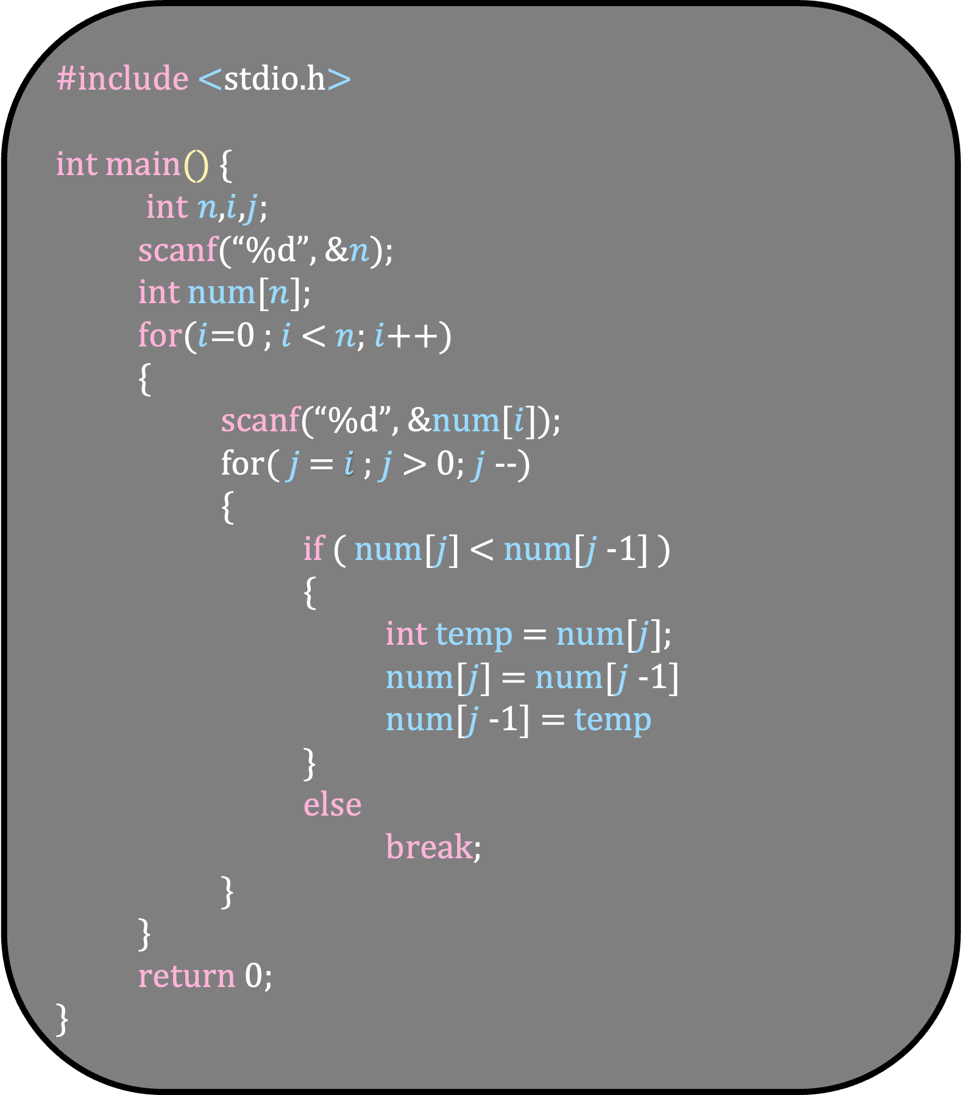
#include <stdio.h> int main() {
int $n$,$i$,$j$;
scanf(“%d”, &$n$);
int num[$n$];
for($i$=0 ; $i$ < $n$; $i$++)
{
scanf(“%d”, &num[$i$]);
for( $j$ = $i$ ; $j$ > 0; $j$--)
{
if ( num[$j$] < num[$j$-1] )
{
int temp = num[$j$];
num[$j$] = num[$j$-1]
num[$j$-1] = temp
}
else
break;
}
} return 0; }
a
b
c
15
7
35
i = 0

Slide 6
#include <stdio.h> int main() {
int $n$,$i$,$j$;
scanf(“%d”, &$n$);
int num[$n$];
for($i$=0 ; $i$ < $n$; $i$++)
{
scanf(“%d”, &num[$i$]);
for( $j$ = $i$ ; $j$ > 0; $j$--)
{
if ( num[$j$] < num[$j$-1] )
{
int temp = num[$j$];
num[$j$] = num[$j$-1]
num[$j$-1] = temp
}
else
break;
}
} return 0; }
a
b
c
15
7
35
i = 0
j = 0

Slide 7
#include <stdio.h> int main() {
int $n$,$i$,$j$;
scanf(“%d”, &$n$);
int num[$n$];
for($i$=0 ; $i$ < $n$; $i$++)
{
scanf(“%d”, &num[$i$]);
for( $j$ = $i$ ; $j$ > 0; $j$--)
{
if ( num[$j$] < num[$j$-1] )
{
int temp = num[$j$];
num[$j$] = num[$j$-1]
num[$j$-1] = temp
}
else
break;
}
} return 0; }
a
b
c
15
7
35
i = 1
j = 0

Slide 8
#include <stdio.h> int main() {
int $n$,$i$,$j$;
scanf(“%d”, &$n$);
int num[$n$];
for($i$=0 ; $i$ < $n$; $i$++)
{
scanf(“%d”, &num[$i$]);
for( $j$ = $i$ ; $j$ > 0; $j$--)
{
if ( num[$j$] < num[$j$-1] )
{
int temp = num[$j$];
num[$j$] = num[$j$-1]
num[$j$-1] = temp
}
else
break;
}
} return 0; }
a
b
c
15
7
35
i = 1
j = 0

Slide 9
#include <stdio.h> int main() {
int $n$,$i$,$j$;
scanf(“%d”, &$n$);
int num[$n$];
for($i$=0 ; $i$ < $n$; $i$++)
{
scanf(“%d”, &num[$i$]);
for( $j$ = $i$ ; $j$ > 0; $j$--)
{
if ( num[$j$] < num[$j$-1] )
{
int temp = num[$j$];
num[$j$] = num[$j$-1]
num[$j$-1] = temp
}
else
break;
}
} return 0; }
a
b
c
15
7
35
i = 1
j = 0

Slide 10
#include <stdio.h> int main() {
int $n$,$i$,$j$;
scanf(“%d”, &$n$);
int num[$n$];
for($i$=0 ; $i$ < $n$; $i$++)
{
scanf(“%d”, &num[$i$]);
for( $j$ = $i$ ; $j$ > 0; $j$--)
{
if ( num[$j$] < num[$j$-1] )
{
int temp = num[$j$];
num[$j$] = num[$j$-1]
num[$j$-1] = temp
}
else
break;
}
} return 0; }
a
b
c
15
7
35
Is b < a?
i = 1
j = 1

Slide 11
#include <stdio.h> int main() {
int $n$,$i$,$j$;
scanf(“%d”, &$n$);
int num[$n$];
for($i$=0 ; $i$ < $n$; $i$++)
{
scanf(“%d”, &num[$i$]);
for( $j$ = $i$ ; $j$ > 0; $j$--)
{
if ( num[$j$] < num[$j$-1] )
{
int temp = num[$j$];
num[$j$] = num[$j$-1]
num[$j$-1] = temp
}
else
break;
}
} return 0; }
a
b
c
15
7
35
Is b < a?
i = 1
j = 1

Slide 12
#include <stdio.h> int main() {
int $n$,$i$,$j$;
scanf(“%d”, &$n$);
int num[$n$];
for($i$=0 ; $i$ < $n$; $i$++)
{
scanf(“%d”, &num[$i$]);
for( $j$ = $i$ ; $j$ > 0; $j$--)
{
if ( num[$j$] < num[$j$-1] )
{
int temp = num[$j$];
num[$j$] = num[$j$-1]
num[$j$-1] = temp
}
else
break;
}
} return 0; }
Is b < a?
b
a
c
7
15
35
i = 1
j = 0

Slide 13
#include <stdio.h> int main() {
int $n$,$i$,$j$;
scanf(“%d”, &$n$);
int num[$n$];
for($i$=0 ; $i$ < $n$; $i$++)
{
scanf(“%d”, &num[$i$]);
for( $j$ = $i$ ; $j$ > 0; $j$--)
{
if ( num[$j$] < num[$j$-1] )
{
int temp = num[$j$];
num[$j$] = num[$j$-1]
num[$j$-1] = temp
}
else
break;
}
} return 0; }
Is b < a?
b
a
c
7
15
35
i = 2
j = 0

Slide 14
#include <stdio.h> int main() {
int $n$,$i$,$j$;
scanf(“%d”, &$n$);
int num[$n$];
for($i$=0 ; $i$ < $n$; $i$++)
{
scanf(“%d”, &num[$i$]);
for( $j$ = $i$ ; $j$ > 0; $j$--)
{
if ( num[$j$] < num[$j$-1] )
{
int temp = num[$j$];
num[$j$] = num[$j$-1]
num[$j$-1] = temp
}
else
break;
}
} return 0; }
Is b < a?
b
a
c
7
15
35
i = 2
j = 0

Slide 15
#include <stdio.h> int main() {
int $n$,$i$,$j$;
scanf(“%d”, &$n$);
int num[$n$];
for($i$=0 ; $i$ < $n$; $i$++)
{
scanf(“%d”, &num[$i$]);
for( $j$ = $i$ ; $j$ > 0; $j$--)
{
if ( num[$j$] < num[$j$-1] )
{
int temp = num[$j$];
num[$j$] = num[$j$-1]
num[$j$-1] = temp
}
else
break;
}
} return 0; }
Is b < a?
b
a
c
7
15
35
i = 2
j = 0

Slide 16
#include <stdio.h> int main() {
int $n$,$i$,$j$;
scanf(“%d”, &$n$);
int num[$n$];
for($i$=0 ; $i$ < $n$; $i$++)
{
scanf(“%d”, &num[$i$]);
for( $j$ = $i$ ; $j$ > 0; $j$--)
{
if ( num[$j$] < num[$j$-1] )
{
int temp = num[$j$];
num[$j$] = num[$j$-1]
num[$j$-1] = temp
}
else
break;
}
} return 0; }
Is b < a?
b
a
c
7
15
35
i = 2
j = 2

Slide 17
#include <stdio.h> int main() {
int $n$,$i$,$j$;
scanf(“%d”, &$n$);
int num[$n$];
for($i$=0 ; $i$ < $n$; $i$++)
{
scanf(“%d”, &num[$i$]);
for( $j$ = $i$ ; $j$ > 0; $j$--)
{
if ( num[$j$] < num[$j$-1] )
{
int temp = num[$j$];
num[$j$] = num[$j$-1]
num[$j$-1] = temp
}
else
break;
}
} return 0; }
Is b < a?
Is c < a?
b
a
c
7
15
35
i = 2
j = 2

Slide 18
#include <stdio.h> int main() {
int $n$,$i$,$j$;
scanf(“%d”, &$n$);
int num[$n$];
for($i$=0 ; $i$ < $n$; $i$++)
{
scanf(“%d”, &num[$i$]);
for( $j$ = $i$ ; $j$ > 0; $j$--)
{
if ( num[$j$] < num[$j$-1] )
{
int temp = num[$j$];
num[$j$] = num[$j$-1]
num[$j$-1] = temp
}
else
break;
}
} return 0; }
Is b < a?
Is c < a?
b
a
c
7
15
35
i = 2
j = 2

Slide 19
#include <stdio.h> int main() {
int $n$,$i$,$j$;
scanf(“%d”, &$n$);
int num[$n$];
for($i$=0 ; $i$ < $n$; $i$++)
{
scanf(“%d”, &num[$i$]);
for( $j$ = $i$ ; $j$ > 0; $j$--)
{
if ( num[$j$] < num[$j$-1] )
{
int temp = num[$j$];
num[$j$] = num[$j$-1]
num[$j$-1] = temp
}
else
break;
}
} return 0; }
Is b < a?
Is c < a?
b
a
c
7
15
35
i = 2
j = 2

Slide 20
#include <stdio.h> int main() {
int $n$,$i$,$j$;
scanf(“%d”, &$n$);
int num[$n$];
for($i$=0 ; $i$ < $n$; $i$++)
{
scanf(“%d”, &num[$i$]);
for( $j$ = $i$ ; $j$ > 0; $j$--)
{
if ( num[$j$] < num[$j$-1] )
{
int temp = num[$j$];
num[$j$] = num[$j$-1]
num[$j$-1] = temp
}
else
break;
}
} return 0; }
Is b < a?
Is c < a?
b
a
c
i = 2
j = 2

Slide 21
a
b
c
Is b < a?
Is c < a?
b
a
c

Slide 22
Is b < a?
b
a
c
Is c < a?
b
a
c

Slide 23
Is b < a?
Is c < a?
b
c
a
b
a
c

Slide 24
Is b < a?
Is c < a?
b
b
c
c
a
a
Is c < b?
b
a
c

Slide 25
Is b < a?
Is c < a?
Is c < b?
b
a
c
c
b
a
b
c
a

Slide 26
a
a
a
b
b
b
c
c
c
Is b < a?
Is c < a?
Is c < b?
b
a
c
c
b
a
b
c
a

Slide 27
Is b < a?
a
a
a
b
b
b
c
c
Is c < a?
c
Is c < b?
b
a
c
c
b
a
b
c
a

Slide 28
Is b < a?
a
a
a
b
b
b
c
c
Is c < a?
Is c < b?
c
Is c < b?
b
a
c
c
b
a
b
c
a

Slide 29
Is b < a?
Is c < a?
Is c < b?
b
a
c
a
c
b
Is c < b?
a
c
b
a
b
c
c
b
a
b
c
a

Slide 30
Is b < a?
Is c < a?
Is c < b?
Is c < b?
b
a
c
Is c < a?
a
b
c
a
c
b
a
c
b
c
b
a
b
c
a

Slide 31
Is b < a?
Is c < a?
Is c < b?
Is c < b?
b
a
c
Is c < a?
a
b
c
c
b
a
b
c
a
c
a
b
a
c
b
Execution tree of insertion sort
Each leaf represent an execution of insertion sort
It contains 6 leaves when the input contains 3 numbers

Slide 32
Execution tree of insertion sort
Each leaf represent an execution of insertion sort
It contains 6 leaves when the input contains 3 numbers
Important Observations
We can make this execution tree for any comparison based sorting algorithm
Each leaf is an execution of the algorithm
The tree is an exact binary tree – each internal node contains exactly two children
If the input contains n numbers, how many leaves are there in the execution tree?
n! leaves

Slide 33
n! leaves
Can the execution tree be of height n?
No, because in an exact binary tree of height n, there are at most $O(2^{n})$ leaves
The height of any exact binary tree with n! leaves is at least

Slide 34
n! leaves
Can the execution tree be of height n?
No, because in an exact binary tree of height n, there are at most $O(2^{n})$ leaves
The height of any exact binary tree with n! leaves is at least
$$\log{n!}$$

Slide 35
n! leaves
Can the execution tree be of height n?
No, because in an exact binary tree of height n, there are at most $O(2^{n})$ leaves
The height of any exact binary tree with n! leaves is at least
$$\log{n!}=Ω(n\log{n})$$

Slide 36

The height of any exact binary tree with n! leaves is at least
$$\log{n!}=Ω(n\log{n})$$
There is a path from the root to a leaf with distance $Ω$(n log n)
This implies that there is an execution of the algorithm on some sequence that take $Ω$(n log n) time
Any comparison based sorting algorithm requires $Ω(n\log{n)}$ time.

