Slide 1
Graphs

Slide 2
A graph contains a set of vertices
And a set of edges
An edge is between two vertices in the graph
4
2
3
0
5
1

Slide 3
A graph contains a set of vertices
And a set of edges
An edge is between two vertices in the graph
4
2
3
0
5
1

Slide 4
Let us first see how we should represent a graph in our data-structure
4
6 8
4 2
4 3
2 3
3 5
2 5
2 0
0 1
5 1
2
3
0
5
1
How would you represent a graph in your preferred data-structure?

Slide 5
4
0
1
2
3
4
5
2
3
0
0
5
1
2
1
3
4
5
Adjacency Matrix

Slide 6

4
0
1
2
3
4
5
2
3
0
0
1
1
0
0
0
0
5
1
1
0
0
0
0
1
2
1
0
0
1
1
1
1
3
0
0
1
0
1
1
Space taken by adjacency matrix
4
0
0
1
1
0
0
O($n^{2}$)
5
0
1
1
1
0
0
Adjacency Matrix

Slide 7
0
1
2
3
4
5
Most graph algorithms require you to list the neighbours of a vertex quickly
0
0
1
1
0
0
0
How much time does it take to list the neighbours of a vertex?
1
1
0
0
0
0
1
O(n)
2
1
0
0
1
1
1
3
0
0
1
0
1
1
These are the disadvantages of adjacency matrix
What are its advantages?
4
0
0
1
1
0
0
5
0
1
1
1
0
0
Easy to implement
Easy to check if an edge is present in the graph or not

Slide 8
4
0
2
3
1
0
5
2
3
4
1
5
Array of Lists
Each cell of the array contains the head of the linked list
The linked list at cell i contains all the vertices adjacent to node i

Slide 9
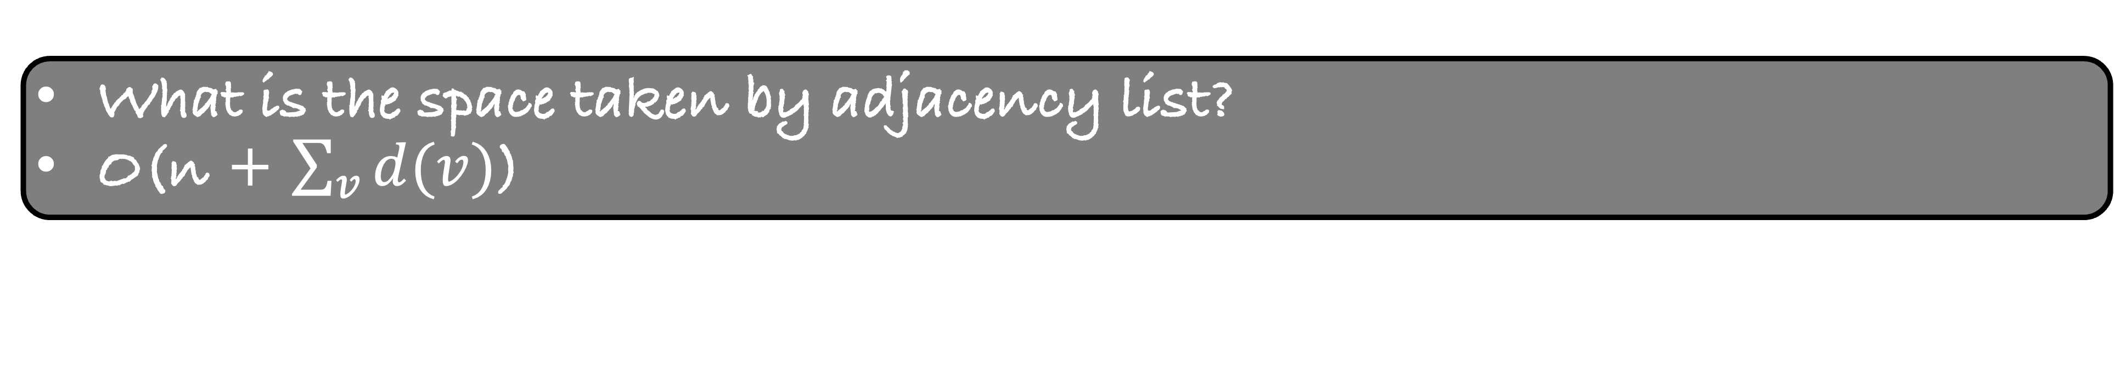
4
0
1
2
2
3
1
0
5
0
5
2
0
5
3
4
3
4
5
2
4
2
3
1
5
3
1
2
Adjacency List
What is the space taken by adjacency list?
O(n + $\sum_{v}{d(v)}$)

Slide 10
4
0
1
2
2
3
1
0
5
0
5
2
0
5
3
4
3
4
5
2
4
2
3
1
5
3
1
2
What is the space taken by adjacency list?
O(n + m)

Slide 11
0
1
2
Most graph algorithms require you to list the neighbours of a vertex quickly
1
0
5
2
0
5
3
4
How much time does it take to list the neighbours of a vertex?
3
4
5
2
O(d(v))
4
2
3
5
3
1
2
These are the advantages of adjacency list
What are its disadvantages?
Slightly hard to implement
Not easy to check if an edge is present in the graph or not

Slide 12

We will use adjacency list which is “easy” to implement
Our adjacency list will take O($n^{2}$) space
But we will retain the main property of adjacency list
Most graph algorithms require you to list the neighbours of a vertex quickly

Slide 13
0
1
2
0
1
2
0
0
0
0
1
0
5
1
0
5
0
0
0
0
2
0
5
3
4
2
0
5
3
4
0
0
3
4
5
2
4
2
3
3
4
5
2
0
0
0
5
3
1
2
4
2
3
0
0
0
0
5
3
2
1
0
0
0

Slide 14
0
1
2
0
1
2
0
0
0
0
1
0
5
1
0
5
0
0
0
0
2
0
5
3
4
2
0
5
3
4
0
0
3
4
5
2
4
2
3
3
4
5
2
0
0
0
5
3
1
2
4
2
3
0
0
0
0
5
3
2
1
0
0
0
But then how would we know when the list has ended?

Slide 15
0
1
2
0
1
2
0
0
0
0
1
0
5
1
0
5
0
0
0
0
2
0
5
3
4
2
0
5
3
4
0
0
3
4
5
2
4
2
3
3
4
5
2
0
0
0
5
3
1
2
4
2
3
0
0
0
0
5
3
2
1
0
0
0
degree
2
2
4
3
2
3

Slide 16
0
1
2
0
0
0
0
This is not a space efficient data-structure
But it is easy to implement
1
0
5
0
0
0
0
2
0
5
3
4
0
0
3
4
5
2
0
0
0
4
2
3
0
0
0
0
5
3
2
1
0
0
0
degree
2
2
4
3
2
3

Slide 17
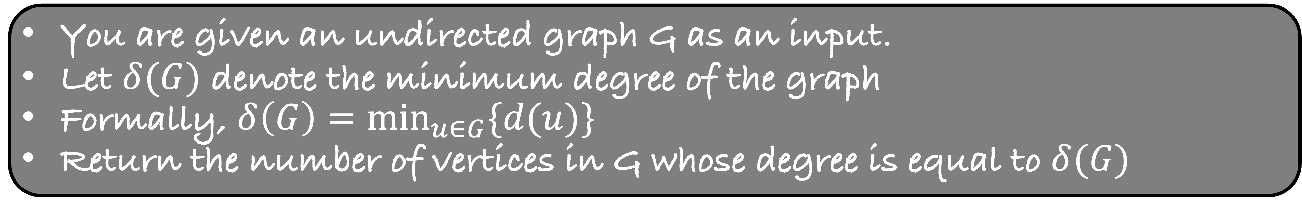
You are given an undirected graph G as an input.
Let $δ(G)$ denote the minimum degree of the graph
Formally, $δ\left(G\right)=\min_{u∈G}{\{d(u)\}}$
Return the number of vertices in G whose degree is equal to $δ(G)$

Slide 18
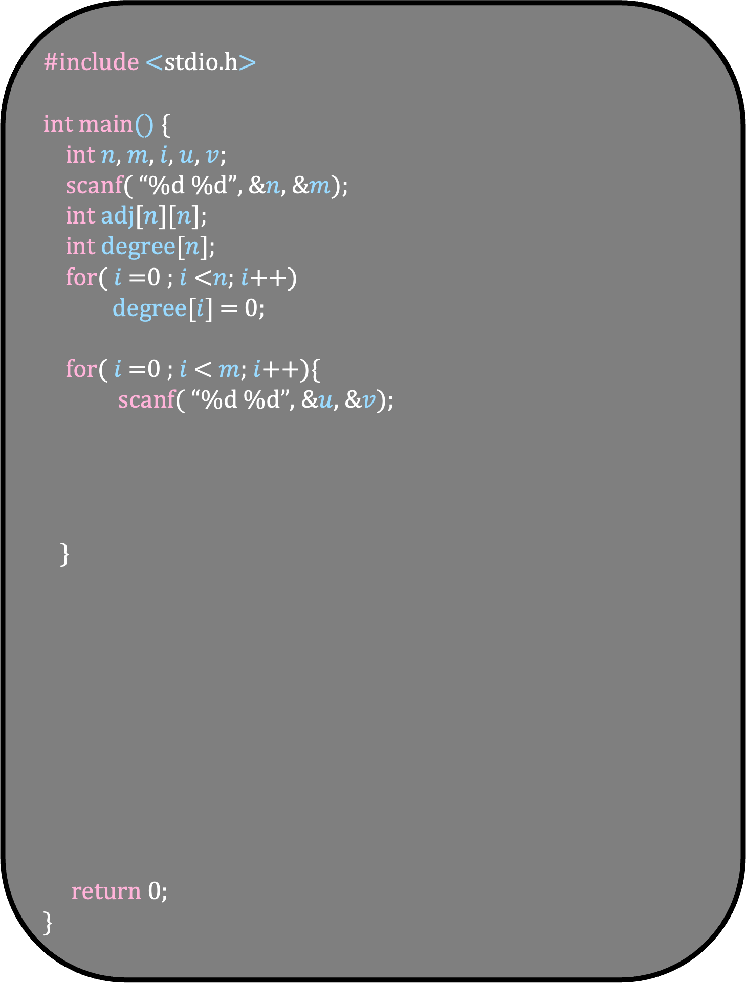
#include <stdio.h>
int main() {
int $n$, $m$, $i$, $u$, $v$;
scanf( “%d %d”, &$n$, &$m$);
int adj[$n$][$n$];
int degree[$n$];
for( $i$ =0 ; $i$ <$n$; $i$++)
degree[$i$] = 0;
for( $i$ =0 ; $i$ < $m$; $i$++){
scanf( “%d %d”, &$u$, &$v$);
}
return 0;
}

Slide 19
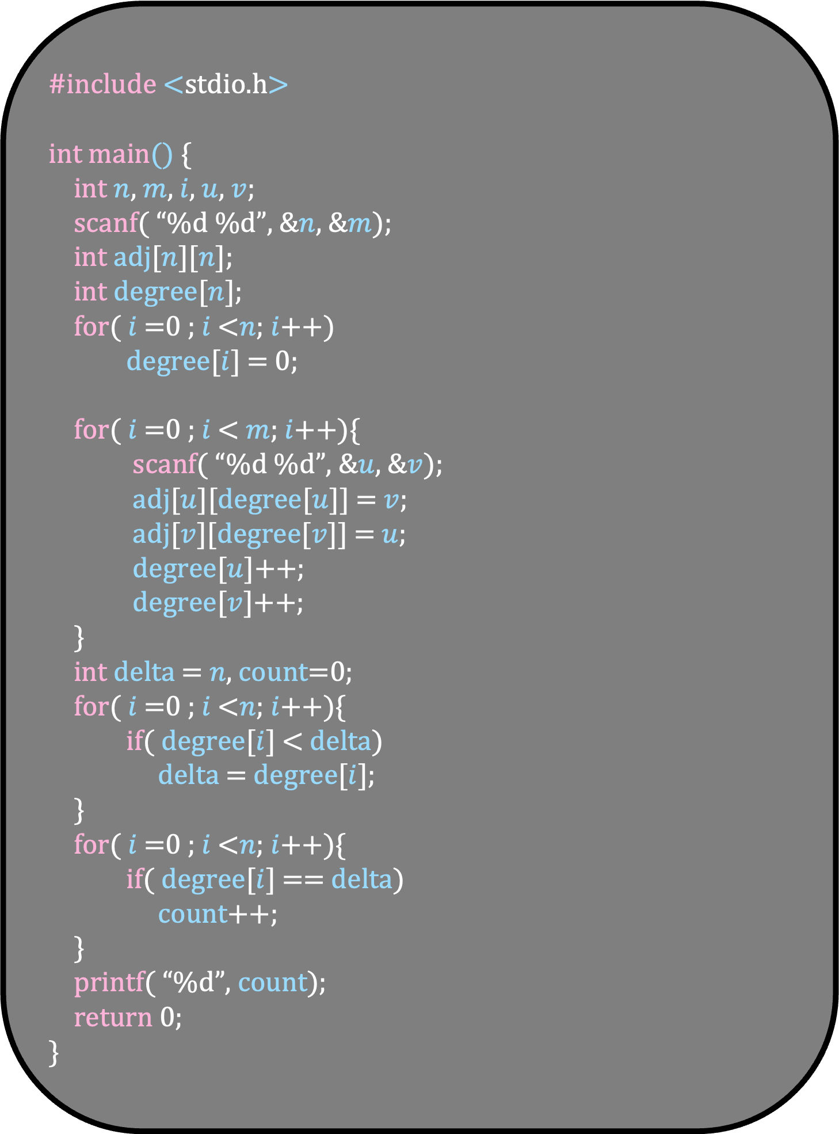
#include <stdio.h>
int main() {
int $n$, $m$, $i$, $u$, $v$;
scanf( “%d %d”, &$n$, &$m$);
int adj[$n$][$n$];
int degree[$n$];
for( $i$ =0 ; $i$ <$n$; $i$++)
degree[$i$] = 0;
for( $i$ =0 ; $i$ < $m$; $i$++){
scanf( “%d %d”, &$u$, &$v$);
adj[$u$][degree[$u$]] = $v$;
adj[$v$][degree[$v$]] = $u$;
degree[$u$]++;
degree[$v$]++;
}
int delta = $n$, count=0;
for( $i$ =0 ; $i$ <$n$; $i$++){
if( degree[$i$] < delta)
delta = degree[$i$];
}
for( $i$ =0 ; $i$ <$n$; $i$++){
if( degree[$i$] == delta)
count++;
}
printf( “%d”, count);
return 0;
}

Slide 20
Directed graph
A graph contains a set of vertices
And a set of edges
An edge is from one vertex to another vertex
4
2
3
0
5
1

Slide 21
4
6 9
2 4
4 3
3 2
3 5
5 2
0 2
0 1
5 1
1 0
2
3
0
5
1

Slide 22
4
0
1
2
3
2
0
5
3
4
1
5

Slide 23
4
0
1
2
0
0
0
0
1
0
0
0
0
0
0
2
3
2
4
0
0
0
0
0
0
5
3
2
5
0
0
0
0
4
3
0
0
0
0
0
1
5
1
2
0
0
0
0
outdegree
2
1
1
2
1
2
indegree
1
2
3
1
1
1

Slide 24
You are given a directed graph G as an input.
Count the number of pairs of vertices that are connected to each other in both directions
Count each unordered pair of distinct vertices {u,v} once if both edges u →v and v → u exist
4
2
3
0
5
Ans=1
1

Slide 25
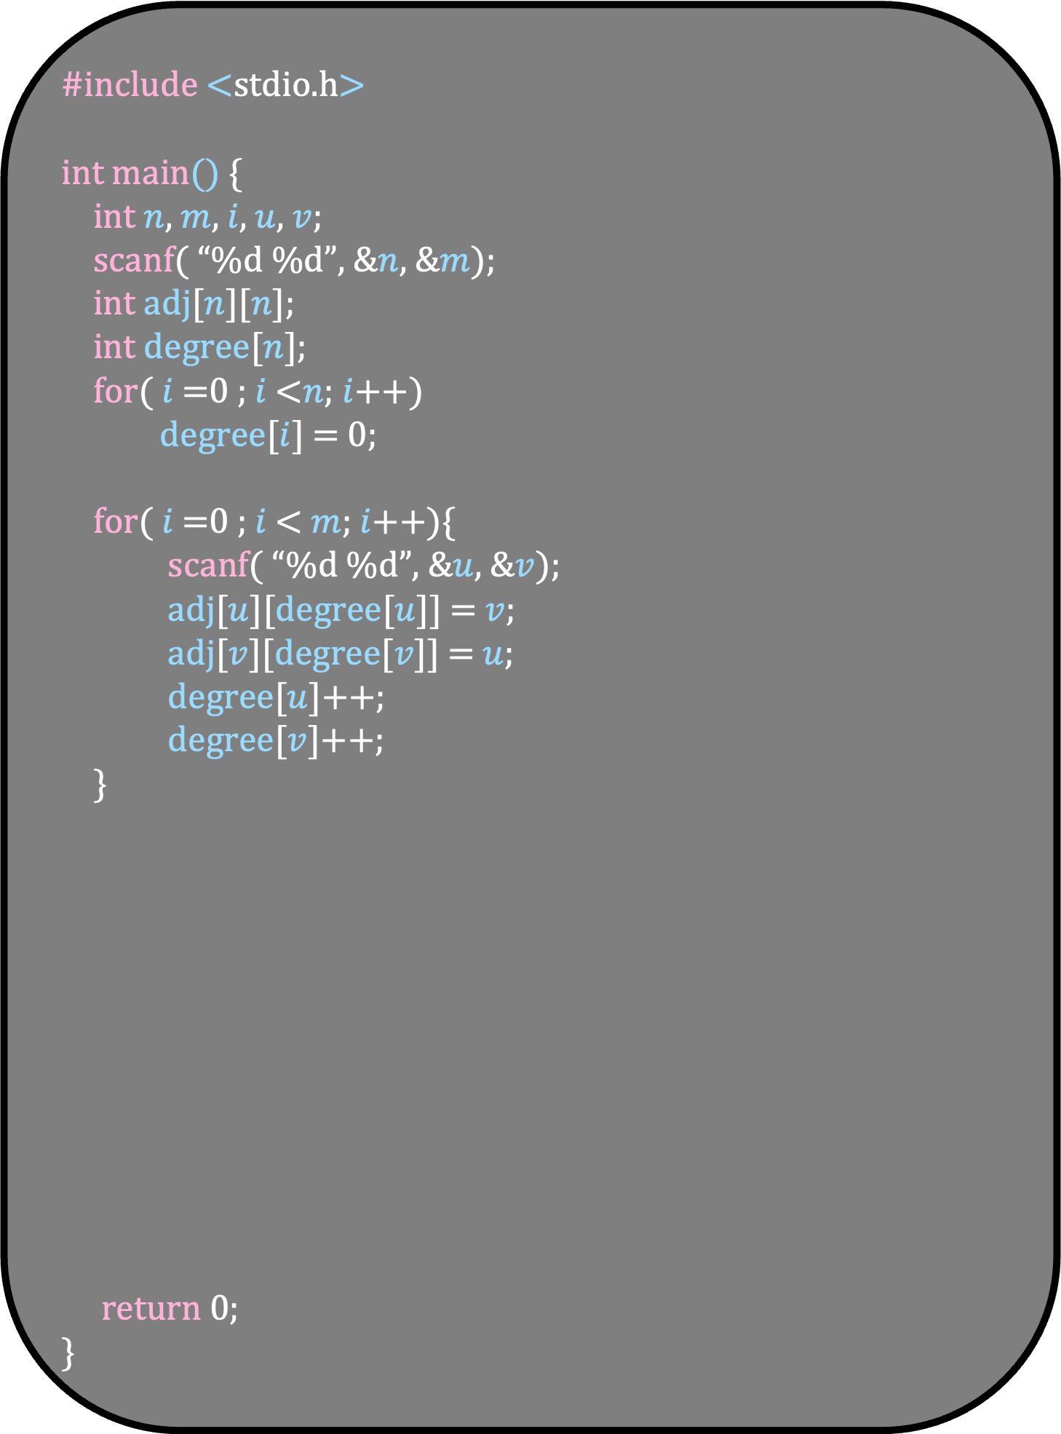
#include <stdio.h>
int main() {
int $n$, $m$, $i$, $u$, $v$;
scanf( “%d %d”, &$n$, &$m$);
int adj[$n$][$n$];
int degree[$n$];
for( $i$ =0 ; $i$ <$n$; $i$++)
degree[$i$] = 0;
for( $i$ =0 ; $i$ < $m$; $i$++){
scanf( “%d %d”, &$u$, &$v$);
adj[$u$][degree[$u$]] = $v$;
adj[$v$][degree[$v$]] = $u$;
degree[$u$]++;
degree[$v$]++;
}
return 0;
}

Slide 26
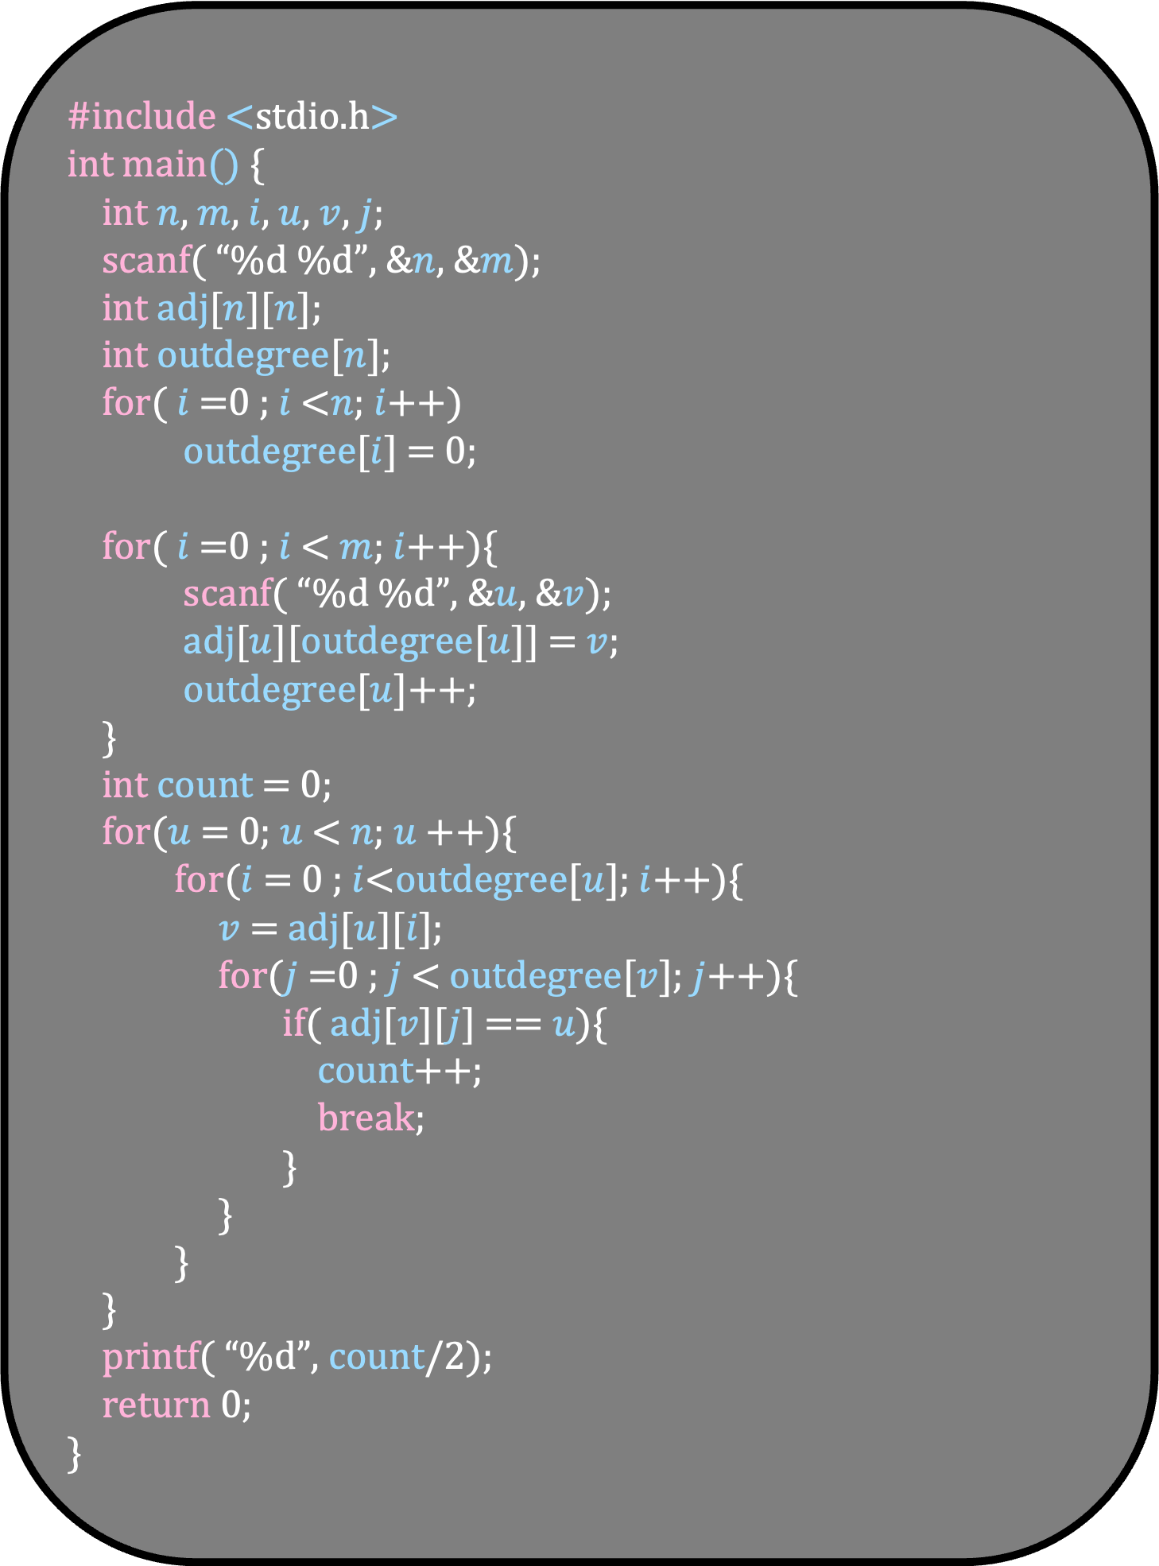
#include <stdio.h>
int main() {
int $n$, $m$, $i$, $u$, $v$, $j$;
scanf( “%d %d”, &$n$, &$m$);
int adj[$n$][$n$];
int outdegree[$n$];
for( $i$ =0 ; $i$ <$n$; $i$++)
outdegree[$i$] = 0;
for( $i$ =0 ; $i$ < $m$; $i$++){
scanf( “%d %d”, &$u$, &$v$);
adj[$u$][outdegree[$u$]] = $v$;
outdegree[$u$]++;
}
int count = 0;
for($u$ = 0; $u$ < $n$; $u$++){
for($i$ = 0 ; $i$<outdegree[$u$]; $i$++){
$v$ = adj[$u$][$i$];
for($j$=0 ; $j$< outdegree[$v$]; $j$++){
if( adj[$v$][$j$] == $u$){
count++;
break;
}
}
}
}
printf( “%d”, count/2);
return 0;
}

Slide 27
You are given an undirected graph G.
A triangle in the graph is a tuple (u,v,w) such that u →v and v → w and w →u exist
Report the number of triangles in the graph
4
2
3
Number of triangles = 2
0
5
1

Slide 28
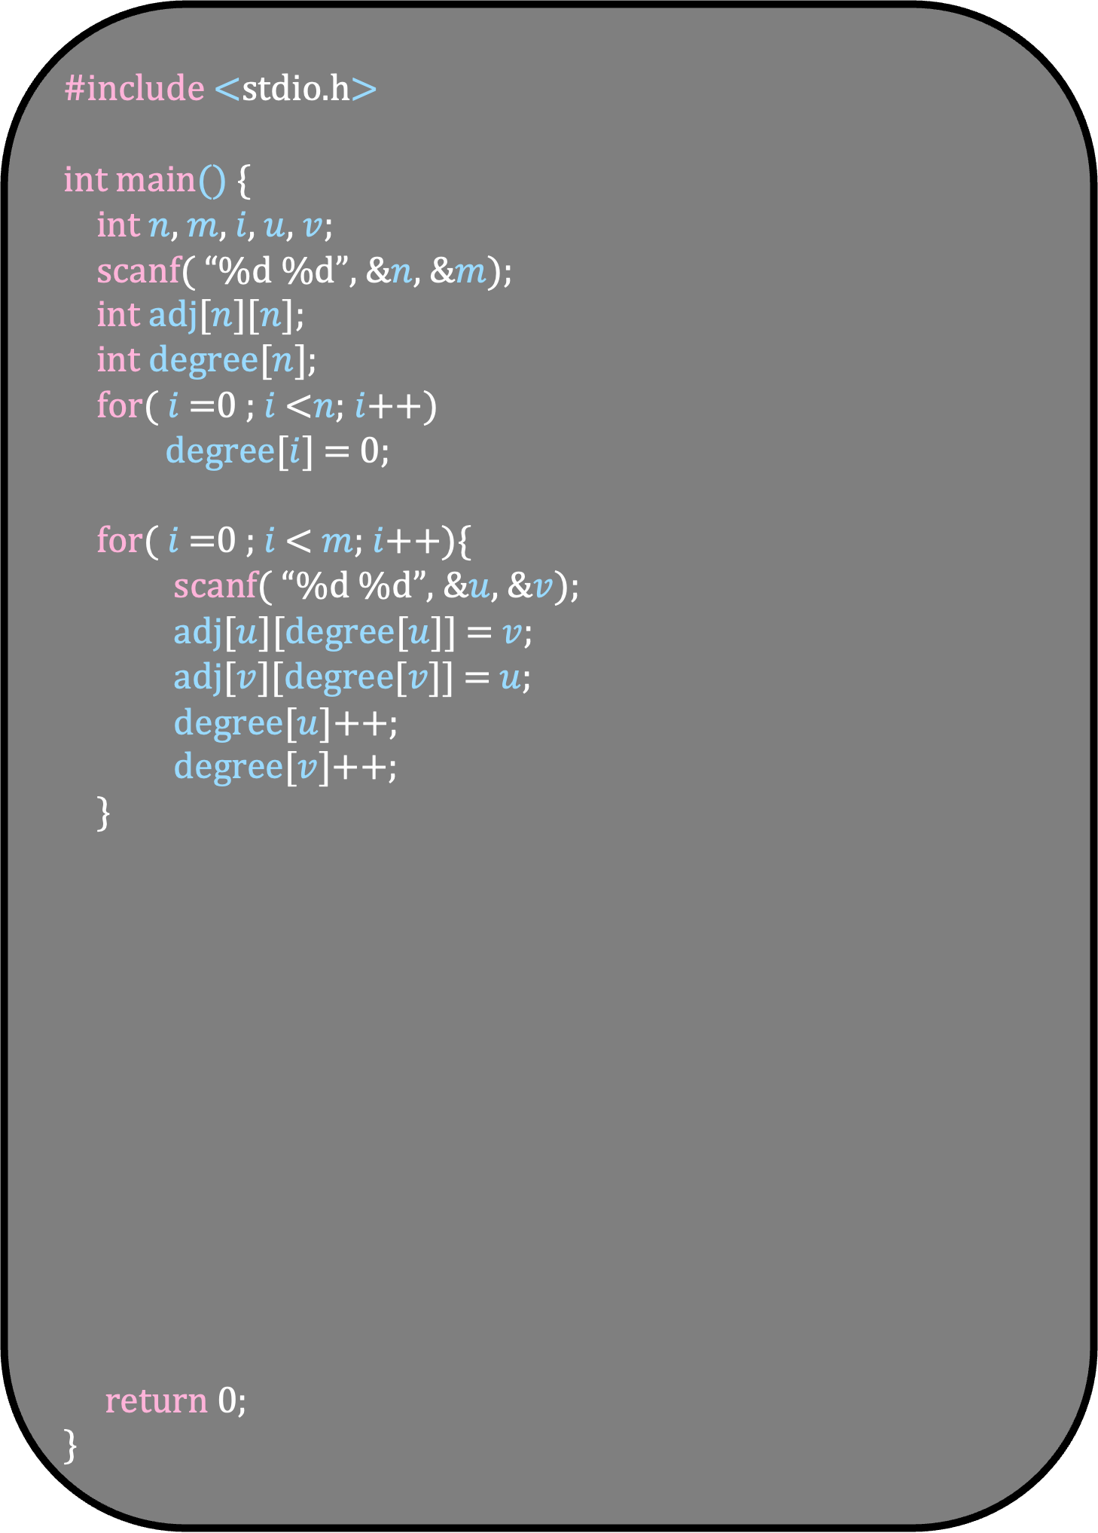
#include <stdio.h>
int main() {
int $n$, $m$, $i$, $u$, $v$;
scanf( “%d %d”, &$n$, &$m$);
int adj[$n$][$n$];
int degree[$n$];
for( $i$ =0 ; $i$ <$n$; $i$++)
degree[$i$] = 0;
for( $i$ =0 ; $i$ < $m$; $i$++){
scanf( “%d %d”, &$u$, &$v$);
adj[$u$][degree[$u$]] = $v$;
adj[$v$][degree[$v$]] = $u$;
degree[$u$]++;
degree[$v$]++;
}
return 0;
}

Slide 29
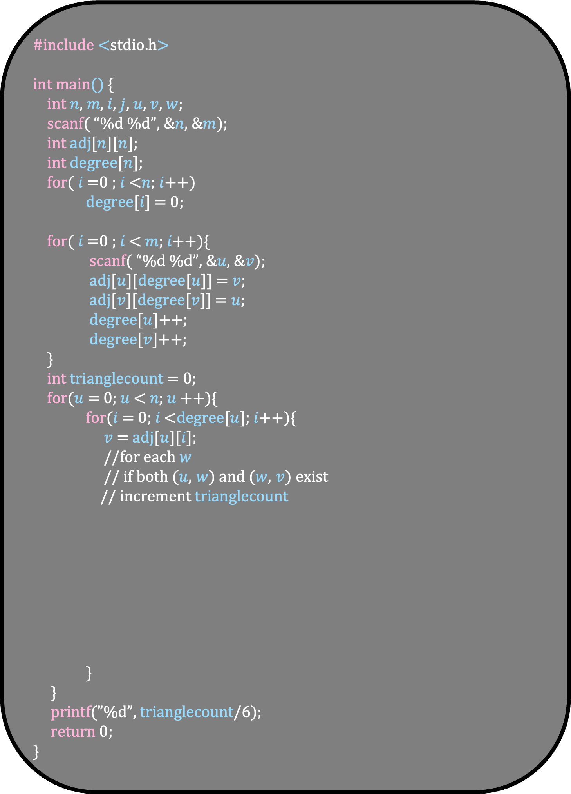
#include <stdio.h>
int main() {
int $n$, $m$, $i$, $j$, $u$, $v$, $w$;
scanf( “%d %d”, &$n$, &$m$);
int adj[$n$][$n$];
int degree[$n$];
for( $i$ =0 ; $i$ <$n$; $i$++)
degree[$i$] = 0;
for( $i$ =0 ; $i$ < $m$; $i$++){
scanf( “%d %d”, &$u$, &$v$);
adj[$u$][degree[$u$]] = $v$;
adj[$v$][degree[$v$]] = $u$;
degree[$u$]++;
degree[$v$]++;
}
int trianglecount = 0;
for($u$ = 0; $u$ < $n$; $u$++){
for($i$ = 0; $i$ <degree[$u$]; $i$++){
$v$ = adj[$u$][$i$];
//for each $w$
// if both ($u$, $w$) and ($w$, $v$) exist
// increment trianglecount
}
}
printf(”%d”, trianglecount/6);
return 0;
}

Slide 30
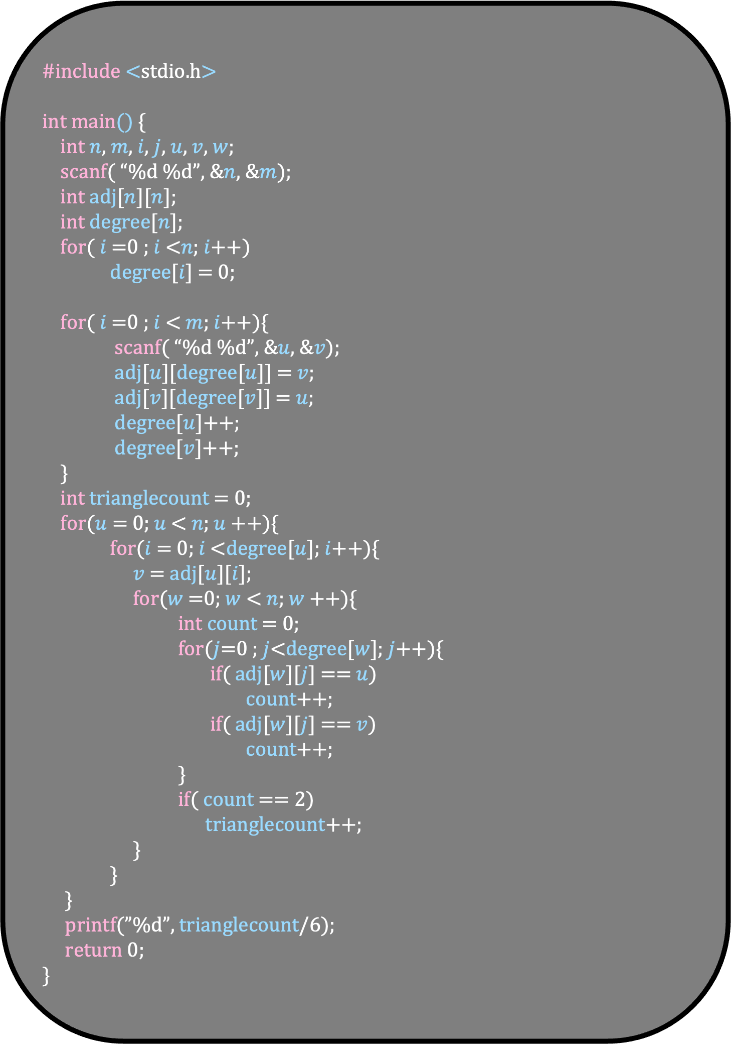
#include <stdio.h>
int main() {
int $n$, $m$, $i$, $j$, $u$, $v$, $w$;
scanf( “%d %d”, &$n$, &$m$);
int adj[$n$][$n$];
int degree[$n$];
for( $i$ =0 ; $i$ <$n$; $i$++)
degree[$i$] = 0;
for( $i$ =0 ; $i$ < $m$; $i$++){
scanf( “%d %d”, &$u$, &$v$);
adj[$u$][degree[$u$]] = $v$;
adj[$v$][degree[$v$]] = $u$;
degree[$u$]++;
degree[$v$]++;
}
int trianglecount = 0;
for($u$ = 0; $u$ < $n$; $u$++){
for($i$ = 0; $i$ <degree[$u$]; $i$++){
$v$ = adj[$u$][$i$];
for($w$=0; $w$ < $n$; $w$++){
int count = 0;
for($j$=0 ; $j$<degree[$w$]; $j$++){
if( adj[$w$][$j$] == $u$)
count++;
if( adj[$w$][$j$] == $v$)
count++;
}
if( count == 2)
trianglecount++;
}
}
}
printf(”%d”, trianglecount/6);
return 0;
}

Slide 31
You are given an undirected graph G
A path of length two counts the path u — v—w
Note that path u—v—w is same as w—v — u and should be counted just once
Report the (number of length 2 paths in G) mod 5
The time taken by your algorithm should be O(m+n)
The number of length 2 paths can be huge
So int may not be large enough to fit in the number of paths
Thus, we report a smaller number
Remember that (a+b) mod 5 = (a mod 5 + b mod 5) mod 5

Slide 32
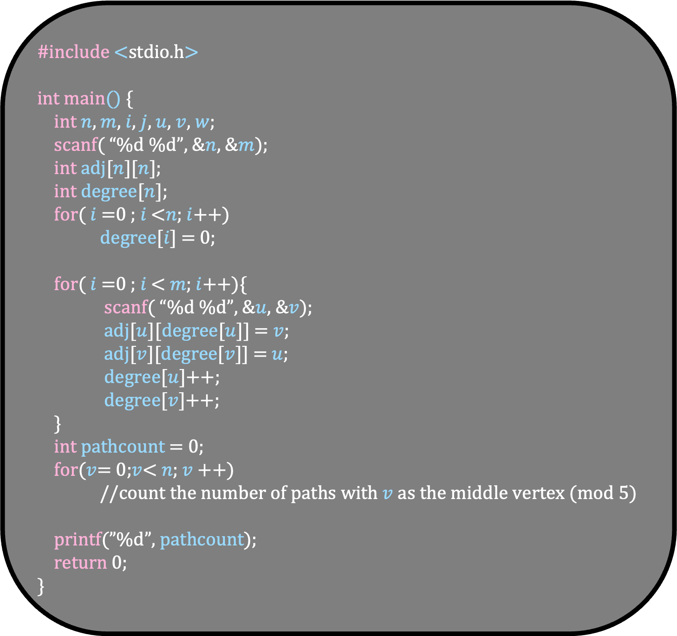
#include <stdio.h>
int main() {
int $n$, $m$, $i$, $j$, $u$, $v$, $w$;
scanf( “%d %d”, &$n$, &$m$);
int adj[$n$][$n$];
int degree[$n$];
for( $i$ =0 ; $i$ <$n$; $i$++)
degree[$i$] = 0;
for( $i$ =0 ; $i$ < $m$; $i$++){
scanf( “%d %d”, &$u$, &$v$);
adj[$u$][degree[$u$]] = $v$;
adj[$v$][degree[$v$]] = $u$;
degree[$u$]++;
degree[$v$]++;
}
int pathcount = 0;
for($v$= 0;$v$< $n$; $v$++)
//count the number of paths with $v$ as the middle vertex (mod 5)
printf(”%d”, pathcount);
return 0;
}

Slide 33
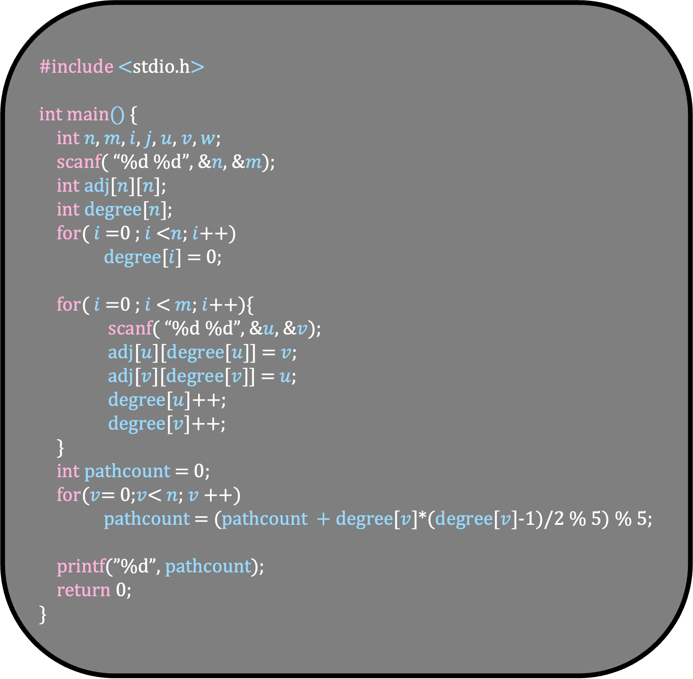
#include <stdio.h>
int main() {
int $n$, $m$, $i$, $j$, $u$, $v$, $w$;
scanf( “%d %d”, &$n$, &$m$);
int adj[$n$][$n$];
int degree[$n$];
for( $i$ =0 ; $i$ <$n$; $i$++)
degree[$i$] = 0;
for( $i$ =0 ; $i$ < $m$; $i$++){
scanf( “%d %d”, &$u$, &$v$);
adj[$u$][degree[$u$]] = $v$;
adj[$v$][degree[$v$]] = $u$;
degree[$u$]++;
degree[$v$]++;
}
int pathcount = 0;
for($v$= 0;$v$< $n$; $v$++)
pathcount = (pathcount + degree[$v$]*(degree[$v$]-1)/2 % 5) % 5;
printf(”%d”, pathcount);
return 0;
}

