Slide 1

HOTEL RATING CLASSIFICATION
Presentation by team 1

Slide 2
TEAM MEMBERS
ANUP
DHAWAN
SHOAIB
ADHULYA P
SNEHA S
SANDHRA SRIRAJ

Slide 3
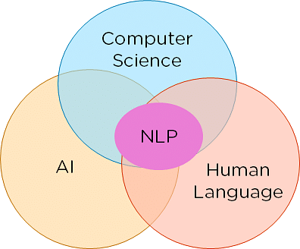
WHAT IS NLP
Natural Language Processing (NLP): This is a field of artificial intelligence (AI) that focuses on the interaction between computers and humans through natural language. The ultimate objective of NLP is to enable computers to understand, interpret, and generate human language in a way that is both meaningful and useful. NLP involves several challenges, including natural language understanding, language generation, machine translation, sentiment analysis, and more.

Slide 4
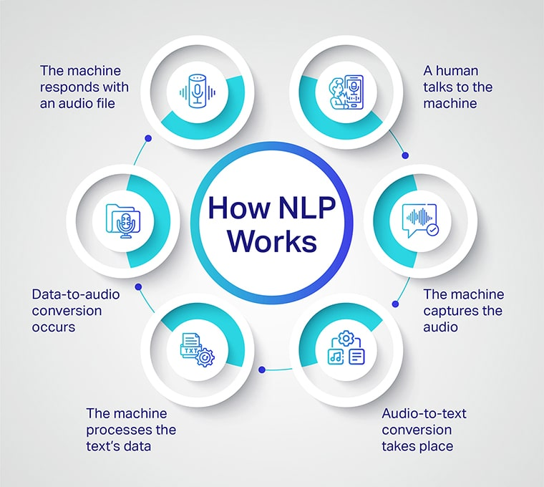

Slide 5
OBJECTIVE
Examine how travelers are communicating their positive and negative experiences in online platforms for staying in a specific hotel.
Find out what are the attributes that travelers are considering while selecting a hotel. Which elements of the hotel influence more in forming a positive review or improves hotel brand image.

Slide 6
IMPORTING THE LIBRARIES
import pandas as pd
import matplotlib.pyplot as plt
import plotly.express as px
import numpy as np
import seaborn as sns
from google.colab import drive
drive.mount('/content/drive’)
import re
from textblob import TextBlob
import nltk
from nltk.corpus import stopwords
from nltk.stem import WordNetLemmatizer
from sklearn.feature_extraction.text import CountVectorizer,TfidfVectorizer
from wordcloud import WordCloud
from sklearn.model_selection import train_test_split
from sklearn.ensemble import RandomForestClassifier
from sklearn.pipeline import Pipeline
from sklearn.metrics import accuracy_score,classification_report,confusion_matrix

Slide 7
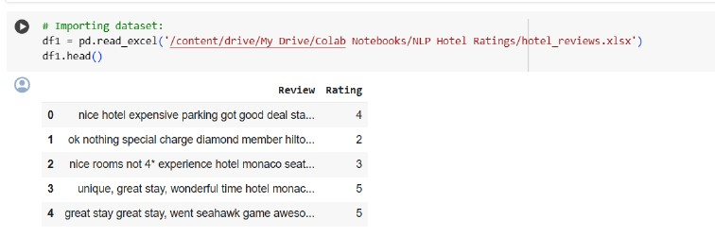
READING THE DATA

Slide 8
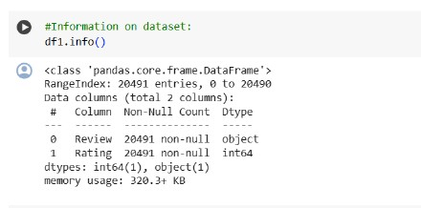
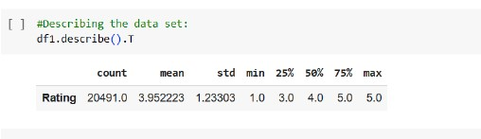
DATA OVERVIEW
Info and describtion of data

Slide 9
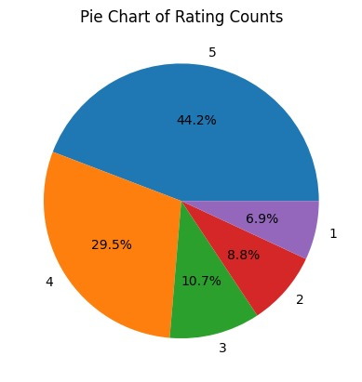
Pie chart
The majority of ratings are 5, followed by 4, then 3, then 2, then 1. This suggests that the majority of people are satisfied with their experience.
The ratings are not evenly distributed, as there is a large gap between the highest and lowest ratings. This suggests that there is a high variance in the quality and experience of the stay.
We can clearly notice class imbalance.
No duplicates or null values in data set.

Slide 10
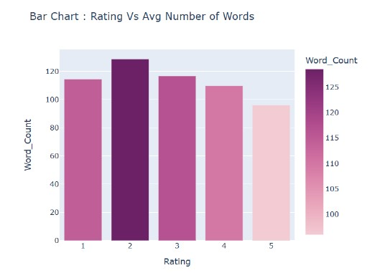
BAR CHART
We can see that there are few reviews that can be considered outliers based on their length.
Sometimes these kind of lengthy reviews provide us more information or they may containe noise and irrelevent details.
However, removing them will make our dataset more balanced and representative of the overall population of reviews and it will also make the model faster and more scalable.
We can also note that on an average, Positive reviews are more lengthy as compared to negative reviews.

Slide 11
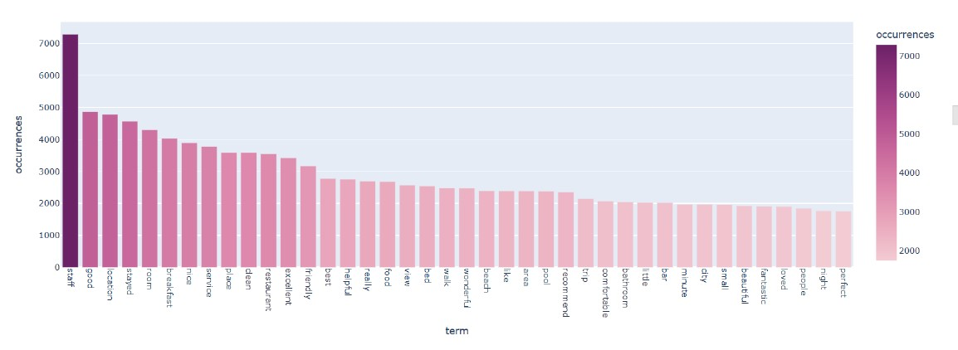
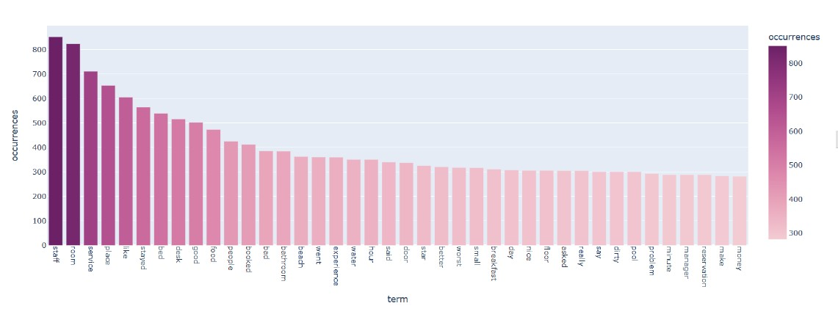
UNI-GRAM
Uni-grams for positive reviews with rating = 5
Uni-grams for negative reviews with rating = 1

Slide 12
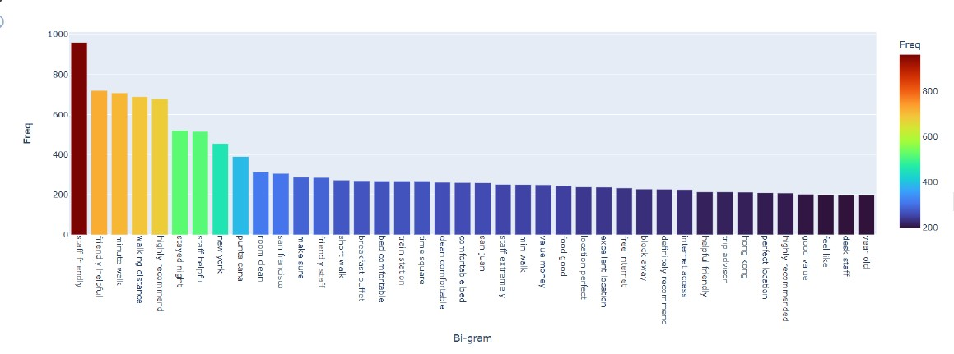
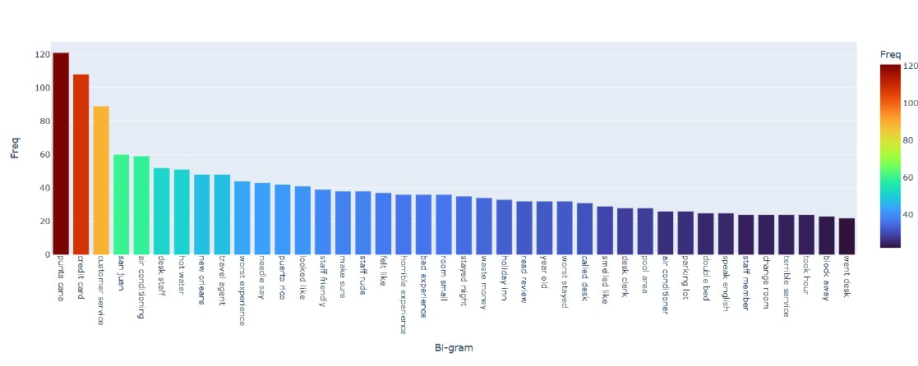
BI-GRAM
Bar chart of most common positive Bi-grams
Bar chart of most common negative Bi-grams

Slide 13
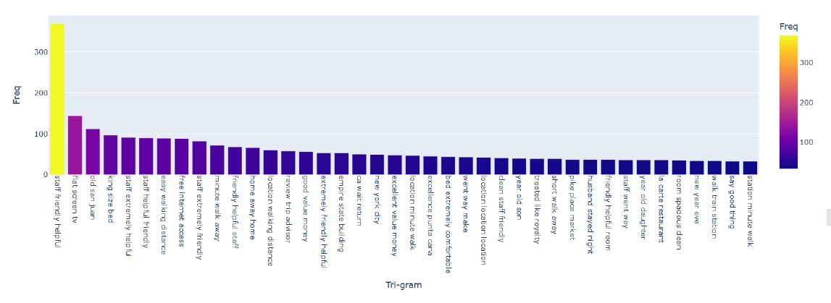
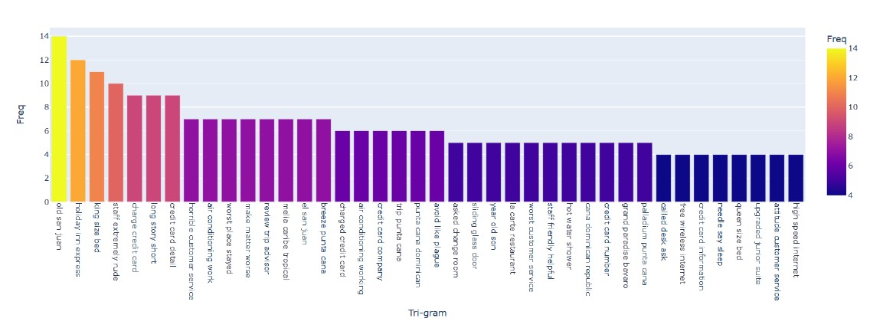
TRI-GRAM
Bar chart of most common positive Tri-gram
Bar chart of most common negative Tri-grams

Slide 14
SENTIMENT ANALYSIS
Polarity is a float value within the range [-1.0 to 1.0] that indicates how positive or negative a text is. A value of 0 means neutral, a value closer to 1 means very positive, and a value closer to -1 means very negative.
Subjectivity is a float value within the range [0.0 to 1.0] that indicates how objective or subjective a text is. A value of 0 means very objective, a value of 1 means very subjective, and a value in between means a mix of both. Objective texts are based on factual information, while subjective texts are based on personal opinions, emotions, or judgments.

Slide 15
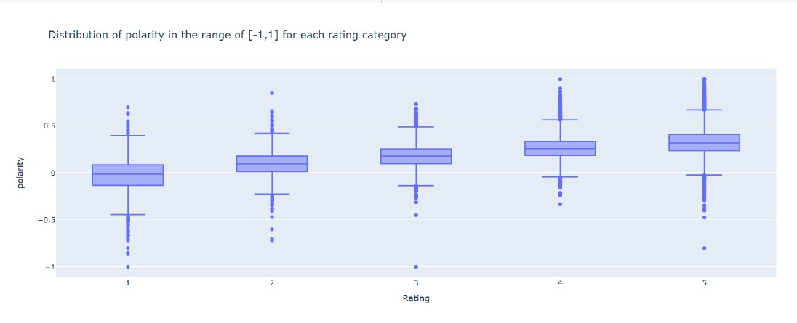
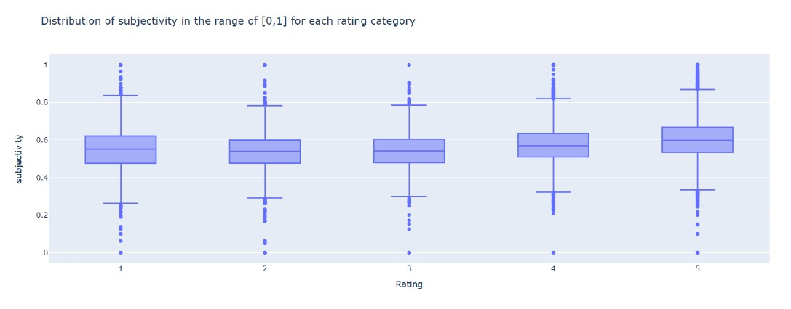
BOX PLOT

