Slide 1
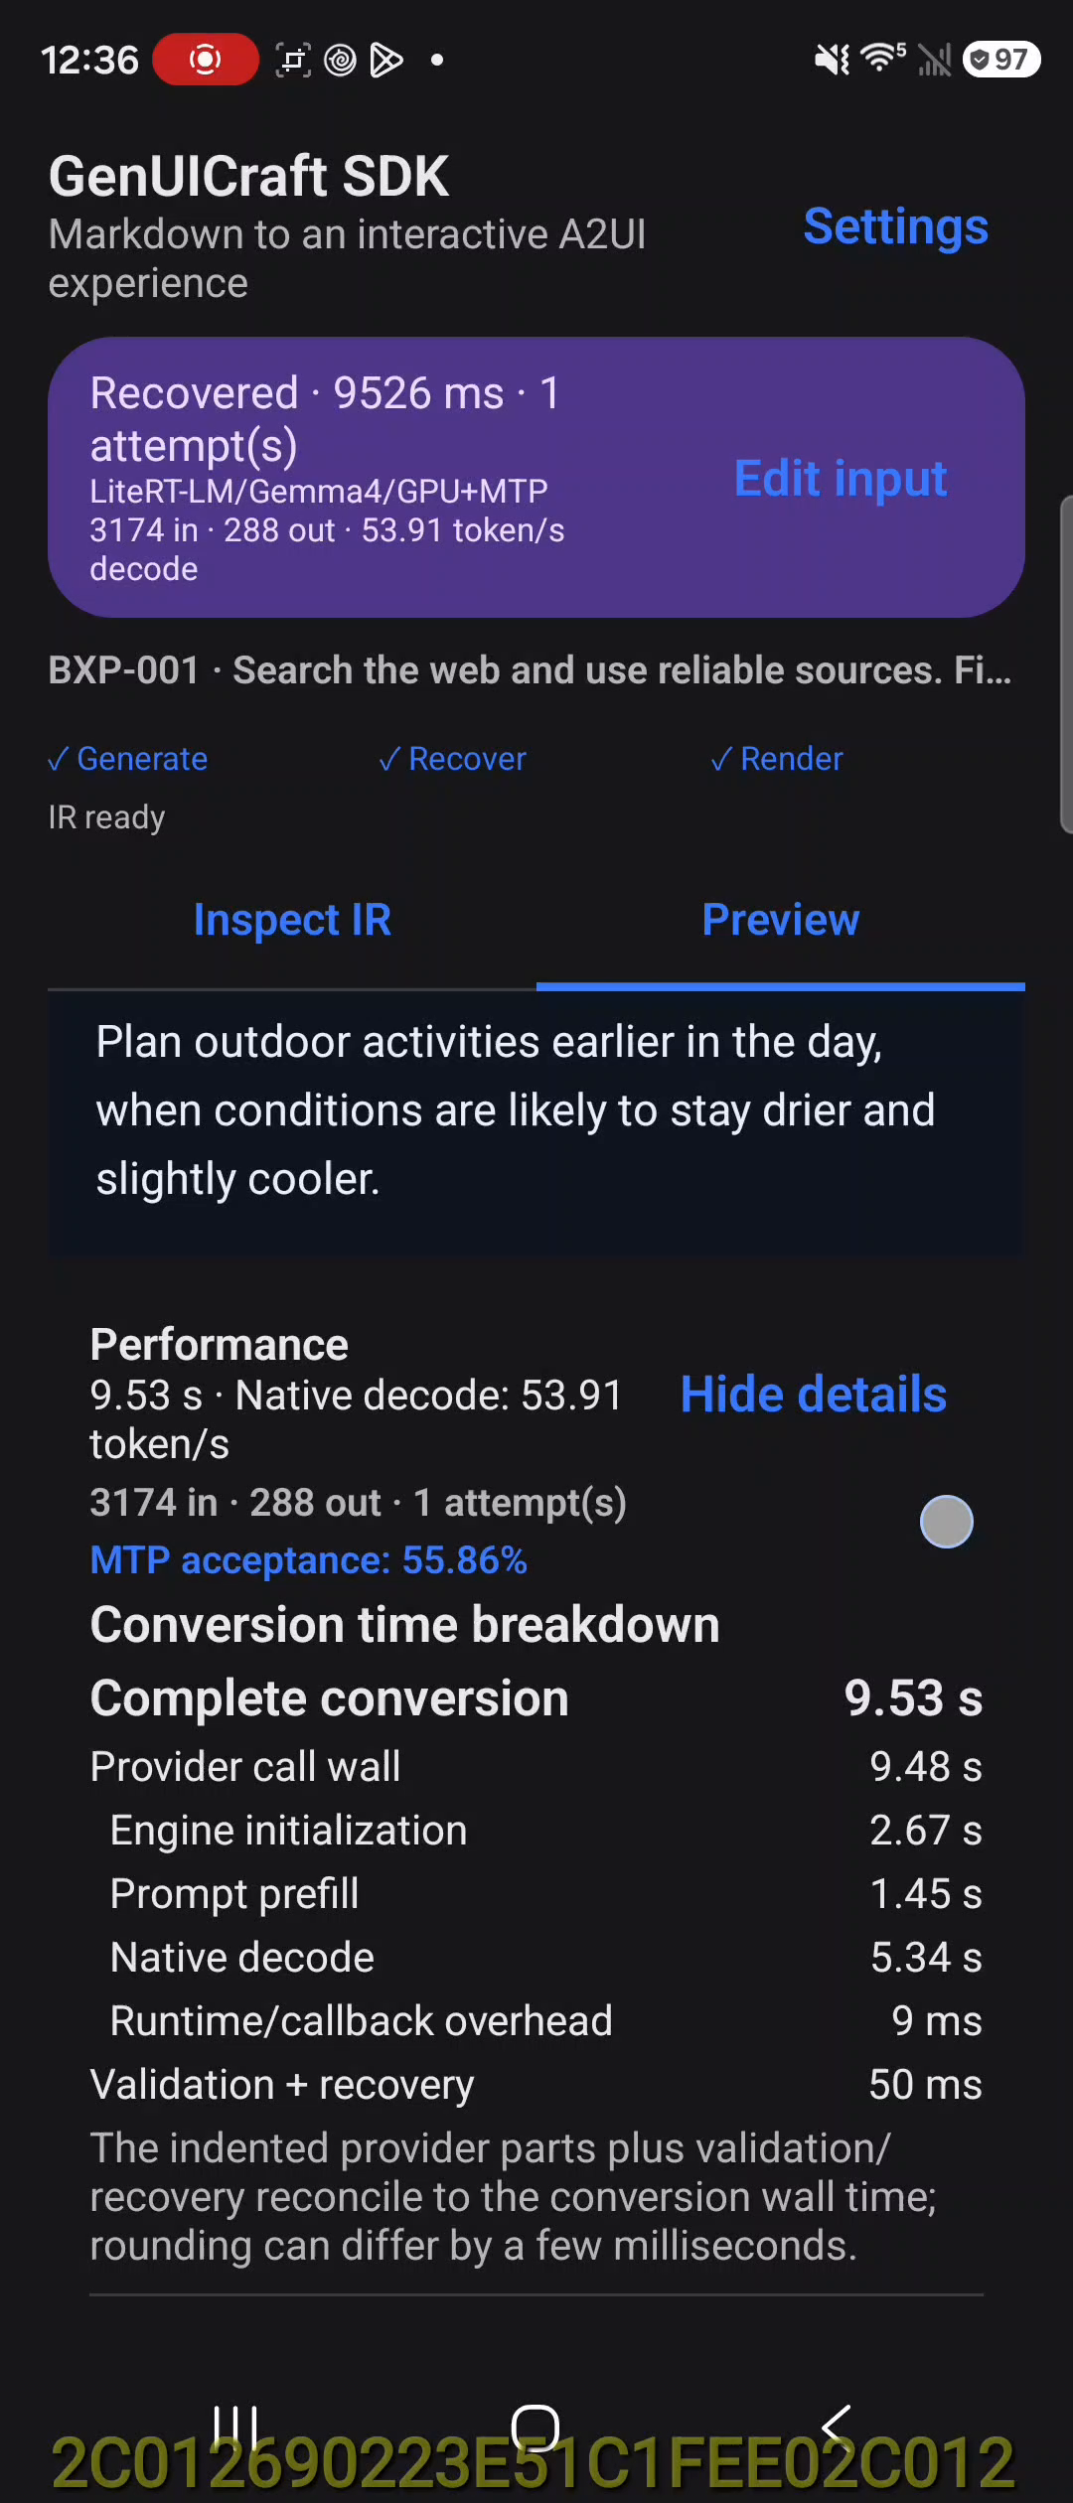
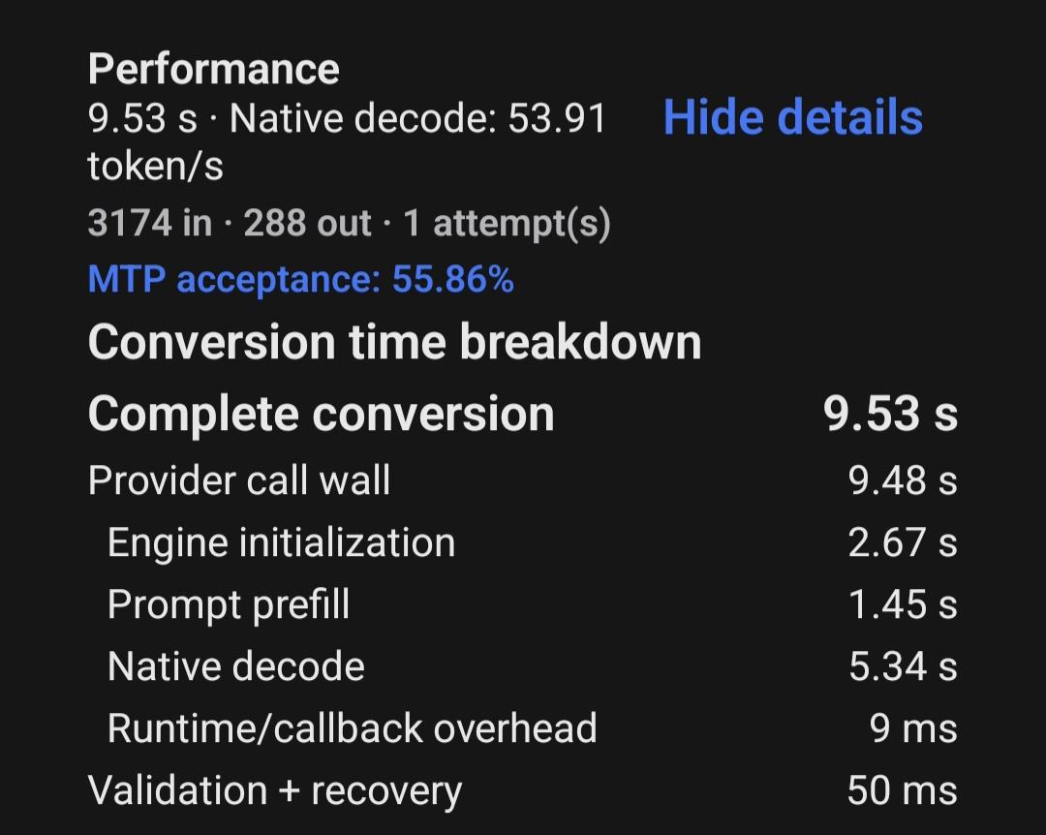
Bixby50 Markdown to A2UI on Fold8
Trained E2B W4 on GPU with MTP, sample BXP-001
Demo recording
Captured performance
Latency breakdown
9.53 s
Complete conversion
3,174 input tokens 288 output tokens
Provider call wall
9.48 s
Engine initialization
2.67 s
Prompt prefill
1.45 s
Native decode
5.34 s
Runtime/callback
9 ms
Validation + recovery
50 ms
17.75 s Fold8 capture
Native decode rate
53.91 token/s
Live IR, recovered output, and native A2UI rendering
MTP acceptance
55.86%
Notes:
Source: Galaxy Fold8 SM-F776U, serial R3GL203AKSF, 23 Sep 2026. Screen recording Screen_Recording_20260923_003626_GenUICraft.mp4, SHA-256 2dcc...2b1975, duration 17.75 seconds. Screenshot Screenshot_20260923_003645_GenUICraft.jpg, SHA-256 57f2...4db82. Both show BXP-001 with trained E2B W4 on LiteRT GPU+MTP. Values on slide transcribed exactly from the screenshot: 9.53 s conversion, 9.48 s provider wall, 2.67 s init, 1.45 s prefill, 5.34 s decode, 9 ms runtime/callback, 50 ms validation/recovery, 53.91 token/s, 55.86% MTP acceptance.

