Slide 1
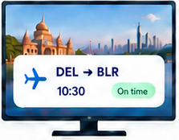


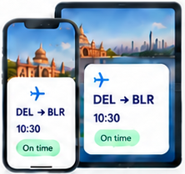





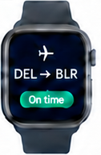

End to End Architecture
TV / PC
AI Agent 1
Mobile / Tablet
GenUI Craft LM
IR
Agent
responses
Native Renderer
A2UI Express
Device-adaptive UI
AI Agent 2
User Utterance
Response to IR generation
Intermediate
Representation
Voice or text
Watch
AI Agent 3
Notes:
Source: the architecture image supplied by the user in this conversation, codex-clipboard-136cdd9c-dde4-44c3-a2f8-81064a3a48eb.png.
User utterances fan out to AI Agents 1, 2 and 3. Their responses enter GenUI Craft LM with A2UI Express. The model generates an intermediate representation, which the native renderer adapts to TV/PC, mobile/tablet and watch.
The Delhi-to-Bengaluru flight cards are illustrative UI examples from the reference, not live flight information. The watch intentionally omits the 10:30 time shown by the other devices.

