Slide 1
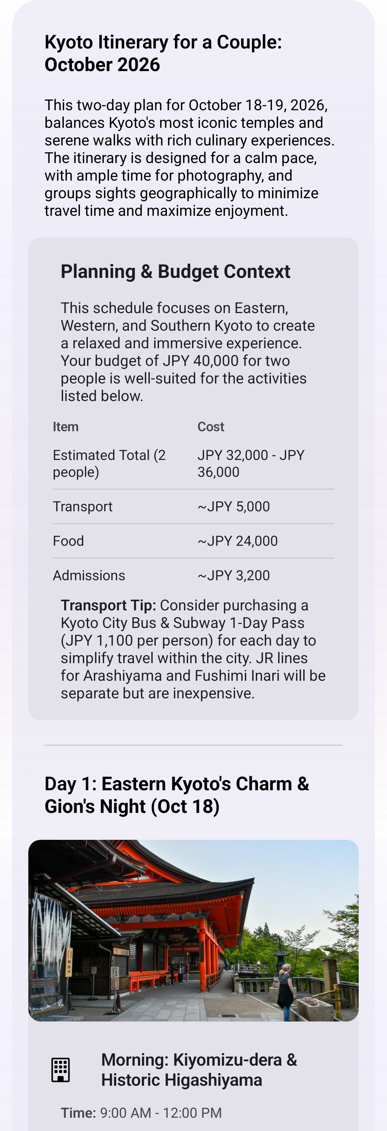
GenUICraft FlatSpec IR: data model + UI graph
Kyoto response -> FlatSpec JSON -> OneUI-native Android render.
Response
FlatSpec
OneUI
Rendered Android surface
08_u_000008_01
Natural language itinerary, media, actions
->
->
Renderer owns layout, style, actions
root + state + elements
root
Entry point: kyoto_itinerary
state
Reusable data: budgetRows, dayCards
elements
Flat component graph: Text, Table, Card, Image, Button
bindings
$item, repeat, statePath, openUrl
Representative IR pattern
{
"root": "kyoto_itinerary",
"state": {
"budgetRows": [...],
"dayCards": [{ "title": "...", "image": "...", "url": "..." }]
},
"elements": {
"budgetTable": { "type": "Table",
"props": { "statePath": "/budgetRows" }},
"dayCardTemplate": { "type": "Card",
"repeat": { "statePath": "/dayCards" }}
}
}
Why this matters
No executable UI code. Compact state-driven tables/cards. Local validation and repair before render. Compose owns OneUI typography, spacing, cards, dark mode, and actions.

