Slide 1


Intelligent FX Reporter Blaze Scope Document
Global Data Science Team
August 2019

Slide 2

Agenda
Business Challenges
Proposed Solution
MVP Details
Data Scope & Requirements
Architecture
Delivery
Deliverables
Roles & Responsibilities
Assumptions
Risks
Timelines
Success Criteria
Business Value

Slide 3

Business Challenges
Current process is operated manually with majority of the business knowledge residing only to specific employees.
Not all employees are following the same process or sources to prepare reports.
Cannot execute analysis on historical level (Lack of the first layer of the “ML cake”)
Effort and time spend from the Product Controller to establish the high-level picture for FXO products.
The Product Owner
loses time on trivial tasks (when there is no any notable movement on the FX products)
but also spends significant time on mundane tasks (google search) to deal with complex cases to locate news stories that verify the PnL commentary.

Slide 4













Architecture – In a picture
</>
Data Modeling
Web Server
JavaScript
Text Analytics
Predictive
Route, move and process data
Create Data model
Text Analysis
…
Orchestrate data pipelines
Semi-structured/ Structured
Structured
Profit & Loss Report Helps to Focus on What News To Look Out For
SAP HANA Platform

Slide 5







MVP Details
Develop ui design using build.me prototyping tool
Build interactive dashboard to visualise the results
Visualise results also using SAC
Visualization and Report
SCB Data & Locate 3rd Party APs
6
1
What news sources the bank wants to use?
Would other news sources like Twitter would provide good market sentiments?
SCB Data - currency pairs
Expose Results
Data Extraction
Connect to news APIs
Publish raw text against storage API, store raw news text in HANA
Operationalised the flow to execute it in intervals
Enable reporting API
5
2
Multi-Step
Approach
Text Analytics
Build Data Model
Build sentiment analysis
Identify polarity of each article whether they are positive, negative or neutral
Extract key topics and organisations
Aggregate results to provide an overall score
Apply custom rules to provide insight to deeper context
ML model to measure the impact on currency pairs
4
3
Data Cleansing on raw text
Transform cleaned text to Data Model (HANA Tables)
Currency pairs data on HANA

Slide 6




Machine Learning part :
In sentiment analysis, there are two main approaches:
Use sentiment-labelled word lists (which we will also refer to as dictionaries).
Use sentiment classifiers based on language models trained on huge corpora (domain specific)
Since for this project we don’t have available tagged data (articles associated with a specific sentiment) , we will have to begin with the first approach, which is also the native HANA Text Engine functionality.
Moving forward with the project we could leverage the collected data to untap some ML oriented use-cases
Include financial subjects (non-text) that can be derived or computed from the market, e.g. prices, volume of trade, volatilities and so on to enhance the sentiment prediction.
* Receive financial data from SCB and run a ML model in order to correlate sentiment analysis with the movement in a currency pair
* NDA required

Slide 7

SAP Deliverables
Within SAPs internal HANA Platform development environment, SAP will :
Develop code that consumes data from 3rd party APIs and twitter accounts.
Operate Text Analysis tasks on modeled text data.
Extract Sentiment polarities on articles and tweets.
Correlate sentiment analysis results with the movement in a currency pair
Develop Code that exposes that HANA results from consumption in front-end.
Visualize the results on SAC or SAPUI5 custom application or iOS app (to be decided).
Documentation on data sources used.
Final Presentation of the MVP Results.

Slide 8
SAP Roles and Responsibilities
SAP will prepare the required text modeled dataset.
SAP will build the text analysis flow to extract sentiments from raw 3rd party text.
The MVP will be done using the Agile Scrum Methodology (“bi-weekly” sprints)
SAP will inform SCB at the end of each sprint in a bi-weekly status meeting and demonstration of current status , open topics and overall progress
Final presentations will be done jointly by SAP and SCB MVP owners.

Slide 9
SCB Roles and Responsibilities
SCB will appoint a product owner for the MVP.
SCB will attend status update meetings.
SCB will be responsible to evaluate data sources and their business content.
SCB will provide SAP with all the needed business knowledge.
FXO Products
Currency Pairs
Terminology

Slide 10

Timelines
Connect first results with UI
Final
Presentation
Month 1
Month 2
Month 3
Investigate all available APIs
From Raw text to Modeled Text
ETL & Data Model
Data modeling
&
SCB provided Data validation & data Preparation on HANA
Build pipeline to automate the data consumption
Sentiment Analysis
Machine Learning
Consume manually 3rd party API
Machine Learning model development
Build connectors with Twitter accounts
SME Validation
Prepare Final presentation
First Mock up
Build API to expose results from HANA
UI
Decide on key UI components
Build UI
SME Validation
Prepare Final presentation

Slide 11

Success Criteria
3 Months From Now:
Solution with Commentary and Sentiment Analysis
Able to link Commentary to News Sources
Understand the Underlying Sentiments and News Sources
Drive Commentary on News Sites and Twitter/Social Media
Able to Categorize and Store Daily News and Situation
Accuracy of Commentary and Sentiment Analysis (based on actual P&L Drivers)
Reduce time to deliver information to management
6 Months From Now:
FXO P&L Commentary Populated from the System
Accuracy and Timeliness to improve further
P&L Commentary and Group VaR Breach Commentary
Consistency of Commentary and Sentiment Analysis
Macro Level Commentary for FM

Slide 12
Appendix

Slide 13

Proposed Solution

Slide 14
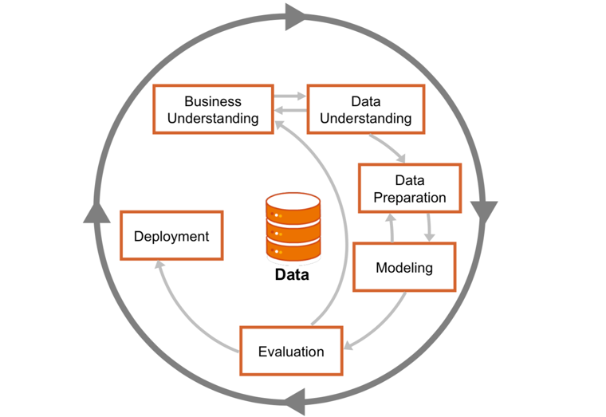
Data Science Project Methodologies Cross-industry standard process for data mining (CRISP-DM)
https://en.wikipedia.org/wiki/Cross-industry_standard_process_for_data_mining
Notes:
https://en.wikipedia.org/wiki/Cross-industry_standard_process_for_data_mining

Slide 15
Proposed Solution
Data cleansing
Remove unnecessary text
Text Analysis
Run Sentiment Analysis on HANA to extract among various sentiments the prevailing one.
Expose results
Develop and deploy in HANA an API that will expose the extracted results to a dashboard
Display results
Display results in SAC page
Data extraction
Retrieve and insert data to HANA from 3rd Party APIs
Create connectors with Twitter accounts and store tweets in HANA database
Identify key topics and phrases
Add custom metadata to enhance the sentiment analysis step
In case of many, scoring could be applied
Associate sentiments with phrases appearing to articles
Moving data not required as HANA has built-in web server
Articles list, topics identified, sentiments, scoring between sentiments will be displayed
Focus on G10 currency news.

Slide 16


Data Scope & Requirements
Facts
Open Topics
Sites with financial news are creating their own content, or they are authorized to redistribute news by partnering with other news sources. A mixed approach is usually followed from the majority of the financial news providers.
It is vital to identify which one of the afore-mentioned offer access through APIs that we can leverage as our dataset to operate the text analysis tasks.
As currently, SCB has no specific way to operate these searches and does not own business subscriptions to any of those, an agreement on which APIs to focus on and in what detail still remains to be decided.
More specifically
SCB analysts have to elaborate on the terminology used when they operate the Google Searches
SCB to provide currency pairs and terminology used
Does the free APIs text suffices for the text mining we are targeting to?
E.g. Financial Times Free API provides only Headlines and no content. Would that be sufficient? If not, who is paying for the subscription?
Identify twitter feeds to catch highlights on news.
Below is a list of popular news websites for stock markets, economy, finance, and related business news.
MarketWatch News Viewer
Bloomberg Portal
Reuters
Wall Street Journal
Financial Times
CNBC
Google Finance (Aggregator)
Seeking Alpha
However, in many cases stories have appeared on a reporter's Twitter feed before it appeared on the actual website.
Integrating social media to gain an edge on the market news it is recommended.

Slide 17
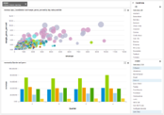

High Level Architecture for the POC
SAC
SAP HANA Platform
Text Engine & Time Series Engine
SAP Predictive Analytics
Time Series Data Types
Text Analytics
Automated Predictive Libraries (APL)
Predictive Analysis Libraries (PAL)
Data modeling
API
External news
SCB Data

Slide 18
Architecture – Main Components
All Devices
SAP or Custom Applications
SAP HANA PLATFORM
APPLICATION SERVICES
PROCESSING SERVICES
INTEGRATION & QUALITY SERVICES
</>
Web Server
JavaScript
Spatial
Graph
Predictive
Search
Data Virtualization
ETL & Replication
ALM
Fiori UX
Graphic Modeler
Application Lifecycle Management
Text Analytics
Streaming Analytics
Series Data
Business Functions
Data Quality
Hadoop & Spark Integration
Remote Data Sync
DATABASE SERVICES
Columnar OLTP+OLAP
Multi-Core & Parallelization
Advanced Compression
Multi-tenancy
Multi-Tier Storage
Data Modeling
Openness
Admin & Security
High Availability & Disaster Recovery
ONE Copy of the Data
= Main components of the SAP HANA Platform used to Text Analytics projects

Slide 19

Solution Delivery

Slide 20
SCB Deliverables
Final Presentation of the MVP Results.
Additional use cases to be added to the final presentation by SCB with SAP support that will reflect the vision for sales and services.

Slide 21

Risks
If SCB historical data provided, we depend a lot on “coming news”.
The project will depend entirely on what is happening “today” and onwards.
A solution on that would be to get access from 3rd party APIs on past articles and compare our sentiment analysis with reports that SCB has already generated on that same past day.
Another solution is to test our text analysis against an FX product in a daily base.
If we rely entirely on external data sources
Significant effort remains to identify which news sources APIs are available from technical and legal and financial standpoint.
Identify reliable and secure APIs to retrieve financial news.
Assess the cost for accessing and use the 3rd party content.
SCB in already using APIs but they are configured on personal accounts.
Relying to external sources may disrupt business in case of unavailability due to technical reasons that either SCB or SAP can handle.
Not quantified business value and measured impact compared between the As-IS and the proposed MVP.

Slide 22
As-Is State
Current process is not scalable and does not provide scalable insights to underlying FXO Movements
Process is de-centralized and non-standard
Users may provide conflicting commentary as a result
No single source to get commentary and relevant articles up from
Current process relies on an individual’s view of the market (which may be shaped with their own perceptions and biases)
Current commentary only focuses on big ticket items, not granular enough

Slide 23
Ideal End State
Commentary to be more reliable and without any biases to support senior management decisions and understanding of the portfolio and periodic moves
Commentary that dovetails with the risk positions and market moves
This process should be able to run automatically between months to date, quarter to date and year to date market commentaries
Linkages between the commentary, market movement and news sources

Slide 24

Business Value
Automate repeatable and mundane tasks.
Save time by getting access to the first PnL commentary draft before the business day starts for the Product Controller
If trivial can be delivered instantly to PC Manager.
If complex apply critical thinking and complex reasoning leveraging a wide number of pre-analyzed articles.
Collect and persist historical data that can be used in the future for further analysis an untap various machine learning use-cases.
Establish process for once that can scale to a number of other products.
Evolution of PC Role.

Slide 25
Thank you.
Contact information:
F name L name
Title
Address
Phone number
Partner logo

