Slide 1

Sentiment Analysis Components
Speaker’s Name, SAP
August 11, 2020
Partner logo

Slide 2
Agenda
Agenda item/divider headline
Details
Agenda item/divider headline
Details
Agenda item/divider headline
Details
Agenda item/divider headline
Details

Slide 3
Part 1

Slide 4
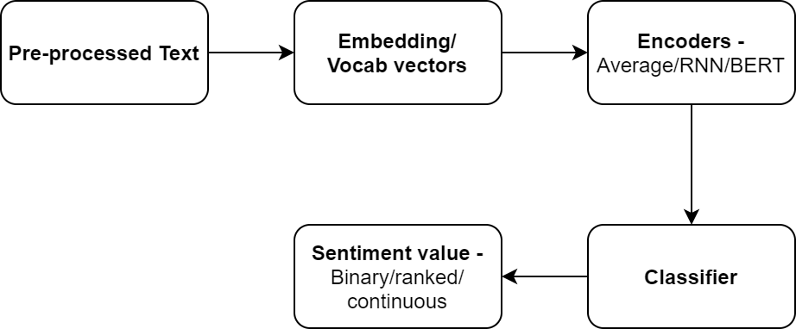
Flow Diagram
Data cleansing
Remove unnecessary text
Text Analysis
Run Sentiment Analysis on HANA to extract among various sentiments the prevailing one.
Expose results
Develop and deploy in HANA an API that will expose the extracted results to a dashboard
Display results
Display results in SAC page
Data extraction
Retrieve and insert data to HANA from 3rd Party APIs
Create connectors with Twitter accounts and store tweets in HANA database
Identify key topics and phrases
Add custom metadata to enhance the sentiment analysis step
In case of many, scoring could be applied
Associate sentiments with phrases appearing to articles
Moving data not required as HANA has built-in web server
Articles list, topics identified, sentiments, scoring between sentiments will be displayed
Focus on G10 currency news.

Slide 5
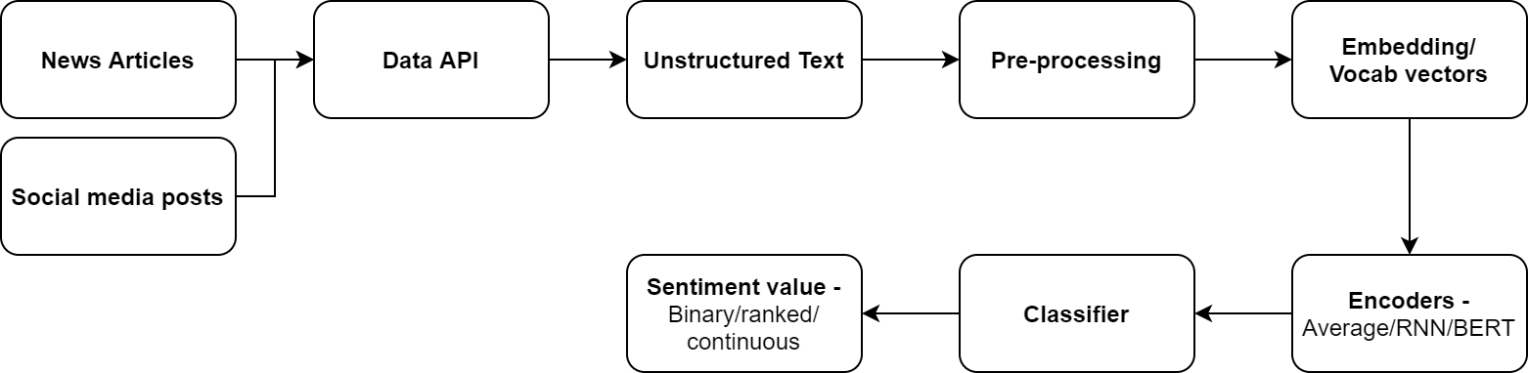
Flow Diagram

Slide 6
Embedding / Vocab vectors
Tokens in the sentence are replaced with vectors that encode the meaning of the word (embeddings).
Embeddings may be trained with data from a particular domain or using universal corpus.

Slide 7
Encoders
This component takes the embeddings of words in a sequence and tries to derive meaning from the sequence of embeddings in terms of a sentence/document encoding.
Example encoder functions
Averaging of word embeddings
RNN – LSTM/GRU
BERT
Tensorflow universal sentence encoder
The final vector represents some meaning of the input sentence in a form that can be used by a classifier.

Slide 8
Classifier
Can be any of the machine learning techniques.
Examples include
SVM
Conditional Random Fields
Neural Networks

Slide 9
Links
Twitter API - http://docs.tweepy.org/en/v3.5.0/api.html
Code for downloading realtime posts - https://github.com/feconroses/gather-tweets-from-stream/blob/master/stream.py
Example project using nltk - https://github.com/saodem74/Sentiment-Analysis-facebook-comments
Example project using Textblob - https://github.com/mehdiassefi/Sentiment-Analysis-on-Social-Media
Example using fuzzy rules - https://github.com/SrishtiVashishtha/Fuzzy-Rule-based-Unsupervised-Sentiment-Analysis-from-Social-Media-Posts
Datasets for topic detection - https://www.cs.umb.edu/~smimarog/textmining/datasets/
Refinitiv Data API –
https://developers.refinitiv.com/eikon-apis/eikon-data-api/quick-start
https://developers.refinitiv.com/all/api-overviews
https://developers.refinitiv.com/open-permid/intelligent-tagging-restful-api
https://www.niemanlab.org/2016/11/reuters-built-its-own-algorithmic-prediction-tool-to-help-it-spot-and-verify-breaking-news-on-twitter/

Slide 10
News APIs
NewsAPI - https://newsapi.org/docs
Newscatcher - https://rapidapi.com/newscatcher-api-newscatcher-api-default/api/newscatcher/endpoints
ContextualWeb - https://rapidapi.com/contextualwebsearch/api/web-search/endpoints
AYLIEN - https://docs.aylien.com/newsapi/endpoints/

Slide 11
Twitter API
Libraries in python
Tweepy - http://docs.tweepy.org/en/latest/
Twitter API - https://github.com/geduldig/TwitterAPI
searchtweets - https://github.com/twitterdev/search-tweets-python
Search time limit
Standard search API – 7 days
Premium and Enterprise search API – Two options
30 day window
Full archive since March 21, 2006
Rate limit
Limits at minute and second granularity depending on the purchased API.

Slide 12
Tweepy python API
Function Name | Description | Parameters
API.statuses_lookup | Returns full Tweet objects for up to 100 tweets per request, specified by the id_ parameter. | id_ – list of tweet IDs to return
API.get_status | Returns a single status specified by the ID parameter. | id – The numerical ID of the status.
API.search_users | Run a search for users. It is only possible to retrieve the first 1000 matches from this API. | q – The query to run against people search.
API.search | Returns a collection of relevant Tweets matching a specified query. | q – the search query string of 500 characters maximum, including operators result_type – mixed, recent, popular geocode – Returns tweets by users located within a given radius of the given latitude/longitude eg. (18.72363,72.823748,200km)
API.user_timeline | Returns most recent statuses posted from the user specified | [id/user_id/screen_name] – any one user detail count – The number of results to try and retrieve per page. page – Specifies the page of results to retrieve.
API.rate_limit_status | Returns the current rate limits for methods belonging to the specified resource families. | resources – A comma-separated list of resource families you want to know the current rate limit disposition for.

Slide 13
Operators for Twitter Search API
Operator | Finds Tweets...
watching now | containing both “watching” and “now”. This is the default operator.
“happy hour” | containing the exact phrase “happy hour”.
love OR hate | containing either “love” or “hate” (or both).
beer -root | containing “beer” but not “root”.
#haiku | containing the hashtag “haiku”.
from:interior | sent from Twitter account “interior”.
list:NASA/astronauts-in-space-now | sent from a Twitter account in the NASA list astronauts-in-space-now
to:NASA | a Tweet authored in reply to Twitter account “NASA”.
@NASA | mentioning Twitter account “NASA”.
Link to complete list: https://developer.twitter.com/en/docs/twitter-api/v1/tweets/search/guides/standard-operators

Slide 14

Library output structure

Slide 15
Output in different Libraries
Textblob (Pattern based)
Polarity [-1,1]
Subjectivity [0,1]
0 is very objective i.e. sticking to the facts and 1 is very subjective i.e. may depend upon feeling.
NLTK
Negative [0,1]
Neutral [0,1]
Positive [0,1]
Compound [-1,1]
The Positive, Negative and Neutral scores represent the proportion of text that falls in these categories. All these should add up to 1.
Based on human-curated gold standard sentiment lexicon.
VADER (Valence Aware Dictionary and sEntiment Reasoner) is a lexicon and rule-based sentiment analysis tool that is specifically attuned to sentiments expressed in social media, but works well in other areas. - Paper
Flair
Positive/Negative
Confidence Score [0,1]

Slide 16
Output in different Libraries
Stanford NLP
Returns a confidence score for 5 classes, very negative, negative, neutral, positive, very positive.
Generates a tree for a document with all these labels for every node in the tree.
http://nlp.stanford.edu:8080/sentiment/rntnDemo.html
http://www.coffeewithshiva.com/introduction-to-sentiment-analysis-using-stanford-nlp/
Deeppavlov
Has classification models for various purposes.
One of the models named rusentiment_bert classifies text as “positive” or “negative”.
https://towardsdatascience.com/the-bert-based-text-classification-models-of-deeppavlov-a85892f14d61

Slide 17
Comparing Textblob, NLTK and Flair
S.no | Sentence | Textblob | NLTK | Flair
1 | The food is good. | polarity=0.7, subjectivity=0.600 | 'neg': 0.0, 'neu': 0.508, 'pos': 0.492, 'compound': 0.4404 | POSITIVE (0.9871)
2 | The food is GOOD. | polarity=0.7, subjectivity=0.600 | 'neg': 0.0, 'neu': 0.452, 'pos': 0.548, 'compound': 0.5622 | POSITIVE (0.9859)
3 | The food is GOOD! | polarity=0.875, subjectivity=0.600 | 'neg': 0.0, 'neu': 0.433, 'pos': 0.567, 'compound': 0.6027 | POSITIVE (0.9955)
4 | The food is good but the service is dreadful | polarity=-0.1500, subjectivity=0.8 | 'neg': 0.301, 'neu': 0.547, 'pos': 0.152, 'compound': -0.4404 | NEGATIVE (0.9963)
5 | The food is not so good. | polarity=0.7, subjectivity=0.600 | 'neg': 0.377, 'neu': 0.623, 'pos': 0.0, 'compound': -0.464 | NEGATIVE (0.9999)
6 | The food is very good. | polarity=0.9099, subjectivity=0.7800 | 'neg': 0.0, 'neu': 0.556, 'pos': 0.444, 'compound': 0.4927 | POSITIVE (0.9941)
7 | The service is dreadful but the food is good. (Opposite of 4.) | polarity=-0.1500, subjectivity=0.8 | 'neg': 0.152, 'neu': 0.547, 'pos': 0.301, 'compound': 0.4404 | NEGATIVE (0.9849)

Slide 18
Comparing Textblob, NLTK and Flair
S.no | Sentence | Textblob | NLTK | Flair
1 | I just got my ordered food. Do they realize how less they give us? | polarity= -0.1667, subjectivity=0.0667 | 'neg': 0.0, 'neu': 1.0, 'pos': 0.0, 'compound': 0.0 | NEGATIVE (0.9183)
2 | I just got my ordered food. Do they realize how less they give us? :( | polarity= -0.4583, subjectivity=0.5333 | 'neg': 0.182, 'neu': 0.818, 'pos': 0.0, 'compound’: -0.4404 | NEGATIVE (0.9967)
3 | I just got my ordered food. Do they realize how less they give us? Smh :( | polarity=-0.45833, subjectivity=0.5333 | 'neg': 0.286, 'neu': 0.714, 'pos': 0.0, 'compound': -0.6369 | NEGATIVE (0.9995)
4 | I just got my ordered food. Do they realize how less they give us? Smh | polarity=-0.1667, subjectivity=0.0667 | 'neg': 0.15, 'neu': 0.85, 'pos': 0.0, 'compound': -0.3182 | NEGATIVE (0.9977)

Slide 19
Libraries for Sentiment Analysis
Spacy
Has tools for preprocessing text.
Makes use of external models for sentiment analysis.
The external model can be imported into spacy pipeline for classification.
The output of the pipeline depends on the external model.
Classifier Examples
Recurrent Neural Network models (keras, pytorch)
Example: https://github.com/explosion/spaCy/blob/master/examples/deep_learning_keras.py
Classical Algorithms (sklearn)
Example: https://www.dataquest.io/blog/tutorial-text-classification-in-python-using-spacy/

Slide 20
Deeppavlov Sentiment Analysis
Pre-trained Models available
Multi-language BERT (Ru)
5-classes SST on conversational BERT (En)
5-classes SST on multilingual BERT (En)
5-classes Yelp on conversational BERT (En)
Training pipeline
Deeppavlov provides api functions for training model on new data.
Configuration files of a model contain settings for training of the model.

Slide 21
Deeppavlov Examples (5-classes SST on conversational BERT)
You can do this by watching what customers say about you after you launch a new product or even a certain marketing campaign
Deeppavlov: Neutral NLTK: {'neg': 0.0, 'neu': 0.905, 'pos': 0.095, 'compound': 0.2732}
Not for everyone , but for those with whom it will connect , it 's a nice departure from standard moviegoing fare .
Deeppavlov: Very positive NLTK: {'neg': 0.0, 'neu': 0.829, 'pos': 0.171, 'compound': 0.5719}
Though it is by no means his best work , Laissez-Passer is a distinguished and distinctive effort by a bona-fide master , a fascinating film replete with rewards to be had by all willing to make the effort to reap them .
Deeppavlov: Very positive NLTK: {'neg': 0.049, 'neu': 0.711, 'pos': 0.24, 'compound': 0.8625}
Though everything might be literate and smart , it never took off and always seemed static .
Deeppavlov: Negative NLTK: {'neg': 0.0, 'neu': 0.838, 'pos': 0.162, 'compound': 0.4019}
Pricing for this, while relatively inexpensive for a Las Vegas attraction, is completely over the top.
Deeppavlov: Negative NLTK: {'neg': 0.0, 'neu': 0.777, 'pos': 0.223, 'compound': 0.7759}
At such a fine institution, I find the lack of knowledge and respect for the art appalling.
Deeppavlov: Very Negative NLTK: {'neg': 0.232, 'neu': 0.531, 'pos': 0.237, 'compound': 0.0258}

Slide 22
Unaccounted Influencers
THE MARKET PLACE - The marketplace determines share prices. While seller supply and buyer demand meet in the market, there is no perfect equation that lets investors know exactly how share prices will behave.
DEMAND AND SUPPLY - Demand and supply in the market affect the prices of shares. When demand for shares exceeds supply, which means the buyers are more than sellers, the prices increase. When demand is less than supply, meaning that buyers are less than sellers, the prices decrease.
INTEREST RATES - In case of lower interest rates, demand for funds is higher and the subsequent demand for shares rises. On the other hand, high interest lowers the demand for funds and the demand for shares is lower.
INVESTORS - Market players have an impact on share prices. With more bulls than bears, the prices increase. With more bears than bulls, share prices decline.
DIVIDENDS - Dividends indicate the movement of share prices. When companies make dividend announcements, the share prices of such companies are likely to increase. It is important to note that if the dividend rate announced is lower than the investors’ expectations, share prices decline while if they are up to more than expected, share prices increase.
MANAGEMENT - Management profile has a significant effect on company success and stock prices. If management consists of experienced professionals with a proven track record, share prices are likely to be higher. If the management that takes over a company lacks integrity, share prices tend to fall.
ECONOMY - Fluctuations in the economy feature what are commonly referred to as booms and depressions. Under favorable conditions share prices are at their peak and their lowest point is experienced during depressions. Share prices gradually rise during recovery and fall during recessions.
POLITICAL CLIMATE - Political factors that range from relations with other nations to government policies can affect share prices.
SHORT-TERM AND LONG-TERM INVESTORS

Slide 23
Reasons for using time series stock price data
Trying to account for external factors that are not reflected in news data.
Reusing already available data models

Slide 24
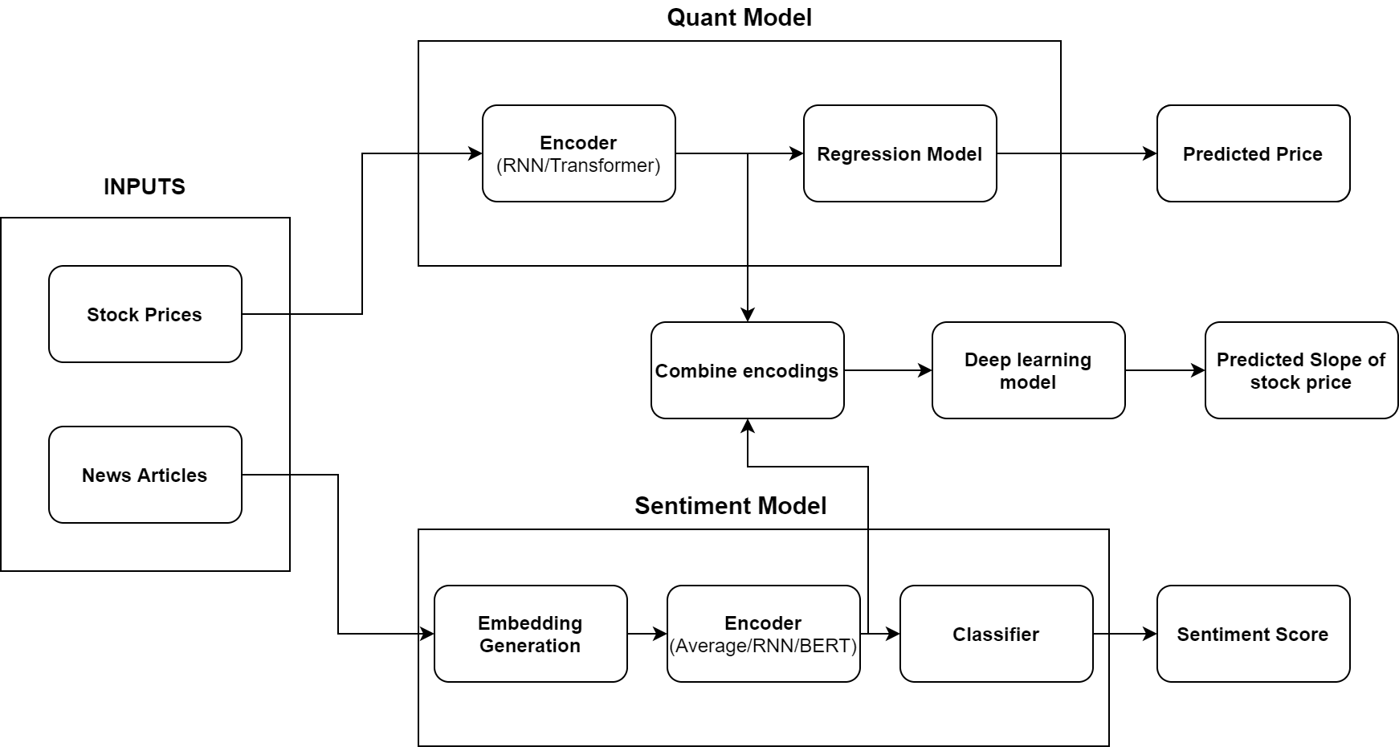
Using stock trends in predicting slope

Slide 25
Part 2

Slide 26
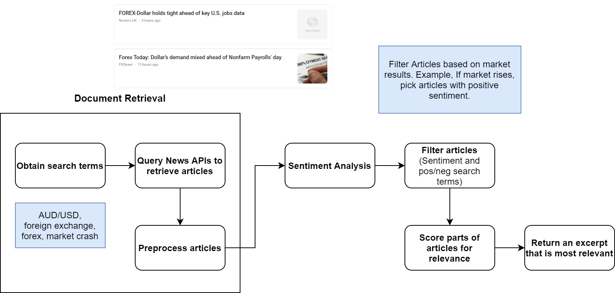
Process Flow

Slide 27
Dictionary of relevant words
Relevant news articles
Tokenization and stop words removal (preprocessing)
Extracting important words using keyword extraction (+ Other ML Techniques)
GDP, Economic Growth, interest rates fall, fxtrade
RBA Slash Interest Rates but Australian Dollar US Dollar (AUD/USD) Exchange Rate Survives
SBI FXTRADE to add eight currency pairs to offering
Slumbering FX confounds traders, prompts fear of rude awakening
Analyzing sentiments
Forex data
Article 1: positive
Article 2: neutral
Article 3: negative
AUD/USD rises by 0.07
+
Ranking the news articles and output most relevant ones
RBA Slash Interest Rates but Australian Dollar US Dollar (AUD/USD) Exchange Rate Survives
+

Slide 28
Dictionary of relevant words
Historical relevant news articles
Sentiment analysis + Clustering + ranking
Relevant News Articles
News Articles
Forex Data

Slide 29
Process Flow
Search/Extract relevant news articles using API’s
List of words (influencing factors) for each portfolio
Eg. - GDP, Economic Growth, interest rates fall, fxtrade etc…
RBA Slash Interest Rates but Australian Dollar US Dollar (AUD/USD) Exchange Rate Survives
SBI FXTRADE to add eight currency pairs to offering
Slumbering FX confounds traders, prompts fear of rude awakening
Ranking the news articles and output most relevant ones
(Using ML/Heuristics)
Forex Exchange data
Preprocessing
90%
RBA Slash Interest Rates but Australian Dollar US Dollar (AUD/USD) Exchange Rate Survives
57%
SBI FXTRADE to add eight currency pairs to offering
AUD/USD rises by 0.07
Slumbering FX confounds traders, prompts fear of rude awakening
23%
Analyzing sentiments
Provided by SCB
Article 1: positive
Article 2: neutral
Article 3: negative

Slide 30
Ranking Process Flow – Method 1(Same during training and deployment)
‘N’ number of news articles for a day
Preprocessing
Sentiment Title
w1
Ranking of Article
[-1,1] or [0,1]
Sentiment score calculation
{-1,1}
Sentiment Article
w2
Correlation of forex price (+ve/-ve)

Slide 31
Open points for Ranking method 1
How weights should be assigned to title and article.
Validating sentiment score.
Adding influencing words in ranking.

Slide 32
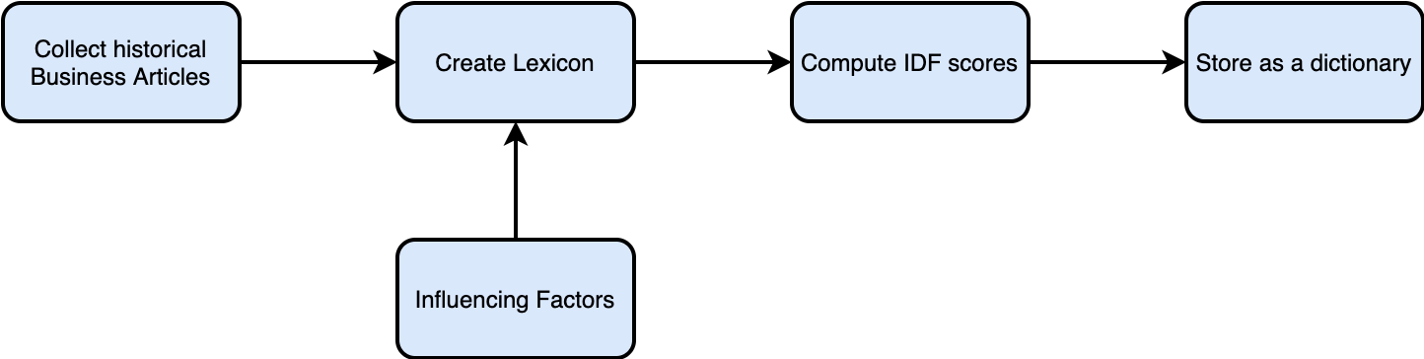
Dataset Preparation

Slide 33
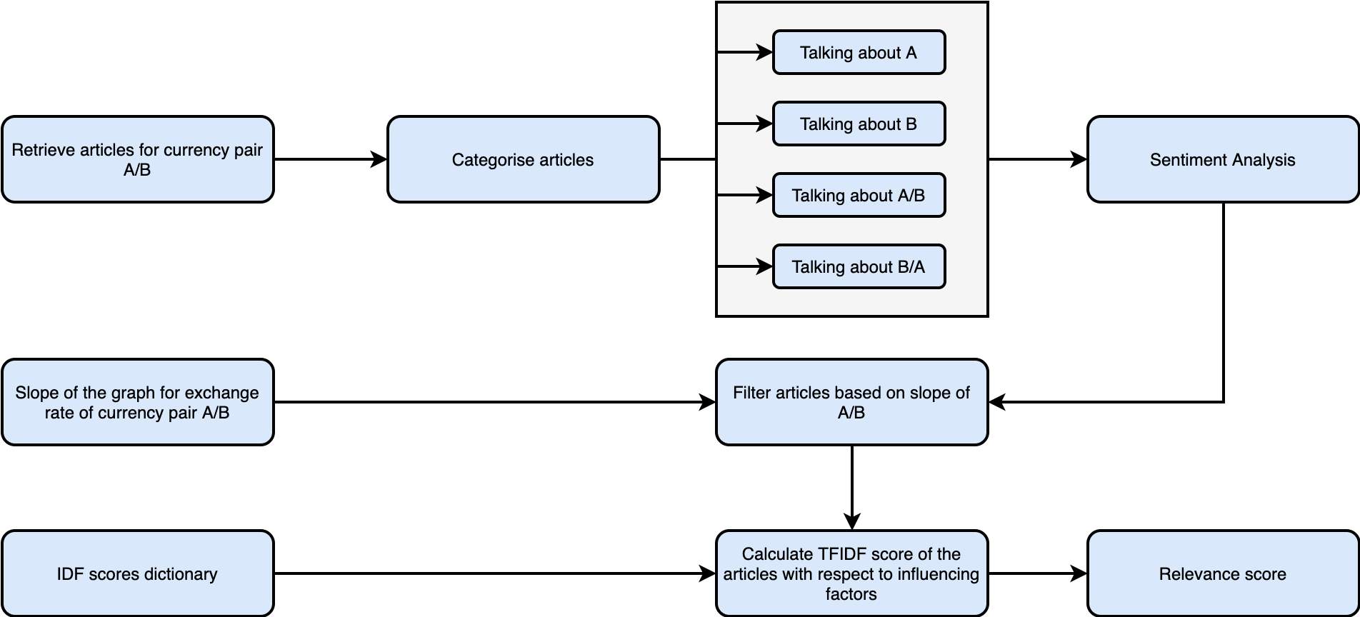
Relevance Scoring

Slide 34
Process Components
Database Preparation
Articles Retrieval
Article Filtering
Relevance Scoring

Slide 35
Database Preparation
News corpora collection
Create lexicons from all historical articles
Word Lexicons
Value Lexicon
Value co-occurrence lexicon
Run data processing techniques to assign feature scores to words and phrases (lexicon).
idf Calculation
Calculate idf for influencing factors in the corpora.

Slide 36
Article Filtering
We assign article fragments into 4 groups for any given currency pair.
Example: We are looking for USD/SGD currency pair. We make 4 groups for the fragments:
Talking about USD
Talking about SGD
Talking about USD/SGD
Talking about SGD/USD
Based on the sentiment of the fragment in these 4 groups we can decide to keep or filter out the article.

Slide 37
Relevance Scoring
We calculate a log tfidf score for each fragment (article) for the influencing factors
log(tf)*idf Calculation -> log(term frequency) * (inverse document frequency)
Inverse document frequency -> log(1/df)
Term frequency normalization - The scoring methods that take into account term frequency (log tfidf) based on the size of the document. The idea of this normalization is to take into account how frequent a term occurs in the document, relative to the other documents in the database.

Slide 38
Improvements to incorporate
Use semantics data to score relevance
Compare terms in the news articles appearing in single day and try to determine what factors are important for that day. Use this importance scores calculated for factors to compute relevance.
Try to identify elements from the constructed lexicon that are directly related to influencing factors and use them for relevance scoring.

Slide 39
Steps Followed in Ecodrivers Ranking
Preprocessing of Articles
Convert to lower case
Remove punctuation, numbers and special characters
Remove single characters
Remove stop words
Remove URLs
Preprocessing of Eco drivers – same as Articles
Lemmatization of Articles using NLTK wordnet Lemmitizer

Slide 40
New Ecodriver Ranking
Preprocessing Articles
Remove emails and new lines
Convert a document into a list of lowercase tokens, ignoring tokens that are too short or too long and remove punctuations
Remove stopwords
Make bigrams
Do lemmatization
Preprocessing eco drivers same as above (only single words or bigrams)
Tfidf calculation
Articles – train, eco drivers – test, vocab from articles
Eco drivers – train, articles – test , vocab from eco drivers
We obtain a train matrix and test matrix.
The dot product gives us a matrix of the form (num_ecodrivers X num_articles) – we can call it a similarity matrix – tfidf ranking matrix

Slide 41
Steps followed in LDA
Preprocessing
Remove emails and new lines
Convert a document into a list of lowercase tokens, ignoring tokens that are too short or too long and remove punctuations
Remove stopwords
Make bigrams
Do lemmatization
Create Dictionary (give unique id to each lemmatized word in text)
Create Corpus (store in form of wordid, freq) for all docs
Build LDA models ie identify topics and words in each topic.
Visualize LDA model ie how far apart they are and what they represent
Further analyze
We can find the topic that has the highest percentage contribution in that document.
Sometimes just the topic keywords may not be enough to make sense of what a topic is about. So, to help with understanding the topic, we can find the documents a given topic has contributed to the most and infer the topic by reading that document.

Slide 42

Insert page title (sentence case)
First level
Second level
Third level
NOTE: Delete the yellow stickers when finished.
The text placeholders have different, preformatted text levels. Each level has different formatting (font size, indent, bullet).
To jump between the preformatted text levels, use the Increase List Level and Decrease List Level buttons in the Paragraph toolbar.
Type your text in the placeholder.
Click the Increase List Level button in the Paragraph toolbar to go to the next level.
If you need a bullet list, choose level 2.
Avoid working with spaces, other bullets, or bullets in the wrong level. Only when you use the right levels it is possible to reset the slide layout.

Slide 43
Insert page title (sentence case) Subheadline
First level
Second level
Third level

Slide 44
“Quote goes here and here and here.”
Source

Slide 45
“Quote goes here and here and here.”
Source

Slide 46
Insert page title (sentence case)
First level
Second level
Third level

Slide 47
Insert page title (sentence case)
First level
Second level
Third level

Slide 49
Insert page title (sentence case)
First level
Second level
Third level
First level
Second level
Third level

Slide 50
Insert page title (sentence case)
First level
Second level
Third level
First level
Second level
Third level
First level
Second level
Third level

Slide 51
Insert page title (sentence case)
First level
Second level
First level
Second level

Slide 52
Insert page title (sentence case)
First level
Second level
First level
Second level
First level
Second level

Slide 53
Thank you.
Contact information:
F name L name
Title
Address
Phone number
Partner logo

