Slide 1
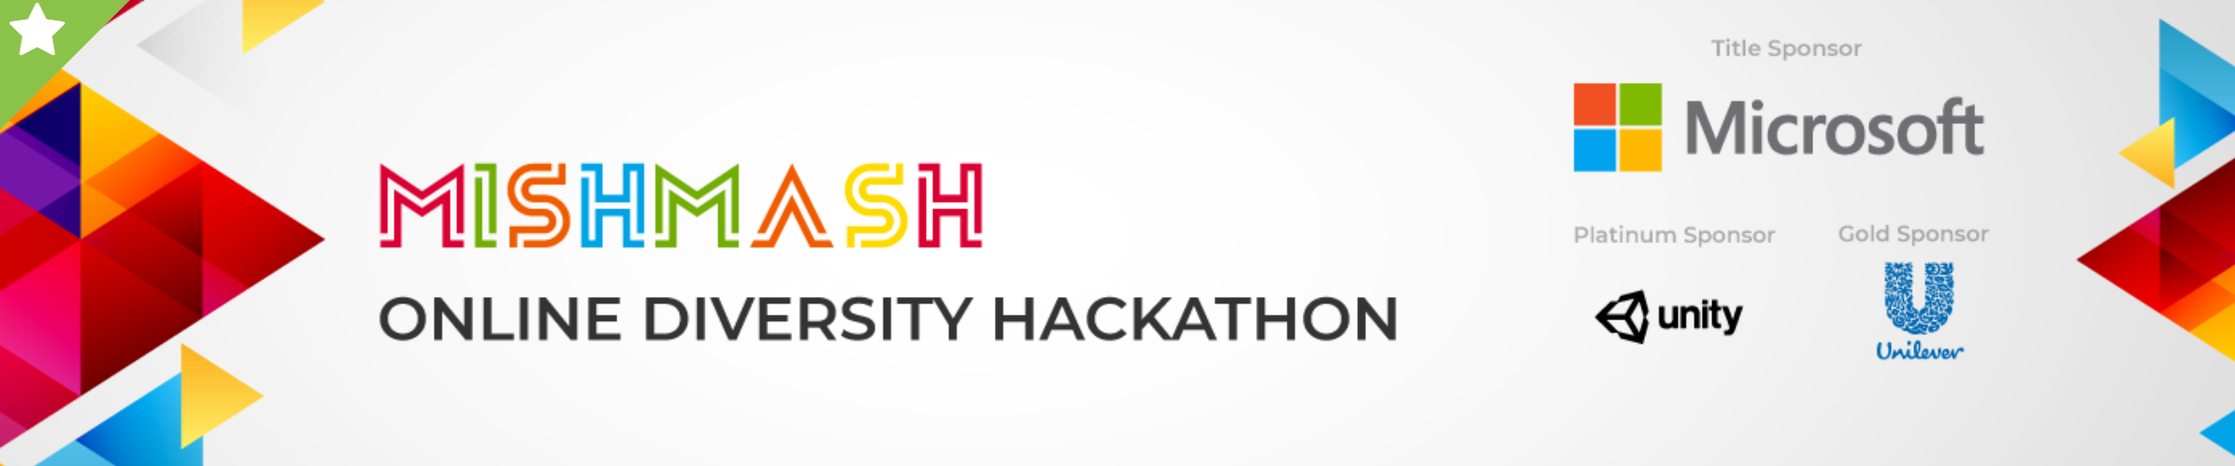
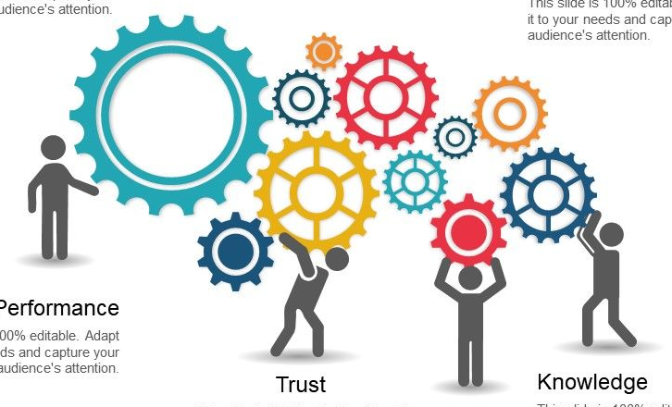









Theme: Deep Tech/Machine Learning
Team: Data Deciphers
Project Title: Unilever Data Science POC Use Case
Problem Statement:
One of Unilever’s brands is going through some major changes in business execution plans and they like to know.
What are the major drivers for sales(EQ)?
Prediction of future sales for next 6 periods?
Anup Rana
Ashutosh Kumar
Salai Siva Madhavan S
Harikrishna Otra
Technologies and Libraries Used:
a) Frameworks/languages/libraries
b) ML Algorithms
Linear Regression, ElasticNet, XGBoost, ARIMA
Image references:
1) https://skillenza.com/challenge/mishmash-hackathon-bangalore
2) https://www.slideteam.net/powerpoint-presentation-essentials/team-introduction-slides/team-engagement-tools-ppt-summary.html

Slide 2
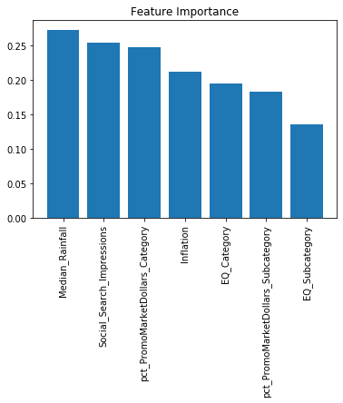
Identifying Drivers of Sales (EQ)
Project Pipeline:
train-test
split
Model
building
log1p
MinMaxScaler
Data
Log transformed
target variable
Train & Test
data
Scaled
data
Trained
model
Linear Regression
r2_score_{train}: 0.88, r2_score_{test}: 0.81
log1p(EQ) = -0.2196 + (0.2550 X Social_Search_Impressions) +
(0.2732 X Median_Rainfall) + (0.2127 X Inflation) +
(0.2477 X pct_PromoMarketDollars_Category) +
(0.1949 X EQ_Category) + (0.1364 X EQ_Subcategory) +
(0.1837 X pct_PromoMarketDollars_Subcategory)
Model
Building
ElasticNet
r2_score_{train}: 0.88, r2_score_{test}: 0.88
XGBoost
r2_score_{train}: 0.99, r2_score_{test}: 0.99
Linear Regression
Top three drivers of sales (Linear Regression and ElasticNet):
Note: a) All the three methods selected same top seven features
b) Linear Regression and ElasticNet yielded same relative weights of the top 7 features
c) Relative weights of the features varies in case of XGBoost
Median_Rainfall
Social_Search_Impressions
pct_PromoMarketDollars_Category

Slide 3
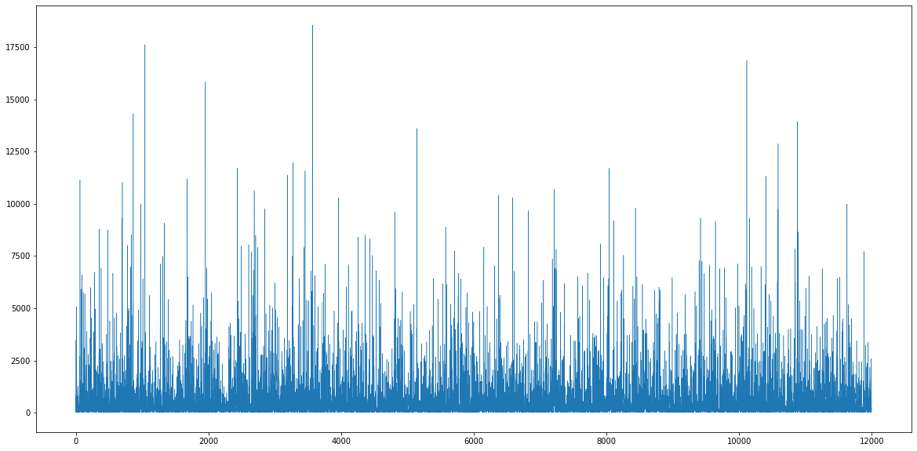
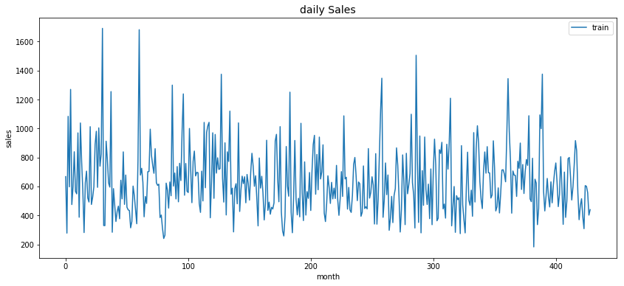
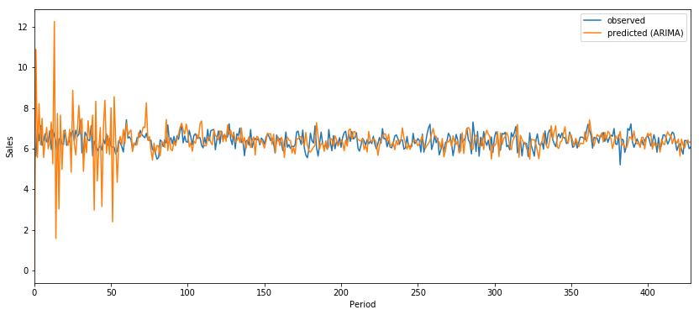
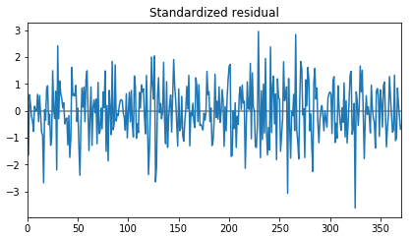
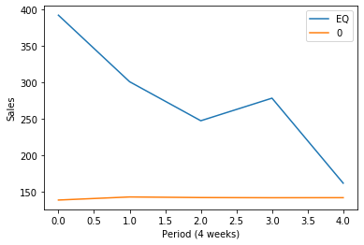
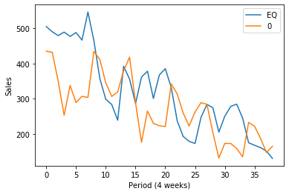
Time Series Forecasting
Chalange-1
Chalange-2
EQ vs Time
in raw data
Loading
data
The test data in Chalange-1 was further splitted to train and test
Does the less amount of data makes the Chalange-2 more challenging
A similar strategy followed, here, with the exception that we did not do any grouping in the new train dataset
EQ vs Time
After grouping
(28 days interval)
Grouping
The data was found to be
Stationary
Stationary
or not
p, q & d
Best p, q & d were selected
from all possible combinations
ARIMA
model
Training
Residual
The residual
is white
noise
The model has done pretty
good forecasting,
with a MAPE of 26.3445
Forecasting
Forecasting
Forecasting
MAPE: 44.2956

