Slide 1

Department Store
Inventory Management System (DSIMS)

Slide 2

Table of content
INTRODUCTION
MOTIVATION
STATEMENT OF PROBLEMS
OBJECTIVE
SCOPE AND APPLICATION
LITERATURE REVIEW
GENERIC MODEL
FLOWCHART
RESULT AND DISCUSSION
CONCLUSION

Slide 3
Introduction
A department store is a retail establishment offering a wide range of consumer goods in different areas of the store.
Products are usually categorized as per their types which include ready-to-wear clothing and accessories, furnitures, cosmetics and often food.
DSMS is an application that keeps the information related to the management of the departmental store which includes product, staff, stock, sale and purchase, etc.
Provides information on calculating, adding, viewing goods and other features.
Minimizes errors while making bills and also limits the delay of delivering bills to the customers.
It has very least risk of data/record loss and is easy to operate.

Slide 4
Motivation
Department store management system(DSMS), commonly found in retail establishment and known as DSM.
It often feature a complex arrangement of software.
Numbers of problem can appear when software or user don’t perform as expected.

Slide 5
Statement Of Problems
Previously, this system lacked user friendly environment and recording of material consumed long time.
We want to make interactive program.
There might occur error during updating the details.

Slide 6
Objectives
To use or familiarize with c/c++ language to build a large program.

Slide 7
Scope and Application
DSMS is easy to use and eliminates the error caused by paperwork.
It helps to provide information to the staff about the items that are purchased, their price, bill generation system and so on.

Slide 8
Literature review
A Departmental Store is a large store that stocks many varieties of goods in different departments [1]
A Department store management system should not interfere or make it harder for you to run your business. It should run parallel to your business operation. A perfect DSM system should run your business for you [2].
A Departmental Store Management System (DSMS) is an application that executes a collection of protocols to co-ordinate the actions of multiple processes on a network, such that all components cooperate together to perform a single or small set of related tasks [3]
"Inventory Management of a Department Store: A Case Study," Zhang et al. [4] analyze the inventory management practices of a department store in China.
The purpose of this literature review is to examine various studies on department store management systems and highlight their findings and contributions.

Slide 9
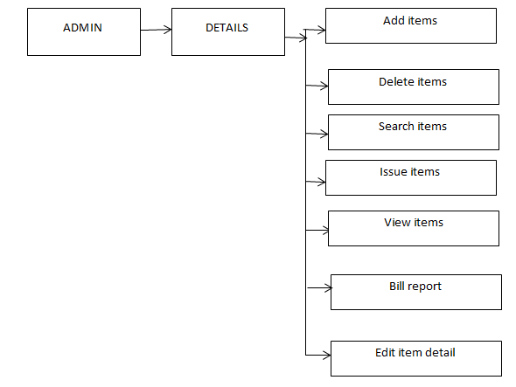
Generic Model

Slide 10
Algorithm
Step 1: Start
Step 2: Choose Admin or Exit.
If admin is encountered go to step 3.
If exit is encountered, the program closes.
Step 3: choose any one from these 5 options
i. Add items
ii. Modify item
iii. Display items
iv. Bill Generate
Close the application
Step 4: If choice is ‘a’, select an option.
i. Add category
ii. Add items
iii. Exit
If option ‘i’ is encountered, we can add new category.
If option ‘ii’ is encountered, we can add new items.
If option ‘iii’ is encountered, go to step 3.
Search according to your choice. And go to step 3 after completion.
Step 5: If choice is ‘b’ select an option.
i. Delete items
ii. Edit items list
iii. Remove issued item
iv. Exit

Slide 11
If option ‘i’ is encountered, then enter item id to be deleted. If item id exists delete the item. If item id is valid then go to further process and if invalid go to step 5.
If option ‘ii’ is encountered, we can edit items detail in the store. Then go to step 5.
If option ‘iii’ is encountered, we can remove issued item record for a particular id. Then go to step 5. If option ‘iv’ is encountered, go to step 3.
Step 6: If choice is ‘c’. Select an option
i. View items in store
ii. Search items in store
iii. View issued item
iv. Search issued item
v. exit
If option ‘i’ is encountered, view the list of all items in the store. If option ‘ii’ is encountered, search the items in store by id or name. If option ‘iii’ is encountered, view the list of all issued item or the list of issued item for a particular data in the store. If ‘iv’ is encountered, we can search issued item by id. If ‘v’ is encountered, go to step 3 else go to step 6.
Step 7: If choice is ‘d’. Select an option
i. bill
ii. Issue an item.
iii. exit
If option ‘i’ is encountered, generate bill. If option ‘ii’ is encountered, issue record is maintained. If ‘iii’ encountered, go to step 3.
Step 8: If choice is ‘e’, close the application’.
Step 9: end

Slide 12
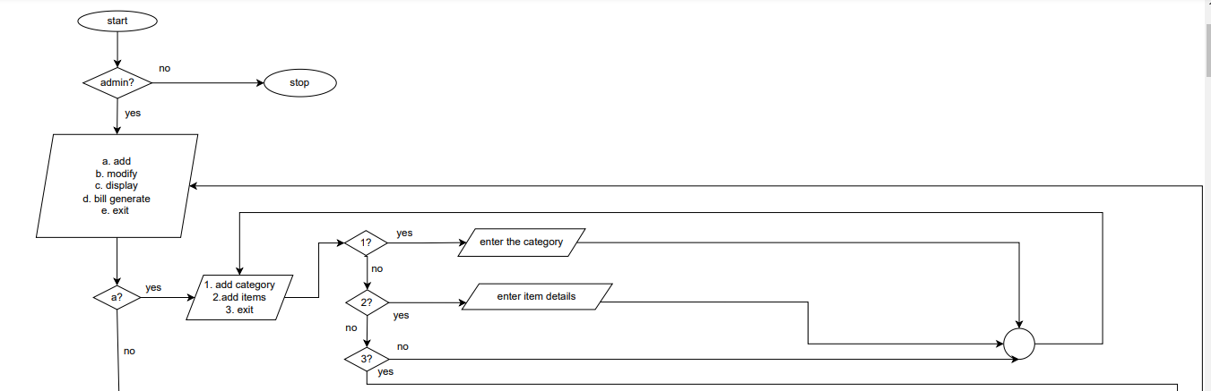
Flowchart

Slide 13
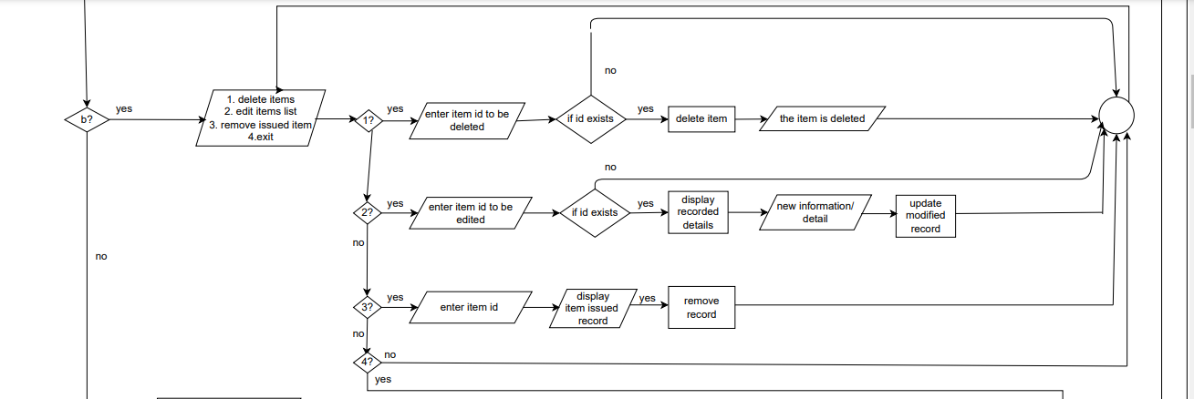

Slide 14
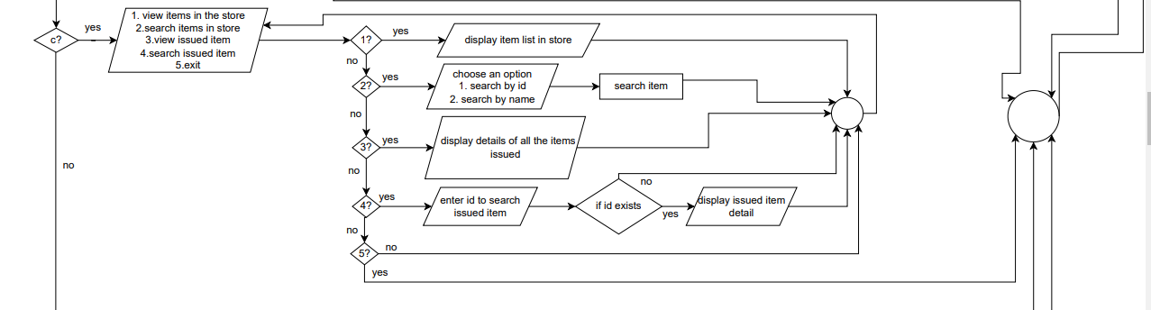

Slide 15
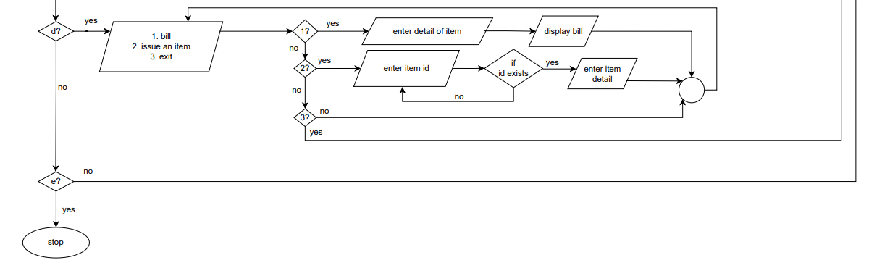

Slide 16
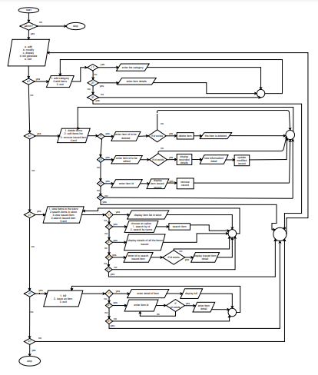
FLOWCHART

Slide 17
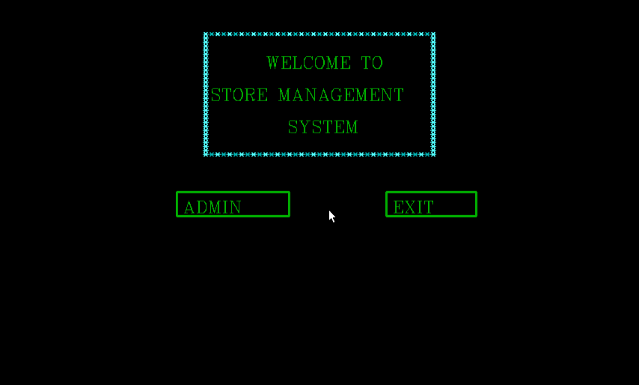
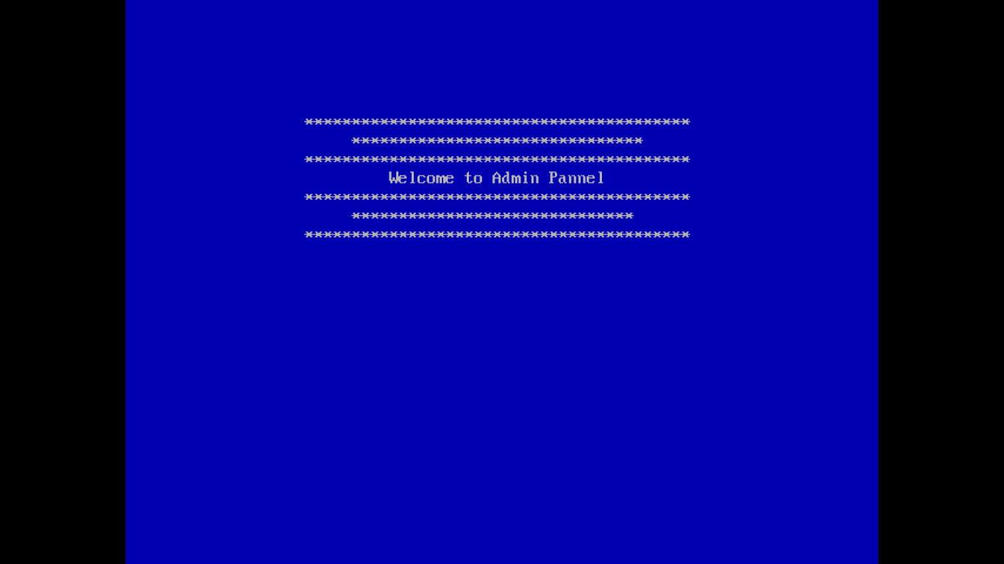
Result and discussion
We have created a management system which includes 9 basic functions needed to manage the department store system.
Fig 5.1: Admin/Exit interface
Fig 5.2: Welcome message

Slide 18
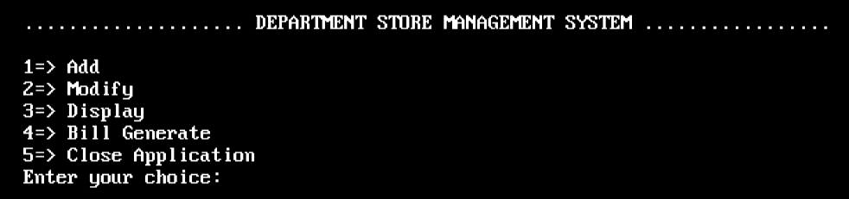

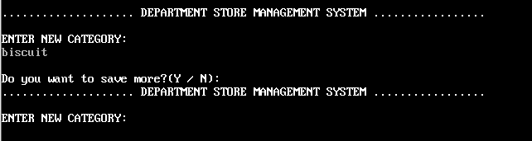
Fig 5.5: Adding Category
Fig 5.3: Admin panel
Fig 5.4: Add
Fig 5.5: Adding Category

Slide 19
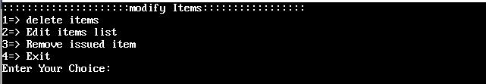
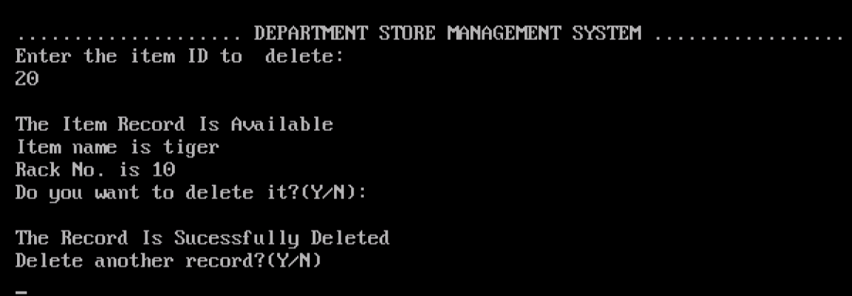
Fig 5.6: Modify items
Fig 5.7: Deleting items

Slide 20
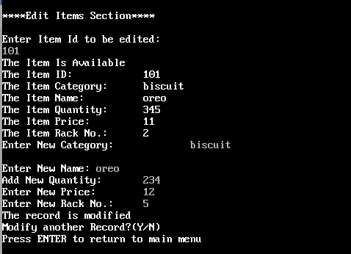

Fig 5.8: Editing section
Fig 5.9: Removing issued item section

Slide 21
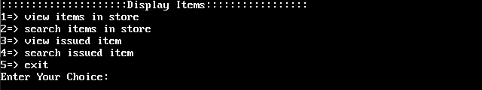
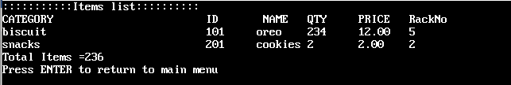
Fig 5.10: Display items
Fig 5.11: View Items list

Slide 22
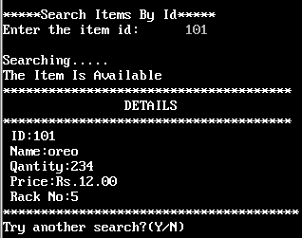
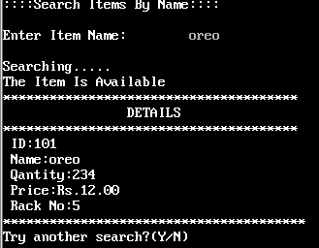
Fig 5.12: Searching items
Fig 5.13: View Issued Items

Slide 23
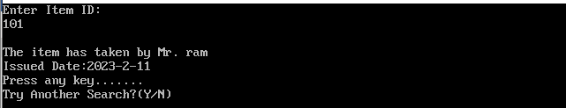
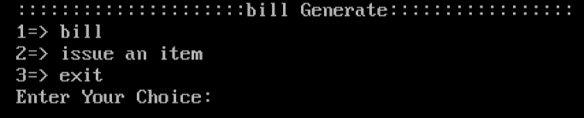
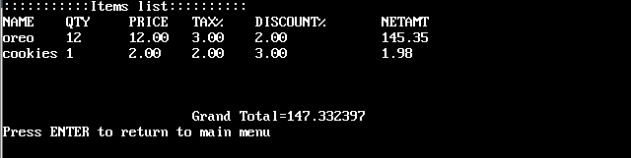
Fig 5.14: Search Issued Items
Fig 5.15: Bill generate
Fig 5.16 Billing section

Slide 24
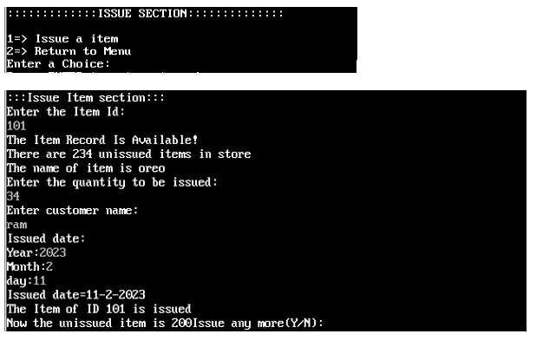
Fig 5.17: Issuing items

Slide 25
Future Enhancement
Interactive user interface design.
Making the system flexible in any type.
Profit and loss details can be added.
Sales and purchase return system.
Payment system can be added.

Slide 26
Conclusion
Satisfy the needs in a department store to keep and maintain the record.
User friendly coding/system.
Improves client experience, prevents against difficulties like refunds and encourage purchase.
Better planning and ordering stock products.
Through it has some limitations, we believe that the implementation of this system will surely benefit the organization.

Slide 27
REFERENCE
https://en.wikipedia.org/wiki/Department_store
Rajib, S. A. (2017). Departmental Store Management System (Doctoral dissertation, East West University).
Departmental Store System. A online document (2022) Retrieve on (2022-12-04) from https://www.scribd.com/document/446419614/DEPARTMENTAL-STORE-MANAGEMENT-SYSTEM
http://dspace.ewubd.edu:8080/bitstream/handle/123456789/2349/Shahrear_Amir_Rajib.pdf?sequence=1&isAllowed=y#:~:text=A%20Departmental%20Store%20Management%20System%20(DSMS)%20is%20an%20application%20that,small%20set%20of%20related%20tasks.
https://www.academia.edu/42879292/Store_Management_System_Project_Report
http://cppprojectcode.blogspot.com/2010/09/inventory-management-system.html
https://www.studytonight.com/c-projects/departmental-store-management-using-c-language
https://www.academia.edu/26003928/Final_Year_Project_On_Inventory_Management_System_Submitted_By

Slide 28
Thank you!

