Slide 1

AN ENGINEERING DEEP-DIVE
Beyond the Agents
Testing & Deploying an Agentic System
What it takes to make a multi-agent system trustworthy and resilient — using a LangGraph debate bot as the running example.
PART 1
PART 2
Testing
Deployment
Earning trust in a non-deterministic system
Surviving failure in a long-running one
23 Jul 2026 · Talentica

Slide 2

THE RUNNING EXAMPLE
The System Under Test
A LangGraph multi-agent debate — Pro & Con argue, a Moderator decides.
Topic
Round 1
Round 2
Round 3
Moderator
user input
Opening · Pro + Con
Rebuttal · Pro + Con
Closing · Pro + Con
verdict → Winner
Shared state (DebateState) flows through every node — topic, all arguments, memory context, winner
● What makes it agentic: multiple cooperating agents, a shared evolving state, streamed output, and a decision at the end.
● Two hard questions follow: can we trust its output? and will it stay up when something breaks?
Testing & Deploying an Agentic System
02 / 17

Slide 3
THE PROBLEM
Why Agentic Systems Break the Playbook
PROPERTY 1
PROPERTY 2
Non-deterministic
Long-running & stateful
Same input, a different answer every time. You cannot assert equality — traditional pass/fail tests don't apply to the interesting behavior.
A task is a sequence of steps, not one request. A crash mid-run loses real work — not just a connection.
→ Part 1 · Testing solves this.
→ Part 2 · Deployment solves this.
Agenda Part 1 · Testing (trust) → Part 2 · Deployment (resilience)
Testing & Deploying an Agentic System
03 / 17

Slide 4
PART 1 · TESTING
A Shift in Thinking: 3 Steps
1
2
3
Define the dimensions that matter for this system
Split each into deterministic vs. non-deterministic
Route each to the right tool
Dimensions come from what the agent is for:
Some things have a right answer (is the winner "Pro" or "Con"?). Some are judgments (is the argument persuasive?).
Rubric metric = a named criterion + a 1–5 scale, graded by a stronger model.
Argument quality
Correctness & robustness
Deterministic → script / regex
Coherence / integrity
Performance & streaming
Non-deterministic → LLM-as-a-judge
The metrics each dimension is actually scored on
LLM-judge
Relevance · Persuasiveness · Rebuttal engagement · Moderator soundness — scored 1–5
Deterministic
winner-valid · all fields present · word-count caps · moderator 3-part structure
Testing & Deploying an Agentic System
04 / 17

Slide 5
PART 1 · TESTING
The Method Generalizes — "Nexus Guard"
A different agentic system (a guarded customer-ops agent network). Same 3 steps — dimensions fall out of its purpose.
DIMENSION
WHAT IT TESTS
SCORED ON — THE METRIC
Routing & loop integrity
Passes a query across ≥3 agents; breaks routing loops
hops ≤ 3 · no A→B→A cycle
PII masking / safety
Aadhaar, cards, API keys masked in every stream
mask recall = 100% · Safety
Self-correction quality
A judge gates the reply before it reaches the user
Relevance · Factuality · Safety
Streaming performance
Eval + masking keep up with the token stream
P95 latency < 200 ms / chunk
Cost & budget guardrails
Runaway session degrades to human-in-the-loop
tokens ≤ budget · graceful handoff
green = deterministic · teal = LLM-judge | Same 3 steps, new dimensions — the method transfers.
Testing & Deploying an Agentic System
05 / 17

Slide 6
PART 1 · TESTING
One System, Validated Four Ways
Same system, dataset, and judge — the only variable is the harness. It's a buy-vs-build decision.
BUILD OUR OWN
HOSTED
OFF-THE-SHELF
Custom pytest
LangSmith
deepeval / promptfoo
Total control, zero cost, fully private. Every metric and judge prompt is yours — but you maintain it.
Dashboards, history, free per-node traces. The price: data leaves the machine.
Fast to adopt, rich prebuilt rubrics. The abstraction can hide what's actually measured.
Testing & Deploying an Agentic System
06 / 17

Slide 7
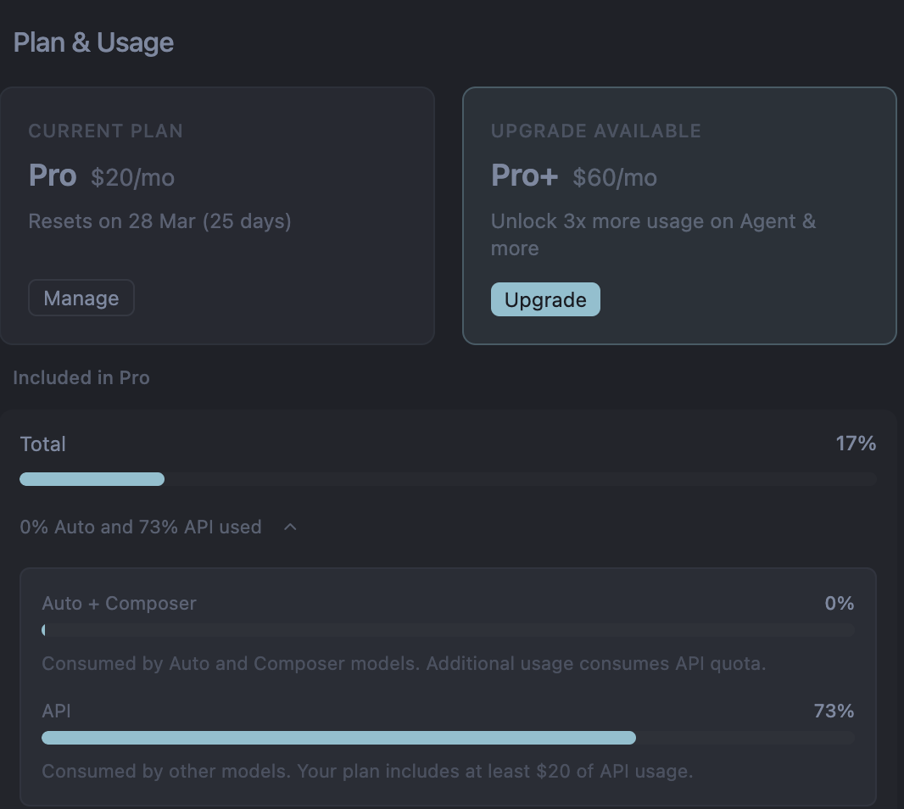
Testing & Deploying an Agentic System
06 / 17

Slide 8
APPROACH 1 OF 4 · TESTING
Custom pytest + LLM-as-judge
WHAT IT IS
STRENGTHS
A small evals/ harness on the existing pytest + Anthropic stack. No new dependencies.
Zero-dependency, fully offline, you own every metric, trivial in CI.
HOW IT WORKS
COST
run_debate(topic) over a golden dataset → deterministic scorers (Python / regex) + an LLM-judge scorer (1–5 on 4 axes) → a scorecard.
You build & maintain the harness, dataset, and report yourself.
ROLE
The backbone — the default CI gate and single source of scoring truth.
Testing & Deploying an Agentic System
07 / 17

Slide 9
APPROACH 2 OF 4 · TESTING
LangSmith (hosted)
WHAT IT IS
STRENGTHS
Flip on a dependency that's already present — upload the dataset, define evaluators, turn on tracing.
Hosted dashboard for scores + traces, free per-node latency, versioned datasets and regression history.
HOW IT WORKS
COST
Reuses the same scorers as Approach 1, run on a hosted platform. LangGraph auto-emits per-node traces.
Needs an account + network — data leaves the machine. Don't point it at sensitive data.
ROLE
Add when you need history + performance monitoring.
Testing & Deploying an Agentic System
08 / 17

Slide 10
APPROACH 3 OF 4 · TESTING
deepeval — G-Eval rubrics in pytest
Off-the-shelf rubric metrics, run in pytest. Here's G-Eval, adapted to a debate exchange.
Task Introduction
Input Context
"You will be given one exchange from a debate. Rate it on one metric."
Topic + Pro opening: "Athletes are overpaid…"
Input Target
Evaluation Criteria
Con rebuttal (the text being scored)
Auto-CoT
Rebuttal Engagement (1–5) — does the Con rebuttal address ≥1 specific point from the Pro opening?
G-Eval
Evaluation Steps
Rebuttal Engagement: 4.2
1. Read Pro opening. 2. Read Con rebuttal; check which Pro points it addresses. 3. Assign 1–5.
1
2
3
4
5
Testing & Deploying an Agentic System
09 / 17

Slide 11
APPROACH 4 OF 4 · TESTING
promptfoo (declarative YAML + CLI)
WHAT IT IS
STRENGTHS
Config-driven eval — YAML test cases + a Python provider wrapping run_debate, run via a Node CLI.
Declarative and readable, polished local HTML report, no pip dependency (uses Node).
HOW IT WORKS
COST
Declare llm-rubric asserts (Claude grader) + javascript deterministic asserts (winner valid, word caps) → HTML report grid.
Needs a Node toolchain; another tool's conventions to learn.
ROLE
Nice when you want declarative config + a visual report.
Testing & Deploying an Agentic System
10 / 17

Slide 12
PART 1 · TESTING
How the Three Options Compare
Same job, different harness — here's where each one wins.
Custom pytest
LangSmith
deepeval / promptfoo
New dependency
None
Already present
Adds a library
Offline / privacy
Fully local
Data leaves machine
Mostly local
Scoring control
Own every metric
Custom evaluators
Prebuilt rubrics
Dashboards & traces
Build your own
Hosted + free traces
Local HTML report
Regression history
Manual JSON diff
Versioned & hosted
Stored runs
CI fit
Excellent — is pytest
Needs key + network
Needs Node / lib
Best at
Zero-dep CI gate
Tracing & history
Declarative rubrics
Testing & Deploying an Agentic System
11 / 17

Slide 13
PART 1 · TESTING
Testing: The Recommendation
DEFAULT
ADD WHEN NEEDED
OPTIONAL
Custom pytest
LangSmith
deepeval / promptfoo
Zero-cost, offline, enforced on every release. Start here.
For regression history and per-node performance over time.
Proof the system can be scored by third-party tooling without forking.
The bottom line: turn subjective quality into a release gate
CI runs the evals on every change. If scores fall below thresholds you set, the release is blocked automatically — no human eyeballing each debate.
Deterministic
winner-valid ≥ 90%
LLM-judge
mean relevance ≥ 3.5
≥90% of test debates parsed a valid Pro/Con winner (a hard fact).
judge's average relevance across the set, ≥ 3.5 out of 5.
Testing & Deploying an Agentic System
12 / 17

Slide 14
PART 2 · DEPLOYMENT
Deployment: The Landscape
Managed = speed & convenience. Self-hosted = control & privacy, at the cost of building the resilience machinery yourself.
MANAGED PLATFORM
MANAGED PLATFORM
SELF-HOSTED
LangSmith / LangGraph Platform
Google ADK
Roll our own
Google's managed agent runtime (Vertex Agent Engine). Cloud-native, scales for you — ties you to GCP.
Full control and privacy. You must solve durability, streaming, and failover — the next slides show how.
Hosted agent server — durable state and streaming handled for you. Fastest path; vendor lock-in + Enterprise license to self-host the server.
Testing & Deploying an Agentic System
13 / 17

Slide 15
PART 2 · DEPLOYMENT
The Self-Hosting Challenge: Life Without Redis
THE PROBLEM
THE FIX
Streaming is glued to execution
Redis pub/sub decouples them
A single node couples graph execution and the client's live stream into one process. Behind a load balancer, the node a user is watching may not be the node doing the work — and there's no way to relay between them. The connection drops, the live view dies.
A channel per run separates "who streams to the user" from "who executes the agent." Any node can relay any run.
Pair it with durable state (Postgres checkpoints) so a dead executor can be resumed — Redis alone fixes streaming, not execution recovery.
Testing & Deploying an Agentic System
14 / 17

Slide 16
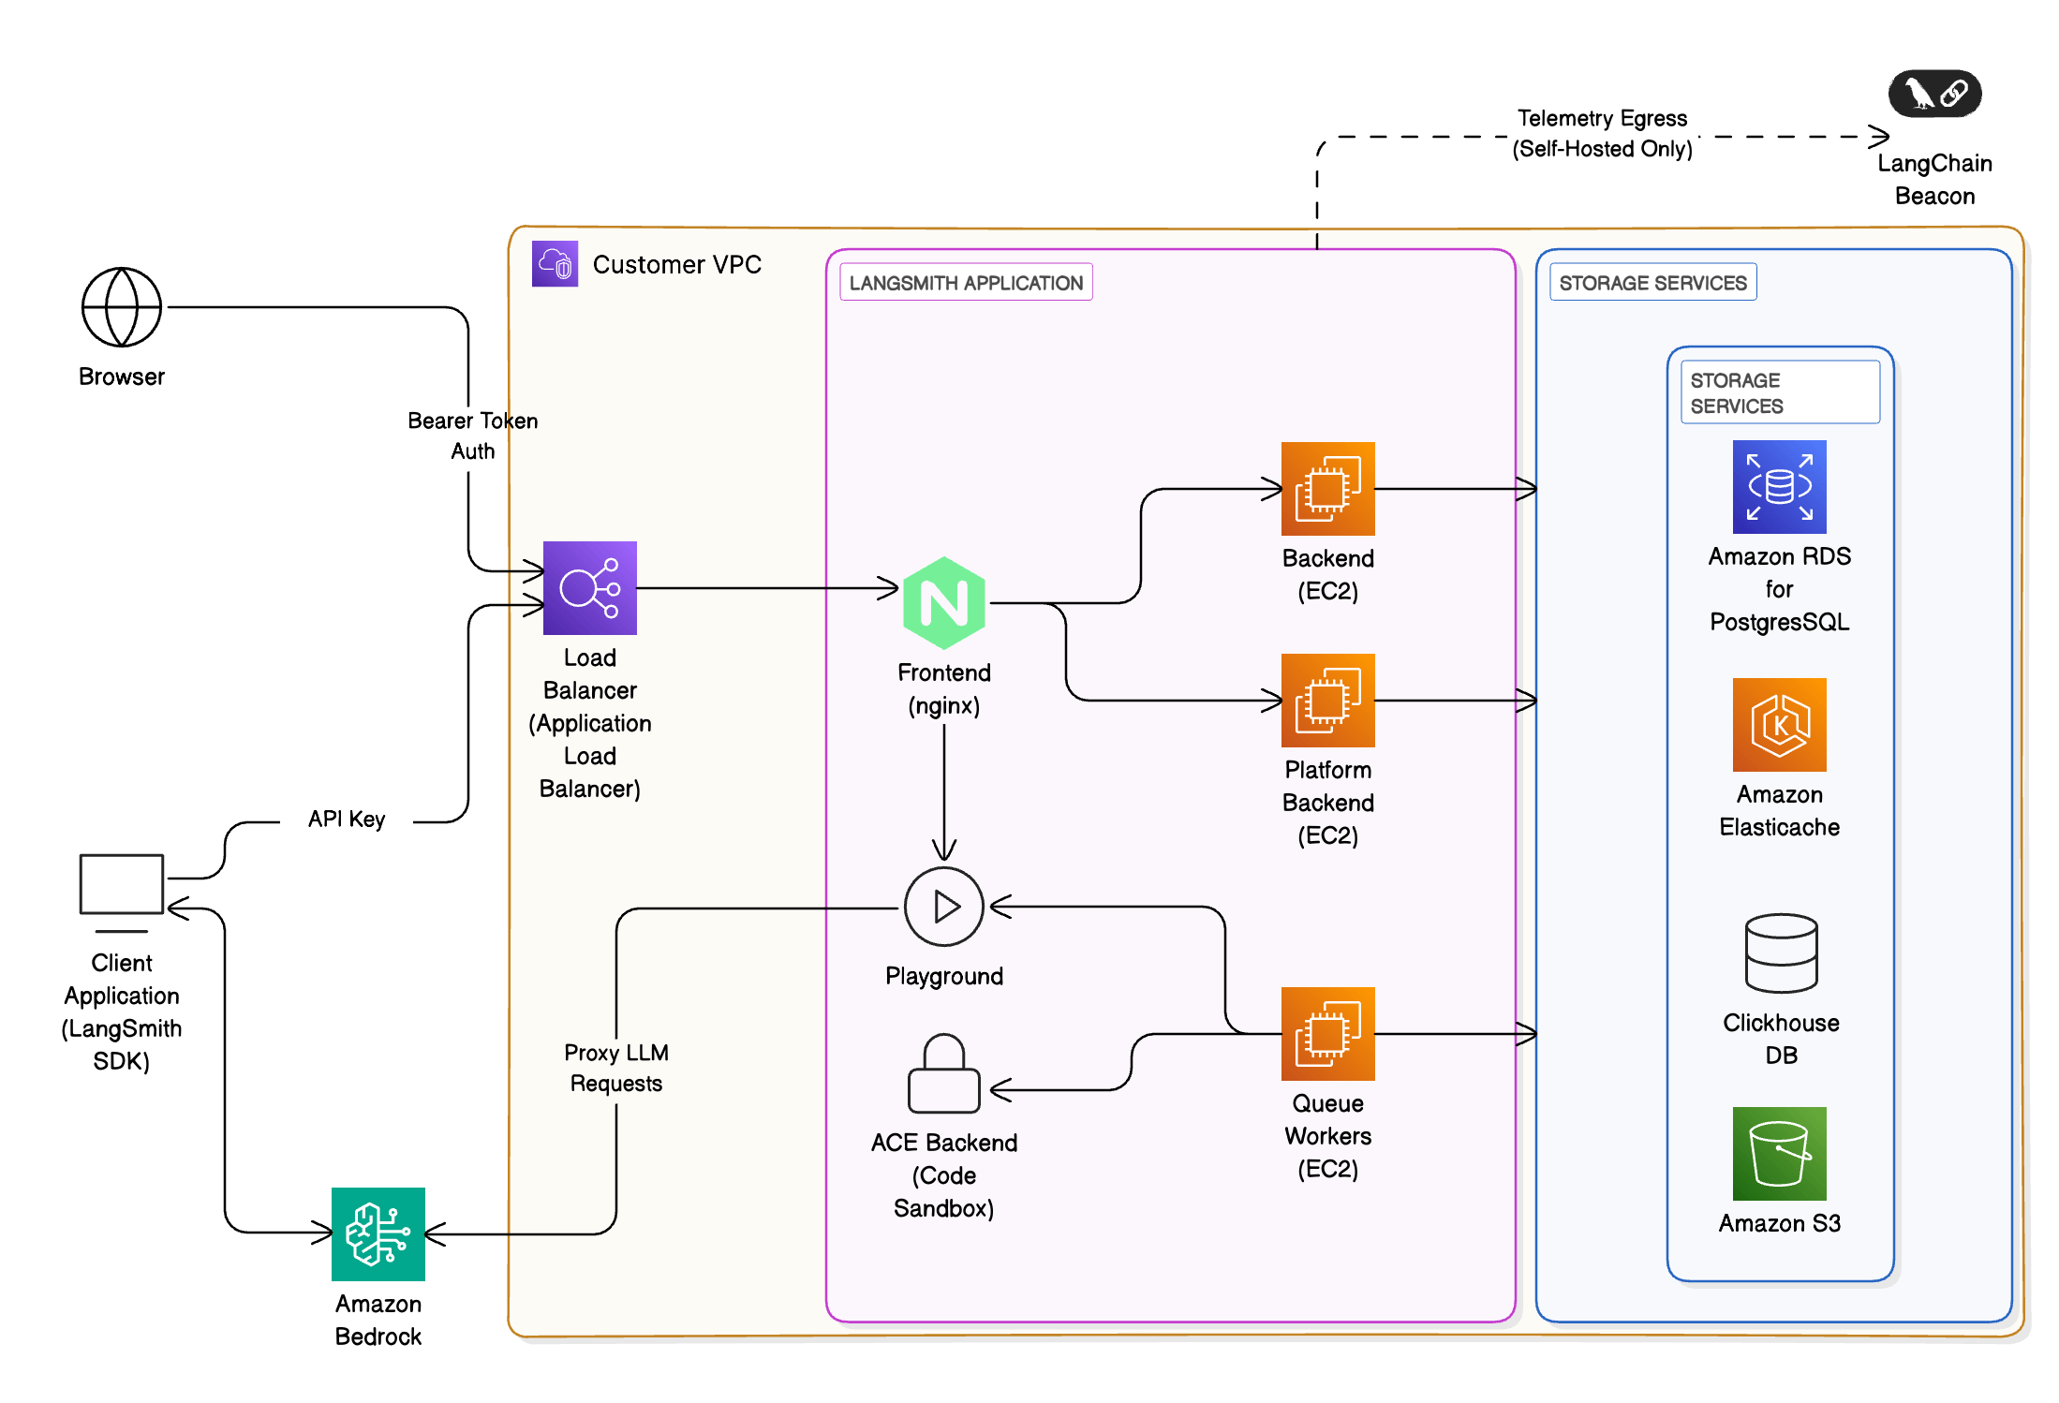
PART 2 · DEPLOYMENT
The Reference Architecture (with Redis)
Testing & Deploying an Agentic System
15 / 17

Slide 17
PART 2 · DEPLOYMENT
The Reference Architecture (with Redis)
A hand-rolled version of the official LangGraph Agent Server — the same two building blocks it uses.
Streamlit UI Client
POST /start · GET /stream (SSE)
Load Balancer · nginx
routes to any node — client doesn't care which
debate-node 1
debate-node 2
debate-node 3
↓ checkpoint read/write & ownership heartbeat · publish / subscribe ↓
Postgres
Redis
durable checkpoints + run ownership → any node resumes
pub/sub channel per run → streaming decoupled from execution
Testing & Deploying an Agentic System
15 / 17

Slide 18
PART 2 · DEPLOYMENT
The Payoff: Surviving a Crash
Kill the node running a live debate — another node picks it up mid-sentence and finishes it. The user never notices.
FAILURE MODE 1
FAILURE MODE 2
You lose your screen
You lose the worker
The client disconnects, but the executor is fine. Redis re-attach — reconnect to the same run's channel.
The executing node dies. Its heartbeat goes stale, another node claims ownership and resumes from the Postgres checkpoint.
Testing & Deploying an Agentic System
16 / 17

Slide 19
WHAT TRANSFERS TO EVERY AGENT WE BUILD
An agent isn't ready when it works —
it's ready when it's measurable and survivable.
TRUST
RESILIENCE
Define dimensions → split deterministic vs. judge → gate releases automatically.
Durable state + streaming decoupled with Redis + automatic failover.
Thank you · Talentica

