Slide 1
DevOps

Slide 2
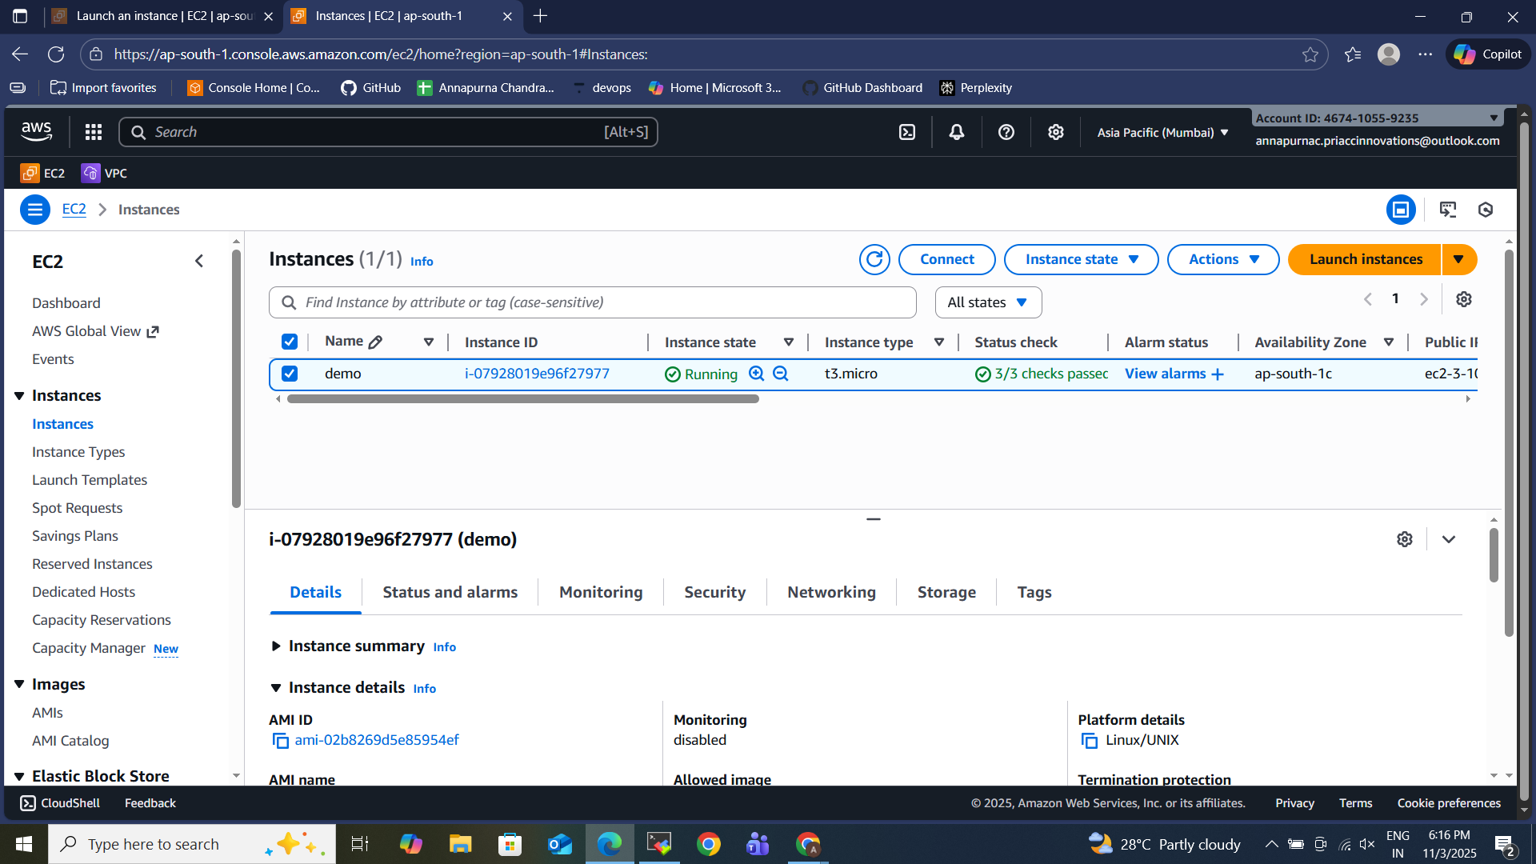
Server

Slide 3
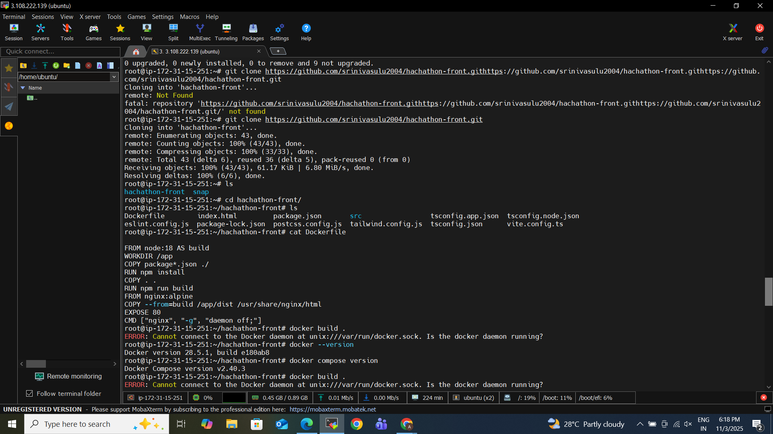
GIT cloning & dockerfile

Slide 4
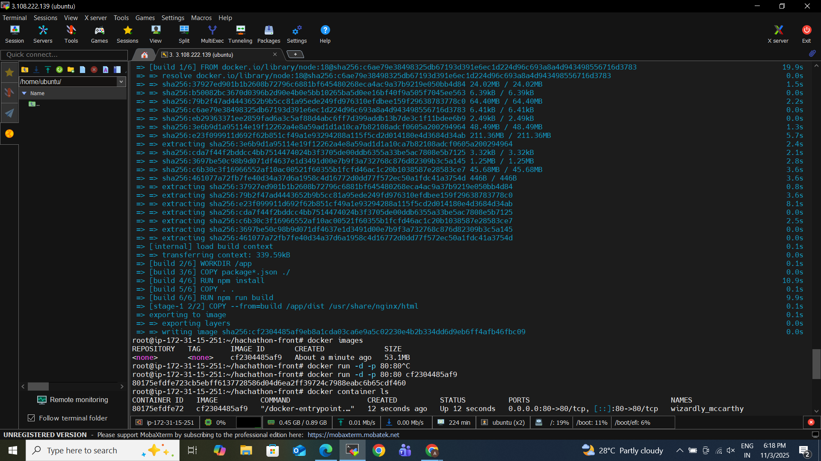
DOCKER BUILD

Slide 5
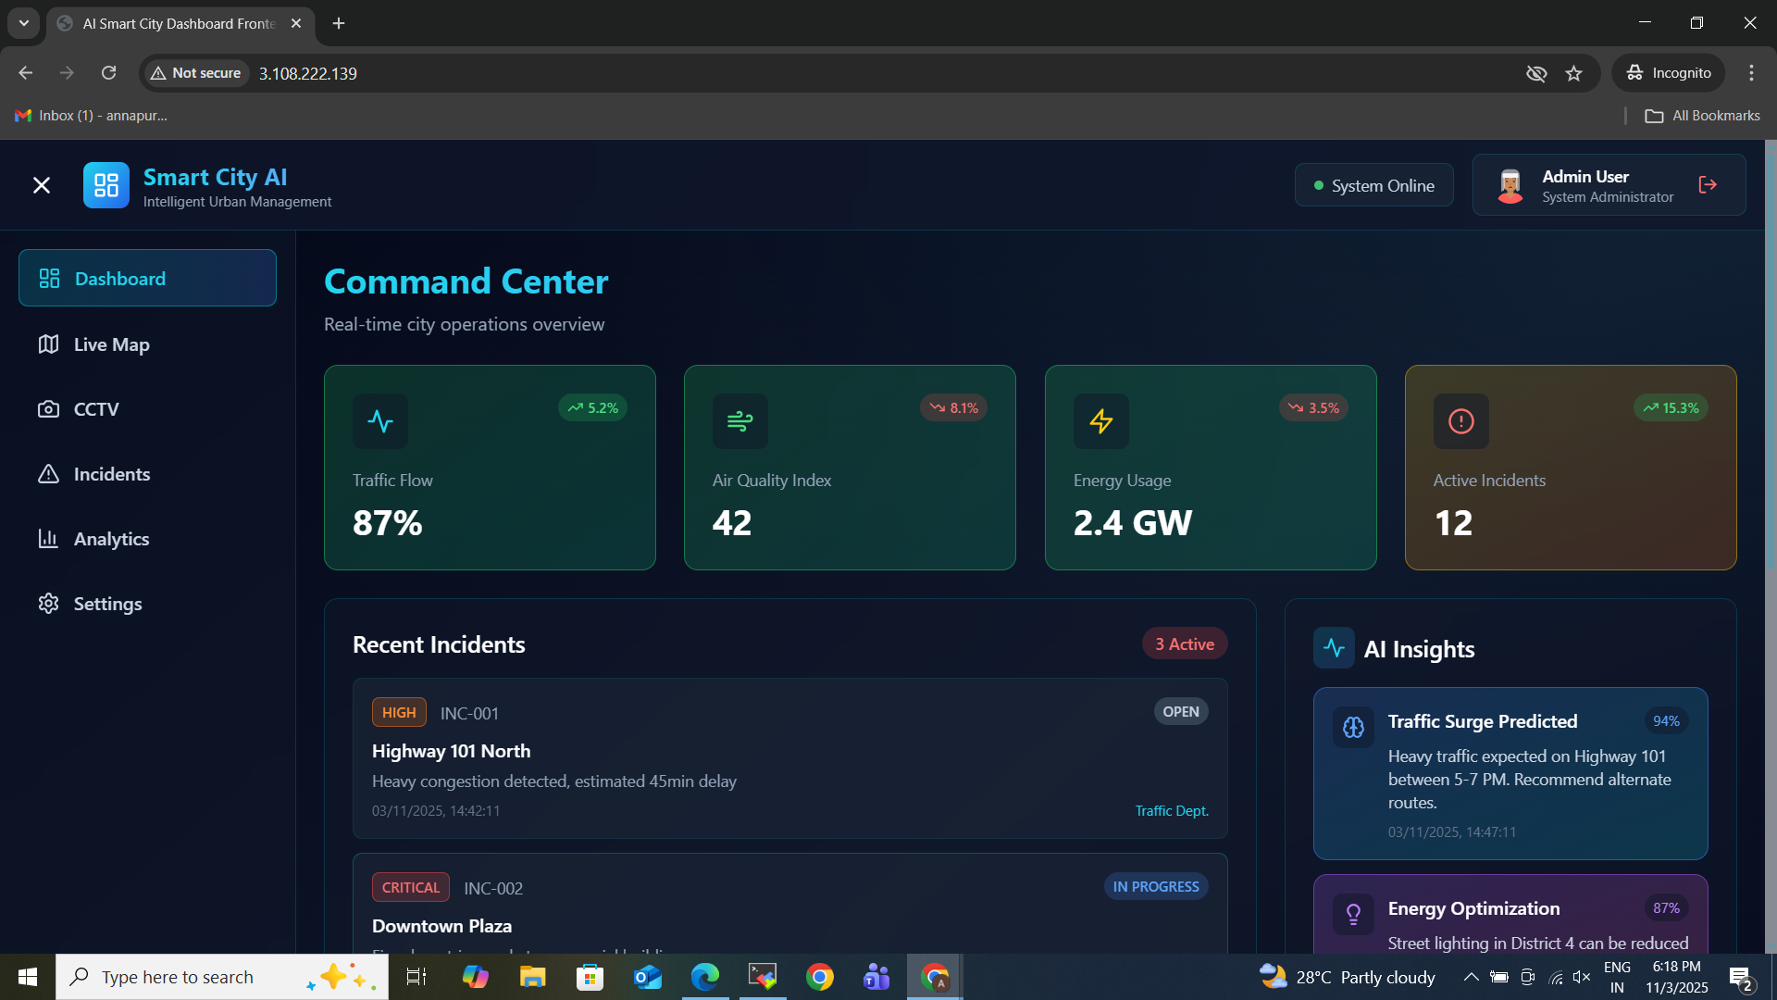

Slide 6
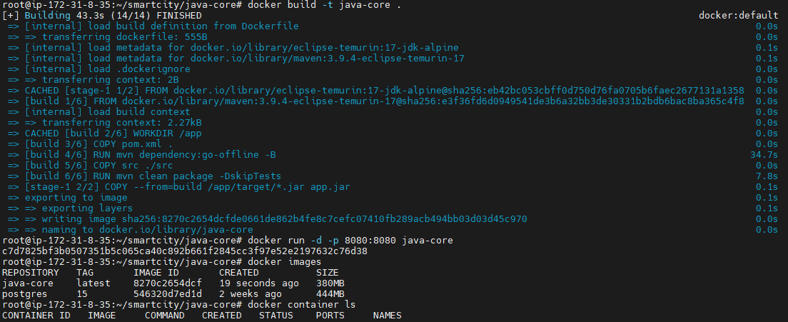
BACKEND_BUILD

Slide 7
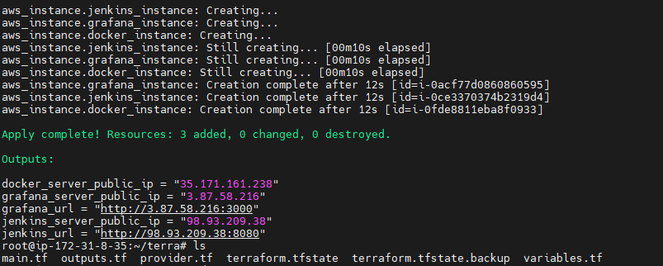
Terraform Infra Creation

