Slide 1
AI Smartcity Management System
Traffic Accident, Energy Demand, and Air Quality Prediction
Tools: Python, Pandas, Scikit-learn, Machine learning, Matplotlib

Slide 2
Overview
- Objective: Build predictive models for real-world safety and environmental challenges.
- Focus Areas:
1. Traffic Accident Analysis
2. Household Energy Forecasting
3. Air Quality Prediction

Slide 3
Traffic Accident Analysis – Introduction
- Goal: Predict accident severity and key influencing factors.
- Importance: Reduce road accidents and improve traffic safety.

Slide 4
Dataset Overview
- Features: Traffic_Density, Speed_Limit, Driver_Alcohol, Weather, Road_Type.
- Target: Accident (Yes/No)

Slide 5
Data Preprocessing
- Filled missing numeric values with median.
- Filled categorical columns with mode.
- Removed duplicates and outliers.
- Created Age_vs_Experience feature.

Slide 6
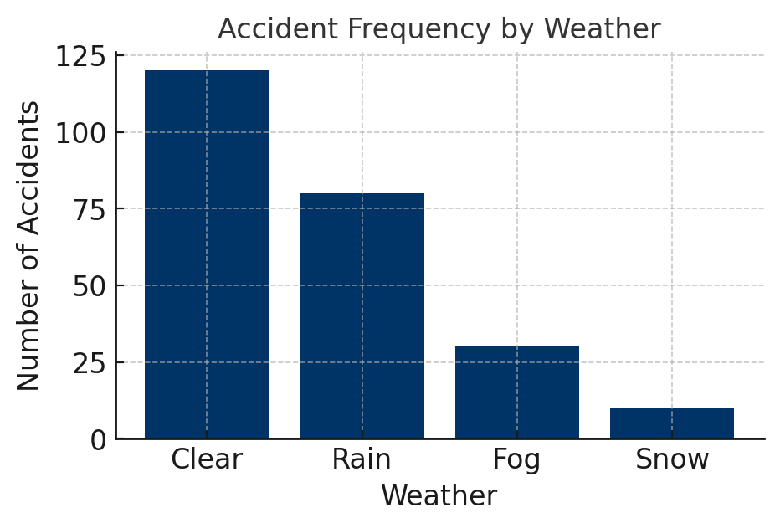
EDA: Accident Frequency by Weather

Slide 7
Model Training & Results
- Models: RandomForestClassifier, XGBoostClassifier
- Accuracy: ~90%
- Metrics: Confusion Matrix, Classification Report
- Model saved: traffic_model.pkl

Slide 8
Energy Demand Forecasting – Introduction
- Goal: Predict next-day household energy demand.
- Importance: Supports smart grid and efficient power planning.

Slide 9
Model & Evaluation
- Model: RandomForestRegressor
- RMSE ≈ 0.05
- R² ≈ 0.92
- Visualization: Predicted vs Actual Consumption
- Model saved: energy_consumption.pkl

Slide 10
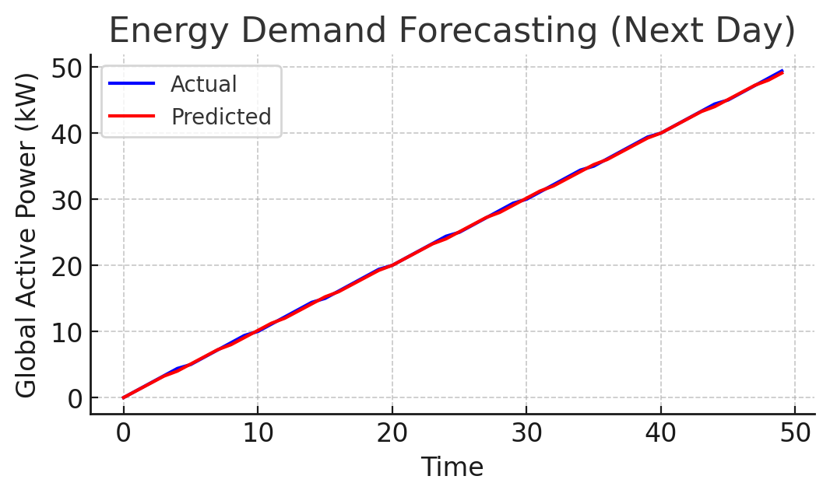
Energy Consumption: Actual vs Predicted

Slide 11
Air Quality Prediction – Introduction
- Goal: Predict Air Quality Index (AQI) using sensor data.
- Importance: Monitor and forecast pollution levels.

Slide 12
Model & Evaluation
- Model: XGBoostRegressor
- RMSE ≈ 5.5
- R² ≈ 0.97
- Model saved: aqi.pkl

Slide 13
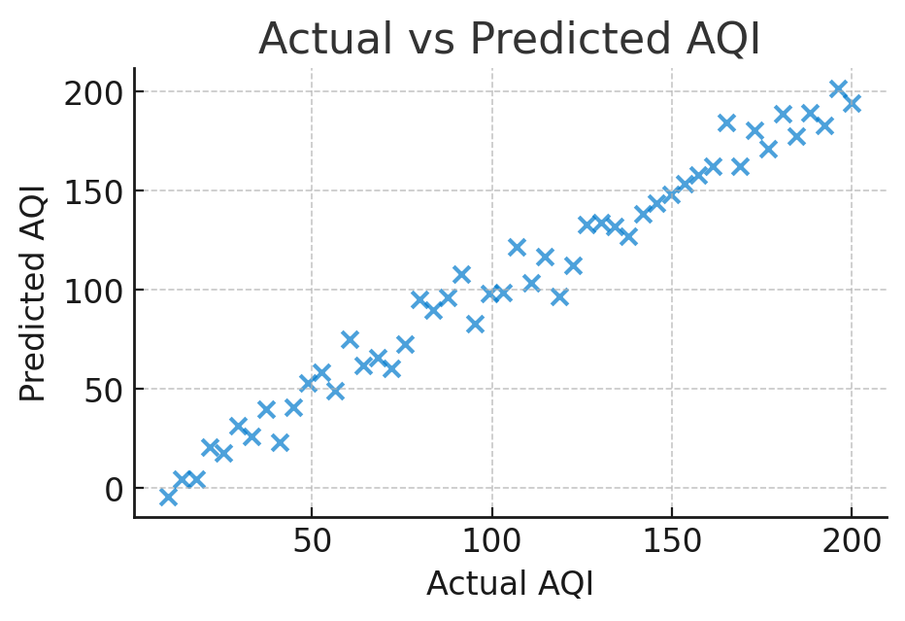
Air Quality: Actual vs Predicted AQI

Slide 14
Comparative Summary
Traffic Accident → RandomForest (Acc ≈ 90%)
Energy Forecasting → RF Regressor (R² ≈ 0.92)
Air Quality → XGBoost (R² ≈ 0.97)

Slide 15
Future Work
- Integrate all models into unified AI dashboard.
- Deploy with Streamlit or Flask.
- Add real-time IoT data for live monitoring.

Slide 16
Conclusion
- ML provides valuable insights across multiple domains.
- Predictive analytics supports safer and cleaner environments.

