Slide 1
Python
Introduction
Installation
Syntax
Data Types and Operators
5. User Inputs
6. Conditional Statements
7. Loops
8. Strings

Slide 2
Introduction
One of the fastest growing Language
In what terms?
No. of developers who are using it
No. of Libraries we have
No. of companies who are using it
Areas we can implement it (ML, GUI, Software Dev., Web Dev. and many more)
Why is Python so famous? We already have C, C++, Java, JS !!
It solved the brackets({…}) and semicolon(;) issues for the developers
Variables are not declared with datatypes
We just need to write one line of code to take inputs(in java we need to import Scanner class and then Scanner declaration after that the input statement)(Q. How many types of User Inputs are there in Java?)
Some people say Python is a new language but it actually came before Java!
Java-1995 and Python-1989

Slide 3
Introduction
Other reasons that made it more POPULAR:-
The advancement of ML, AI… This is a field where we have research scientists, they don’t want to spend much time on any other Programming Languages
So they went for the easiest Language available in the market and the easiest language available in the market is PYTHON
Companies using Python:-
Google, YouTube, Dropbox, Yahoo, NASA and many more!
Now they can use it as a main language or a support language. Google has so many features, some of them is coded in Python
Reddit – It’s totally written in Python

Slide 4
Introduction
How name came? Did it come from a Snake?
Developed by:- Guido Van Rossum. He was a big fan of the movie- Monty Python’s Flying Circus so he named the language as Python(Q. Who developed Java and why did he give the name JAVA?)
Versions in Python:-
Python 1.0
Python 2.0
Python 3.0(much more different from the other versions and it has so many awesome features (specially its Libraries) that make us easier to code!
Non-Technical Background students can also start with Python. It’s damn easy to learn!!!

Slide 5
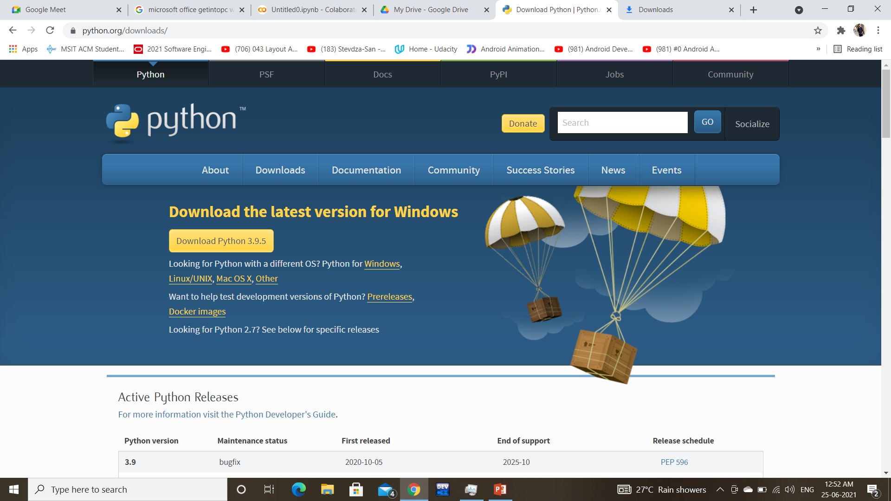
installation

Slide 6
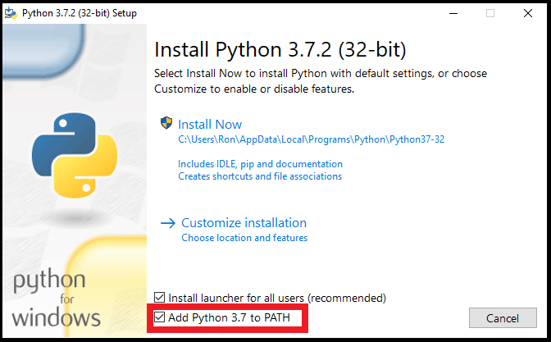
installation

Slide 7
WHERE TO CODE ?
IDLE
PyCharm
VS Code
Jupyter Notebook
Google Colab and many more…

Slide 8
Interpreter Vs Compiler
We generally write a computer program using a high-level language. A high-level language is one that is understandable by us, humans. This is called source code.
However, a computer does not understand high-level language. It only understands the program written in 0's and 1's in binary, called the machine code.
To convert source code into machine code, we use either a compiler or an interpreter.
What is Compiler?
A compiler is a computer program that transforms code written in a high-level programming language into the machine code.
What is Interpreter?
An interpreter is a computer program, which coverts each high-level program statement into the machine code.
Both compiler and interpreters do the same job which is converting higher level programming language to machine code. However, a compiler will convert the code into machine code (create an exe) before program run. Interpreters convert code into machine code when the program is run.

Slide 9
SYNTAX
Arithmetic Operations:-
+, -, *, /, %
Special Operations such as Integer Division using // and Calculating Power using **
For example, 5/2 will give 2.5 as output but 5//2 will give 2(quotient) as output
For example, 2*3 will give 6 as output but 2**3 will give 8 as output
The print statement:-
Same line
print(“Hello", end=“”)
print(“Hi”)
Next line
print(“Hello")
print(“Hi”)

Slide 10
Data types and operators
Data Types:-
None
Numeric
List
Tuple
Set
Strings
Dictionary

Slide 11
Data types and operators
Numeric Data Types:-
a=5.6
type(a)
float
a=5 + 6j
type(a)
complex
a=5
b=6
c=complex(a,b)
print(c)
5 + 6j

Slide 12
Data types and operators
Types of Operators:-
Arithmetic Operators(+, -, *, /, %)
Assignment Operators(=)
Swapping in one line
a , b = b , a
Relational Operators(<, <=, ==, >, >=, !=)
Logical Operators(AND, OR, NOT)
Unary Operators(+5, -11)

Slide 13
User inputs
Reduced the number of lines
Python:
N=input(“Enter a number:”)→ In String format
OR
N=int(input(“Enter a number:”))→In Integer Format

Slide 14
Conditional statements
The if statement:
if test expression:
Statement
if num > 0:
print(“Positive”)
The if-else statement:
if test expression:
Statement 1
else:
Statement 2
if num%2==0:
print(“EVEN”)
else:
print(“ODD”)

Slide 15
Conditional statements
The if-elif-else statement:
if test expression:
Statement 1
elif test expression:
Statement 2
else:
Statement 3
if(num > 0):
print(“Postive”)
elif(num < 0):
print(“Negative”)
else:
print(“Zero”)

Slide 16
Conditional statements
Nested if:
if test expression:
if test expression:
Statement 1
else:
Statement 2
else:
Statement 3

Slide 17
LOOPS
for loop:
for val in sequence:
Code here…
Printing numbers from 1 to 10:
for i in range(1,10):
print(i)
Sum of Digits:
n=123
sum=0
num=str(n) (Q. How to convert an integer to string in Java?)
for i in num:
sum=sum+int(i)
print(sum)

Slide 18
LOOPS
while loop:
while test_expression:
Code here…
Checking whether a number is palindrome or not:
n=121
num=n
rev=0
while num>0:
rev=rev*10+num%10
num=num//10
if rev==n:
print("Palindrome")
else:
print("Not Palindrome")

Slide 19
loop control statements
Break Statement
It terminates a loop block
Continue Statement
It skips a loop block
Pass Statement(can also be implemented in if-else block)
If you don’t want to write code in a block you can simply execute the pass statement

Slide 20
Break Continue pass
for i in range(0,100):
if(i==50):
break
elif(i%2==0):
continue
elif(i%5==0):
print(i)
else:
pass

Slide 21
strings
Printing Strings:-
print(“Rohit’s Laptop”)
Rohit’s Laptop
print('Rohit's "Laptop"')
Error!!!
print(‘Rohit\'s "Laptop"')
\ has a special meaning that will treat the inverted comma as a normal character so the output will be Rohit’s Laptop
print(“C:\docs\new_file.png”)
C:\docs
ew_file.png
print(r “C:\docs\new_file.png”)
C:\docs\new_file.png
r/R is raw string which doesn’t allow special meaning to \n and treat them as normal characters

Slide 22
strings
Playing with string index:-
name="Rohit"
print(name[0])
R
name="Rohit“
print(name[-1])
t
The negative i0xndex is used to print values from backward
0 1 2 3 4
R o h i t
-5 -4 -3 -2 -1
R o h i t

Slide 23
strings
Playing with string index:-
name="Rohit“
print(name[0:2])
Ro
name="Rohit“
print(name[2:])
hit
name="Rohit“
print(name[:3])
Roh
name="Rohit"
print(name[:])
Rohit

Slide 24
strings
Playing with string index:-
str="Hello World“
print(str[2:10:2])
loWr
The format should be [start:end:step]
str="Hello World"
print(str[::-1])
dlroW olleH
Each word in a sentence can be reversed like this without any loop!
name="Rohit"
name[0]='M'
print(name)
Error! As strings in Python are immutable so we cannot assign values in this way!

