Slide 2
A Sorting Algorithm is used to rearrange a given array or list of elements according to a comparison operator on the elements. The comparison operator is used to decide the new order of elements in the respective data structure.
Sorting is arranging the elements in a list or collection in increasing or decreasing order of some property
Remember- List should be homogeneous. data should be of same type.

Slide 3
Classification of sorting algorithms
We often classify algorithm based on some parameters
Time complexity
Space complexity or memory usage
Stability
Internal sort vs external sort
Recursive or non recursive

Slide 4
Selection sort
The list is divided into two sub lists, sorted and unsorted.
Search through the list and find the smallest element.
Swap the smallest element with the first element
Repeat starting at second element and find the second smallest element.
The time complexity of Selection Sort is O(N2)
Auxiliary Space: O(1)

Slide 5
Advantages
Simple and easy to understand.
Works well with small datasets.
Disadvantages
Selection sort has a time complexity of O(n^2) in the worst and average case.
Does not work well on large datasets.
Does not preserve the relative order of items with equal keys which means it is not stable

Slide 6
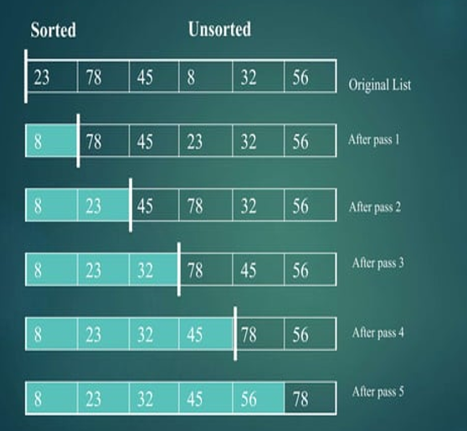
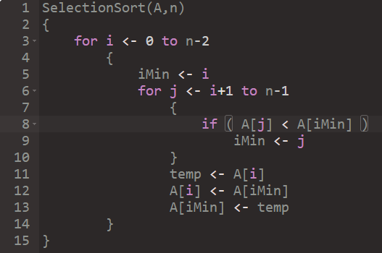

Slide 7
Bubble Sort
Simple and unconditional
The largest element is placed in its correct position, i.e., the end of the array.
Compare neighboring elements.
Swap if out of order
Time Complexity: O(N2)
Auxiliary Space: O(1)

Slide 8
Advantages :
Bubble sort is easy to understand and implement.
It does not require any additional memory space.
It is a stable sorting algorithm, meaning that elements with the same key value maintain their relative order in the sorted output.
Disadvantages :
Bubble sort has a time complexity of O(N²) which makes it very slow for large data sets.
Bubble sort is a comparison-based sorting algorithm, which means that it requires a comparison operator to determine the relative order of elements in the input data set. It can limit the efficiency of the algorithm in certain cases.

Slide 9
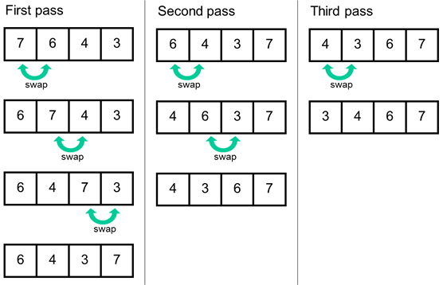
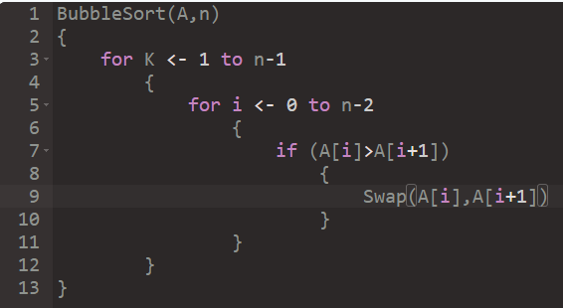

Slide 10
Insertion sort
Another of the O(n^2) sort
The first item is sorted
Compare the second item to the first
If smaller swap
Third item, compare to item next to it need to swap
After swap compare again
And so forth…
Auxiliary Space: O(1)

Slide 11
Advantages of Insertion Sort:
Simple and easy to implement.
Stable sorting algorithm.
Efficient for small lists and nearly sorted lists.
Space-efficient.
Disadvantages of Insertion Sort:
Inefficient for large lists.
Not as efficient as other sorting algorithms (e.g., merge sort, quick sort) for most cases.

Slide 12
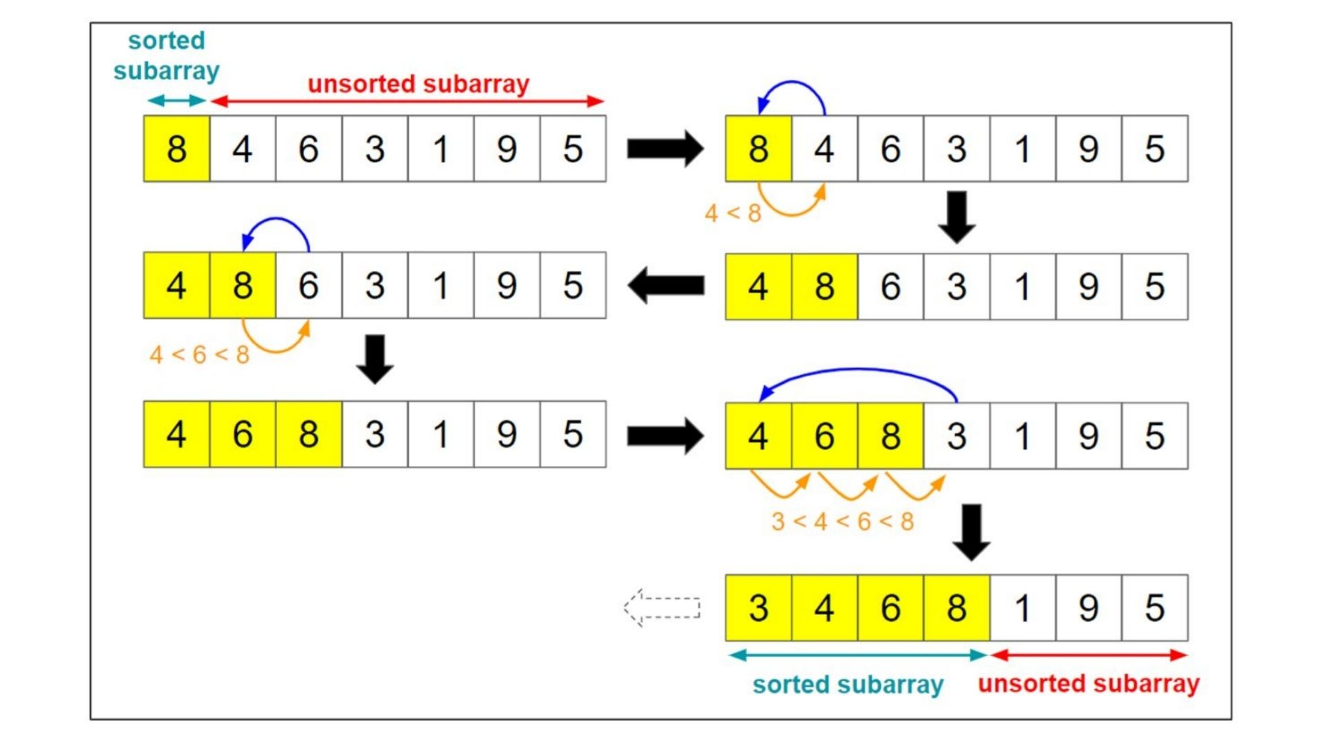
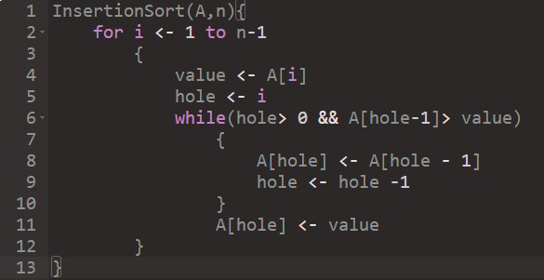

Slide 13
Merge sort
It id based on divide-and-conquer sorting algorithm
Requires an extra array memory
It is a recursive algorithm.
Divide the list into halves.
Sort each halves separately, and
Then merge the sorted halves into one sorted array
Both worst and average are of O(nlog₂n)
Space Complexity: O(n), Additional space is required for the temporary array used during merging.

Slide 14
Advantages of Merge Sort:
Stability: Merge sort is a stable sorting algorithm, which means it maintains the relative order of equal elements in the input array.
Guaranteed worst-case performance: Merge sort has a worst-case time complexity of O(N logN), which means it performs well even on large datasets.
Simple to implement: The divide-and-conquer approach is straightforward.
Disadvantage of Merge Sort:
Space complexity: Merge sort requires additional memory to store the merged sub-arrays during the sorting process.
Not in-place: Merge sort is not an in-place sorting algorithm, which means it requires additional memory to store the sorted data. This can be a disadvantage in applications where memory usage is a concern.

Slide 15
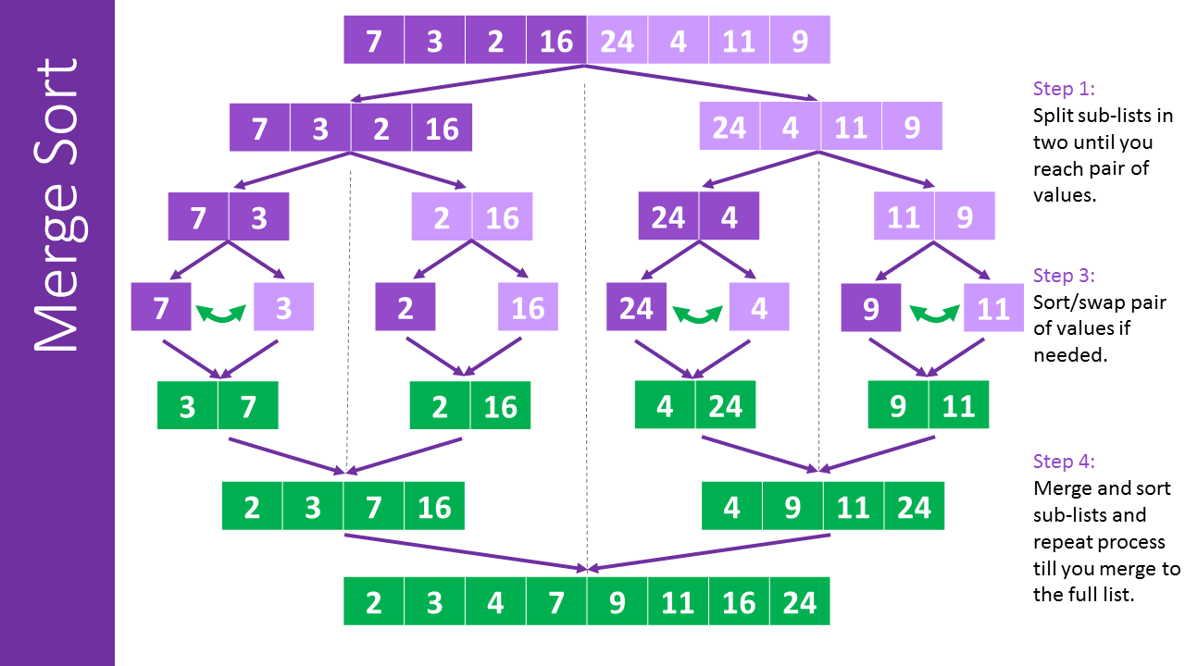
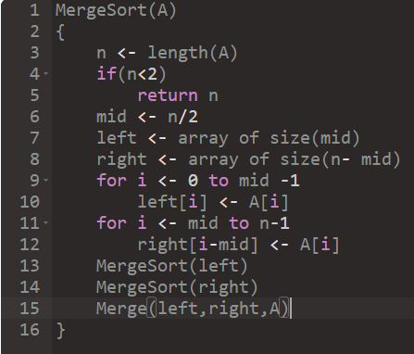

Slide 16
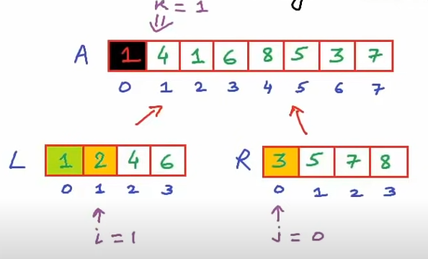
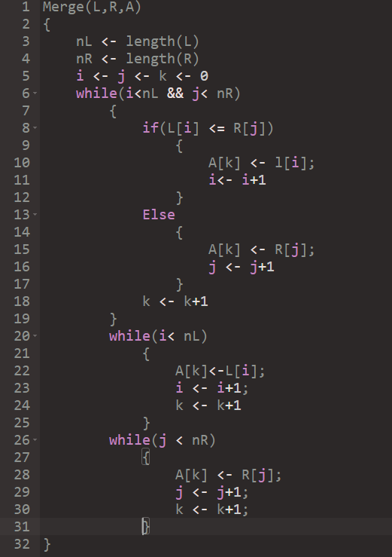
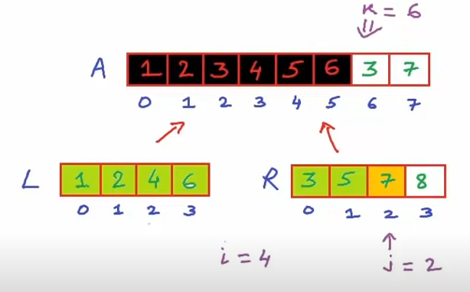
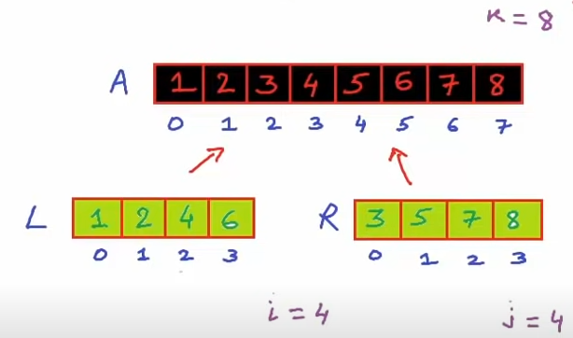

Slide 17
Quick Sort
It is based on divide-and-conquer
It works as follows:
First it partitions an array into two parts
Then it sorts the parts independently
Finally it combines the sorted subsequences by a simple concatenation

Slide 18
Advantages of Quick Sort:
It is a divide-and-conquer algorithm that makes it easier to solve problems.
It is efficient on large data sets.
It has a low overhead, as it only requires a small amount of memory to function.
Disadvantages of Quick Sort:
It has a worst-case time complexity of O(N²), which occurs when the pivot is chosen poorly.
It is not a good choice for small data sets.
It is not a stable sort, meaning that if two elements have the same key, their relative order will not be preserved in the sorted output in case of quick sort, because here we are swapping elements according to the pivot’s position (without considering their original positions).

Slide 19
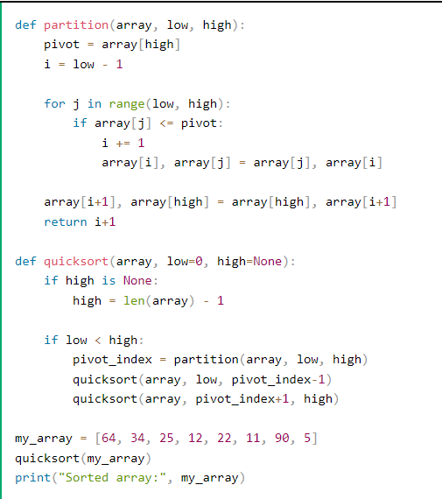
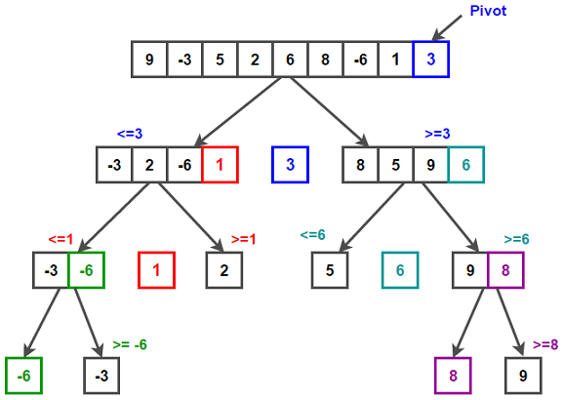

Slide 20
Linear Search
This algorithm is really straight forward.
Every value is checked from the start of the array to see if the value is equal to 11, the value we are trying to find.
When the value is found, the searching is stopped, and the index where the value is found is returned.
If the array is searched through without finding the value, -1 is returned.
Time complexity: O(N)
Auxiliary Space: O(1)

Slide 21
Advantages of Linear Search:
Linear search can be used irrespective of whether the array is sorted or not. It can be used on arrays of any data type.
Does not require any additional memory.
It is a well-suited algorithm for small datasets.
Drawbacks of Linear Search:
Linear search has a time complexity of O(N), which in turn makes it slow for large datasets.
Not suitable for large arrays.

Slide 22
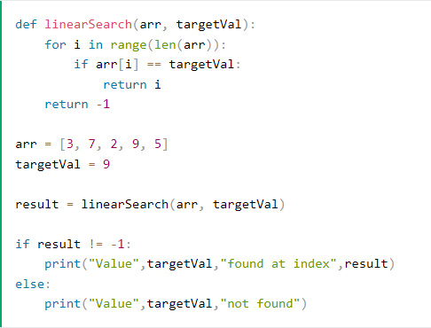
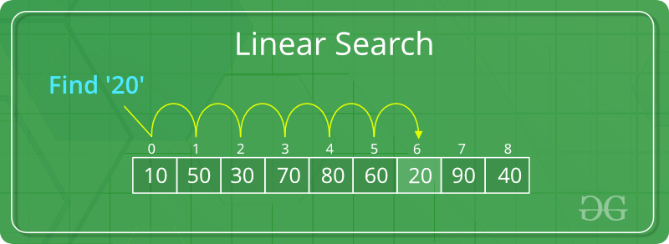

Slide 23
Binary Search
Compare the middle element of the search space with the key.
If the key is found at middle element, the process is terminated.
If the key is not found at middle element, choose which half will be used as the next search space.
If the key is smaller than the middle element, then the left side is used for next search.
If the key is larger than the middle element, then the right side is used for next search.
This process is continued until the key is found or the total search space is exhausted.
Time complexity: O(log N)
Auxiliary Space: O(1)

Slide 24
Advantages of Binary Search:
Binary search is faster than linear search, especially for large arrays.
More efficient than other searching algorithms with a similar time complexity.
Binary search is well-suited for searching large datasets that are stored in external memory, such as on a hard drive or in the cloud.
Drawbacks of Binary Search:
The array should be sorted.
Binary search requires that the data structure being searched be stored in contiguous memory locations.
Binary search requires that the elements of the array be comparable, meaning that they must be able to be ordered.

Slide 25
