Slide 1

RNS Institute of Technology
(AICTE Approved, VTU Affiliated and NAAC ‘A’ Accredited)
Department of Information Science and Engineering
(Accredited by NBA for the Academic Years 2018-19, 2019-20 and 2020-21)
Data structures Laboratory-18CSL38
BY:
Abhishek – 005
Anurag - 032
Chandan - 051
Anurag Sharma (1RN19IS032)
Chandan Parmar (1RN19IS051)
Abhishek Kumar Singh(1RN19IS005)

Slide 2
CONTENTS
Introduction
Objective of the project
Data Structure
System requirements
Implementation modules
Results
Advantages
Future Enhancements
References
Department of ISE,RNSIT

Slide 3
Introduction
This system is basically concerned with the reservation of railway tickets to the passengers.
In this we are discussing that how the reservation is done with the feature of cancelling and waiting list.
In the project we are going to include entities like
Reservation
Cancellation
Display reserved and waiting list passengers.
Department of ISE,RNSIT

Slide 4
OBJECTIVE OF THE PROJECT
All the manual work should be converted into computerized so that the load of employees should decrease.
The data should be stored in computer rather than in register manually.
Booking can be done by sitting at your home only, no need to visit the booking counter.
Department of ISE,RNSIT

Slide 5
Singly Linked List
Data Structure
Linked List is a sequential collection of nodes.Which is faster than array in terms of deletion of nodes. It’s memory is dynamically allocated in runtime. This saves time and space.
Each node consists of four different data field :
#Name
#Age
#Registration Number
#Link to the next node
Department of ISE,RNSIT

Slide 6

Queue
Data Structure
Queue is a data structure in which insertion and deletion takes place from the ends. It follows First In First Out Principle.
Queue data structure is used here to store the waiting list passengers. If anyone cancels their ticket then that seat is allocated to the first passenger in the queue.
Department of ISE,RNSIT

Slide 7
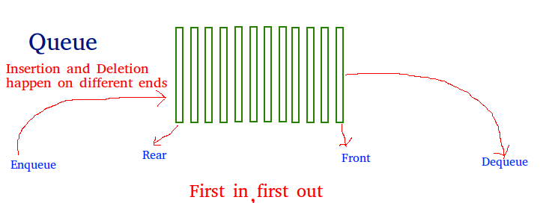
Data Structure
LINEAR QUEUE
A Queue is a linear structure which follows a particular order in which the operations are performed. The order is First In First Out (FIFO) .In a queue, we remove the item the least recently added.
Department of ISE,RNSIT

Slide 8
SYSTEM REQUIREMENTS
SOFTWARE SPECIFICATION
Operating System : OSx
Frontend : C programming
Backend : C programming
IDE : Visual Studio Code
Department of ISE,RNSIT

Slide 9
Implementation modules
node* deq();
int create();
int reserve(node*);
int cancel(int);
void enq(node*);
void display();
Department of ISE,RNSIT

Slide 10
Implementation modules
typedef struct NODE
{
int reg_no;
int age;
char name[20];
struct NODE *next;
} node;
Department of ISE,RNSIT

Slide 11
Implementation modules
int create( )
{
node *new;
new=(node *)malloc(sizeof(node));
new->reg_no=1;
printf("Name: ");
scanf("%s", new->name);
printf("Age : ");
scanf("%d", &new->age);
if(new->age>=90 || new->age<=10) {
free(new);
return -1;
}
start=new;
new->next=NULL;
num++;
return 1;
}
Department of ISE,RNSIT

Slide 12
Implementation modules
int reserve(node *start){
int temp;
if(start==NULL){
temp = create(start);
return temp;
}
else {
node *temp, *new_node;
temp=start;
while(temp->next!=NULL){
temp=temp->next;
}
new_node=(node *)malloc(sizeof(node));
printf("Name: ");
scanf("%s", new_node->name);
printf("Age : ");
scanf("%d", &new_node->age);
if(new_node->age >=90 || new_node>age<=10) {
return -1;
}
new_node->next=NULL;
if(num<=size){
num++;
new_node->reg_no=num;
temp->next=new_node;
return 1;
}
else{
enq(new_node);
return 0;
}
}
}
Department of ISE,RNSIT

Slide 13
Implementation modules
int cancel(int reg)
{
node *ptr, *preptr, *new;
ptr=start;
preptr=NULL;
if(start==NULL)
return -1;
if(ptr->next==NULL && ptr->reg_no==reg)
{
start=NULL;
num--;
free(ptr);
return 1;
}
else{
while(ptr->reg_no!=reg && ptr->next!=NULL)
{
preptr=ptr;
ptr=ptr->next;
}
if(ptr==NULL && ptr->reg_no!=reg)
return -1;
else
preptr->next=ptr->next;
free(ptr);
new=deq();
while(preptr->next!=NULL)
preptr=preptr->next;
preptr->next=new;
num--;
return 1;
}
}

Slide 14
Implementation modules
void enq(node *new_node)
{
if(rear==NULL)
{
rear=new_node;
rear->next=NULL;
front=rear;
}
else
{
node *temp;
temp=new_node;
rear->next=temp;
temp->next=NULL;
rear=temp;
}
count++;
}
node* deq(){
node *front1;
front1=front;
if(front==NULL)
return NULL;
else{
count-- ;
if(front->next!=NULL){
front=front->next;
front1->next=NULL;
return front1;
}
else{
front=NULL;
rear=NULL;
return front1;
}}}

Slide 15
Implementation modules
void display()
{
node *temp;
temp=start;
while(temp!=NULL)
{
printf("\nRegistration Number: %d\n", temp->reg_no);
printf("Name : %s\n\n", temp->name);
temp=temp->next;
}
}

Slide 16
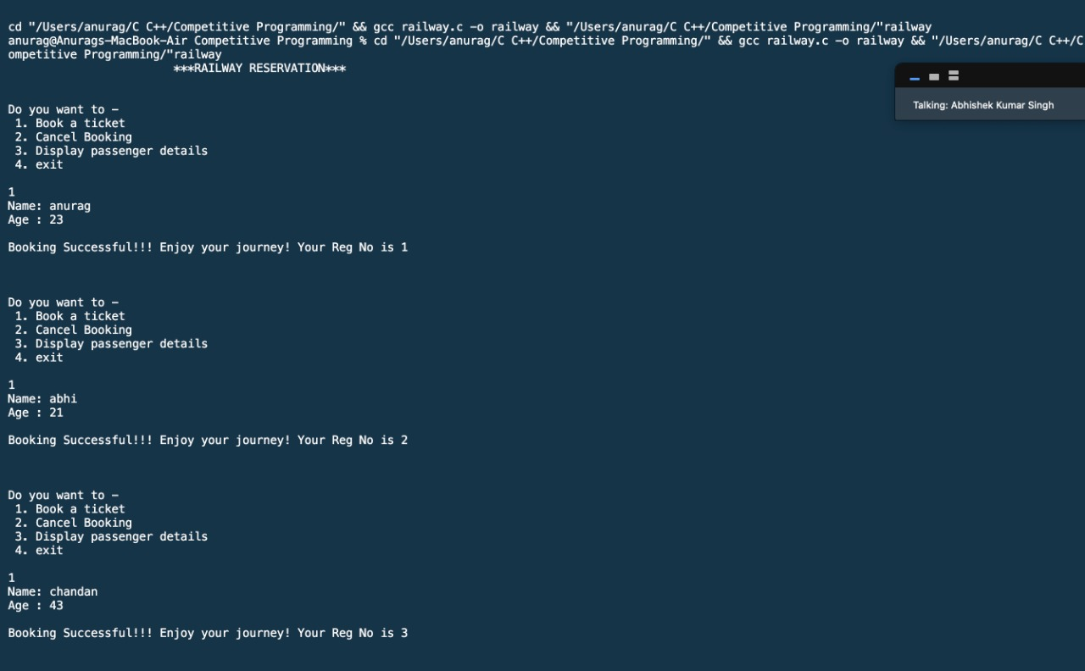
Results
Department of ISE,RNSIT

Slide 17
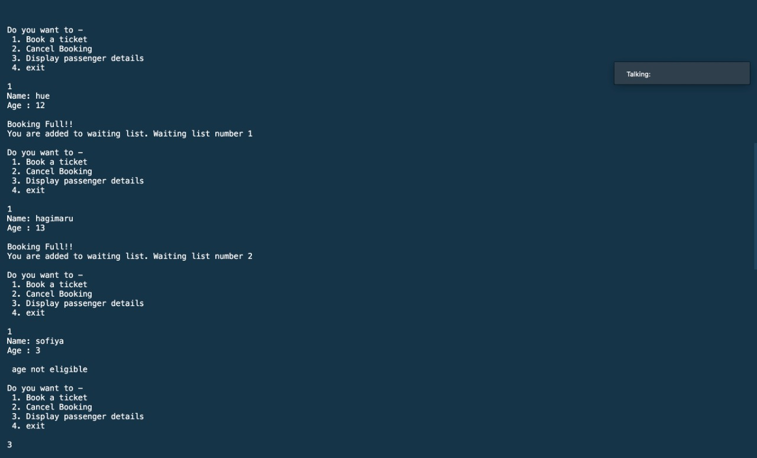
Results
Department of ISE,RNSIT

Slide 18
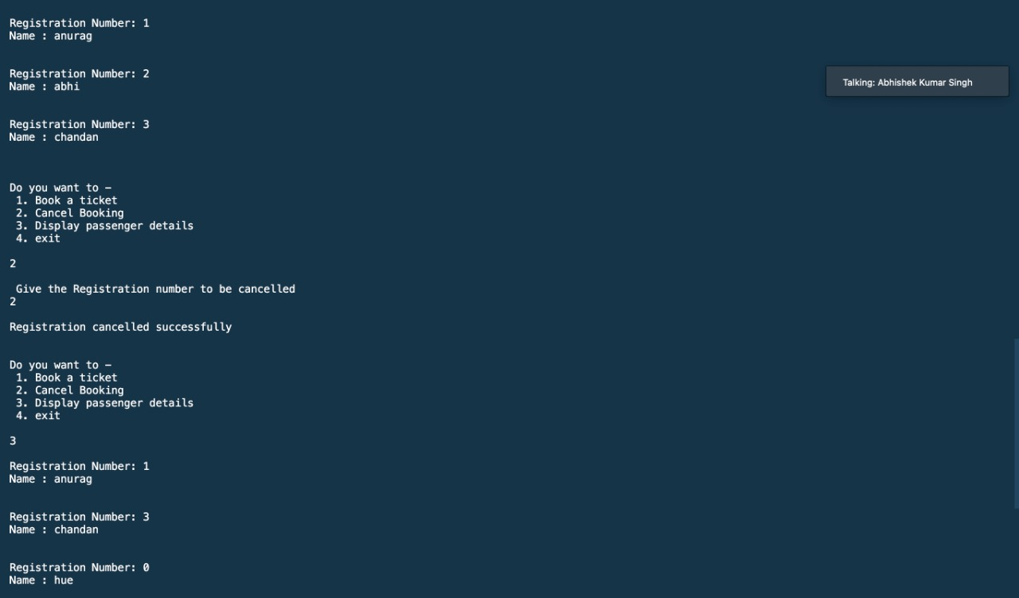
Results
Department of ISE,RNSIT

Slide 19
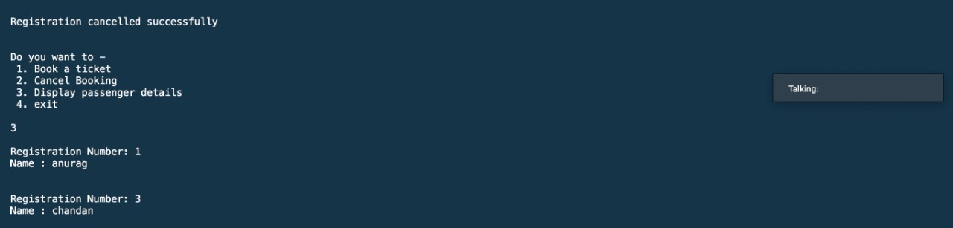
Results
Department of ISE,RNSIT

Slide 20
ADVANTAGES
Reduces the burden of traveler waiting in the booking counter.
User-friendly.
Convenient.
Time savings.
Helpful during COVID.
Department of ISE,RNSIT

Slide 21
Future Enhancements
We can optimise our time complexity using some different data structure.
We can add features such as prioritising on the basis of age or railway employees and gender.
We can add feature of tatkal reservation.
We can provide this solution on online portal.
Department of ISE,RNSIT

Slide 22
References
www.youtube.com
www.tutorialspoint.com
www.greeksforgreek.org
Department of ISE,RNSIT

Slide 23
Any Questions?
Department of ISE,RNSIT

