Slide 1

ADHYAVI
AI Emergency Support
& Safety Dispatcher
Name | ANUPAMA SETHI
Registration ID | SummerSaas26752

Slide 2
ADHYAVI
Main Title: ADHYAVI
Sub-title: AI Emergency Support & Safety Dispatcher
Official Track Information:
Primary Track: Saasum AI (AI Customer Support Chatbot Category)
Problem Statement: Transforming standard corporate customer service chat blocks into a context-aware emergency safety dispatcher for nighttime commuters.

Slide 3
The Core Problem Statement
The Structural Failure of Commercial Chatbots: The primary track problem statement requires the development of an AI Customer Support Chatbot. However, traditional conversational customer service bots are built entirely for safe, static commercial environments—such as answering retail delivery questions, managing item returns, or processing credit card resets.
When applied to real-world, high-stress public transit crises, these commercial bots completely break down. They require users to follow slow, automated text trees that are entirely useless when a citizen is navigating a dark road or facing a live safety threat. Current technology treats safety as an afterthought, creating a massive gap in active civic defense infrastructure.

Slide 4
Target User Demographics & Real-World Barriers
The Target Demographic: The application directly serves late-shift female corporate workforce employees (such as BPO, customer care, and IT tech park workers), solo evening transit commuters, and university campus students navigating unlit city corridors after dark.
Pain Point 1 - The Active Typing Barrier (The Panic Trap): Existing emergency helper tools require a victim under intense stress to stare down at their device, interact with small interface elements, and type a paragraph of text or speak commands out loud. In an active threat situation, this behavior is highly dangerous because it breaks situational awareness and alerts potential perpetrators exactly what the user is doing.
Pain Point 2 - The Connectivity Mirage: High-end AI chatbots fail completely the moment a user enters low-network public areas. Places like concrete basement parking structures, deep elevators, or underground transit metro tunnels frequently experience cellular data drops, rendering traditional cloud-dependent AI tools completely useless when help is needed most.

Slide 5
The Solution: Empowered Conversational Dispatching
Adapting the Chatbot Structure: Project ADHYAVI completely reimagines the Saasum AI customer support layout. Instead of processing ecommerce tickets, the system provides real-time emergency safety routing, utilizing an AI support assistant named Shakti.
Zero-Typing Interaction Deck: To eliminate the typing barrier under stress, the lower interface places high-visibility, single-tap macro action chips directly above the input line. With one touch, an anxious user walking down a street can launch background location-tracking sequences without ever standing still or typing a single character.
The Deep Stealth Veil Innovation: At the top header sits a dedicated privacy utility button. Clicking it fires an instantaneous global style swap, instantly transforming the deep crimson safety center dashboard into a boring, plain light-gray academic lecture note sheet. This completely cloaks the user's safety actions from prying eyes in public transit lines while keeping background tracking active.

Slide 6
High-Contrast Technical Architecture
The Frontend Experience: Designed as a mobile-first Progressive Web App (PWA) using pure semantic HTML5 structural containers and a clean CSS3 layout framework. It features high-visibility glassmorphism panels, solid black outer smartphone hardware casing borders, and bright white text parameters to guarantee maximum legibility on a laptop display during evaluation.
The Interaction Logic Layer: Powered by clean, lightweight Vanilla JavaScript. It handles layout shifts, button text injection, and chat timeline generation smoothly via native event listeners, ensuring the application functions flawlessly across any browser tab with zero compilation bugs.
Hardware Defense Integration: Rather than pulling massive audio assets from the cloud, the application leverages the browser's native Web Audio API. It uses built-in audio oscillators to synthesize high-frequency siren waves directly from the device's physical speakers on command, creating an instant acoustic deterrent without needing internet bandwidth.

Slide 7
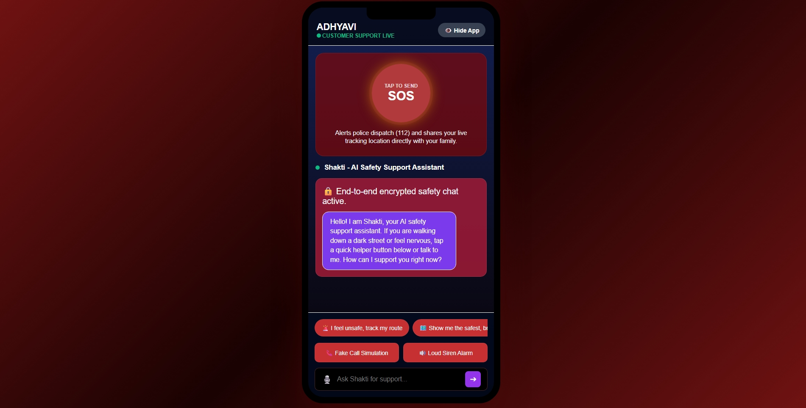

Slide 8
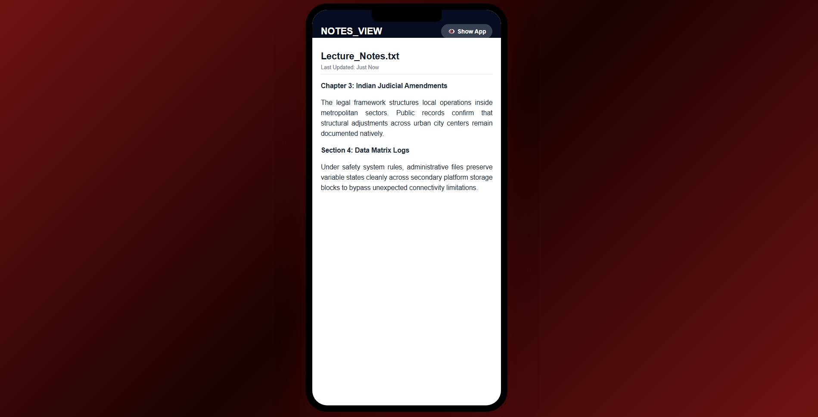

Slide 9
CONCLUSION
Project ADHYAVI completely reimagines the traditional customer support chatbot framework into a resilient, high-stakes public safety platform. By building Shakti on a lightweight, vanilla architecture, we have successfully eliminated the two primary physical barriers faced by late-night commuters under threat: The Active Typing Barrier and The Connectivity Mirage.Through our Zero-Typing Interaction Deck, native Web Audio API hardware sirens, and the Deep Stealth Veil, we prove that safety technology should never be an afterthought—it must be context-aware, instantaneous, and structurally invisible.

Slide 10
THANK YOU
Name | ANUPAMA SETHI
Registration ID | SummerSaas26752

