Slide 1
Variable Template, Alias Template & Variadic Template

Slide 2
Variable Templates
C++14
A variable template defines a family of variables or static data members
They are constexpr and perform compile time computation
Syntax:
When not explicitly specialized or explicitly instantiated, it is implicitly instantiated where a specialization of the variable template is used.
Variable templates can be partially/explicitly specialized

Slide 3

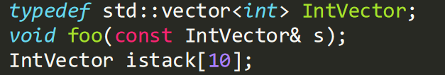
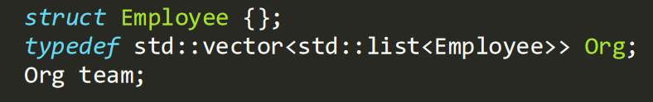
Typedef
Introduces a name for an existing type
Useful to construct shorter more meaningful name for types
Encapsulates implementation details that may change
Only introduces new name for existing type – not a new type

Slide 4

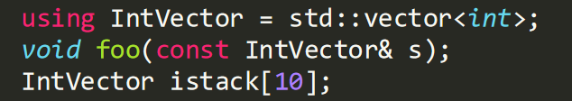
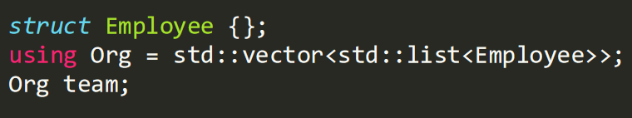
Type Alias (C++ 11)
Creates a name that is a synonym of existing type
Does not introduce a new type
Creates through using keyword
Natural, similar to declaring variables

Slide 5
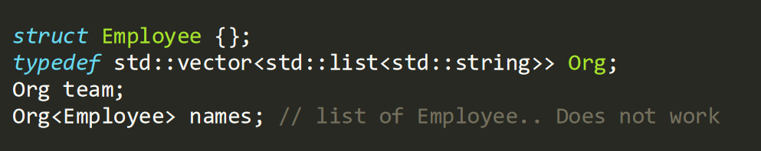
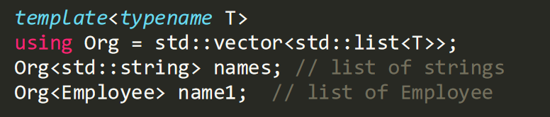
Alias Templates
C++11
Typedef cannot be templatized
Alias templates allow templatization of different types while allowing typedef type synonyms.

Slide 6
Variadic Templates
C++11
Since C++11, templates can have parameters that accept a variable number of template arguments.
C variadic functions which is generally referred to as the varargs construct is the first implementation of a mechanism to support variable arguments
With C++11 implementation using templates, the compiler is able to guarantee type safety and deduce the number of applied parameters following a function call.

Slide 7
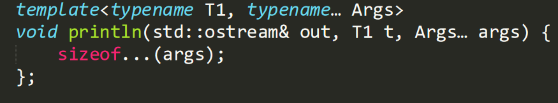
Variadic Templates – Parameter Packs
Syntax

Slide 8
Folding in C++11
In C++11, folding may be implemented using recursive templates
Folding is the implicit destructuring of the parameter pack by passing a head argument as a separate parameter to the function
To correctly terminate the recursion, an identity function is needed

Slide 9
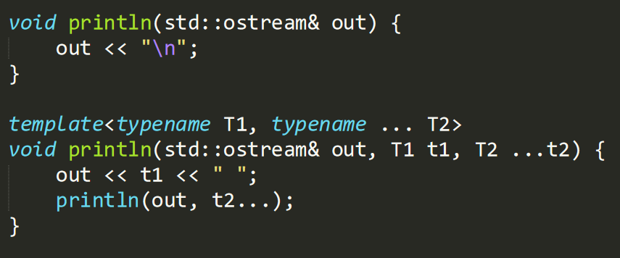
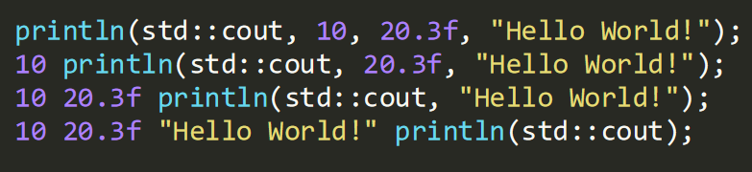
Folding in C++11

Slide 10
Fold Expressions
C++17
A fold expression performs a fold of a template parameter pack over a binary operator.
Solves the problem of recursive template folding in C++
An expression of the form (... op e) or (e op ...), where op is a fold-operator and e is an unexpanded parameter pack, are called unary folds.
An expression of the form (e1 op ... op e2), where op are fold-operators, is called a binary fold. Either e1 or e2 is an unexpanded parameter pack, but not both.
https://en.cppreference.com/w/cpp/language/fold

Slide 11
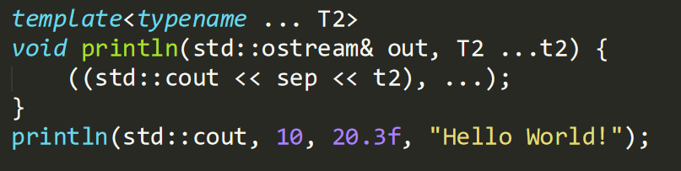
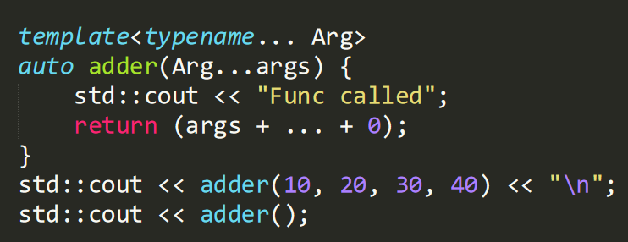
Fold Expressions
C++17

Slide 12
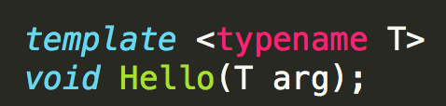
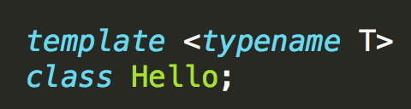
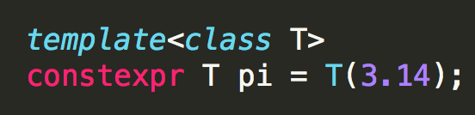
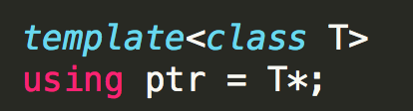
Types of Templates
Function Template - defines a family of functions
Class Template - defines a family of classes
Variable templates (C++ 14) – variables that are templated
Alias Templates (C++11) – alias to a family of types

