Slide 1
AI Investment Committee Environment
OpenEnv Theme #1 submission: multi-agent strategic decision-making in a professional workflow
Train a Portfolio Manager agent inside a realistic investment committee, not a toy market game.
Scripted Research and Risk actors create conflicting incentives, partial observability, and negotiation-like decisions.
Goal: teach an LLM to ask for the right information, balance opportunity with risk, and adapt over time.
Environment Innovation • Storytelling • Observable Training Evidence

Slide 2
Why This Is Novel
The updated judging brief rewards fresh environments that could plausibly drive real RL-for-LLM research.
What it teaches
Why it is underexplored
Structured disagreement resolution between Research and Risk.
Action under partially observable incentives and hidden regimes.
Longer-horizon workflow behavior instead of one-step ranking.
Most finance demos stop at prediction or static allocation.
Few RL/LLM environments model institutional coordination with verifier-based rewards.
A researcher could ask whether RL improves strategic coordination under changing constraints.

Slide 3
Environment Design
Three roles, four tasks, and decomposed verifier-style rewards.
Agents
Task suite
Portfolio Manager: only trainable agent.
Research Analyst: scripted, noisy but useful signal provider.
Risk Officer: scripted, enforces concentration and mandate pressure.
guided_allocation
research_risk_conflict
regime_shift_recovery
mandate_drift
Reward components: return, drawdown, compliance, information usage, risk response, costs, and invalid-action penalties.

Slide 4
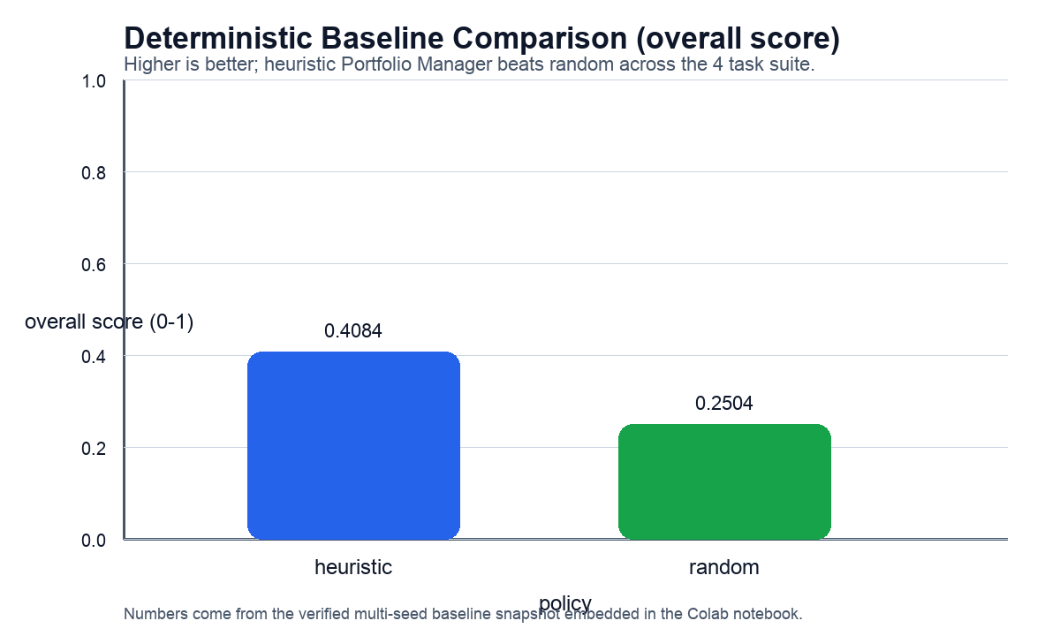
Baseline Evidence
Multi-seed deterministic evaluation from the verified Colab setup.
Heuristic overall score: 0.4084
Random overall score: 0.2504
Score delta vs random: +0.1580
Heuristic wins on the multi-objective overall metric across the 4-task suite.

Slide 5
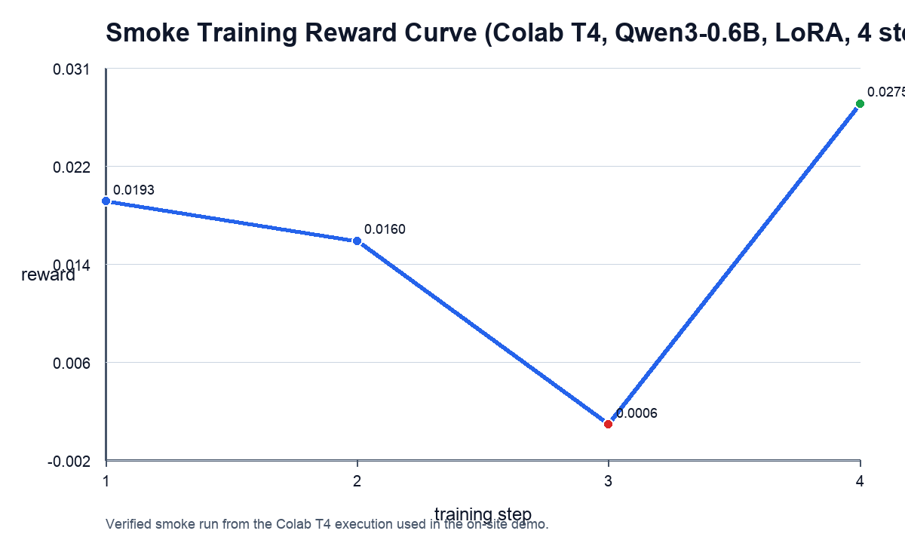
Training Evidence
Short, repeatable T4 smoke run using TRL GRPO + LoRA with Qwen/Qwen3-0.6B.
Reward start: 0.0193
Reward end: 0.0275
Reward delta: +0.0082
Best step: 4
Artifacts: judging_report.md, onsite_demo_summary.md, reward_curve.png, training_log_history.json

Slide 6
Why It Matters
This is a trainable professional workflow benchmark, not a finance-themed toy.
Capability gap: LLMs still struggle with structured multi-agent decision loops in realistic domains.
Theme alignment: cooperation, conflict, partially observable incentives, and strategic behavior.
Deliverables already in repo: OpenEnv environment, HF Space, Colab training notebook, committed plots, README, pitch script, and judge-facing reports.
Next step on-site: rerun the smoke training, show the artifacts, and tell a clear before/after story.
Repo: github.com/anupamagarwal001/hackathon_submission Space: huggingface.co/spaces/anupamagarwal001/amc_allocator_env

