Slide 1
Design and Implementation of Approximate Logarithmic Multipliers
By ANUPAM HASSA PURTY (19MVD0005)
Guide : Prof. RAJEEV PANKAJ NELAPATI

Slide 2
INTRODUCTION
Multiplication is one of the most important operations in computer arithmetic.
It consists of a long series of adder circuits which takes up lot of area and hence generating lot of delay and power. Examples : Look Ahead Carry Adder, Carry Save Adders, Adder trees etc.
Accuracy plays a huge factor in the implementation of design which directly contributes to its area.
For low accuracy applications where speed is the priority we can reduce the area and complexity to minimize the PDP.
Examples : DSP, Cryptography, machine learning etc.
Approximate multipliers can used to achieve greater speeds with lesser power and design complexity.
Using limited adder circuits to achieve approximate results gives a huge range of errors.
Hence we need logarithmic multipliers to improve the accuracy and reduce PDP.

Slide 3
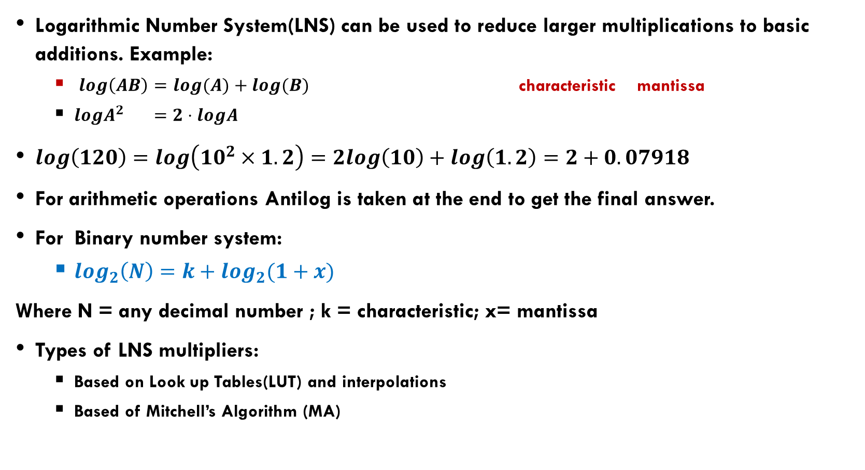
MOTIVATION
Logarithmic Number System(LNS) can be used to reduce larger multiplications to basic additions. Example:
$log\left(AB\right)=log(A)+log(B)$ characteristic mantissa
$logA^{2} =2⋅logA$
$log\left(120\right)=log\left(10^{2}×1.2\right)=2log\left(10\right)+log\left(1.2\right)=2+0.07918$
For arithmetic operations Antilog is taken at the end to get the final answer.
For Binary number system:
$log_{2}\left(N\right)=k+log_{2}(1+x)$
Where N = any decimal number ; k = characteristic; x= mantissa
Types of LNS multipliers:
Based on Look up Tables(LUT) and interpolations
Based of Mitchell’s Algorithm (MA)

Slide 4
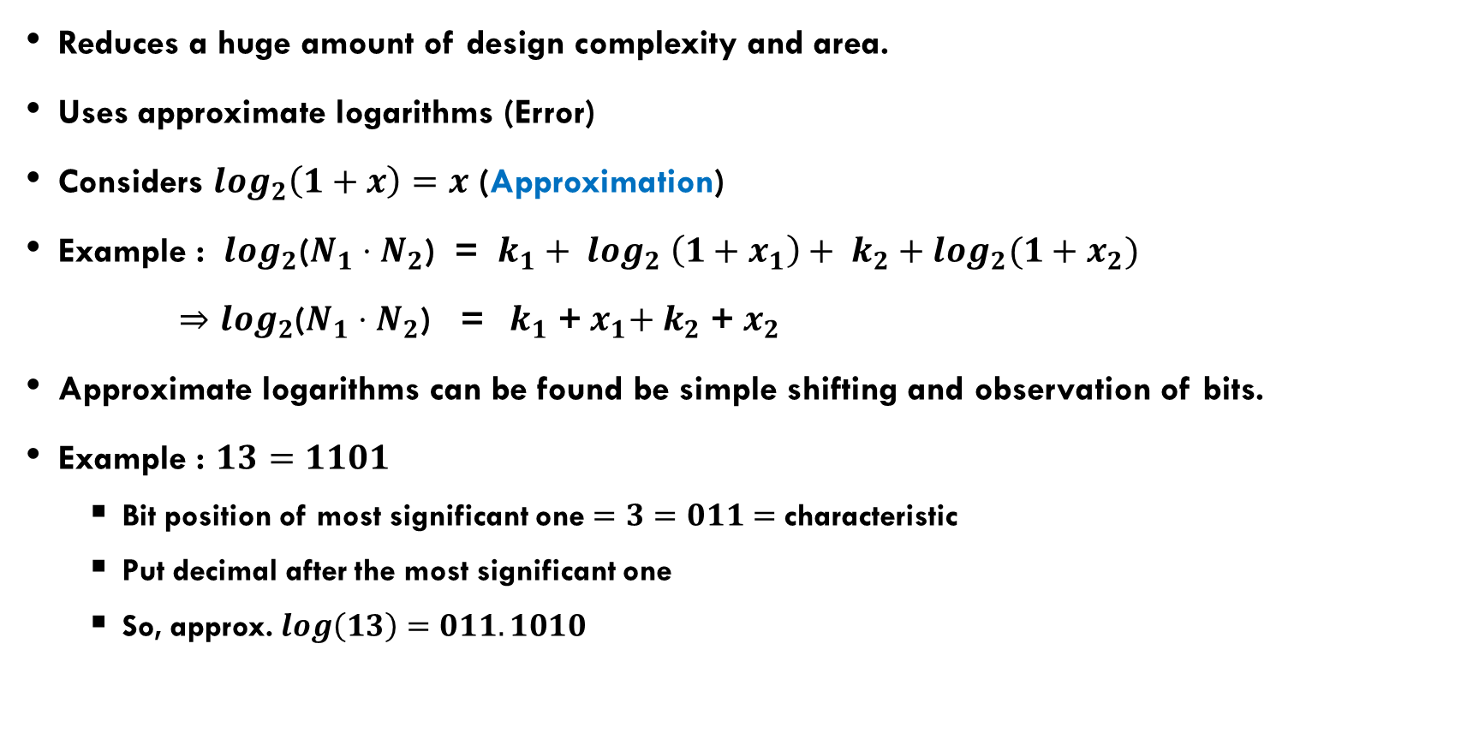
Mitchell’s Algorithm
Reduces a huge amount of design complexity and area.
Uses approximate logarithms (Error)
Considers $\log_{2}\left(1+x\right)=x$ (Approximation)
Example : $\log_{2}$($N_{1}{⋅N}_{2}$) = $k_{1}+ \log_{2} \left(1+x_{1}\right)+ k_{2}+\log_{2}(1+x_{2})$
${⇒log}_{2}$($N_{1}⋅N_{2}$) = ${ k}_{1}$ +${ x}_{1}+{ k}_{2}$ +${ x}_{2}$
Approximate logarithms can be found be simple shifting and observation of bits.
Example : $13=1101$
Bit position of most significant one $=3=011=$characteristic
Put decimal after the most significant one
So, approx. $log\left(13\right)=011.1010$

Slide 5
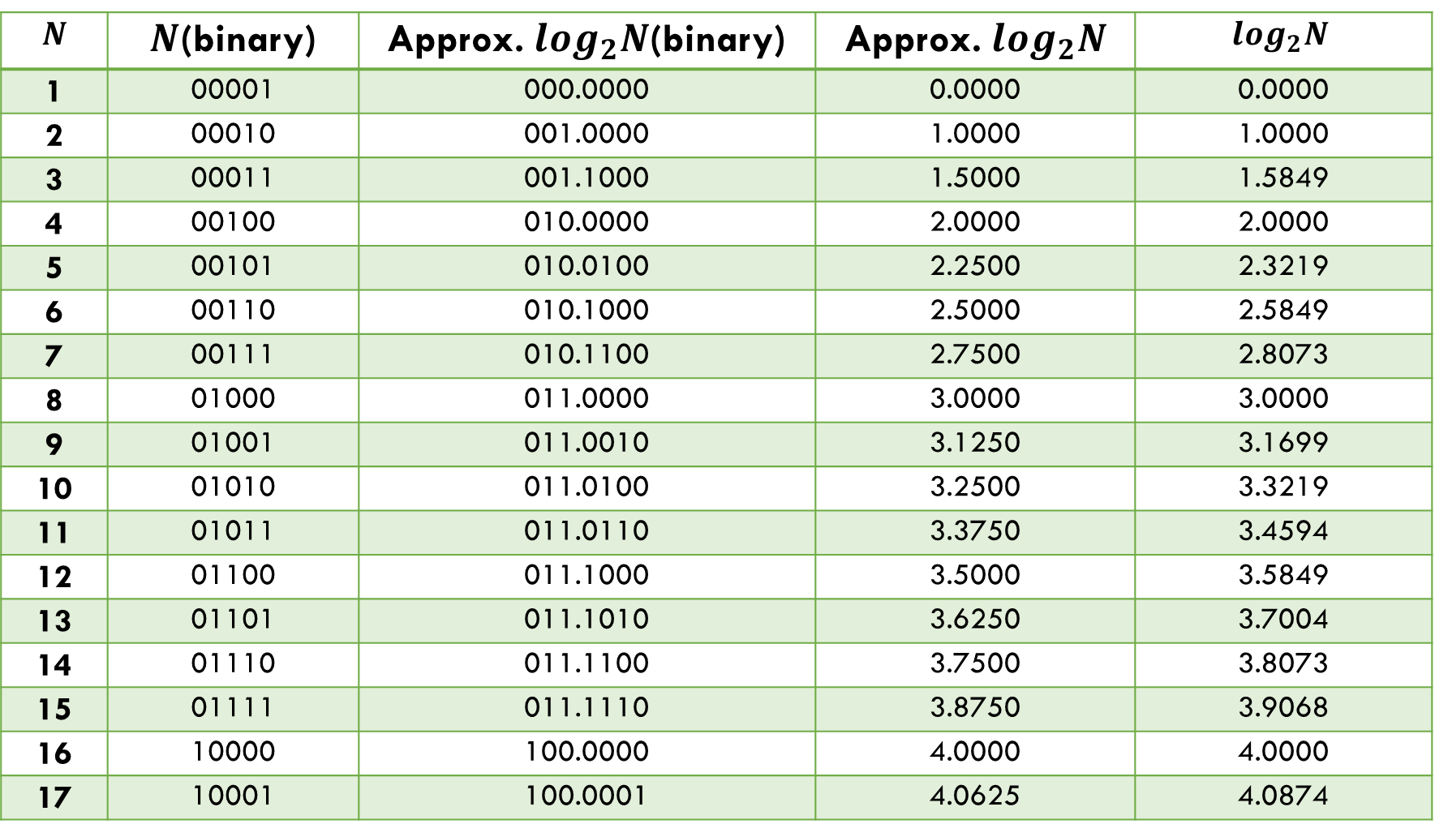
Table of binary Logarithms
$$N$$ | $N$(binary) | Approx. $log_{2}N$(binary) | Approx. $log_{2}N$ | $$log_{2}N$$
1 | 00001 | 000.0000 | 0.0000 | 0.0000
2 | 00010 | 001.0000 | 1.0000 | 1.0000
3 | 00011 | 001.1000 | 1.5000 | 1.5849
4 | 00100 | 010.0000 | 2.0000 | 2.0000
5 | 00101 | 010.0100 | 2.2500 | 2.3219
6 | 00110 | 010.1000 | 2.5000 | 2.5849
7 | 00111 | 010.1100 | 2.7500 | 2.8073
8 | 01000 | 011.0000 | 3.0000 | 3.0000
9 | 01001 | 011.0010 | 3.1250 | 3.1699
10 | 01010 | 011.0100 | 3.2500 | 3.3219
11 | 01011 | 011.0110 | 3.3750 | 3.4594
12 | 01100 | 011.1000 | 3.5000 | 3.5849
13 | 01101 | 011.1010 | 3.6250 | 3.7004
14 | 01110 | 011.1100 | 3.7500 | 3.8073
15 | 01111 | 011.1110 | 3.8750 | 3.9068
16 | 10000 | 100.0000 | 4.0000 | 4.0000
17 | 10001 | 100.0001 | 4.0625 | 4.0874

Slide 7
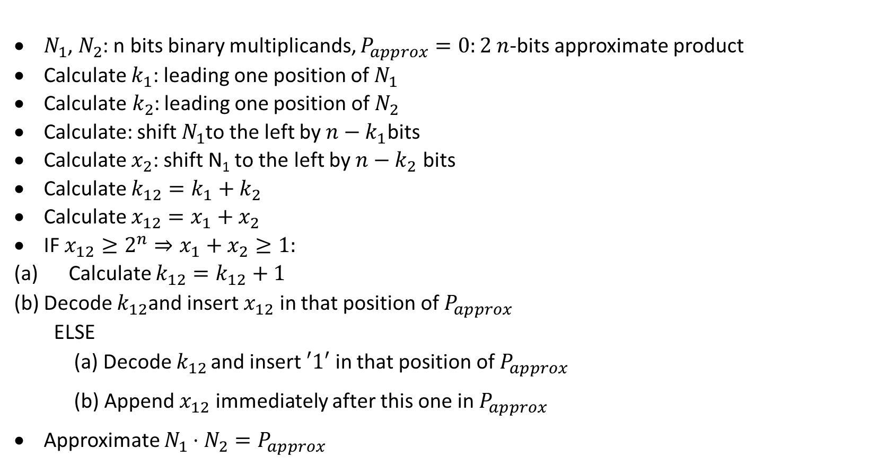
Mitchell’s Algorithm
$N_{1}$, $N_{2}$: n bits binary multiplicands, $P_{approx}=0:2 n$-bits approximate product
Calculate $k_{1}$: leading one position of $N_{1}$
Calculate${ k}_{2}$: leading one position of $N_{2}$
Calculate: shift $N_{1}$to the left by $n−k_{1}$bits
Calculate $x_{2}$: shift N₁ to the left by $n−k_{2}$ bits
Calculate $k_{12}=k_{1}+k_{2}$
Calculate $x_{12}=x_{1}+x_{2}$
IF $x_{12}≥2^{n}⇒x_{1}+x_{2}≥1:$
Calculate $k_{12}=k_{12}+1$
Decode $k_{12}$and insert $x_{12}$ in that position of $P_{approx}$
ELSE
(a) Decode $k_{12}$ and insert $′1′$ in that position of $P_{approx}$
(b) Append $x_{12}$ immediately after this one in $P_{approx}$
Approximate $N_{1}⋅N_{2}=P_{approx}$

Slide 8
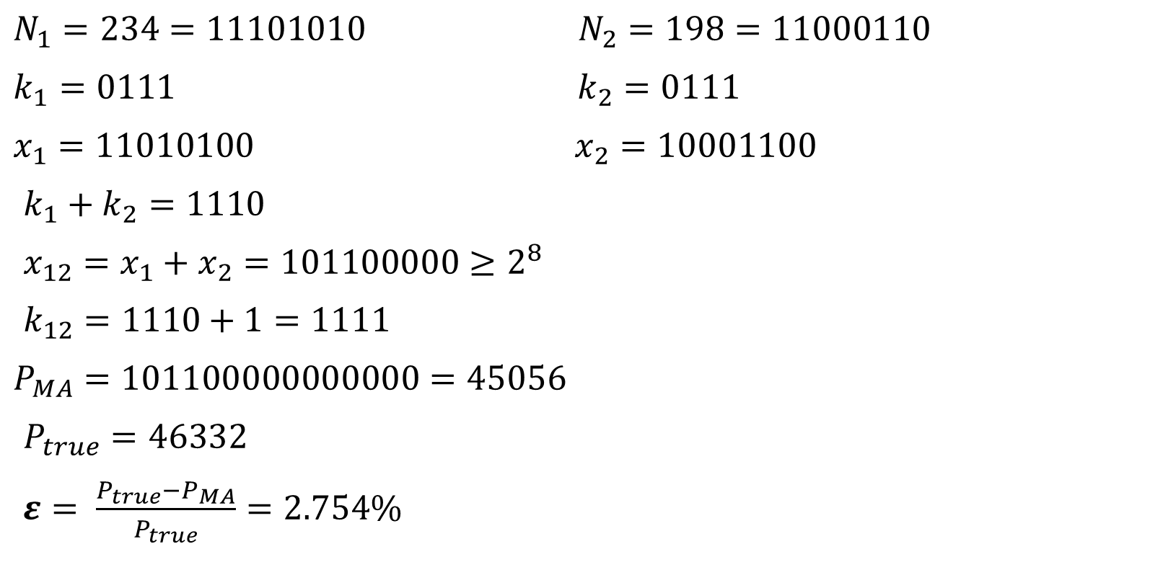
EXAMPLE
$N_{1}=234=11101010$ $N_{2}=198=11000110$
$k_{1}=0111$ $k_{2}=0111$
$x_{1}=11010100$ $x_{2}=10001100$
$k_{1}+k_{2}=1110$
${x_{12}=x}_{1}+x_{2}=101100000≥2^{8}$
$k_{12}=1110+1=1111$
$P_{MA}=101100000000000=45056$
$P_{true}=46332$
$ε= \frac{P_{true}−P_{MA}}{P_{true}}=2.754\%$

Slide 9
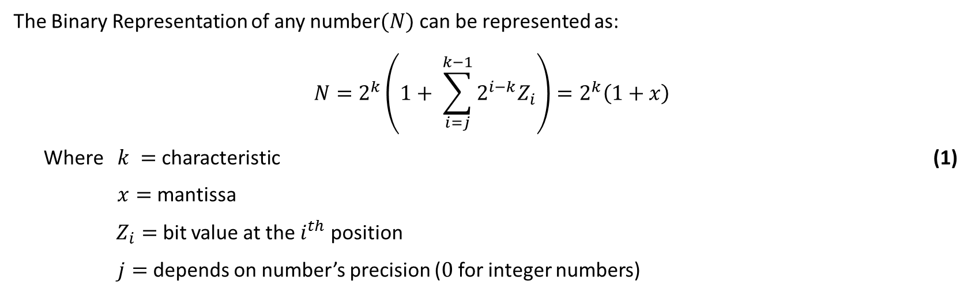
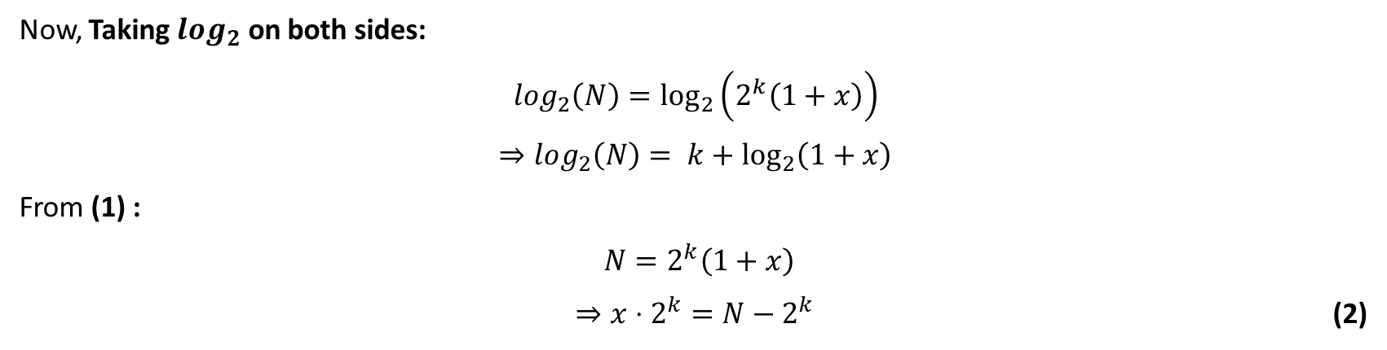
MATHEMATICAL MODEL
The Binary Representation of any number$(N)$ can be represented as:
$$N=2^{k}\left(1+ \sum_{i=j}^{k−1}{2^{i−k}Z_{i}}\right)=2^{k}\left(1+x\right)$$
Where $k =$ characteristic (1)
$x=$ mantissa
$Z_{i}=$ bit value at the $i^{th}$ position
$j=$ depends on number’s precision ($0$ for integer numbers)
Now, Taking $log_{2}$ on both sides:
$$log_{2}\left(N\right)=\log_{2}\left(2^{k}\left(1+x\right)\right)$$
$⇒log_{2}\left(N\right)= k+\log_{2}\left(1+x\right)$
From (1) :
$N=2^{k}\left(1+x\right)$
$⇒x⋅2^{k}=N−2^{k}$ (2)

Slide 10
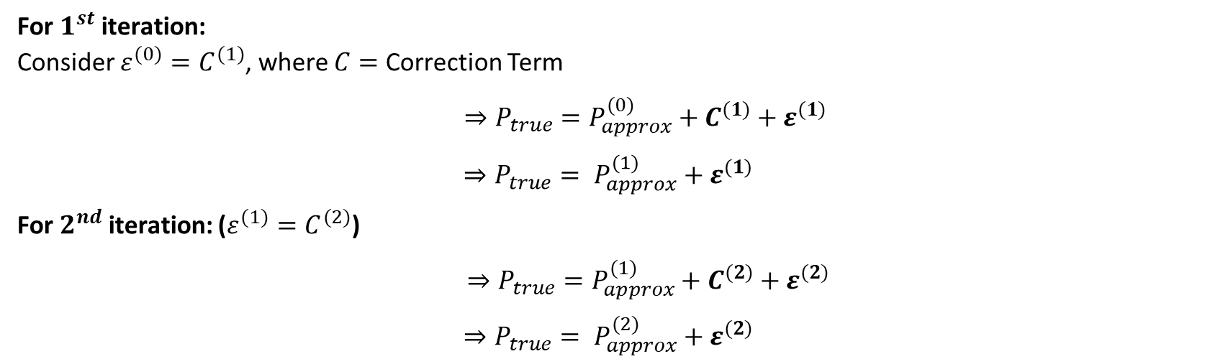
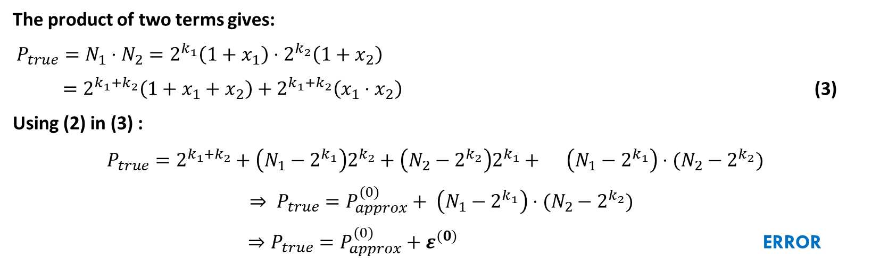
The product of two terms gives:
$P_{true}=N_{1}⋅N_{2}=2^{k_{1}}\left(1+x_{1}\right)⋅2^{k_{2}}\left(1+x_{2}\right)$
$=2^{k_{1}+k_{2}}\left(1+x_{1}+x_{2}\right)+2^{k_{1}+k_{2}}\left(x_{1}⋅x_{2}\right)$ (3)
Using (2) in (3) :
$P_{true}=2^{k_{1}+k_{2}}+\left(N_{1}−2^{k_{1}}\right)2^{k_{2}}+\left(N_{2}−2^{k_{2}}\right)2^{k_{1}}+ \left(N_{1}−2^{k_{1}}\right)⋅(N_{2}−2^{k_{2}})$
$⇒ P_{true}=P_{approx}^{(0)}+ \left(N_{1}−2^{k_{1}}\right)⋅(N_{2}−2^{k_{2}})$
$⇒P_{true}=P_{approx}^{(0)}+ε^{(0)}$ ERROR
For $1^{st}$ iteration: Consider $ε^{(0)}=C^{(1)}$, where $C=$ Correction Term
$⇒P_{true}=P_{approx}^{(0)}+{C^{(1)}+ε}^{(1)}$
$$⇒P_{true}= P_{approx}^{(1)}+ε^{(1)}$$
For $2^{nd}$ iteration: ($ε^{(1)}=C^{(2)}$)
$⇒P_{true}=P_{approx}^{(1)}+{C^{(2)}+ε}^{(2)}$
$$⇒P_{true}= P_{approx}^{(2)}+ε^{(2)}$$

Slide 11
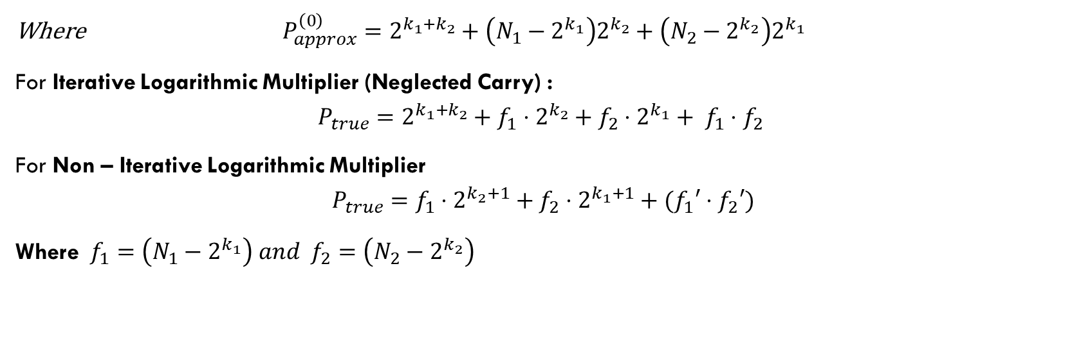
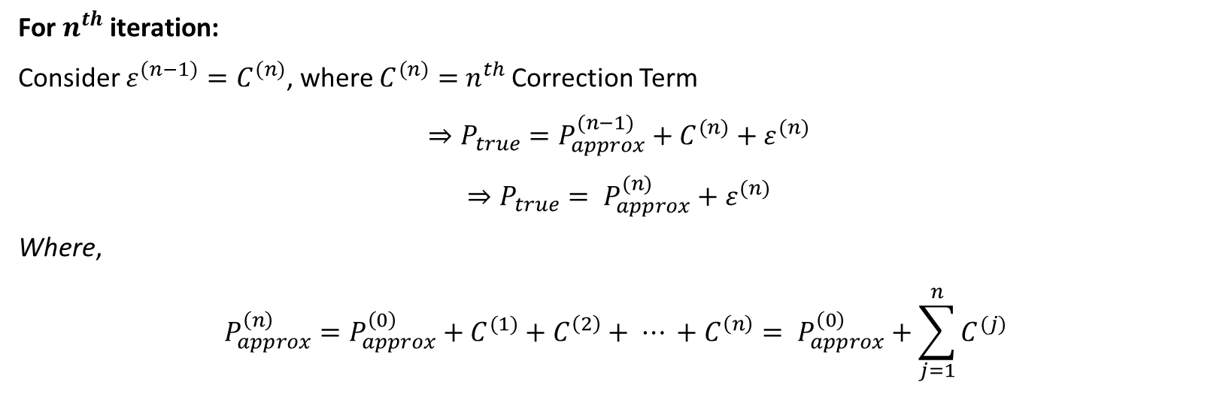
For $n^{th}$ iteration:
Consider $ε^{(n−1)}=C^{(n)}$, where $C^{(n)}=$ $n^{th}$ Correction Term
$$⇒P_{true}=P_{approx}^{(n−1)}+{C^{(n)}+ε}^{(n)}$$
$$⇒P_{true}= P_{approx}^{(n)}+ε^{(n)}$$
Where,
$$P_{approx}^{\left(n\right)}=P_{approx}^{\left(0\right)}+C^{(1)}+C^{\left(2\right)}+ ⋯ +C^{\left(n\right)}= P_{approx}^{\left(0\right)}+\sum_{j=1}^{n}{C^{(j)}}$$
Where $P_{approx}^{\left(0\right)}=2^{k_{1}+k_{2}}+\left(N_{1}−2^{k_{1}}\right)2^{k_{2}}+\left(N_{2}−2^{k_{2}}\right)2^{k_{1}}$
For Iterative Logarithmic Multiplier (Neglected Carry) :
$$P_{true}=2^{k_{1}+k_{2}}+f_{1}⋅2^{k_{2}}+f_{2}⋅2^{k_{1}}+ f_{1}⋅f_{2}$$
For Non – Iterative Logarithmic Multiplier
$$P_{true}=f_{1}⋅2^{k_{2}+1}+f_{2}⋅2^{k_{1}+1}+(f_{1}′⋅f_{2}′)$$
Where $f_{1}=\left(N_{1}−2^{k_{1}}\right) and f_{2}=\left(N_{2}−2^{k_{2}}\right)$

Slide 12
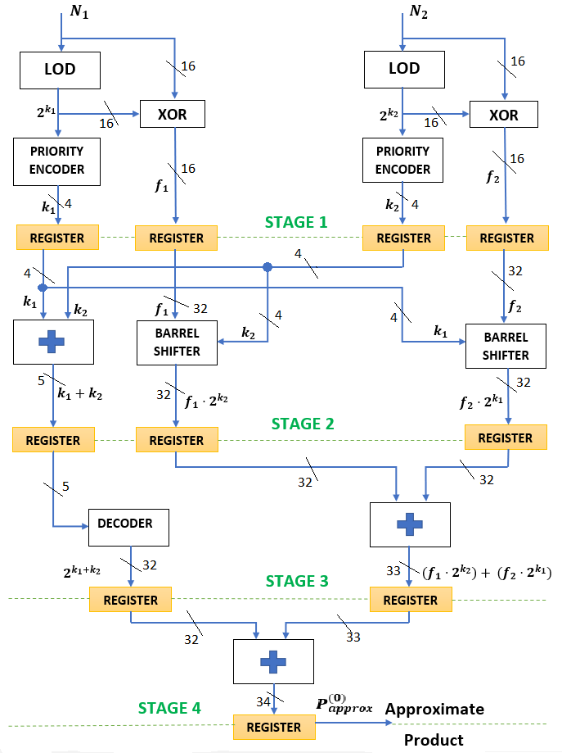
Iterative LOG MULTIPLIER (ILM)– BASIC BLOCK

Slide 13
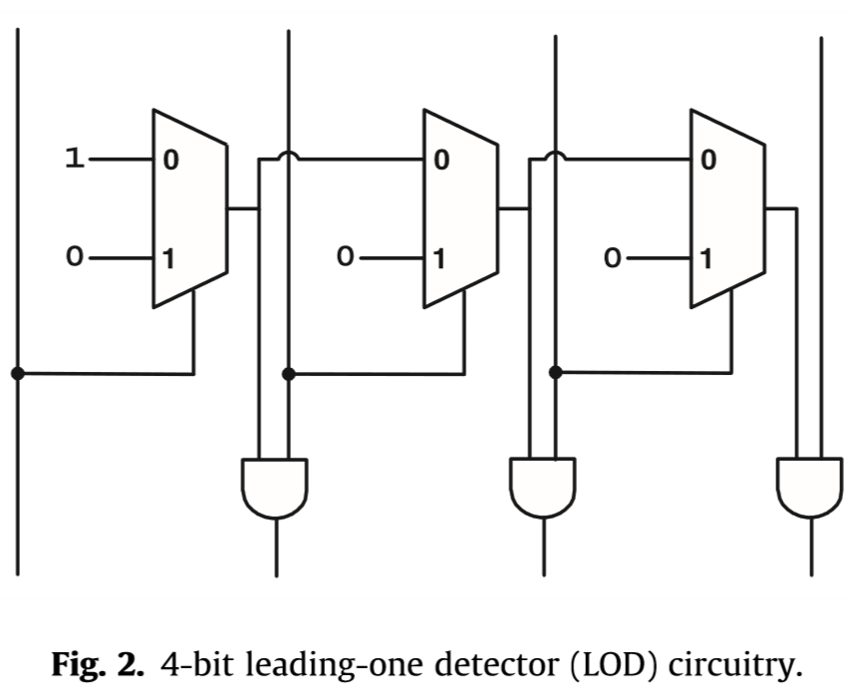
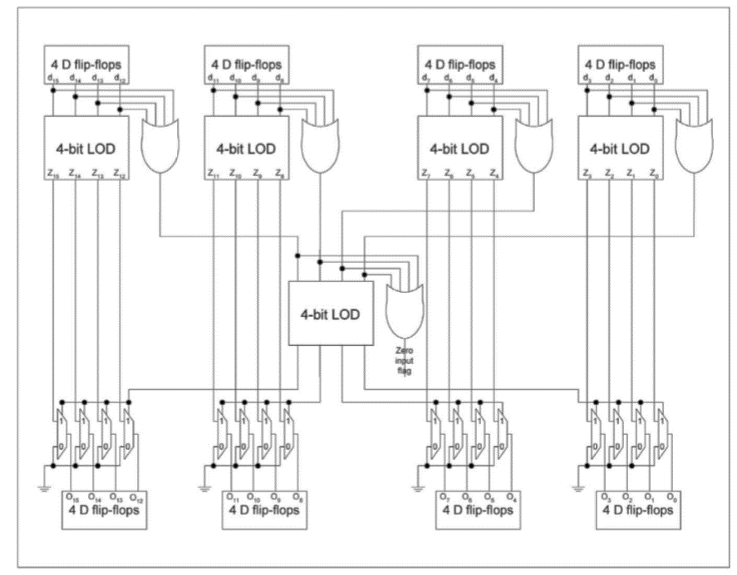
Leading ONE DETECTOR(LOD)

Slide 14
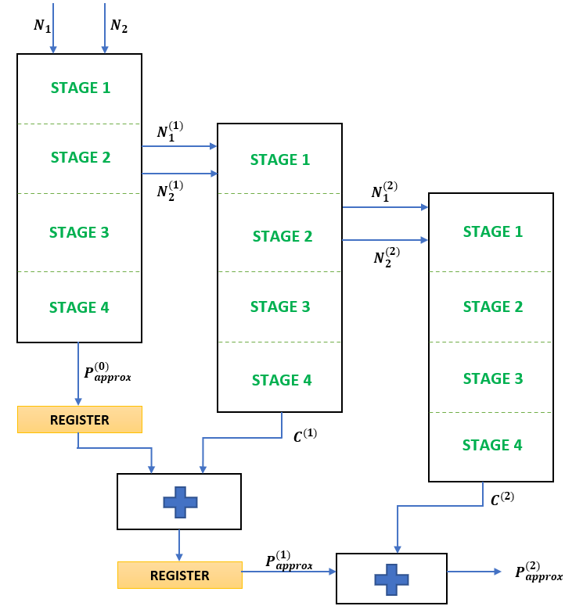
ITERATIVE LOG MUTIPLIER (ILM)

Slide 15
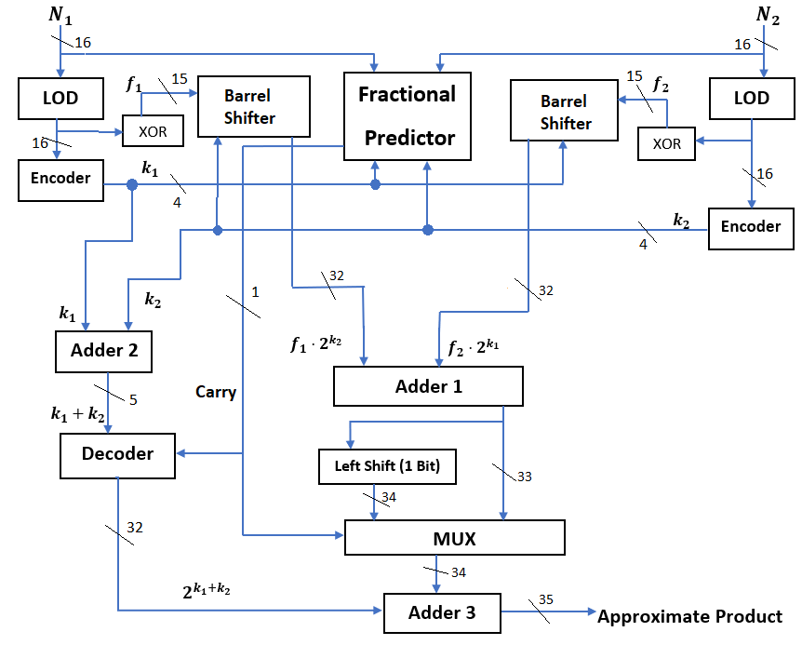
Non – Iterative log multiplier

Slide 16
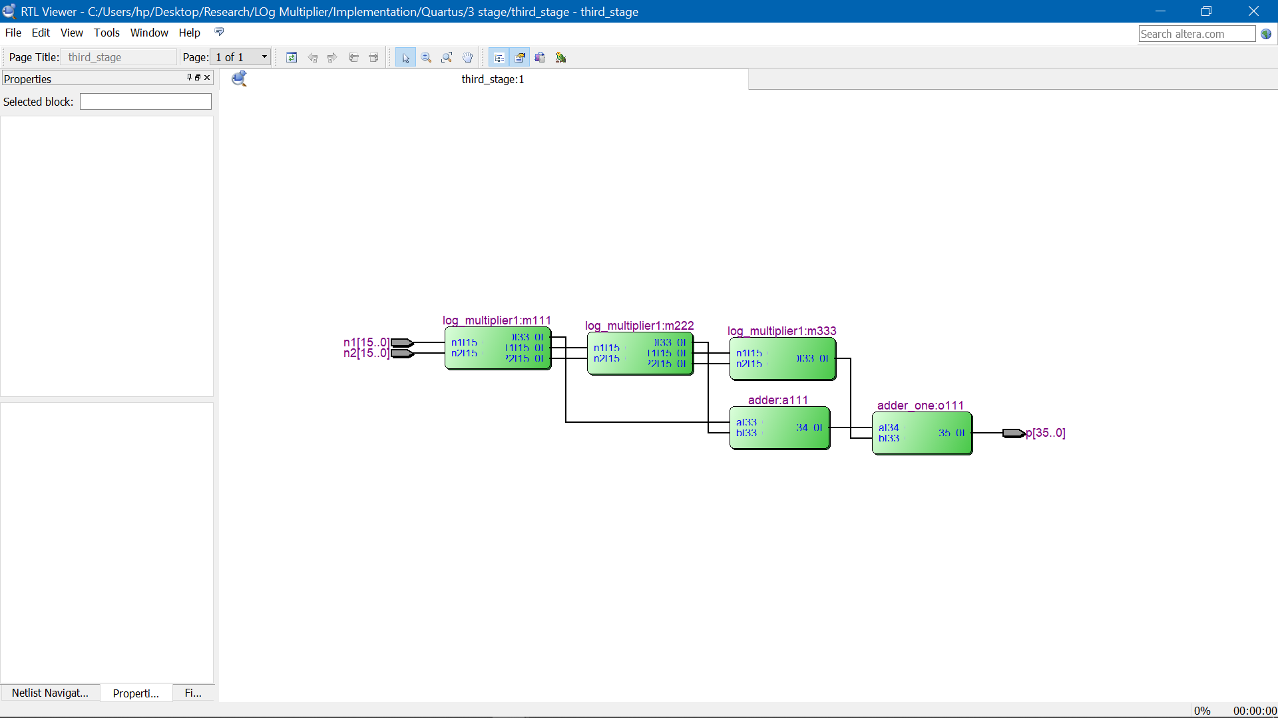
Implementation - ILM Family - Cyclone IV E Device - EP4CE115F29C7

Slide 17
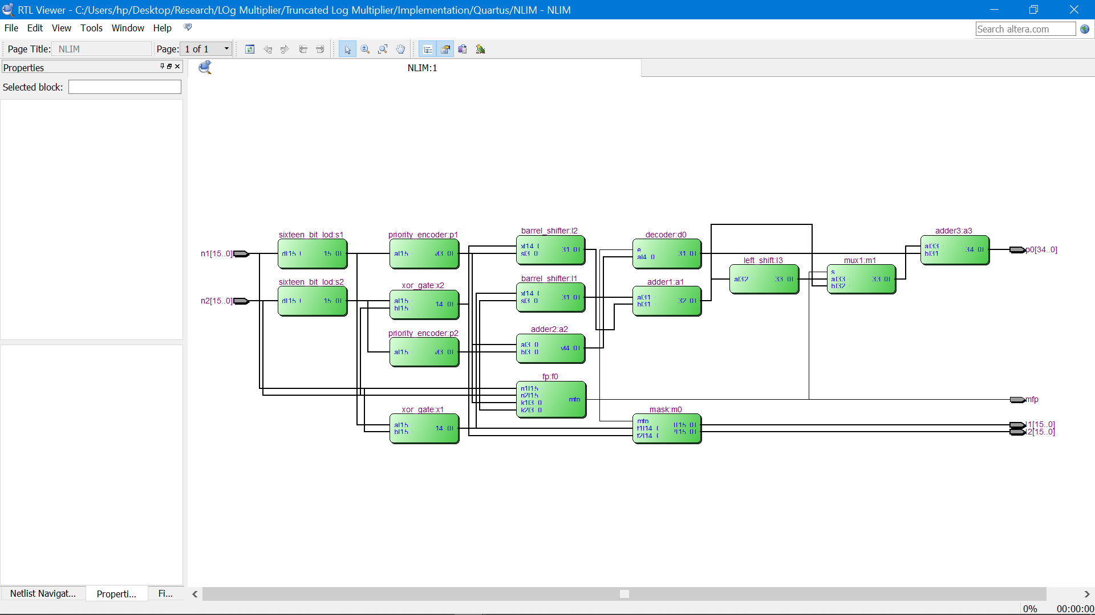
Implementation NON – ILM Family - Cyclone IV E Device - EP4CE115F29C7

Slide 18
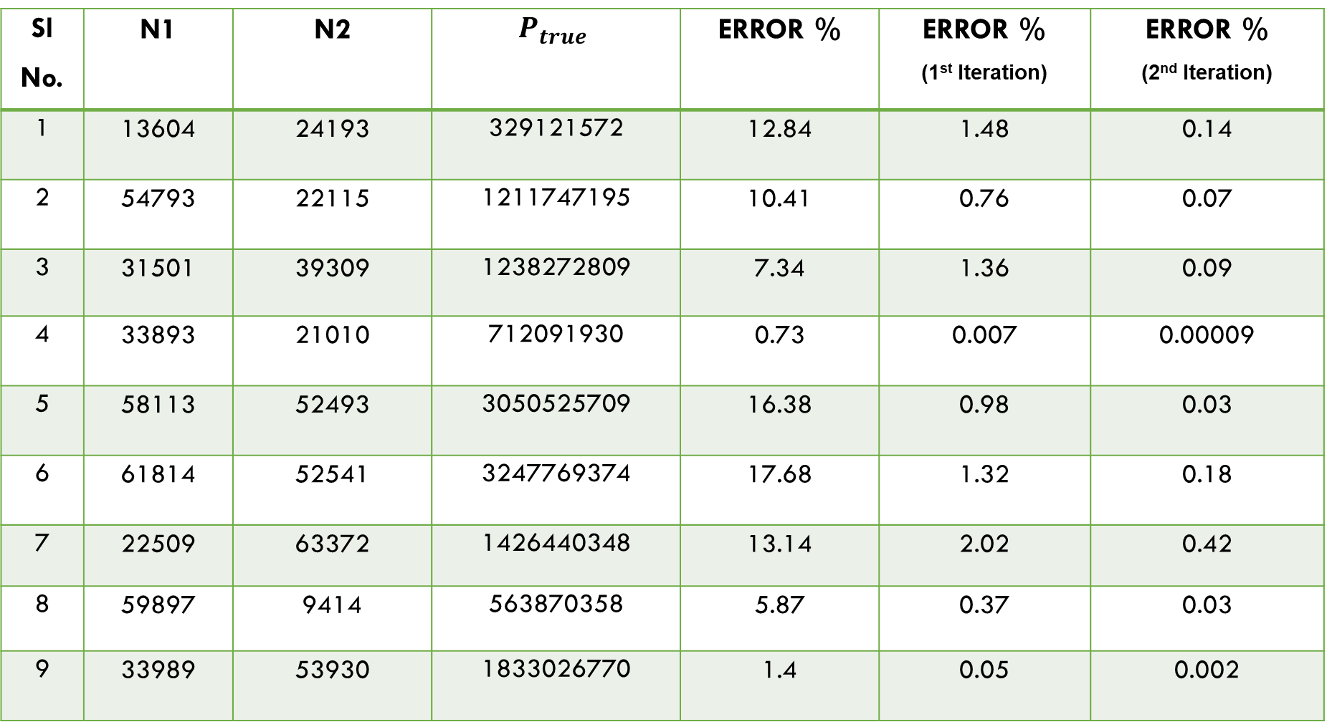
RESULTS - ILM
Sl No. | N1 | N2 | $$P_{true}$$ | ERROR % | ERROR % (1st Iteration) | ERROR % (2nd Iteration)
1 | 13604 | 24193 | 329121572 | 12.84 | 1.48 | 0.14
2 | 54793 | 22115 | 1211747195 | 10.41 | 0.76 | 0.07
3 | 31501 | 39309 | 1238272809 | 7.34 | 1.36 | 0.09
4 | 33893 | 21010 | 712091930 | 0.73 | 0.007 | 0.00009
5 | 58113 | 52493 | 3050525709 | 16.38 | 0.98 | 0.03
6 | 61814 | 52541 | 3247769374 | 17.68 | 1.32 | 0.18
7 | 22509 | 63372 | 1426440348 | 13.14 | 2.02 | 0.42
8 | 59897 | 9414 | 563870358 | 5.87 | 0.37 | 0.03
9 | 33989 | 53930 | 1833026770 | 1.4 | 0.05 | 0.002

Slide 19
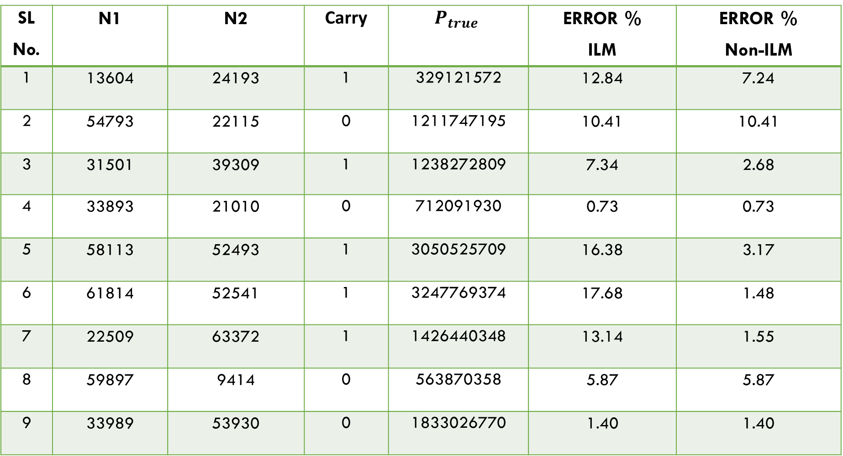
RESULTS NON - ILM
SL No. | N1 | N2 | Carry | $$P_{true}$$ | ERROR % ILM | ERROR % Non-ILM
1 | 13604 | 24193 | 1 | 329121572 | 12.84 | 7.24
2 | 54793 | 22115 | 0 | 1211747195 | 10.41 | 10.41
3 | 31501 | 39309 | 1 | 1238272809 | 7.34 | 2.68
4 | 33893 | 21010 | 0 | 712091930 | 0.73 | 0.73
5 | 58113 | 52493 | 1 | 3050525709 | 16.38 | 3.17
6 | 61814 | 52541 | 1 | 3247769374 | 17.68 | 1.48
7 | 22509 | 63372 | 1 | 1426440348 | 13.14 | 1.55
8 | 59897 | 9414 | 0 | 563870358 | 5.87 | 5.87
9 | 33989 | 53930 | 0 | 1833026770 | 1.40 | 1.40

Slide 21
 | Logic Elements Used | Current(mA) | Power(mW) | Minimum Propagation Delay (ns) | Maximum Propagation Delay (ns)
ILM | 341 | 15.81 | 140.44 | 7.940 | 28.371
ILM – 1 | 717 | 20.57 | 146.15 | 12.966 | 32.295
ILM – 2 | 1088 | 25.92 | 152.60 | 18.583 | 33.723
Non – ILM | 481 | 42.23 | 172.51 | 15.877 | 32.635

Slide 22
REFRENCES
Zdenka Babic Aleksej Avramovic Patricio Bulic An Iterative Mitchell's Algorithm Based Multiplier 2011
Patricio Bulic, Zdenka Babic A Simple Pipelined Logarithmic Multiplier 2011
A Hardware-Efficient Logarithmic Multiplier with Improved Accuracy Mohammad Saeed Ansari Bruce F. Cockburn Jie Han 2019
An efficient VLSI architecture for Iterative Logarithmic Multiplier Durgesh Nandan Jitendra Kanungo Anurag Mahajan 2017
On the Design of Logarithmic Multiplier Using Radix-4 Booth Encoding ratko pilipovic and patricio bulic 2020
M.H. Rais. Efﬁcient Hardware Realization of Truncated Multipliers using FPGA, International Journal of Applied Science, Vol. 5, No. 2, pp. 124 - 128, 2009.
An Improved Logarithmic Multiplier for Media Processing Syed Ershad Ahmed M. B. Srinivas 2018
V. Hampel, P. Sobe, E. Maehle, Experiences with a FPGA-based Reed/Solomon-encoding coprocessor, Microprocessors and Microsystems, Vol. 32, No. 5-6, pp. 313-320, August 2008.

Slide 23
Thank You

