Slide 1
STUDENT RESULT PROCESSING SYSTEM
Rishabh 12/ICS/004
anupam 12/ICS/008
Piyush 12/ICS/033
shubham 12/ICS/039
Disha 12/ics/054
Submitted Do:
Dr. neeta singh
Assistant professor
School of I.c.t
Gautam Buddha university

Slide 2
Todays Outline
What is Student Result Processing System?
Why do we need Student Result Processing System in GBU?
Design phase of Project.
Implementation phase. (technologies to be used)
Demo of Student Result Processing System.
Conclusion.

Slide 3
What is Student Result Processing System?
An individual report card of each student, according to any selected format.
An important aid for teachers to judge student performance.
Merit list printing by totals for a class by individual subject marks for a class.
Student performance in a particular subject or all the subjects must be expressed.”

Slide 4
Why do we need Result processing system in GBU?
The system displays the list of all issues that are open, closed, in progress.
If the user can get registered by clicking on the login button and provide the required information as specified.
Each time the registered customer come on to the site he can makes use of the user name and the password that is allocated to him.

Slide 5
Key Features
User configurable grading system.
User configurable examination pattern.
Examinations-weightage handling.
Calculated / Average Column handling.
Special Analysis section.
Sub-subjects marks entry handling.

Slide 6
Design Phase of Student Result Processing System
Data Model: Database Design
USE CASE DIAGRAMS
User Interface Design

Slide 7
What are data model and process model?
Data Model: A data model is a conceptual representation of the data structures that are required by a database.
It consists of database design.
Process Model: A Process Model tells us about how the data is processed and how the data flows from one table to another to gather the required information.
It consists of Functional Deposition Diagram and Data Flow Diagram.

Slide 8
Database Design for Student Result Processing System
Name of Database: studentmarks
DB client: MySQL
The DB can be managed by either phpmyAdmin or through Command Line Tool (MySQL).
Name of Tables:
users
student

Slide 9
Actors in Student Result Processing System
The various actors involved and their possible actions are as follows:
Users:
View/edit personal details.
Analyse results through Graphs, Pie Charts.
View reports.
Edit/Delete the users.
Administrator:
View/Edit personnel details .
View/Compile results.
Publish Result in PDF formant.

Slide 10
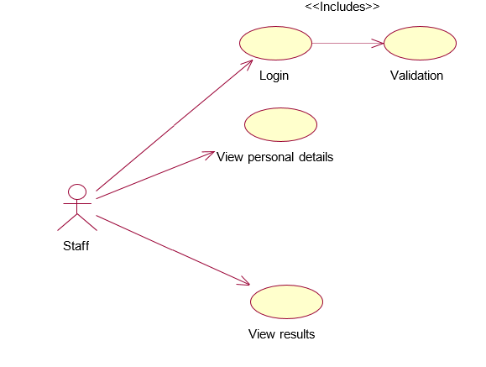
Admin & Staff Use Case Diagram
<<includes>>
Login
validation
Add results
Admin

Slide 11
Implementation Phase of Student Result Processing System
Hardware requirements
Software Requirements

Slide 12
Hardware Requirements
Processor : Standard processor with a speed of 1.6 GHz or more
RAM : 256 MB RAM or more
Hard Disk : 2 GB or more
Monitor : Standard color monitor
Keyboard : Standard keyboard
Mouse : Standard mouse

Slide 13




Software Requirements
Operating System : Window 2000, XP
User interface : HTML and CSS, WAMP, PHP
Database : My SQL
Documentation Tool : Microsoft Office
All of the above mentioned packages can be installed manually or they can be installed by using an all in one package WAMP.

Slide 14

WAMP
WAMP is a free and open source cross platform web server solution stack package.
WAMP is a Windows web development environment. It allows you to create web applications with Apache2, PHP and a MySQL database. Alongside, phpMyAdmin allows you to manage your databases easily.

Slide 15
After Installation of required packages.
After the installation the following steps have to be followed:
Create a MySQL username with the rights to run the following queries:
SELECT, INSERT, UPDATE, DELETE, CREATE, ALTER, DROP
Create a new directory In the location: C://wamp/www/
Name the directory as studentMarks
After the creation of the directory create further directories to store content like images, includes files (CSS files), PHP scripts etc.
We can then use the text editor of our choice to write the code for our website.
A demo of the current state of the website(during development) can be seen by visiting http://localhost/studentMarks/views/index.php on the web browser.

Slide 16
Demo of Student Result Processing System
In this section of the presentation we will present a live version of STUDENT RESULT PROCESSING SYSTEM being implemented on localhost on this machine (127.0.0.1)

Slide 17
Conclusion
In this project, Student Result Processing System can be used to process the scores of students and subsequently produces their report cards and other analysis charts.
To implement this as a web application we used PHP as the Technology. PHP enables fast implementation of complex solutions, is easily integrated, flexible, and has availability of resources. For the client browser to connect to the PHP engine we used apache organisation’s apache server as the Web Server. MySQL is used as back-end database since it is one of the most popular open source databases, and it provides fast data access, easy installation and simplicity.

Slide 18
Thank You..!

