Slide 1
Collaboration of Multiple Agents for Exploration and Mapping
Presentation submitted for Final Phase of BTP
by
Apoorva Kumar ( Roll No. : 160108010)
Anupam Khandelwal ( Roll No. : 160108008)
Under Guidance of
Dr. Indrani Kar

Slide 2
Abstract
Map exploration has been an important task in the field of robotics and a substantial amount of work has been done towards this. From all the work that has been done, Rapidly Exploring Random Tree(RRT) and Sensor-Based Random Tree(SRT) has seen lot of development in the recent decades. Frontier detection has been another method of exploration which proves vital to mark areas of information gain. Multi-robot systems or swarm systems have emerged a lot in the recent years where each task is divided among multiple robots.
Here we state the use of both the above mentioned techniques to build an exploration algorithm which can be implemented on multi robot systems and can be used to map an area efficiently. SRT will be used for a robot’s motion while RRT will be used on a soft agent to detect the frontiers. The frontiers will be later assigned to the robots for exploration after they have finished mapping an area to prevent inefficiency for which we will have both local and global assignment metric for efficient overall motion. The whole system will be modular i.e. independent of the number of robots so that it can be scaled without any hassle. Next we build the complete map for general use by clustering and connecting disconnected regions and building a path planning algorithm for the same map.
ABSTRACT

Slide 3
Introduction
Build a Multi Agent system which can explore an unknown area optimally by avoiding overlapping of agent paths with each other.
Using information on scanned areas to plan future paths for the agents to find points of information gain for the agents.
Refinement and Allocation of points scanned for information gain optimally.
Processing and refinement of scanned area and prepare it for traversal by other agents in the future.
Building optimal traversal techniques for future use of the area by other agents.
Multi Agent Systems have been in use for a long time and exploiting them to achieve tasks which would otherwise seem impossible is what we plan to achieve here. We list some of our broad motives here and then we will discuss one by one how we achieve them followed by their refinement. Our system is fully scalable and modular to insert as many number of agents as possible in the algorithm without changing the base of the algorithm.
INTRODUCTION

Slide 4
Algorithms Discussed and Proposed
Sensor Based Random Tree ( SRT )
Modifications to Validation Algorithm
Modifications to Backtrack Strategy
Frontier Detection using Rapidly Exploring Random Tree ( RRT )
Strict and Robust Frontier Assignment
Post Processing Algorithm
Clustering Regions for Linear Motion
Path Selection based on Clusters
Estimation of Control Points
To perform the tasks mentioned before we will be using multiple algorithms which will work in unison to perform the task and facilitate the task of exploration. The board algorithms which will be used are listed here and we will discuss how they contribute to the complete set of algorithms
INTRODUCTION

Slide 5
Sensor Based Random Tree
SENSOR BASED RANDOM TREE
Sensor Based Random Tree or SRT is based on random tree search algorithm which exploits the previously stored map to help agents traverse an unknown by picking points to travel in random direction while maintaining two simple facts. First that the random next point must be at a considerable distance from the present point and second that the next point must not lie in any previously scanned area.

Slide 6
Types of SRT
SRT-Ball: In this perception algorithm, the Local Safe Area (LSA) is a circular area of radium ‘r’ around the robot. The area is such that the robot can traverse to any point in that area. No obstacle needs to lie inside that area of radium ‘r’. It is a conservative and safe exploration technique so that the robot takes only fully safe step.
SRT-Star: This is a comparatively more confident approach where we make use of the directional nature of sensors and divide the perceived area into arcs. The radius of each arc is the minimum of the farthest obstacle in that arc and the sensor range. We will be using SRT-Star for our purpose.
SENSOR BASED RANDOM TREE

Slide 7
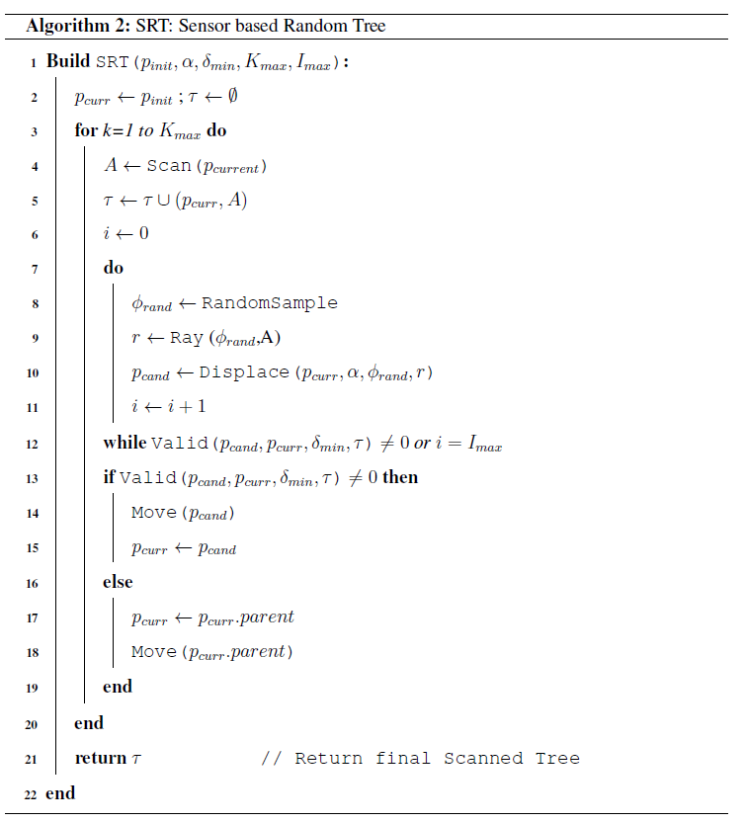
Base Algorithm
Here we have the complete algorithm which we will break down step by step and explain how this whole algorithm works. Below we state two important variables which is consistent across the code.
Position P: Set of all points on map to which the robot has travelled. States the location on the map and is represented in form of p_{something}.
Graph Map τ = ([p ⊂ P] , A) is modified data-structure which consists of points with scanned area A around it. It is build by merging the position p_{scan} and the scan associated with it together.
SENSOR BASED RANDOM TREE

Slide 8
Functions
Scan A: Returns the scan perceived by the robot from its present position and returns it as a map ⊂ X which can be concatenated to already known region.
RandomSample φ: A function that returns random angle which are independent and identically sampled around the given position x.
Ray: Takes an angle φ and area A and return the maximum radius possible in LSA.
Displace: This function takes a location p, a distance r, and angle φ and a constant factor α and returns a point p_{next} in the φ direction at a distance α.r. This is done so as maintain safe travelling distance from the present location and that the bot always falls in LSA.
Move: Moves the current robot physically to the new position specified.
Valid: Takes two points x₁, x_{next}, a map τ and a minimum distance δ_{min} and checks two condition. First that the distance between x₁, x_{next} is more than d_{min}. Secondly that the second point x_{next} doesn’t lie in LSA of any other previously explored point.
SENSOR BASED RANDOM TREE

Slide 9
Algorithm Explanation
The algorithm starts with us initializing the current position of agent p_{int} and the new GraphMap τ.
The area A around the current position p_{curr} is scanned and added to the map.
Loop for finding a new point is begun.
A random angle φ_{rand} is sampled
A line connecting p_{curr} location to the farthest obstacle-free point in the direction φ_{rand} is returned as the length r via Ray function.
The new point p_{cand} is sampled using Displace function at a distance α.r.
New points are sampled unless either a Valid candidate point is found or the number of iterations reaches I_{max}.
The limit to the number of points being sampled is kept so as to see if the robot has reached any dead-ends.
SENSOR BASED RANDOM TREE

Slide 10
Algorithm Explanation
If a valid point is found the robot then uses the Move function to move to that point and if no valid point is found it retreats to its parent and starts searching for new points there.
Its and iterative algorithm which is highly biased towards exploring new area and back tracks only in sporadic cases. It can easily accommodate non-holonomic motion.
SENSOR BASED RANDOM TREE

Slide 11
Validation Condition
An example of validity is shown in the figure here, where three points are sampled one after the other. First point p_{cand1} is rejected because its inside δ_{min} and the second point p_{cand2} is rejected because it lies in LSA of some previous node. Finally, a third and final point p_{cand3} is selected, and the robot travels to that location. The condition of δ_{min} is kept to take in consideration the size of a robot and a set distance outside which the robot must move so that the map expansion is not slow.
SENSOR BASED RANDOM TREE

Slide 12
Modifications to Sensor Based Random Tree
MODIFICATIONS TO SENSOR BASED RANDOM TREE
To accommodate multiple agents and perform a more robust search we did some modifications to the Sensor Based Random Tree Algorithm

Slide 13
Validation Condition
The sampled point must not lie in the LSA of the any previously visited node and should also not lie in the LSA of any other agent or its node. In the figure beside we reject point p_{robot1_next2} because it lies in the LSA of another agent’s map. We also need to establish a connection between the present point and the LSA_{robot2_child} to effectively connect the map of both the robot whenever possible.
The sampled point must be at a safe distance from any obstacle of δ_{obsmin}, which is generally determined by the dimensions of the agent. The point p_{robot1_next3} is rejected because it lies because of the above region.
MODIFICATIONS TO SENSOR BASED RANDOM TREE

Slide 14
Backtracking Strategy
Actual Backtracking requires the robot to move back physically but there can be cases where this can cause the agent to waste lot of time moving rather than actually contributing to the map.
To help with this we use a software agent which backtracks in real-time from the present location until it either finds a node with high information gain or it finds a node with has a frontier point on it.
Nodes with high and low information gain are shown beside and the concept of frontier points will be explained in the next section.
Node with low Information Gain
MODIFICATIONS TO SENSOR BASED RANDOM TREE
Node with high Information Gain

Slide 15
Frontier Detection Using RRT
FRONTIER DETECTION USING RRT
Rapidly Exploring Random Tree(RRT) is a more trivial form of SRT where no scan data is stored w.r.t. to the nodes. We will use this to detect frontier points which are boundaries between known and unknown regions. These are considered points of information gain and can help the robot find regions to visit when backtracking.

Slide 16
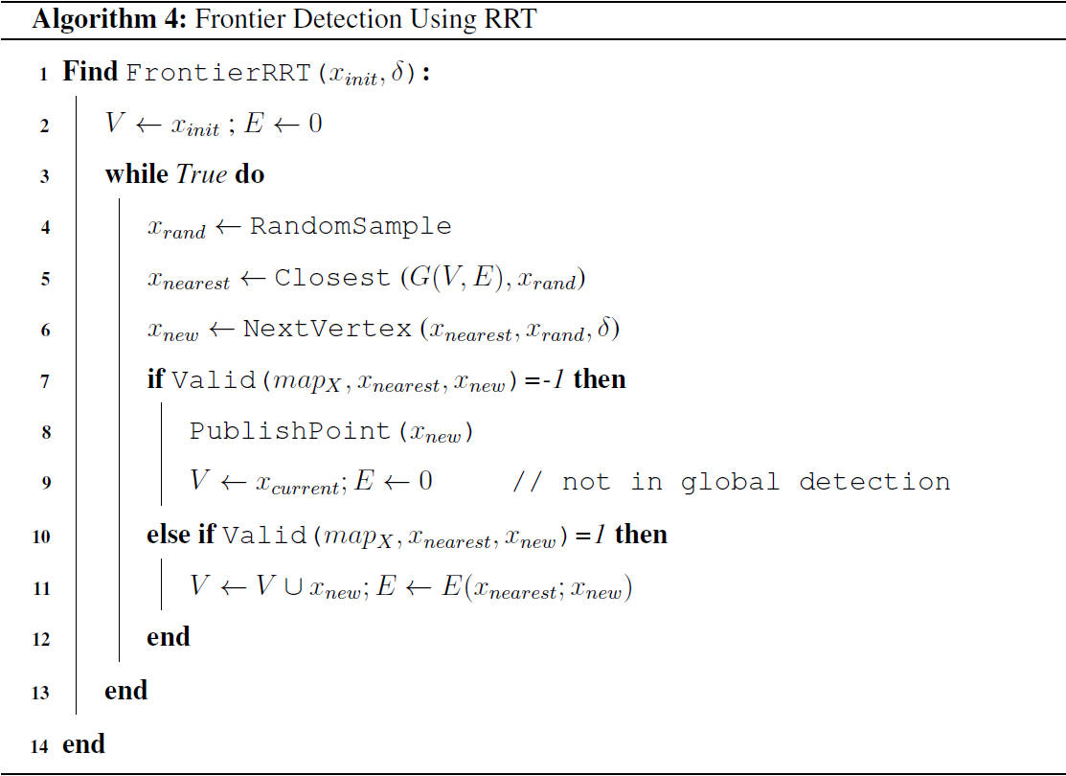
Frontier Detection Using RRT
We have the complete algorithm here which we will explain in the next few slides. We will state some basic variables which will be consistent across our discussion.
Vertices V: Any sample node or point in the space is known as vertex. It is represented in terms of coordinate. All elements of form x_{something} is belong to this set V .
Edge E: A branch connecting two coordinates from the space V is called an edge. The set of all these edges constitute E.
Graph G: The set of edges and vertices form the Graph G = (V ; E). The whole structure of SRT and RRT are some form of this Graph G.
FRONTIER DETECTION USING RRT

Slide 17
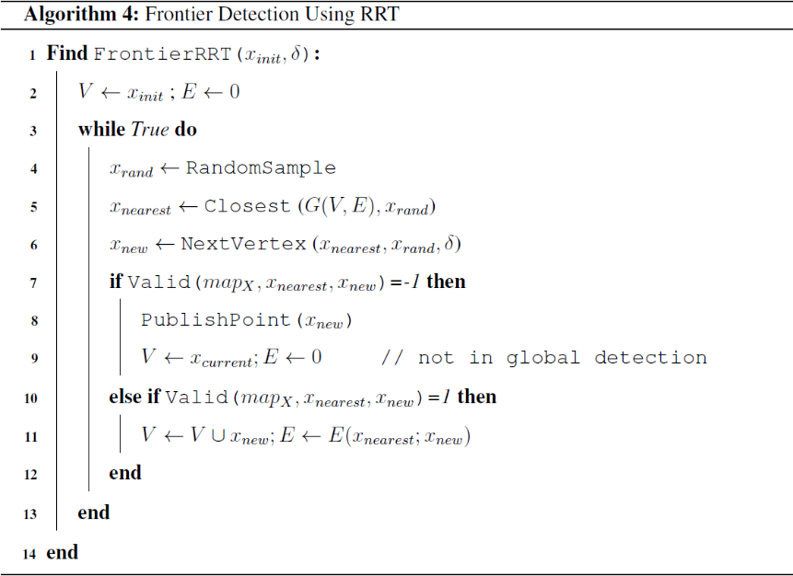
Functions
RandomSample: A function that returns random points which are independent and identically sampled around the given position x
Closest: A function that takes a Graph = (V ; E) and a point x in the free space as input and returns a vertex v ⊂ V which is closest to x. If multiple v satisfy this condition then the one sampled first will be selected.
NextVertex: Takes two points x₁; x₂ and returns a point x_{next} such that ||x_{next} - x₂|| is minimized and ||x_{next} - x₁|| < δ where is the maximum length of tree edge towards exploration.
Valid: Takes two points x₁; x_{next} and a map X and returns 1 if its possible to travel from x₁ to x_{next}, 0 if there is an obstacle in between them and -1 if there is an unexplored area between them.
FRONTIER DETECTION USING RRT

Slide 18
Algorithm
The algorithm samples a random point using x_{rand} and then finds a point in the graph x_{nearest} which is closest to this point.
Next, we try to find a point to which the robot can travel x_{new} such that it is at a minimum distance from x_{rand} while also being close enough to x_{nearest.}
Finally we check if it is possible to travel to this point or not using Valid function.
If it is possible we add this new point to this set V and add an Edge between x_{nearest} and x_{new} indicating a path between them.
If travelling is not possible a new point we publish the point x_{new} as a FRONTIER, Clear the Edge graph and set the Vertex to the current position of the robot for new search to begin.
FRONTIER DETECTION USING RRT

Slide 19
Modifications to Frontier Detection and Assignement
MODIFICATIONS TO FRONTIER DETECTION AND ASSIGNMENT
We introduce some modification to the frontier detection and assignment techniques to reduce suboptimality and perform and fully utilize the versatility offered to us by using a multi-agent system.

Slide 20
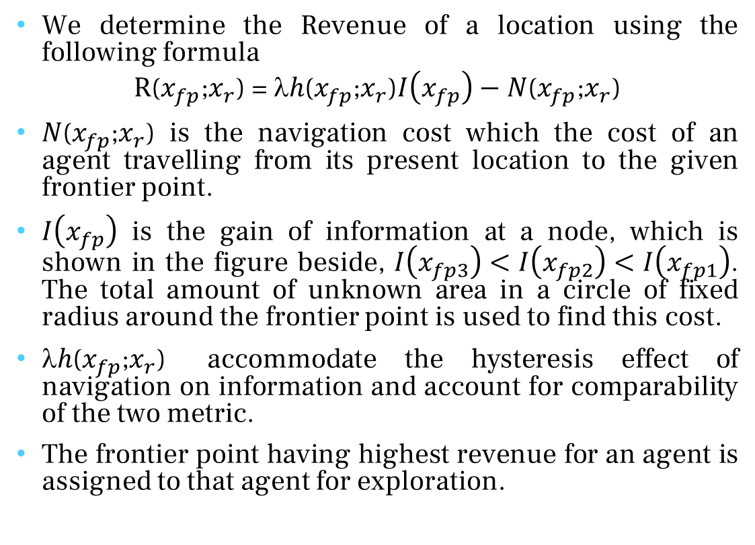
Cost based Frontier Assignment
We determine the Revenue of a location using the following formula
$$\text{R}\text{(}x_{fp}\text{;}x_{r}\text{)}\text{ = }λh\text{(}x_{fp}\text{;}x_{r}\text{)}I\left(x_{fp}\right)−N\text{(}x_{fp}\text{;}x_{r}\text{)}$$
$N\text{(}x_{fp}\text{;}x_{r}\text{)}$ is the navigation cost which the cost of an agent travelling from its present location to the given frontier point.
$I\left(x_{fp}\right)$ is the gain of information at a node, which is shown in the figure beside, $I\left(x_{fp3}\right)<I\left(x_{fp2}\right)<I\left(x_{fp1}\right)$. The total amount of unknown area in a circle of fixed radius around the frontier point is used to find this cost.
$h\text{(}x_{fp}\text{;}x_{r}\text{)}$ accommodate the hysteresis effect of navigation on information and account for comparability of the two metric.
The frontier point having highest revenue for an agent is assigned to that agent for exploration.
MODIFICATIONS TO FRONTIER DETECTION AND ASSIGNMENT

Slide 21
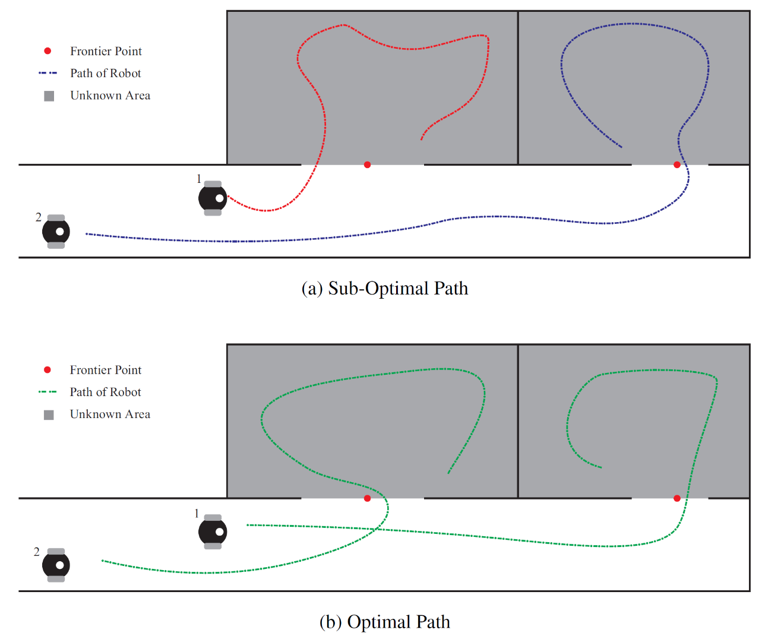
Global and Strict Frontier Assignment
We multiple agents are achieving a task then the time taken by agents to achieve tha task is decided by the agent which takes the maximum time to complete the job. We need to keep this fact when assigning frontiers to the agents for investigation.
As we can see here in the figure the total time taken by the robots to complete the task is greatly reduced if they follow the second assignment rather than the first one, in former the time taken by them is balanced while in the later the the second robot takes comparably higher time this delaying the whole process.
Rather than assigning frontiers to agents on a first come first serve basis we perform a global frontier assignment where rather than maximising the Revenue Gain per agent we maximise the total Revenue Gain of the whole system of agents i.e. the summation of their total revenue.
MODIFICATIONS TO FRONTIER DETECTION AND ASSIGNMENT

Slide 22
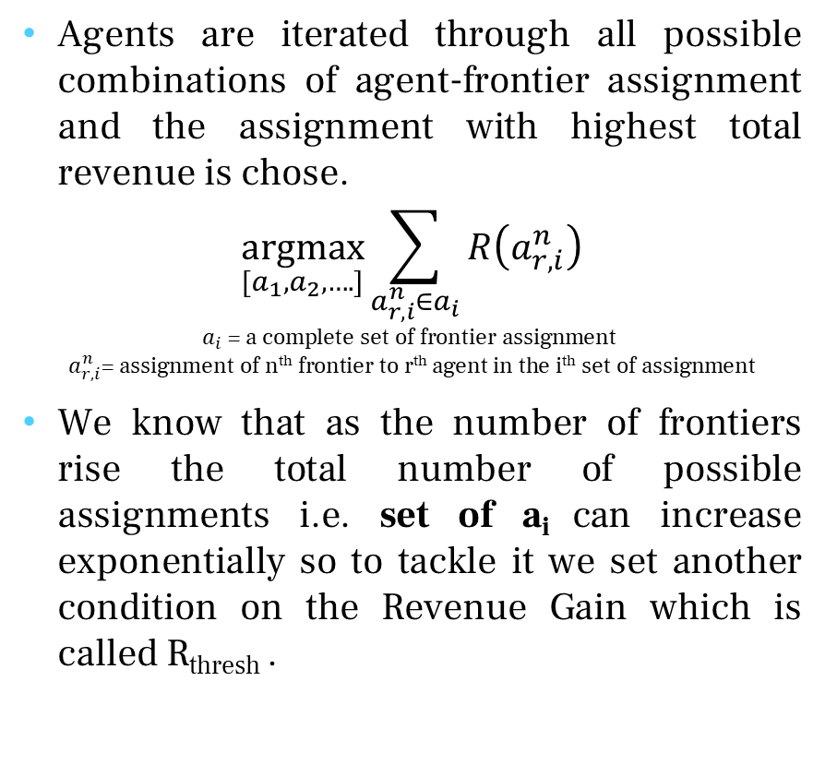
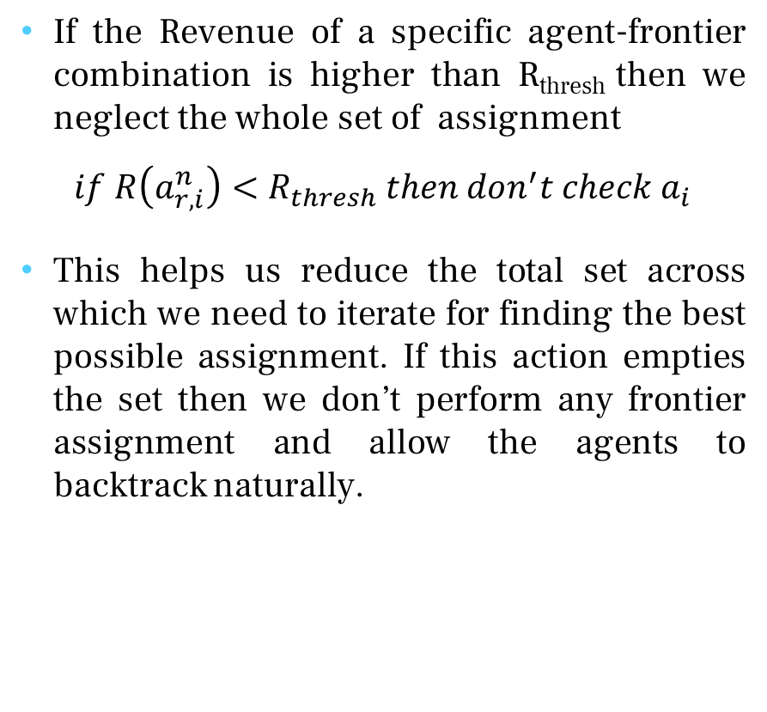
Global and Strict Frontier Assignment
Agents are iterated through all possible combinations of agent-frontier assignment and the assignment with highest total revenue is chose.
$$\underset{[a_{1},a_{2},….]}{argmax}{\sum_{a_{r,i}^{n}∈a_{i}}{R\left(a_{r,i}^{n}\right)}}$$
$$a_{i}\text{ = }\text{a} \text{complete} \text{set} \text{of} \text{frontier} \text{assignment}$$
$$a_{r,i}^{n}\text{= }\text{assignment} \text{of} \text{nth} \text{frontier} \text{to} \text{rth} \text{agent} \text{in} \text{the} \text{ith} \text{set} \text{of} \text{assignment}$$
We know that as the number of frontiers rise the total number of possible assignments i.e. set of a_{i} can increase exponentially so to tackle it we set another condition on the Revenue Gain which is called R_{thresh} .
If the Revenue of a specific agent-frontier combination is higher than R_{thresh} then we neglect the whole set of assignment
$$if R\left(a_{r,i}^{n}\right)<R_{thresh} then don^{′}t check a_{i}$$
This helps us reduce the total set across which we need to iterate for finding the best possible assignment. If this action empties the set then we don’t perform any frontier assignment and allow the agents to backtrack naturally.
MODIFICATIONS TO FRONTIER DETECTION AND ASSIGNMENT

Slide 23
Search Processing and Path Planning
SEARCH PROCESSING AND PATH PLANNING
After we have completely built the map we still need to ready it up for traversal by other robots and make it more efficient by connecting naturally disconnected areas and building a path planning algorithm for the map.

Slide 24
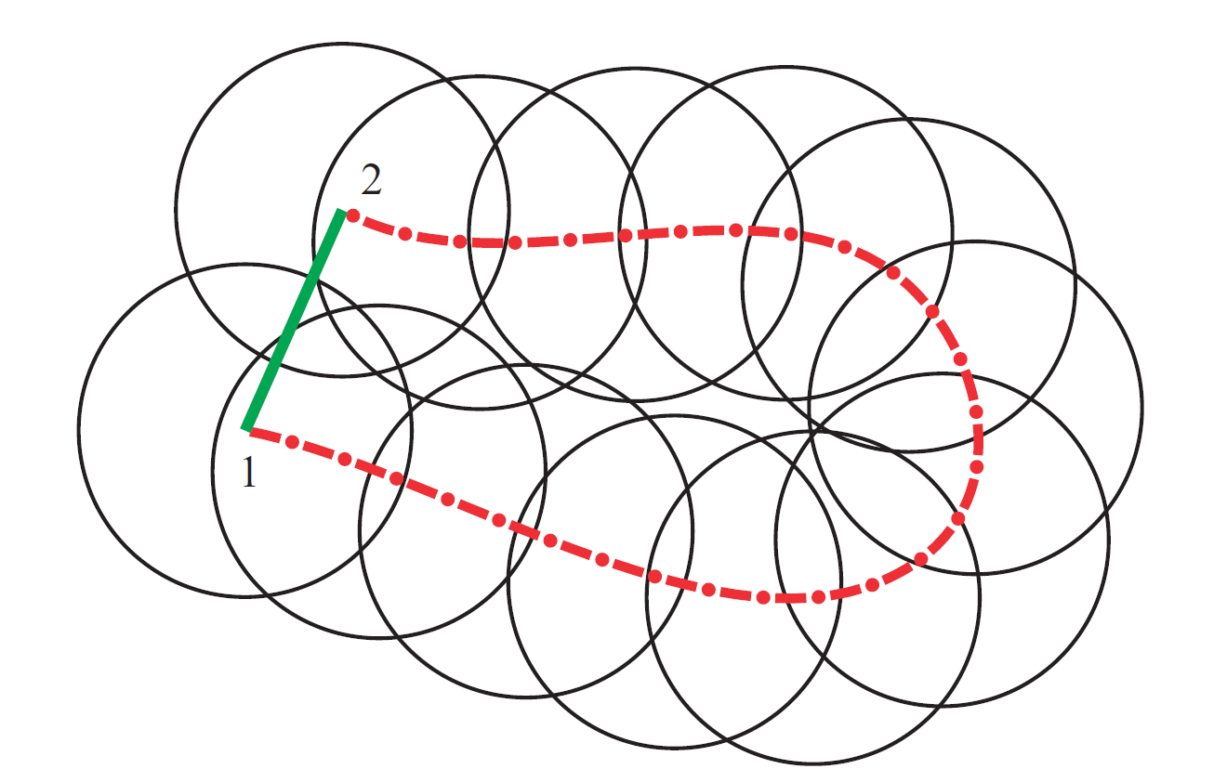
Clustering and Its Need
To understand the need of clustering we look at the figure here. We see that the actual path shown by our map is red while the optimal path is green. To remove such no optimality we need to cluster points together between which linear travel is possible so that an agent can travel inside such clusters in a linear motion. They are called sections of linear motions.
To perform clustering we first check weather the LSA of a node overlaps with the cluster(consider a cluster to be a large LSA) and then we use regions on the edges of a cluster to check weather a node should be accepted inside the cluster or not. If a node can be linearly reached from each node on the edge on a cluster then we include the node in the cluster inside the node.
CLUSTERING

Slide 25
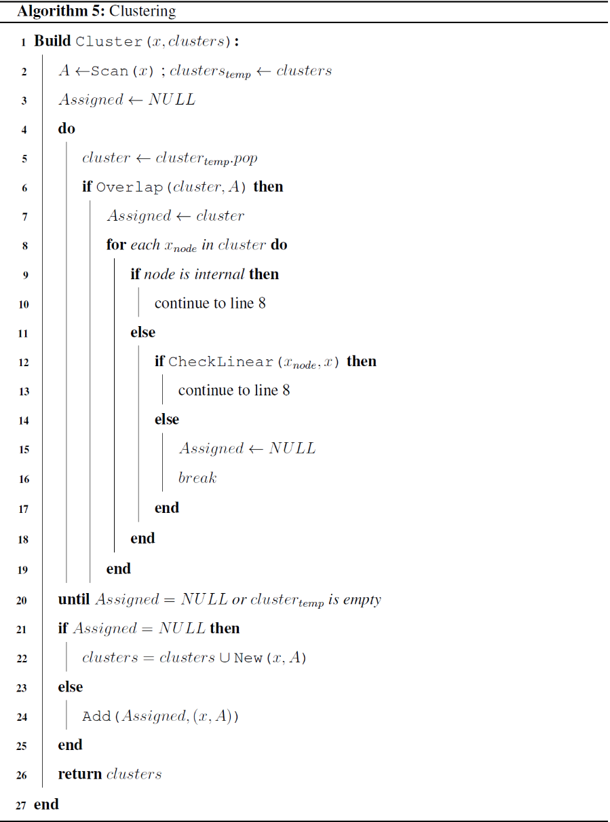
Algorithm
We pick the Scan of a node x and take the list of all clusters.
We pop one cluster at a time and first check it the cluster overlaps with the LSA of our node.
If the clusters overlaps then we iterate through all edge points of the cluster neglecting internal nodes to see if they can be linearly reached from our node.
We do this for all clusters and if our points satisfies all criteria for a cluster it is assigned to that cluster else if the cluster list goes empty we assign our point as a new cluster.
A node is assigned an internal node if it has more than 8 LSA from its own cluster overlapping it. We reached this number by checking internal nodes on multiple maps ourselves.
CLUSTERING

Slide 26
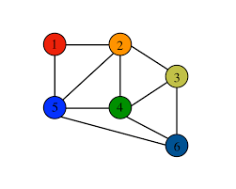
Path Selection
The clusters are then stored in form of a undirected graph where each node represents a cluster (in which we can traverse in a straight line between any two points) and the edges of the graph represent whether we can traverse from one cluster to another or not. Two clusters which share a common boundary in the map will be connected by an edge in the graph.
The purpose of representation of explored regions into a graph structure is so that we can apply any graph based search algorithm to find the shortest path between any two nodes which in turn helps us to find the clusters that the agent needs to traverse in order to reach the goal. We’ve used A* Search Algorithm which is a heuristic based search algorithm.
PATH SELECTION

Slide 27
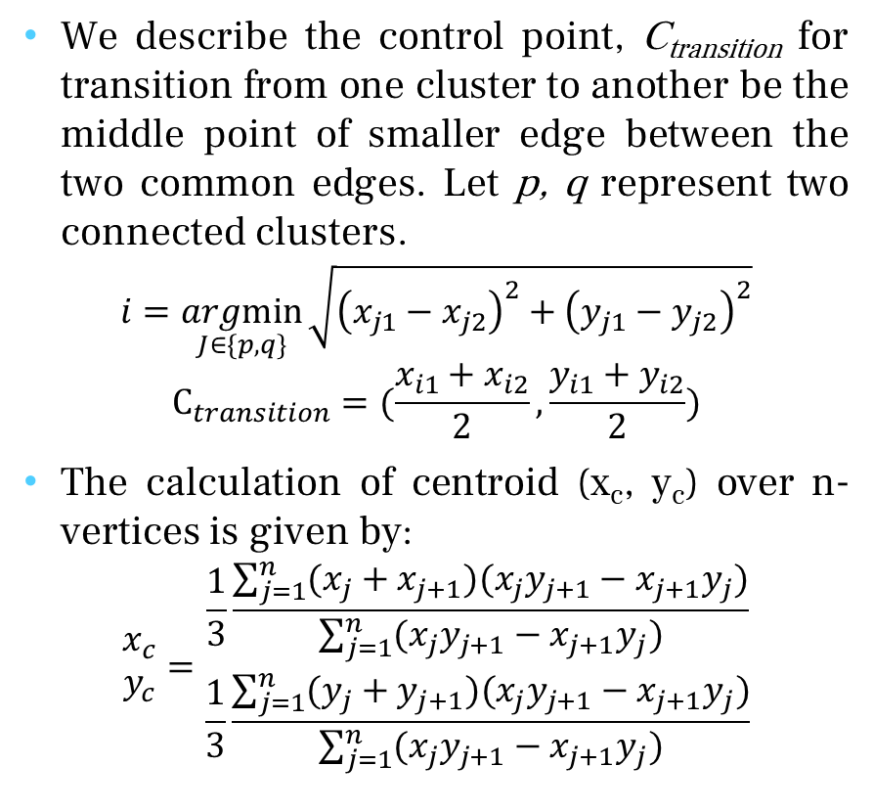
Estimation of Control Points
Control points are a specific set of points used to parametrize and generate smooth curves for efficient trajectory planning for agents in an environment full of obstacles since a direct straight line path between the starting and destination coordinates might not be always possible.
We propose two types of control points to be extracted from the clusters; firstly at the transition from one cluster node to another and secondly as the centroid of the clusters itself.
We describe the control point, C_{transition} for transition from one cluster to another be the middle point of smaller edge between the two common edges. Let p, q represent two connected clusters.
$$i=\underset{J∈\{p,q\}}{argmin}{\sqrt{{\left(x_{j1}−x_{j2}\right)}^{2}+{\left(y_{j1}−y_{j2}\right)}^{2}}}$$
$$C_{transition}=(\frac{x_{i1}+x_{i2}}{2},\frac{y_{i1}+y_{i2}}{2})$$
The calculation of centroid (x_{c}, y_{c}) over n-vertices is given by:
$$\begin{matrix}x_{c} \\ y_{c}\end{matrix}=\begin{matrix}\frac{1}{3}\frac{\sum_{j=1}^{n}{(x_{j}+x_{j+1})(x_{j}y_{j+1}−x_{j+1}y_{j})}}{\sum_{j=1}^{n}{(x_{j}y_{j+1}−x_{j+1}y_{j})}} \\ \frac{1}{3}\frac{\sum_{j=1}^{n}{(y_{j}+y_{j+1})(x_{j}y_{j+1}−x_{j+1}y_{j})}}{\sum_{j=1}^{n}{(x_{j}y_{j+1}−x_{j+1}y_{j})}}\end{matrix}$$
ESTIMATION OF CONTROL POINTS

Slide 28
Estimation of Control Points
The purpose of taking centroids as a control point is to introduce an extra point of freedom in terms of trajectory selection as planning just on the basis of transition points may sometimes lead to trajectories with extremely sharp turns which might be significantly hard to achieve in a practical scenario.
After the computation of control points, the whole path can be described as a series of control points which are actual physical coordinates in a given map with starting and destination coordinates at the ends, respectively. S and G represents the starting and destination coordinates, C_{i, c} represents the centroid of i^{th} cluster while C_{i, j, t} represents the transition control point from i^{th} cluster to j^{th} cluster.
Now that we have obtained the control points, we can use standard parametric curves such as Bézier Curves, B-splines, etc. in obtaining the smooth curve equations for a desired trajectory.
ESTIMATION OF CONTROL POINTS

Slide 29
Results and Conclusion
RESULTS AND DISCUSSIONS
Following are the results of the three tasks achieved; improved exploration algorithm and estimation of clusters and control points for path planning.

Slide 30
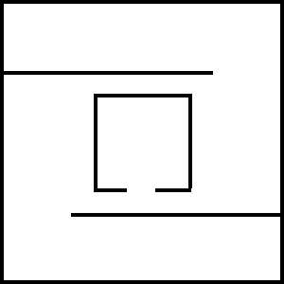
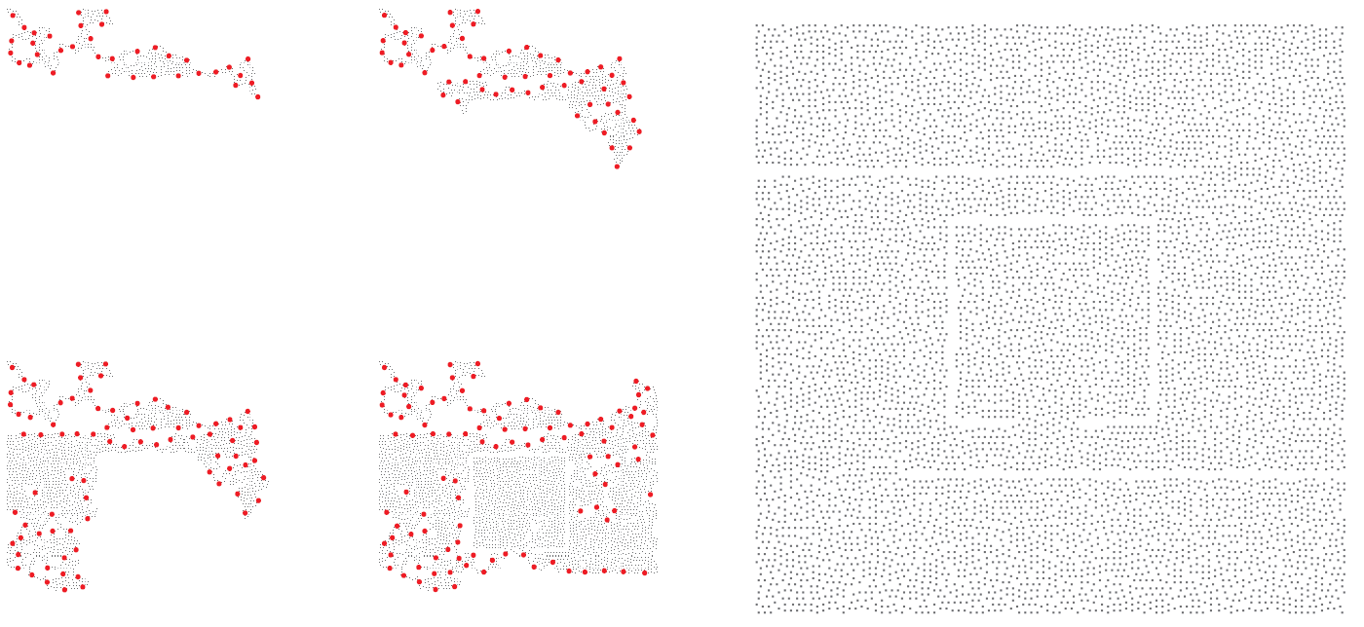
Improved Exploration Results
IMPROVED EXPLORATION RESULTS
First figure represents the actual map, the second figure represents the map explored at various instants and the third one after exploration is completed. The red dots corresponds to frontier points which are explored when an agent has completely explored a local region.
The number of nodes backtracked were considerably reduced, thereby improving the efficiency of exploration w.r.t time after using the proposed frontier assignment approach.

Slide 31
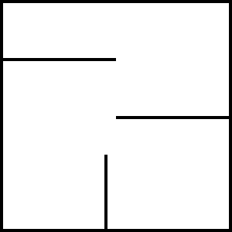
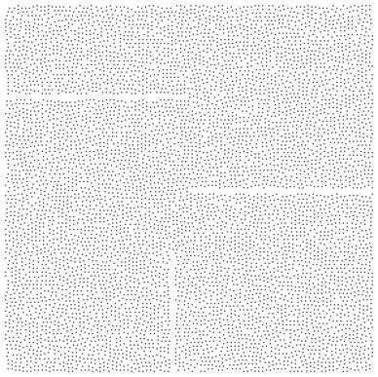
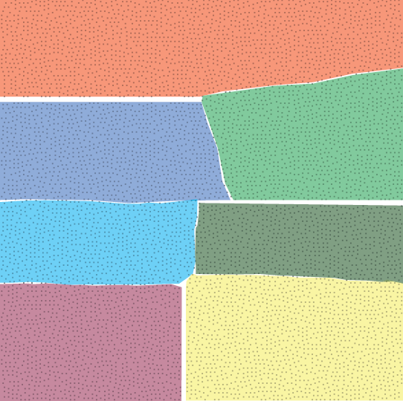
Clustering Results
CLUSTERING RESULTS
First figure represents the actual map, the second one as obtained through exploration and the third one represents the clustering of coordinates traversed into simple convex polygons i.e. regions in which any two points can be connected using a straight line.
The information of these regions is stored in the form of nodes in an undirected graph, for e.g. in the graph, the node corresponding to the first orange cluster will be connected to the node representing the light green cluster.

Slide 32
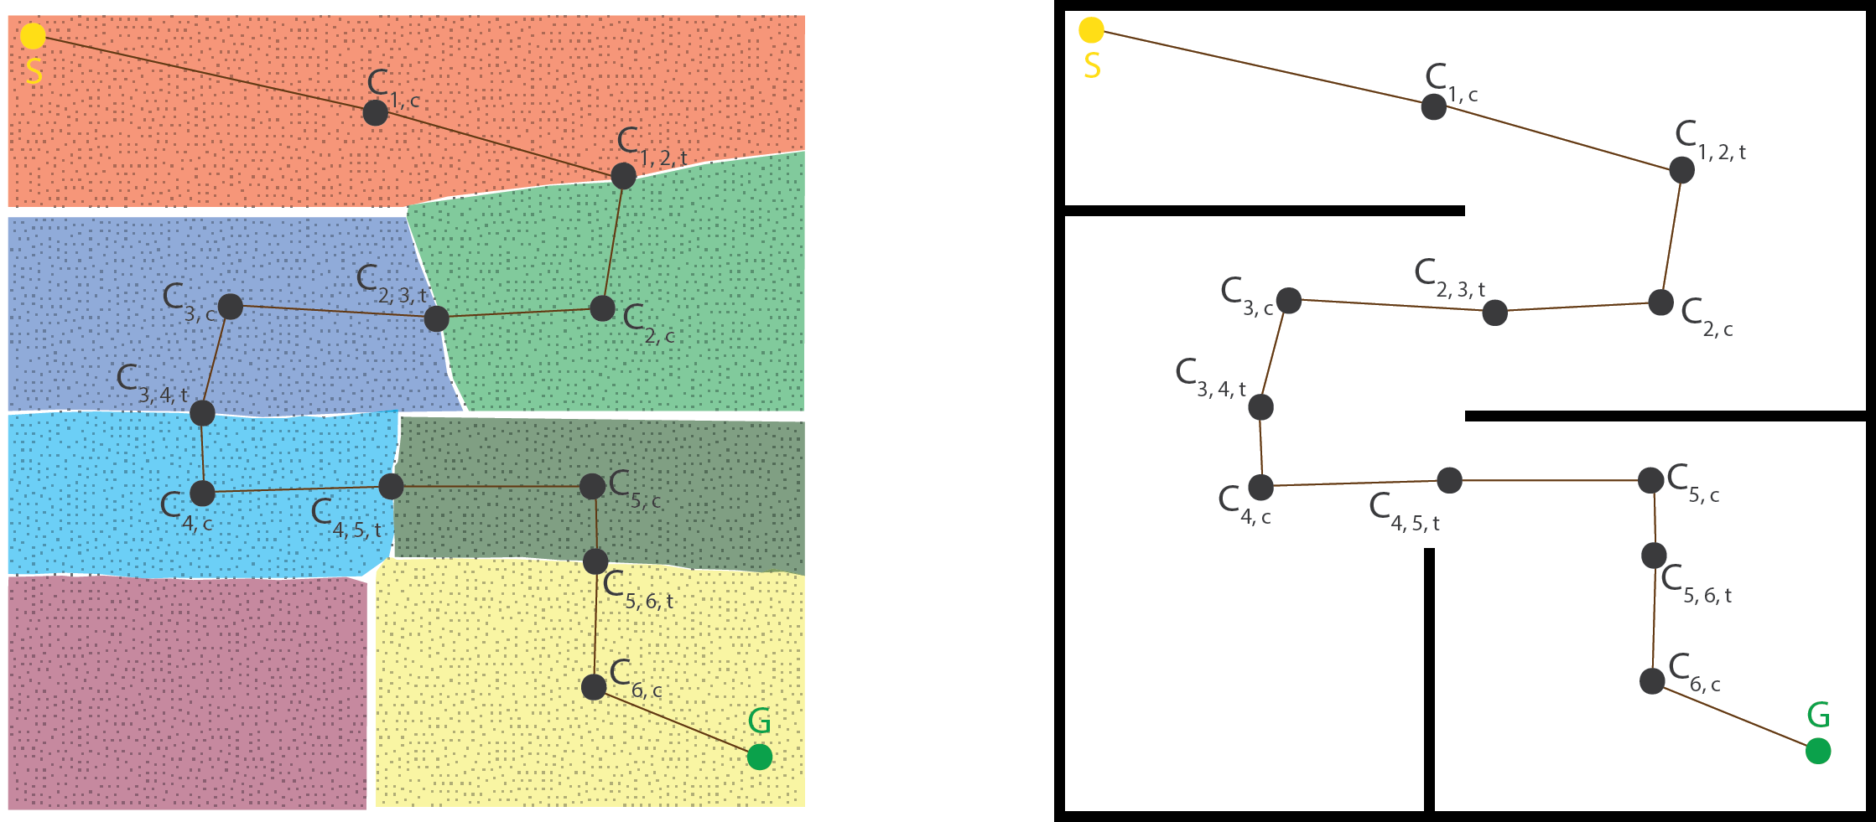
Path Planning Results
PATH PLANNING USING CONTROL POINTS
S and G represents the starting and destination coordinates, C_{i, c} represents the centroid of i^{th} cluster while C_{i, j, t} represents the transition control point from i^{th} cluster to j^{th} cluster.
The control points shown can be used to compute standard parametric curves such as Bézier Curves, B-splines, etc. in obtaining the smooth curve equations for a desired trajectory.

Slide 33
Conclusion
A modified map exploration strategy was proposed to enhance already existing methods. SRT was used for moving the agent while frontier detection was done using RRT. Significant amount of time was reduced by improving the backtracking towards unexplored regions using frontier points.
Further, after the map of unexplored area was created, a novel idea to decompose the map into smaller convex polygons (clusters) for path planning was proposed. The decomposition of the map by clustering of traversed points into convex polygons significantly reduced the memory consumption as only vertices of the polygons were required to be kept into memory, compared to the formal SRT case in which all the coordinates of the traversed points need to be maintained.
Since map exploration and trajectory planning are two widely researched independent fields, and this algorithm tries to connect the two using the method proposed. Usually, in trajectory planning algorithms, it is assumed that control points are known, and optimization is done for computing better trajectories, the proposed method instead tries to find the control points thereby allowing it to be combined with already existing state-of-the-art methods.
CONCLUSION

Slide 34
Thank You

