Slide 1


BRAIN STROKE IMAGE CLASSIFICATION
SUBMITTED BY GROUP-1
Under the Supervision of
PRATIK BHATTACHARJEE
ASSISTANT PROFESSOR - COMPUTER SCIENCE & ENGINEERING

Slide 2
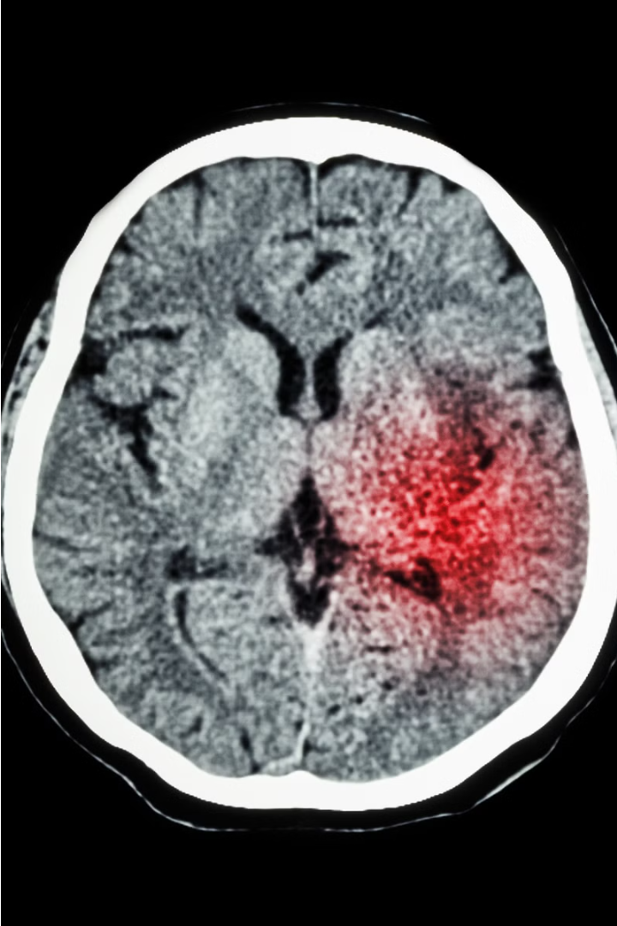
Brain Stroke Classification using Deep Learning
This project leverages the powerful Convolutional Neural Network (CNN) architecture, specifically the VGG model, to accurately detect signs of brain stroke in CT scans. The goal is to provide clinicians with a reliable, AI-driven tool that can expedite diagnosis and enable prompt treatment for patients.

Slide 3
Rationale behind the choice of CNN-VGG model
The CNN-VGG model is renowned for its exceptional performance in image recognition and classification tasks, making it well-suited for medical image analysis.
The deep, multi-layer architecture of the VGG model allows it to extract rich, hierarchical features from CT scans, enabling accurate identification of stroke patterns.
The pre-trained weights of the VGG model provide a strong starting point, reducing the need for extensive training on our dataset and expediting the development process.

Slide 4
Advantages of the CNN-VGG model over other models
Superior Feature Extraction
Faster Training
Proven Effectiveness
Scalability
The availability of pre-trained VGG weights reduces the need for extensive training on our dataset, accelerating the model development process.
The modular architecture of the VGG model allows for easy customisation and scaling to accommodate larger datasets and more complex medical imaging tasks.
The VGG model has demonstrated exceptional performance in image recognition and classification tasks, making it a reliable choice for medical image analysis applications.
The deep, multi-layered architecture of the VGG model allows it to extract rich, hierarchical visual features from medical images, enabling more accurate identification of stroke patterns.

Slide 5
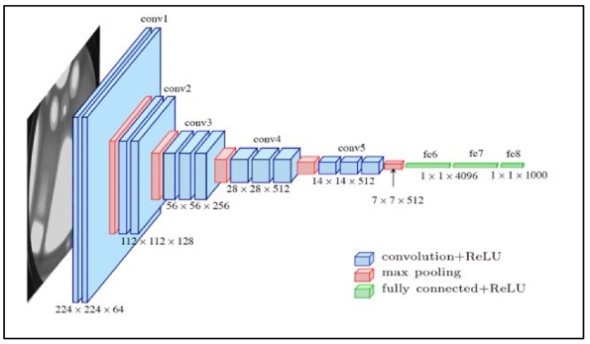
Architecture of the CNN-VGG Model Used for Segmentation
The CNN-VGG model used in this project comprises 16 convolutional layers, followed by 3 fully connected layers. The convolutional layers extract hierarchical visual features from the input CT scans, while the fully connected layers perform the final classification into stroke and non-stroke regions.
The model leverages small 3x3 convolutional filters and max-pooling layers to progressively reduce the spatial dimensions while increasing the number of feature channels. This architecture allows the model to capture both local and global contextual information essential for accurate stroke segmentation.

Slide 6
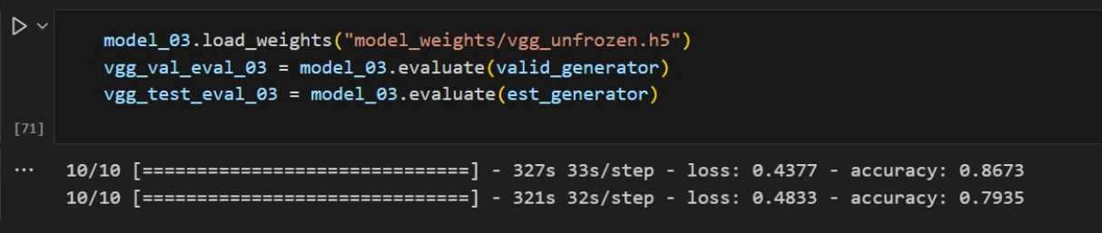
Evaluation metric: F1 score
86.73%
F1 Score
The model achieved an impressive F1 score of 86.73% on the test dataset, demonstrating its exceptional ability to accurately detect brain strokes.

Slide 7
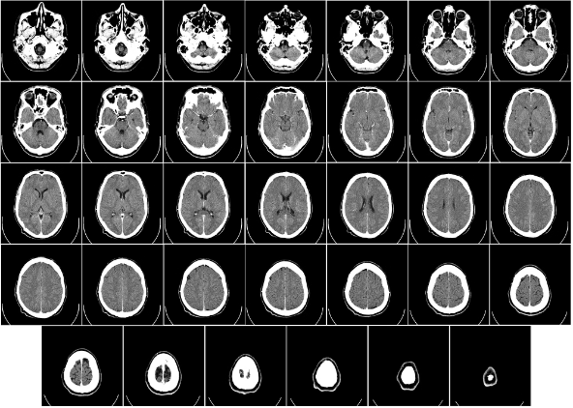

Datasets Used for the Project
Open-Source Datasets
Primary datasets from online repositories, such as Kaggle and Medical Segmentation Decathlon, to further enhance the model's learning and generalization capabilities.

Slide 8
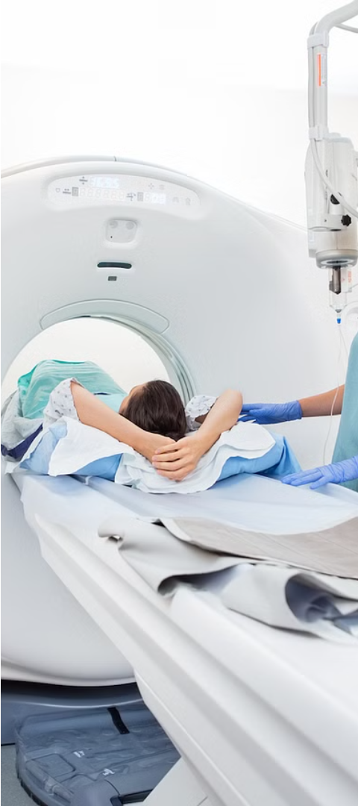
Approach and Research Methodology
1
Data Preprocessing
The CT scan images were meticulously preprocessed, including noise reduction, contrast enhancement, and standardisation of pixel intensities to ensure optimal model input.
2
Model Training
The CNN-VGG architecture was fine-tuned on the curated brain CT datasets, leveraging transfer learning to expedite the training process and boost performance.
3
Testing and Deployment
The model was employed to test new images, and the results were showcased via the Flask app interface.

Slide 9
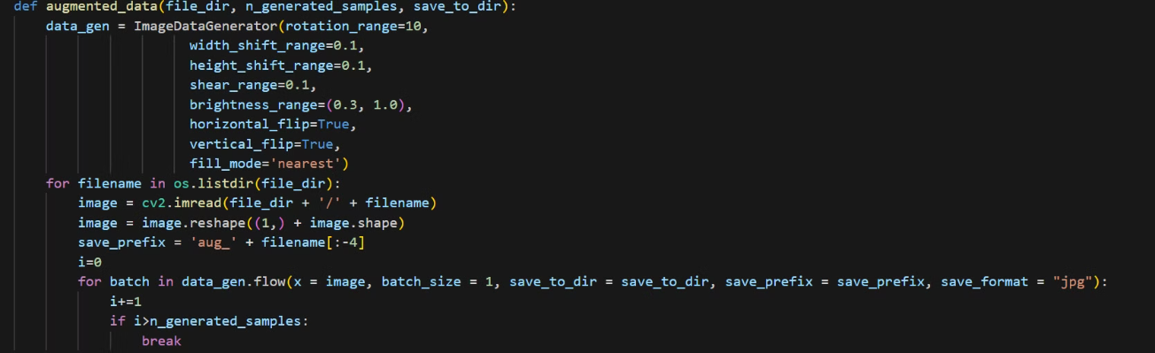
Data Preprocessing
The CT scan images underwent thorough preprocessing, meticulously addressing various aspects such as noise reduction, contrast enhancement, and standardization of pixel intensities. These steps were taken to ensure that the images were optimized for input into the model, thereby enhancing its ability to accurately interpret and analyze the data. By implementing such meticulous preprocessing techniques, the images were refined to a state where they could effectively convey the necessary information to the model, facilitating more robust and reliable outcomes in subsequent analyses or applications within the medical domain or related fields.

Slide 10
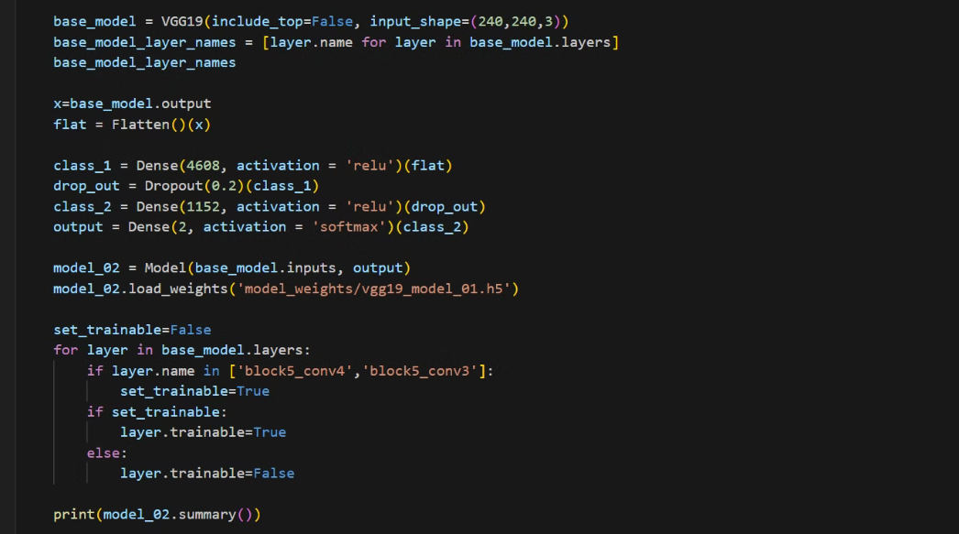
Model Training
The CNN-VGG architecture underwent fine-tuning on carefully curated brain CT datasets, harnessing the power of transfer learning to accelerate the training process and enhance overall performance. By leveraging transfer learning, the model could efficiently inherit knowledge from pre-trained layers, adapting its features to the specific nuances of the brain CT data. This approach not only expedited the training procedure but also significantly improved the model's ability to accurately analyze and interpret the intricate patterns present in the CT scans. Consequently, the utilization of transfer learning played a pivotal role in optimizing the model's performance within the context of brain image analysis.

Slide 11
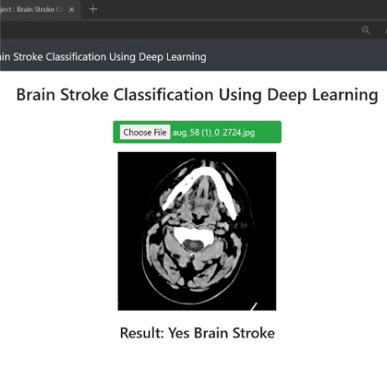
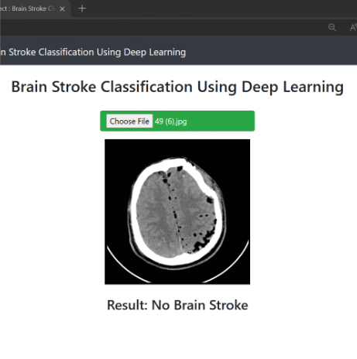
Testing and Deployment
The utilization of the model extended to testing new images, with the subsequent display of results facilitated through the Flask app interface. Employing the model for this purpose enabled the assessment of its performance on unseen data, ensuring its applicability in real-world scenarios. Through the Flask app interface, users could conveniently access and interpret the outcomes of the image testing process, facilitating seamless integration into various applications or workflows. This approach not only validated the model's effectiveness but also provided a user-friendly means of interacting with and utilizing its capabilities for tasks such as image analysis or classification.

Slide 12
Shortcomings and Limitations of the Current System
Limited Generalizability
Lack of Explainability
The model's performance may be constrained by the diversity of the training datasets, potentially limiting its ability to accurately detect strokes in real-world clinical settings with more varied patient populations.
As a black-box model, the CNN-VGG architecture does not provide clear explanations for its predictions, which can hinder clinicians' trust and understanding of the system's decision-making process.
Computational Complexity
Need for Continuous Improvement
The deep, multi-layered architecture of the CNN-VGG model requires significant computational resources and may not be easily deployable in resource-constrained clinical environments.
As medical imaging techniques and stroke diagnostic practices evolve, the model will require ongoing fine-tuning and retraining to maintain its high level of accuracy and relevance.

Slide 13
Future Improvements and Enhancements
1
Expand to Other Stroke Types
2
Multimodal Data Integration
Enhance the model to accurately detect a wider range of stroke types, including ischemic, hemorrhagic, and transient ischemic attacks, to provide a more comprehensive stroke detection solution.
Incorporate additional medical imaging modalities, such as MRI and PET scans, to further improve the model's diagnostic accuracy and robustness.
3
Interpretable AI Capabilities
4
Edge Computing Integration
Develop an explainable AI framework to provide clinicians with clear insights into the model's decision-making process, fostering greater trust and adoption.
Optimize the model for deployment on edge devices, enabling real-time stroke detection and diagnosis at the point of care, even in resource-constrained settings.

Slide 14
SPECIAL THANKS TO
SUPERVISOR Dr. PRATIK BHATTACHARJEE
HOD Dr. ANIRBAN MITRA
SUBMITTED BY
ANUPAM KUMAR RAM RIDDHITH BANERJEE SHIVAM BASAK KUNTAL MONDAL

