Slide 1
INFERNO : A Fire Alarm System
Group number-:16
Group Members-:
1)Raunak Krishan Jaiswal(IIT2020031)
2)Aditya Biswakarma(IIT2020033)
3)Anupam Raj(IIT2020034)
4)Katam Bala(IIT2020040)
5)Rohan Tirkey(IIT2020080)

Slide 2
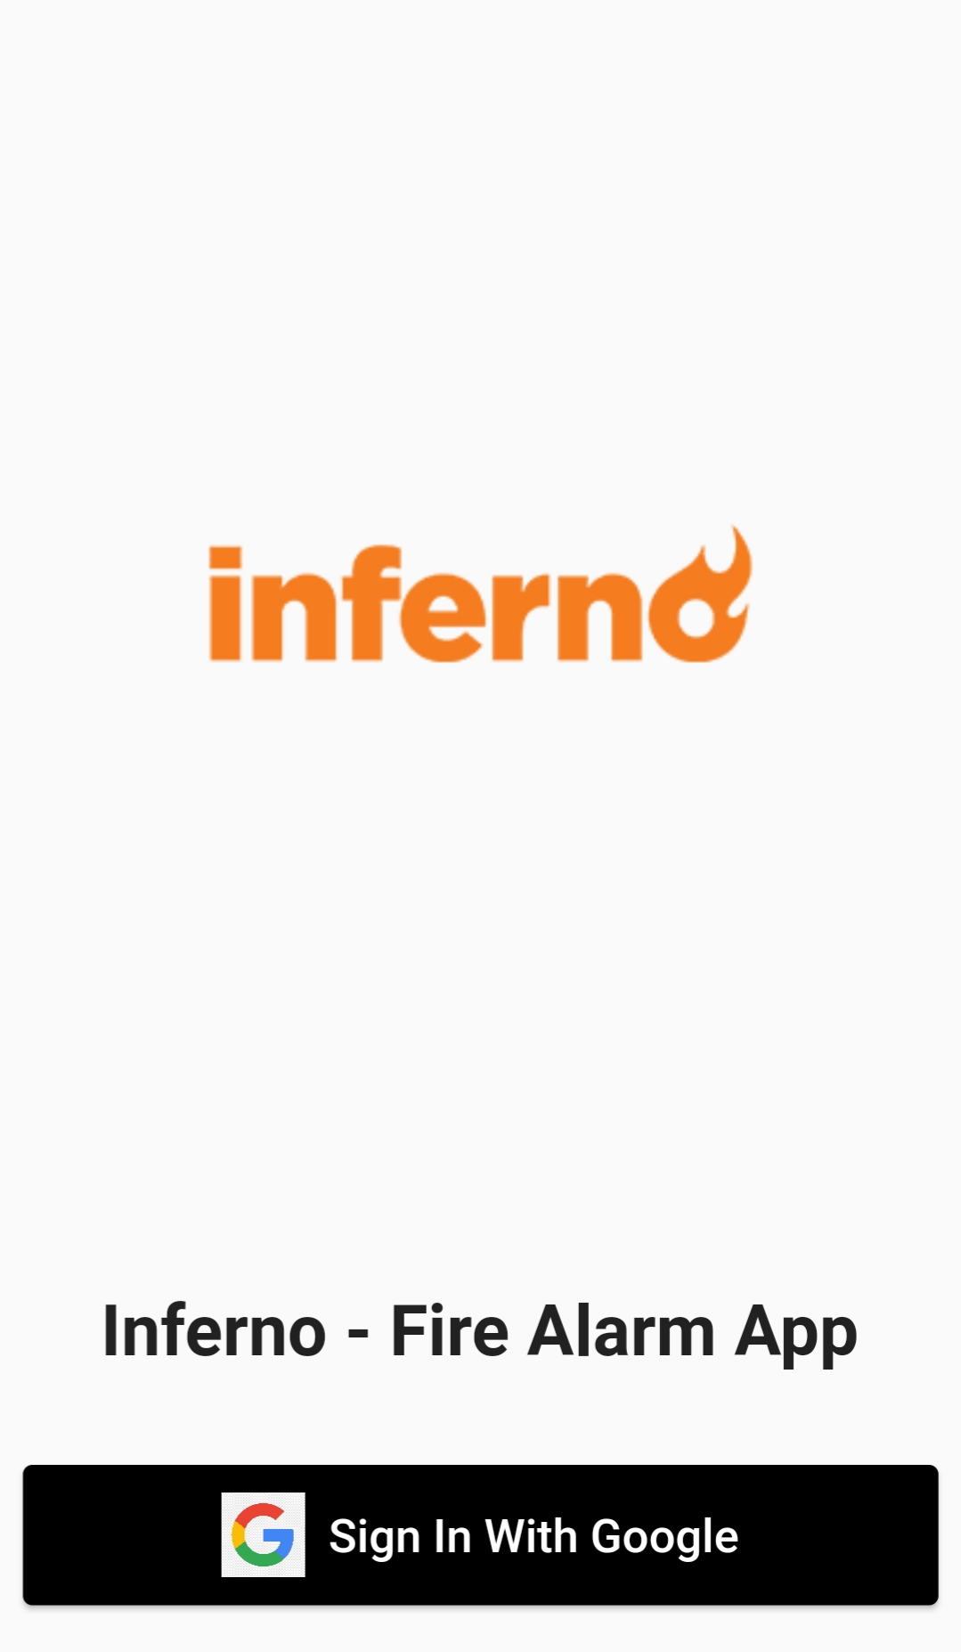
INTRODUCTION
Fire accidents are not common. But when they take place, they cause great harm
and destruction and sometimes loss of life. This device helps detect fire accidents
by collecting data from various sensors like heat and smoke sensors.
After detecting/confirming the fire by admins, we will generate an alert on mobile of
students/professors/ta’s. Admins can also initiate building alarms.

Slide 3
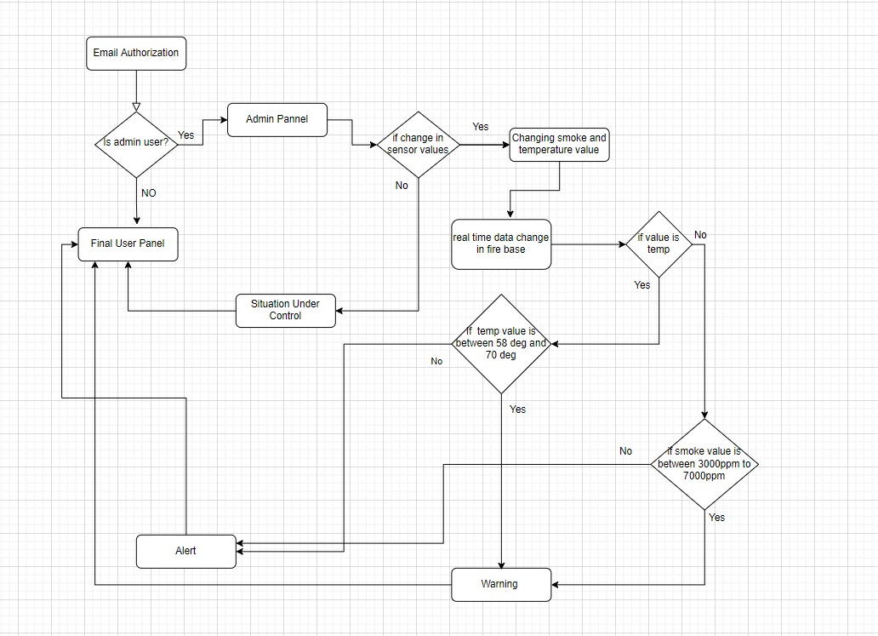
FLOWCHART

Slide 4
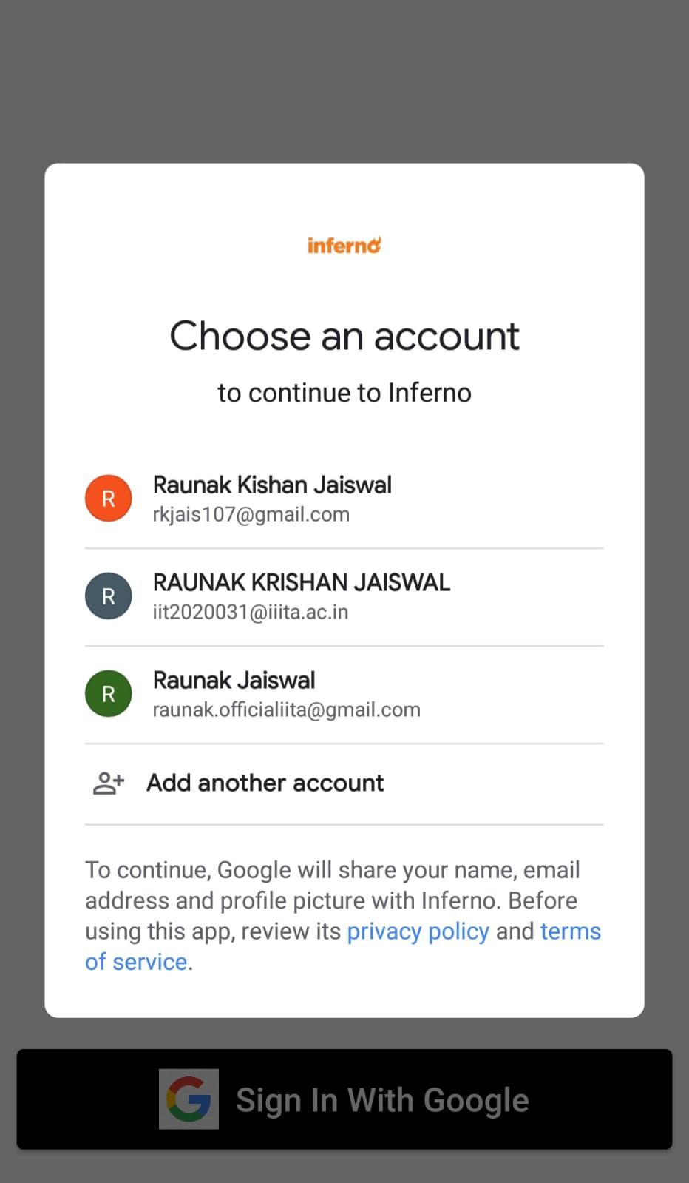
SIGIN PAGE

Slide 5
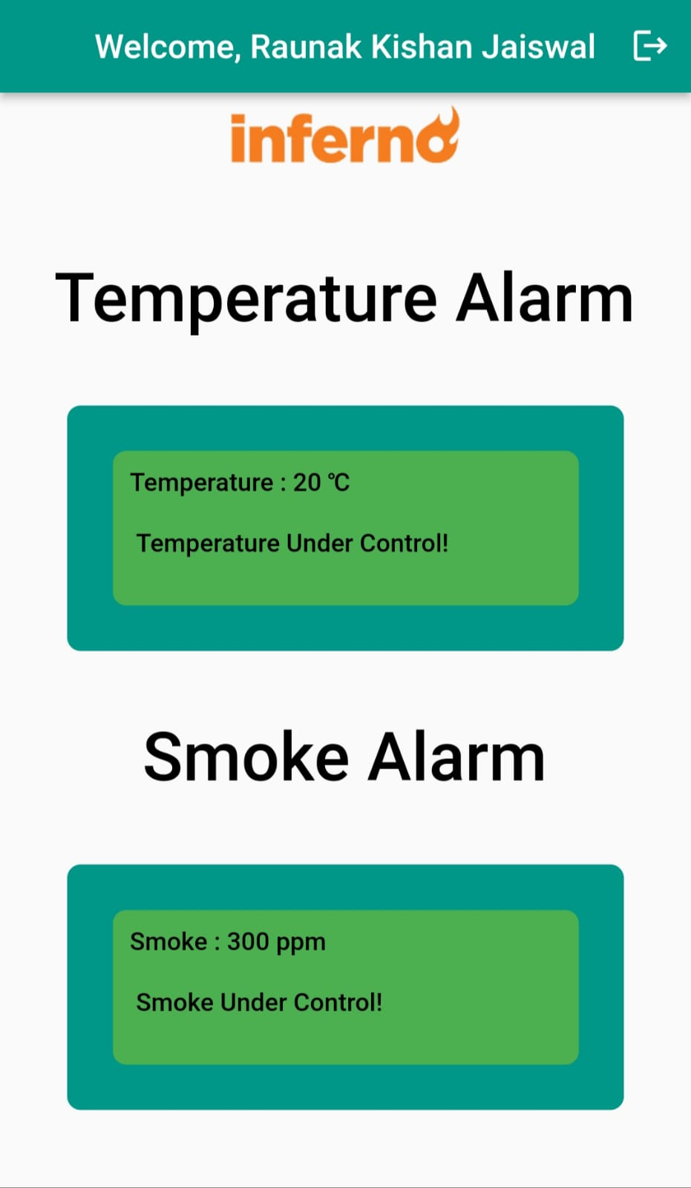
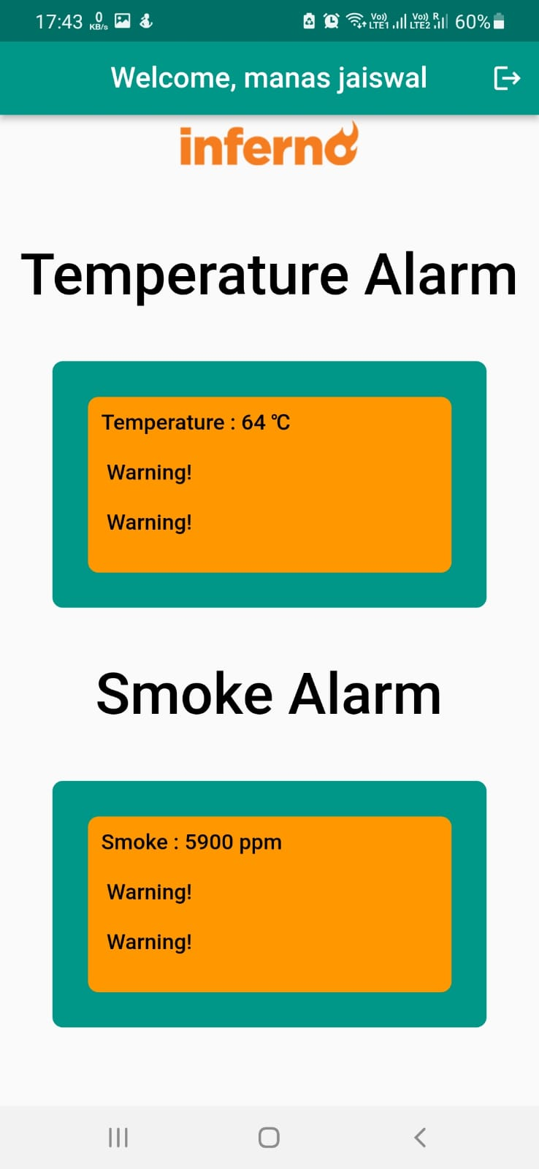
USER PANEL
Situation Under control
Warning

Slide 6
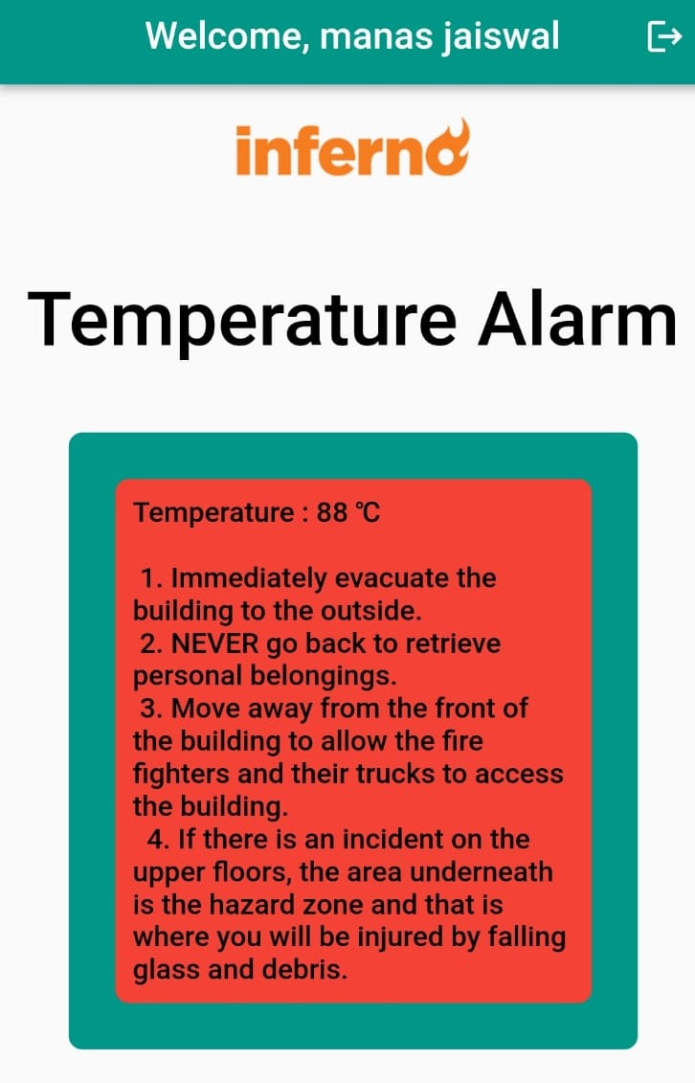
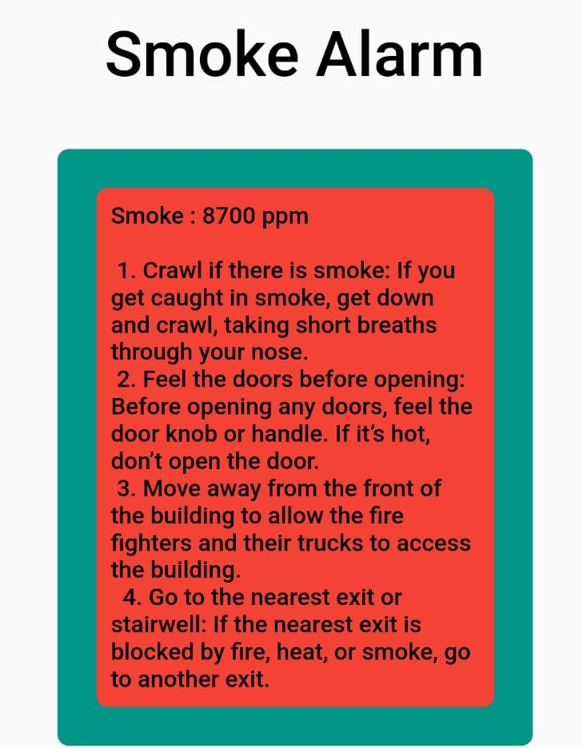
Alert

Slide 7
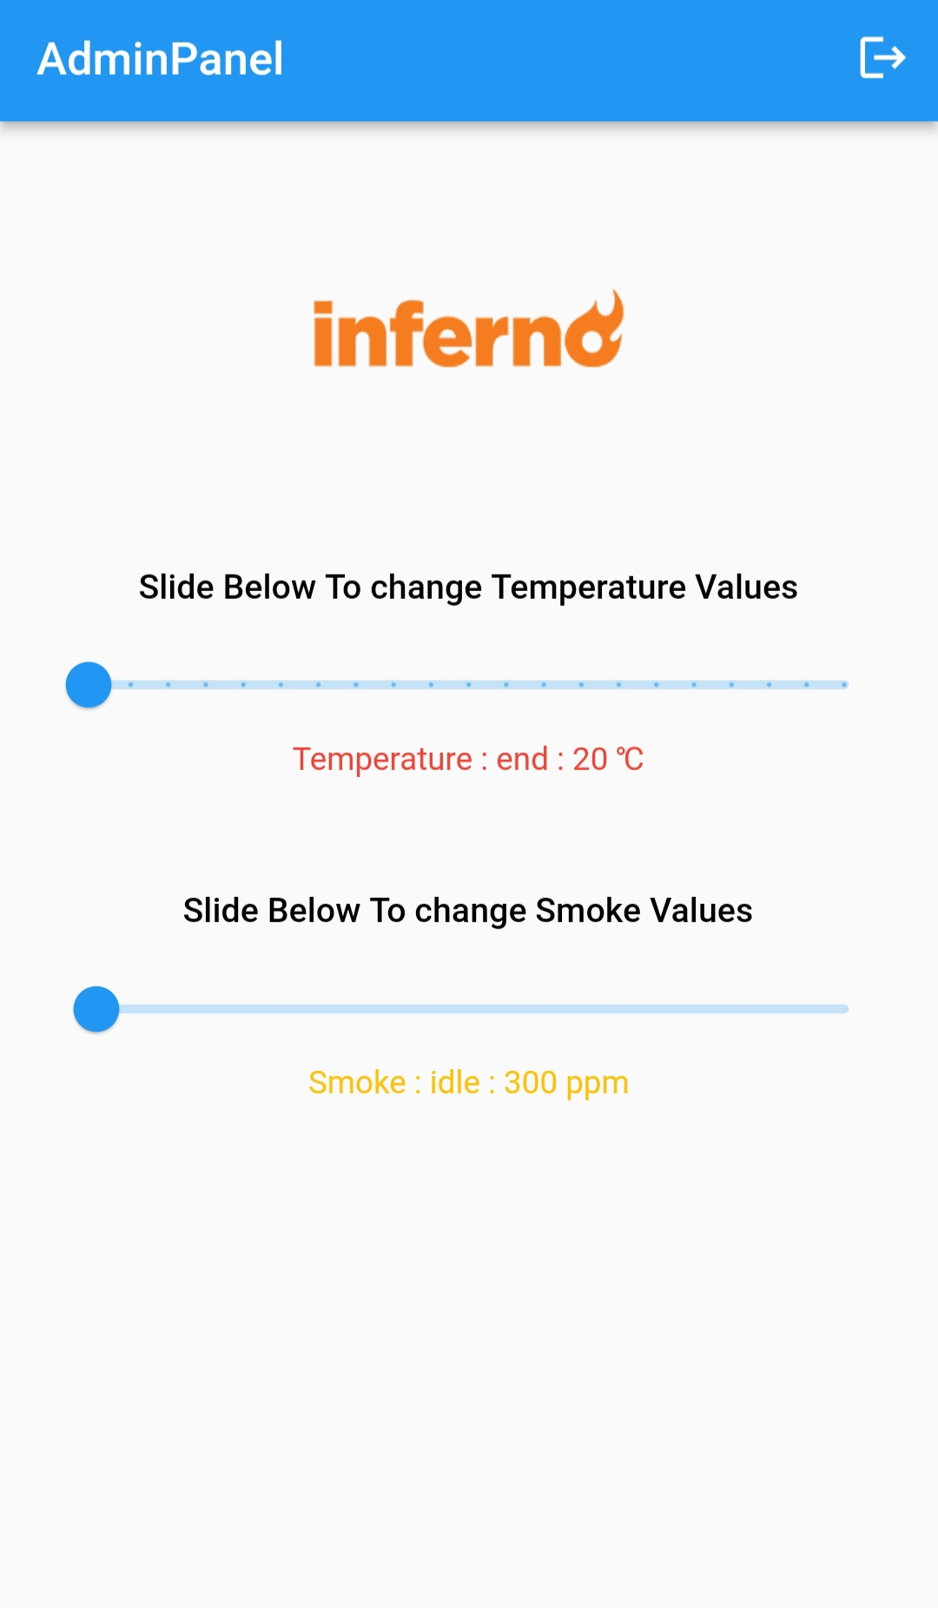
ADMIN PANEL
After checking values from the sensor, In admin panel admin will change the value and that value will simultaneously get updated in firebase data base and the value which is stored in data base will be displayed in the user panel

Slide 8
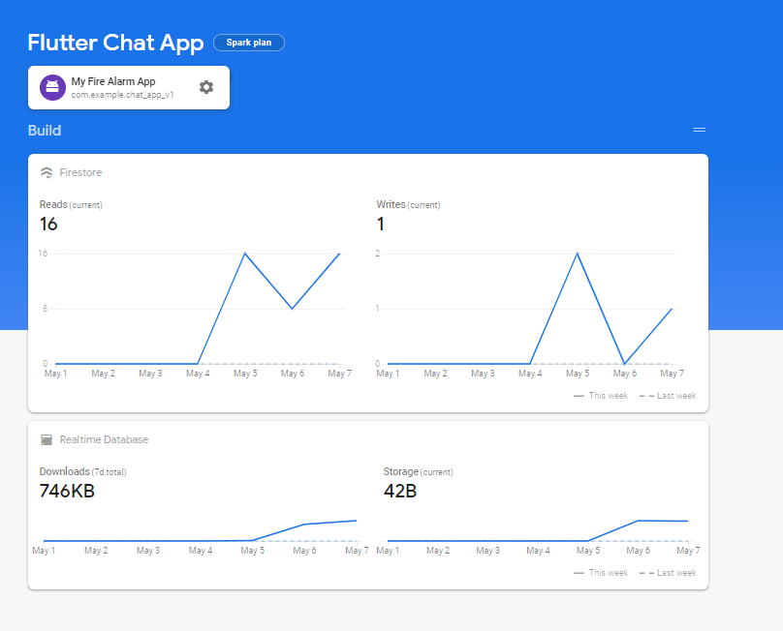
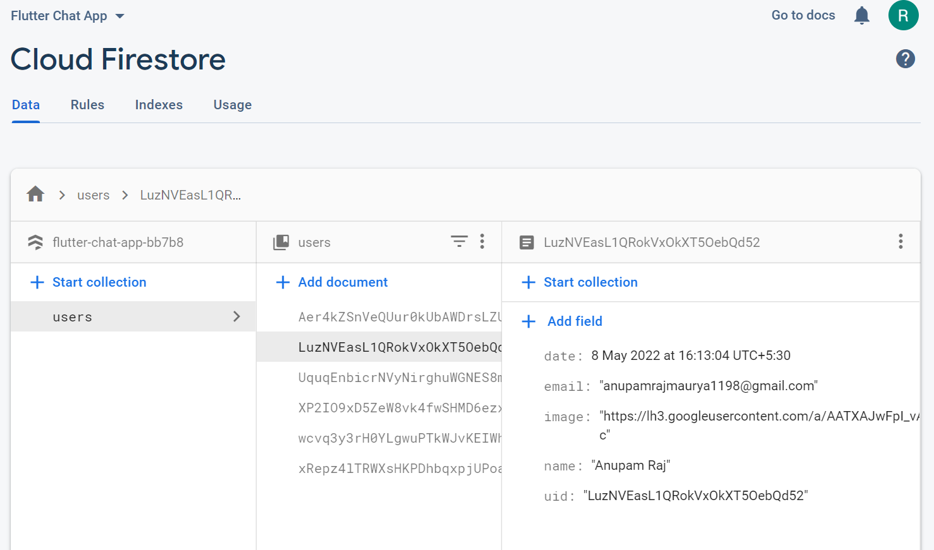
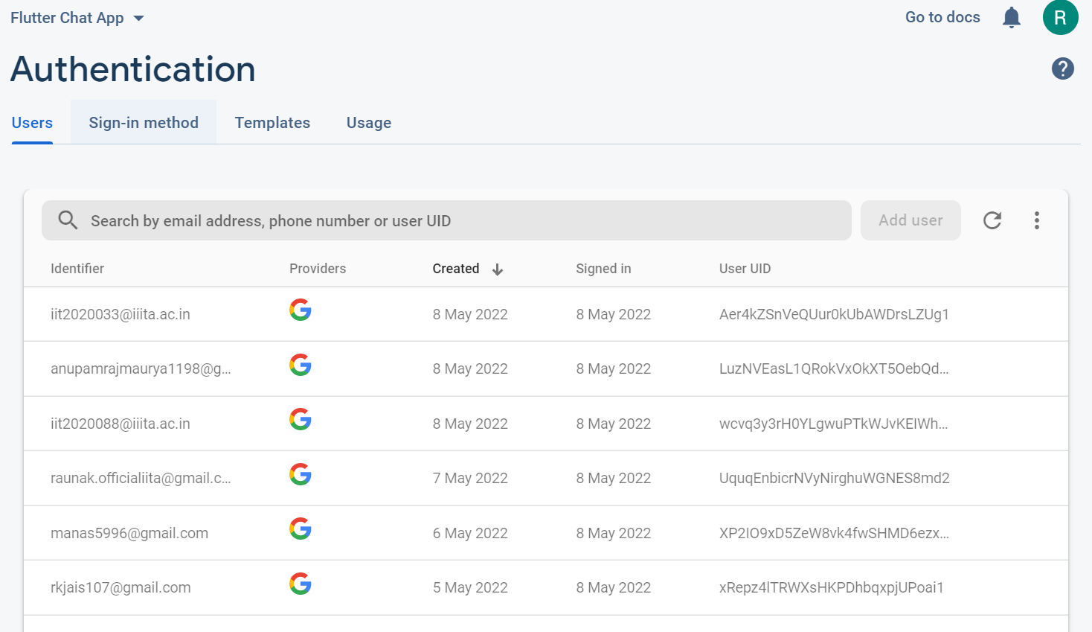
FIREBASE
Google Firebase is a Google-backed application development software that enables developers to develop iOS, Android and Web apps. Firebase provides tools for tracking analytics, reporting and fixing app crashes, creating marketing and product experiment.
We have used firebase for -:
1.) user authorization
2.) for storing user data
3.) for storing real time data and also displaying back to the user

Slide 9
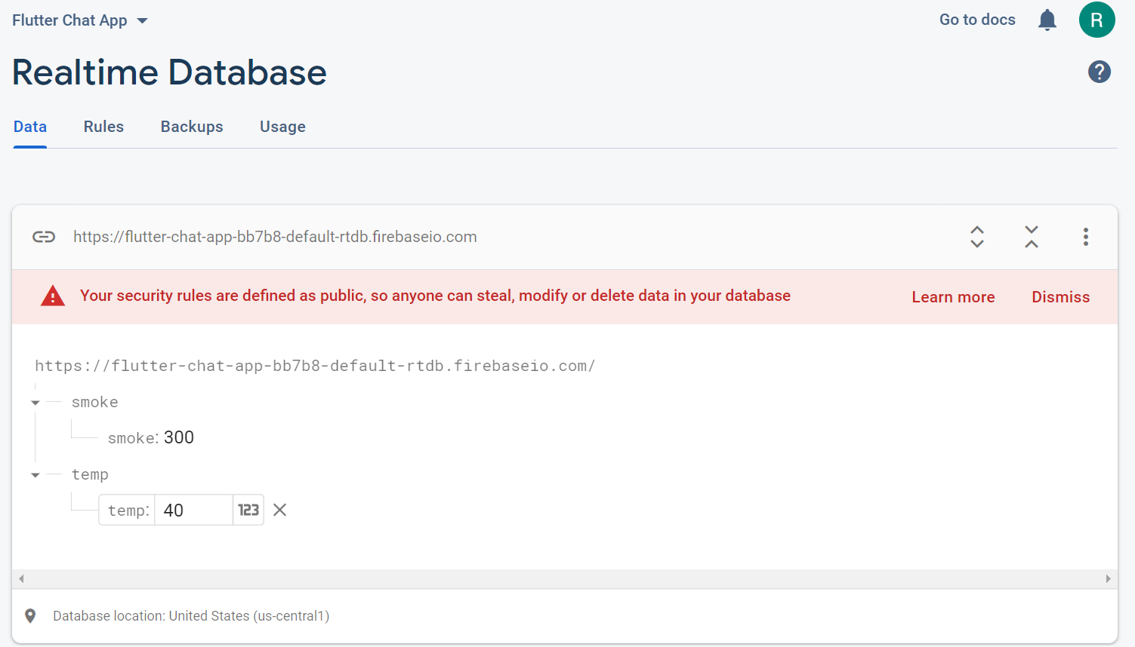
Real Time Database
The Firebase Realtime Database is a cloud-hosted NoSQL database that lets you store and sync data between your users in realtime.

