Slide 1

Web Development Lab
Submitted To-
Submitted By-
Anupam kumar shukla
MANIT Bhopal
Department of Computer
Appllication
MCA –I(semester)
Sch no-202120143
Prof. Anirban Chowdhury
MANIT BHOPAL
Department of Computer
Appllication

Slide 2
CONTENT
JavaScript HTML DOM
Structure(HTML)
Arrow Key Control
Game Area
Game line
Append child using javascript
Car , Enemy car
Car Collision

Slide 3
JAVASCRIPT HTML DOM
With the HTML DOM, JavaScript can access and change all the elements of an HTML document.
When a web page is loaded, the browser creates a Document Object Model of the page.

Slide 4
DOM GIVES PROPERTIES
With the object model, JavaScript gets all the power it needs to create dynamic HTML:
JavaScript can change all the HTML elements in the page
JavaScript can change all the HTML attributes in the page
JavaScript can change all the CSS styles in the page
JavaScript can remove existing HTML elements and attributes
JavaScript can add new HTML elements and attributes
JavaScript can react to all existing HTML events in the page
JavaScript can create new HTML events in the page.

Slide 5
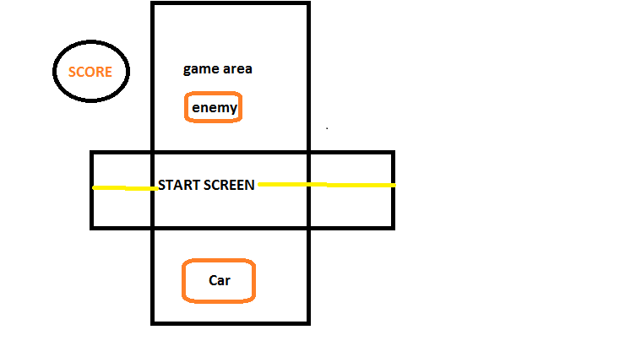
STRUCTURE(HTML)

Slide 6
ARROWKEY(addEventListener())
Sometimes we need to detect the keys and sometimes even detect which keys were pressed. To detect which arrow key is pressed.
document.addEventListener(event, function)
event: This parameter is required. It specifies the name of the event in string format.
function: This parameter is required. It specifies the function to run when the event happens.When the event occurs, an event object as a first parameter is passed to the function. Event object’s type depends on the specified event.

Slide 7
GAME AREA
In the game area section the problem is the start screen is on the game area when user start the game.
The start screen is hide and the game is start to play for this work we are add an class using java script append child method.
gameArea.appendChild(car);
or
Node.appendChild(node);
let car= document.createElement('div');

Slide 8
GAME LINE
In the center of the Road the white line is present and when the game start the come many times from this type of problem we are over come using
Window.requestAnimationFrame()
Your callback routine must itself call requestAnimationFrame() again if you want to animate another frame at the next repaint. requestAnimationFrame() is 1 shot.

Slide 9
Window.requestAnimationFrame
The window.requestAnimationFrame() method tells the browser that you wish to perform an animation and requests that the browser calls a specified function to update an animation before the next repaint. The method takes a callback as an argument to be invoked before the repaint.

Slide 10
APPEND CHILD USING JAVASCRIPT
Node.appendChild()
The Node.appendChild() method adds a node to the end of the list of children of a specified parent node. If the given child is a reference to an existing node in the document, appendChild() moves it from its current position to the new position (there is no requirement to remove the node from its parent node before appending it to some other node).

Slide 11
APPEND CHILD USING JAVASCRIPT
var node = document.createElement("LI");
// Create a <li> node var textnode = document.createTextNode("Water");
// Create a text node node.appendChild(textnode);
// Append the text to <li> document.getElementById("myList").appendChild(node);
// Append <li> to <ul> with id="myList"

Slide 12
CAR,ENEMYCAR
On the game area the two things requires first is the car and second is the enemycar . And both car is need to move from this problem to over come we are using maths function.
CAR-car is under the the control of user using the arrow key.
ENEMYCAR-enemycar is need to come on the different place on the road area. for this we are use
Math.floor()
Math.floor(Math.random()*300)+'px';

Slide 13
MATH.FLOOR(Math.Random())
The Math.floor() function returns the largest integer less than or equal to a given number.
The Math.random() function returns a floating-point, pseudo-random number in the range 0 to less than 1 (inclusive of 0, but not 1) with approximately uniform distribution over that range — which you can then scale to your desired range. The implementation selects the initial seed to the random number generation algorithm; it cannot be chosen or reset by the user.

Slide 14
CAR COLLISION
When the user car and enemycar is collision thee need to restart the game and stop the all game for finding the collision we are use getboundrect() method
To know to the collision of cars.
Object. getBoundingClientRect();

Slide 15
Element. getBoundingClientRect()
The Element.getBoundingClientRect() method returns a DOMRect object providing information about the size of an element and its position relative to the viewport.
Syntax- domRect = element.getBoundingClientRect()
DOMRect- DOMRect inherits properties from its parent, DOMRectReadOnly. The difference is that they are not read-only anymore.
DOMRectReadOnly.xThe x coordinate of the DOMRect's origin (typically the top-left corner of the rectangle).DOMRectReadOnly.yThe y coordinate of the DOMRect's origin (typically the top-left corner of the rectangle).

Slide 16
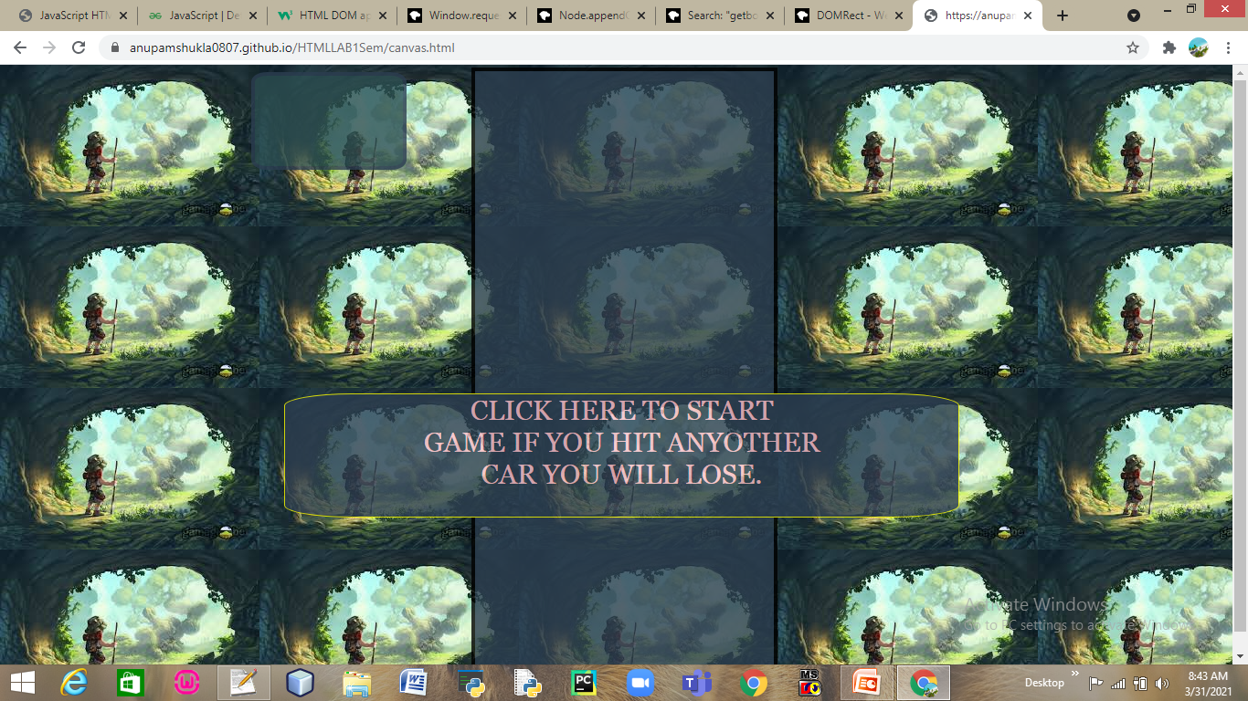

Slide 17
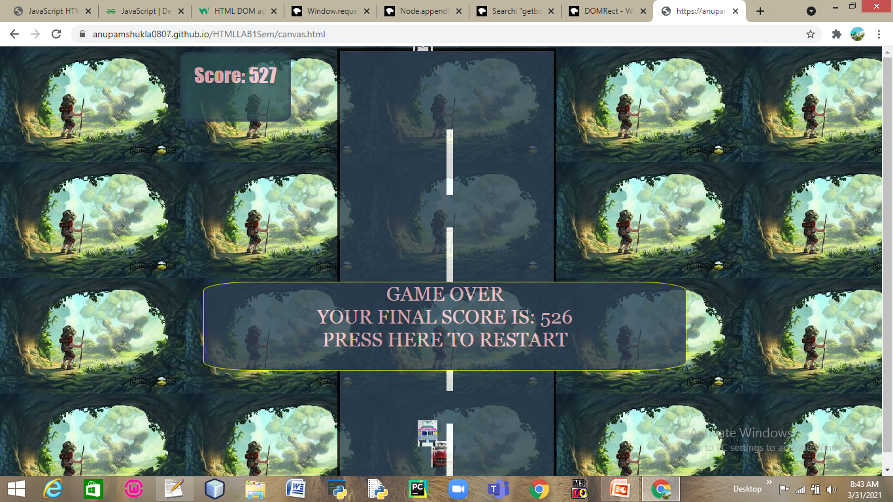
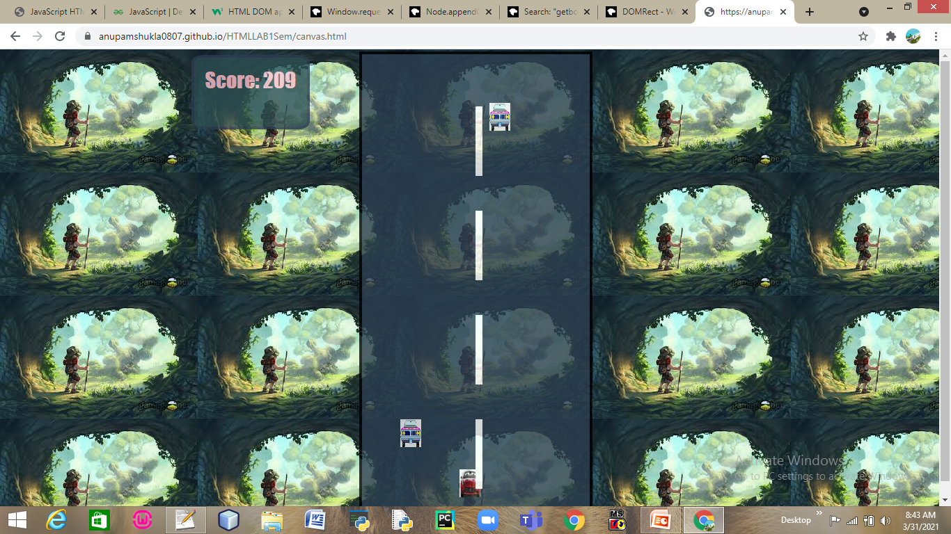
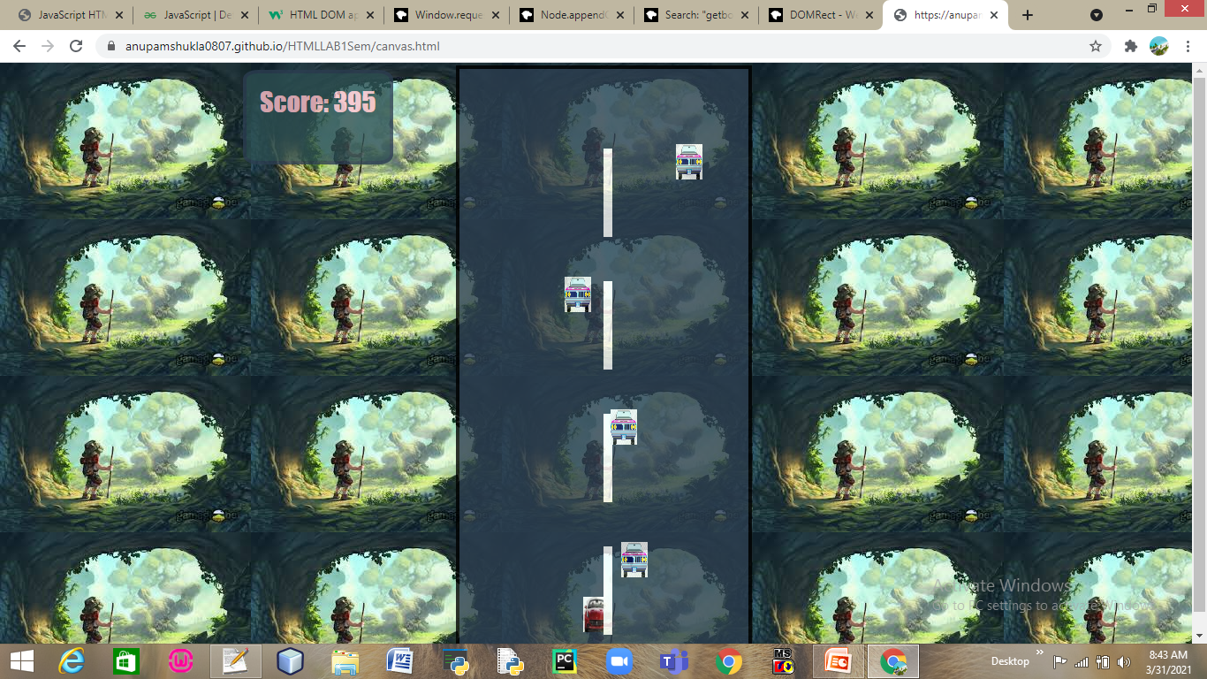

Slide 19


