Slide 1
Coursera_Capstone_NY-Toronto_Neighbourhoods Solution : Finding a suitable relocation neighborhood while planning to move from New York to Toronto

Slide 2
Business Problem section
This use case will center around an employee named Luke,
currently residing in New York in the Manhattan area
has found a suitable Job opportunity in Scarborough, Toronto.
He has never been to Toronto and has limited friends in that area.
He is not satisfied with his research and the locations suggested to him by friends and agents.
He is looking for neighborhoods similar to his current neighborhood.
Can we find neighborhoods in Toronto that are similar to Like's current area of residence?

Slide 3
Data
New York and Toronto geo data pertaining to Luke's current area of residence.
The two City geo data in general will have Borough, neighborhood, latitude longitude mainly.
venues associated with his current residence:
source venue data from foursquare.
venue data will be used mainly the category data
New York geo data is available at https://geo.nyu.edu/catalog/nyu_2451_34572.
Toronto is available at https://en.wikipedia.org/wiki/List_of_postal_codes_of_Canada:_M

Slide 4
Methodology
Approach:
Lukes current geo data and venue data provided with top 10 venues in his current locality.
Similar top 10 venue data for Toronto neighborhoods
This data was computed for similarity with the venues within clusters in Scarborough that we will arrive at with our model.
------------------------------------------------------------------------------------------
New York data processing
Toronto Data Analysis and k-means Clustering
Matching Lukes current Venues against clusters drawn for toronto's neighbourhood venues
Similarity computation

Slide 5
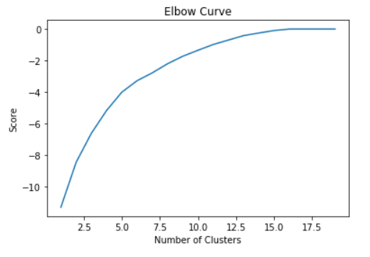
Best K means decision and cluster

Slide 6
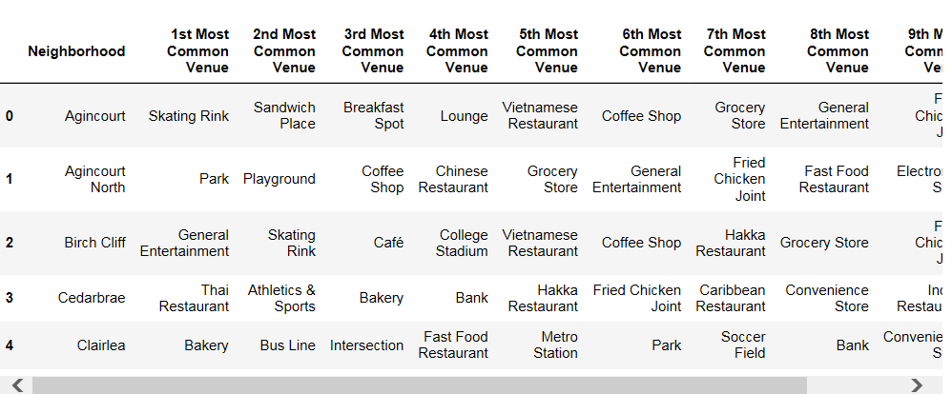
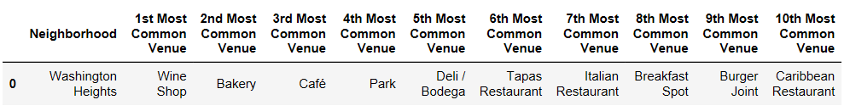
Top 10 venues
Toronto
New York

Slide 7
Results, Discussion and Conclusion:
Cluster index 0 and 3 scored highest
Each containing at lease three neighborhoods
At least 6 neighborhoods were suggested to Luke
One can drill down the similarity computation to neighborhood
Other similarity computation can be employed and results compared.
Similarity result will become more crisp if more venue can be added over and above the top 10 venues we limited to in this PoC.
Suggestions can also include Lukes other preferences but has not been included in the scope of the study.
Other clustering methods can also be studied as future work.
Employees continue to look for better opportunities and relocation does not pose a limitation if such methodologies are adopted to come up with informed decisions before relaocation is finalized. It also saves om cost due to multiple visits to chose a best locality to live.

