Slide 1
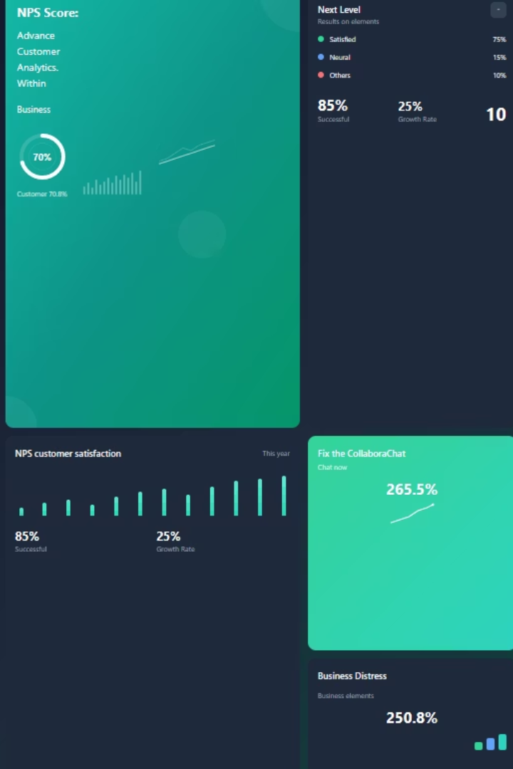


NPS Analysis Report
All Touchpoints Combined - Comprehensive NPS & Satisfaction Analysis
Analysis Coverage: Q3 2023-24, Q4 2023-24, Q1 2024-25, Q2 2024-25, Q3 2024-25
Touchpoints: Health Claim, Motor Claim, Policy Issuance, Renewal
2 Contributors

Slide 2
Executive Summary Dashboard
Analysis Scope & Coverage
Key Performance Indicators
Analysis Mode: All
Metric
Value
Status
Touchpoints Analyzed: 4 (Health Claim, Motor Claim, Policy Issuance, Renewal)
Total Survey Responses
217,947
📊
Quarters Covered: Q3 2023-24, Q4 2023-24, Q1 2024-25, Q2 2024-25, Q3 2024-25
Current NPS Score
55.0
🟢
Customer Distribution:
Promoter Rate
70.0%
🟢
Promoters (9-10): 70.0% (152,562 customers)
Passives (7-8): 15.1% (32,909 customers)
Detractor Rate
14.9%
🟢
Detractors (0-6): 14.9% (32,474 customers)
Avg Recommendation Score
8.4/10
🟢
Status Legend:
NPS: 🟢 > 50 🟡 1–50 🔴 ≤ 0 | Promoter Rate: 🟢 > 60% 🟡 41–60% 🔴 ≤ 40% | Detractor Rate: 🟢 < 20% 🟡 20–30% 🔴 > 30% | Avg. Recommendation (0–10): 🟢 > 8 🟡 6–8 🔴 < 6

Slide 3
Performance Trends & Insights
Overall Direction
Trend Magnitude
Improving
+1.3 points
Performance Volatility
Recent vs Average
4.2 (Standard Deviation)
54.4 vs Overall Average
Peak Performance Periods
Best Quarter: Q2 2024-25 (NPS: 57.9)
Challenging Quarter: Q3 2023-24 (NPS: 49.2)
Peak Volume: 53,765 responses in Q1 2024-25

Slide 4
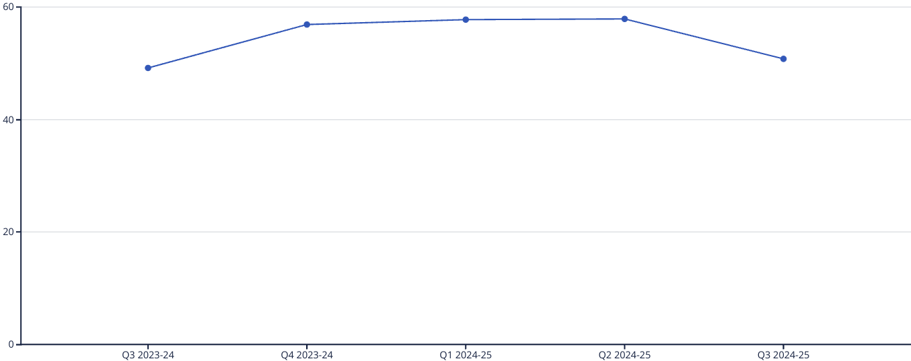
NPS Performance Detail
Quarter
NPS Score
Change
Total Responses
Volume Change
Promoters
Detractors
Q3 2023-24
49.2
42,088
27683
6970
Q4 2023-24
56.9
📈 +7.7
42,179
⬆️ +91
29769
5752
Q1 2024-25
57.7
📈 +0.8
53,765
⬆️ +11586
38568
7530
Q2 2024-25
57.9
📈 +0.2
49,634
⬇️ -4131
35866
7104
Q3 2024-25
50.8
📉 -7.1
30,281
⬇️ -19353
20591
5203

Slide 5
Touchpoint Performance Analysis
60.3
54.3
50.3
49.7
Policy Issuance
Renewal
Health Claim
Motor Claim
🟢 Excellent (70,341 responses)
🟡 Good (86,466 responses)
🟡 Good (27,491 responses)
🟡 Good (33,649 responses)
Touchpoint Performance Trends by Quarter
Quarter
Health Claim
Motor Claim
Policy Issuance
Renewal
Q3 2023-24
43.4
45.5
53.0
49.8
Q4 2023-24
51.8
50.8
62.5
55.2
Q1 2024-25
52.6
51.9
63.1
55.2
Q2 2024-25
50.3
54.2
65.1
55.5
Q3 2024-25
54.0
47.1
-100.0
54.7

Slide 6
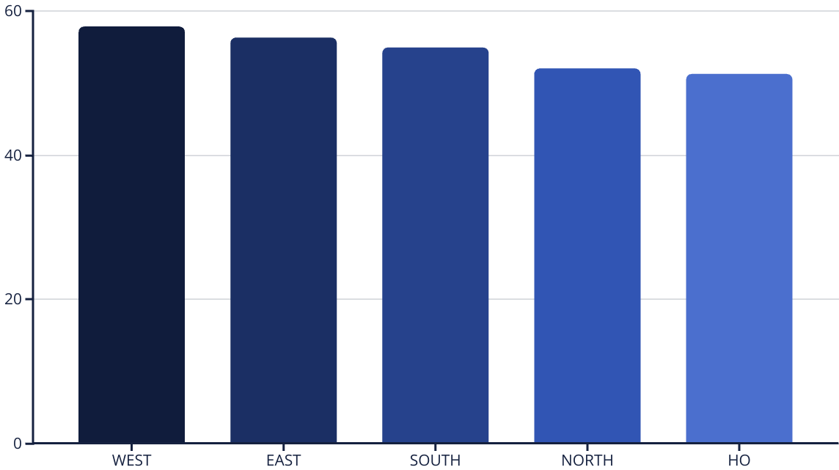
Geographic Performance Analysis
Geographic Performance Trends by Quarter
Quarter
EAST
HO
NORTH
SOUTH
WEST
Q3 2023-24
52.6
44.6
45.5
51.4
51.4
Q4 2023-24
56.9
54.0
55.4
54.8
60.2
Q1 2024-25
57.2
55.5
55.6
57.6
60.0
Q2 2024-25
59.0
54.9
55.1
58.6
59.9
Q3 2024-25
54.2
39.2
46.6
48.3
56.0

Slide 7




Customer Channel Performance
TRAVEL AGENT
NPS 68.3 (4,489 responses)
MIDS
NPS 64.8 (25,476 responses)
POS
NPS 62.1 (609 responses)
ENTERPRISE PARTNERS
NPS 61.0 (9,410 responses)
GROWTH MARKETS
NPS 58.4 (7,986 responses)
Channels Needing Attention:
DIRECT: NPS 49.8 (644 responses)
BANC ASSURANCE: NPS 49.1 (67,349 responses)
RETAIL CALL CENTER: NPS 33.3 (945 responses)
Channel Performance Trends by Quarter
Quarter
TRAVEL AGENT
MIDS
POS
ENTERPRISE PARTNERS
GROWTH MARKETS
Q3 2023-24
62.7
58.4
48.3
-
-
Q4 2023-24
69.2
66.5
64.9
-
-
Q1 2024-25
73.9
66.6
76.0
60.7
59.9
Q2 2024-25
67.1
68.7
79.2
61.2
59.6
Q3 2024-25
42.9
63.0
-
60.8
54.4

Slide 8






Customer Segment Performance
BLUE
CLASSIC
🟢 NPS 60.5 (3,874 responses)
🟢 NPS 55.5 (32,481 responses)
ETERNIA
SELECT
🟢 NPS 52.5 (73,854 responses)
🟢 NPS 54.7 (23,574 responses)
CELESTIA
OTHER
🟢 NPS 52.6 (20,634 responses)
🟢 NPS 54.5 (1,889 responses)
Customer Segment Trends by Quarter
Quarter
BLUE
CLASSIC
SELECT
OTHER
CELESTIA
ETERNIA
Q3 2023-24
63.1
43.7
48.9
50.5
46.5
47.2
Q4 2023-24
57.7
51.5
53.1
57.3
53.3
53.1
Q1 2024-25
53.3
53.5
55.5
-
54.3
53.6
Q2 2024-25
62.4
61.0
59.8
-
56.1
55.1
Q3 2024-25
43.5
54.3
52.6
-
52.0
52.5

Slide 9




Line of Business Performance
TRAVEL
🟢 NPS 70.7 (8,444 responses)
MOTOR
🟢 NPS 59.0 (106,565 responses)
PROPERTY
🟢 NPS 53.1 (12,309 responses)
HEALTH
🟡 NPS 49.2 (90,629 responses)
Line of Business Trends by Quarter
Quarter
TRAVEL
MOTOR
PROPERTY
HEALTH
Q3 2023-24
66.5
53.1
49.8
43.0
Q4 2023-24
72.5
59.6
57.0
51.8
Q1 2024-25
73.1
61.5
54.2
51.5
Q2 2024-25
70.3
62.8
54.5
51.5
Q3 2024-25
-
55.5
40.4
47.0

Slide 10
Voice of Customer - Topic Analysis
🟢 Top Positive Drivers (Strengths to Leverage)
🔴 Top Pain Points (Priority for Improvement)
Agent Performance Quality: 35,311 positive mentions
Customer Support Responsiveness: 14,682 negative mentions
Service Quality Improvement: 27,941 positive mentions
Claim Process: 16,007 positive mentions
Claim Process: 9,084 negative mentions
Customer Support Responsiveness: 11,694 positive mentions
Claim Amount Discrepancy: 7,410 negative mentions
Agent Performance Quality: 3,586 negative mentions
Service Process Efficiency: 7,939 positive mentions
Agent Communication Efficiency: 3,007 negative mentions
⚪ Neutral Feedback Areas
Feedback Handling Process: 6,415 neutral mentions
Customer Support Responsiveness: 4,670 neutral mentions
Claim Process: 2,474 neutral mentions

Slide 11
Topic Trend Analysis
Agent Performance Quality
📈 +74.7% sentiment
Agent Followup Reliability
📈 +58.4% sentiment
Agent Communication Efficiency
📈 +30.0% sentiment
Topic
Total Volume
Avg Quarterly
Net Sentiment
Sentiment Range
Positive %
Negative %
Agent Communication Efficiency
11,300
2,260
📈 +30.0%
+3.5 to +51.6
60.0%
29.9%
Agent Followup Reliability
4,891
978
📈 +58.4%
+30.6 to +73.8
76.9%
18.5%
Agent Performance Quality
40,728
8,146
📈 +74.7%
+62.2 to +83.5
85.1%
10.4%
Claim Amount Discrepancy
10,576
2,115
📉 -43.9%
-60.2 to -29.6
25.6%
69.5%
Claim Process
27,633
5,527
📈 +25.5%
+16.8 to +30.1
58.1%
32.6%
Claim Settlement Speed
4,653
931
📈 +33.8%
+16.7 to +45.1
64.6%
30.8%
Customer Support Responsiveness
31,113
6,223
➡️ -7.7%
-20.9 to +17.2
38.6%
46.3%
Feedback Handling Process
8,469
1,694
➡️ -9.9%
-23.2 to -3.8
8.9%
18.8%

Slide 12








Executive Strategic Insights
NPS Improvement and Volatility
Promoter and Detractor Distribution
The overall NPS has improved by 1.3 points over the analysis period, with a best quarter NPS of 57.9. However, the standard deviation of 4.2 indicates volatility. Focus on stabilizing performance by addressing key detractor issues.
With 70% promoters and 14.9% detractors, there is a significant opportunity to convert passives (15.1%) into promoters by enhancing service quality, especially in underperforming areas.
Service Quality Discrepancy
Volume and Response Patterns
The average service rating is notably low at 4.5/10, despite a high recommendation score of 8.4/10. This gap suggests a need to align service delivery with customer expectations.
The peak response volume in Q1 2024-25 suggests heightened customer engagement during this period. Leverage this engagement to gather deeper insights and drive targeted improvements.
Regional Performance Variability
Channel Performance Disparity
The NORTH and HO zones underperform compared to other regions. Implement targeted regional strategies to address specific local challenges and improve overall performance.
The Retail Call Center significantly underperforms with an NPS of 33.3. Prioritize improvements in this channel to enhance customer interactions and satisfaction.
Line of Business Insights
Agent Performance
The Travel line of business leads with an NPS of 70.7, presenting a model for best practices that can be adapted to underperforming segments like Health (49.2).
Despite being a top strength, agent performance also has significant negative mentions. Implement continuous training and feedback mechanisms to maintain and improve agent quality.

Slide 13
Strategic Focus Segments
🎯 1. Enhance Customer Support Responsiveness
Given 14,682 negative mentions, prioritize improving response times and resolution effectiveness. Aim for a 20% reduction in negative mentions by Q3 2025-26.
🎯 2. Streamline Claim Processes
Address the 9,084 negative mentions on claim processes by simplifying procedures and enhancing transparency. Target a 15% improvement in claim process satisfaction by Q2 2025-26.
🎯 3. Improve Communication Clarity
With 2,981 negative mentions on policy information clarity, develop clearer communication materials and training for agents. Reduce negative mentions by 25% by Q3 2025-26.
🎯 4. Regional Strategy Development
Focus on improving performance in the NORTH and HO zones by implementing tailored strategies and support. Aim for a 5-point NPS increase in these regions by Q4 2025-26.
🎯 5. Channel Optimization
Enhance the Retail Call Center's performance by implementing advanced training and technology solutions. Target a 10-point NPS increase by Q2 2025-26.
🎯 6. Customer Journey Mapping
Conduct comprehensive journey mapping to identify pain points across touchpoints. Implement changes to improve the customer experience by Q4 2025-26.
🎯 7. Data-Driven Decision Making
Utilize customer feedback and data analytics to inform strategic decisions and prioritize initiatives that align with customer needs.
🎯 8. Sustainability and Growth
Leverage strengths in the Travel line of business to explore new growth opportunities and expand successful practices to other segments.

Slide 14
Tactical Focus Segments
⚡ 2. Quick Wins in Claim Processing
⚡ 1. Immediate Customer Support Enhancements
Introduce a pilot program for expedited claims in the Motor and Health segments to improve satisfaction and reduce process-related complaints by 15% by Q1 2025-26.
Implement a rapid response team to address urgent customer issues and reduce negative mentions by 10% within the next two quarters.
⚡ 4. Policy Documentation Review
⚡ 3. Agent Training and Development
Conduct a thorough review of policy documents to eliminate errors and enhance clarity. Reduce documentation errors by 30% by Q1 2025-26.
Launch a targeted training program focusing on communication and service delivery to address agent performance issues. Achieve a 20% improvement in agent-related feedback by Q2 2025-26.
⚡ 6. Technology Integration
⚡ 5. Enhanced Feedback Mechanisms
Integrate advanced CRM systems to streamline customer interactions and improve service efficiency. Complete integration by Q2 2025-26.
Implement real-time feedback tools to capture customer sentiment and address issues promptly. Aim for a 10% increase in positive feedback by Q3 2025-26.
⚡ 8. Promoter Engagement Programs
⚡ 7. Cross-Functional Collaboration
Develop programs to engage promoters as brand advocates, leveraging their positive sentiment to drive referrals and new customer acquisition.
Foster collaboration between departments to address systemic issues affecting customer experience. Establish regular cross-functional meetings by Q1 2025-26.

Slide 15








Action Plan & Recommendations
Action 1: Customer Support Training
Action 2: Claim Process Automation
Action 3: Communication Strategy Overhaul
Action 4: Regional Performance Initiatives
Implement a comprehensive training program for customer support teams to improve responsiveness and satisfaction. Measure success by a 15% reduction in support-related complaints by Q2 2025-26.
Introduce automation in claim processing to reduce manual errors and expedite resolutions. Target a 20% reduction in claim-related complaints by Q3 2025-26.
Revise communication strategies to ensure clarity and consistency across all customer touchpoints. Aim for a 25% reduction in communication-related complaints by Q4 2025-26.
Launch targeted initiatives in underperforming regions to address specific challenges. Measure success by a 5-point NPS increase in these areas by Q4 2025-26.
Action 5: Retail Call Center Revamp
Action 6: Feedback Loop Enhancement
Action 7: Agent Performance Monitoring
Action 8: Promoter Engagement Strategy
Implement new training and technology solutions to enhance call center performance. Achieve a 10-point NPS increase by Q2 2025-26.
Develop a robust feedback loop to capture and act on customer insights in real-time. Increase positive feedback by 10% by Q3 2025-26.
Establish a performance monitoring system to provide continuous feedback and support to agents. Aim for a 20% improvement in agent-related feedback by Q2 2025-26.
Create a strategy to leverage promoters for brand advocacy and referrals. Increase promoter-driven referrals by 15% by Q3 2025-26.

Slide 16




Success Metrics & Monitoring
NPS Stability
Customer Support Response Time
Monitor NPS quarterly to ensure consistent improvement and reduced volatility. Target a standard deviation below 3.0 by Q4 2025-26.
Track average response times and aim for a 20% reduction by Q2 2025-26.
Agent Performance Ratings
Claim Resolution Time
Monitor agent performance ratings and aim for a 20% improvement by Q2 2025-26.
Measure the average time to resolve claims and target a 15% reduction by Q3 2025-26.
Communication Clarity Score
Regional NPS Scores
Implement a communication clarity score and target a 25% improvement by Q4 2025-26.
Track NPS scores for underperforming regions and aim for a 5-point increase by Q4 2025-26.
Promoter Engagement Rate
4
Call Center NPS
Measure the rate of promoter-driven referrals and aim for a 15% increase by Q3 2025-26.
Monitor the Retail Call Center's NPS and target a 10-point increase by Q2 2025-26.

Slide 17

From Insights To Action
1
What You Just Discovered
2
The Traditional Challenge
3
The ConvertML Difference
This NPS analysis revealed 8 strategic focus areas and 8 tactical quick wins. It identified specific pain points affecting 14,682 customers and found Travel as the strongest performing line of business.
Generating this level of analysis takes weeks. By the time you act on these findings, customer sentiment may have already shifted.
Get this same depth of analysis in real-time. Create intelligent customer segments instantly. Launch targeted campaigns in minutes, not weeks.

Slide 18







Make Every Quarter Count
Don't wait for the next quarterly review to spot problems. Monitor customer sentiment continuously and act on insights immediately.
Real-time NPS monitoring
See satisfaction drops across all customer touchpoints with core themes and topics
Instant drop alerts
Notify teams when satisfaction metrics fall below thresholds
AI-powered recommendations
Get targeted actions for each customer segment
Predictive NPS
Identify at-risk customers long before they become detractors
One-click deployment
Sends campaigns directly to your CRM without delays
Automated reporting
Generate presentation-ready reports with insights and visuals
ConvertML is the Ultimate Customer Insight Platform that combining automated analytics, campaign orchestration, agentic alerting, and dynamic PPT generation—built on no-code integrations to deliver end-to-end funnel optimization.

