Slide 1
Computer Organization and Architecture: Basic Processing Unit
Ashok Kumar Turuk

Slide 2
Basic Processing Unit
Chapter 5: Hamacher 6th Ed.

Slide 3
Basic Processing Unit
A processor is responsible for reading program instructions from the computer’s memory and executing them.
It fetches one instruction at a time.
It decodes (interprets) the instruction.
Then, it carries out the actions specified.

Slide 4
Basic Processing Unit
To execute an instruction, the processor has to perform the following steps:
1. Fetch the contents of the memory location pointed to by the PC.
IR←[[PC]]
2. Increment the PC to point to the next instruction.
PC←[PC] + 4
3. Carry out the operation specified by the instruction in the IR.

Slide 5
Basic Processing Unit
The operation specified by an instruction can be carried out by performing one or more of the following actions:
Read the contents of a given memory location and load them into a processor register.
Read data from one or more processor registers.
Perform an arithmetic or logic operation and place the result into a processor register.
Store data from a processor register into a given memory location.

Slide 6
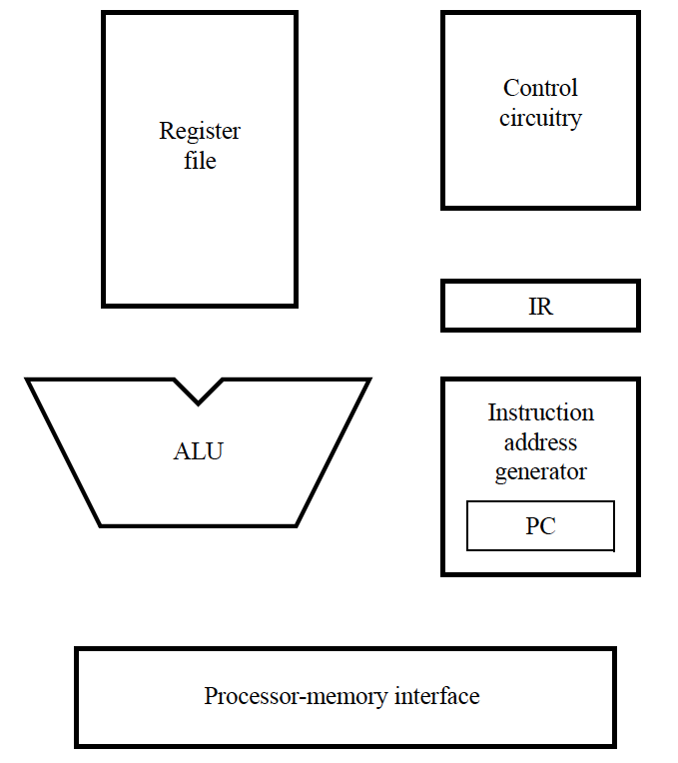
Basic Processing Unit
PC provides instruction address.
Instruction is fetched into IR
Instruction address generator updates PC
Control circuitry interprets instruction and generates control signals to perform the actions needed.

Slide 7
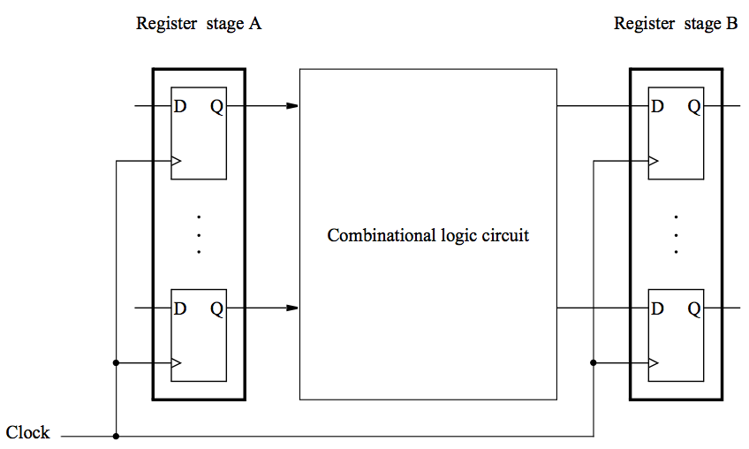
Data Processing Hardware
Contents of register A are processed and deposited in register B.

Slide 8
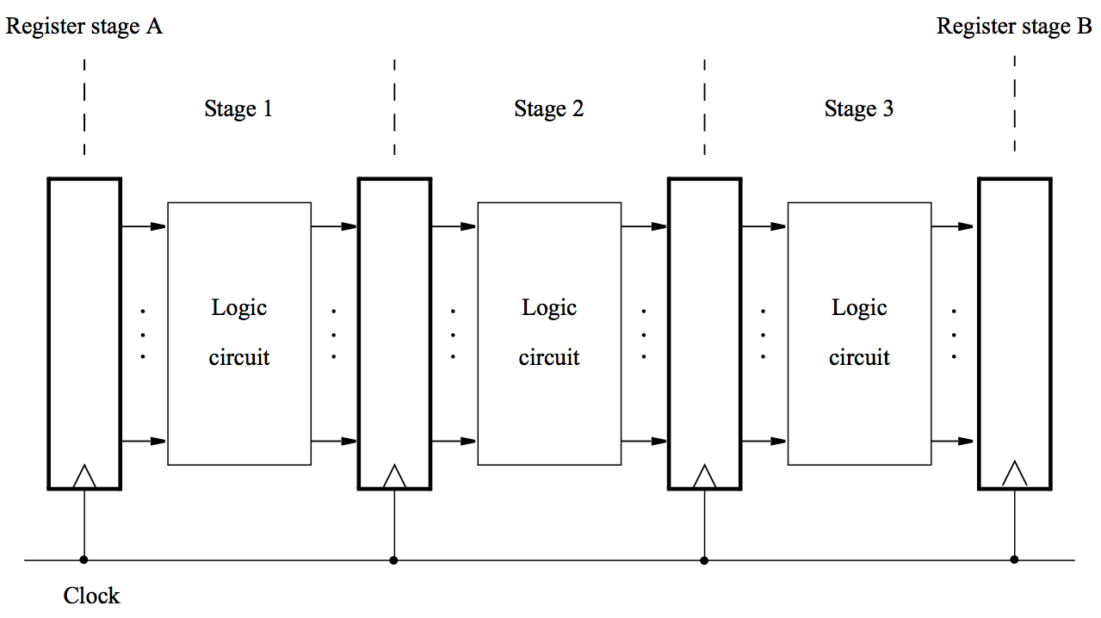
Data Processing Hardware
A multi-stage digital processing system

Slide 9
Why multi-stage?
Processing moves from one stage to the next in each clock cycle.
Such a multi-stage system is known as a pipeline.
High-performance processors have a pipelined organization.
Pipelining enables the execution of successive instructions to be overlapped.
Pipelining will be discussed later.

Slide 10
Instruction execution
Pipelined organization is most effective if all instructions can be executed in the same number of steps.
Each step is carried out in a separate hardware stage.
Processor design will be illustrated using five hardware stages.
How can instruction execution be divided into five steps?
What actions involved in fetching and executing instructions

Slide 11
Load Instructions: Load R5, X(R7)
Execution of this instruction involves the following actions:
Fetch the instruction from the memory.
Increment the program counter.
Decode the instruction to determine the operation to be performed.
Read register R7.
Add the immediate value X to the contents of R7.
Use the sum X + [R7] as the effective address of the source operand, and read the contents of that location in the memory.
Load the data received from the memory into the destination register, R5.

Slide 12
Load Instructions: Load R5, X(R7)
Fetching and executing the Load instruction above can be completed as follows:
Fetch the instruction and increment the program counter.
Decode the instruction and read the contents of register R7 in the register file.
Compute the effective address.
Read the memory source operand.
Load the operand into the destination register, R5.

Slide 13
Arithmetic and Logic Instructions
Arithmetic and logic instructions differ from the Load instruction in two ways:
There are either two source registers, or a source register and an immediate source operand.
No access to memory operands is required.

Slide 14
Arithmetic and Logic Instructions
Add R3, R4, R5
It requires the following steps:
1. Fetch the instruction and increment the program counter.
2. Decode the instruction and read the contents of source registers R4 and R5.
3. Compute the sum [R4] + [R5].
4. Load the result into the destination register, R3.

Slide 15
Arithmetic and Logic Instructions
Add R3, R4, R5
Fetch the instruction and increment the program counter.
Decode the instruction and read registers R4 and R5.
Compute the sum [R4] + [R5].
No action.
Load the result into the destination register, R3.
Stage 4 (memory access) is not involved in this instruction.

Slide 16
Arithmetic and Logic Instructions
Add R3, R4, #1000
Fetch the instruction and increment the program counter.
Decode the instruction and read registers R4 .
Compute the sum [R4] + 1000.
No action.
Load the result into the destination register, R3.
Stage 4 (memory access) is not involved in this instruction.

Slide 17
Store Instructions
Store R6, X(R8)
Fetch the instruction and increment the program counter.
Decode the instruction and read registers R6 and R8.
Compute the effective address X + [R8].
Store the contents of register R6 into memory location X + [R8].
No action

Slide 18
Summary – Actions to implement an instruction
Fetch an instruction and increment the program counter.
Decode the instruction and read registers from the register ﬁle.
Perform an ALU operation.
Read or write memory data if the instruction involves a memory operand.
Write the result into the destination register.
This sequence determines the hardware stages needed.

Slide 19
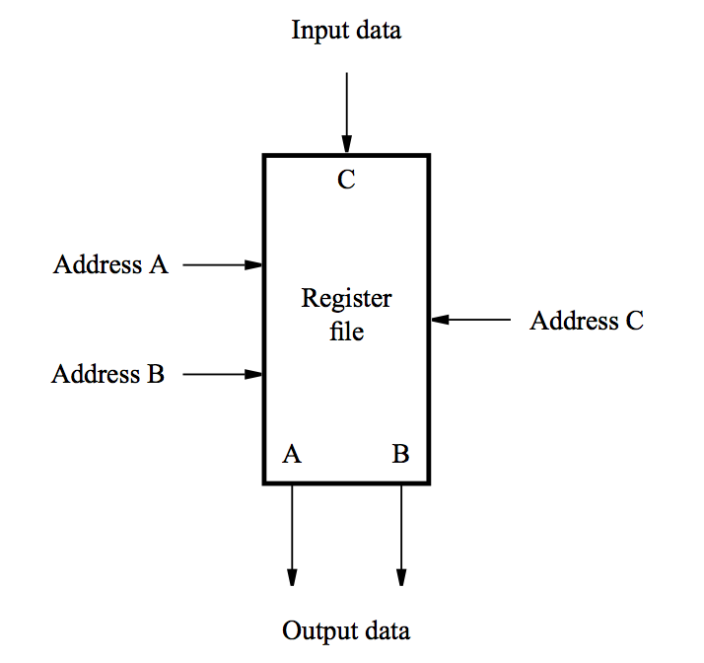
Hardware Components: Register File
A 2-port register file is needed to read the two source registers at the same time.
It may be implemented using a 2-port memory.

Slide 20
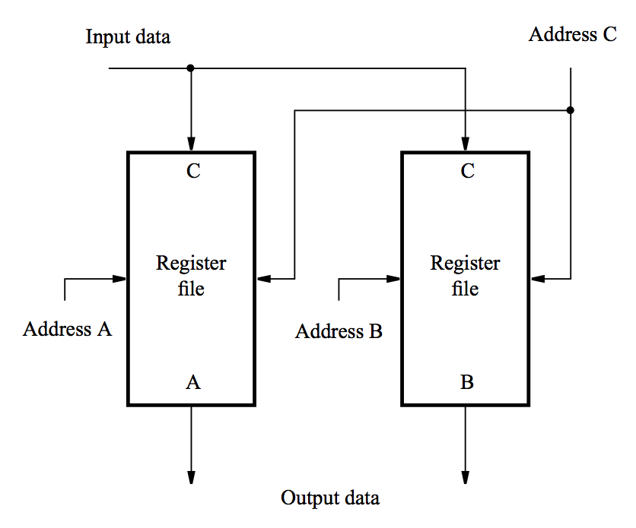
Hardware Components: Register File
Using two single-ported memory blocks.

Slide 21
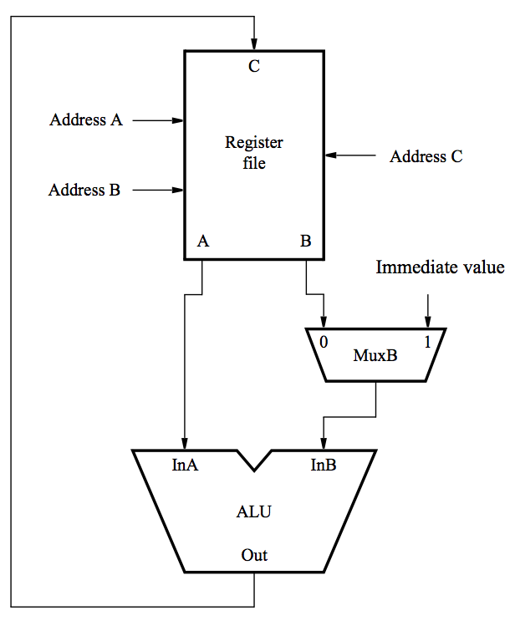
Hardware Components: ALU
Both source operands and the destination location are in the register file. [RA] and [RB] denote values of registers that are identified by addresses A and B new [RC] denotes the result that is stored to the register identified by address C
[RB]
new [RC]
[RA]

Slide 22
Hardware Components: ALU
One of the source operands is the immediate value in the IR.
new [RC]
[RA]

Slide 23
Hardware Components: Datapath
Instruction processing consists of two phases:
fetch phase and
execution phase.
Divide the processor hardware into two corresponding sections.
One section fetches instructions (also responsible for decoding them and for generating the control signals that cause appropriate actions to take place in the execution section) and
the other executes them (The execution section reads the data operands specified in an instruction, performs the required computations, and stores the results)

Slide 24
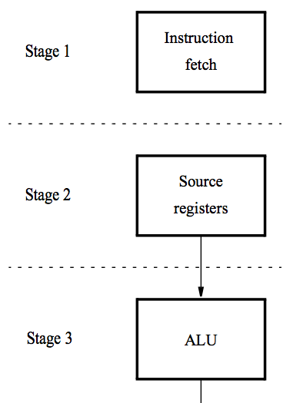
Hardware Components: Datapath
Instruction processing moves from stage to stage in every clock cycle, starting with fetch.
The instruction is decoded and the source registers are read in stage 2.
Computation takes place in the ALU in stage 3.

Slide 25
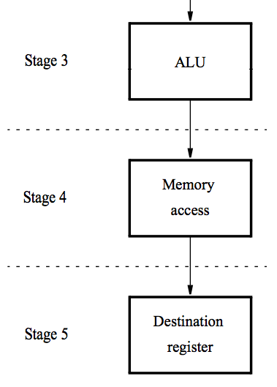
Hardware Components: Datapath
If a memory operation is involved, it takes place in stage 4.
The result of the instruction is stored in the destination register in stage 5.

Slide 26
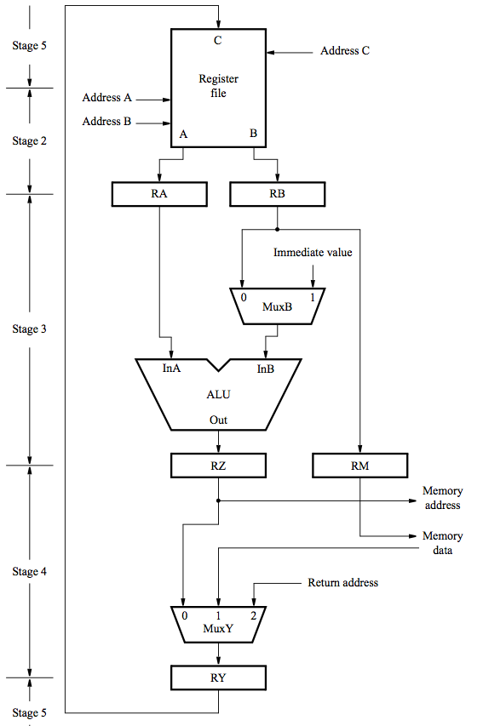
Hardware Components: Datapath
Register file, used in stages 2 and 5
(Inter-stage registers RA, RB, RZ, RY needed to carry data from one stage to the next.)
ALU stage
Memory stage
Final stage to store result to the register file

Slide 27
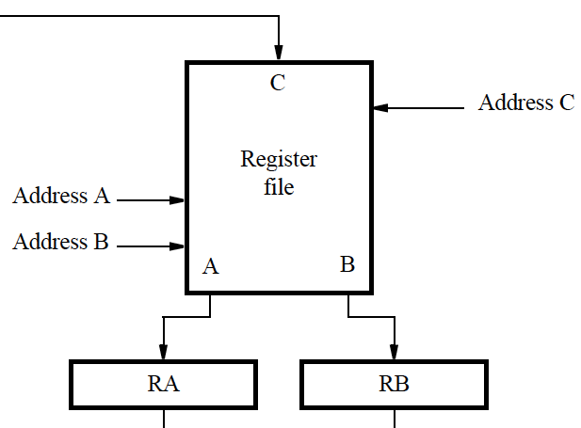
Hardware Components: Datapath (Register File)
Address inputs are connected to the corresponding fields in IR.
Source registers are read in stage 2; their contents are stored in RA and RB.
In stage 5, the result of the instruction is stored in the destination register selected by address C.

Slide 28
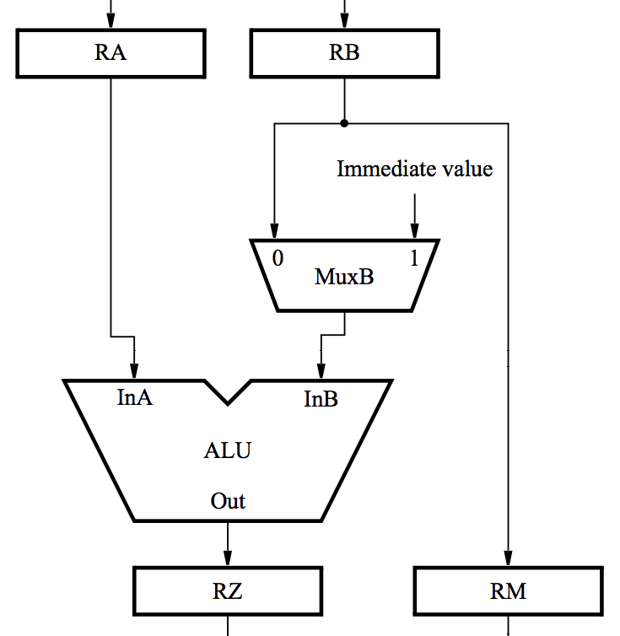
Hardware Components: Datapath (ALU)
ALU performs calculation specified by the instruction.
Multiplexer MuxB selects either RB or the Immediate field of IR.
Results stored in RZ.
Data to be written in the memory are transferred from RB to RM.

Slide 29
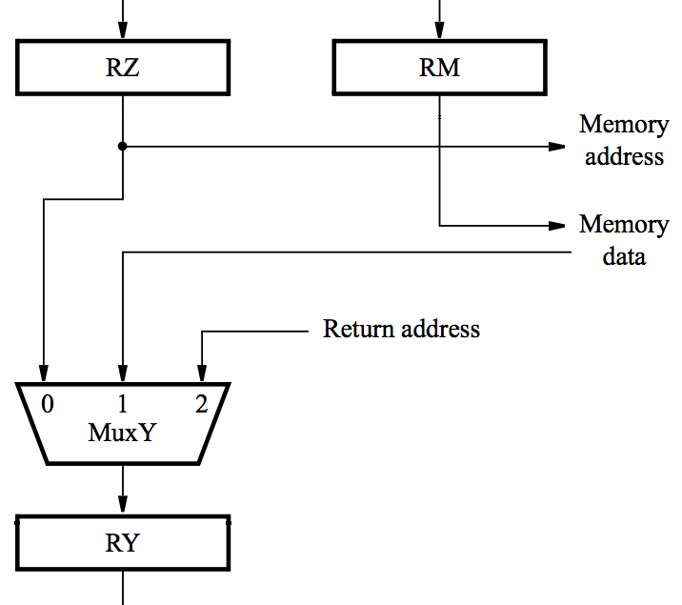
Hardware Components: Datapath (ALU)
For a memory instruction, RZ provides memory address, and MuxY selects read data to be placed in RY.
RM provides data for a memory write operation.
For a calculation instruction, MuxY selects [RZ] to be placed in RY.
Input 2 of MuxY is used in subroutine calls.

Slide 30
Hardware Components: Instruction Fetch Section
MuxMA selects the PC when fetching instructions.
The Instruction address generator increments the PC after fetching an instruction.
It also generates branch and subroutine addresses.
MuxMA selects RZ when reading/writing data operands

Slide 31
Hardware Components: Instruction Fetch Section
When an instruction is read, it is placed in IR.
The control circuitry decodes the instruction.
It generates the control signals that drive all units.
The Immediate block extends the immediate operand to 32 bits, according to the type of instruction.

Slide 32
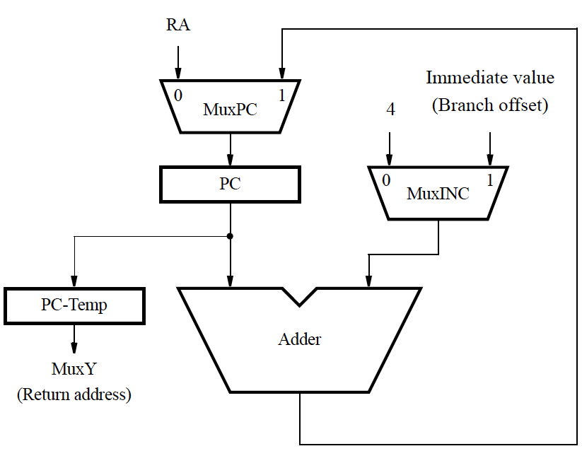
Hardware Components: Instruction Fetch Section
Connections to registers RY and RA are used to support subroutine call and return instructions.
Register PC-Temp is needed to hold the contents of the PC temporarily during the process of saving the subroutine or interrupt return address.

Slide 33
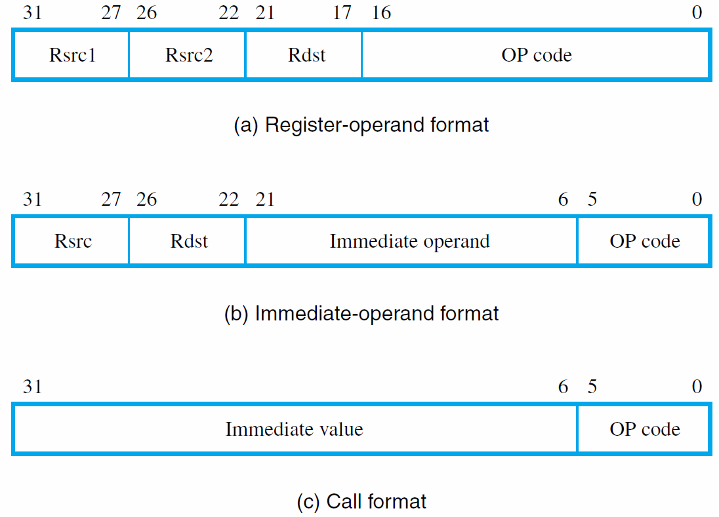
Instruction Encoding

Slide 34
Instruction Fetch and Execution Steps: Add R3, R4, R5
Memory address ← [PC], Read memory, IR ←Memory data, PC ← [PC] + 4
Decode instruction, RA ← [R4], RB ← [R5]
RZ ← [RA] + [RB]
RY ← [RZ]
R3 ← [RY]

Slide 35
Instruction Fetch and Execution Steps: Load R5, X(R7)
Memory address ← [PC], Read memory, IR ← Memory data, PC ←[PC] + 4
Decode instruction, RA ←[R7]
RZ ←[RA] + Immediate value X
Memory address ←[RZ], Read memory, RY ← Memory data
R5 ←[RY]

Slide 36
Instruction Fetch and Execution Steps: Store R6, X(R8)
Memory address ←[PC], Read memory, IR ← Memory data, PC ← [PC] + 4
Decode instruction, RA ←[R8], RB ←[R6]
RZ ←[RA] + Immediate value X, RM ←[RB]
Memory address ←[RZ], Memory data ←[RM], Write memory
No action

Slide 37
Branching: Unconditional branch
Memory address ←[PC], Read memory, IR ← Memory data, PC ←[PC] + 4
Decode instruction
PC ←[PC] + Branch offset
No action
No action
Branch offset is the distance between the branch target and the memory location following the branch instruction

Slide 38
Branching: Conditional branch
In processors that do not use condition-code flags, the branch instruction specifies a compare-and-test operation that determines the branch condition.
For example, the instruction Branch_if_[R5]=[R6] LOOP
Memory address ←[PC], Read memory, IR ← Memory data, PC ←[PC] + 4
Decode instruction, RA ←[R5], RB ←[R6]
Compare [RA] to [RB], If [RA] = [RB], then PC ←[PC] + Branch offset
No action
No action

Slide 39
Branching: Subroutine Call Instructions
The address of the subroutine may either be computed using an immediate value given in the instruction or it may be given in full in one of the general-purpose registers
Call_Register R9
Memory address ←[PC], Read memory, IR ← Memory data, PC ←[PC] + 4
Decode instruction, RA ←[R9]
PC-Temp ←[PC], PC ←[RA]
RY ← [PC-Temp]
Register LINK ← [RY]

Slide 40
Waiting for Memory
Processor-memory interface circuit is to control data transfers between the processor and the memory
When the requested information is not in the cache, the interface circuit inform the processor’s control circuitry about such situations, to delay subsequent execution steps until the memory operation is completed
The processor-memory interface circuit generates a signal called Memory Function Completed (MFC)
The command Wait for MFC to indicate that a given execution step must be extended, if necessary, until a memory operation is completed

Slide 41
Waiting for Memory
Step 1 of the execution sequence of any instruction involves fetching the instruction from the memory.
Therefore, it must include a Wait for MFC command, as follows:
1. Memory address ← [PC], Read memory, Wait for MFC, IR ← Memory data, PC ←[PC] + 4

Slide 42
Control Signals
The operation of the processor’s hardware components is governed by control signals.
These signals determine which multiplexer input is selected, what operation is performed by the ALU, and so on.
Select multiplexer inputs to guide the flow of data.
Set the function performed by the ALU.
Determine when data are written into the PC, the IR, the register file, and the memory.
Inter-stage registers are always enabled because their contents are only relevant in the cycles for which the stages connected to the register outputs are active.

Slide 43
Control signals for the datapath

Slide 44
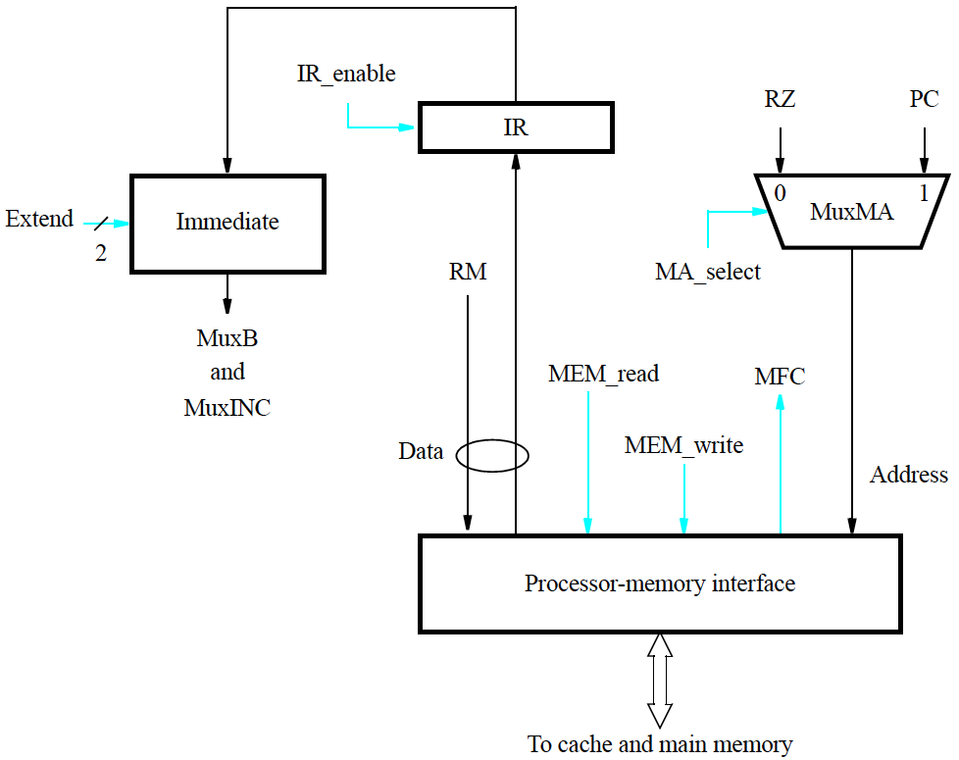
Processor-memory interface and IR control signals

Slide 45
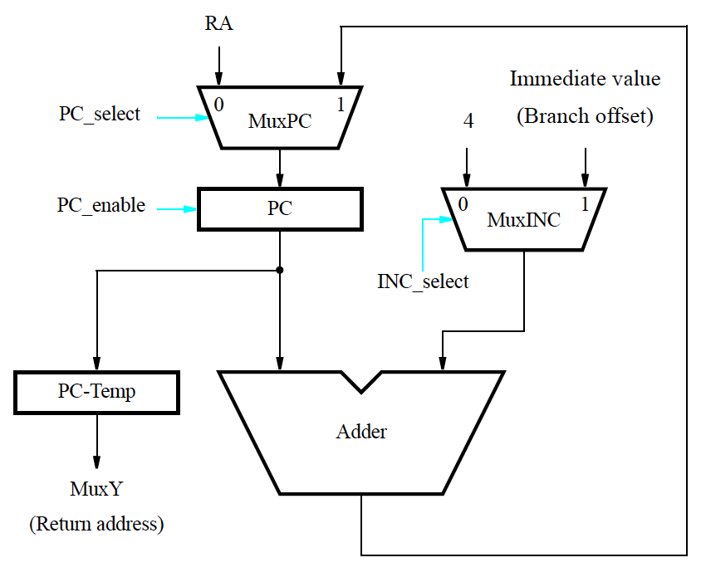
Control signals of instruction address generator

Slide 46
Control signal generation
Circuitry must be implemented to generate control signals so actions take place in correct sequence and at correct time.
There are two basic approaches: hardwired control and microprogramming
Hardwired control involves implementing circuitry that considers step counter, IR, ALU result, and external inputs.
Step counter keeps track of execution progress one clock cycle for each of the five steps described earlier (unless a memory access takes longer than one cycle).

Slide 47
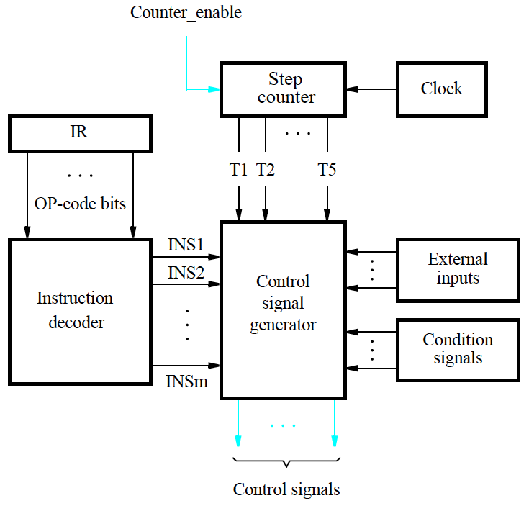
Hardwired generation of control signals
The setting of the control signals depends on:
Contents of the step counter
Contents of the instruction register
The result of a computation or a comparison operation
External input signals, such as interrupt requests
RF_write = T5.(ALU+Load + Call)
B_select = Immediate
Counter_enable = WMFC + MFC
PC_enable = T1.MFC + T3.BR

Slide 48
CISC-Style Processors
CISC-style processors have more complex instructions.
The full collection of instructions cannot all be implemented in a fixed number of steps.
Execution steps for different instructions do not all follow a prescribed sequence of actions.
Hardware organization should therefore enable a flexible flow of data and actions to accommodate CISC.

Slide 49
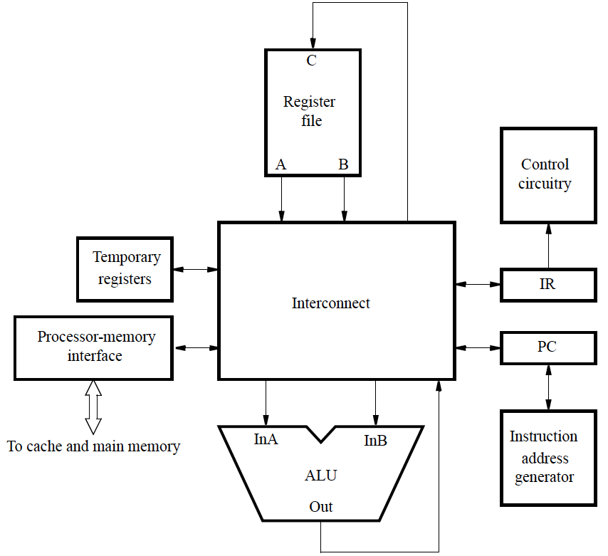
Hardware organization for a CISC computer

Slide 50
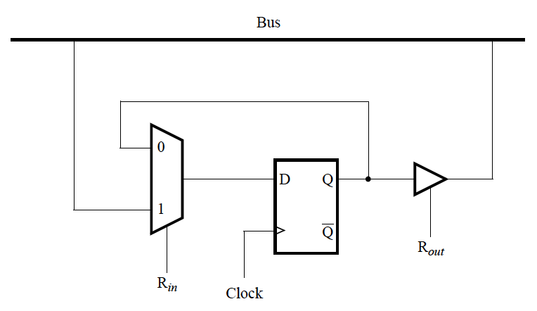
Bus
An example of an interconnection network.
When functional units are connected to a common bus, tri-state drivers are needed.

Slide 51
An Interconnect using Buses
Example: Add R5, R6
Memory address ←[PC], Read memory, Wait for MFC, IR ← Memory data, PC ←[PC] + 4
Decode instruction
R5 ←[R5] + [R6]

Slide 52
Example: And X(R7), R9
Memory address ←[PC], Read memory, Wait for MFC, IR ← Memory data, PC ←[PC] + 4
Decode instruction
Memory address ←[PC], Read memory, Wait for MFC, Temp1 ← Memory data, PC ←[PC] + 4
Temp2 ←[Temp1] + [R7]
Memory address ←[Temp2], Read memory, Wait for MFC, Temp1 ← Memory data
Temp1 ←[Temp1] AND [R9]
Memory address ←[Temp2], Memory data ←[Temp1], Write memory, Wait for MFC

Slide 53
Microprogrammed Control
Microprogramming is a software-based approach for the generation of control signals.
The values of the control signals for each clock period are stored in a microinstruction (control word).
A processor instruction is implemented by a sequence of microinstructions that are placed in a control store.
From decoding of an instruction in IR, the control circuitry executes the corresponding sequence of microinstructions.
μPC maintains the location of the current microinstruction.

Slide 54
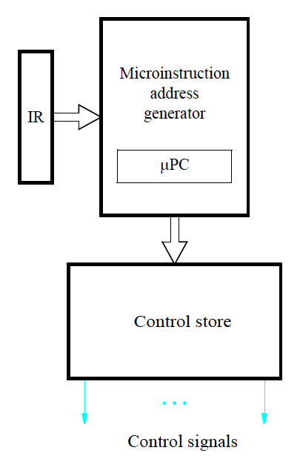
Control signals generated from a microprogram
Microprogramming provides the flexibility needed to implement more complex instructions in CISC processors.
However, reading and executing microinstructions incurs undesirably long delays in high-performance processors

