Slide 1



Name of Project
Water quality prediction
Name- Ananya Patade
Student Id - INTERNSHIP_1746416864681834e0e35d8

Slide 2

Learning Objectives
Understand how water quality can be predicted using ML algorithms.
Perform data preprocessing and handle missing values.
Apply classification models to predict water potability.
Evaluate model performance using accuracy and confusion matrix.
Goal
To develop a machine learning model that can predict whether a given water sample is potable (safe to drink) based on its chemical properties.
GOAL
Source :
www.freepik.com/

Slide 3
Tools and Technology used
Programming Language: Python
Libraries: pandas, numpy, seaborn, matplotlib, scikit-learn
Web Deployment: Streamlit
Environment: Jupyter Notebook

Slide 4
Methodology
Loaded the dataset and analyzed it.
Checked for null values and performed imputation using the mean strategy.
Used Label Encoding and StandardScaler for preprocessing.
Split the data into training and testing sets.
Trained the following models:
Logistic Regression
Random Forest Classifier
Decision Tree Classifier
Evaluated models using accuracy and confusion matrix.

Slide 5
Problem Statement:
Access to clean and safe drinking water remains a major global challenge, especially in rural and underdeveloped areas. Contaminated water can lead to serious health issues like cholera, typhoid, and diarrhea. Traditional water quality testing is time-consuming, costly, and requires laboratory equipment, making it impractical for frequent use.
To address this issue, there is a need for an efficient, automated system that can quickly determine whether water is potable based on its chemical properties. This project uses machine learning to provide a fast, reliable solution for predicting water safety, helping prevent health risks and improve access to clean water.

Slide 6
Solution:
We developed a predictive machine learning model that classifies water samples as potable (1) or non-potable (0) with high accuracy. The model analyzes 9 key chemical attributes that directly impact water quality:
pH: Measures acidity or alkalinity
Hardness: Indicates calcium and magnesium levels
Solids: Dissolved particles affecting taste and safety
Chloramines: Used for disinfection, but excessive levels are harmful
Sulfate: Impacts taste and can cause health issues in high amounts
Conductivity: Represents ion concentration, a marker of contamination
Organic Carbon: Indicates presence of organic pollutants
Trihalomethanes: By-products of chlorination, toxic in large amounts
Turbidity: Clarity of water, associated with microbial risks
Using models like Logistic Regression, Decision Tree, and Random Forest, we found that the Random Forest Classifier performed best, delivering the highest accuracy. The final solution was deployed using Streamlit, allowing users to easily input chemical values and instantly receive a prediction of water safety.

Slide 7
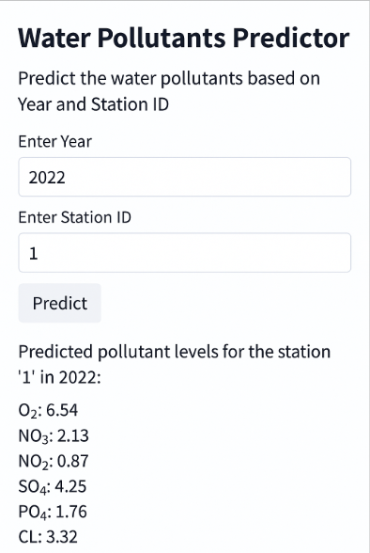
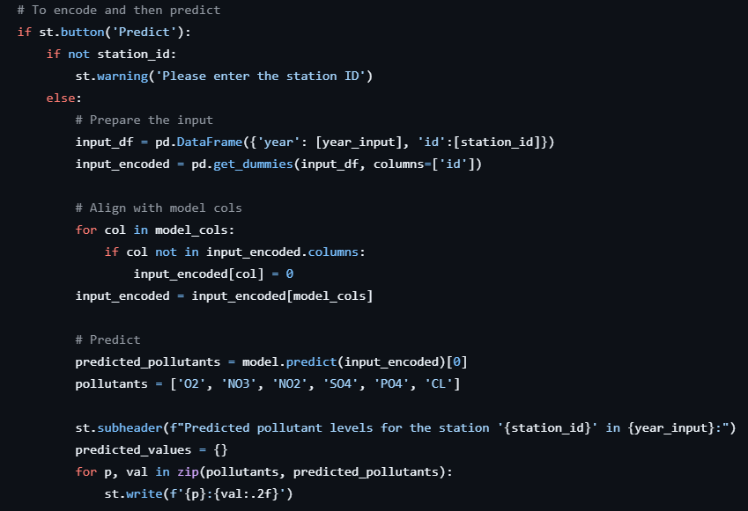
Screenshot of Output:
CODE

Slide 8
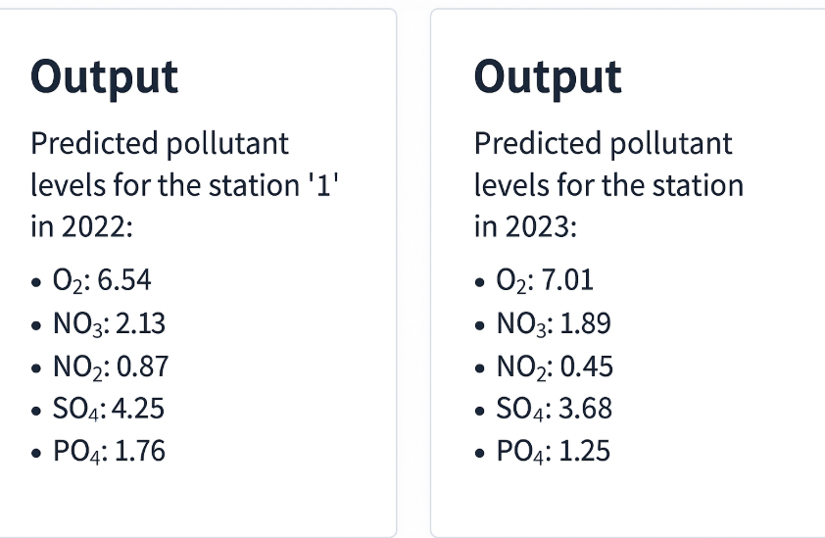
Screenshot of Output:

Slide 9
Conclusion:
This project successfully demonstrated how machine learning can be used to predict water potability based on chemical properties.
After testing multiple models, the Random Forest Classifier provided the best accuracy and reliability.
The solution was deployed using Streamlit, allowing users to input real data and instantly check water quality.
This model offers a fast, low-cost, and scalable alternative to manual water testing, with potential for real-world impact in public health and environmental monitoring.
Future Scope
Real-Time Monitoring: Integrate with IoT-based sensors for live water quality detection.
Mobile Application: Develop a cross-platform app to make predictions accessible in remote areas.
Larger & Global Dataset: Train the model with diverse water samples for better accuracy.
Contamination Type Detection: Extend the model to identify specific pollutants in water.
Collaboration with NGOs & Government: Deploy in rural and underdeveloped regions to support safe drinking water initiatives.
GITHUB LINK:
https://github.com/anupat27/AICTE-water-pred

