Slide 1

Screenshots

Slide 2
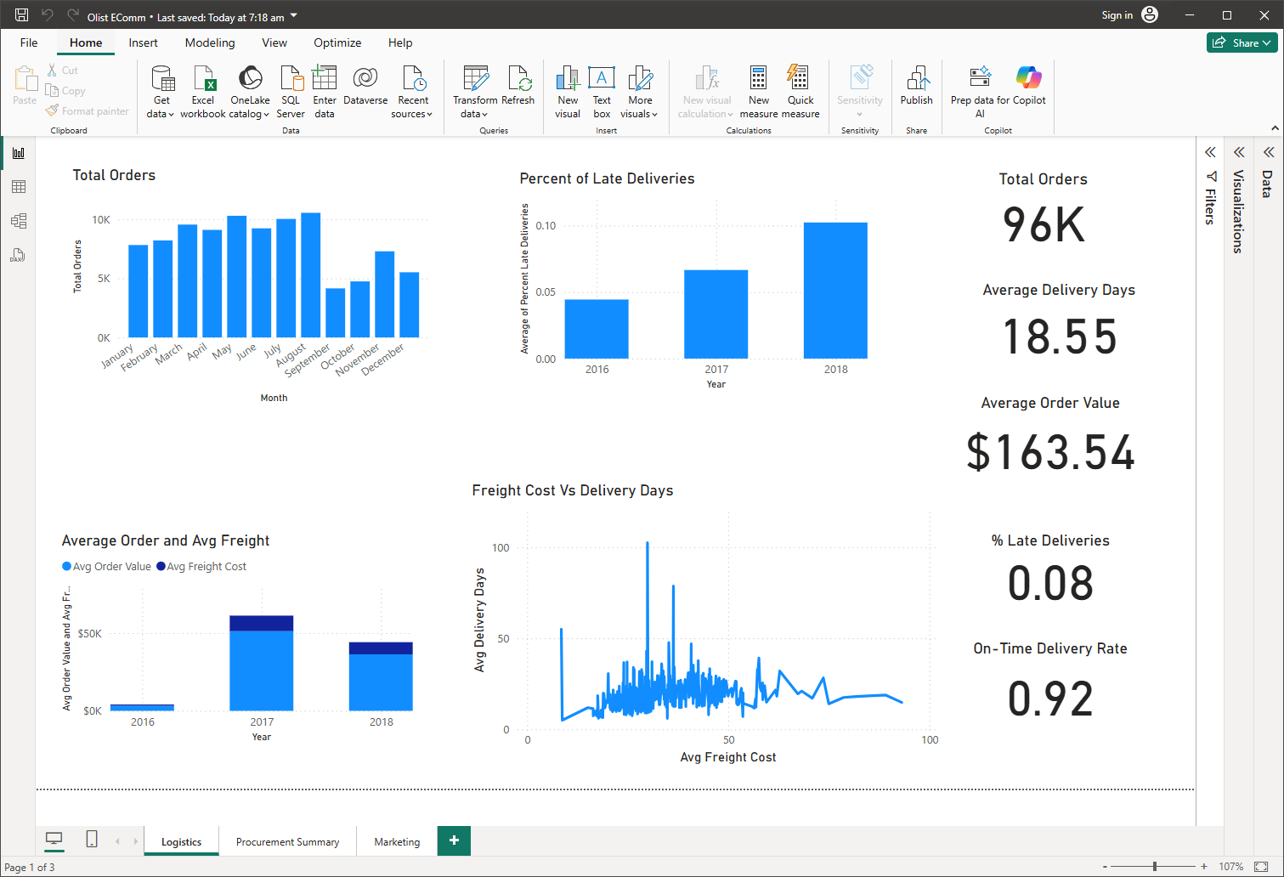
Logistics Dashboard

Slide 3
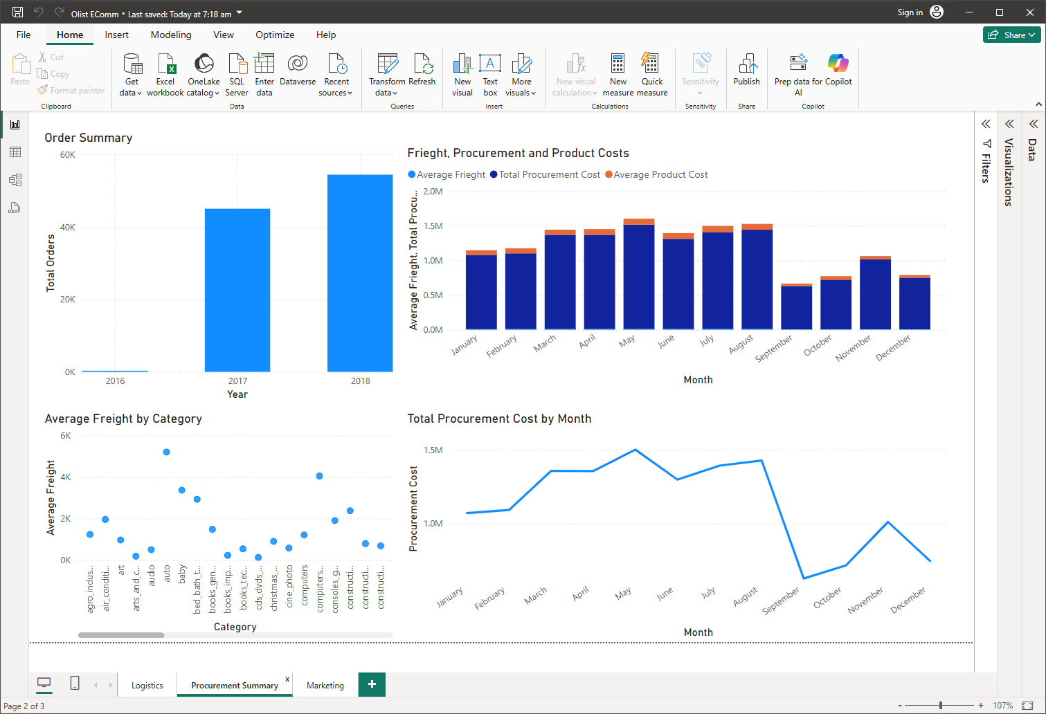
Procurement Dashboard

Slide 4
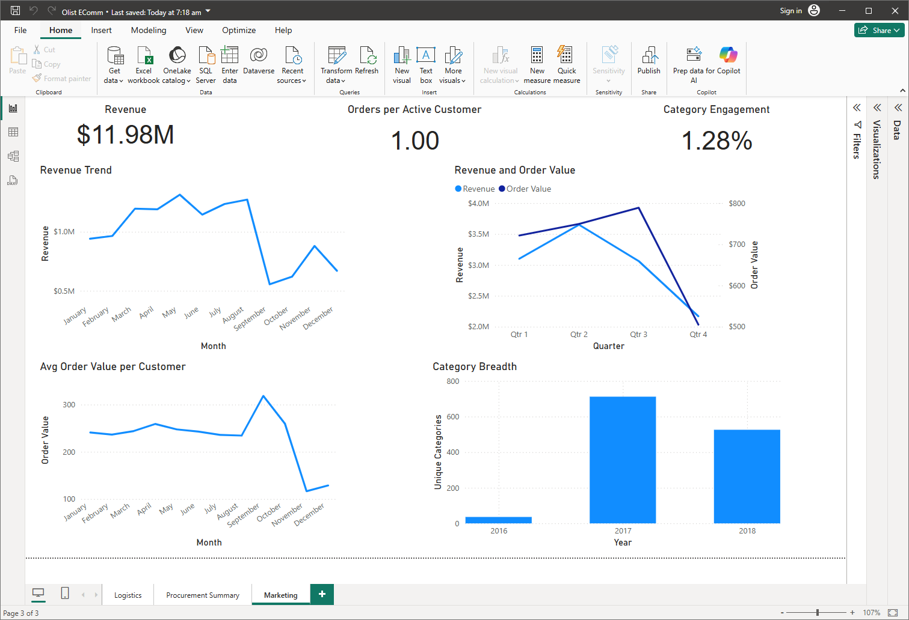
Marketing Dashboard

