Slide 1


Correlations between EEG and blood glucose metabolism: A pilot study
Anup Pillai
Research Associate
University of Ottawa

Slide 2
Aims of the project
Explore potential correlations between EEG and blood glucose
Find features that exhibit high correlation with the target signal
Visualization for easy interpretation and understanding by clinicians

Slide 3
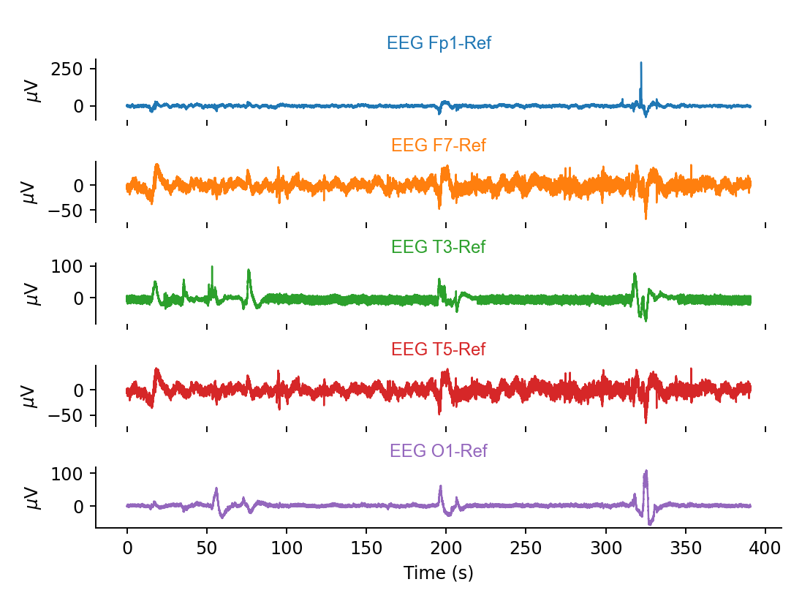
Preprocessing and visualizing EEG

Slide 4
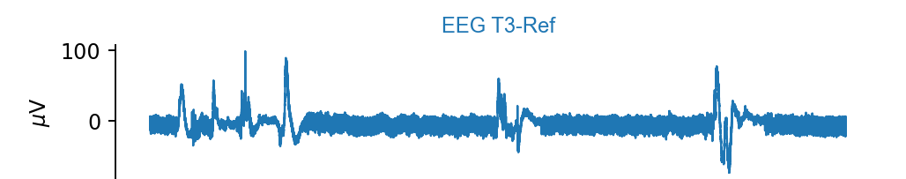
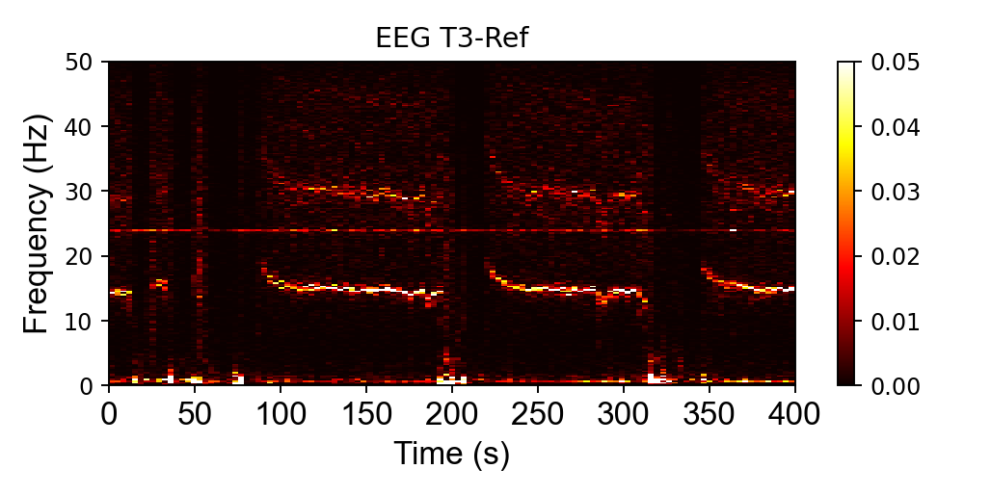
EEG spectrogram
ERPs
γ
β
α
θ
δ

Slide 5
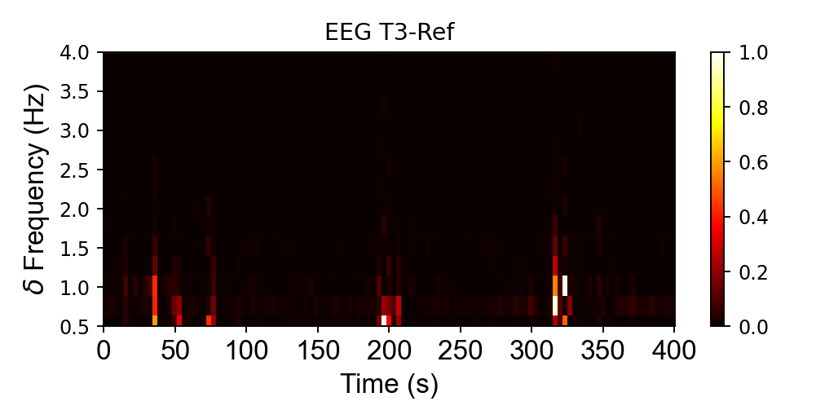
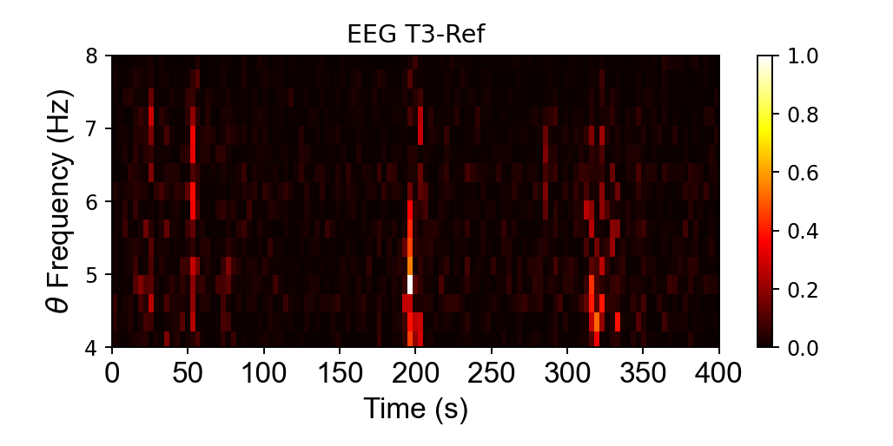
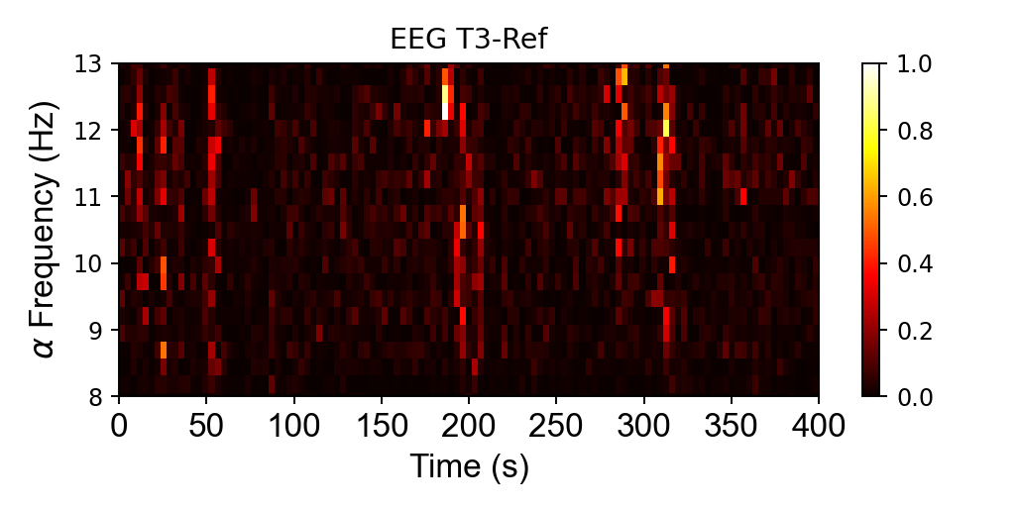
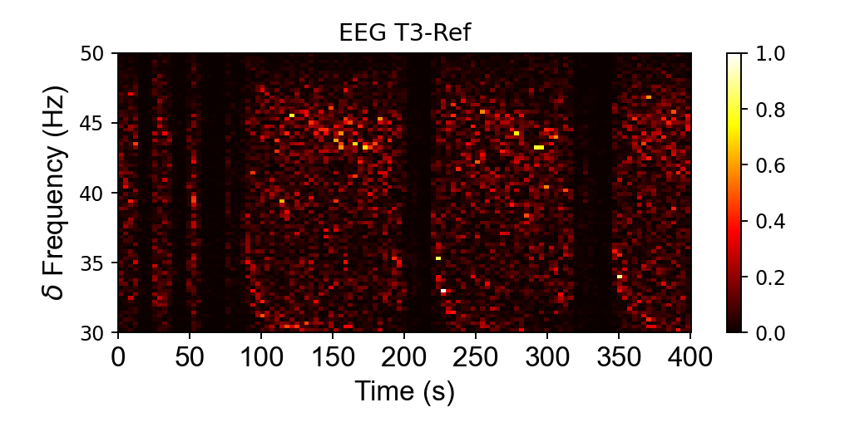
Visualizing EEG power in different frequency bands

Slide 6
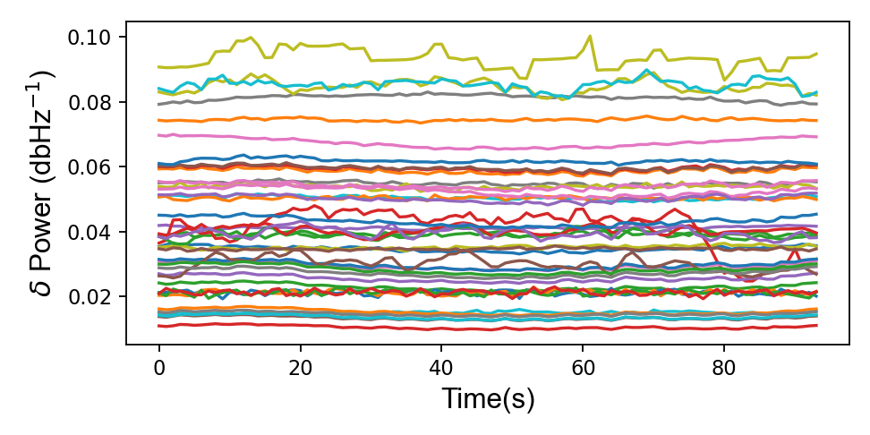
Visualizing the time evolution of signal power
in different EEG channels
Delta

Slide 7
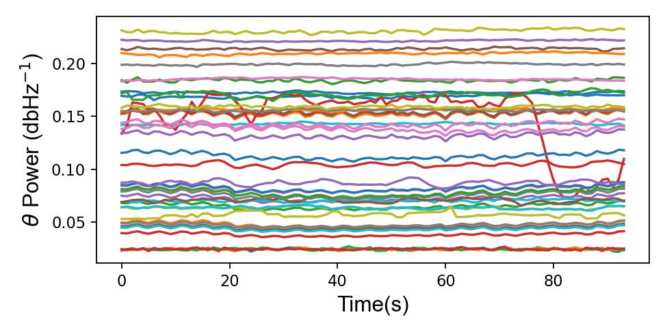
Visualizing the time evolution of signal power
in different EEG channels
Theta

Slide 8
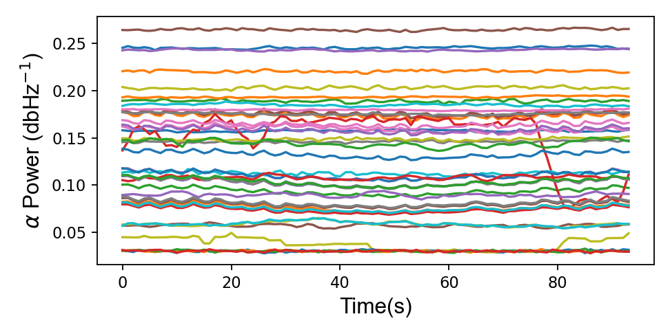
Visualizing the time evolution of signal power
in different EEG channels
Alpha

Slide 9
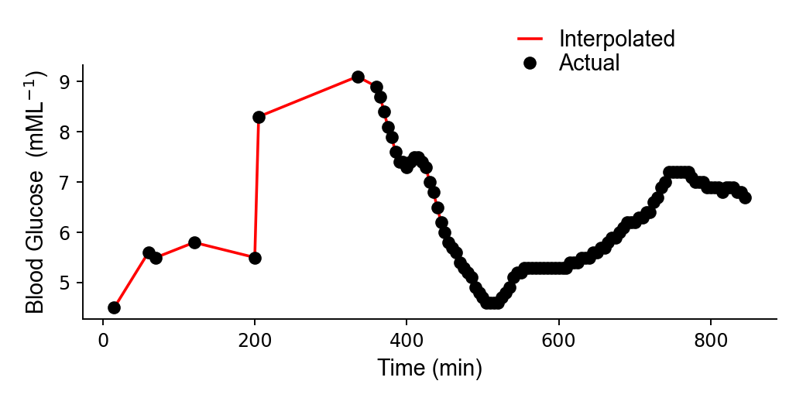
Blood glucose levels measured during EEG

Slide 10
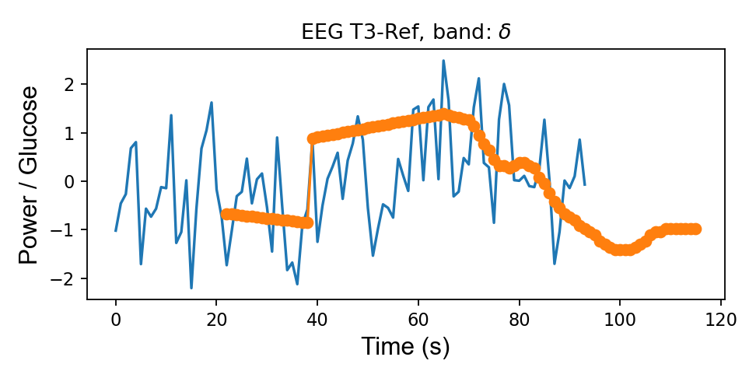
Correlating Z-scored EEG with blood glucose levels

Slide 11
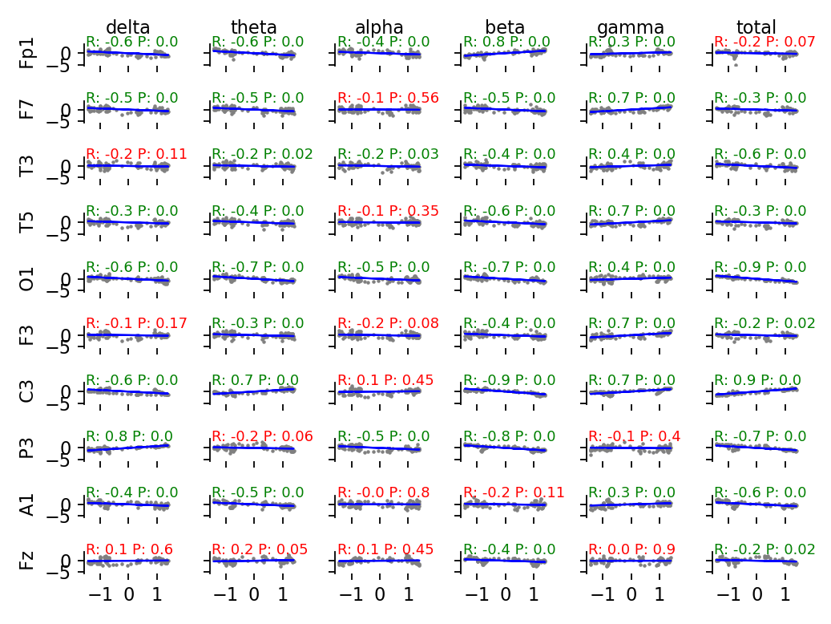
Linear correlation between EEG powers in different channels
& blood glucose levels

Slide 12
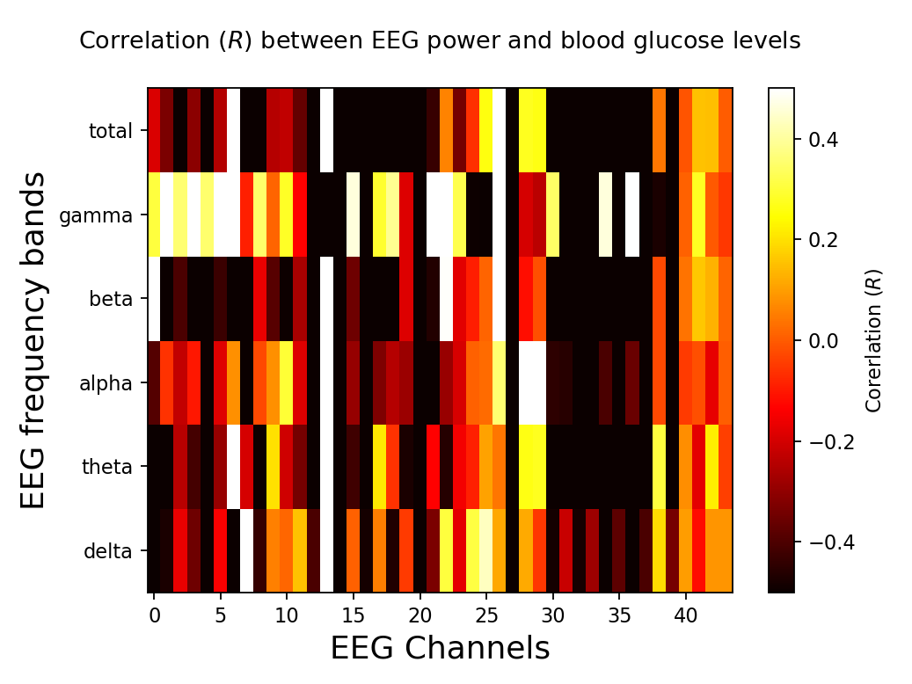
Visualizing EEG versus blood glucose correlation using a heatmap
Positive correlation of DC potentials with blood glucose levels

Slide 13
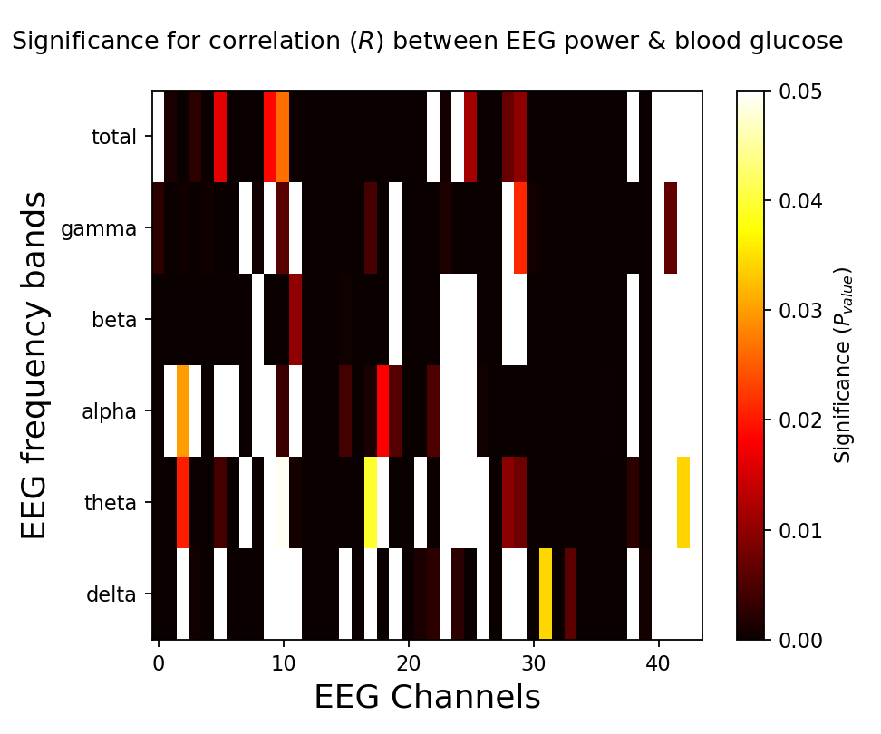
Inspecting the statistical significance of correlations across all EEG
Channels
Strong correlation of DC potentials with blood glucose levels

Slide 14
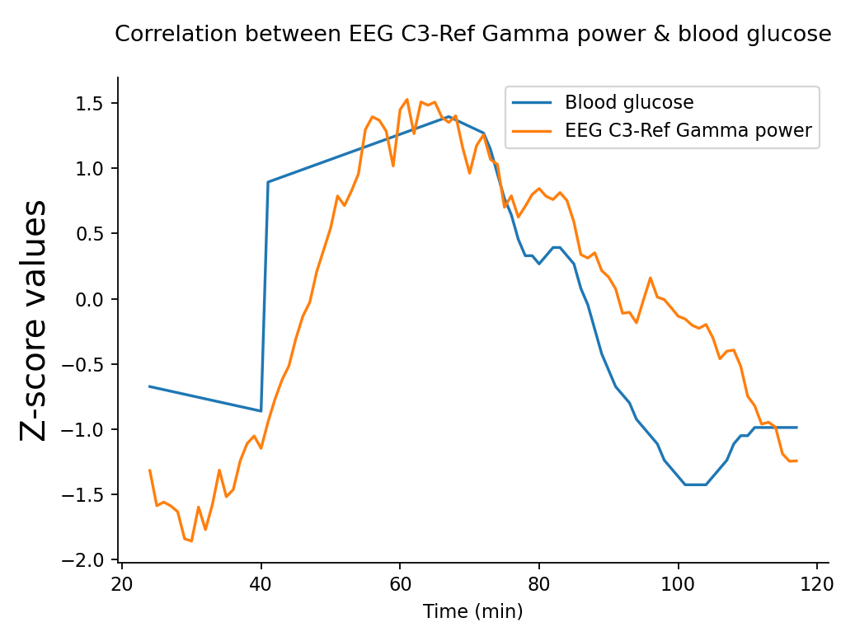
EEG gamma power from C3 was found to be significantly correlated
with changes in blood glucose levels

Slide 15
Conclusions & Future directions
Significant correlations were observed with EEG and blood glucose measurements
Review methodologies for analyzing and quantifying ERPs with behavioral aspects such as perception and attention
Explore different machine learning techniques with EEG data
Explore deep convolutional networks for signal classification
Continue the more detailed analysis by making use of public EEG repositories containing labeled data

