Slide 1
SportsOS: An AI-Powered Sports ERP
for IIT (ISM) Dhanbad
Thesis Mid-Evaluation · 13 November 2026
Anup Kumar
Admission No. 22JE0143 · Integrated M.Tech, Mathematics and Computing
Mentor: Prof. Scindhiya Laxmi
Department of Mathematics and Computing, IIT (ISM) Dhanbad
Notes:
Good morning. I am Anup Kumar, 22JE0143, and this is the mid-evaluation of my thesis, SportsOS, an integrated sports ERP for IIT (ISM) Dhanbad, under Prof. Scindhiya Laxmi. This is a software engineering and information systems project; AI is an optional layer on top of the transactional system.

Slide 2
Where the Project Stands Today
143
31
18 × 70
375
API endpoints in 20 modules
database models (PostgreSQL)
roles × permissions
automated checks, all passing
Done
Partial
Next
Booking, attendance, inventory, tournaments, complaints, analytics
Scoped, time-bound RBAC with two-person approval
Hash-chained audit ledger
AI assistant: offline mode verified, LLM untested
Mobile app: type-checked, not run on a phone
Analytics on synthetic data only
Validation with SPEC and real data
Security hardening (password reset, cookies)
Load, penetration and device testing
Notes:
In one slide: the core ERP is built and tested. 143 API endpoints, 31 database models, 18 roles with 70 permissions. On 12 November I re-ran the full verification suite on a fresh database: 375 automated checks, all passing. The AI layer and the mobile app are implemented but only partially verified, and all data is synthetic. The second half is validation and hardening.

Slide 3




Sports at IIT (ISM): The Setting
Sport is administered under the Dean (Students' Welfare) through the Sports & Physical Education Center (SPEC)
SPEC organises intramural events, including the Annual Sports Meet and the Inter-Hostel General Championship
Participation is competitive, inter-hostel and recreational: SportsOS models all three
Lower Ground
Sports Complex
Football ground; 8-lane, 400 m floodlit track
Floodlit basketball, volleyball and tennis courts
Students Activity Centre
Swimming Pool
Gym, 4 badminton courts, yoga, boxing, billiards
50 m standard-size pool
Source: SPEC activity and facilities pages, people.iitism.ac.in/~dsw/spec (undated; to be re-confirmed with SPEC)
Notes:
Sport here is run under the Dean of Students' Welfare through SPEC. SPEC's own pages describe the Annual Sports Meet and the Inter-Hostel General Championship, and list these facilities. I am citing only what those pages state; they are undated, so I will re-confirm with SPEC. I do not name any staff.

Slide 4




Problem: Fragmented, Unauditable Operations
No centralised records
Why this is worth a thesis
Attendance, equipment logs and complaints live in separate paper books
Sports-digitalisation research studies one solution for one stakeholder; multi-stakeholder systems are a stated gap (Haffner et al., 2025)
Integrated sports-facility MIS improve service quality but remain little studied (Saputra & Asmawati, 2025)
Broken access control is the #1 web-application risk (OWASP); 18 roles make this a realistic test bed
No real-time visibility
No live view of court availability, ground status or stock
Proxy-prone attendance
Paper sign-in sheets are easy to manipulate and hard to audit
No data for decisions
No metrics on participation, demand or equipment wear
Notes:
These four gaps are from my approved proposal; the baseline is a stated premise, not yet measured. Academically, the motivation is that sports digitalisation research has focused on single stakeholders, integrated facility systems are little studied, and access control in multi-role systems is the top security risk.

Slide 5






Research Objectives (Unchanged from Proposal)
O1 · Centralise
O2 · Automate
O3 · Role-based access
Booking, tournaments, attendance, inventory and events in one platform
Scheduling, approvals, record management and reporting
Secure, customised access for every stakeholder
O4 · Analytics
O5 · Student experience
O6 · Future-ready
Dashboards and reports for data-driven decisions
One portal for bookings, check-in, notifications
Secure, scalable, able to host AI features
Notes:
The six objectives from the approved proposal are unchanged. I will come back to each one at the end with evidence of how far it has been achieved.

Slide 6
Related Work and Research Gap
Work | Setting | Attendance proof | Access control | Audit trail
Haffner et al. 2025 | IS review, sports digitalisation | — | Stakeholder lens | —
Saputra & Asmawati 2025 | Review, sports facilities | Not reported | Not reported | Not reported
Shahrom & Mohamad Sukri 2025 | University pool system | No (OTP for login) | RBAC + 2FA | Not reported
Sandhu et al. 2000 (NIST) | RBAC reference model | — | Flat → symmetric RBAC | —
SportsOS | Institute-wide campus sports | TOTP + GPS + device | Scoped, time-bound | SHA-256 hash chain
Gap: no integrated, verifiable system for an academic sports ecosystem where office-bearers hold only scoped authority, attendance must be provably physical, records must stay consistent and auditable, and authorisation is tested across every role.
Notes:
The literature gives the principles: stakeholder thinking, integrated facility systems, the NIST RBAC model and OWASP ASVS 5.0.0 for verification. No reviewed work combines proof-of-presence attendance, scoped governance of student office-bearers, a reconciled ledger and role-exhaustive testing in an academic institution. That is the gap SportsOS addresses. Claims about the 2025 papers are limited to their abstracts.

Slide 7
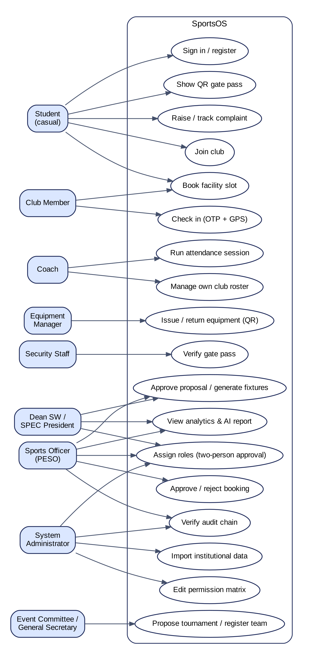
Requirements: 18 Stakeholder Roles
18
roles
70
permissions
4
scope types
346
default grants
Scopes: club, hostel, sport, facility; time-bound roles lapse automatically
Seniority grants nothing: a Director sees dashboards but cannot approve bookings
Hierarchy is the proposal's model, used only for the org chart; to be validated with SPEC
Notes:
Each stakeholder in the proposal became a role, giving 17 organisational roles plus a system administrator, with 70 fine-grained permissions. Authority can be limited to one club, hostel, sport or facility and can expire. The hierarchy from my proposal is only used to draw the organisation chart; it never grants permissions, and I still need to validate it with SPEC. On the right are the principal use cases, all of which exist in code.

Slide 8
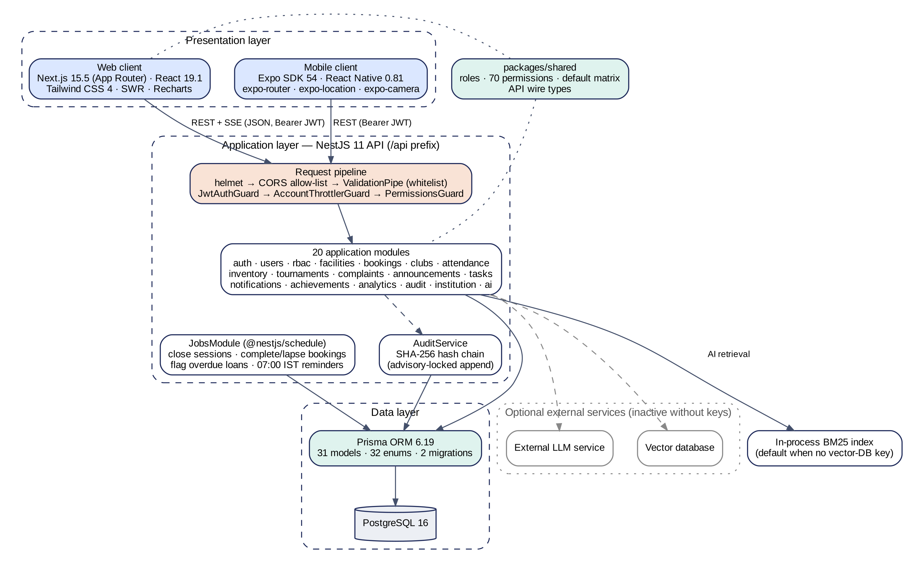
System Architecture
Modular monolith
20 NestJS modules share one transactional database
Three global guards
Authenticate → rate-limit per account → authorise
One shared package
Roles, permissions and types reused by API and web
Optional AI
External LLM and vector database used only when configured; offline fallback
Notes:
Three tiers: a Next.js 15 web client and an Expo SDK 54 mobile client call a NestJS 11 REST API, which stores everything in PostgreSQL 16 through Prisma. I chose a modular monolith because bookings, attendance and the audit ledger must commit in one transaction, and one institute does not need microservices. All versions were verified from the package manifests.

Slide 9
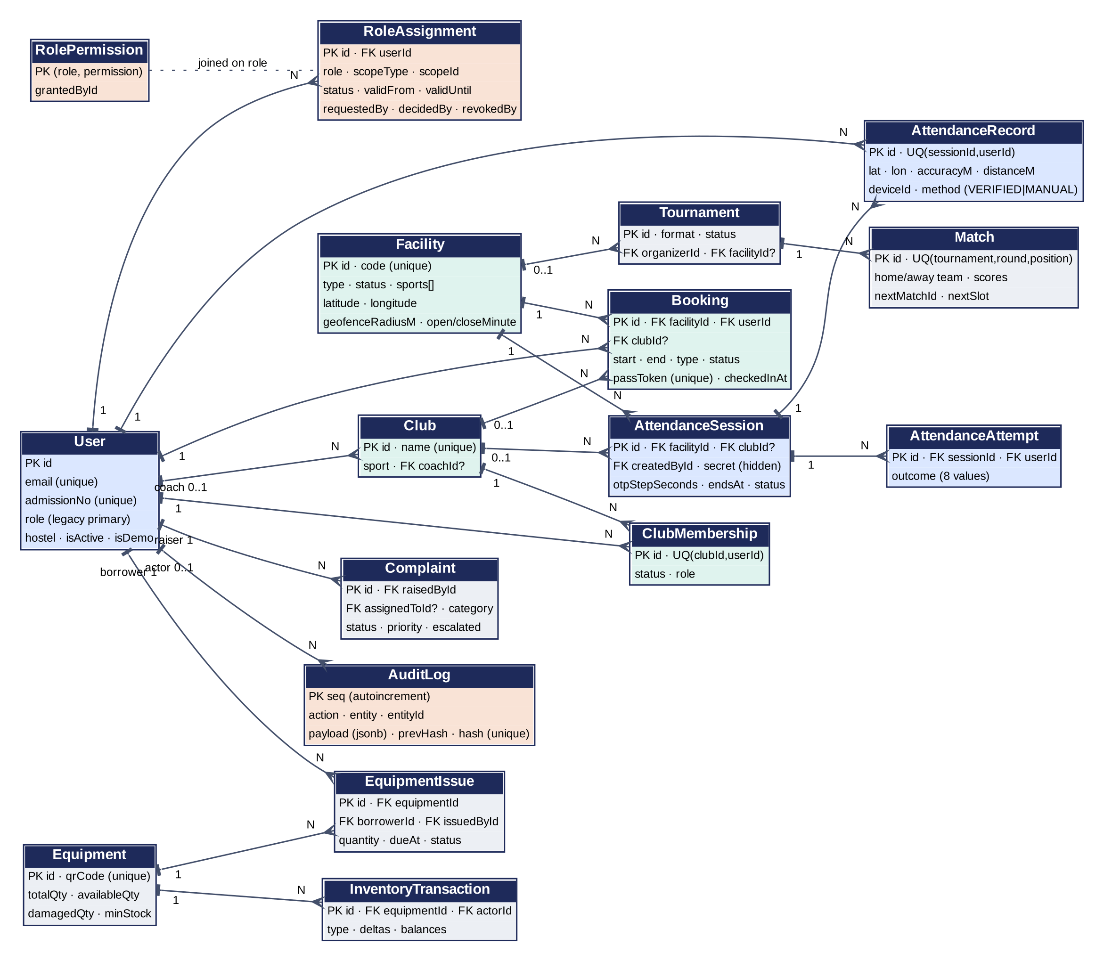
Database Design: Integrity Enforced by PostgreSQL
31 models · 32 enums · 2 migrations
Unique constraints
One attendance record per student per session
Advisory locks
Bookings serialised per facility; audit appends serialised
Conditional updates
UPDATE … WHERE available ≥ n: stock never negative
History, not deletion
Roles, stock moves and corrections are append-only
Notes:
The schema has 31 models. The key design decision is to let the database enforce the business rules: unique constraints, PostgreSQL advisory locks for bookings and the audit chain, and conditional updates so stock can never go negative even under concurrent requests. Nothing important is deleted; history is append-only.

Slide 10
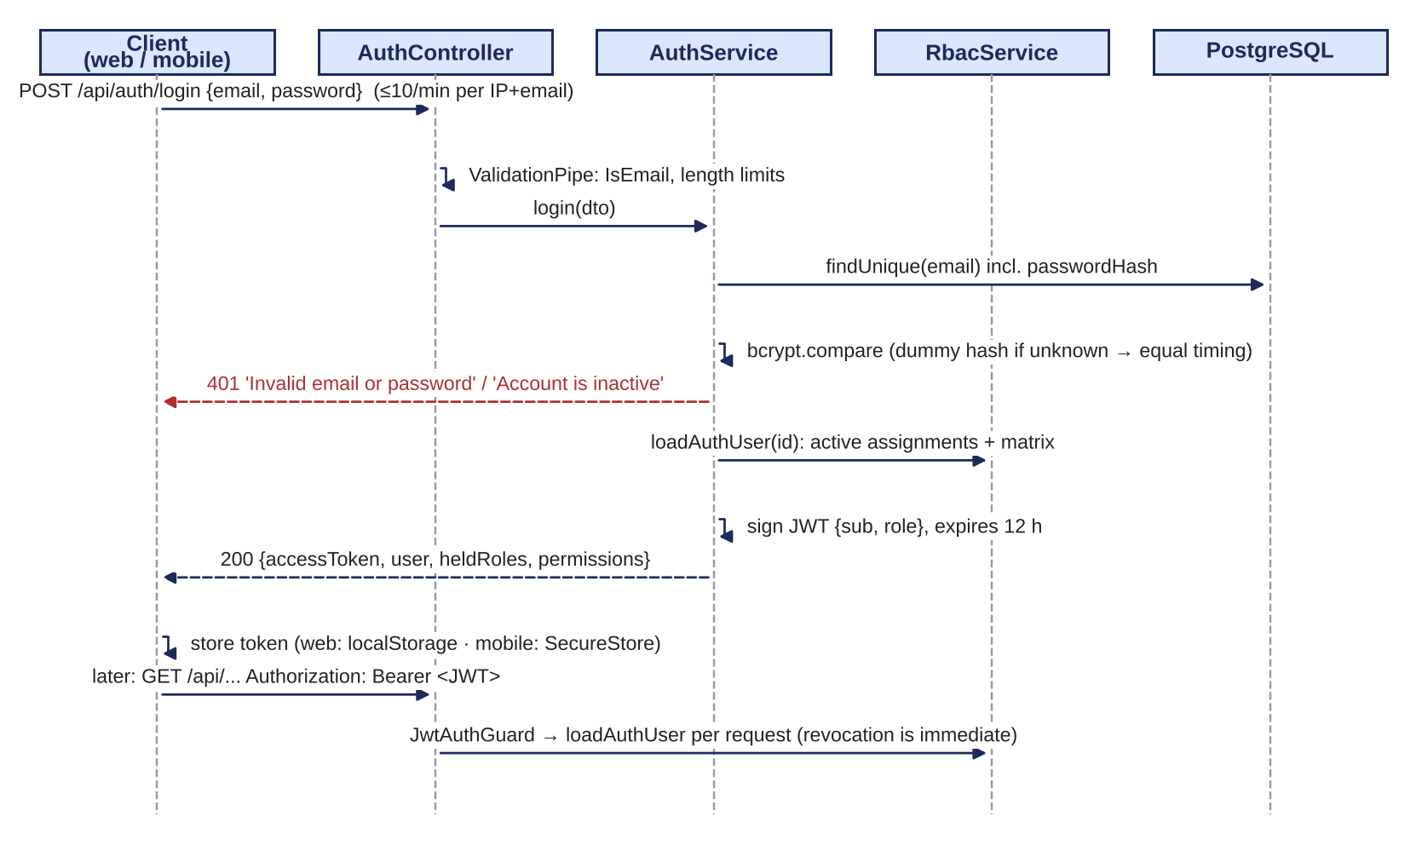
Authentication and Role-Based Access Control
bcrypt hashes; login throttled; timing-equalised for unknown emails
12-hour JWT, but the user is reloaded from the database on every request, so revocation is immediate
Active-role header must name a held role, otherwise 403
Object-level scope checks: a coach manages only clubs they coach
Privileged roles need approval by a second person
Login and authenticated request (from auth.service.ts and guards.ts)
Notes:
Authentication uses bcrypt and a 12-hour token, but the server ignores the role inside the token and rebuilds the user's permissions from the database on every request, so revoking a role works instantly. Authorisation has two layers: route guards check the permission, and services check the scope, for example a football coach cannot touch the basketball club.

Slide 11
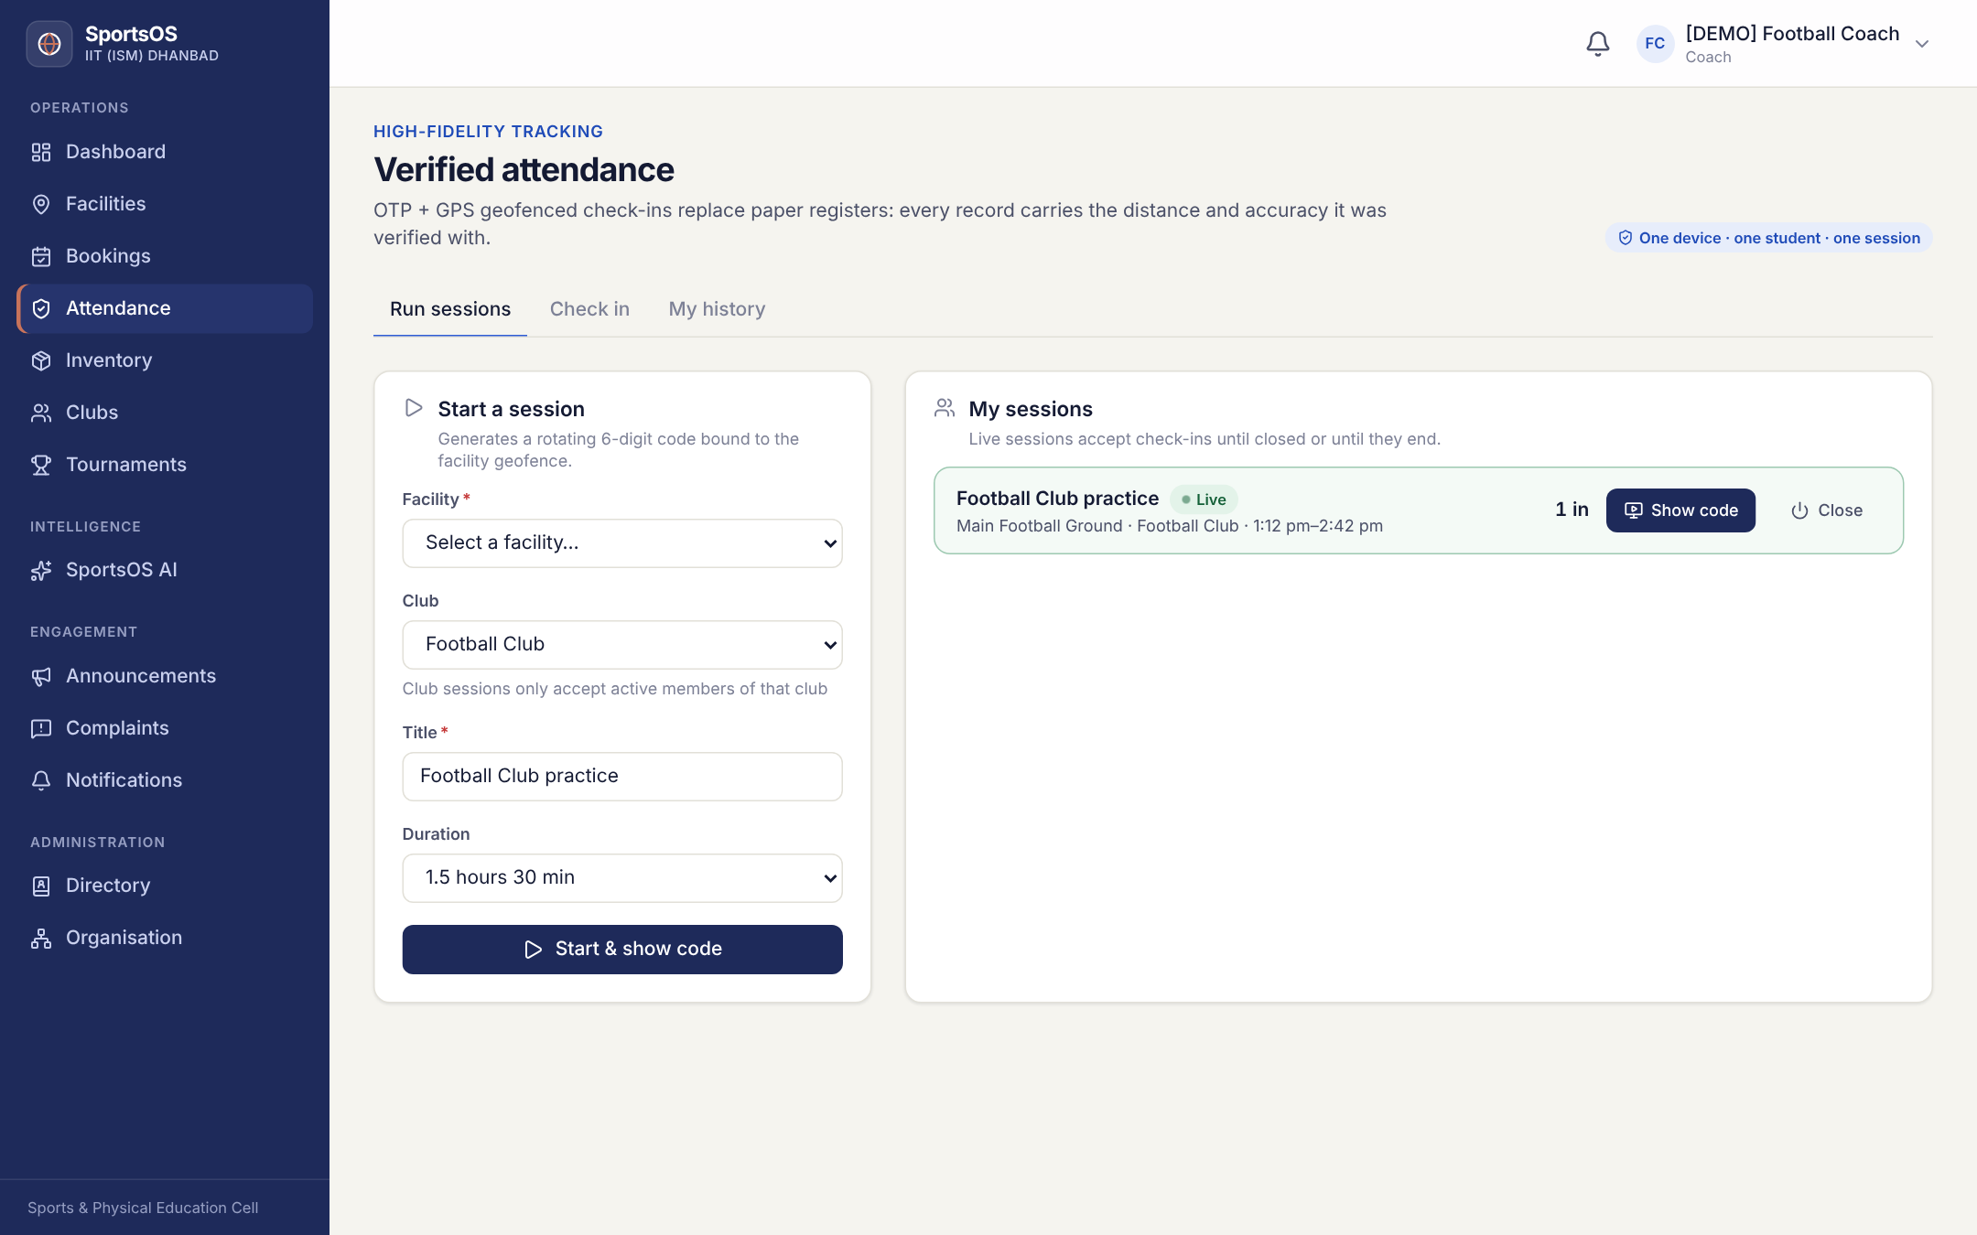
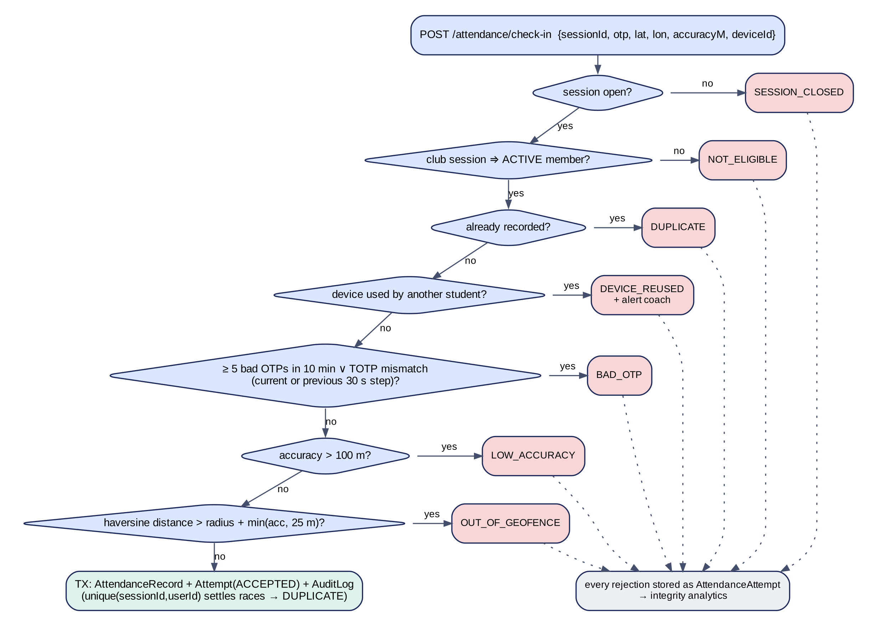
Verified Attendance: OTP + GPS + Device
Coach console with a live session (synthetic demo data)
6-digit code rotates every 30 s (RFC 6238 TOTP)
GPS accuracy ≤ 100 m; distance ≤ radius + min(accuracy, 25 m)
Every attempt logged; device reuse alerts the coach
Notes:
This is the most distinctive module. The coach's screen shows a code that changes every 30 seconds. A student must enter the current code from a phone whose GPS fix is accurate and inside the facility's geofence, and one device can check in only one student. Every rejected attempt is stored, which feeds an integrity report. It raises the bar against proxy attendance; it cannot defeat a rooted phone spoofing GPS, and it has not yet been tested in the field.

Slide 12
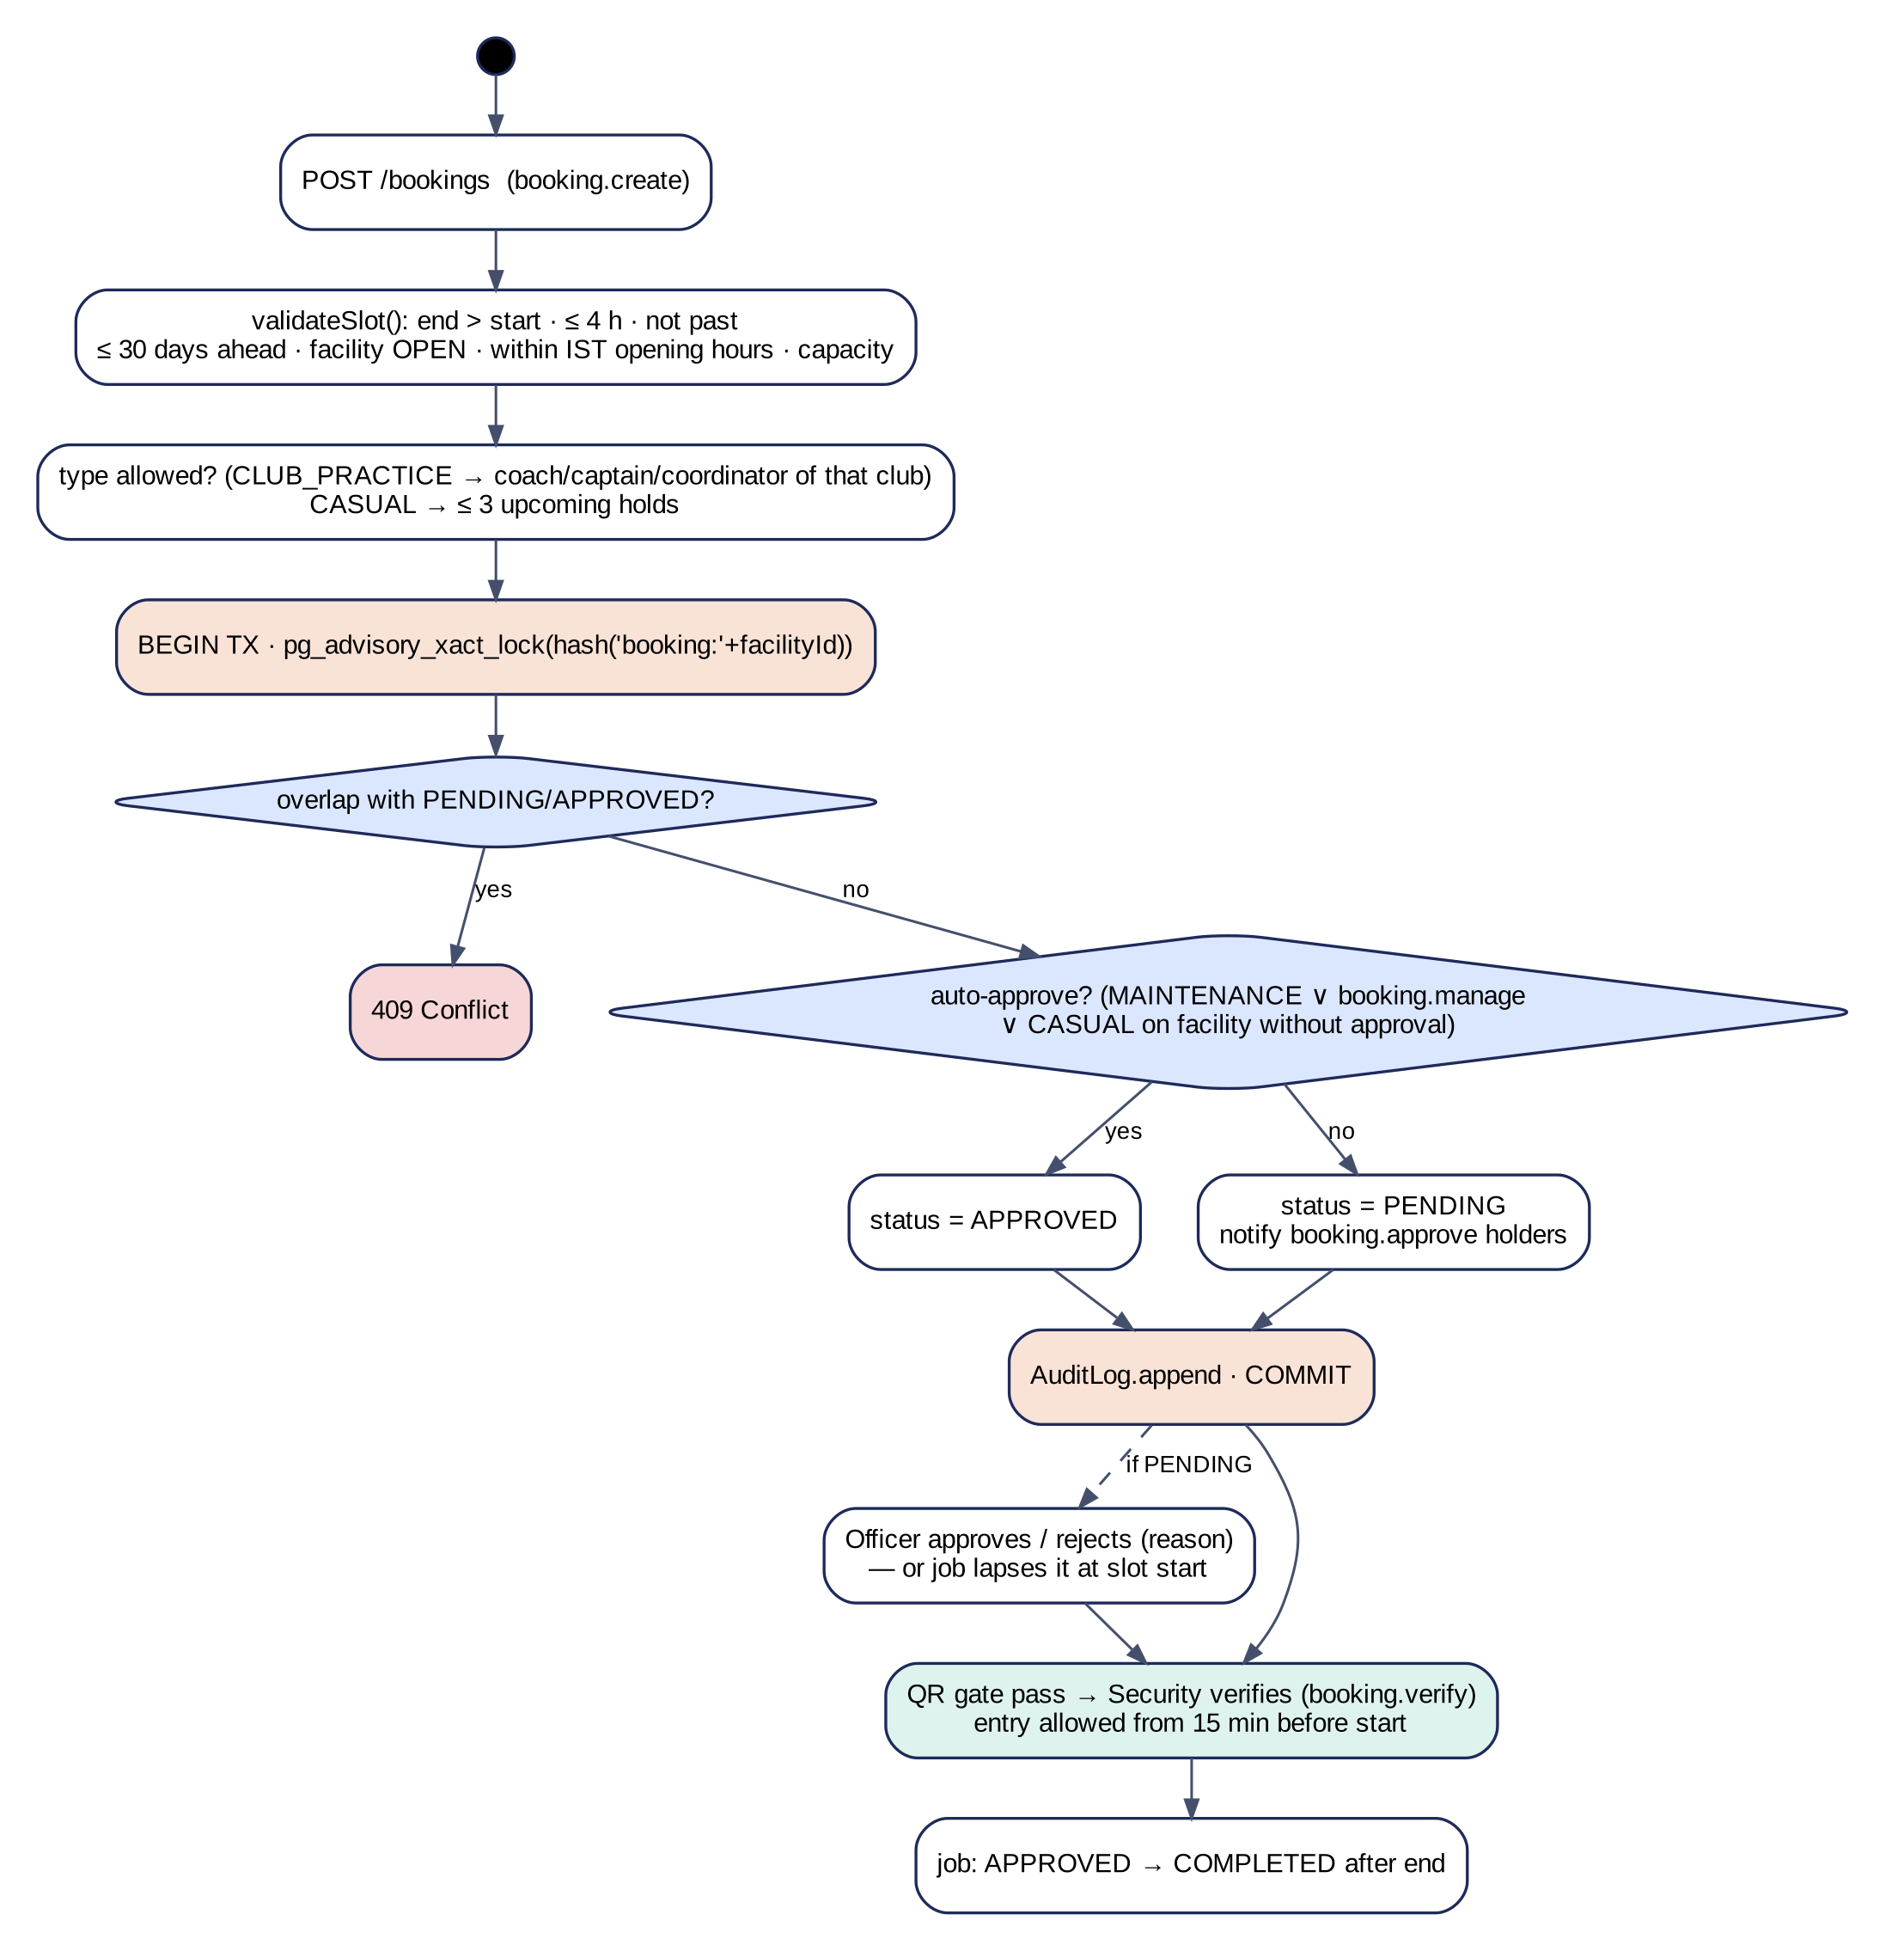
Booking and Inventory Stay Consistent
6 → 1
six simultaneous requests for one slot: exactly one booking created, five refused (409)
8 → 3
eight simultaneous issues against 3 units in stock: exactly three succeed
0
difference between ledger totals and stored stock after all movements
Notes:
Bookings are validated for hours, capacity and conflicts under a facility lock; approved bookings get a QR gate pass. Equipment issue and return go through one function that writes a ledger row. I tested concurrency directly: six simultaneous booking requests produced exactly one booking, and eight issues against three units produced exactly three. These are small-scale tests; load testing is still to come.

Slide 13
Module-Wise Implementation Status
Authentication & users
RBAC (scoped, two-person)
Facilities & booking
QR gate pass
Tested
Tested
Tested
Tested
Clubs & rosters
OTP + GPS attendance
Inventory ledger & QR
Tournaments & fixtures
Tested
Tested
Tested
Tested
Complaints & tasks
Announcements & notifications
Analytics & audit ledger
Institutional data import
Tested
Tested
Tested
Tested
AI assistant
Mobile app
Password reset · Redis
Cloud deployment
Partial
Partial
Not built
Planned
Notes:
Twelve modules are implemented and covered by automated tests. The AI assistant is verified only in offline mode because no API keys were available, and the mobile app is type-checked but not yet run on a device. A password-reset flow and Redis do not exist yet, and cloud deployment is planned.

Slide 14
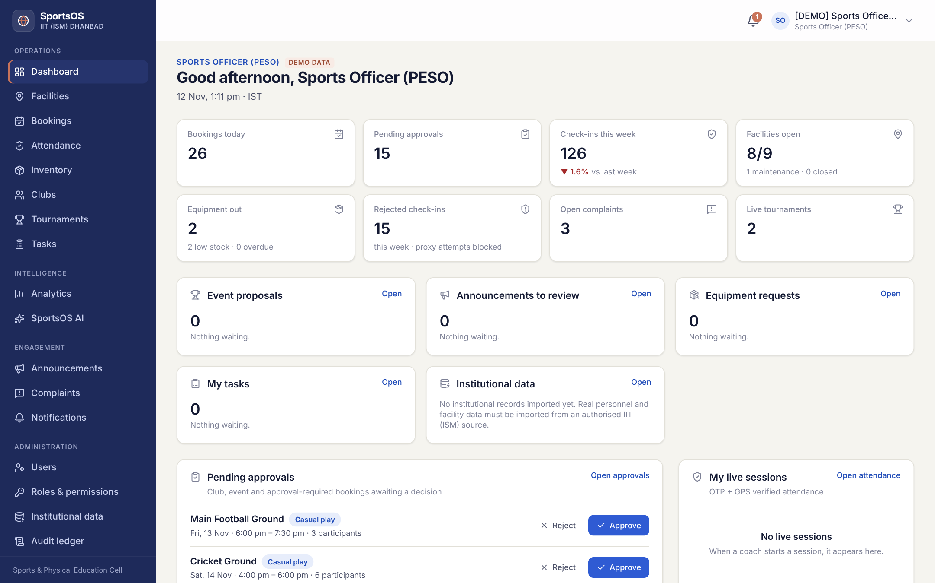
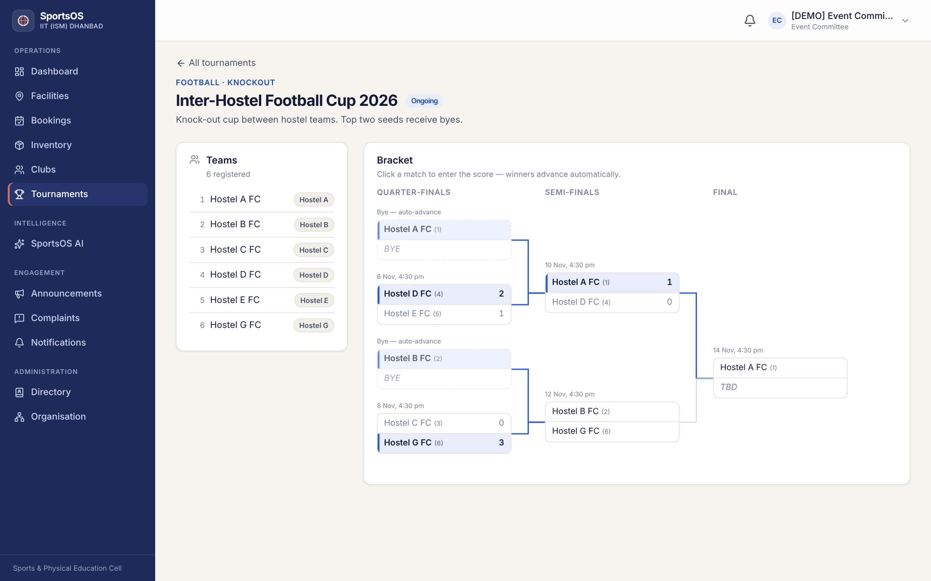
Working Prototype
Sports Officer dashboard: KPIs and approval queue
Knock-out bracket with seeded byes and auto-advancement
All screens show synthetic demo data; no real student or staff records are used.
Notes:
These are from the production build. On the left, the Sports Officer's dashboard with live KPIs and the approval queue; on the right, a generated knock-out bracket where byes go to the top seeds. Every record shown is synthetic and labelled as demo data. If time permits, I can show a live demo.

Slide 15
Verification Results (Run on 12 Nov 2026)
71 / 71
83 / 83
200 / 200
21 / 21
19 / 19
Unit tests
API smoke checks
RBAC & workflow
Browser checks
Demo logins
OTP vectors, geofence, hash chain, RBAC
Every module, end to end
23 endpoints × 18 roles + workflows
9 roles, 12 interactive flows
Every seeded role account
Fresh database (prisma migrate deploy + synthetic seed), production builds, TypeScript and ESLint clean (0 errors)
Previously reported demo-login failures and duplicate port-4000 processes could not be reproduced
Preliminary: no load, penetration, device or user testing yet
Notes:
I re-ran everything myself on 12 November on a freshly migrated database rather than trusting earlier reports. All 375 checks passed. The RBAC suite calls 23 protected endpoints with every one of the 18 roles: allowed roles must get through and denied roles must get exactly 403. The demo-login failures reported earlier came from a seed script that did not load its configuration; that is fixed. This evaluation is preliminary.

Slide 16
Representative Test Cases
ID | Scenario | Expected | Actual | Status
T-02 | Invalid login (unknown account) | 401 | 401 | PASS
T-04 | Student calls analytics endpoint | 403 | 403 | PASS
T-06 | Football coach opens Basketball session | 403 | 403 | PASS
T-07 | 6 concurrent requests for one slot | 1 succeeds | 201 ×1, 409 ×5 | PASS
T-08 | Correct code, 1.1 km away | OUT_OF_GEOFENCE | 1,112 m, rejected | PASS
T-12 | Return with one damaged unit | Stock updated | available 13 → 12 | PASS
T-14 | Audit chain verification | Valid | Valid, 589 entries | PASS
T-15 | Forgot-password request | Reset flow | Not available | Not built
Selected from Table 6.2 of the report (15 test cases)
Notes:
A sample of the test cases from Table 6.2 of the report. Each row lists the expected and the actual result. Note the last row: password reset is not implemented, and I report it as such rather than leaving it out.

Slide 17
Achievement Against Objectives
O1
Centralise operations
One schema and API for all modules
Met
O2
Automate administration
Approval workflows, 4 scheduled jobs, import rollback
Met
O3
Role-based access
18 roles, 70 permissions; 200/200 checks
Met
O4
Analytics
Dashboards and forecast, synthetic data only
Partly met
O5
Student experience
Web portal done; mobile not device-tested; no user study
Partly met
O6
Future-ready
No cloud, load test, live AI or shared cache yet
Partly met
Notes:
Measured against the six objectives: three are met at prototype level and three are partly met. The partial ones depend on real data, device testing and deployment, which is exactly what the remaining months are for.

Slide 18
Current Limitations
No password reset
Web token in localStorage
Needs an approved email channel
Move to httpOnly cookie session
No Redis
10 dependency advisories
Rate limits and cache are per process
7 high; to triage and upgrade
Mobile not run on a phone
AI verified offline only
GPS and camera unverified
No keys; LLM path mocked
Synthetic data only
No load or pen testing
Geofences are placeholders
Containers configured, not run
Notes:
These are the honest limits of the prototype today. None of them is hidden in the report; each has a planned action. One small cosmetic bug was also found during the evaluation: the duration picker shows 1.5 hours 30 minutes for 90 minutes.

Slide 19
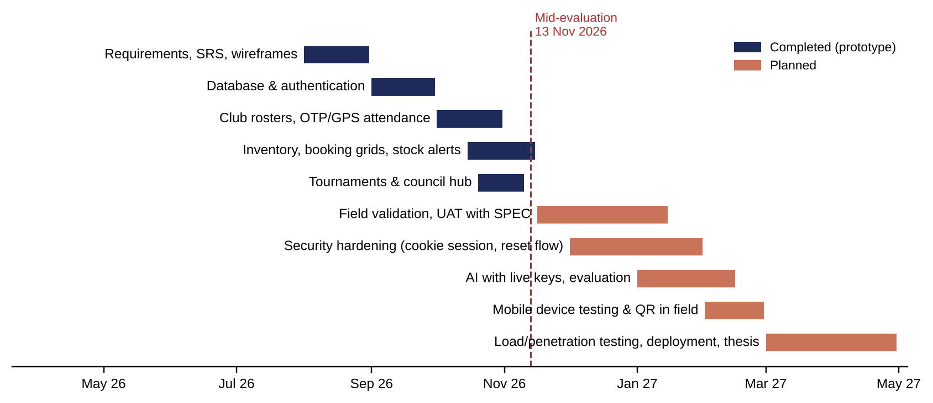
Revised Roadmap (Nov 2026 – Apr 2027)
Nov–Jan
SPEC validation, UAT, ground survey
Dec–Jan
Security hardening
Jan–Feb
Live AI evaluation
Feb
Mobile device testing
Core modules (Sep–Dec milestones) finished early, so the remaining months move to validation and hardening.
Mar–Apr
Load and penetration tests, staging, thesis
Notes:
Because the core modules, including the December tournament milestone, were completed early, I have re-planned the remaining months towards validation with SPEC, security hardening, live AI evaluation, device testing, and finally load and penetration testing before the final submission.

Slide 20
References
[1] Sports & Physical Education Center (SPEC), IIT (ISM) Dhanbad, "Activities" and "Facilities." people.iitism.ac.in/~dsw/spec/activity.html; people.iitism.ac.in/~dsw/spec/facilities.html
[2] L. Haffner, I. Oshri and J. Kotlarsky, "Directions for future IS research on sports digitalisation: A stakeholder perspective," J. Strategic Information Systems, 34(2), 101905, 2025. doi.org/10.1016/j.jsis.2025.101905
[3] D. E. W. Saputra and P. Asmawati, "Elevating user experience and service excellence in sports facilities via integrated management information systems: A systematic review," Sports Science and Health, 15, 111–118, 2025. doi.org/10.7251/SSH25V111S
[4] M. D. Shahrom and K. A. Mohamad Sukri, "Swimming facilities management system for UTHM Sport Centre with two-factor authentication," Applied IT and Computer Science, 6(2), 625–643, 2025. penerbit.uthm.edu.my/periodicals/index.php/aitcs/article/view/20507
[5] R. Sandhu, D. Ferraiolo and R. Kuhn, "The NIST model for role-based access control: Towards a unified standard," Proc. 5th ACM RBAC Workshop, 47–63, 2000. doi.org/10.1145/344287.344301
Notes:
The SPEC pages give the institutional context, and the four papers are the research basis of SportsOS: the multi-stakeholder view, integrated facility management, OTP-based security in a university sports system, and the NIST RBAC model.

Slide 21
Conclusion
SportsOS is a working, tested prototype: one system for booking, verified attendance, inventory, tournaments, complaints and analytics
Verified claims: access confined to role and scope; attendance needs physical presence; records consistent under concurrency; every change audited
Open: real data, device and field testing, live AI, security hardening, deployment
Thank you · Questions?
Notes:
To conclude: SportsOS has moved from proposal to a working prototype whose core claims are verified by tests I ran for this evaluation, and the remaining work is clearly scoped. Thank you; I am happy to take questions.

