Slide 1
CS542 Distributed Systems Raft Consensus Algorithm
Anup Kumar 210101019
Sachin Gautam 210101090
Sahil Jaiswal 210101091

Slide 2
What is Consensus Algorithm?
A consensus algorithm is a protocol in distributed systems that ensures agreement among multiple nodes on a single data value or sequence of values, even in the presence of failures or malicious actors. Its primary goal is for all non-faulty nodes to reach the same decision, maintaining consistency and reliability.
Its goals include:
- Agreement: All non-faulty nodes must reach the same value.
- Consistency: The system remains uniform despite failures or delays.
Fault Tolerance: It can withstand a certain number of node failures.
- Liveness: Correct nodes eventually make progress and reach consensus.
- Performance: Efficient in terms of message exchanges and latency.

Slide 3
Raft Algorithm
The Raft consensus algorithm is designed to manage a replicated log in distributed systems, ensuring that multiple servers agree on a sequence of operations. It is known for its understandability and practicality compared to other consensus algorithms like Paxos.
Key components of Raft:
Roles: Raft divides participating nodes into three roles:
Leader: Manages log replication and client interactions.
Followers: Replicate the leader’s log entries and respond to requests.
Candidates: Used during leader election when a follower believes the leader is unresponsive.

Slide 4
Leader Election: When a system starts or if a leader fails, a candidate is elected as a leader through a voting process. A candidate must receive votes from a majority of nodes to become the leader.
Log Replication: The leader receives client requests and appends them to its log. It then replicates these log entries to the followers. Once a majority of followers acknowledge the entry, it is considered committed.
Safety: Raft ensures that if a log entry is committed, it will not be lost, maintaining consistency across nodes.
Terms: The algorithm organizes time into terms, where each term has one leader. Terms are incremented during leader elections to maintain freshness and ensure that old leaders cannot reestablish control.

Slide 5
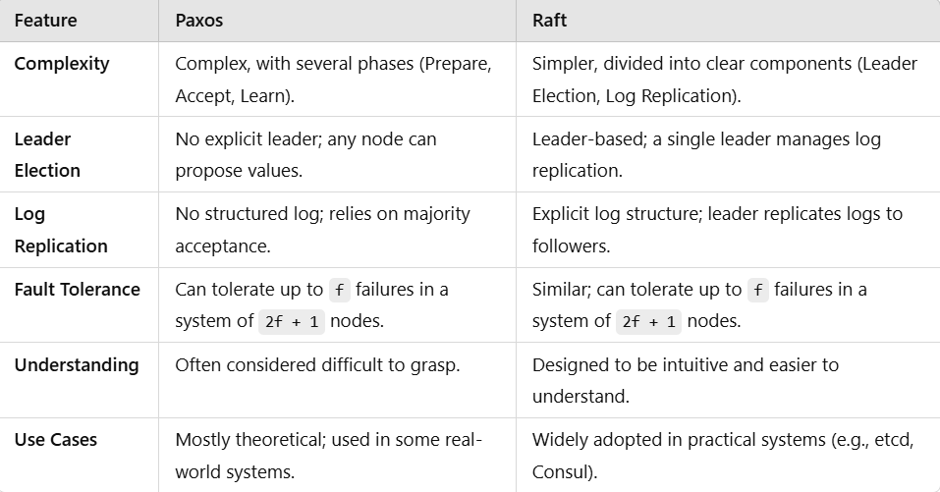
Raft Vs Paxos

Slide 6
Scope of Improvement in Raft
Frequent Elections:
In scenarios where a leader fails or network partitions occur, Raft may trigger frequent leader elections. This can waste computational resources and introduce delays in reaching consensus, as resources are consumed without making meaningful progress.
Predictable Leader Election:
Currently, Raft employs randomized timers for leader election, which can lead to non-deterministic outcomes. By introducing a mechanism to prioritize member nodes based on predefined criteria, we can create a more predictable and efficient leader election process, reducing unnecessary delays while still maintaining the probabilistic nature of elections.

Slide 7
Suggested Improvements in Leader election
Pre-Vote Mechanism
Leader Election Priority mechanism

Slide 8
Pre-Vote Mechanism for Leader Election
How Pre-Vote Helps
Before Becoming a Candidate: Even if a follower hasn’t received heartbeats (and thinks the leader is down), it doesn’t jump straight to an election. Instead, it first asks other nodes, "Have you heard from the leader recently?" (this is the pre-vote request).
Check with Other Followers: If most of the other followers are still receiving heartbeats from the leader, they will reject the pre-vote. This means the system won't trigger an unnecessary election. But if most followers also haven’t heard from the leader, they will accept the pre-vote, and then the node will go ahead and start the actual election.

Slide 9
Real-Life Example of Pre-Vote Mechanism
Scenario: Consider a distributed system where S1 is the leader and S5 is a follower. Imagine that a temporary network delay occurs, causing S5 to stop receiving heartbeats from S1.
Without Pre-Vote: In this situation, S5 might mistakenly assume that S1 has failed and immediately transition to the candidate state, initiating a leader election. This action could disrupt the system because S1 may still be functioning properly but is simply unable to communicate with S5 due to the network issue. Consequently, multiple nodes could begin the election process simultaneously, leading to wasted resources and potential instability.
With Pre-Vote: Instead, when S5 employs the pre-vote mechanism, it first checks with its peer nodes (S2, S3, and S4) before deciding to become a candidate. During this check, S2, S3, and S4 confirm they are still receiving heartbeats from S1, indicating that the leader is still active and functioning. As a result, they reject S5's request for a pre-vote.

Slide 10
Leader Election Priority Mechanism for Leader Election
Purpose
Instead of every node having an equal chance to become the leader, this mechanism makes leader elections more predictable by giving higher priority to certain nodes. The idea is to prioritize nodes with higher importance (or capacity) for leadership roles, while still using Raft's randomized timers to avoid conflicts.

Slide 11
How It Works
Priority System: Each node gets a priority score. Higher priority means a better chance of becoming the leader. A node with priority 0 will never be a leader.
Target Priority: Each node also keeps track of the highest priority in the system (called target priority). Initially, it is set to the maximum priority of all nodes.
Election Process: If the current leader dies and a node's election timeout expires, the node checks if its own priority is higher than or equal to the target priority. If its priority is too low, the node waits and reduces its target priority for the next election. If its priority is high enough, it starts an election.
Reducing Target Priority: If no leader is elected during an election round, nodes gradually reduce their target priority (e.g., by multiplying it by 0.8), allowing nodes with lower priority to eventually become candidates.

Slide 12
Vote Requests: When a node receives a vote request from another node, it compares its own target priority with the candidate’s priority. If the candidate’s priority is lower, it rejects the vote; otherwise, it follows Raft’s standard voting rules.
Example: S1 and S2 have the highest priority (100).If S1 dies, S2 will likely become the leader because it has the highest priority. If both S1 and S2 die, nodes with lower priorities (S3, S4) wait for their chance but will eventually initiate elections after the target priority is reduced.
Outcome: Fast election when high-priority nodes are available. Gradual fallback to lower-priority nodes if no high-priority leader is elected. This approach gives control over which nodes become leaders and can improve overall system performance by selecting stronger or more capable nodes for leadership roles.

Slide 13
Conclusion
In summary, the Raft consensus algorithm effectively addresses the challenges of achieving distributed consensus through its clear structure and emphasis on understandability.
With enhancements such as the pre-vote mechanism and leader election priority, Raft can reduce the frequency of leader elections and improve system stability.

