Slide 1

RESEARCH CENTRE IMARAT
DIRECTORATE OF EMBEDDED AND ARTIFICIAL INTELLIGENCE SYSTEMS
Project presentation
on
Simulation of UAV Swarm
RCI Guide: Archana Ma’am & Sai Charan Sir
Anup Kumar Tiwari →College Guide: Dr. Soumya S.
Akshaan Gupta →College Guide: Dr. MM Kuber
Asuwin.J →College Guide: Dr. MM Kuber

Slide 2
Problem Statement
Challenges faced by UAV swarm in a complex environments:
Dense Obstacles
Dynamic Conditions
Limited communications
Need for robustness, scalable and autonomous coordination.
Need for simulation:
Safe, repeatable testing of swarm algorithms over a complex settings

Slide 3
Objectives
Developing a simulation of swarm using Colosseum and simulating on an environment using Unreal Engine.
Implementing and testing Swarm algorithms that addresses main features including:
Formation Control
Path planning
Obstacle Avoidance
Task allocation
Effective navigation

Slide 4
Literature Survey
 | Name | Authors | Year of Publication | Comments
1. | Formation Control for Multiple Unmanned Aerial Vehicles in Constrained Space using Modified Artificial Potential Field. | Hang Yin, Lea L. Cam, Utpal Roy | 2017 | Proposed artificial potential field for formation control.
2. | A Proximal Policy Optimization Method in UAV swarm formation Control | Ning Yu, Feng Juan, Hongwei Zhao | 2024 | Used Reinforcement Learning for adaptive swarm behaviour.
3. | Swarm of Micro Flying Robots in the Wild | Xin Zhou, Xiangyong Wen, Zhepei Wang | 2022 | Demonstrated real-world UAV swarm navigation in forests using decentralized control in a complex environment.

Slide 5
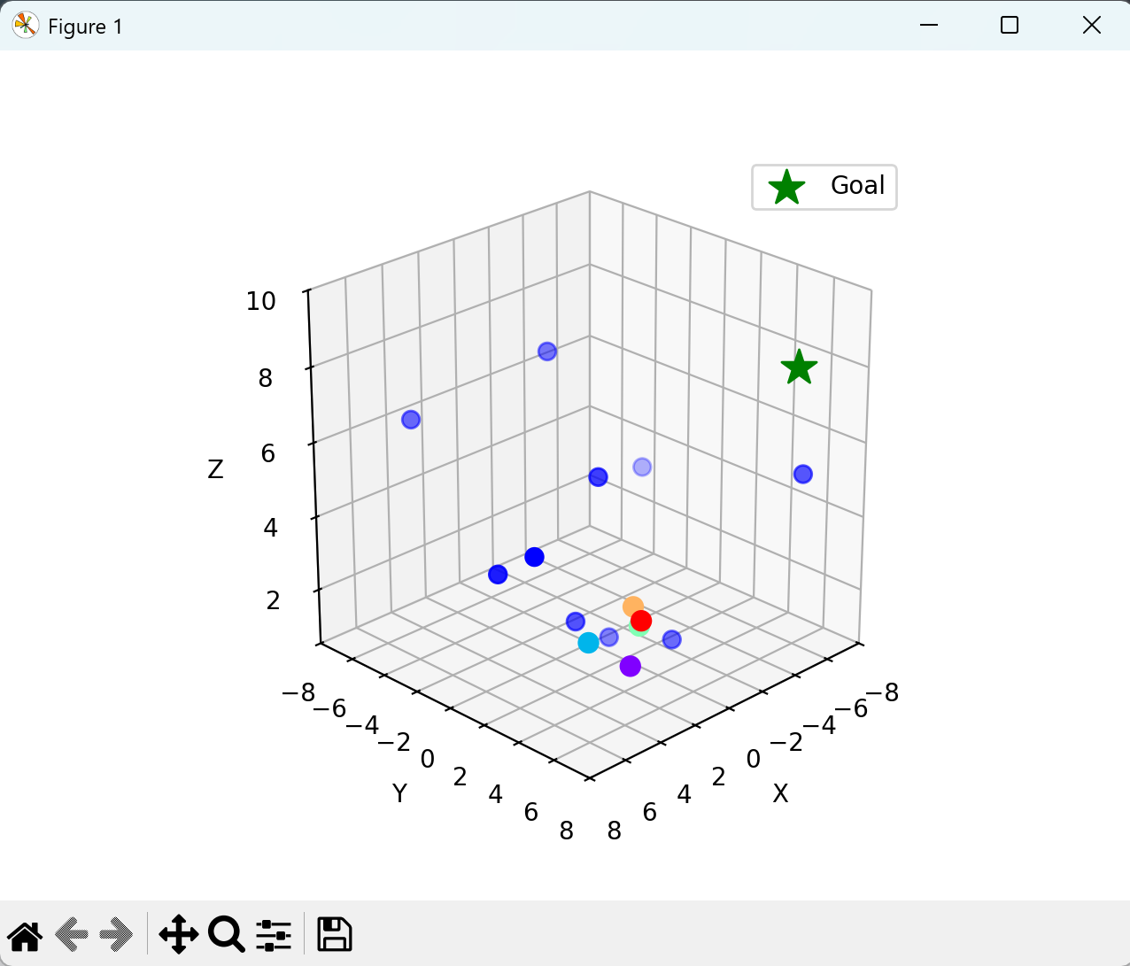
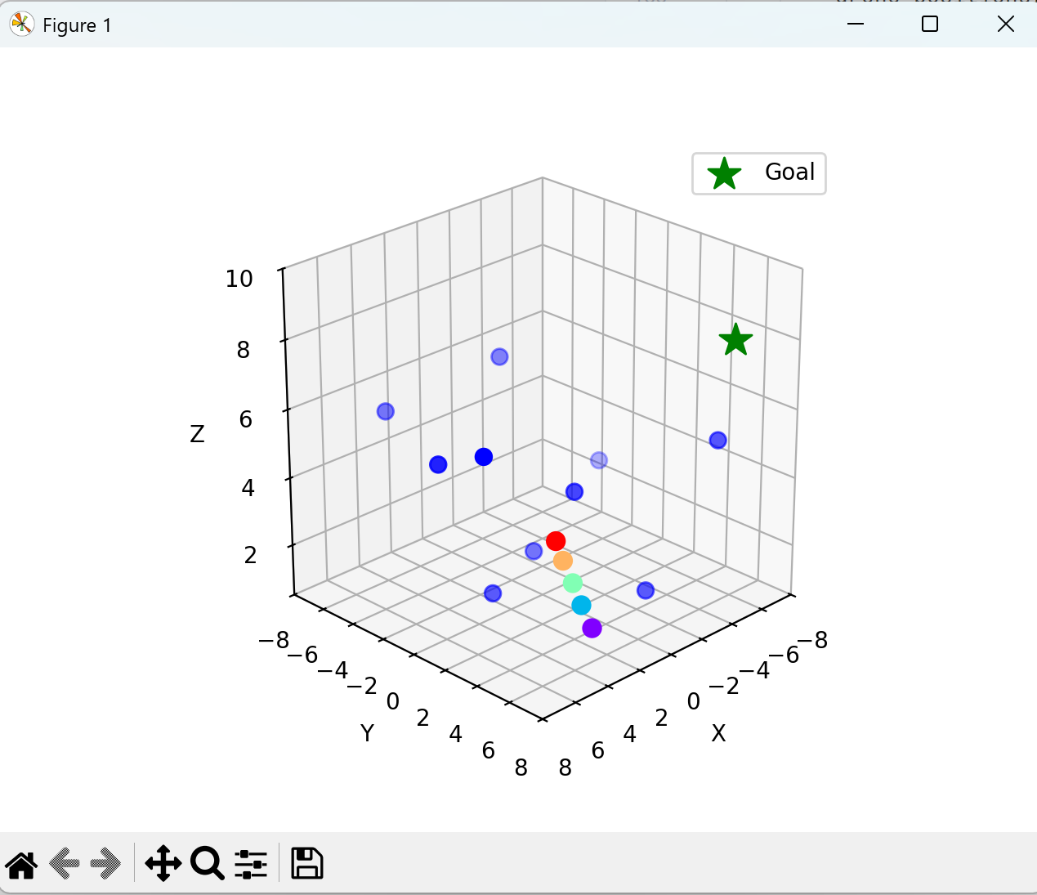
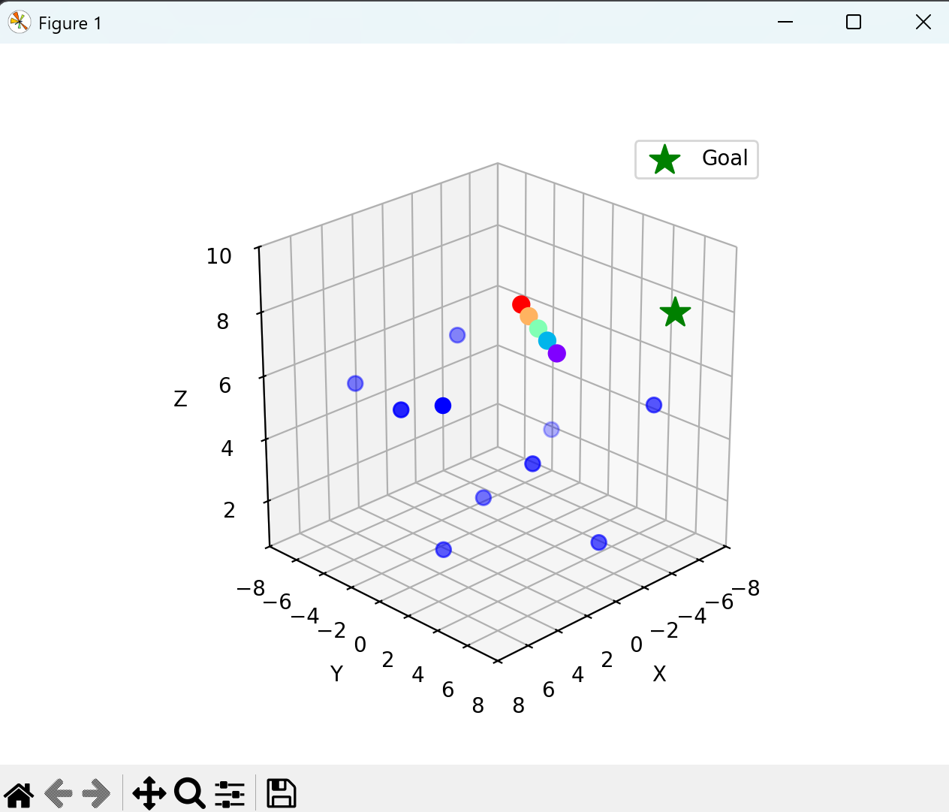
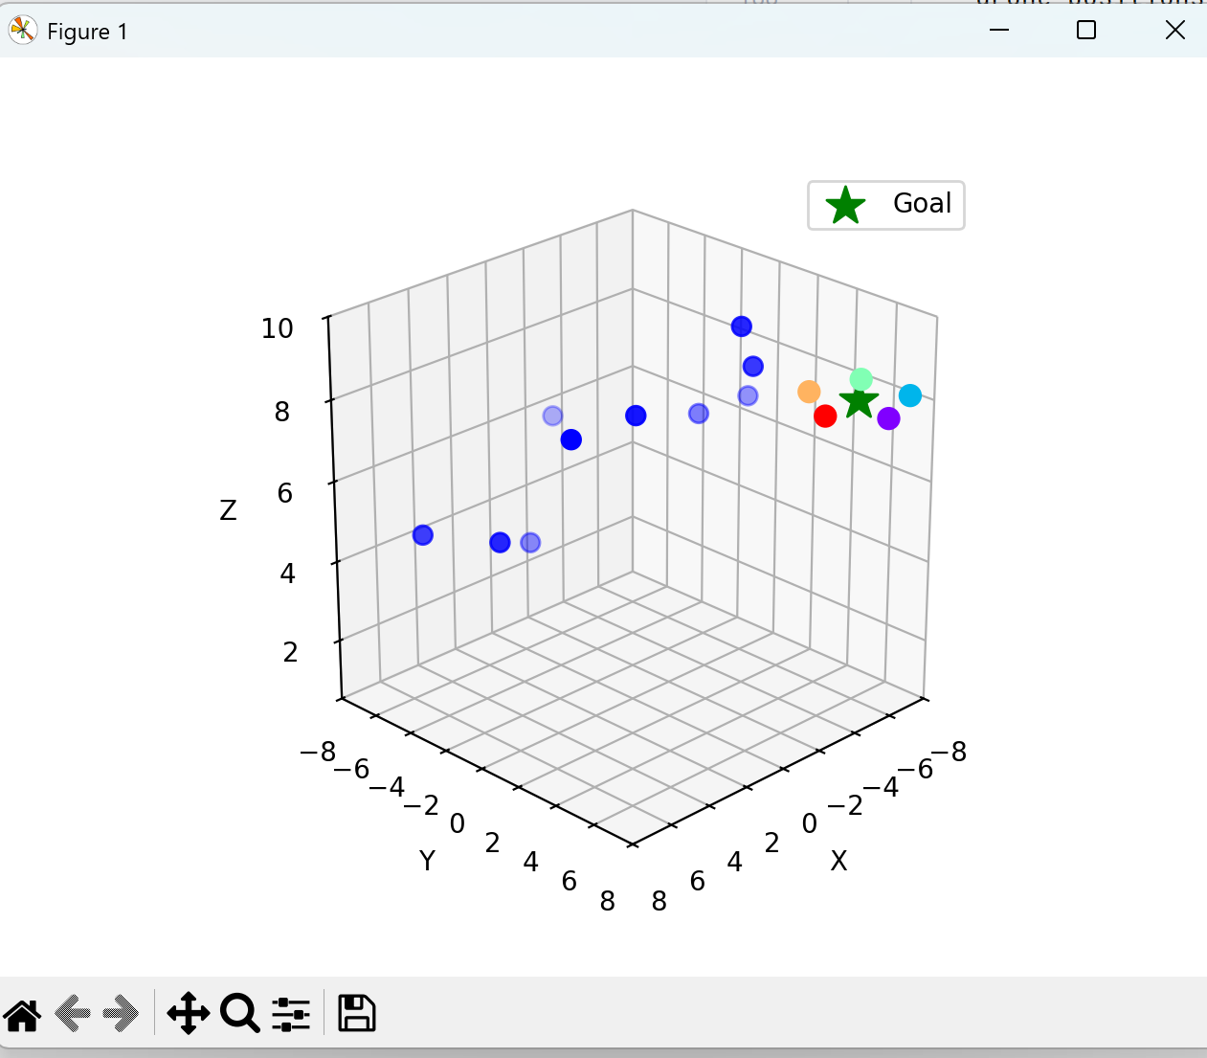
Simulation on Matplotlib

Slide 6
Equations used in Python code
pos_obs += vel_obs ; vel_obs[(pos_obs < min) | (pos_obs > max)] *= -1 # Obstacles move & bounce
perp_dir = [-goal_dir_y, goal_dir_x, 0] / ||...|| # Perpendicular direction
line_pos[i] = center + perp_dir*(i-(n-1)/2)*spacing # Line formation
pos_drn += (target_pos - pos_drn) / norm(target_pos - pos_drn) * speed # Move toward target
target_pos = goal + R * [cos(angle + i*Δθ), sin(angle + i*Δθ), h] # Circle formation target
angle += ω # Rotate circle over time

Slide 7
Progress Report:
Initially, the project simulated a swarm of five UAVs navigating via the shortest line path to the goal in an obstacle-free environment. The algorithm was later enhanced to include obstacle avoidance, straight-line formation, circular swarm formation, and rotation around the goal point. The UAVs now operate under a decentralized control system for improved coordination and robustness.

Slide 8
Thank You

