Slide 1
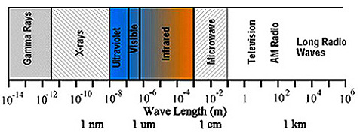
Josh Jones
Geos 654 HW #1
Frequency:
υ = c/λ
Energy:
E = hυ
h = 6.626x10⁻³⁴ Js

Slide 3
The EM spectrum can be broken up into numerous parts
based on wavelength/frequency.
Some of the more general regions, with their wavelengths,
that are generally accepted are, although some differences
exist between where certain regions begin and end, these
values are from Dr. Nicholas Short’s “Remote Sensing
Tutorial” (http://rst.gsfc.nasa.gov/):
- Gamma rays (~1x10⁻⁵ μm and smaller)
X-rays (~1x10⁻⁵ μm to ~1x10⁻² μm)
Ultraviolet (~1x10⁻² μm to ~0.4 μm)
Visible light (~0.4 μm to ~0.7 μm)
Infrared (~.7 μm to ~1000 μm)
Microwave (~1000 μm to ~1x10⁵ μm)
Television & Radio Waves (~1x10⁵ μm and larger; to 1x10⁸ μm
    based on calculations in previous slide)

Slide 4
Many of these bands can be further divided into smaller regions.
For example, visible light is divided into blue (~.4 μm to ~.5 μm),
green (~.5 μm to ~.6 μm), and red (~.6 μm to ~.7 μm). These
can be further divided into violet and blue for blue, green-yellow
to yellow-orange for green light moving towards red light. The
infrared region can be divided into near infrared (NIR) or short
wave infrared, mid-Infrared (MIR), and thermal infrared or far
Infrared or long wave infrared. The distinctions are made based on the energy of the wave’s interaction with matter. So the division of the different parts of the spectrum will depend on the nature of the study or observations. For instance, the actual end of the NIR and MIR may overlap between different sources, or the thermal IR may be distinct from the far infrared region.

Slide 5
References consulted for this homework:
Elachi, C and J. van Zyl (2006). Introduction to the Physics and Techniques of Remote Sensing.
Lillesand, T.M. and R.W. Kiefer (2000). Remote Sensing and Image Interpretation.
Suits, G.H. (1975). The Nature of Electromagnetic Radiation from Manual of Remote Sensing v.1. R.G. Reeves (editor).
(I could not find volume one of the most recent version in the library)
Short, N. (2009). Remote Sensing Tutorial found at http://rst.gsfc.nasa.gov/.

