Slide 1
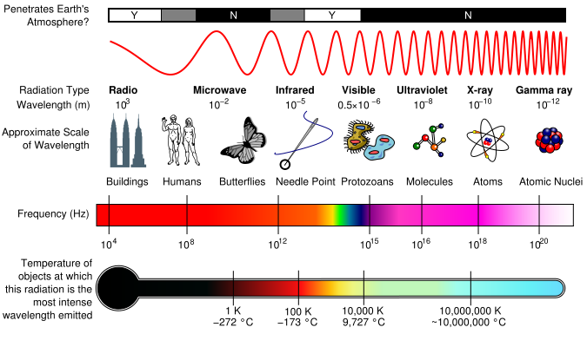
Electromagnetic Spectrum:
General Overview
Radio
Microwave
Infrared
Visible
Ultraviolet
X-Ray
Gamma Ray
10³
10⁻²
10⁻⁵
0.5x10⁻⁶
10⁻⁸
10⁻¹⁰
10⁻¹²
Wavelength (m)
10⁴
10⁸
10¹²
10¹⁵
10¹⁶
10¹⁸
10²⁰
Frequency (Hz) (approximate)

Slide 2
Electromagnetic Spectrum:
Visible Spectrum
Orange
Green
Indigo
700
600
500
400
Wavelength (nm)
Wavelength (μm)
Wavelength (m)
0.7
0.6
0.5
0.4
7x10⁻⁷
6x10⁻⁷
5x10⁻⁷
4x10⁻⁷
Red
Yellow
Blue
Violet
Electromagnetic Spectrum:
Infrared Spectrum
←warmer
cooler→
10³
10⁴
10⁵
Wavelength (nm)
Wavelength (μm)
Wavelength (m)
1
10
100
10⁻⁶
10⁻⁵
10⁻⁴
SWIR
Near-IR
Mid-IR
Far-IR

Slide 3
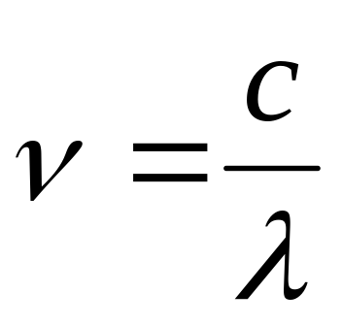
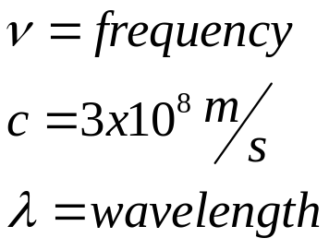
Frequency → Wavelength:
Direct Conversions
λ (m) | λ (μm) | λ (nm) | ν (Hz)
1.00E+03 | 1.00E+08 | 1.00E+11 | 3.00E+05
100.00 | 1.00E+07 | 1.00E+10 | 3.00E+06
10.00 | 1.00E+06 | 1.00E+09 | 3.00E+07
1.00 | 1.00E+05 | 1.00E+08 | 3.00E+08
0.10 | 1.00E+04 | 1.00E+07 | 3.00E+09
0.01 | 1.00E+03 | 1.00E+06 | 3.00E+10
1.00E-03 | 100.00 | 1.00E+05 | 3.00E+11
1.00E-04 | 10.00 | 1.00E+04 | 3.00E+12
1.00E-05 | 1.00 | 1.00E+03 | 3.00E+13
1.00E-06 | 0.10 | 100.00 | 3.00E+14
1.00E-07 | 0.01 | 10.00 | 3.00E+15
1.00E-08 | 1.00E-03 | 1.00 | 3.00E+16
1.00E-09 | 1.00E-04 | 0.10 | 3.00E+17
1.00E-10 | 1.00E-05 | 0.01 | 3.00E+18
1.00E-11 | 1.00E-06 | 1.00E-03 | 3.00E+19
1.00E-12 | 1.00E-07 | 1.00E-04 | 3.00E+20

Slide 4
Nomenclature Discrepancies:
Many pictures of the electromagnetic spectrum have labels that correspond to a general area on the spectrum.
These labels seem to allow some ‘wiggle-room’ for the start and stop of the regions. This makes sense as it would be hard to imagine a distinct line between x-ray and gamma ray wavelengths.
There are also numerous sources with numerous breakdowns of sections of the spectrum:
  The infrared spectrum can be broken down into over 6 categories, most overlapping.

Slide 5
Sources
Other Notes:
Shorter wavelength = Higher frequency
Far IR = thermal energy
Near IR = used in remote controls
Remote Sensing and Image Interpretation (Lillesand, Keifer, Chipman)
NASA Remote Sensing Tutorial
CCRS Tutorial
Wikipedia

