Slide 1
LMAX disruptor
Who/What is LMAX?
The London Multi-Asset Exchange
Spin-off from Betfair into retail finance
Access the wholesale financial markets on equal terms for retail traders
We aim to build the highest performance financial exchange in the world

Slide 2
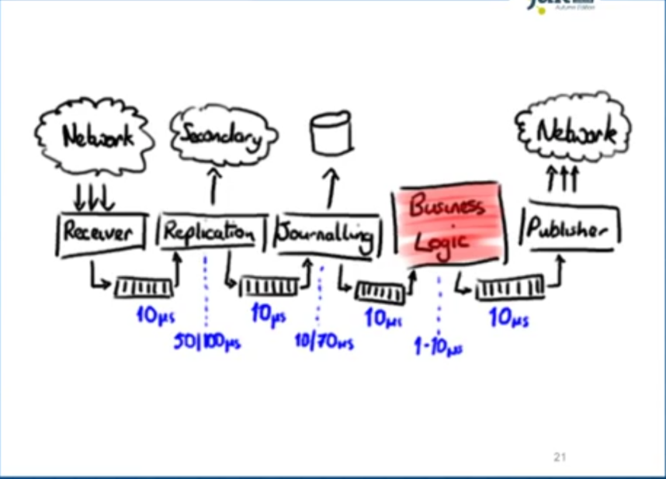
What problem are they trying to solve?

Slide 3
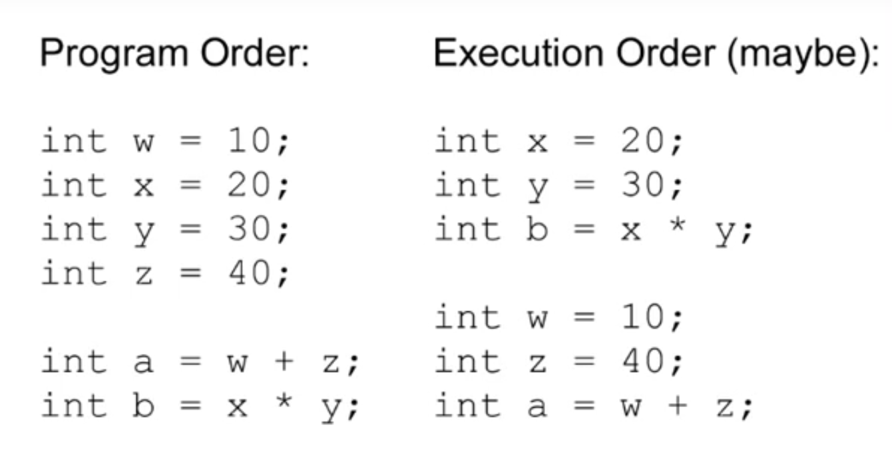
What makes concurrency so difficult
Reordering
Visibility

Slide 4
Contention (which approach has least latency)
Example – Increment a 64 bit counter 5 million times using –
Single thread
Locks
CAS
Volatile /final

Slide 5
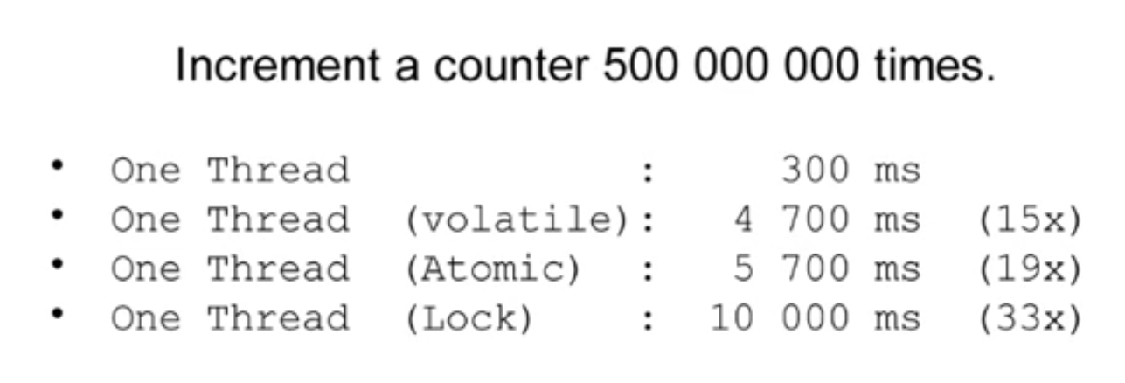
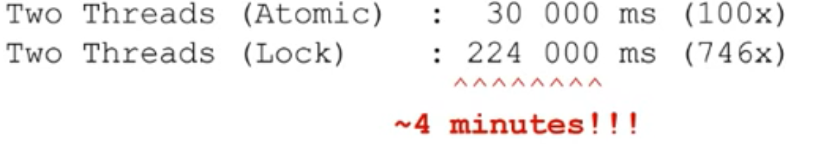
Results

Slide 6
Why so ?
Locks are relatively expensive –
Lot of atomic work happening in the background-
Putting a thread in queue(waiting queue)
Removing it from thread scheduling
Waking it up when the current owner release the monitor
Memory Barriers
Note – Locks internally uses CAS to change the status of thread from owned to un-owned
CAS are relatively less expensive –
It follows the principle of “it is easier to obtain forgiveness than permission” whereas thread is based on principle “ask permission first and then change”
It does not do lock housekeeping as compared to threads.
In worst case our code might just run in loop a couple of times rather than being context switched out for milliseconds to wait for a simple variable increment.
However CAS is not free of cost –
The processor must lock it’s instruction pipeline to ensure atomicity and employ memory barriers make the changes visible to other threads.
Best approach –
The most ideal algorithm would be one with only a single thread owning all writes to a single resource with other threads reading the results .
However reading the results require memory barriers so that changes made by one thread are visible to other threads

Slide 7
Queues and their own problems
Problems with Queues –
Contention over read and write (tail ,head and size) .Alternate to this approach is use a Large grain locks on whole queue(put and take) .This is simple to implement but represents a significant bottleneck to throughput.
Cache line (false sharing)
No cache striding .
They are significant sources of garbage . Thus Garbage collection runs to re-claim the garbage .(More pause cycles )

Slide 8
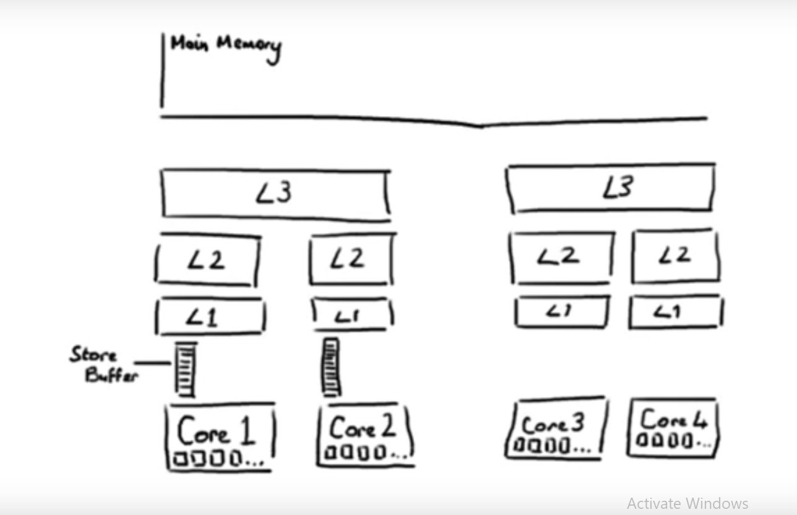
Caching
Why should we care about it

Slide 9
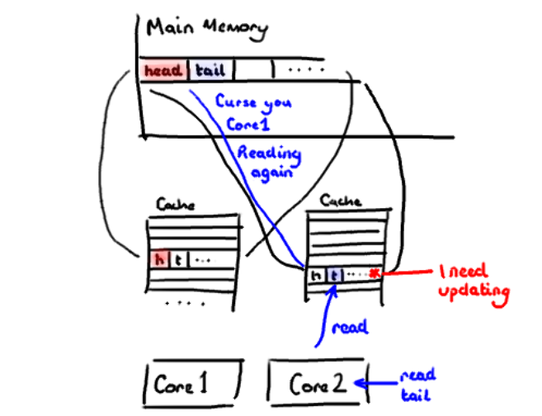
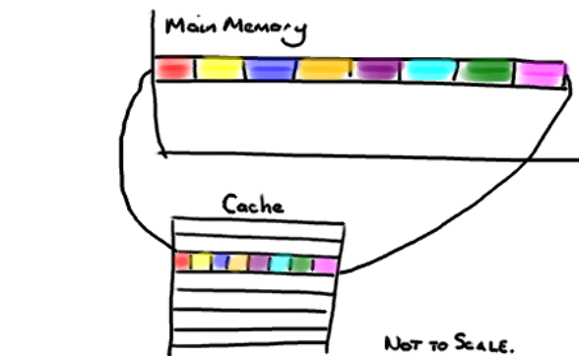
Cache lines
Solution – Magic cache line padding –
public long p1, p2, p3, p4, p5, p6, p7; // cache line padding private volatile long cursor = INITIAL_CURSOR_VALUE;

Slide 10
Cache striding
When accessing memory in a predictable manner CPUs are able to hide the latency cost of accessing main memory by predicting which memory is likely to be accessed next and pre-fetching it into the cache in the background.
This only works if the processors can detect a pattern of access such as walking memory with a predictable “stride”.
When iterating over the contents of an array the stride is predictable and so memory will be pre-fetched in cache lines, maximizing the efficiency of the access.
Strides typically have to be less than 2048 bytes in either direction to be noticed by the processor.
However, data structures like linked lists and trees tend to have nodes that are more widely distributed in memory with no predictable stride of access.

Slide 11
Disruptor to rescue
Advantages of Disruptor –
The Disruptor a number of advantages over traditional approaches: No contention = no locks = it's very fast.
Having everything track its own sequence number allows multiple producers and multiple consumers to use the same data structure.
Tracking sequence numbers at each individual place (ring buffer, claim strategy, producers and consumers), plus the magic cache line padding, means no false sharing and no unexpected contention.
Encourages cache striding
Minimizing garbage collection (by using pre allocated arrays)

