Slide 1
IntelliQuorum (Social Network for Researchers)
By
Anup Patil
Poonam Bhide
College of Computer and Information Science
Northeastern University
Summer 2013

Slide 2
Motivation
Inspired by ResearchGate / Quora
Social Network : Persuasive Technology
Unified platform for Students, Researchers
Direct interaction with the Experts, Scientists
Huge number of publications at one place
Any questions related to technology
Relevant companies and Jobs

Slide 3
Tasks using IntelliQuorum
Ask/Read a question
Follow topic / Subtopic
Answer/Read a Question
RESEARCHER
Follow any other researcher
View / Add publication
View Projects related to publication
Find relevant job
View Publications as per Institution/Topic/Subtopic/Author

Slide 4
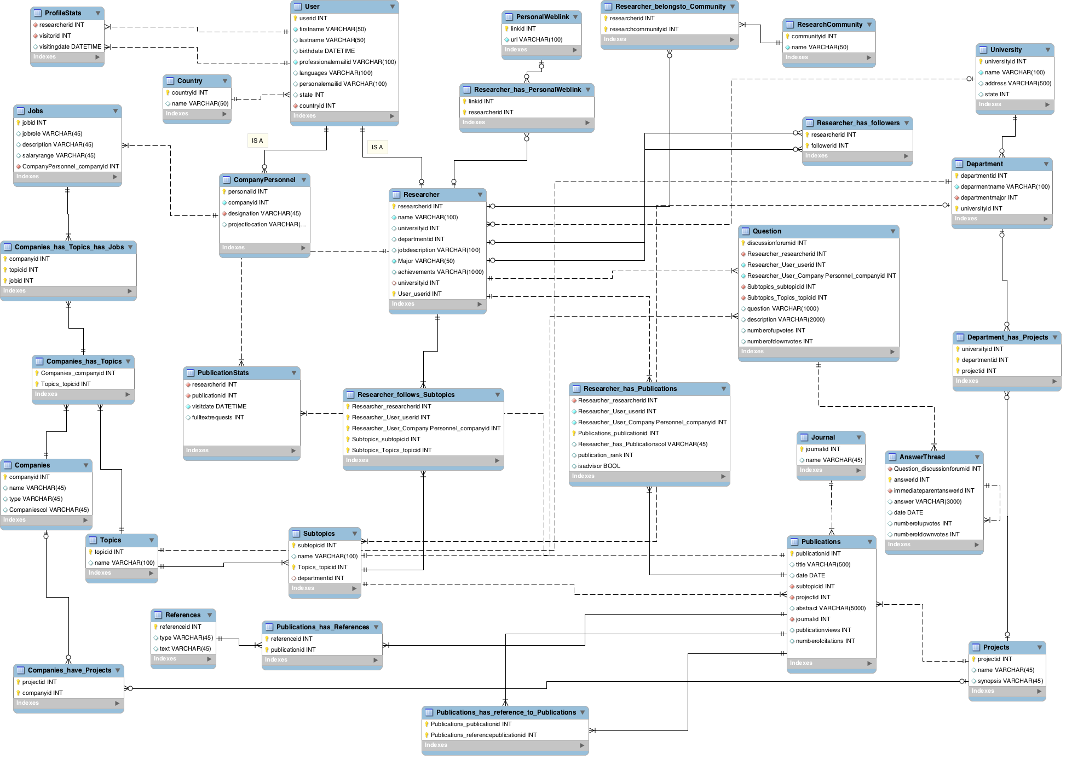
Database Diagram

Slide 5
Overview of modules in IntelliQuorum
Users Profiles
Researcher/Student
Company/Corporate Associate
Publications
References (Other Publication / Books)
Question Answers
Jobs

Slide 6
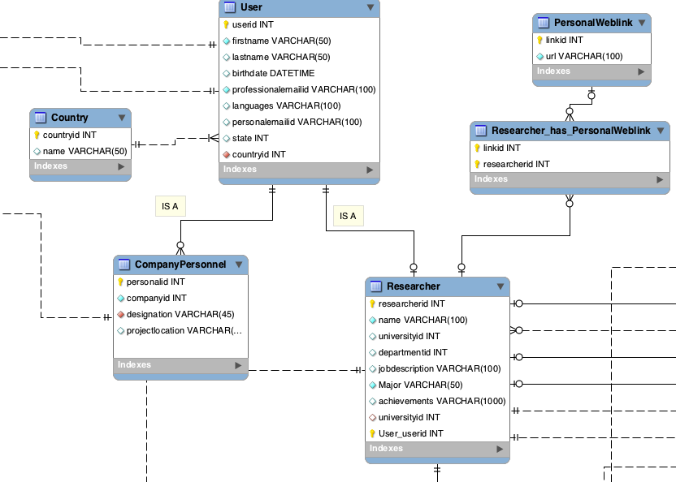
Module Wise DB: Users

Slide 7
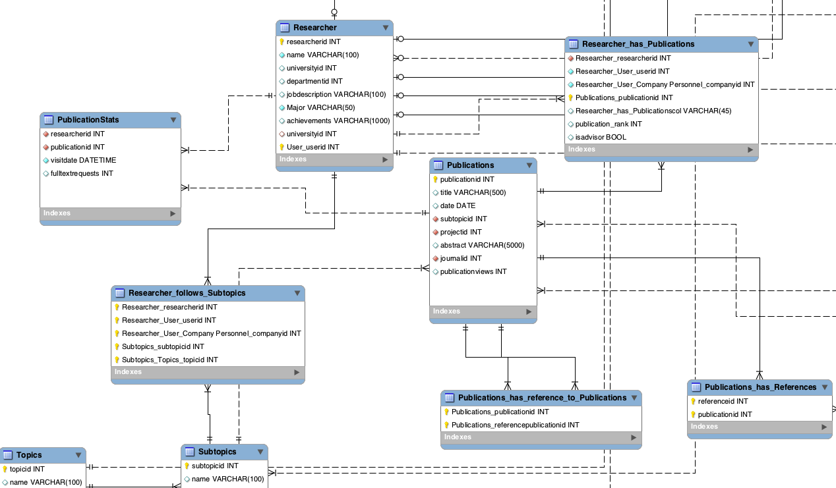
Module Wise DB: Publications

Slide 8
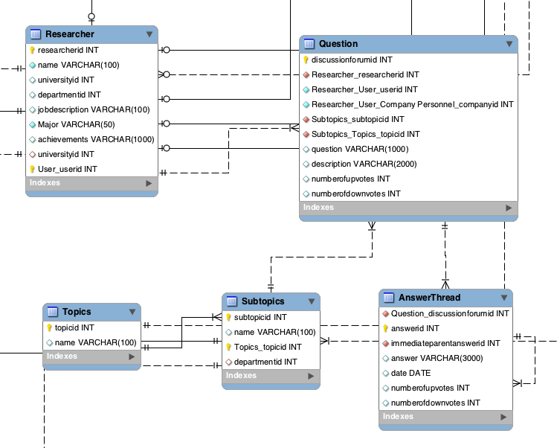
Module Wise DB: Question Answers

Slide 9
Challenges in Data Generation
Random Text for abstract of papers and question and answers using Java code.
Use of "org.postgresql.Driver“ for java connection to postgres.
Use of Microsoft Excel to generate random names, dates, numbers.

Slide 10
Applications and Reports
Show all publications under topic Computer Science
Researchers with their total number of publications
Find number of citations of publications by author with given id.
Find number of citations for researchers.
Researcher score for a given researcher.
Find publications under "Physics" and display the result university wise.
Find the followers of authors whose publication has maximum citations for a subtopic "Systems”
Find references to publications
Profile views daily/weekly/monthly for a particular researcher
Researcher score for a given researcher
Find all questions and answers posted under "Database management" sub_topic

Slide 11
1. Researcher score for a given researcher:
NO | PARAMETER | WEIGHTAGE
1 | Number of citations for publication | 0.4
2 | Number of publications | 0.3
3 | Contribution to answers and questions | 0.2
4 | Number of followers | 0.1
Researcher Score RS based on Parameters P_{i} and W_{i} is given by :
RS = Σ P_{i}*W_{i} where i= 1 to 4

Slide 12

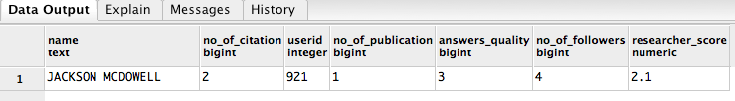
Researcher Score
with all_publications_by_author as
(select rpub.publications_publicationid as publicationid,
r.researcherid as researcher_id
from researcher r
join researcher_has_publications rpub on rpub.researcher_researcherid=r.researcherid
where r.researcherid = 921),
cited_by as
(select pp.publications_publicationid as pubids,allp.researcher_id from publications_has_reference_to_publications pp
join all_publications_by_author allp on pp.publications_referencepublicationid=allp.publicationid),
-- Citations
total_citations_by_researcher as
(select count(*) as no_of_citation,researcher_id from
publications pub join
cited_by refpub on pub.publicationid=refpub.pubids
group by researcher_id order by count(*) desc),
-- Publications
total_publications_by_researcher as
(select count(*) as no_of_publication,researcher_id from all_publications_by_author
group by researcher_id),
-- Answers answered
total_answers_answered as
(select sum(numberofupvotes)/1000 as no_of_ans,replierid from answerthread ans join all_publications_by_author ap on ans.replierid=ap.researcher_id
group by replierid
),
total_followers as
(select count(*) as no_of_followers,rf.researcherid from researcher_has_followers rf join all_publications_by_author ap
on rf.researcherid=ap.researcher_id
group by researcherid)
select (u.firstname ||' ' || u.lastname) as name,
tot.no_of_citation,u.userid,tpub.no_of_publication,tans.no_of_ans as answers_quality,tfs.no_of_followers,(0.4*tot.no_of_citation)+(0.3*tpub.no_of_publication)+(0.2*tans.no_of_ans)+(0.1*tfs.no_of_followers) as Researcher_score
from users u
join total_citations_by_researcher tot
on u.userid=tot.researcher_id
left outer join total_publications_by_researcher tpub on u.userid=tot.researcher_id
left outer join total_answers_answered tans on tans.replierid=u.userid
left outer join total_followers tfs on tfs.researcherid=u.userid
order by (0.4*tot.no_of_citation)+(0.3*tpub.no_of_publication)+(0.2*tans.no_of_ans)+(0.1*tfs.no_of_followers) desc
Query

Slide 13

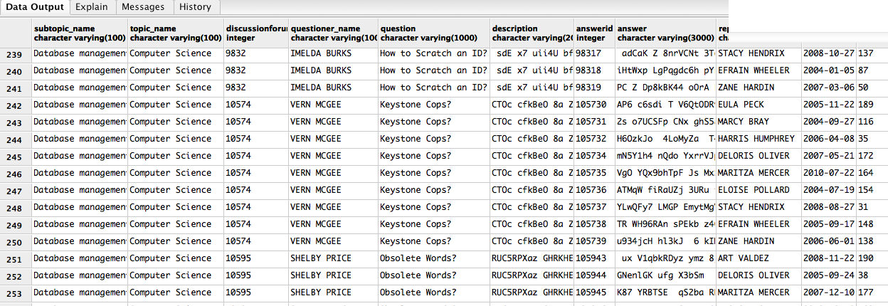
2.Questions and Answers Under Particular Subtopic
Query

Slide 14
create function find_question_answers_subtopicwise (text)
returns setof record as $$
with forumdiscussion as
(
select
s.name as subtopic_name, t.name as topic_name,q.discussionforumid, u.firstname || ' ' || u.lastname as questioner_name,
q.question,q.description,a.answerid, a.answer, u1.firstname || ' ' || u1.lastname as replier_name,a.date as answer_date,
a.numberofupvotes as NumberOfUpVotes, a.numberofdownvotes as NumberOfDownVotes,, a.immediateparentanswerid
from question q
join answerthread a on a.question_discussionforumid = q.discussionforumid
join subtopics s on q.subtopics_subtopicid = s.subtopicid
join topics t on s.topics_topicid = t.topicid
join researcher r on q.researcher_researcherid = r.researcherid
join users u on u.userid = r.researcherid
join researcher r1 on a.replierid = r1.researcherid
join users u1 on u1.userid = r1.researcherid
where s.name ilike $1
)
select
fd.subtopic_name, fd.topic_name,fd.discussionforumid, fd.questioner_name,fd.question,
fd.description,fd.answerid, fd.answer,fd.replier_name,fd.answer_date,
fd.NumberOfUpVotes,fd.NumberOfDownVotes, fd.immediateparentanswerid,ans.answer
from forumdiscussion fd
left outer join answerthread ans on fd.immediateparentanswerid = ans.answerid
$$ language SQL

Slide 15
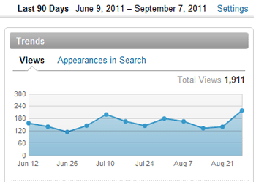
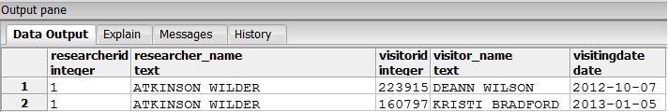
3. Profile Views
Monthly Profile View
Weekly Profile View
Profile View Between Dates

Slide 16
Profile Views
Monthly View
Weekly View
create function monthly_stats (text,text,text,text)
returns setof record as $$
select r.researcherid,u.firstname || ' ' || u.lastname as researcher_name,
ps.visitorid,u1.firstname || ' ' || u1.lastname as visitor_name,ps.visitingdate
from researcher r
join researcher_has_publications rhp on r.researcherid = rhp.researcher_researcherid
join users u on u.userid = r.researcherid
join profilestats ps on ps.researcherid = r.researcherid
join users u1 on u1.userid = ps.visitorid
where (u.firstname ilike $1) and (u.lastname ilike $2)
and (date_part('Month',ps.visitingdate)::text = $3) and (date_part('Year',ps.visitingdate)::text = $4)
$$ language SQL
create function weekly_stats (text,text,text)
returns setof record as $$
select r.researcherid,u.firstname || ' ' || u.lastname as researcher_name,ps.visitorid,
u1.firstname || ' ' || u1.lastname as visitor_name,ps.visitingdate
from researcher r
join researcher_has_publications rhp on r.researcherid = rhp.researcher_researcherid
join users u on u.userid = r.researcherid
join profilestats ps on ps.researcherid = r.researcherid
join users u1 on u1.userid = ps.visitorid
where (u.firstname ilike $1) and (u.lastname ilike $2)
and (ps.visitingdate >= ($3)::date) and (ps.visitingdate < (($3)::date + 7))
$$ language SQL

Slide 17
Conclusion and Lessons Learnt
End-to-End process of database generation
Indexing techniques
Constraints
Normalization
Handling complex queries
Future scope

Slide 18
References
https://www.researchgate.net/
http://www.quora.com/
http://itp.nyu.edu/~sd107/diyhealth2012/wp-content/uploads/2012/09/Fogg-2009-Creating-persuasive-technologies-an-eight-step-design-process.pdf
http://link.springer.com/chapter/10.1007/978-3-540-68504-3_3
http://moz.com/blog/tracking-the-roi-of-social-media

Slide 19
THANK YOU

Slide 20
Questions?

