Slide 1
EXPERIMENT 7 · BUSINESS INTELLIGENCE LAB
Why is profit lagging sales?
Advanced-analytics review of Global Superstore using Power BI
Sales have doubled since 2014 – but the margin is stuck at ~11.7%
Business Intelligence Consultant · Data: 51,290 order lines · 2014–2017
Notes:
Introduce the scenario: management sees rising sales but profit not growing as expected. Our task: find out where profit is made and lost, and recommend corrective action.

Slide 2
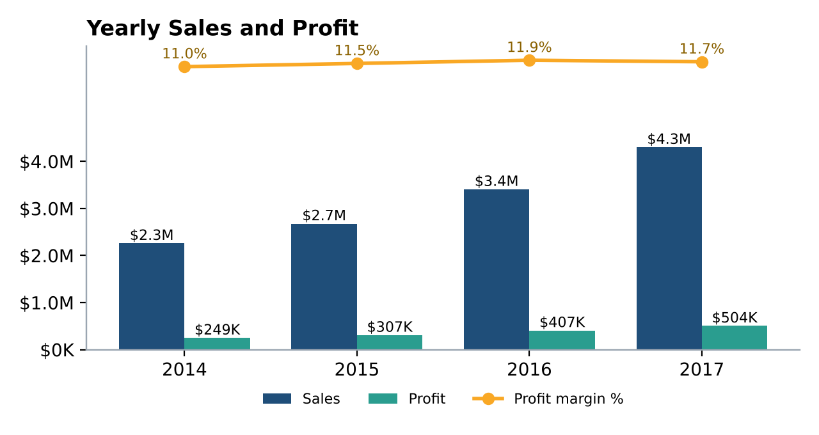
Dashboard overview
Sales almost doubled; profit grew with it, but margin has plateaued
$12.64M
$1.47M
25,728
11.6%
What the dashboard shows
• Sales +90% (2014→2017), 24% a year
• Profit +103%
• Margin 11.0% → 11.9% (2016) → 11.7% (2017)
• In 2017 profit growth (+23.9%) fell behind sales growth (+26.3%)
• Sep–Dec = 45% of annual sales
Growth is coming from volume, not from better profitability.
Total Sales
Total Profit
Total Orders
Profit Margin
Global Superstore · Business Insight Review · Exp. 7
2
Notes:
Pages used: Executive Dashboard, Business Scorecard, Business Analysis and the new Advanced Analytics page in the Power BI project.

Slide 3
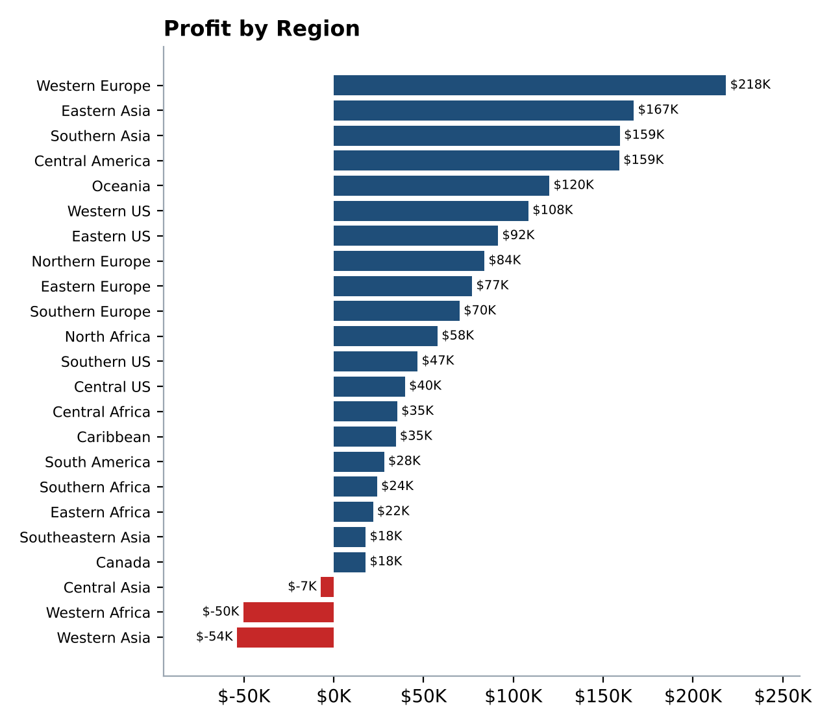
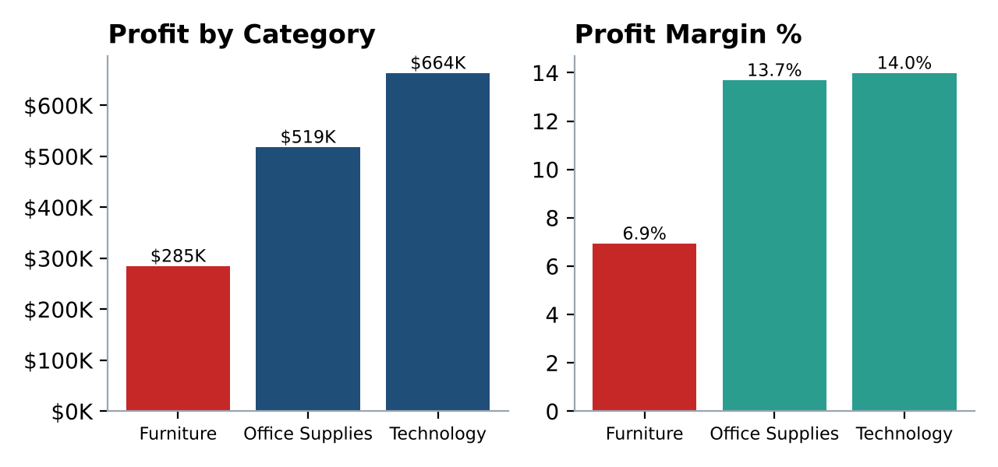
Key findings: where profit is made and lost
Region and category performance (all years)
Best region: Western Europe – $218K profit
Worst region: Western Asia – $54K loss
Most profitable category: Technology – $664K (14.0%)
Least profitable: Furniture – $285K (6.9%)
Segments are not the issue: margins 11.5–12.0% for all three
Global Superstore · Business Insight Review · Exp. 7
3
Notes:
Steps 2-4: region, category and segment analysis. Three regions lose money: Western Asia, Western Africa and Central Asia (-$111.6K combined).

Slide 4
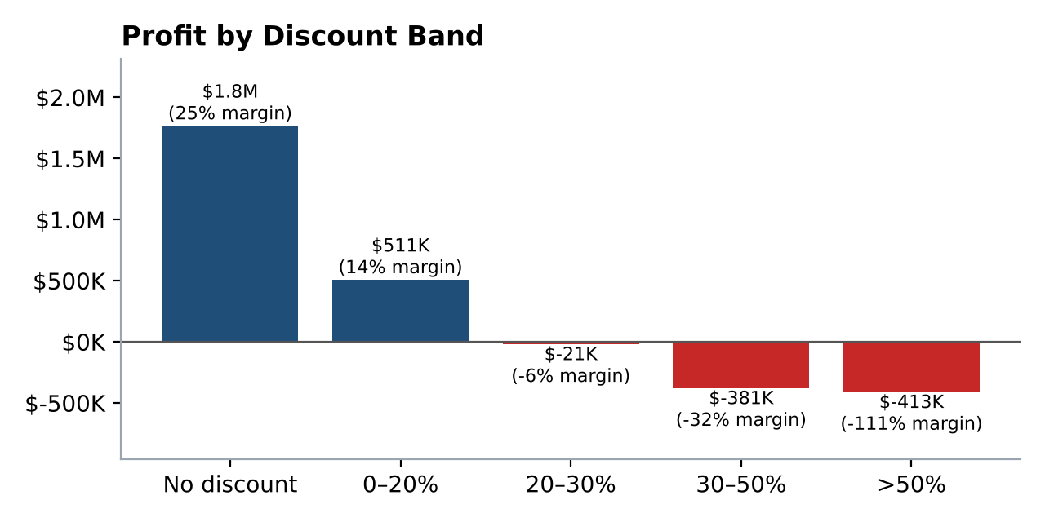
Business issue: discounts destroy profit
Margin falls as discount rises – above 20% every order band loses money
$815K
lost on lines discounted > 20%
25.3% vs 11.6%
margin with no discount vs overall
• 22% of order lines are discounted > 20%
• Loss-making regions average 35–43% discount; best regions 5–9%
• Tables: −$64K at 29% average discount
• Average discount has stayed ~14% every year → margin stuck
Global Superstore · Business Insight Review · Exp. 7
4
Notes:
This is the root cause. Lines with no discount earn $1.77M profit at 25% margin; lines discounted over 20% generate $1.93M sales and an $815K loss.

Slide 5
Strengths, weaknesses and opportunities
Strengths
Weaknesses
Opportunities
• Consistent growth: +18%, +27%, +26% a year
• Technology + Office Supplies = 81% of profit
• Diversified customers: top 10 = 2.7% of sales
• Europe margin 13.7% (best market)
• Discount erosion: −$815K above 20%
• 3 loss-making regions: −$112K
• Furniture margin 6.9%; Tables lose money
• 45% of sales in Sep–Dec
• Discount governance: up to +$815K (≈ +56%)
• Grow high-margin regions: E. Asia 19.5%, S. Asia 18.4%, Canada 26.6%
• Fix Furniture: ≈ +$0.28M
• Plan Q4 stock & promotions
Global Superstore · Business Insight Review · Exp. 7
5
Notes:
At least two strengths, two weaknesses and two opportunities, each supported by evidence from the dashboard.

Slide 6
Recommendations
Ranked by profit impact – each backed by the data
Recommendation
Impact
Evidence
1
Discount policy: approval above 20%, hard cap 30%
Up to +$815K
Lines >20%: −$815K
2
Turn around Western Asia, Western Africa, Central Asia
+$112K
Combined loss −$111.6K
3
Re-price Furniture; stop discounting Tables
+$0.06–0.28M
Margin 6.9%; Tables −$64K
4
Grow Technology & Office Supplies in high-margin regions
Higher margin mix
81% of profit; 12–27% regional margins
5
Plan Sep–Dec stock/promotions; add margin & discount KPIs to scorecard
Stable margin
45% of sales in Sep–Dec
Global Superstore · Business Insight Review · Exp. 7
6
Notes:
Justify every recommendation with the evidence column. Even capturing half of the discount loss adds about $0.4M (+28%) profit.

Slide 7
Conclusion
Growth is healthy; profitability is not keeping pace – and discounts are the cause.
• Sales doubled, but margin is flat at ~11.7%
• Discounts above 20% cost $815K of profit
• Three regions and the Tables line lose money
• Technology and Office Supplies are the growth engine
• Discipline on discounts, regions and Furniture can add ≈ $0.4–1.0M profit a year without extra sales
KPIs to monitor monthly
• Profit margin % (11.6% → 14%)
• Average discount % (14% → ≤12%)
• Loss-making sales lines
• Profit by region vs target
Global Superstore · Business Insight Review · Exp. 7
7
Notes:
Close by restating the one-line message and asking for approval of the discount policy as the first action.

