Slide 1

TRANSFER LEARNING OF DETECTING DEPRESSION ON SOCIAL NETWORK
      Student: Oliver Chi
Student ID: U1037192
Supervisor: Dr. Xiaohui Tao
Notes:
My name is Oliver. I am here to present my research… first I want to thank my Supervisor Dr. Xiaohui Tao, without his help this research will not complete at this level.

Slide 2

CONTENTS
        Introduction
        Background
        Literature Review
        Research Problem
        Methodology
        Experiment
        Results and Discussion
        Future Work
        Conclusion
Notes:
In this presentation, I will outline all key elements in the research and talk about the research problem, methodology and experiment. And further I will discuss the outcome and point out the future work.

Slide 3
INTRODUCTION
Aim: classification method for preliminary detection of depression
Try to answer:
  How to transfer psychological knowledge for analysis of intricate health data
  How to use machine learning technique for distinguishing depression cases from health dataset
  How to improve the predictive performance in the classification
Notes:
My research is to implement machine learning technology to explore the new solution, new classification method for detecting depression on social network. It aims to provide doctor a decision support while screening a large number of potential depression cases from Big data on social media. In order to solve this mental health problem, First, we have to understand the data in psychological domain, to understand how the data being organised and the meaning behind. otherwise, we can’t process them without a full acknowledge. We need to transfer psychological knowledge, rules into the actions of mining health data.
Furthermore, this research need to answer which machine learning method is more suitable in this problem, how to build a more effective classifier and how to improve the predictive performance in the classification.

Slide 4
BACKGROUND
Major Depressive Disorder (Depression)
Importance in early detection of depression
Mental screen inventory: quick but expensive
Notes:
In order to understand well the background of this reseach, there are several terms and issues we need to have a look first.
Major depressive disorder, simple know as depression, is a very serious worldwide healthcare problem. According to the report of World Health Organisation, depression has became the second cosy disease in global healthcare. And in the worse circumstance, it directly lead to suicide which is an extreme social problem in Australia, Europe and U.S.
Due to the nature of metal disorder, people with depression occasionally don’t seek medical assistance. So doctors are not able to approach those patients in the early stage of their disease. Therefore, The method for early detection of depression becomes very critical for the whole community.
Psychology researchers have create a method named Mental screen inventory for quickly screening patients if they have depression. Almost of applications in this method is consisted by medical questionnaire. Normally more 20 questions. However, it is very expensive for doctors to examine these questions for many patients. And apparently it is impossible to implement on social media.
Therefore, it is necessary to seek a new classification method of depression detection for screening a wide range of samples.

Slide 5
LITERATURE REVIEW
Most screening methods based on depression diagnostic criteria [1]
    For instance, PHQ-9 assesses 9 diagnostic criteria [2]
Classification methods: SVM, Naive Bayes, Decision Tree, Random Forest, KNN….
    depend on implementation and datasets [3]
Ensemble method: improve the performance [3]
Validation: expertise (slow & too cosy) or screen inventory (quick) [4]
Notes:
Through literature review of up-to-date researches in this area, several key information are found. First, almost all screening methods are based on identifying depression diagnostic criteria, which is defined in the standard manual of mental disorder. For instance, a popular method named PHQ-9 assess 9 mental diagnostic criteria to identify depressive patients. alternatively, a few of research work used machine learning technology to classify instances or groups into two classes, depression and non-depression. They used many classification algorithms such as SVM, Naive Bayes, Decision tree, Random Forest, KNN and so on. The researchers discovered that the selection of suitable classification method was mainly depended on the implementation and datasets. They also suggest that ensemble method may improve the performance of classification. For the technical of validation, some researches compared their models to the diagnosis by clinical expertises, but involving clinical diagnosis is too expensive and very slow; Other researches preferred mental screen inventory like PHQ-9 and CES-D because these methods are much quicker comparing to expertise judgement.
Learn from previous studies, we can define our research problem.

Slide 6
RESEARCH PROBLEM
Design new binary classifier of automate detecting depressive samples for preliminary screening, which should be:
    Stable and robust
    Effective and high-performed
    Perfect coverage of almost depressed cases
Notes:
The research problem is to design a new binary classification method for automate distinguishing depressed instances from a wide range of samples. It provides a solid approach for preliminary screening.
Moreover, there are three requirements for a suitable classification method for depression detection; it should be stable and robust; it should be effective and high-performed and it should cover almost all potential depressed cases without missing a potential. Based on those requirement, we propose a new methodology which has a better stable performance.

Slide 7
METHODOLOGY
Transfer psychology knowledge
Data preprocessing and restructure
Binary ensemble classification and evaluation
Notes:
Our proposed methodology include three parts, 1, 2, 3.
The order and relationship between each part are better to be illustrated in the concept.

Slide 8
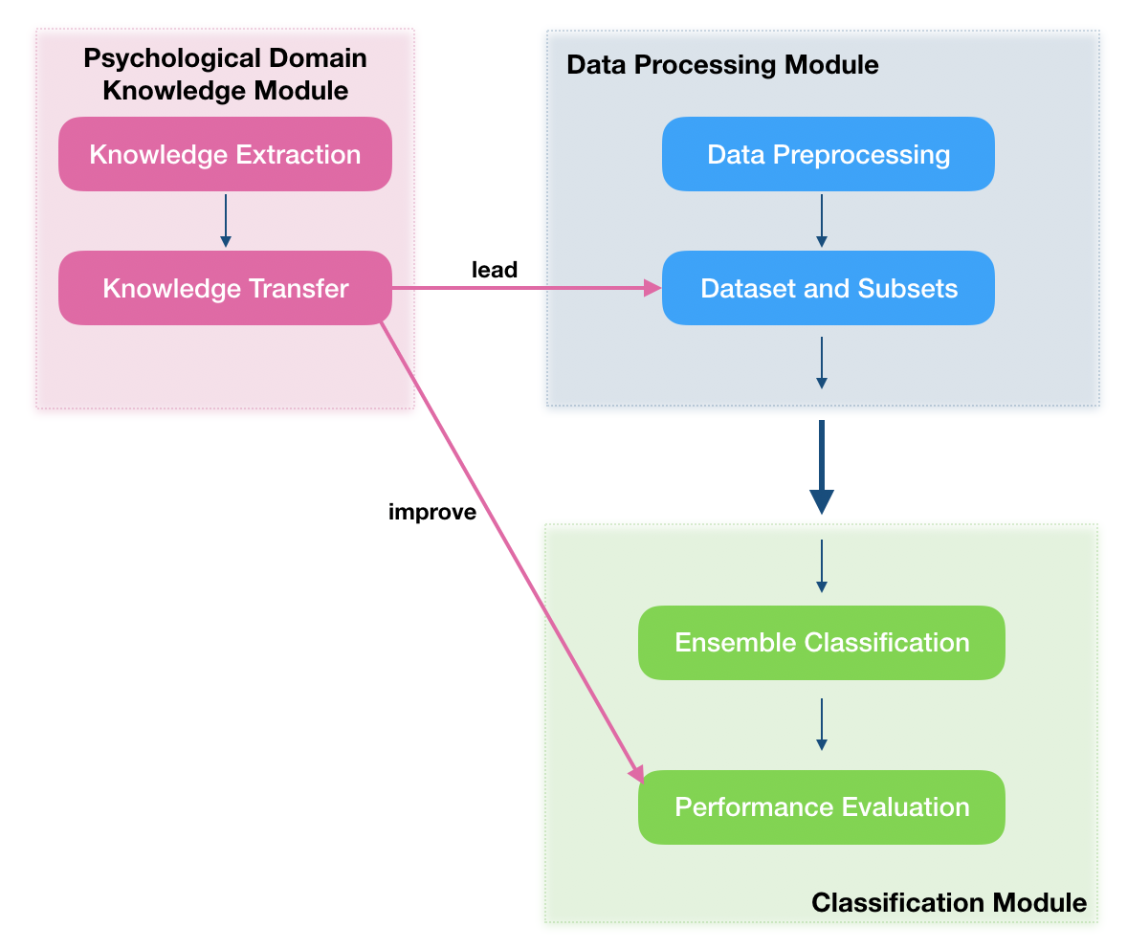
CONCEPT DESIGN
Notes:
First module is psychological module, having two elements, extracting knowledge from previous studies then knowledge transfer for next dataset forming and performance evaluation.
The second module is data processing module. It is an initial step for data mining. It preprocesses the health data and follow the psychological rules to form dataset.
The generated dataset is used for classification in the last module. Because ensemble method is generally stable and robust than single model, we use ensemble model for classification. And we adopt k-fold cross validation method for evaluation.

Slide 9
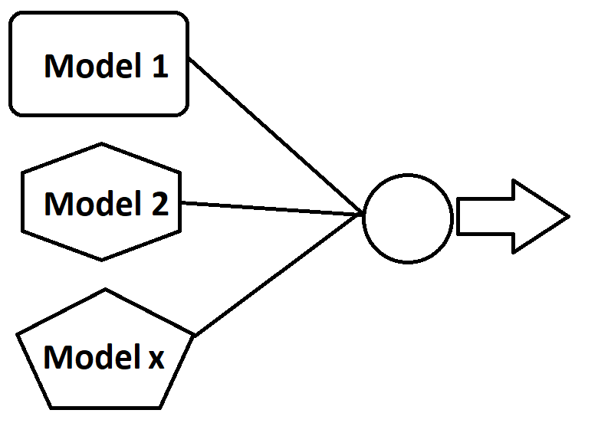

ENSEMBLE CLASSIFICATION
SVM, KNN, ANN, DT
Weighted voting
Advantages:
        Avaid overfitting
        Better in computation
        Strong representation
SVM
W1
KNN
W2
W3
ANN
W4
DT
Notes:
The key element in our methodology is ensemble classification. Ensemble method applies several classification techniques in parallel and wight their outcomes together. While more specifically each independent sub-model is trained, more targeted concepts are covered by the ensemble classifier and more accuracy it becomes. By the consideration of four diverse computing algorithms in supervised learning, we select each in one computing algorithm. So there are four baseline classifiers in our ensemble model. we select support vector machine, k-nearest neighbours, artificial neutral networks, decision tree for baseline models.
Ensemble method has a couple of advantages:
(i) Overfitting avoidance: ensemble methods improve the overall predictive performance by averaging different hypothesis to reduce the risk of choosing an incorrect hypothesis.
(ii) Computational advantage: ensemble methods decrease the risk of obtaining a local minimum by combining several learners, ensemble methods.
(iii) Strong representation: ensemble methods achieve a better fit to the data space due to combining different models and extending the search space.

Slide 10
DATA
NCHS health survey 2013-2014
Dataset
Ground truth: PHQ-9 scale
Categoric Survey question Feature
Notes:
NCHS health survey is a population-based survey designed to collect health-related information of the U.S. household population. It is a very rich resource for health professionals and researchers to expand our knowledges of various modern health problems. We employ the questionnaire data in NHANES 2013 - 2014 collection as input data of experiment.
After we preprocess the data to form an overall dataset, we also divide the whole dataset into six sub-sets which are according to the functional category in metal criteria. It is referred from related psychological work. It provide datasets in different aspects.
The ground truth of classification is provided by PHQ-9 measurement which is an integrated part of health survey data.
And naturally we group answers in one categoric survey question together into one feature.
Through an intricate actions of data mining, we convert health statistics into dataset ready for classification.

Slide 11
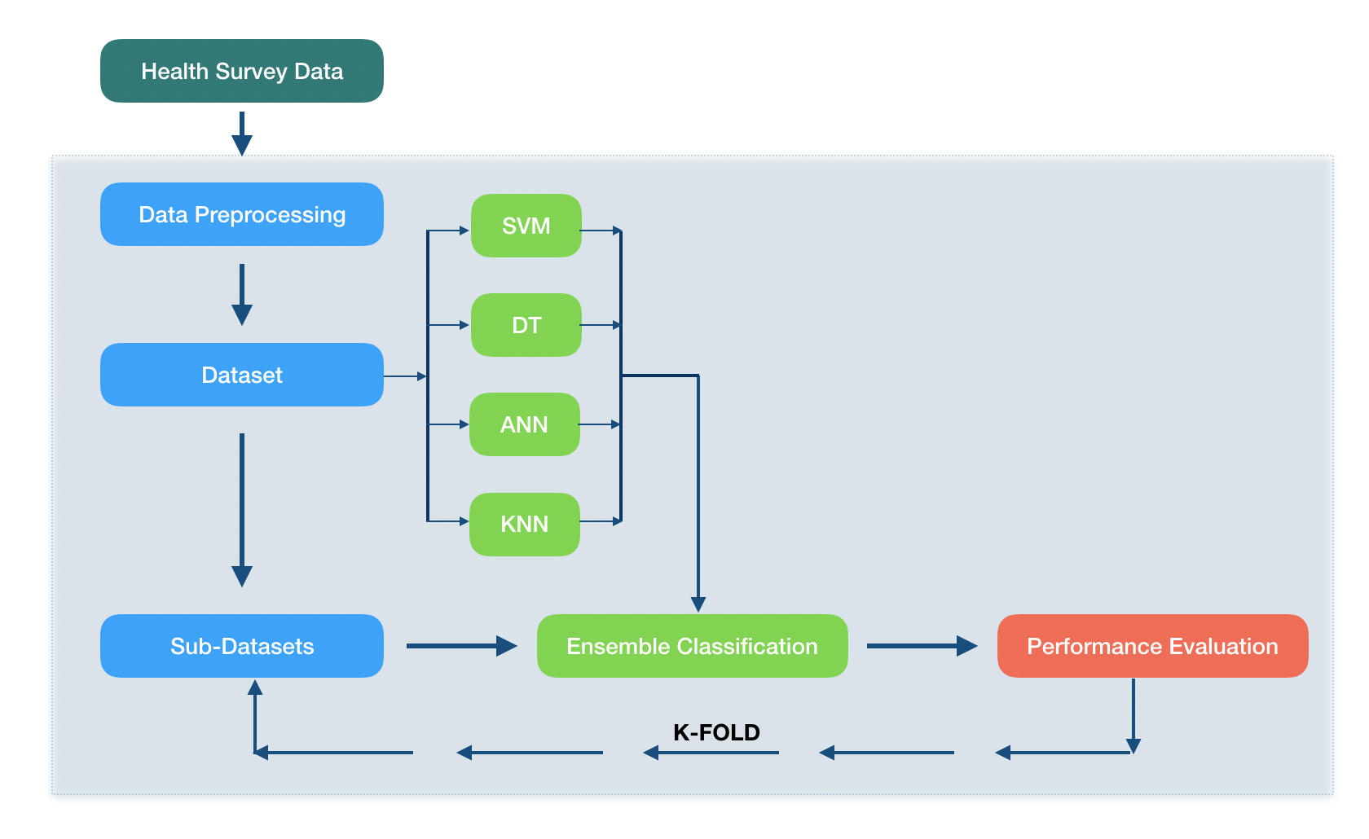
EXPERIMENT
Notes:
In experiment, we first obtain dataset Doverall by data preprocessing on survey data; next, we aggregate all features of Doverall into 6 health related functional classes and follow the same procedure to divide Doverall into 6 sub-sets Dphysical, Drole, Dmental, Dsocial, Dpain and Dgeneral; and we train dataset Doverall by four baseline models to obtain the relevant performances; then we build the ensemble model by calculating the performance weight of each baseline model; furthermore, we train all 6 sub-datasets by the ensemble classifier; and the final step is to use k- fold cross validation algorithm to value the complete predictive performance.

Slide 12
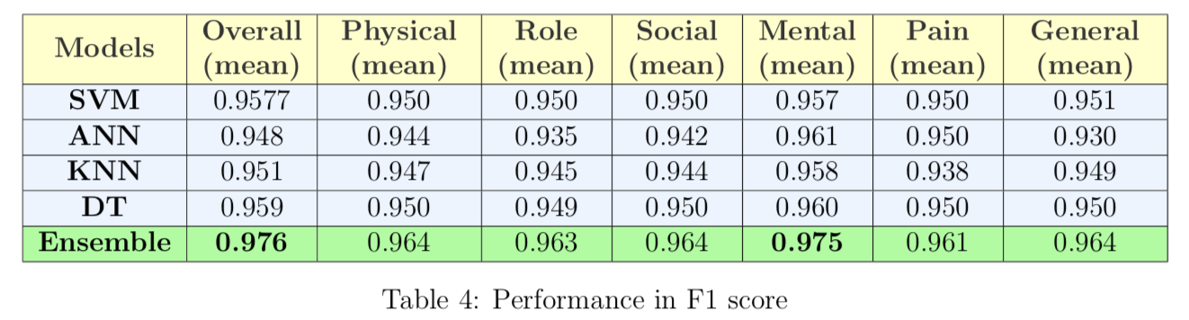
ENSEMBLE PERFORMANCE
30.3% improved comparing to baseline
F1 measure 0.976, Accuracy 95.4%
Precision: 0.956 Recall: 1.000

Slide 13
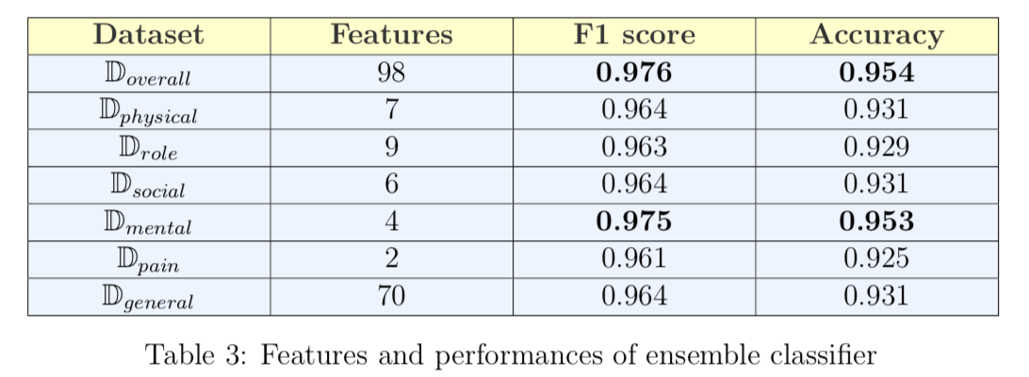
F1 AND ACCURACY
Significant F1 measure and Accuracy

Slide 14
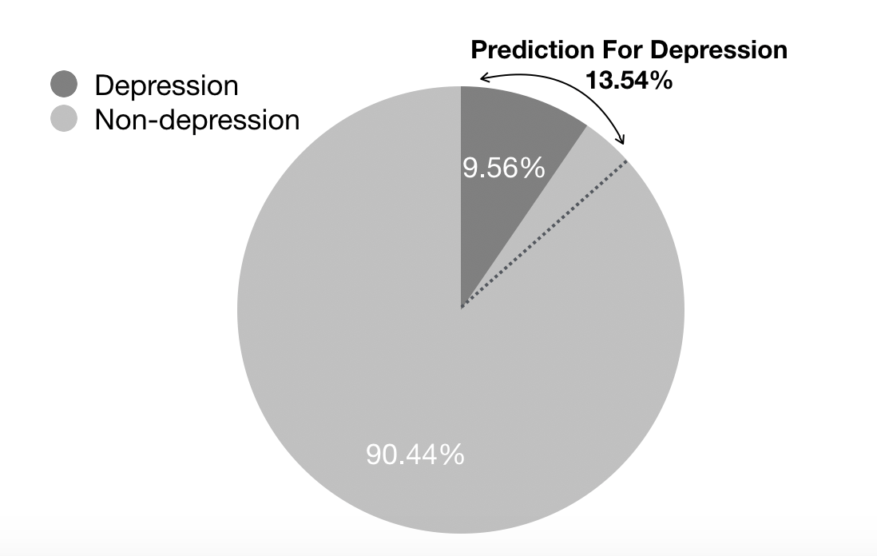
PREDICTION
Full coverage of depressed cases
Only 4% mis-classified

Slide 15
FUTURE WORK
Test reliability on social network platforms
Improve voting algorithm
Improve ensemble method by DNN
Notes:
Social network:It certainly will help improve the reliability and sensitivity of ensemble system.
Deep learning has gained more momentum in such areas. Current ensemble system involves four supervised learning algorithms, however it will not suit for deep learning. In order to detect depression in intricate circumstance, deep learning technologies like DNN will integrate to increase the performance of ensemble system in future.

Slide 16
CONCLUSION
Binary ensemble system with 0.976 F1 measure
Only 4% mis-classified in testing
Help in preliminary screening of depression
Notes:
This work presented a binary ensemble system which is able to preliminarily distinguish depressive cases from a wide range of health data without the missing identification of any potential depressed case. In the experimental evaluation on NCHS dataset, only 4% cases were mistakenly classified into depressed class and no depressed case has been detected incorrectly. this research can help in preliminary screening of depressive cases from a large number of potential cases before formal clinical diagnosis. It is able to save huge cost in the psychological healthcare. It provides a much more efficient way to screen more people than traditional technologies and has a similar accuracy and coverage as current mental scale inventory. However, the reliability and sensitivity of this ensemble system need to be tested next on more datasets and text mining on social network platforms. In the conclusion, the presented work clearly illustrated the predictive capability of the proposed ensemble system to efficiently distinguish depressive instances from a board span of healthcare occasions.

Slide 17
REFERENCE
[1] Zimmerman, M., and Coryell, W.: ‘The Inventory to Diagnose Depression (IDD): A self-report scale to diagnose major depressive disorder’, Journal of Consulting and Clinical Psychology, 1987, 55, (1), pp. 55-59
[2] Kroenke, K., Spitzer, R.L., and Williams, J.B.: ‘The PHQ-9: validity of a brief depression severity measure’, J Gen Intern Med, 2001, 16, (9), pp. 606-613
[3] Sagi, O., and Rokach, L.: ‘Ensemble learning: A survey’, Wiley Interdisciplinary Reviews: Data Mining and Knowledge Discovery, 2018, 8, (4), pp. e1249
[4] Wongkoblap, A., Vadillo, M.A., and Curcin, V.: ‘Researching Mental Health Disorders in the Era of Social Media: Systematic Review’, J Med Internet Res, 2017, 19, (6), pp. e228

