Slide 1


Meesho Order Analytics Using SQL
-Pratheepa

Slide 2
Meesho’s Growth & Market Impact
VALUATION MILESTONE
UNICORN
Status Achieved 2022
Mission: Meri e-Shop
The platform's name and mission are centered on helping local, small, and medium enterprises flourish online.
Social Commerce Model 🤝
Pioneers of India's social e-commerce, enabling sales via trusted networks like WhatsApp and Facebook.
KEY MILESTONE
50M+ Downloads
India’s first social e-commerce company
Tier 2/3 Market Focus 🏙️
Primary target is price-conscious shoppers in smaller cities and rural areas, democratizing online access.
Women Empowerment 👩‍💼
Core strategic niche: offering homemakers a zero-investment path to financial independence as entrepreneurs.
Zero-Commission Model 💼
Key strategic driver for attracting and retaining a massive base of small business and reseller suppliers.
SUPPLIER BASE
11 lakh+
Small Business Suppliers
Low-Cost for Buyers 💰
Focus on providing quality products at affordable prices, driving high volume from value

Slide 3
Project Objective: Fixing the Core Loss
Goal: Identify the core drivers of operational loss (RTO & Cancellations) and quantify their financial impact.
Pinpoint Failure Hotspots
Identify RTO and Cancellation drivers by State and high-risk Products/SKUs.
Quantify Operational Loss
Determine the overall Order Failure Rate to establish a definitive problem size
Provide Actionable Strategy
Develop immediate intervention plans for delisting and quality control.
🎯
💰
🛠️
Scope: Analysis based on a full review of 1,000 Total Orders across all states, products, and lifecycle stages.

Slide 4

Tools Used
SQL- Data Modeling, Data Exploration, Data Analysis
Presentation-PowerPoint

Slide 5
1. The Order Status Breakdown
Total Order Failure Rate (RTO + Cancelled)
53.9%
More than half of all orders fail to complete.
Delivered
11.6%
116 Orders
RTO (Loss 1)
39.9%
399 Orders
Cancelled (Loss 2)
14.0%
140 Orders
Other Statuses (Ready to ship, Pending, Shipped)
34.5%
Insight
The high RTO rate is the primary driver of loss. A target must be set to reduce the combined failure rate below 40% immediately to secure profitability.

Slide 6
2. Monthly Trend Analysis
Month | Total Orders | Delivered Ptg | RTO Ptg | Cancelled Ptg | Shipped Ptg | Ready to Ship Ptg | Pending Ptg
Jan-25 | 107 | 14.95 | 35.51 | 14.02 | 13.08 | 11.21 | 11.21
Feb-25 | 89 | 7.87 | 41.57 | 14.61 | 12.36 | 11.24 | 12.36
Mar-25 | 108 | 12.04 | 38.89 | 14.81 | 11.11 | 12.04 | 11.11
Apr-25 | 108 | 12.04 | 34.26 | 18.52 | 12.04 | 16.67 | 6.48
May-25 | 95 | 13.68 | 41.05 | 10.53 | 12.63 | 9.47 | 12.63
Jun-25 | 107 | 8.41 | 41.12 | 17.76 | 8.41 | 12.15 | 12.15
Jul-25 | 114 | 14.04 | 40.35 | 15.79 | 6.14 | 10.53 | 13.16
Aug-25 | 102 | 7.84 | 41.18 | 9.80 | 14.71 | 13.73 | 12.75
Sep-25 | 91 | 13.19 | 45.05 | 10.99 | 8.79 | 7.69 | 14.29
Oct-25 (Latest) | 79 | 11.39 | 41.77 | 11.39 | 8.86 | 15.19 | 11.39
Insights
RTO rates remain high, peaking at 45.05% in Sep-25.
Delivered order rates fluctuate between 7–15% with no clear growth.
Cancellation rates slightly reduce after April, averaging around 10–15%.
Pending orders increase notably in Sep-25 and Oct-25.
Shipped and ready-to-ship orders stay stable across months.

Slide 7
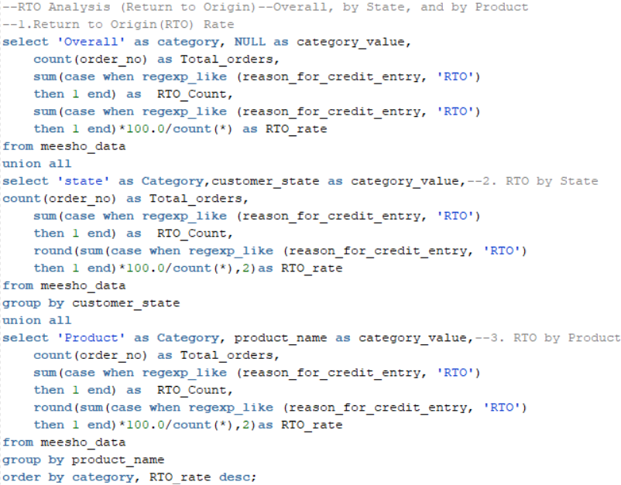
3. RTO Hotspots: Product & State Analysis

Slide 8
Overall RTO Performance
Top 5 Products by RTO Rate
Top 5 States by RTO Rate
Product Name | Total Orders | RTO Rate
Sports T-shirt | 51 | 49.02%
Printed Kurta | 42 | 47.62%
Menâ€™s Jeans | 47 | 46.81%
Denim Jacket | 60 | 46.67%
Cotton Saree | 52 | 46.15%
State Name | Total Orders | RTO Rate
Andhra Pradesh | 53 | 50.94%
Delhi | 50 | 56.00%
Madhya Pradesh | 62 | 50.00%
Maharashtra | 55 | 47.27%
Assam | 53 | 45.28%
Insights
Overall RTO rate is 39.9%, showing 4 in 10 orders fail.
Apparel items like Denim Jacket, T-shirts and Sarees have the highest RTO rates. This suggests potential issues with sizing, fit, or product representation.
Delhi, Andhra Pradesh, and Madhya Pradesh show over 50% RTO rates. These states require immediate intervention.
Focus improvement efforts on apparel orders in these critical states.

Slide 9
4. Cancellation Hotspots
Top 10 Cancellation Hotspots (Count)
CANCELLATION COUNT
140
14% of Total Orders
State | Product Name | Count
Assam | Silk Saree | 3
Madhya Pradesh | Formal Trousers | 3
Gujarat | Men's Jeans | 3
Karnataka | Jumpsuit | 3
Telangana | Women's Dupatta | 2
Punjab | Casual Shorts | 2
Gujarat | Printed Kurta | 2
Goa | Party Gown | 2
Chhattisgarh | Kids Dress | 2
Punjab | Denim Jacket | 2
Bihar | Kids Dress | 2
Insights
The highest cancellation items are Sarees, Trousers, Jeans, Jumpsuits, and Dupattas.
Assam/Silk Saree, MP/Formal Trousers, Gujarat/Men's Jeans, and Karnataka/Jumpsuit key cancellation hotspots.
Punjab, Telangana, Goa, and MP show repeated product cancellation issues.
Investigate quality, stock, or delay issues behind these product-state pairs.

Slide 10
5. Top 10 Worst Performing Products
SKU | Product Name | Total Orders | Delivered | RTO | Cancelled | Fulfillment Rate | Failure Rate
SKU6017 | Winter Jacket | 1 | 0 | 1 | 0 | 0 | 100
SKU6020 | Party Gown | 1 | 0 | 0 | 1 | 0 | 100
SKU6047 | Jumpsuit | 1 | 0 | 0 | 1 | 0 | 100
SKU6052 | Casual Shorts | 1 | 0 | 0 | 1 | 0 | 100
SKU6057 | Women's Kurti | 1 | 0 | 1 | 0 | 0 | 100
SKU6060 | Party Gown | 1 | 0 | 1 | 0 | 0 | 100
SKU6023 | Party Gown | 1 | 1 | 0 | 0 | 100 | 0
SKU6044 | Ethnic Set | 1 | 1 | 0 | 0 | 100 | 0
SKU6055 | Georgette Lehenga Choli | 1 | 1 | 0 | 0 | 100 | 0
SKU6063 | Denim Jacket | 1 | 1 | 0 | 0 | 100 | 0
CRITICAL FINDING
6 SKUs
0% Fulfillment and 100% Failure.
Failure Breakdown
📦↩️RTO-Driven Failures (Logistics Loss)
SKU6017: Winter Jacket
SKU6057: Women's Kurti
SKU6060: Party Gown
❌Cancellation-Driven Failures (Inventory Loss)
SKU6020: Party Gown
SKU6047: Jumpsuit
SKU6052: Casual Shorts
ALL ARE APPAREL CATEGORY ITEMS

Slide 11
6. State Volume: High vs. Low Performers (Last 30 Days)
🚀Demand Leaders (Top 5 Recent Orders)
🐢Low-Activity Zones (Bottom 3 Recent Orders)
State | Total Quantity
Madhya Pradesh | 152
Chhattisgarh | 151
Kerala | 139
Telangana | 138
Tamil Nadu | 137
State | Total Quantity
Rajasthan | 94
Goa | 98
Jharkhand | 102
West Bengal | 110
Odisha | 112
Insights
Top-performing states: Madhya Pradesh (152), Chhattisgarh (151), and Kerala (139) lead in total quantity, indicating strong overall performance.
Moderate performers: Telangana (138) and Tamil Nadu (137) show slightly lower but consistent contributions compared to the top states.
Lower-performing states: Rajasthan (94), Goa (98), and Jharkhand (102) have the least total quantity, highlighting areas for improvement.
Mid-range states: West Bengal (110) and Odisha (112) perform moderately, suggesting potential to boost performance further.

Slide 12
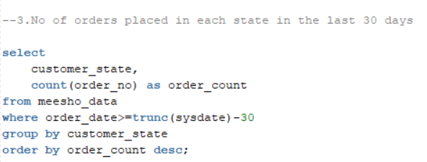
7. Orders Placed (Last 30 Days)
Customer State | Order Count
1. Maharashtra | 9
2. Haryana | 7
3. Punjab | 7
4. Tamil Nadu | 7
5. Madhya Pradesh | 7
6. Gujarat | 6
7. Odisha | 5
8. Rajasthan | 5
9. Jharkhand | 5
10. Assam | 5
11. Telangana | 5
12. West Bengal | 4
13. Uttar Pradesh | 4
14. Bihar | 4
15. Kerala | 4
16. Andhra Pradesh | 4
17. Chhattisgarh | 4
18. Delhi | 3
19. Karnataka | 2
20. Goa | 2
Demand Leaders (Top 5)
Maharashtra leads (9 orders), followed by Haryana, Punjab, Tamil Nadu, and MP (7 orders each).
Low-Activity Zones (Bottom 3)
Karnataka and Goa have the lowest order count (only 2 orders each) in the last 30 days.
Delhi is also significantly low with only 3 orders.

Slide 13
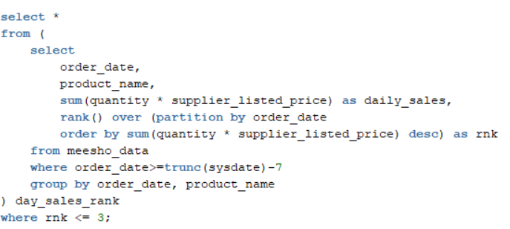
8. Last Week's Revenue Driving Products
Analysis Period: Oct 17th, 2025 to Oct 23rd, 2025
Top 5 Revenue-Generating Items
1. Casual Shorts (15,768 on Oct 17th)
2. Silk Saree (12,556 on Oct 19th)
3. Formal Trousers (10,467 on Oct 22nd)
4. Track Pants (9,543 on Oct 18th)
5. Winter Jacket (8,572 on Oct 18th)
MOST CONSISTENT TOP SELLER
SILK SAREE
Achieved Rank 1 twice(19th,23rd)

Slide 14
8. Customer Segmentation based on Revenue
Customer Segmentation | Total Revenue | Total Orders
Silver | 1667844 | 577
Gold | 4026554 | 423
42.3%
TOTAL ORDERS
Insights
Orders are segmented into Gold and Silver based on total revenue compared to the Average Order Value (AOV).
Gold orders (423 orders) generate the majority of revenue (~70%), indicating high-value transactions.
Silver orders (577 orders) contribute less revenue (~30%), representing lower-value transactions
Offer VIP programs to Gold customers and targeted engagement strategies for Silver customers
70.7%
TOTAL REVENUE

Slide 15
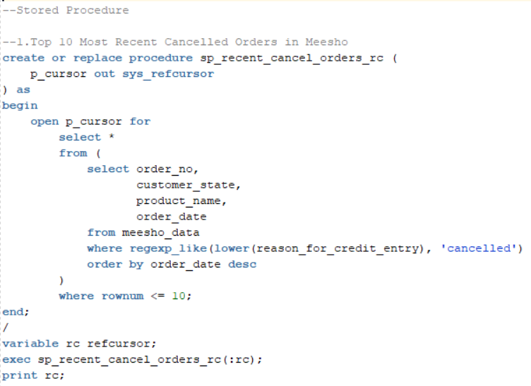
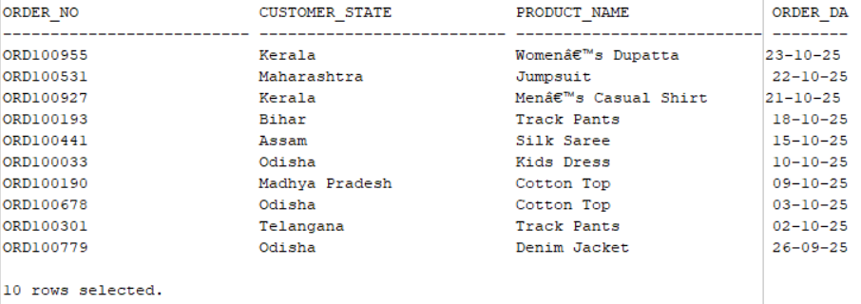
9. Top 10 Most Recent Cancelled Orders
Output

Slide 16
Query Optimization
Removed unused columns and avoided SELECT * to reduce data load.
Selected only necessary columns in queries for better performance.
Aggregated multiple KPIs in a single query to minimize table scans.
Used CTE’s over subqueries.
Implemented stored procedures with REF CURSORs for reusable, fetchable, and stakeholder-friendly results.

Slide 17
FINAL STRATEGY: 5 Priority Actions
🎯1. Target Total Failure Rate
Reduce the overall 53.9% Order Failure Rate to below 40% within the next quarter.
👚2. Control Apparel RTO Risk
Mandatory pre-shipment Quality Checks (QC) for all Top 5 RTO Apparel SKUs.
🚫3. Eliminate 100% Failure SKUs
Immediately Delist or Audit Hold the 6 SKUs with zero fulfillment to stop guaranteed financial losses.
🗺️4. Localize Cancellation Fixes
Launch targeted surveys/investigations in top State/Product cancellation pairs (e.g., Assam/Silk Saree).
📈5. Boost Low-Activity States
Prioritize resources to revive demand in Karnataka, Goa, and Delhi, which showed critically low order counts.

Slide 18
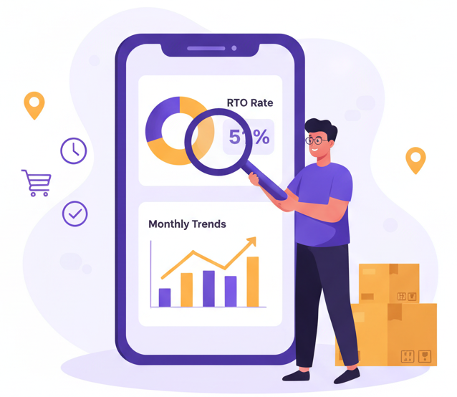
Thank You

