Slide 1

CET Bhubaneswar_CET_Alpha

Slide 2
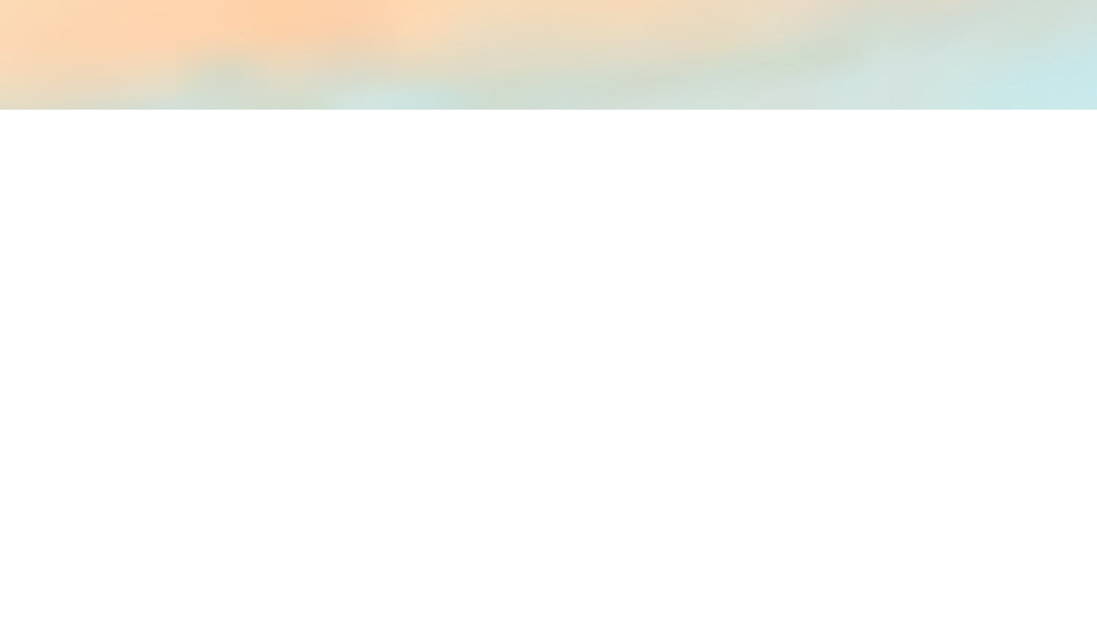
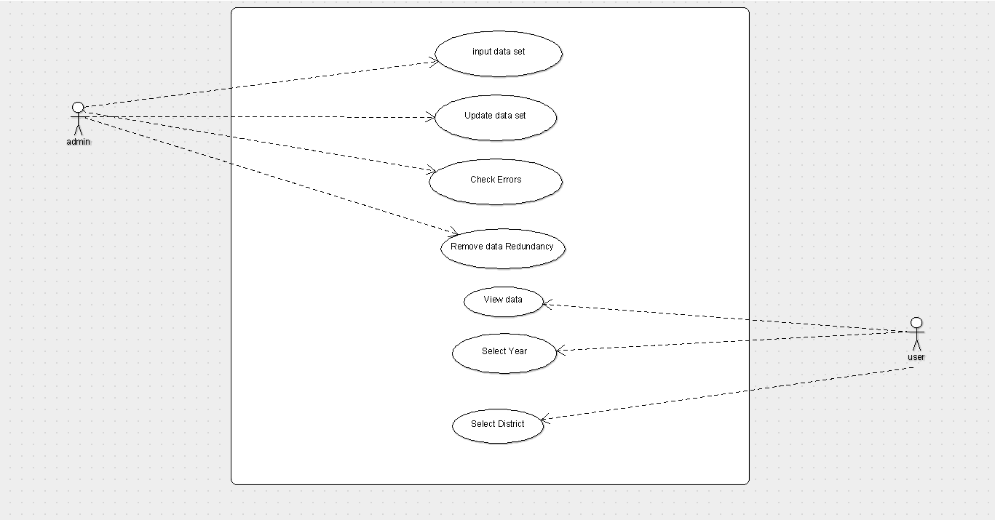
Use Case Diagram

Slide 3
Solution Design and Architecture
The Gathered data is stored into excel file i.e. in .csv format. Various modules of Python3 like Pandas ,numpy, scikit-learn, flask are used .
Flask is used to develop the web application. Data can be searched by using either year or district. Future data can be predicted by using Regression Model of Machine Learning.

Slide 4
Logical Data Modelling
In our project we don't use any type of databases.
Instead of db we use excel files in .xlsx format.
In our project the columns present are:
1.Year
2.District
3.MalariaPatient
4.Percent
5.Cummulative

Slide 5
Logical Data Modelling
In rows there is different years:
1.2012
2.2013
3.2014
4.2015
5.2016
Note:- You can use other datasets but the column name must be exactly same.

Slide 6
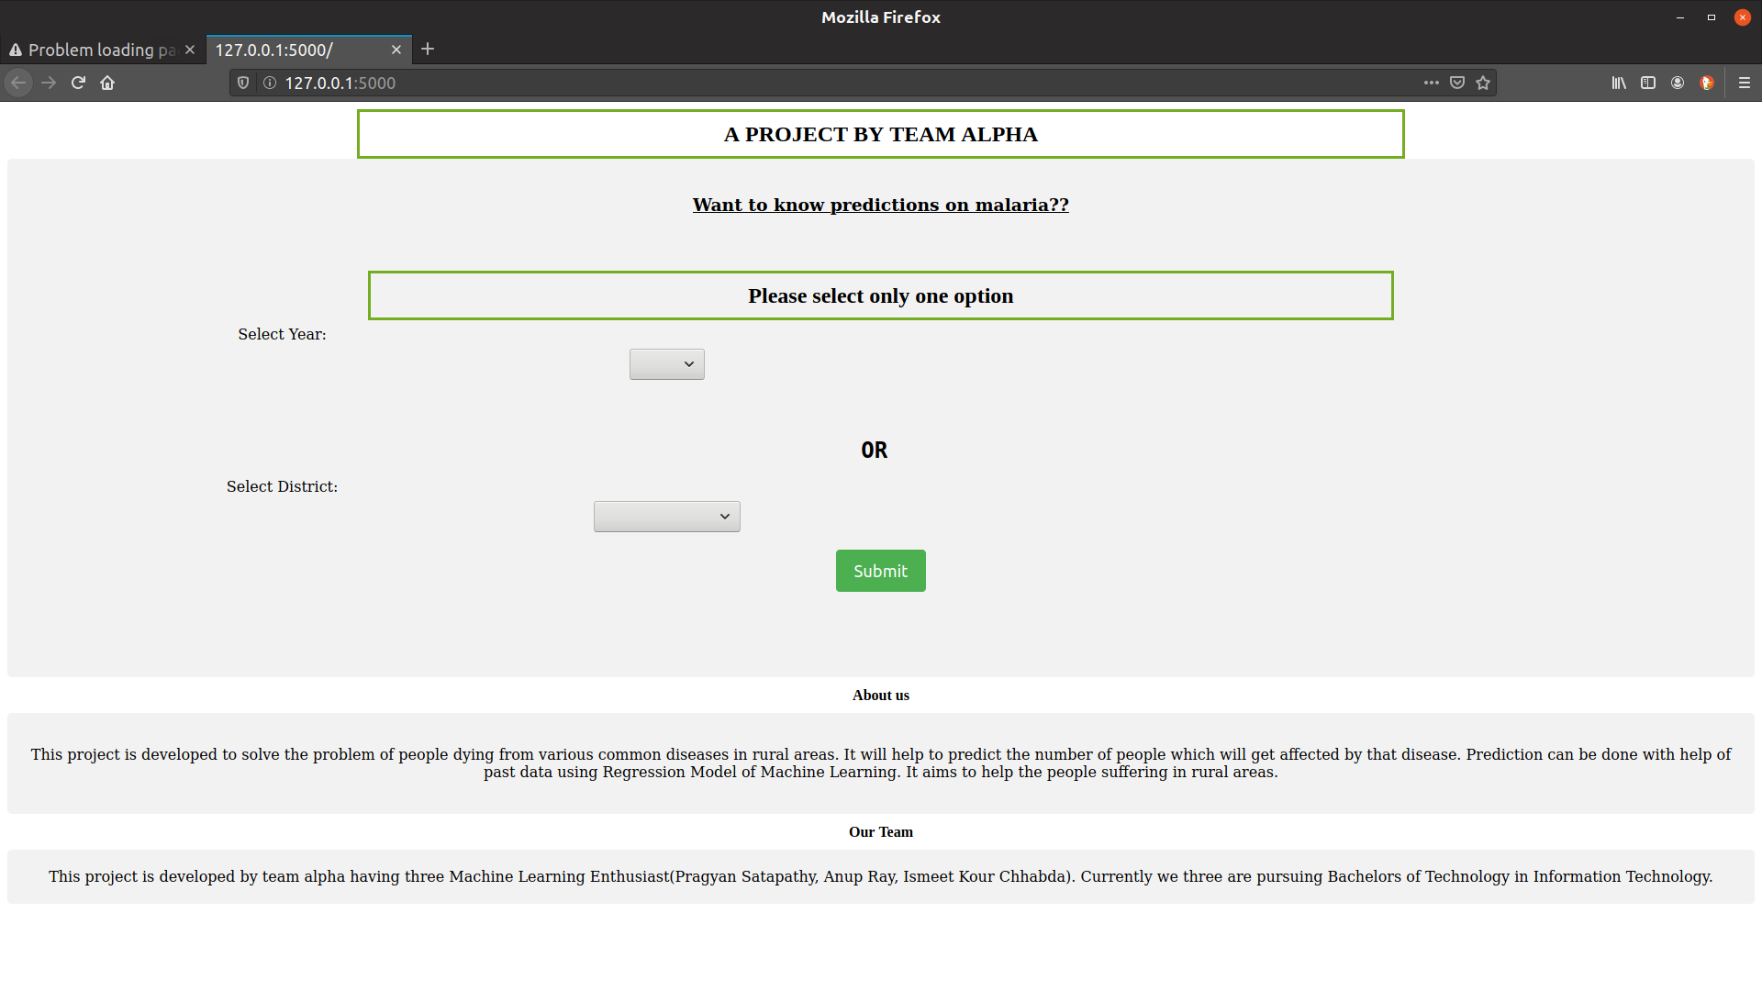
Screenshots

Slide 7
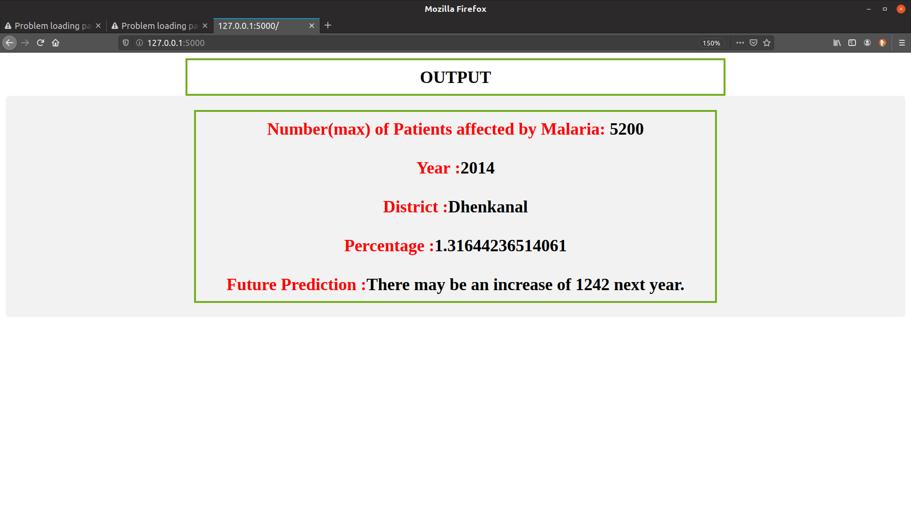
Screenshots

