Slide 1
EKA
An implementation of P6 µarchitecture
Shaizeen Aga
Aasheesh Kolli
Rakesh Nambiar
Shruti Padmanabha
Maheshwarr Sathiamoorthy

Slide 2
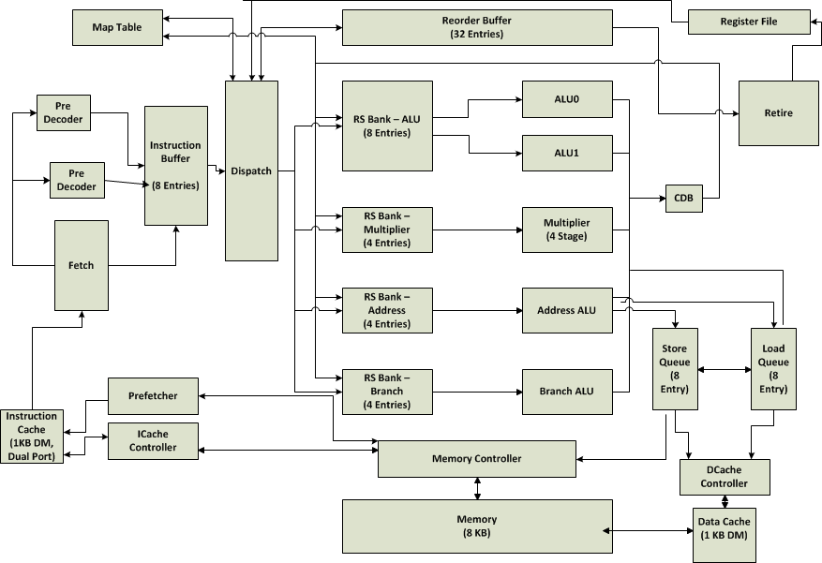
Design Overview

Slide 3
Optional Features
EKA Pipeline supports:
  Superscalar fetch, dispatch and retire width - 2
  Dedicated RS bank and CDB for each functional unit
        Allowing up to 5 simultaneous issue and complete
  Early tag broadcast
EKA Memory Interface (Data) supports:
  Store-Load forwarding
  No processor stall on read miss
        8 outstanding load misses (parameterized)
  No processor stall on write miss
        Post retirement store buffer
EKA Memory Interface (Instruction) supports :
  Dual-ported Icache : Deals with misalignment between fetch group and cache line
  Smart Instruction prefetcher
EKA Branch Support :
  Speculation aware Branch History Table
  Speculation aware Return Address Stack
Notes:
What more?
Do we speak about early recovery?

Slide 4
Testing Strategy
Unit testing + Coverage testing for each individual component
Standalone testbenches for functional testing
Regression test script for automated testing
    Covers all the benchmarks
    Compares memory and writeback outputs
    Reports CPI numbers
Hand written stress test programs
Random memory latency testing for individual memory operations

Slide 5
Performance Summary
Multi banked RS: More than 2 instruction issue in same cycle
    18% for fib_rec.s
Smart window instruction prefetching:
    I$ miss rate down by 69% , CPI up by 77% for btest1.s over no prefetching
Dual ported I$:
    Maximum performance gain of 18% for objsort.s
Speculation aware RAS:
    Improved performance 24% objsort.s
Gshare branch predictor:
    CPI degradation of 54% for copy.s

Slide 6
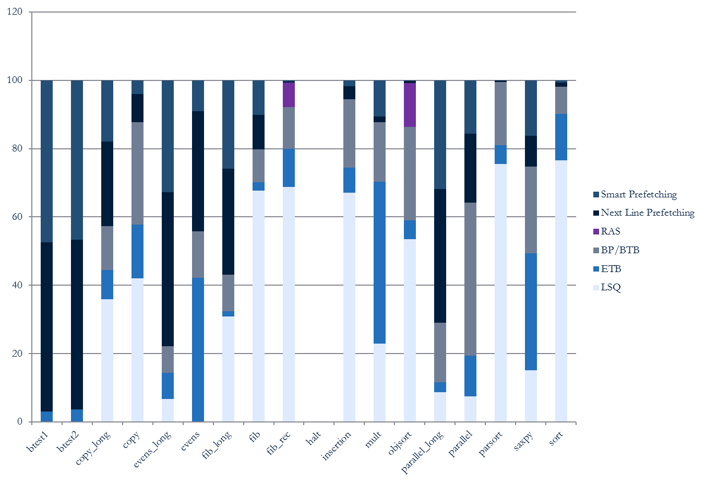
Cool graph!

Slide 7
QUESTIONS?

Slide 8
Notes:
Slide design can be used as Title Slide or Closing Slide.

