Slide 1


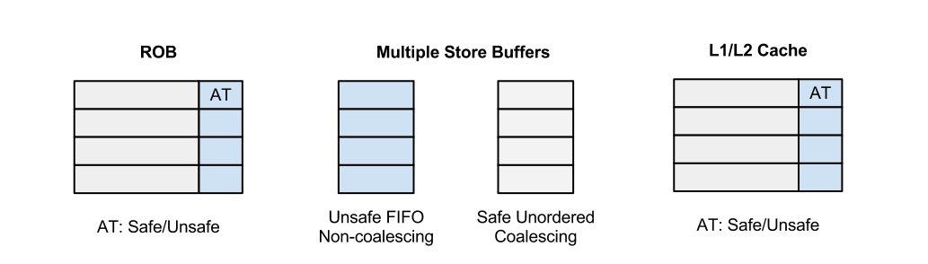
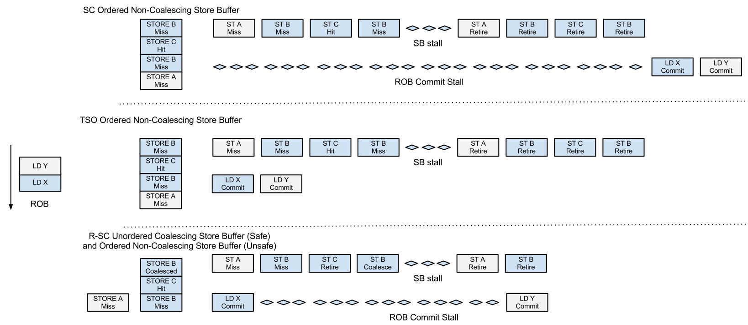
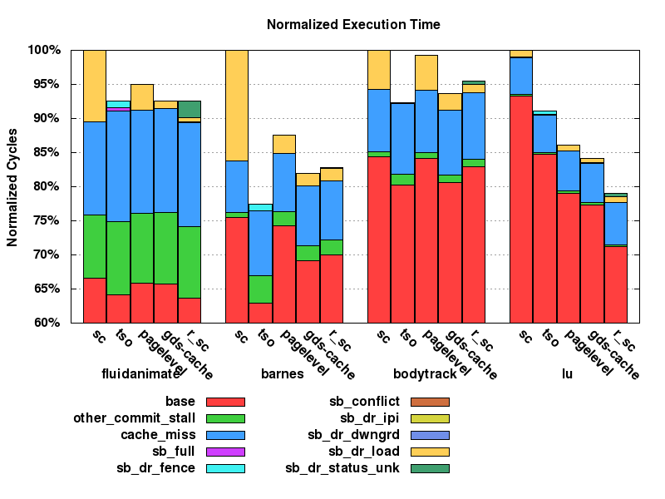
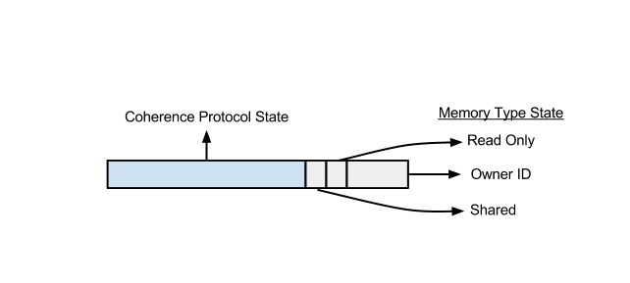
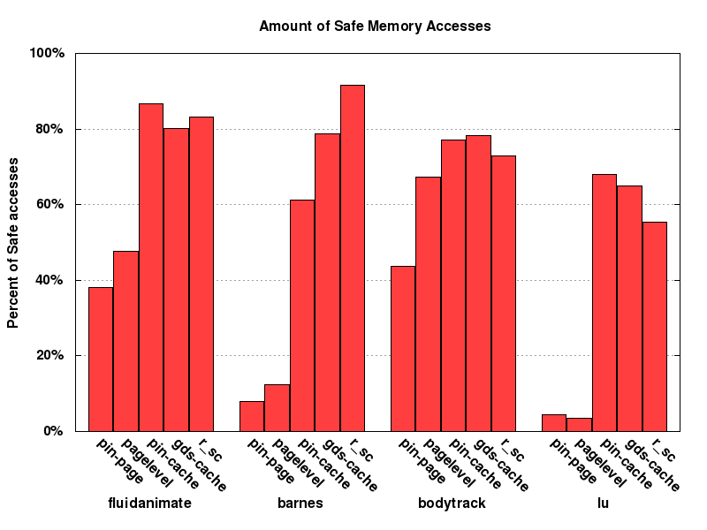
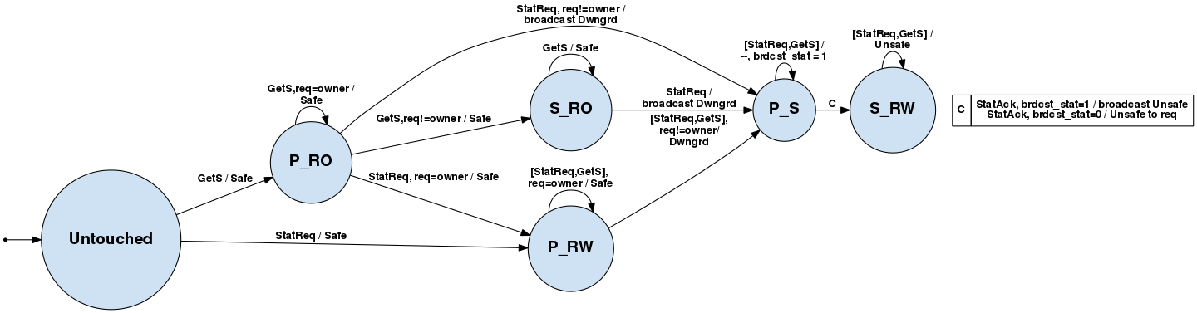
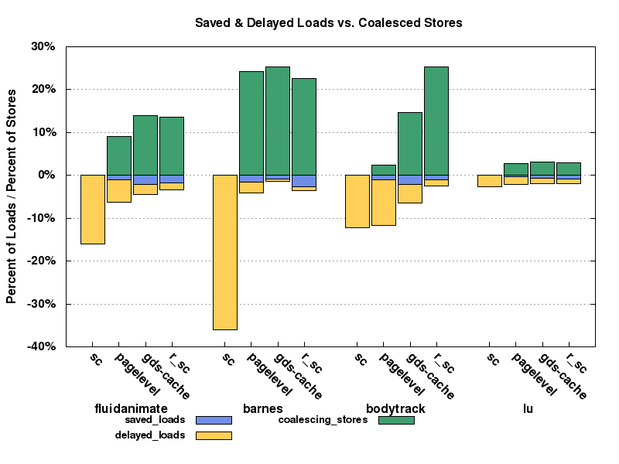
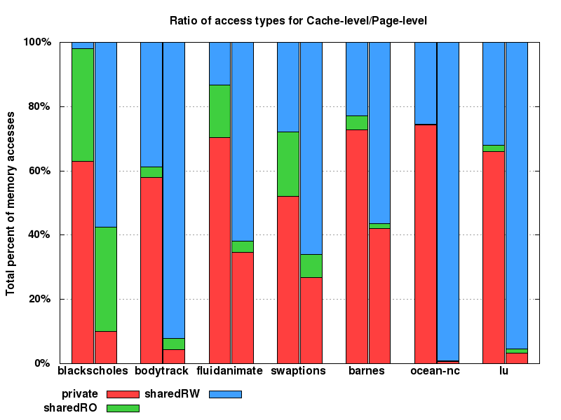
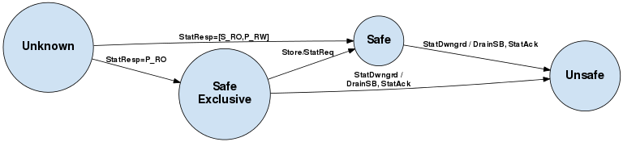
Reactive SC
Speculatively relaxing memory consistency model constraints using dynamic classification of cache blocks
Shaizeen Aga, Cory Perry, Aaron Tami
Overview
Processor Modifications
Execution Example
Evaluation
Memory model constraints limit multiprocessor performance.
Sequential consistency, the most intuitive model, is not practically implementable due to concomitant performance penalties compared to other relaxed memory models.
Reactive SC classifies memory accesses into safe and unsafe types and relaxes consistency constraints for safe accesses.
Memory ordering only matters for shared data!
Private and read-only accesses can be safely reordered as we can guarantee there will be no conflicting accesses.
Experimental results show that Reactive SC closes the performance gap between SC and TSO.
Execution cycle stack composed of stall cycles in commit stage due to various reasons.
Load/stores retire from ROB only when type status is known.
Store buffers with bypassing capabilities for safe loads
Store buffers with bypassing capabilities for unsafe loads (shared FIFO buffer is empty)
Overlapping and coalescing unordered store buffer for safe stores
LSQ snooped for status downgrade messages
SC Execution:
Store hits do not retire until they reach head of the store buffer
Loads at retire stall until store buffer drains
Stores to same location are not coalesced
TSO Execution
Store hits do not retire until they reach head of store buffer
Loads can retire without store buffer drain
Stores to same location not coalesced
Reactive SC Execution
Safe store hits can retire out of order
Safe loads can retire without any store buffer drain
Unsafe loads can retire when FIFO store buffer is empty without safe store buffer drain
Safe stores to same location are coalesced
Unsafe accesses behave like SC
SC: Large number of stalls from store buffer drain due to loads at retire stage.
Reactive SC: Minimal store buffer drain stalls due to loads at retire stage!
Reactive SC: Closes the performance gap between SC and TSO!
Reactive SC: Comes close to ideal global cache data structure implementation!
Memory Access Classifications
Private: Accessed by one thread up to current point in execution.
Shared read-only: Accesses by multiple threads but only read after being initialized.
Shared read write: Accessed by multiple threads with at least one write access.
Safe Access: Private or Shared read-only
Unsafe Access: Shared read write
Directory Protocol
Leverage Directory in the cache coherence protocol to store access classification information.
Augmented Directory Entry
Safe access classification observed with pintool vs. simulated with FeS2.
Untapped Opportunity
End to End Sequential Consistency (ISCA 2012)
Relaxing memory model constraints based on classification of memory accesses.
Memory access classification done at PAGE LEVEL.
Does PAGE LEVEL classification suffice?
NO!
Much more safe accesses observed at CACHE LEVEL than at PAGE LEVEL
Directory Controller State Machine
Page level classification misses a considerable percentage of safe accesses due to false sharing.
Reactive SC successfully classifies additional safe accesses!
Stores sends access requests, loads piggyback access request on coherence messages.
Safe to unsafe transition: Directory sends status downgrade messages; processors drain store buffers and send acknowledgement back.
Experimental Setup
Simulated on cycle accurate, simics-based, full-system simulator called FeS2.
Saved loads: do not cause SB drain
Delayed loads: cause SB drain
Safe stores: coalesced in Reactive SC
Cache Controller Protocol
Status cached locally by processors.
Safe exclusive implies read-only, loads have status hits, stores send request and stall.
Processor | 16-core CMP, 2GHz
Fetch/Exec/Commit | 4 instructions (max 2 loads or 1 store) per cycle per core
FIFO Store Buffer | 64 entry FIFO buffer
Unordered Store Buffer | 8 entry unordered, coalescing store buffer
L1 Cache | 64 KB per-core, 4-way set associative, 64B block size, 1-cycle hit latency, write-back, write up to 8 bytes per cycle
L2 Cache | 512KB per-core, 4-way set associative, 64B block size, 10 cycle hit latency
Coherence | MOESI directory protocol
Interconnection | Torus-2D topology, 512-but link width, 8-cycle link latency
Memory | 80-cycle DRAM lookup latency
SC has large number of delayed loads, TSO has no coalescing stores.
Reactive SC reduces number of delayed loads and coalesces safe stores!
Cache Controller State Machine

