Slide 1
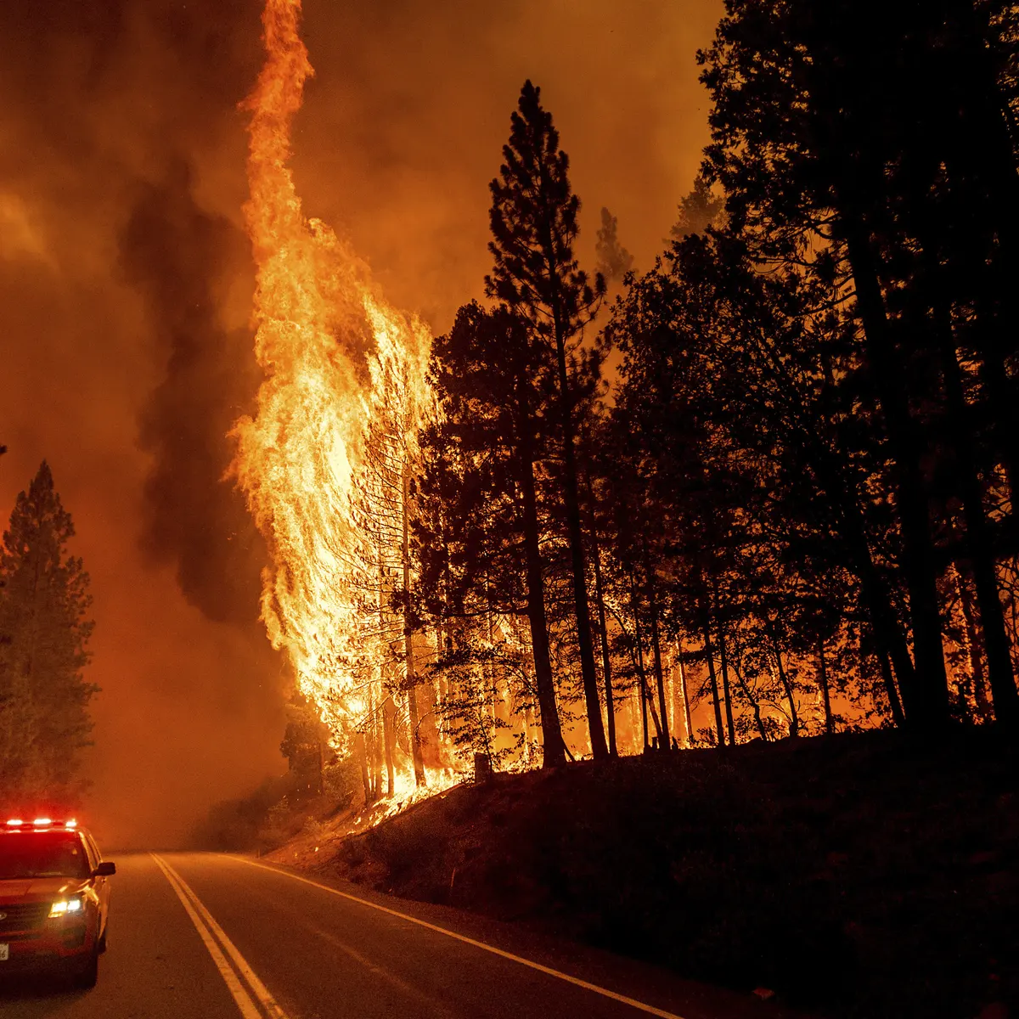
California wildfire
UC Berkeley Extension Bootcamp
Data Analytics and Visualizations
Fall 2021
Due Date: 10/07/2021
Presented By: Taravat Sharafat, Dhivya Ram, Shailee Madhni, Anupriya Sarkar
Notes:
Selected Topic: California WildFire

Slide 2

Outcomes
Reason the topic was selected
Description of the source of data.
Description of the data exploration phase of the project.
Description of the analysis phase of the project.
Technologies, languages, tools, and algorithms used throughout the project.
Results of analysis.
Recommendation for future analysis.
Anything that would have been done differently.
Notes:
Project outcomes

Slide 3
California Fire Perimeters
Data source taken from Kaggle website.
Authentic data source taken from California Government website to validate the initial dataset.
California Fire Incidents
DATA SOURCE
Contains multiple number of columns which helps to train the Machine Learning model.
Contains additional data needed for further analysis such as causes of wildfire.
Contains data on locations where wildfires have occurred including: County name, latitude and longitude values.
Notes:
California Fire Incidents:
https://www.kaggle.com/ananthu017/california-wildfire-incidents-20132020
California Fire Perimeters:
https://gis.data.ca.gov/datasets/CALFIRE-Forestry::recent-large-fire-perimeters-5000-acres/about

Slide 4
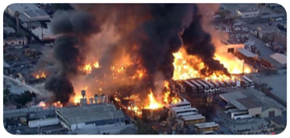
Reasons the topic was selected
Due to increase in global warming, drier conditions because of drought and burning of fossil fuels , wild fires are increasing at alarming rate in California.
To analyze possible causes of wildfire which can be due to human activity or a natural phenomenon.
Help making predictions if California is going to face major fire incident in the future or not.
Notes:
Reasons the topic was selected.

Slide 5

Questions to address
1
What are the top 5 locations where fire can occur ?
2
What time of the year fire usually occurs ?
3
Is California going to face major fire incident in the future?
4
What are the factors that can lead to wildfire ?
Notes:
Questions team are going to get addressed from the datasets.

Slide 6
Loading Data
California Fire Incidents
Cleaning Data
Python
Storing Data
PostgreSQL
California Fire Perimeters
Pandas
Machine Learning Modeling
Logistic Regression
Data Analysis Flow Diagram
Dashboard
Notes:
Project Roadmap Flow Chart

