Slide 1
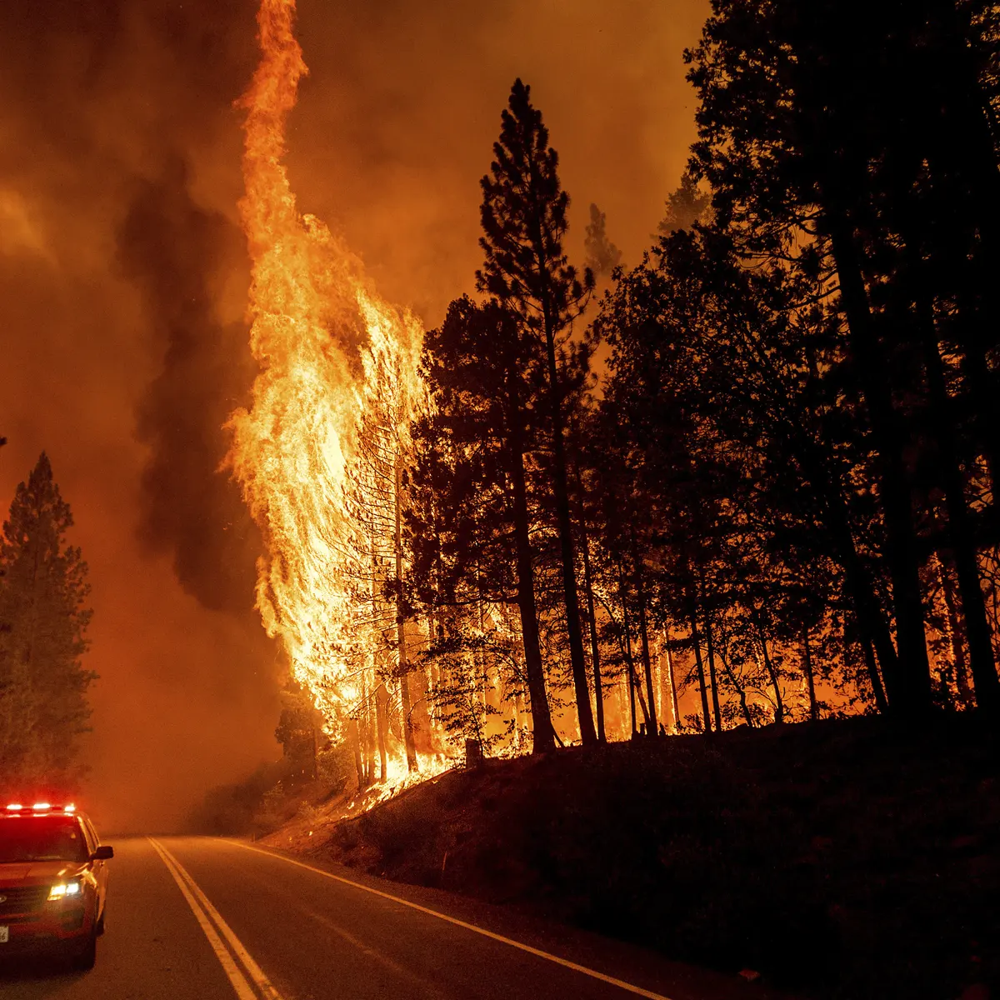
California wildfire
UC Berkeley Extension Bootcamp
Data Analytics and Visualizations
Fall 2021
Due Date: 10/07/2021
Presented By: Taravat Sharafat, Dhivya Ram, Shailee Madhni, Anupriya Sarkar

Slide 2

Outcomes
Reason the topic was selected
Description of the source of data.
Description of the data exploration phase of the project.
Description of the analysis phase of the project.
Technologies, languages, tools, and algorithms used throughout the project.
Results of analysis.
Recommendation for future analysis.
Anything that would have been done differently.

Slide 3

California Fire Perimeters
Location where wildfires have occurred including: County name, latitude and longitude values.
Causes of wildfire.
California WildFires (2013-2020)
Data Sources
Details on fire start and end dates.

Slide 4
Reasons the topic was selected?
CA has most deadliest and destructive wildfire seasons.
Help making predictions on which locations are going to get impacted in the future.
Identify how frequent wildfire occurs.
Get insight on which locations are usually under fire threat.

Slide 5

1
What are the top 5 locations where fire can occur ?
2
What time of the year fire usually occurs ?
3
How long the fire lasted based on the weather ?
4
What are the factors that can lead to wildfire ?

Slide 6
Loading Data
California Fire Incidents
Cleaning Data
Python
Storing Data
PostgreSQL
California Fire Perimeters
Pandas
Machine Learning Modeling
Logistic Regression
Dashboard

